Slide 1

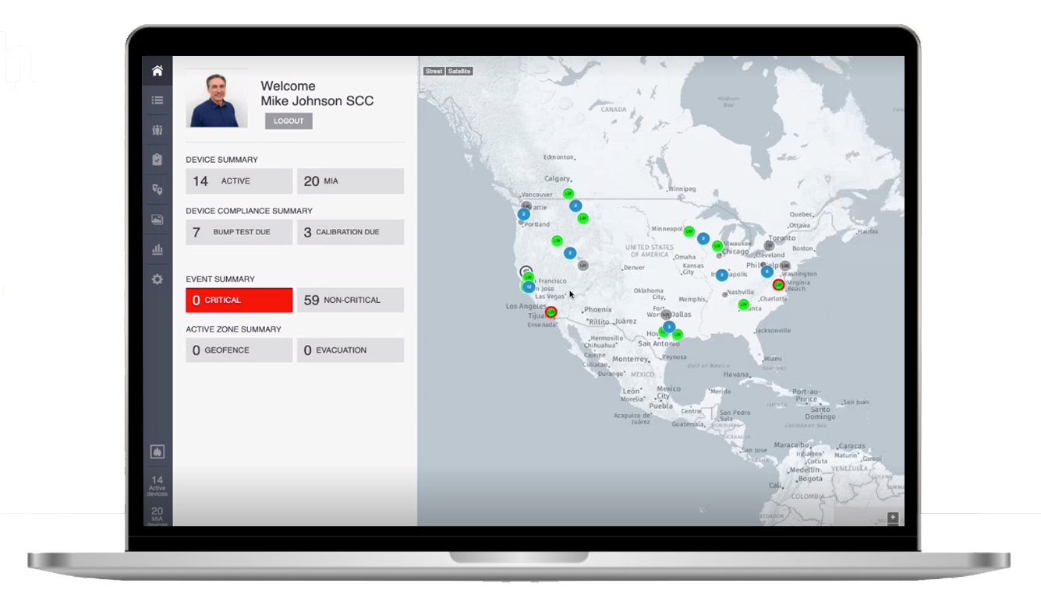



Slide 2


Slide 3
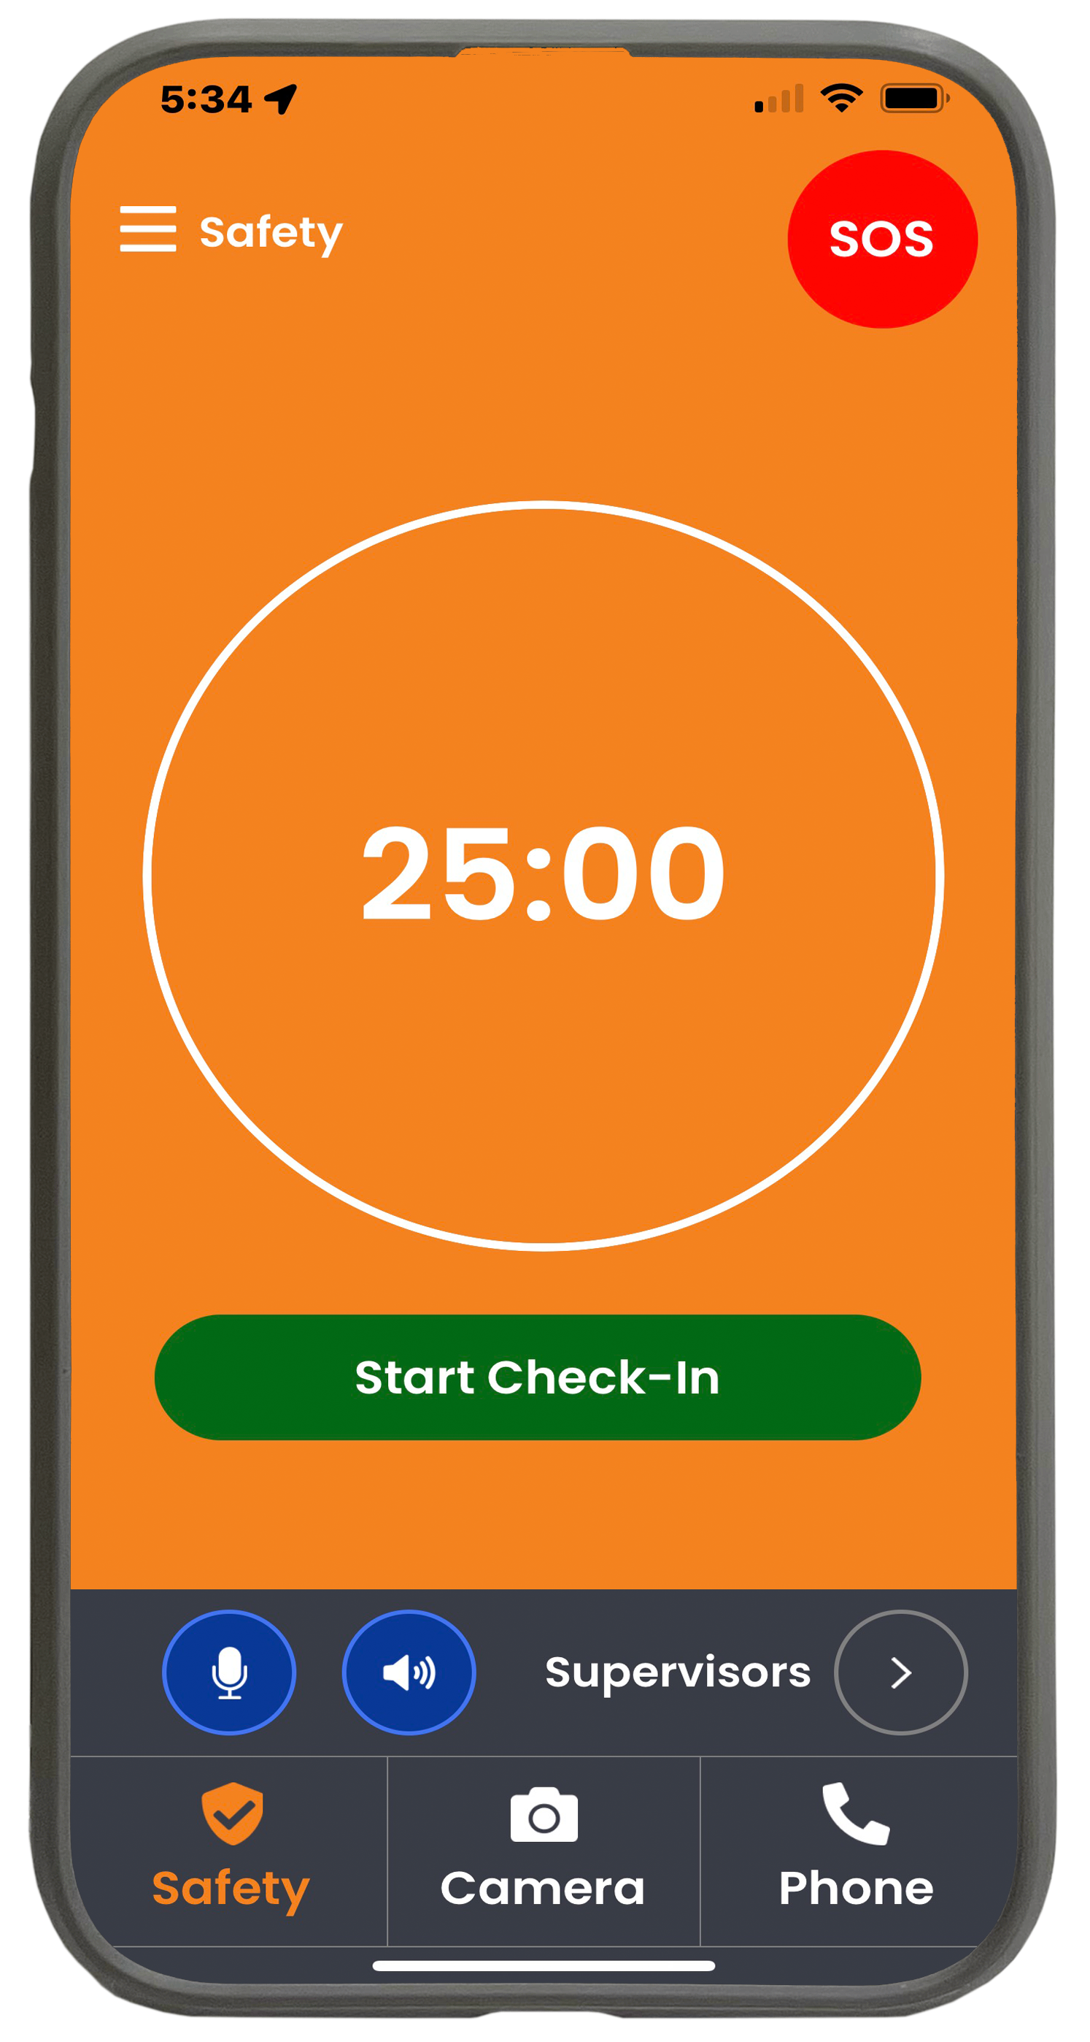
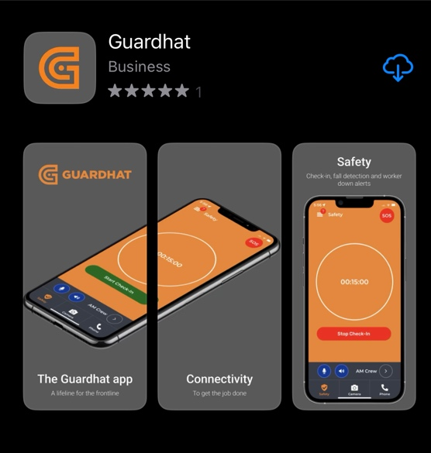

GuardHat App
Settings
SOS Alert
Lone Worker Check in
Push-to-talk
Customize PTP Channels
3 modes

Slide 4
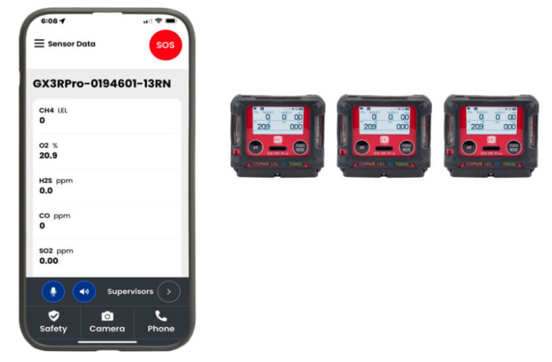
Connect to any GX-3R Pro

Slide 5
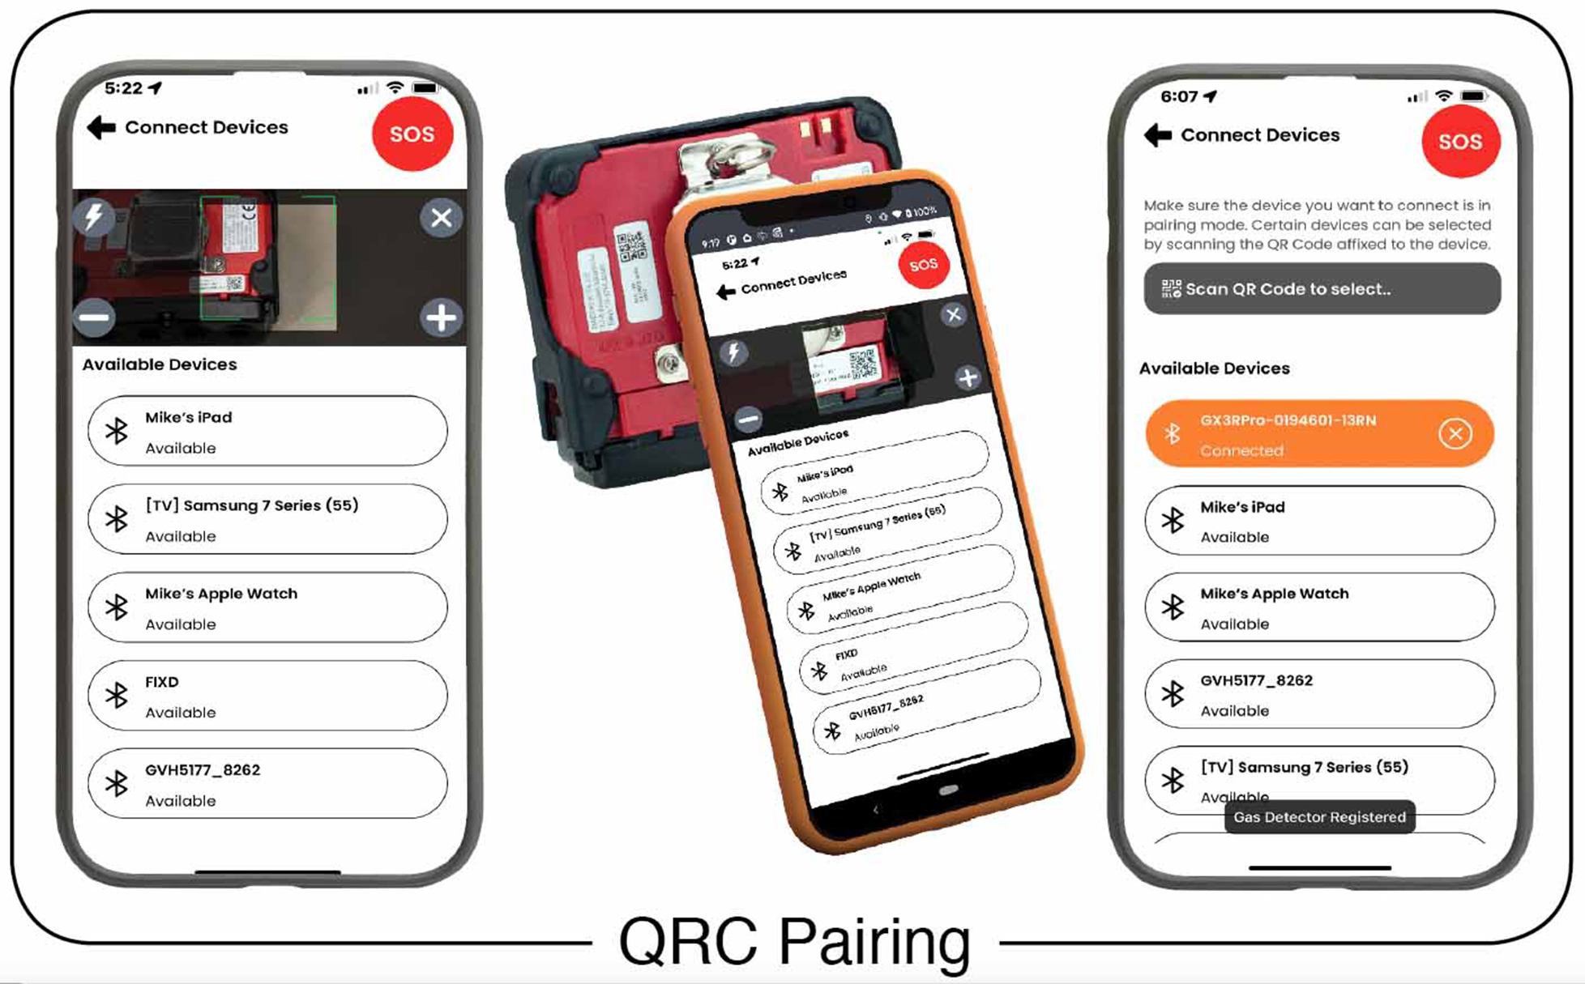
Easy to Connect

Slide 6
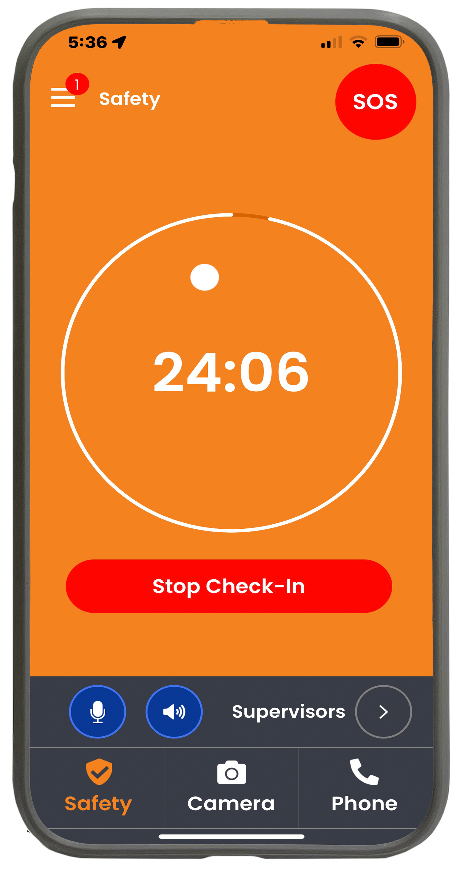
Lone worker with or without gas detection
Monitored check-in

Slide 7
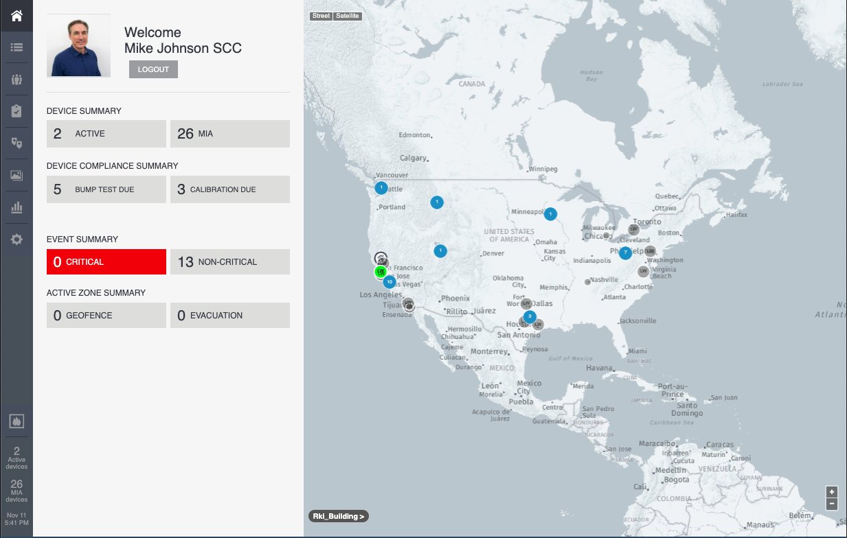
Safety Control Center
Simple Interface
Home
Events
People
Equipment Compliance
Geofencing
Multimedia Gallery
Analytics

Slide 8
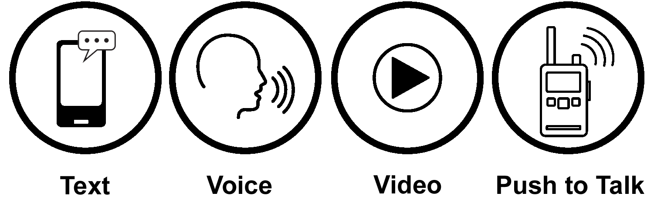
2-Way Communication

Slide 9
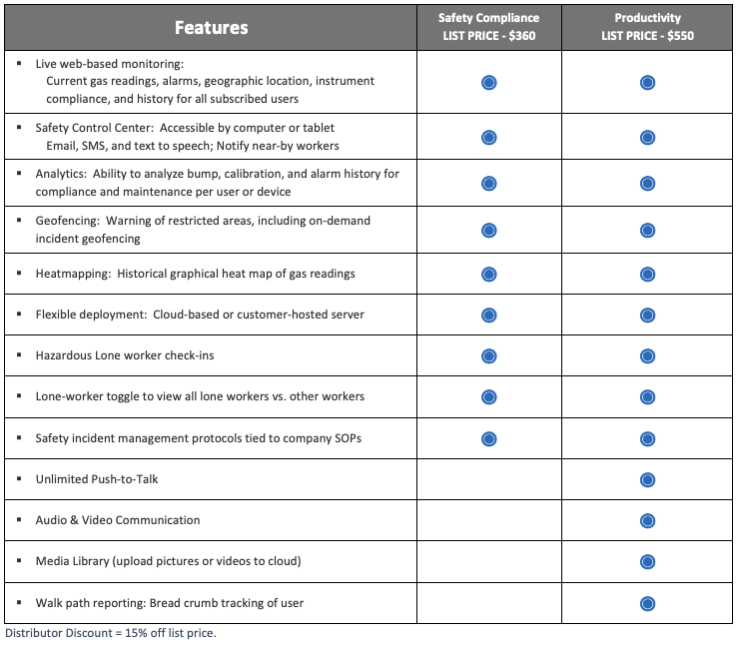
2 Annual Subscriptions

