Slide 1
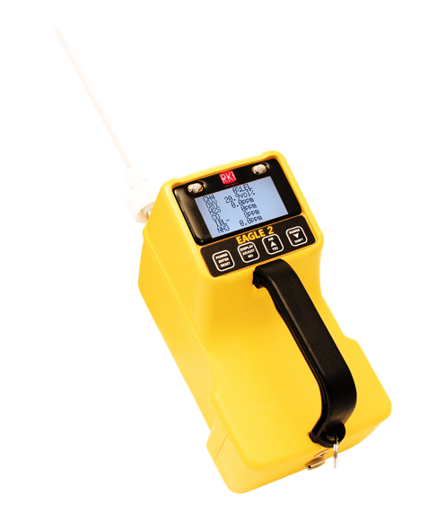
EAGLE 2
User Operation
Youtube Video

Slide 2
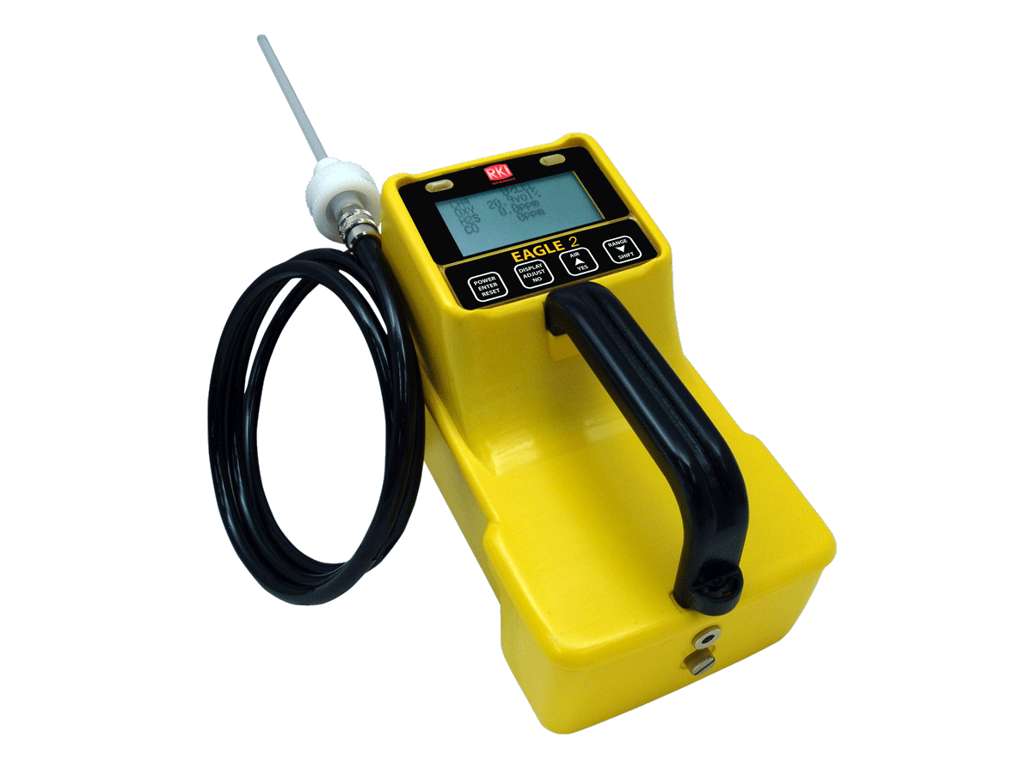
EAGLE 2 Features
PPM / LEL hydrocarbon detection
Monitor up to 6 gases
Plug and play smart toxic sensors
Powerful long-life pump up to 125 feet
PID for VOC detection
IR for CO2, CH4, & HC
Up to 18 hours of continuous operation
Glove friendly handle
Auto calibration
Datalogging standard
Ergonomic RKI/ EMI/ chemical / weather resistant enclosure
IRDA communication port for PC

Slide 3
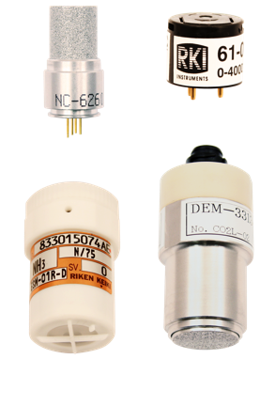
Sensor Advancements
PID Sensor
  Low ppm VOC’s
TC Sensor
  100% volume CH4
  10 / 100% volume H2
Smart ESM-01 toxic sensors
  Auto recognition
  Remote calibration
Combine up to 3 of super-toxic, IR, PID, or TC sensors
PID
Catalytic
Electrochemical
Infrared

Slide 4
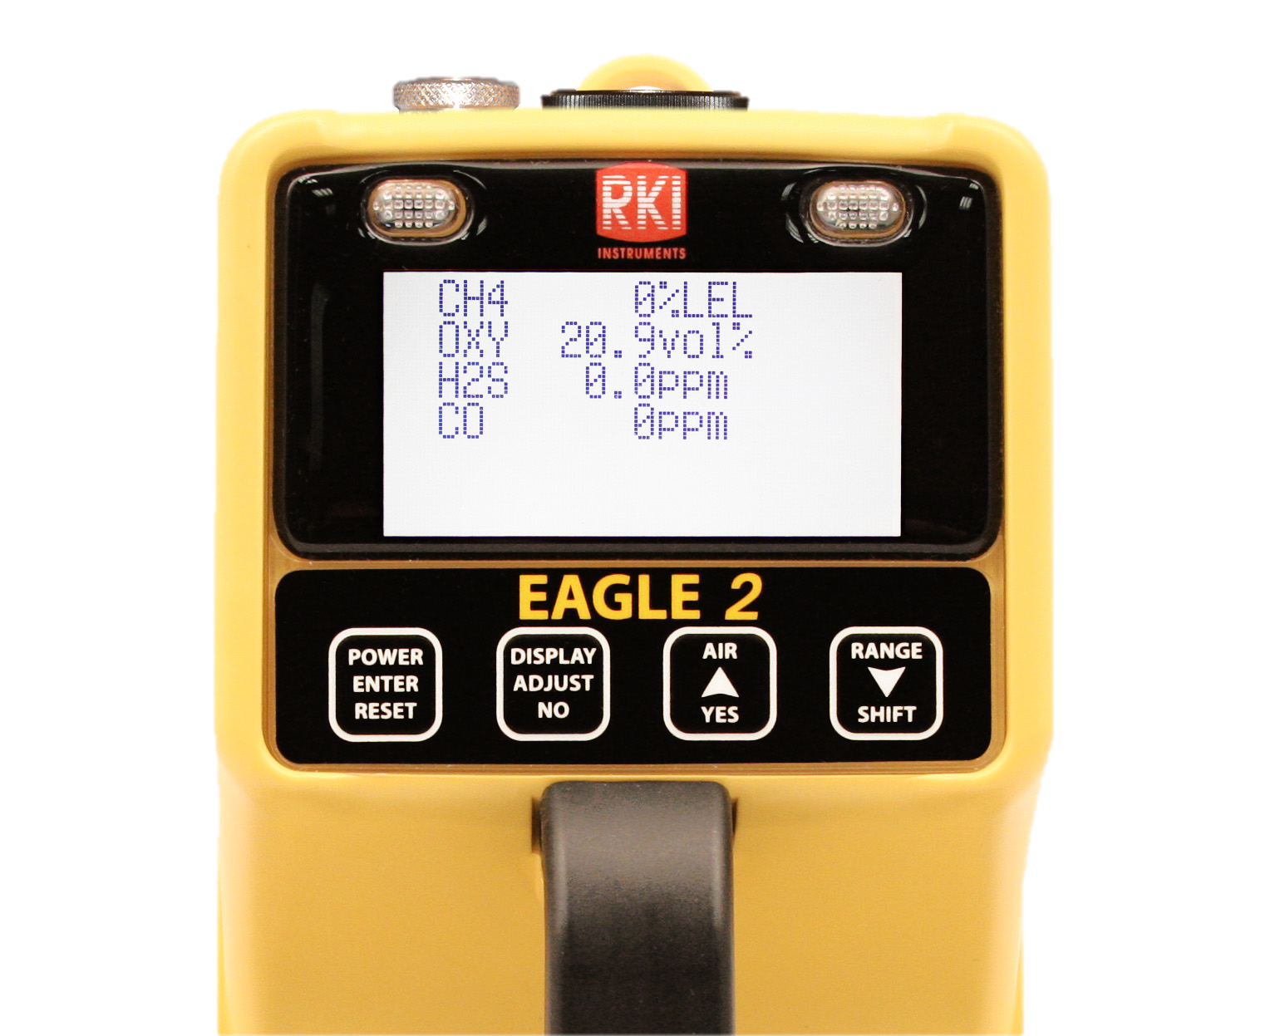
Eagle 2 Operation
After initial startup, the Eagle 2 LCD will display the normal measuring screen:

Slide 5
Fresh Air Adjustment
Take the Eagle 2 to a fresh-air environment.
  This is a environment that is free of combustible and toxic gas and of normal oxygen content.
Press and hold the AIR/YES button. The LCD will show:
  DEMAND ZERO- HOLD AIR BUTTON
  ADJUSTING ZERO- HOLD AIR BUTTON
  ADJUSTING ZERO- RELEASE AIR BUTTON
The Eagle 2 will now set to fresh air values.

Slide 6
Display Mode
To access Display Mode, while the Eagle 2 is in Normal Operation, press and release DISPLAY keypad
Use DISPLAY to scroll through the following screens:
  Peak readings
  Minimum operation and current battery voltage
  Select how active channels are displayed
  Turn catalytic LEL sensor ON or OFF
  Enable or disable Methane elimination mode (if unit is configured appropriately)
  Relative response (if turned on)

Slide 7
Display Mode
  Display STEL readings (H2S & CO only)
  Display TWA readings (H2S & CO only)
  Display alarm settings
  Select user ID (if turned on)
  Select station ID (if turned on)
  Display time in operation
  Display date and time
  Display remaining Data logging time (if turned on)
  Return to Normal Operation

Slide 8
Using the Eagle 2
The standard Eagle 2 is provided with a 5’ polyurethane hose and a 10” probe with internal hydrophobic filter.
The Eagle 2 can be used with the probe connected directly to the end of the instrument or can be used with hoses of varying lengths.
Caution: Sample time must be considered when using longer lengths of hose.

Slide 9
EAGLE 2
User Maintenance
Youtube Video

Slide 10
Eagle 2 Parts List

Slide 11
Eagle 2 Parts List

Slide 12
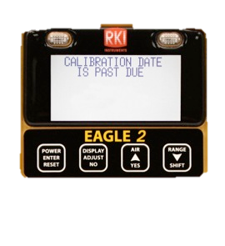
Eagle 2 Auto Calibration
To perform a calibration on a standard 4-gas Eagle 2, you will need:
  Calibration gas cylinder with blend of 50% LEL methane, 12% O2, 25 ppm H2S, 50 ppm CO balance N2
  Demand flow regulator
  Non-absorbent tubing

Slide 13
Eagle 2 Auto Calibration
Once warm up is complete, perform a demand zero setting all sensors to fresh air values.
While in Measuring Mode, press and hold the RANGE SHIFT button, then press the DISPLAY ADJUST button and release.
The Calibration Mode Screen will be displayed with the cursor next to AUTO CALIBRATION.

Slide 14
Eagle 2 Auto Calibration
Press the POWER ENTER button.
The calibration values will be displayed.
  CAL GAS VALUES
  CH4 50% LEL
  OXY 12% vol.
  H2S 25.0 ppm
  CO 50 ppm
  ENTER TO BEGIN CAL

Slide 15
Eagle 2 Auto Calibration
Press the ENTER button to start the calibration.
Screw the Demand Flow regulator onto the calibration cylinder.
Connect the tubing from the demand flow regulator to the rigid tube on the probe.
Allow the Eagle 2 to draw gas for one minute.

Slide 16
Eagle 2 Auto Calibration
Allow readings to stabilize
Press the POWER ENTER RESET button to complete calibration
Remove calibration gas from probe
If all channels passed calibration, the display will prompt you to remove the gas and then it will return to the Calibration Mode Screen.

Slide 17
Eagle 2 Auto Calibration
If any channels didn’t pass, the display will show which sensors failed and the buzzer and alarm LEDs activate. Press ENTER to return to the Calibration Mode Screen.
To return to Normal Operation, use RANGE SHIFT to place the cursor next to NORMAL OPERATION and press ENTER.

Slide 18
Replacing Batteries
The Eagle 2 can take either alkaline or Ni-MH batteries. Either type must be C size.
The battery compartment is located in the back of the bottom case of the Eagle 2.
To access the battery compartment, unscrew the thumbscrew located at the back of the unit.

Slide 19
Replacing Batteries
Pull the battery case away from the bottom case.
Remove the old batteries and make sure the battery compartment is clean.
Carefully put the new batteries into the battery compartment being sure to follow the diagram and push the batteries in all the way.
Reinstall the battery case and tighten the thumbscrew.

Slide 20
Replacing Batteries
After replacing Hi-MH batteries, charge batteries for 4 hours for a complete charge.
Fresh alkaline batteries will operate the Eagle 2 for 18 hours
Charged Ni-MH batteries will operate the Eagle 2 for 20 hours at 25C (77F).

Slide 21
Replacing Hydrophobic Filter
Replace the internal hydrophobic filter when it become dirty or clogged.
An unexplained low flow alarm may indicate the hydrophobic filter needs replacing.
To access the filter, turn the Eagle 2 upside down and unscrew the 3 screws holding the top case to the bottom case.
Carefully lift the top case off and place next to the bottom case.

Slide 22
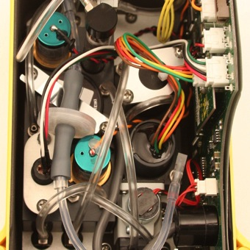
Replacing Hydrophobic Filter
Hydrophobic Filter
Pull the grey connecting tubes off each end of the filter.
Install the new filter with the red RKI logo facing the front of the Eagle 2.
Filter P/N 33-0173RK

Slide 23

Replacing Charcoal Filter
Charcoal Filter
Grasp the charcoal filter end cap and pull it off the charcoal filter.
Grasp the top of the charcoal filter firmly and pull it out of the flow block.

Slide 24
Replacing Charcoal Filter
Insert the new charcoal filter into its position in the flow block and push it in until it bottoms out.
Insert the charcoal filter end cap into the end of the new charcoal filter and push it in until it bottoms out.
Charcoal filter P/N 33-6090RK

Slide 25
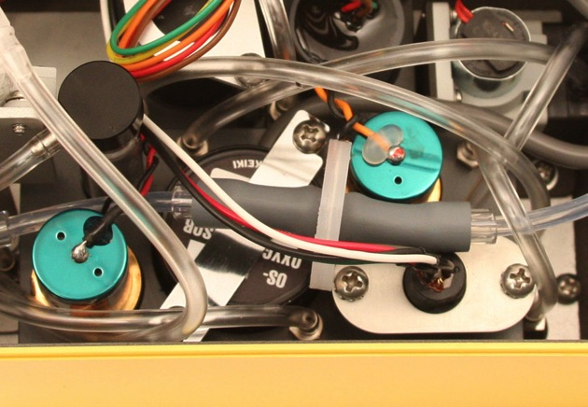
Replacing a Sensor
Locate the sensor you wish to replace.
H2S
Sensor
CO
Sensor
Oxygen Sensor
LEL Sensor

Slide 26
Replacing LEL Sensor
Unscrew and remove the 2 screws holding the LEL sensor retainer.
Grasp the LEL sensor connector and gently pull it up until it either disengages from the LEL sensor or the LEL sensor comes out of the flow block.
If the sensor came out, remove the sensor from the connector.
If the sensor stayed in the flow block, pull it up and remove it.

Slide 27
Replacing the LEL Sensor
Connect the new LEL sensor and the sensor connector.
Insert the LEL sensor into the sensor chamber.
Line up the LEL sensor retaining bracket and screw it back into place
Calibrate the Eagle 2 after replacing the LEL sensor

Slide 28
Replacing Oxygen Sensor
Unscrew the 2 screws that hold the oxygen sensor bracket and remove the bracket.
Note the routing of the oxygen sensor cable to the main PCB.
Move the hydrophobic filter towards the side wall and pull the oxygen sensor out of the flow block making sure the O-ring doesn’t come with it.

Slide 29
Replacing Oxygen Sensor
Grasp the connector on the end of the sensor cable and pull it away from the main PCB.
Insert the new oxygen sensor face down into the flow block.
Route the sensor cable the same way the old sensor cable was routed and connect it to the main PCB.
Reinstall the oxygen sensor bracket.
Calibrate the Eagle 2 after replacing the O2 sensor.

Slide 30
Replacing CO or H2S Sensor
Grasp the sensor firmly and rock it back and forth while pulling.
If this doesn’t work, use a pair of pliers and rock the sensor back and forth while pulling being careful not to damage the sensor.
Grasp the connector on the end of the sensor cable and pull it away from the main PCB.

Slide 31
Replacing CO or H2S Sensor
Insert the sensor face down into the sensor chamber.
Push the sensor until it bottoms out.
Route the sensor cable the same way the old sensor cable was routed and connect it to the main PCB.

