Slide 1
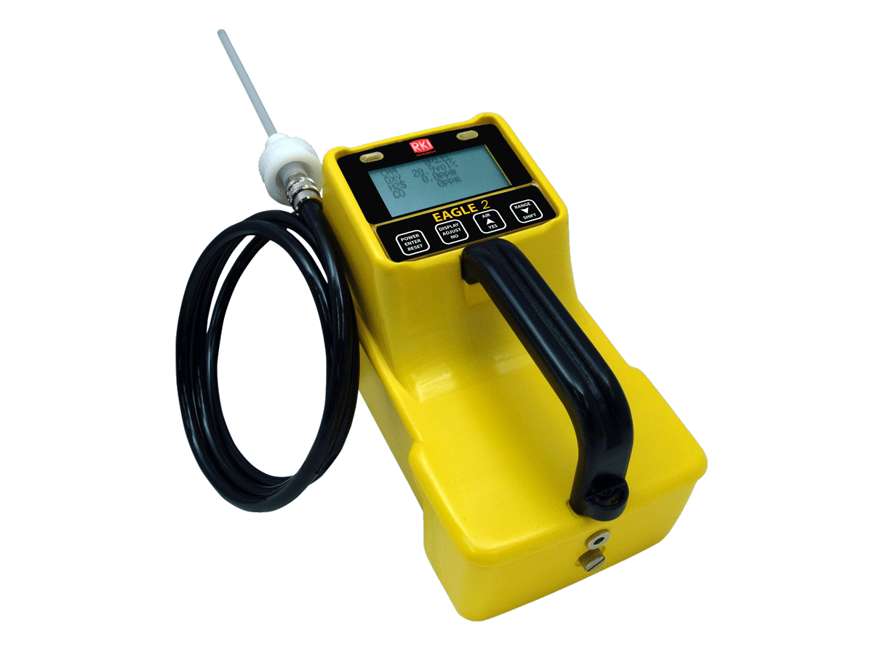
Eagle 2
Service Program
Rev. 1/14/13

Slide 2
Applications
Arson investigation
Breweries
Chemical Plants
Environmental Service
Fire Departments
Hazmat Teams / Emergency Services
Landfills
Marine
Natural Gas Trans.
Power Utilities
Refineries
Waste Management
Waste Water Treatment

Slide 3
Features
Monitor up to 6 Gases
3 operating modes
  Normal Operating Mode (confined space)
  Leak Check Mode (low ppm detection)
  Bar Hole Mode (underground detection)
PID Sensor
PPM or %LEL monitoring

Slide 4
Features
Leak Check Blink Rate
Audible Alarm Silence
Data Logging
Auto Ranging with Combustible Gas
Ni-MH or Alkaline Batteries
Internal Sample Drawing Pump
Low Flow Alarm

Slide 5
Features
Audible and Visual Alarms
Calibration Reminder / Lock Out
Hydrophobic Filters (internal & external)
Multi Lingual (5 languages)
Data logging, up to 600 hours of data
SDM-E2 Calibration Station
2 Year Warranty

Slide 6
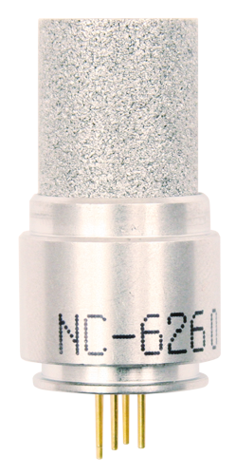
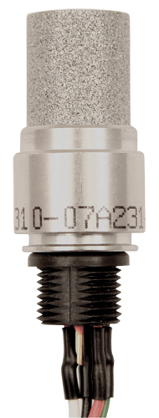
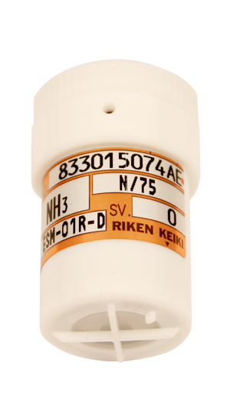
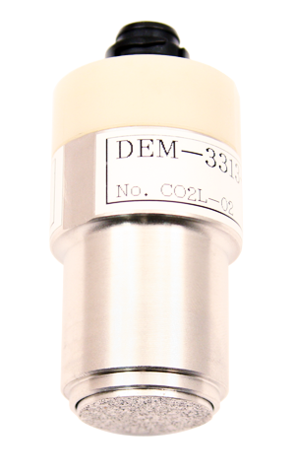
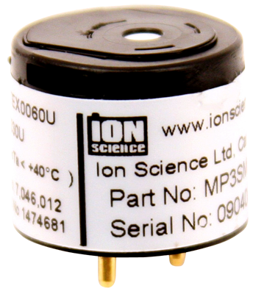
Sensor Technologies
PID- Photo Ionization
IR- Infrared Sensor
TC- Thermal Conductivity
EC- Electrochemical
Catalytic Bead

Slide 7
Sensor Advancements
PID Sensor
  Low ppm VOC’s
TC Sensor
  100% volume CH4
  10 / 100% volume H2
Smart ESM-01 toxic sensors
  Auto recognition
  Remote calibration
Combine up to 3 of super-toxic, IR, PID, or TC sensors

Slide 8
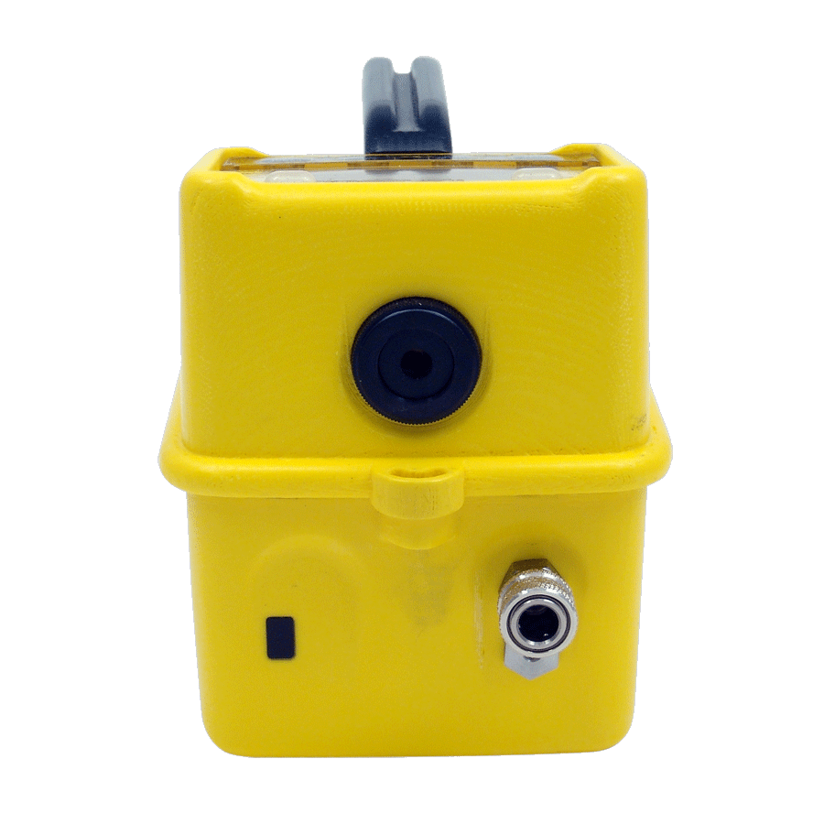
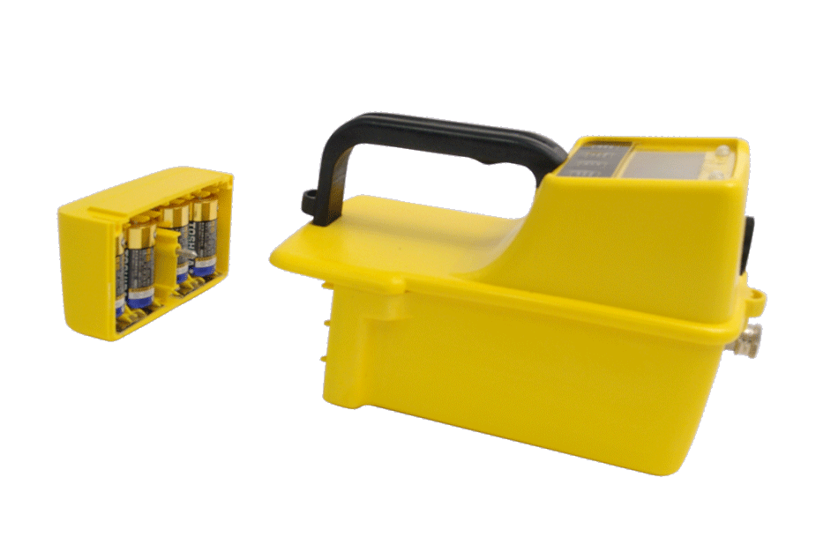
Physical Advancements
35% smaller, 40% lighter
4 button operation
Louder buzzer
  95 dB at 30 cm
Removable battery compartment
  Charge with or without the instrument
  No tools needed to remove
Dual battery options
  18 hours on 4 C size alkaline
  20 hours on 4 C size Ni-MH

Slide 9
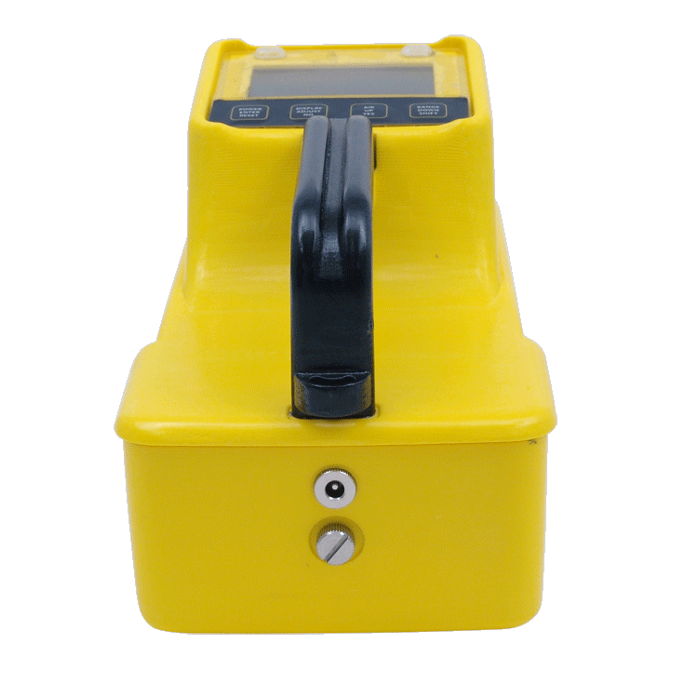
Physical Advancements
Increased visibility of LED alarms
IR communications port
Antistatic enclosure
Increased space under handle
  Fits a large gloved hand comfortably
Intrinsically safe design
  Class I, Groups A, B, C & D
  CSA Approved

Slide 10
Display Advancements
Larger graphical display
  128 x 64 resolution with back light
  Displays up to 6 gases
3 display modes
  Display all gases
  Large font auto scroll
  Large font manual scroll
Back lit contrast & delay control
Protective scratch & impact resistant coating
Flow indicator icon

Slide 11
Software Advancements
3 Operating modes
  Normal
  Leak check
  Bar hole sampling
Data log up to 6 gases
Calibration reminders
  Confirm to cal
  Must cal (lock out)
  Notification only
Gas channel positions fully programmable

Slide 12
Software Advancements
Preprogrammed response factors for LEL and PID sensors
  Change target gas without re-calibrating
Password protection
Software for all configurations included
  No eprom replacements for upgrades
Data logging standard on all versions
Maintenance data loader - utility software
  Reconfigure instrument versions
  Save multiple configurations

Slide 13
Software Advancements
Calibration / Docking Station (SDM-E2)
  Stand alone docking module for bump test, calibration, and battery charging
Gang up to 10 docks together
Connects directly to PC
Available in 5 languages
  English, French, Spanish, Italian, & German

Slide 14
EAGLE 2 Features
Monitor up to 6 gases

Slide 15
EAGLE 2 Features
Monitor up to 6 gases
Plug and play smart toxic sensors

Slide 16
EAGLE 2 Features
Monitor up to 6 gases
Plug and play smart toxic sensors
PID for VOC detection
IR for CO2, CH4, & HC

Slide 17
EAGLE 2 Features
Monitor up to 6 gases
Plug and play smart toxic sensors
PID for VOC detection
IR for CO2, CH4, & HC
Glove friendly handle

Slide 18
EAGLE 2 Features
Monitor up to 6 gases
Plug and play smart toxic sensors
PID for VOC detection
IR for CO2, CH4, & HC
Glove friendly handle
Datalogging standard

Slide 19
EAGLE 2 Features
Monitor up to 6 gases
Plug and play smart toxic sensors
PID for VOC detection
IR for CO2, CH4, & HC
Glove friendly handle
Datalogging standard
IRDA communication port for PC

Slide 20
EAGLE 2 Features
Monitor up to 6 gases
Plug and play smart toxic sensors
PID for VOC detection
IR for CO2, CH4, & HC
Glove friendly handle
Datalogging standard
Ergonomic RKI/ EMI/ chemical / weather resistant enclosure
IRDA communication port for PC

Slide 21
EAGLE 2 Features
Monitor up to 6 gases
Plug and play smart toxic sensors
PID for VOC detection
IR for CO2, CH4, & HC
Glove friendly handle
Autocalibration
Datalogging standard
Ergonomic RKI/ EMI/ chemical / weather resistant enclosure
IRDA communication port for PC

Slide 22
EAGLE 2 Features
Monitor up to 6 gases
Plug and play smart toxic sensors
PID for VOC detection
IR for CO2, CH4, & HC
Up to 18 hours of continuous operation
Glove friendly handle
Autocalibration
Datalogging standard
Ergonomic RKI/ EMI/ chemical / weather resistant enclosure
IRDA communication port for PC

Slide 23
EAGLE 2 Features
Monitor up to 6 gases
Plug and play smart toxic sensors
Powerful long-life pump up to 125 feet
PID for VOC detection
IR for CO2, CH4, & HC
Up to 18 hours of continuous operation
Glove friendly handle
Autocalibration
Datalogging standard
Ergonomic RKI/ EMI/ chemical / weather resistant enclosure
IRDA communication port for PC

Slide 24
EAGLE 2 Features
PPM / LEL hydrocarbon detection
Monitor up to 6 gases
Plug and play smart toxic sensors
Powerful long-life pump up to 125 feet
PID for VOC detection
IR for CO2, CH4, & HC
Up to 18 hours of continuous operation
Glove friendly handle
Autocalibration
Datalogging standard
Ergonomic RKI/ EMI/ chemical / weather resistant enclosure
IRDA communication port for PC

Slide 25
Eagle 2 Operation

Slide 26
Eagle 2 Operation
Note: Always turn the Eagle 2 on in a fresh air environment (one free of combustible and toxic gas and with normal oxygen content).
Attach the hose and probe to the Eagle 2’s inlet fitting.
Press and briefly hold the POWER button.
The Eagle 2 will power up and display the minimum battery voltage and actual battery voltage.

Slide 27
Eagle 2 Operation
If LEAK CHECK MODE is turned on, the LCD will then prompt you to select
  NORMAL MODE or
  LEAK CHECK MODE
  Press the UP or Down buttons to select either mode then press the POWER button.
The LCD will then show the active gases for all sensors installed.

Slide 28
Eagle 2 Operation
If the Lunch Break feature is turned on, it will indicate Lunch Break Mode ON, Resume Peak and TWA Measurements?
  Press the YES button to continue to accumulate the peak and TWA readings.
  To reset the accumulation of these measurements, press and release the DISPLAY ADJUST NO button before the countdown reaches 0.

Slide 29
Eagle 2 Operation
The LCD will then display the alarms as follows:
  LOW Alarm
  HIGH Alarm
  TWA Alarm (8 hour exposure, toxic gas)
  STEL Alarm (15 min. exposure, toxic gas)
After the alarm display, if the CAL REMINDER is turned on, the LCD will display how the CAL PAST DUE ACT is set.

Slide 30
Eagle 2 Operation
The LCD will then show the Date and Time
If the USER/STATION ID is turned on, then the User/Station ID screen appears

Slide 31
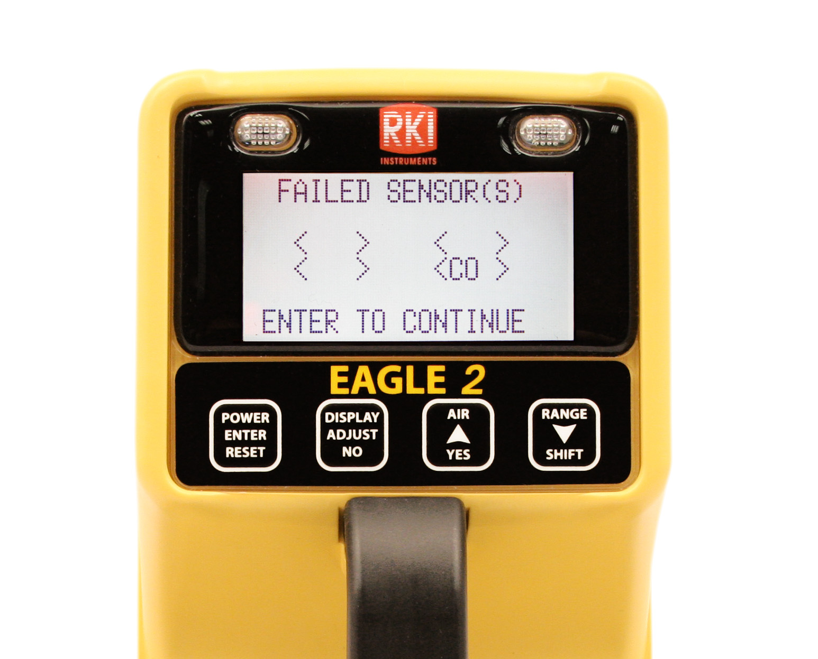
Eagle 2 Operation
If one or more sensors fail during startup, the failed sensor will be shown in brackets. Example: FAILED SENSOR(S) <CO> ENTER TO CONTINUE
  Replace the failed sensor and calibrate the Eagle 2 before use.

Slide 32
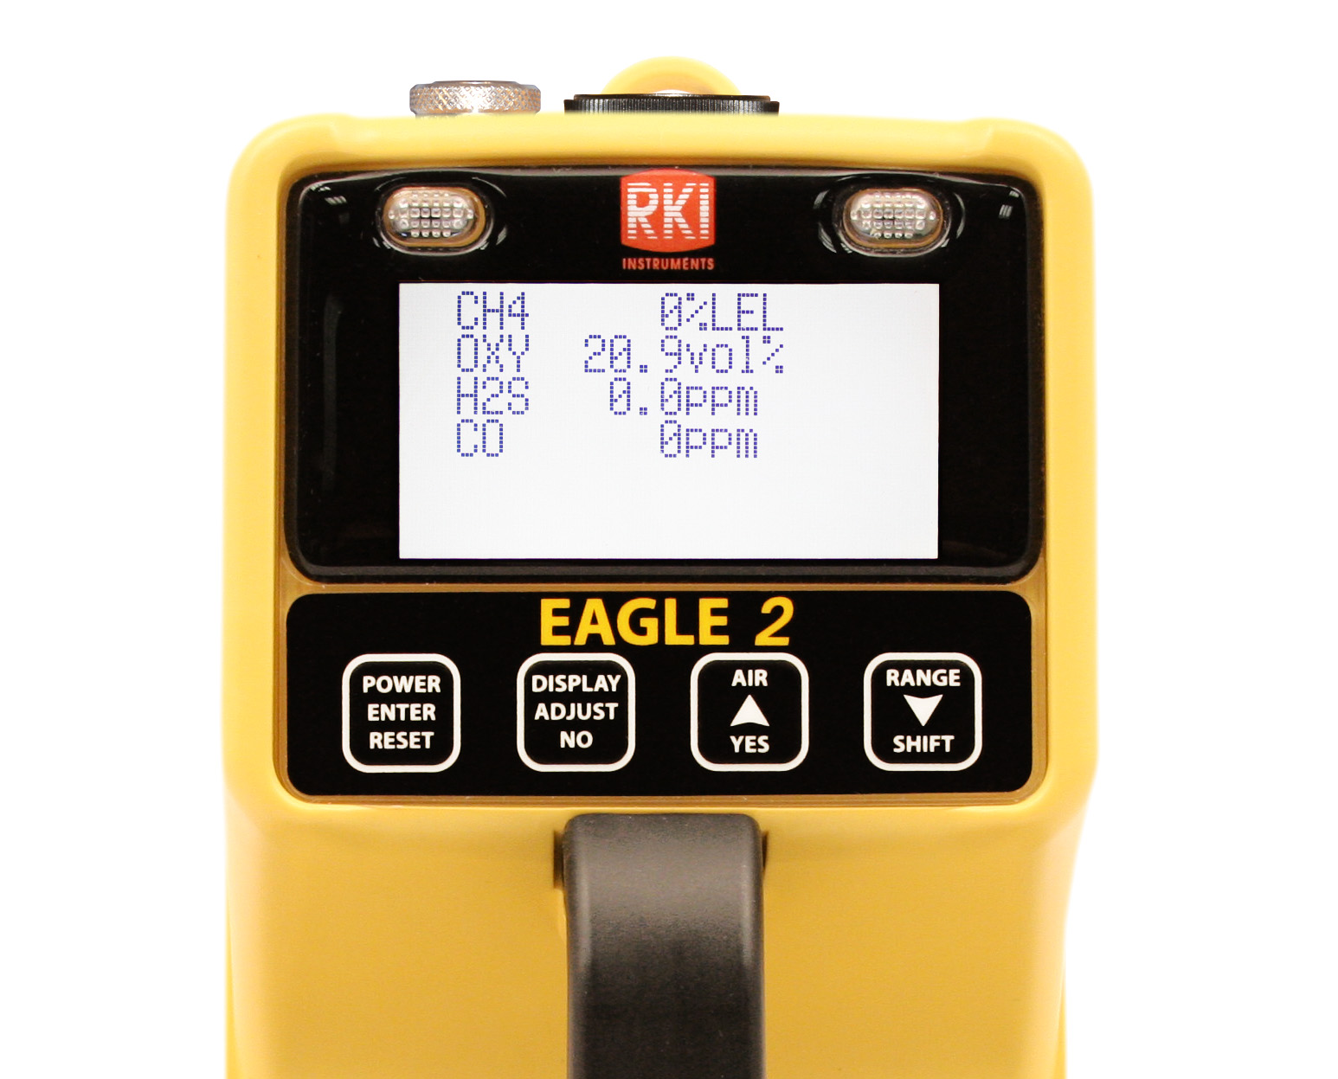
Eagle 2 Operation
After initial startup, the Eagle 2 LCD will display the normal measuring screen:

Slide 33
Performing a Demand Zero
Take the Eagle 2 to a fresh-air environment.
  This is a environment that is free of combustible and toxic gas and of normal oxygen content.
Press and hold the AIR/YES button. The LCD will show:
  DEMAND ZERO- HOLD AIR BUTTON
  ADJUSTING ZERO- HOLD AIR BUTTON
  ADJUSTING ZERO- RELEASE AIR BUTTON
The Eagle 2 will now set to fresh air values.

Slide 34
Performing a Flow Integrity Test
The flow integrity test verifies there are no leaks in the hose and probe assembly, the pump is operating, and the flow fault circuit is active.
With the Eagle 2 in normal operation and with the hose and probe attached, place your finger over the end of the probe to block flow.

Slide 35
Performing a Flow Integrity Test
The Eagle 2 should indicate FAIL LOW FLOW LEVEL within a few seconds. Press POWER ENTER RESET to restart the pump.
If the Eagle 2 does not go into low flow alarm, inspect the hose and probe for leaks.

Slide 36
Performing a Breath Test
Performing a breath test quickly tests the Eagle 2’s oxygen sensor, pump, and audible and visual alarms for proper operation.
Note: The breath test is not a substitute for calibration or a bump test.

Slide 37
Performing a Breath Test
Perform a demand zero
Cup your hand over the end of the probe and gently exhale into the probe.
In a few seconds, the oxygen reading will drop below the alarm point of 19.5% and activate alarms.
Press the RESET button to silence alarms.

Slide 38
Display Mode
To access Display Mode, while the Eagle 2 is in Normal Operation, press and release DISPLAY
Use DISPLAY to scroll through the following screens:
  Peak readings
  Battery voltage
  Gas display
  Methane elimination mode (if unit is configured appropriately)
  Relative response (if turned on)

Slide 39
Display Mode
  STEL
  TWA
  View alarm settings
  Select user ID (if turned on)
  Select station ID (if turned on)
  Time in operation
  Date/time
  Data logging time remaining (if turned on)
  Return to Normal Operation

Slide 40
Display Mode
Tips for using Display Mode:
  To skip an item when a question is asked, press and release NO
  To enter an item when a question is asked, press and release YES
  To change a flashing parameter, use either YES or SHIFT

Slide 41
Using the Eagle 2
The standard Eagle 2 is provided with a 5’ polyurethane hose and a 10” probe with internal hydrophobic filter.
The Eagle 2 can be used with the probe connected directly to the end of the instrument or can be used with hoses of varying lengths.
Caution: Sample time must be considered when using longer lengths of hose.

Slide 42
Eagle 2 Response Times
Accessory Used | Typical Time to 90% of response (T-90)
Probe Only | 12 Seconds
Probe and 5’ hose | 15 Seconds
Probe and 25’ hose | 25 Seconds
Probe and 50’ hose | 35 Seconds
Probe and 75’ hose | 45 Seconds
Probe and 100’ hose | 60 Seconds
Probe and 125’ hose | 75 Seconds

Slide 43
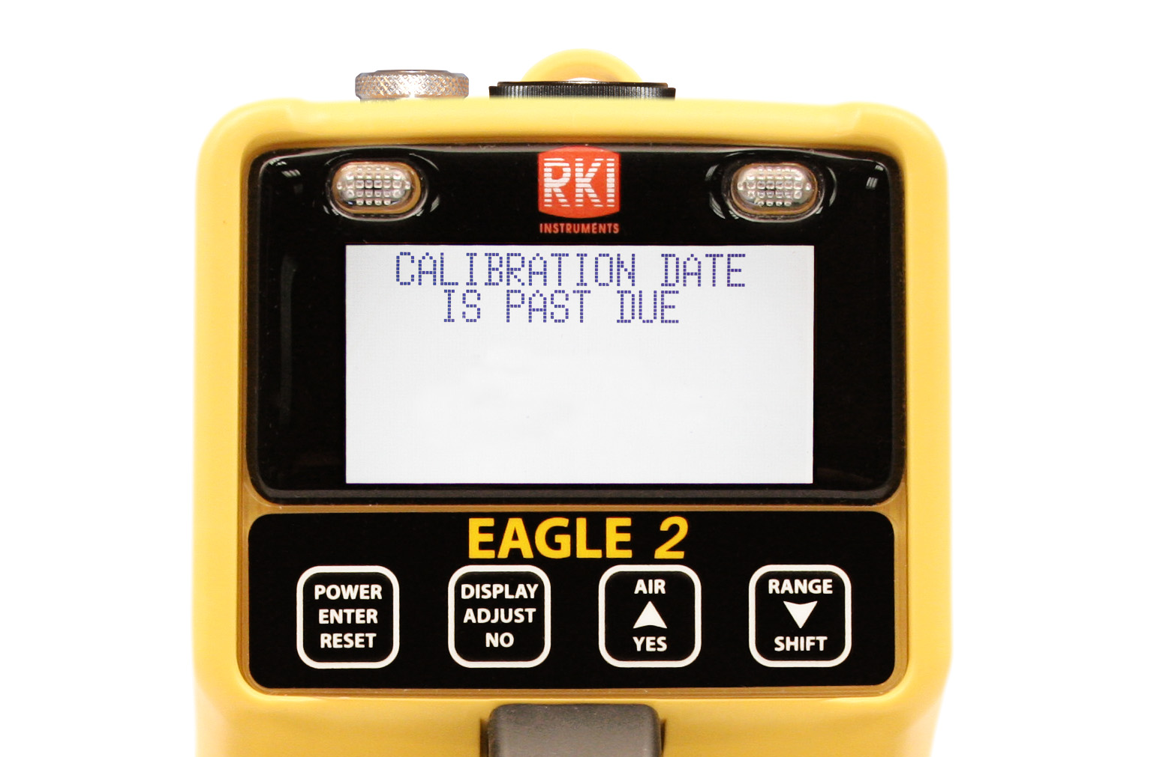
Eagle 2 Auto Calibration
Note: This describes a standard 4 gas unit LEL/O2/H2S/CO

Slide 44
Eagle 2 Auto Calibration
To perform a calibration on a standard 4-gas Eagle 2, you will need:
  Calibration gas cylinder with blend of 50% LEL methane, 12% O2, 25 ppm H2S, 50 ppm CO balance N2
  Demand flow regulator
  Non-absorbent tubing

Slide 45
Eagle 2 Auto Calibration
Take the Eagle 2 to a fresh-air environment.
Attach probe to the front of the instrument.
Turn the Eagle 2 on and allow the instrument to warm up.
Place your finger over the end of the probe and verify that the Eagle 2 indicates flow fail. This verifies that the probe and inlet are leak tight.
Press the RESET switch to start up pump.

Slide 46
Eagle Auto 2 Calibration
Once warm up is complete, perform a demand zero setting all sensors to fresh air values.
While in Measuring Mode, press and hold the RANGE SHIFT button, then press the DISPLAY ADJUST button and release.
The Calibration Mode Screen will be displayed with the cursor next to AUTO CALIBRATION.

Slide 47
Eagle 2 Auto Calibration
Press the POWER ENTER button.
The calibration values will be displayed.
  CAL GAS VALUES
  CH4 50% LEL
  OXY 12% vol.
  H2S 25.0 ppm
  CO 50 ppm
  ENTER TO BEGIN CAL

Slide 48
Eagle 2 Auto Calibration
If the gas concentrations to be used are different than what is displayed, press and hold the RANGE SHIFT button then press the DISPLAY button. The LCD will indicate the following:
ADJUST AUTO
CALIBRATION VALUES
CH4 50% LEL
OXY 12.0 vol%
H2S 25.0 ppm
CO 50 ppm
END

Slide 49
Eagle 2 Auto Calibration
Use the AIR YES or RANGE SHIFT buttons to move the cursor to the channel you wish to change and press ENTER.
The current value will begin to blink
Use the AIR YES or RANGE SHIFT buttons to increase or decrease that value, respectively.

Slide 50
Eagle 2 Auto Calibration
To confirm the new calibration value, press ENTER.
Follow the same procedure for changing other values.
Make sure that the calibration values on the screen match the calibration values on the calibration cylinder.

Slide 51
Eagle 2 Auto Calibration
To return to the auto calibration screen, scroll down to END and press ENTER.
The screen will then ask if you would like to save the changes. Press YES to save them.
You will be returned to the auto calibration screen and the new calibration values will be displayed.

Slide 52
Eagle 2 Auto Calibration
Press the ENTER button to start the calibration.
Screw the Demand Flow regulator onto the calibration cylinder.
Connect the tubing from the demand flow regulator to the rigid tube on the probe.
Allow the Eagle 2 to draw gas for one minute.

Slide 53
Eagle 2 Auto Calibration
Allow readings to stabilize
Press the POWER ENTER RESET button to complete calibration
Remove calibration gas from probe
If all channels passed calibration, the display will prompt you to remove the gas and then it will return to the Calibration Mode Screen.

Slide 54
Eagle 2 Auto Calibration
If any channels didn’t pass, the display will show which sensors failed and the buzzer and alarm LEDs activate. Press ENTER to return to the Calibration Mode Screen.
To return to Normal Operation, use RANGE SHIFT to place the cursor next to NORMAL OPERATION and press ENTER.

Slide 55
Eagle 2 Auto Calibration
Unscrew the flow regulator from the calibration cylinder.
Store the calibration materials in a safe place.

Slide 56
Eagle 2 Single Calibration
A standard 4-gas Eagle 2 can be calibrated using Auto Calibration and a 4-gas mix.
If any additional sensors are installed (eg. PID, toxic gas, IR, or TC), they need to be calibrated individually using Single Calibration.

Slide 57
Eagle 2 Single Calibration
To perform a single calibration, you will need:
  Known concentrations of the target gas
  Demand flow regulator
  Non-absorbent tubing
Enter Calibration Mode by pressing and holding RANGE SHIFT, then pressing DISPLAY and releasing both.

Slide 58
Eagle 2 Single Calibration
Use the RANGE SHIFT button to move the cursor next to SINGLE CALIBRATION and press ENTER.
Screw the demand flow regulator into the calibration cylinder and connect tubing.
Insert the probe into the Eagle 2.

Slide 59
Eagle 2 Single Calibration
SELECT SENSOR
TO CALIBRATE
ESCAPE
CH4 OXY
H2S CO
Use the RANGE SHIFT and AIR YES buttons to move the cursor next to the channel you wish to calibrate and press ENTER.

Slide 60
Eagle 2 Single Calibration
Use the RANGE SHIFT and AIR YES buttons to adjust the calibration value, if necessary.
It is important that the value on the screen match the value on the cylinder.
Press ENTER to begin calibration; the screen will flash CAL IN PROGRESS.

Slide 61
Eagle 2 Single Calibration
Connect the sample tubing to the probe and allow gas to flow for 1 minute.
Press ENTER to finish the calibration.
If the calibration was successful, the Eagle 2 will display the span and then return to the sensor selection screen.

Slide 62
Eagle 2 Single Calibration
If the calibration was unsuccessful, the display will show that the sensor failure and the span. The buzzer and LEDs will pulse.
Press ENTER to silence the alarm and return to the sensor selection screen.

Slide 63
Eagle 2 Single Calibration
Repeat the process for any other sensors.
When finished, move the cursor to ESCAPE and press ENTER to return to the calibration screen.
Move the cursor to NORMAL OPERATION and press ENTER.

Slide 64
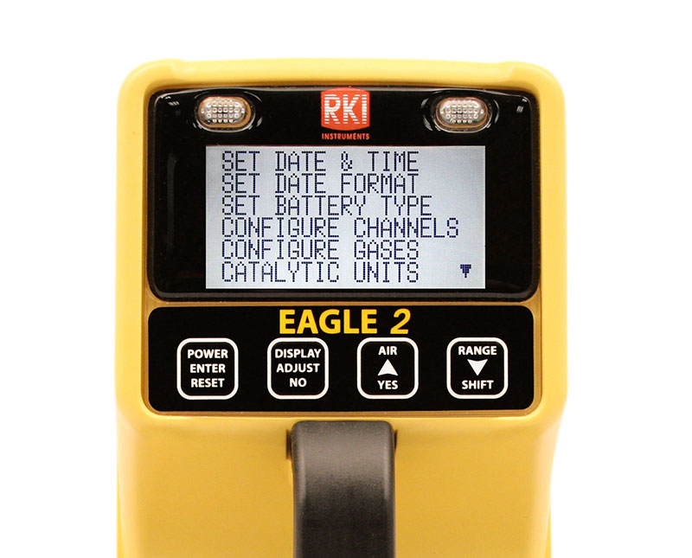
Set up and configuration

Slide 65
Setup Mode
Note: The Eagle 2 is not a gas monitoring device when it is in Setup Mode.
To access Setup Mode, with the unit off, press and hold the AIR YES and RANGE SHIFT buttons and then hold POWER. Release when you hear a beep.
A list of the following will be displayed 6 at a time:

Slide 66
Setup Mode
  Set Date and Time
  Set Date Format
  Set Battery Type
  Configure Channels
  Configure Gases
  Catalytic Units
  Relative Responses
  Alarm Points
  Alarm Latching
  Alarm Silence

Slide 67
Setup Mode
  User/Station ID
  Adj Autocal Values
  Backlight Delay
  Auto Fresh Air Adj
  Data Log Interval
  Data Log Overwrite
  Data Log Memory
  Adjust Contrast
  Cal Reminder
  Cal Past Due Act

Slide 68
Setup Mode
  Cal Interval
  LC/BH Mode Select
  BH Measuring Time
  Zero Follower
  Zero Suppression
  Confirmation Alert
  Change Password
  Default Settings
  Lunch Break
  Select Language
  Normal Operation

Slide 69
Setup Mode
Use the AIR YES and RANGE SHIFT buttons to move through the menu.
Use the ENTER button to enter a selected menu item.
Adjustable, flashing parameters can be changed using the AIR YES and RANGE SHIFT buttons.

Slide 70
Configuring Channels
Channels can be configured to a different gas or be set to “Not Used”.
To enter channel configuration, in Setup Mode, place the cursor next to “Configure Channels” and press ENTER.
Make sure that the correct sensors and electronic hardware are installed and that the construction and flow system are appropriate for installed sensors.

Slide 71
Configuring Channels
The Configure Channels Screen comes up:
CONFIGURE CHANNEL
CH1: CAT (CH4)
CH2: OXY (OXY)
CH3: H2S (H2S)
CH4: CO (CO)
CH5: NOT USED
CH6: NOT USED
END

Slide 72
Configuring Channels
Place the cursor next to the channel you wish to configure and press ENTER.
You may choose between CAT, OXY, H2S, CO, OP1, OP2, OP3, and NOT USED for the new configuration.
OP1, OP2, and OP3 are not defined for a standard 4-gas Eagle 2 and are only factory defined when hardware is installed for the optional sensors.

Slide 73
Configuring Channels
Place the cursor next to the desired configuration and press ENTER.
Repeat the process for any other channels you wish to configure.
When you are finished, move the cursor next to END and press ENTER.
Press YES to save the changes.
You will be returned to the Setup Menu.

Slide 74
Changing Alarm Set Points
To change the alarm set points for any channel, in Setup Mode, place the cursor next to Alarm Points and press ENTER.
The Alarm Points Screen will come up:
CHANGE ALARM
POINT SETTINGS
1: CH4 2: OXY
3: H2S 4: CO
END

Slide 75
Changing Alarm Set Points
Use AIR YES or RANGE SHIFT to place the cursor next to the channel you wish to edit and press ENTER.
The alarm points will be displayed.
To change a set point, place the cursor next to it and press ENTER.

Slide 76
Changing Alarm Set Points
The alarm set point will begin to flash.
Use AIR YES or RANGE SHIFT to increase or decrease the set point, respectively.
When finished, press ENTER.
Repeat this process to change other channel alarm set points.
To return to Setup Mode, move the cursor to END and press ENTER.

Slide 77
Eagle 2 Maintenance

Slide 78
Eagle 2 Maintenance
Some maintenance procedures may be performed by the user. More complicated procedures must be performed by RKI Instruments, Inc.
For all maintenance procedures, be sure that the Eagle 2 is turned off.

Slide 79
Replacing Batteries
The Eagle 2 can take either alkaline or Ni-MH batteries. Either type must be C size.
The battery compartment is located in the back of the bottom case of the Eagle 2.
To access the battery compartment, unscrew the thumbscrew located at the back of the unit.

Slide 80
Replacing Batteries
Pull the battery case away from the bottom case.
Remove the old batteries and make sure the battery compartment is clean.
Carefully put the new batteries into the battery compartment being sure to follow the diagram and push the batteries in all the way.
Reinstall the battery case and tighten the thumbscrew.

Slide 81
Replacing Batteries
After replacing Hi-MH batteries, charge batteries for 4 hours for a complete charge.
Fresh alkaline batteries will operate the Eagle 2 for 18 hours
Charged Ni-MH batteries will operate the Eagle 2 for 20 hours at 25C (77F).

Slide 82
Replacing Hydrophobic Filter
Replace the internal hydrophobic filter when it become dirty or clogged.
An unexplained low flow alarm may indicate the hydrophobic filter needs replacing.
To access the filter, turn the Eagle 2 upside down and unscrew the 3 screws holding the top case to the bottom case.
Carefully lift the top case off and place next to the bottom case.

Slide 83
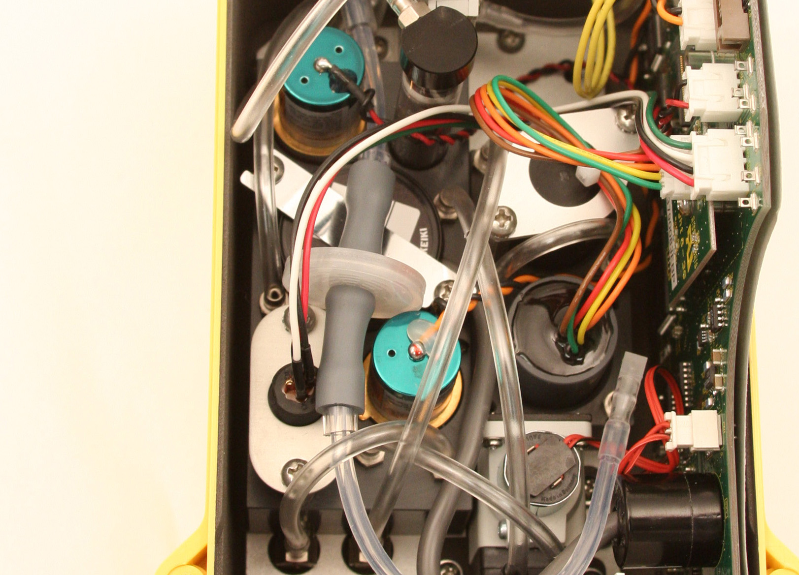
Replacing Hydrophobic Filter
Hydrophobic Filter
Pull the grey connecting tubes off each end of the filter.
Install the new filter with the red RKI logo facing the front of the Eagle 2.
Filter P/N 33-0173RK

Slide 84
Replacing Charcoal Filter
Charcoal Filter
Grasp the charcoal filter end cap and pull it off the charcoal filter.
Grasp the top of the charcoal filter firmly and pull it out of the flow block.

Slide 85
Replacing Charcoal Filter
Insert the new charcoal filter into its position in the flow block and push it in until it bottoms out.
Insert the charcoal filter end cap into the end of the new charcoal filter and push it in until it bottoms out.
Charcoal filter P/N 33-6090RK

Slide 86
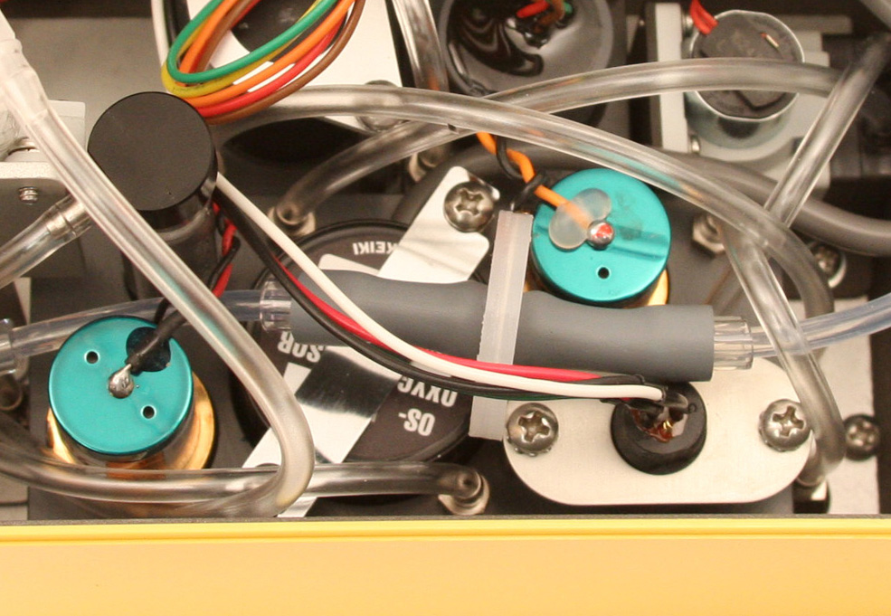
Replacing a Sensor
Locate the sensor you wish to replace.
H2S
Sensor
CO
Sensor
Oxygen Sensor
LEL Sensor

Slide 87
Replacing LEL Sensor
Unscrew and remove the 2 screws holding the LEL sensor retainer.
Grasp the LEL sensor connector and gently pull it up until it either disengages from the LEL sensor or the LEL sensor comes out of the flow block.
If the sensor came out, remove the sensor from the connector.
If the sensor stayed in the flow block, pull it up and remove it.

Slide 88
Replacing the LEL Sensor
Connect the new LEL sensor and the sensor connector.
Insert the LEL sensor into the sensor chamber.
Line up the LEL sensor retaining bracket and screw it back into place
Calibrate the Eagle 2 after replacing the LEL sensor

Slide 89
Replacing Oxygen Sensor
Unscrew the 2 screws that hold the oxygen sensor bracket and remove the bracket.
Note the routing of the oxygen sensor cable to the main PCB.
Move the hydrophobic filter towards the side wall and pull the oxygen sensor out of the flow block making sure the o-ring doesn’t come with it.

Slide 90
Replacing Oxygen Sensor
Grasp the connector on the end of the sensor cable and pull it away from the main PCB.
Insert the new oxygen sensor face down into the flow block.
Route the sensor cable the same way the old sensor cable was routed and connect it to the main PCB.
Reinstall the oxygen sensor bracket.
Calibrate the Eagle 2 after replacing the O2 sensor.

Slide 91
Replacing CO or H2S Sensor
Grasp the sensor firmly and rock it back and forth while pulling.
If this doesn’t work, use a pair of pliers and rock the sensor back and forth while pulling being careful not to damage the sensor.
Grasp the connector on the end of the sensor cable and pull it away from the main PCB.

Slide 92
Replacing CO or H2S Sensor
Insert the sensor face down into the sensor chamber.
Push the sensor until it bottoms out.
Route the sensor cable the same way the old sensor cable was routed and connect it to the main PCB.

Slide 93
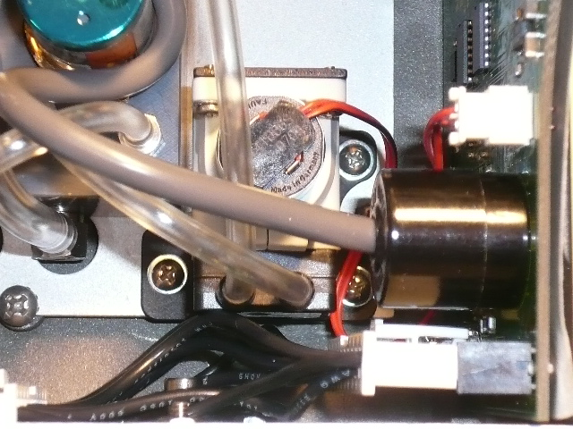
Replacing the pump
Remove the three Phillips screws that hold the pump to the bottom plate.
Remove pump inlet and outlet tubing taking care to mark where each tube attaches.
Screws

Slide 94
Setting the DP Switch
The DP (differential pressure) switch monitors the pressure in the flow system.
Plugged filters, dirt, dust or age can cause the pump flow to decrease activating the flow fail circuit.
If the pump and all filters are found to be good, then adjustment of the DP switch is necessary.

Slide 95
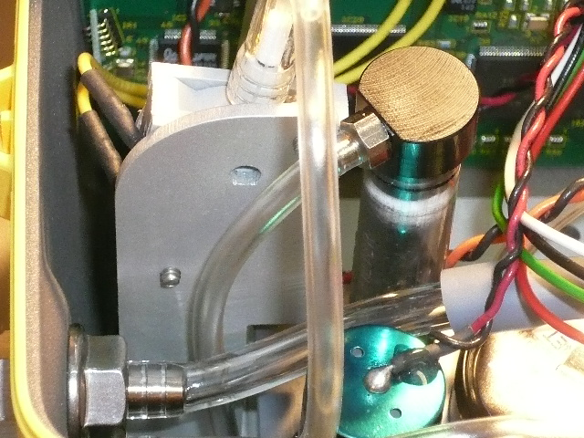
Setting the DP Switch
Normal flow for the Eagle 2 is between 1.6 and 2 SCFH depending on the number of sensors.
Trip point for the DP switch is .6 SCFH +/- .1.
DP switch adjustment screw

Slide 96
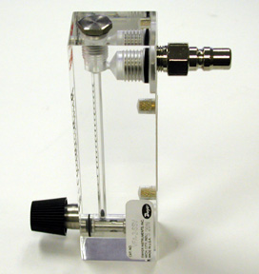
Setting the DP Switch
Recommended parts:
  P/N 17-0505RK male quick connect fitting and
  P/N 31-0023RK 0-2.00 SCFH flow meter.

Slide 97
Setting the DP Switch
Turn on the Eagle 2 and allow unit to warm up.
Perform a Demand Zero if needed.
Attach the flow meter to the inlet fitting of the Eagle 2 making sure that the flow meter valve is fully open.
Verify that the flow rate is between 1.6 and 2 SCFH.

Slide 98
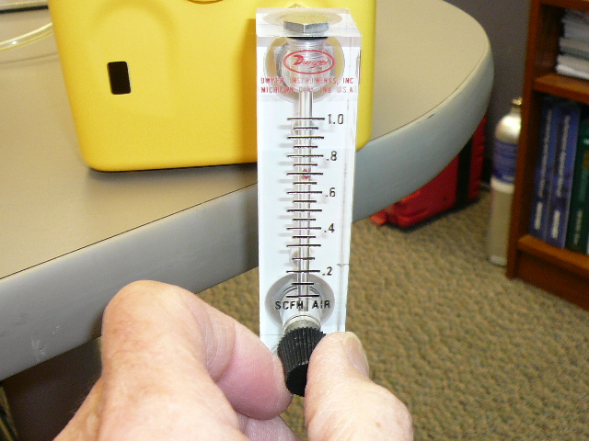
Setting the DP Switch
Slowly close the valve on the flow meter until the the reading drops to about .6 SCFH. The Eagle 2 should activate flow fault and the pump shut down.

Slide 99
Setting the DP Switch
Adjust DP switch as needed to activate flow fault at .6 SCFH +/- .1.
Retest as necessary to verify trip point.

Slide 100

PID Cleaning
Inspect the PID for contamination on the detection window. Contamination will appear as a blue hue
PID Lamp

Slide 101
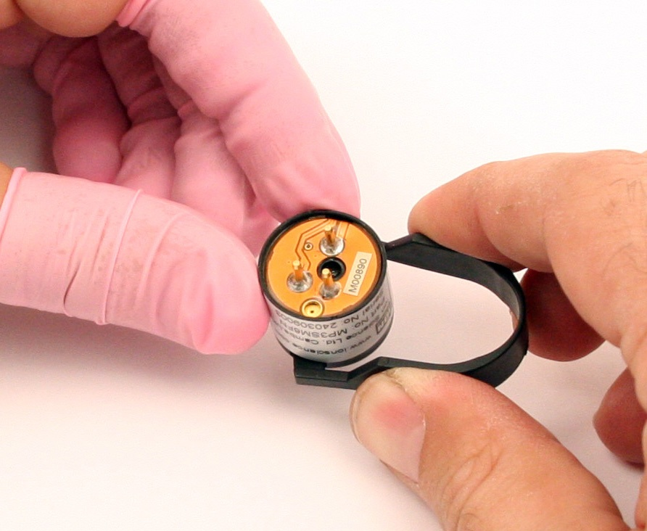
Opening the PID
Use tool to compress tabs to remove PID Lamp

Slide 102
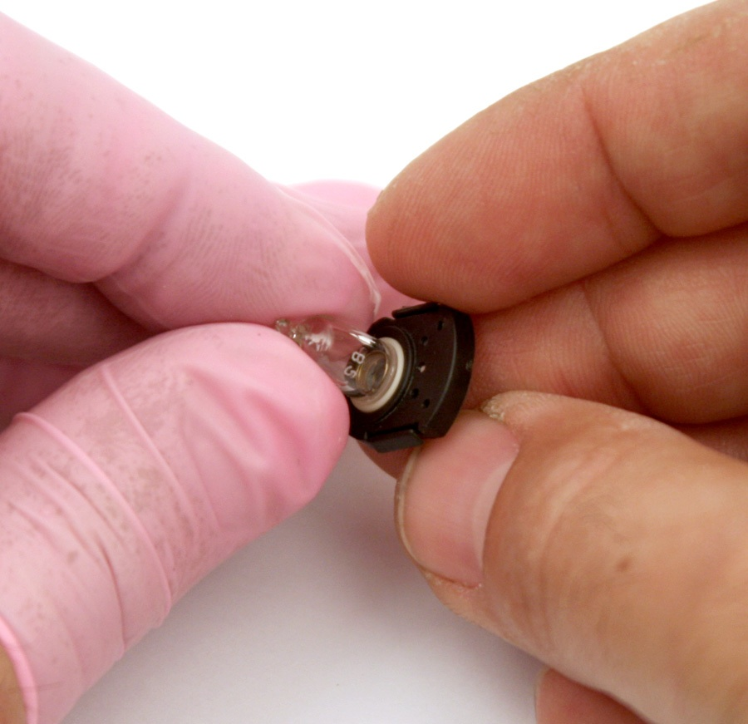
Removing the PID
Grasp lamp with fingers and pull out.
Use finger cots to protect lamp

Slide 103
PID Cleaning
Use PID lamp cleaning kit 82-0300RK
  Vial of cleaning compound contains a very fine aluminum oxide powder.
  Do not breathe vapor or dust.
  Avoid contact with skin, eyes and clothing.
  Wear suitable PPE when cleaning or handling the lamp
  Keep container closed to prevent water adsorption and contamination.

Slide 104
PID Cleaning
Open vial of aluminum oxide polishing compound.
Using a clean cotton swab, collect a small amount of compound.
Use cotton swab to polish the PID lamp window.
  Use a circular action applying light pressure
  Never touch the lamp window with fingers!

Slide 105
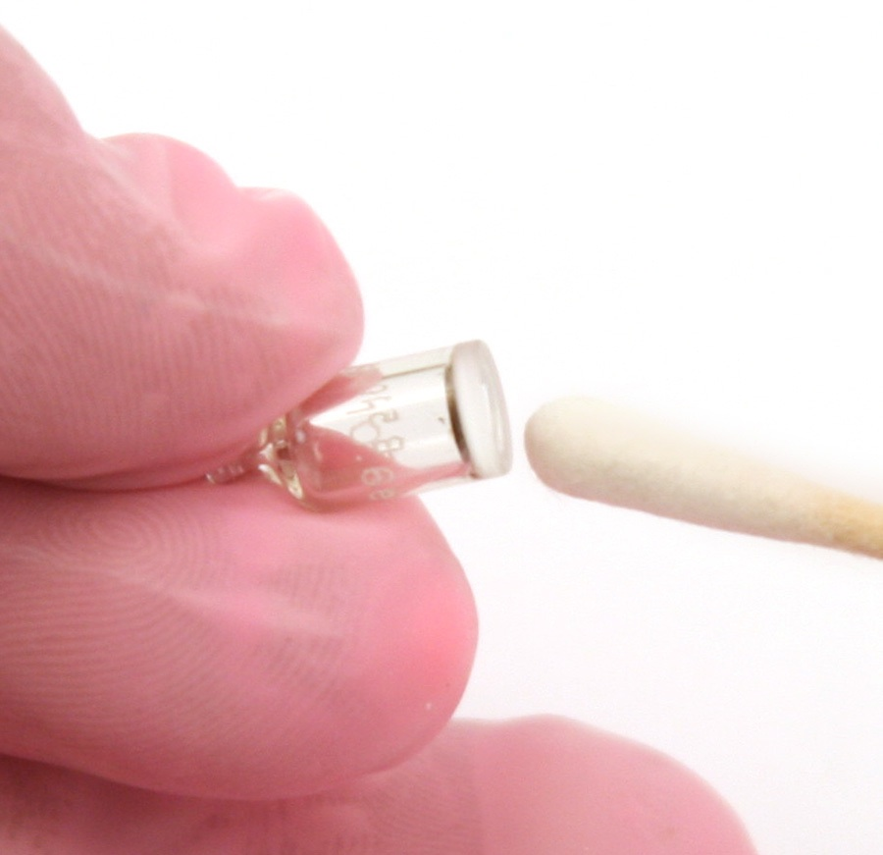
PID Cleaning
Polish the PID lamp window until a audible “squeaking” is heard.
  Usually about 15 seconds
Remove residual powder with clean cotton swab

Slide 106
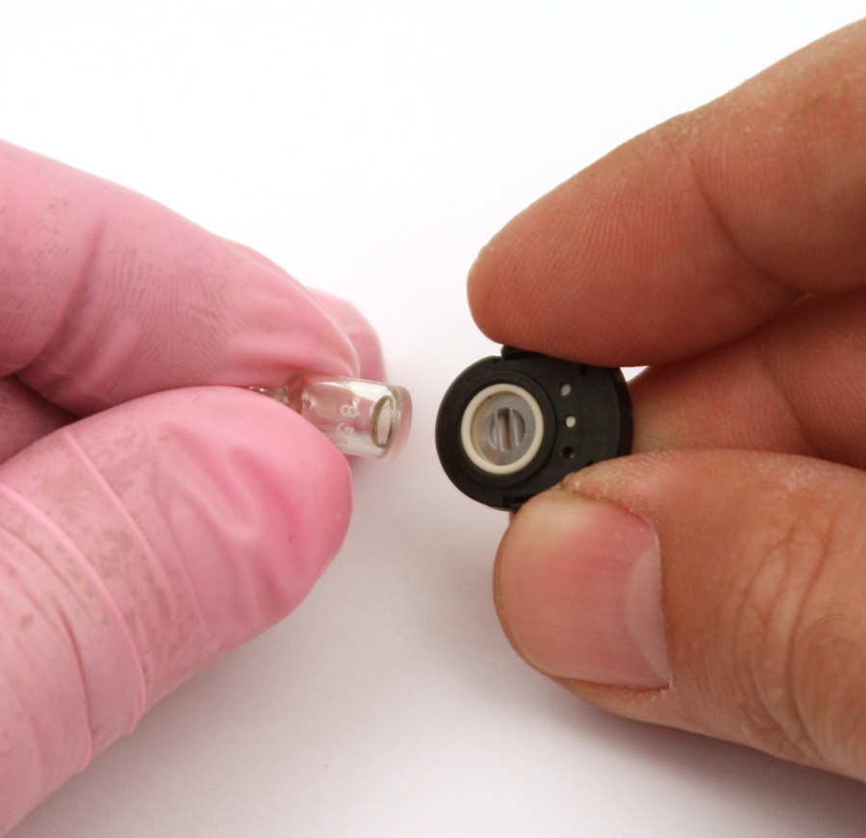
PID Cleaning
Ensure lamp is completely dry and any visible signs of contamination are removed before refitting.
Reinstall lamp into base.

Slide 107
Reassemble PID
Reassemble PID and calibrate as needed.

Slide 108
PID Maintenance
If the EAGLE 2 is having calibration problems that cleaning the lamp could not solve, the lamp may need to be replaced.
A contaminated electrode stack may also cause calibration problems by causing a drop in sensitivity. The electrode stack can also be replaced

Slide 109
PID Maintenance
With the EAGLE 2 off, turn the instrument upside down and unscrew the 3 case screws.
Turn the instrument right side up and carefully remove the top case.

Slide 110
PID Maintenance
Locate the PID sensor and pull it out of the flow block.
Remove the cable connector from the PID’s sub PCB.
Place the PID sensor face down on a working surface and hold it steady.

Slide 111
PID Maintenance
Insert the tabs on the removal tool into the slots on the top of the PID and squeeze until the electrode stack and lamp are released.

Slide 112
PID Maintenance
Carefully lift the PID sensor body away from the electrode stack and lamp.
Replace the old lamp or electrode stack with a new one.
Be careful not to touch the lamp window with bare fingers. The use of finger cots for the lamp handling hand is recommended.

Slide 113
PID Maintenance
Hold the electrode stack with one hand and place the window end of the lamp inside the O-ring. Twisting the lamp helps ensure a seal. The lamp should be freely supported by the O-ring.

Slide 114
PID Maintenance
Holding onto the electrode stack, place the lamp into the lamp cavity in the sensor and then press the electrode stack until the clips engage and the stack and sensor faces are flush.
Carefully line up the PID sensor pins with the sockets in the bottom of the sensor adapter and lower the sensor into the flow block.

Slide 115
PID Maintenance
Plug the cable connector into the PID sub PCB
Place the top case back on the bottom case, turn the instrument upside down, and screw the case screws back on.
Calibrate the PID channel before use.

Slide 116
Eagle 2 Data Logger
The Eagle 2 has the ability to store data in its memory.
That data can be downloaded to a computer using the Eagle 2 Data Logger Management Program.

Slide 117
Eagle 2 Data Logger
Install the Data Logger Management Program on the computer you wish to use and launch the program.
Make sure the Eagle 2 is off.
Locate the IR port on your computer or plug an IrDA downloading cable into a USB port.

Slide 118
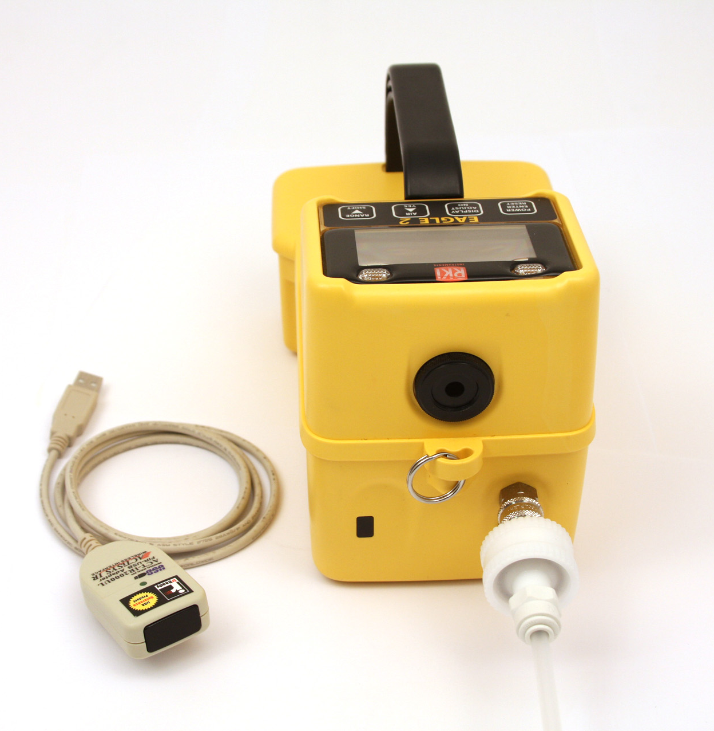
Eagle 2 Data Logger
Align the IR port on the front of the Eagle 2 with either the IR port on your computer or the
IR port on the
IrDA cable.
The 2 IR ports
should be a few
inches part.
IR Port
IrDA Cable

Slide 119
Eagle 2 Data Logger
With the IR ports lined up, turn on the Eagle 2.
It should get part way through its warm up sequence and display CONNECT IrDA.
The connect light in the Download Window of the program will turn green and “Connection Successful” displays in the download area.

Slide 120
Eagle 2 Data Logger
Data can be manually downloaded by pressing “Complete Download”.
All data that the instrument had been collecting will now be on the computer.
To clear the data in the instrument, press “Clear Logger Data”.
Be sure to download data before clearing it from the instrument.

Slide 121
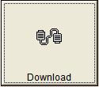
Eagle 2 Data Logger
There are 6 control buttons in the program: Download, Instrument Information, Data, Last Calibration, Set, and Exit.
The Download button opens the Download window if you are in another screen.

Slide 122
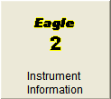
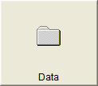
Eagle 2 Data Logger
The Instrument Information button brings up the Instrument Information screen which allows you to view calibration history and alarm set points.
The Data button opens the Data screen which allows you to view calibration history, alarm events, trouble events, alarm trend data, and interval trend data.

Slide 123
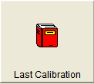
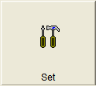
Eagle 2 Data Logger
The Last Calibration button brings up the Last Calibration screen which displays the most recent successful calibration.
The Set button brings up the Set screen which allows you to change alarm set points and to calibrate the instrument.

Slide 124
Eagle 2 Data Logger
When you are finished using the Data Logger Management Program, turn the Eagle 2 off by going to the Download screen and pressing “Power Off”.
Then press the Exit control button to close the program.

Slide 125
Eagle 2 Parts List

Slide 126
Eagle 2 Parts List

