Slide 1

GX-Force
Service PowerPoint

Slide 2
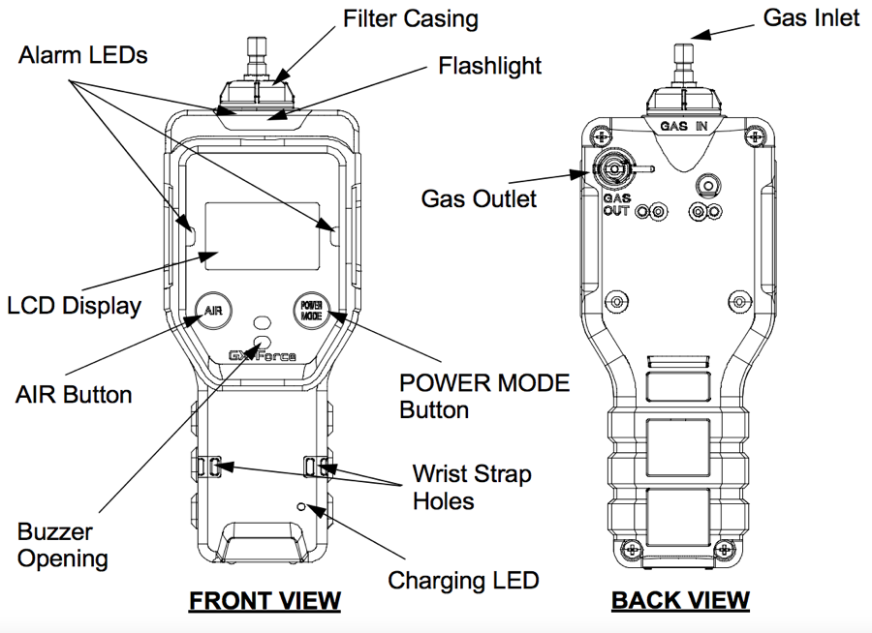

Slide 3

Agenda
Control Buttons
Start-up procedure
Fresh air adjust
Display Mode
Calibration
Filter & sensor replacement

Slide 4

Control Buttons
GX-Force
Button | Function(s)
AIR | Turns on LCD backlight Reset alarm button for latching alarms Enters User Mode, Maintenance Mode, and Gas Select mode when used with POWER MODE Activates the demand zero for fresh air reading Changes the value of a parameter available for adjustment Scrolls through parameter options
Power MODE | Turns the GX-Force on and off Turns on LCD backlight Enters and scrolls through Display Mode Save button Reset alarm button for latching alarms Enters User Mode, Maintenance Mode, and Gas Select mode when used with AIR

Slide 5

Start-up Procedure
GX-Force
Press and hold POWER MODE button.
Release the button when you hear a beep.

Slide 6



Start-up Procedure
GX-Force
Start-up sequence will commence
If CAL.RMDR is set to ON (factory setting) and a calibration is due, the screen that appears next depends on the CAL.EXPD setting in User Mode.
Press the AIR button to bypass
the CAL.RMDR and continue
using the GX-Force
Press the POWER/MODE button
to calibrate the instrument in
User Mode
Date and Time

Slide 7



Start-up Procedure
GX-Force
Battery Voltage
Target Gases
Full Scale

Slide 8



Start-up Procedure
GX-Force
Warning
Alarm
High Alarm

Slide 9



Start-up Procedure
GX-Force
STEL
TWA
Normal Operation Screen

Slide 10


Fresh Air Adjust
GX-Force
Verify that the instrument is in
a fresh air environment
Press and hold the AIR button
Keep holding the AIR button
until prompted to release it

Slide 11



Display Mode
GX-Force
From the Normal Operation Screen ( Measuring Mode )
Press POWER/MODE to cycle through Display Mode’s menu items
Flashlight
Peak
STEL
Press AIR to turn on/off the light

Slide 12




Display Mode
GX-Force
Press AIR to
change HC Gas List
TWA
HC Gas List
Press POWER/MODE to
continue to the next
display menu

Slide 13



Display Mode
GX-Force
Press AIR to
display cal. data
Calibration Data
Press POWER/MODE to
continue to the next
display menu

Slide 14



Display Mode
GX-Force
Press AIR to
display snap log data
Snap Log Data
Press POWER/MODE to
continue to the next
display menu

Slide 15


Display Mode
GX-Force
Press AIR to
display alarm points
Date / Time / Temp
Alarm Points
Press POWER/MODE
to continue to the next
display menu
Normal Operation Screen

Slide 16

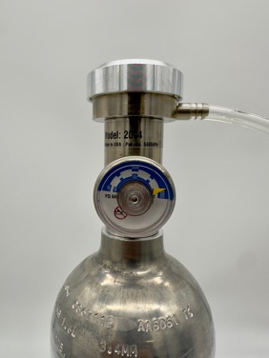
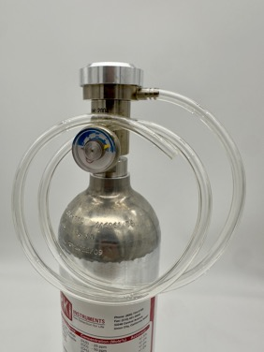
Calibration (GAS CAL)
GX-Force
Calibration Cylinder
Demand Flow Regulator
Tubing

Slide 17

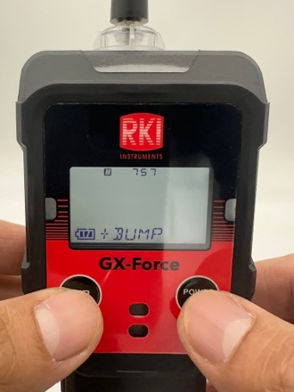
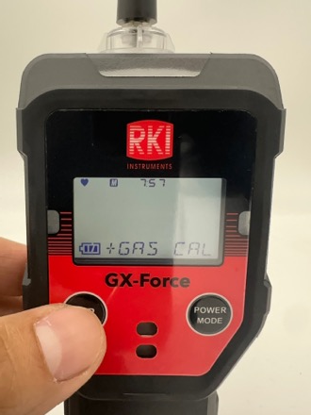
Calibration (GAS CAL)
GX-Force
With the instrument off, Press AIR
and then POWER/MODE to enter
User Mode
BUMP is the first menu to appear
Press AIR to scroll to GAS CAL
and then press POWER/MODE

Slide 18
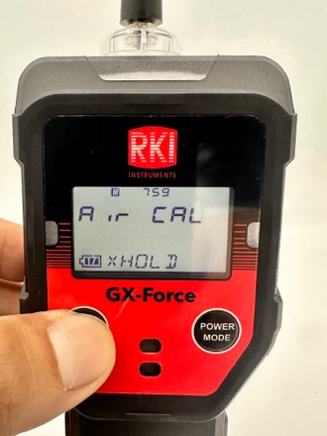

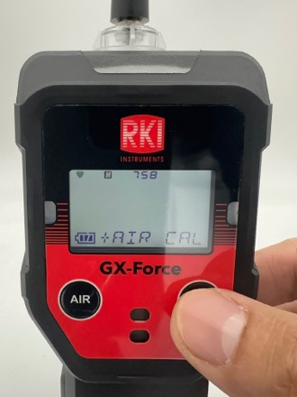
Calibration (GAS CAL)
GX-Force
AIR CAL appears on the screen.
Press POWER/MODE
Press and hold AIR until prompted
to release it

Slide 19
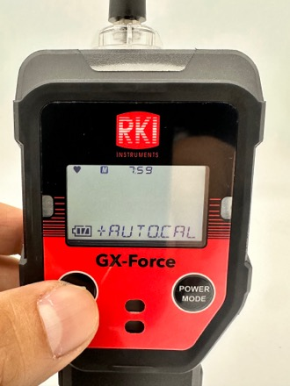

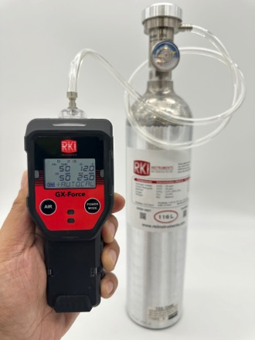
Calibration (GAS CAL)
GX-Force
Press AIR to scroll to AUTOCAL
Press POWER/MODE to enter
AUTOCAL
Connect the demand flow regulator
to the calibration cylinder, attach the
hose to the demand flow regulator and
the instrument

Slide 20
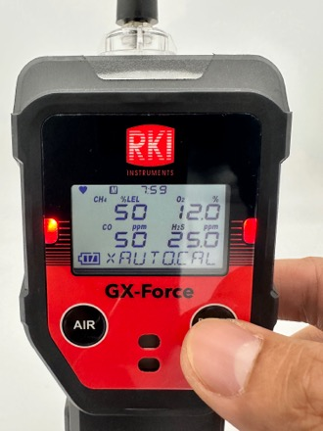
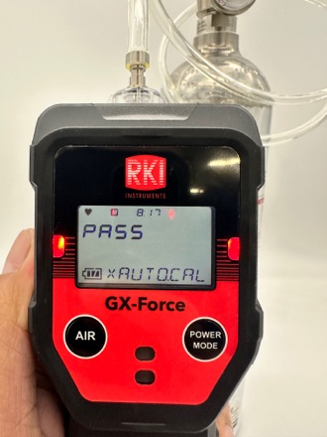
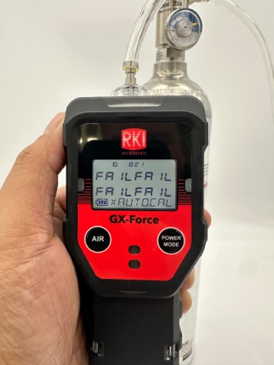
Calibration (GAS CAL)
GX-Force
The screen will show the calibration
values, which should match the
calibration cylinder. Press POWER/
MODE, and let the gas flow for 1 minute
After the reading stabilizes, press
POWER/MODE. The result will show
PASS. The instrument will automatically
start up to Normal Operation
If the result shows FAIL, press POWER
/MODE. The instrument will prompt
you to repeat the calibration process

Slide 21
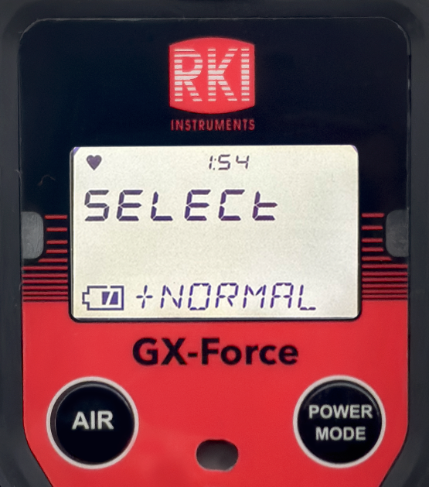
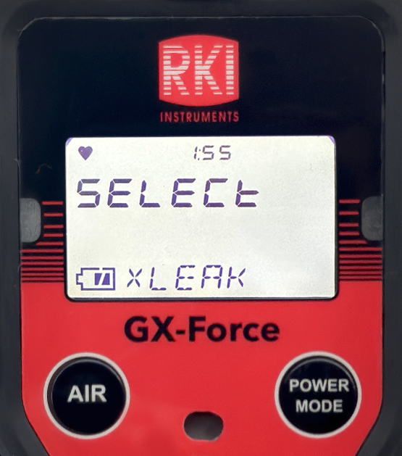
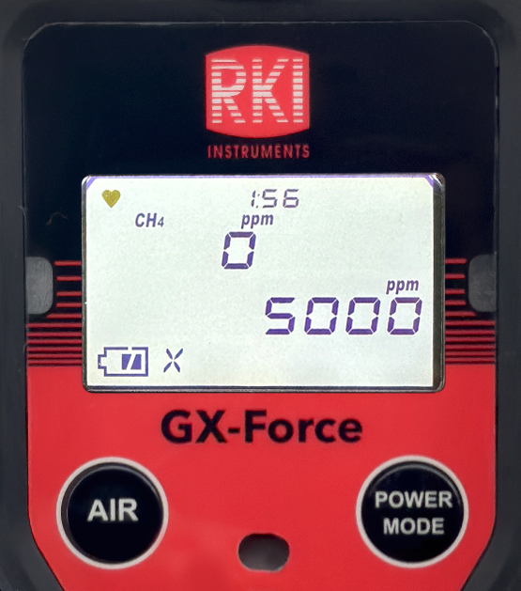
Leak Check Mode
GX-Force
Press and briefly hold down POWER MODE. Release the button when you hear a beep.
The Mode Select Screen displays
Press AIR to scroll to the
Leak Check Mode item
With the Leak Check Mode selection
displayed, press POWER MODE to
begin the Leak Check Mode startup
sequence
With the Leak Check Mode displayed, you are ready to use the GX-Force

Slide 22
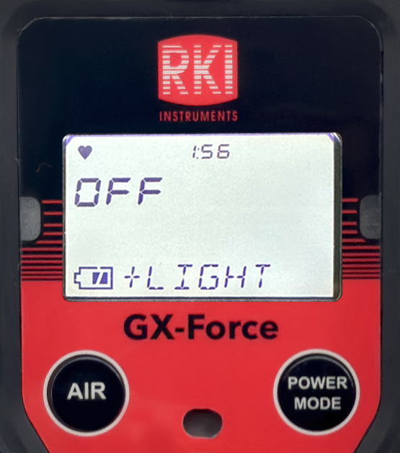
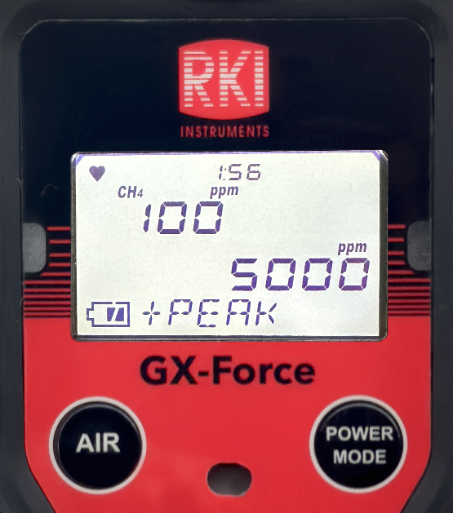
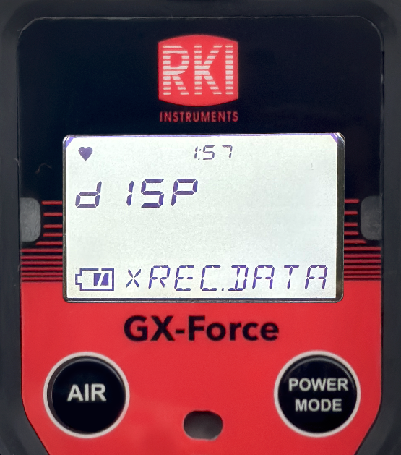
Leak Check Mode
GX-Force
From the Leak Check Operation Screen
Press POWER/MODE to cycle through Display Mode’s menu items
Flashlight
Peak
Snap Log Data

Slide 23

Adjusting Leak Check Settings
GX-Force
Download the GX-Force Setup Program to adjust Leak Check Mode parameters
Navigate to the RKI website
Select “Product Resources”, then
click on “Software”

Slide 24
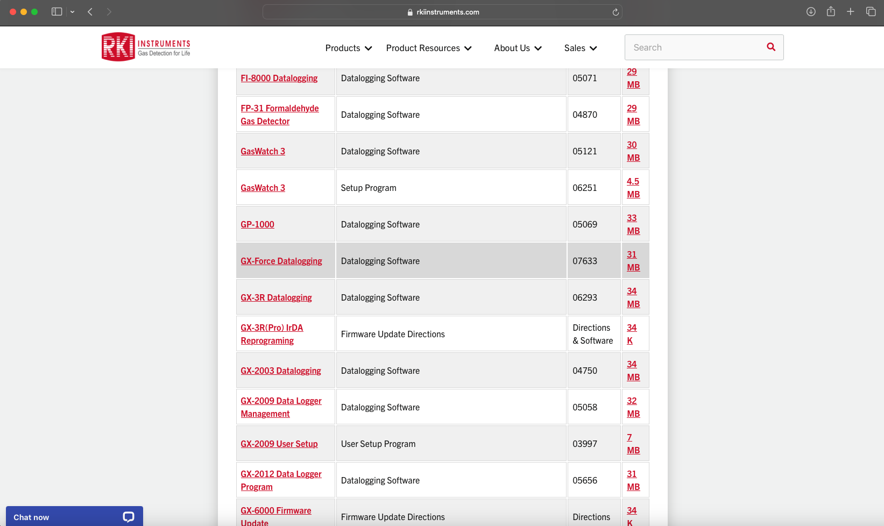
Adjusting Leak Check Settings
GX-Force
On the Software page, click “Portable
Monitors”, then click on the “GX-Force
Setup Program” link to begin downloading the installation file

Slide 25
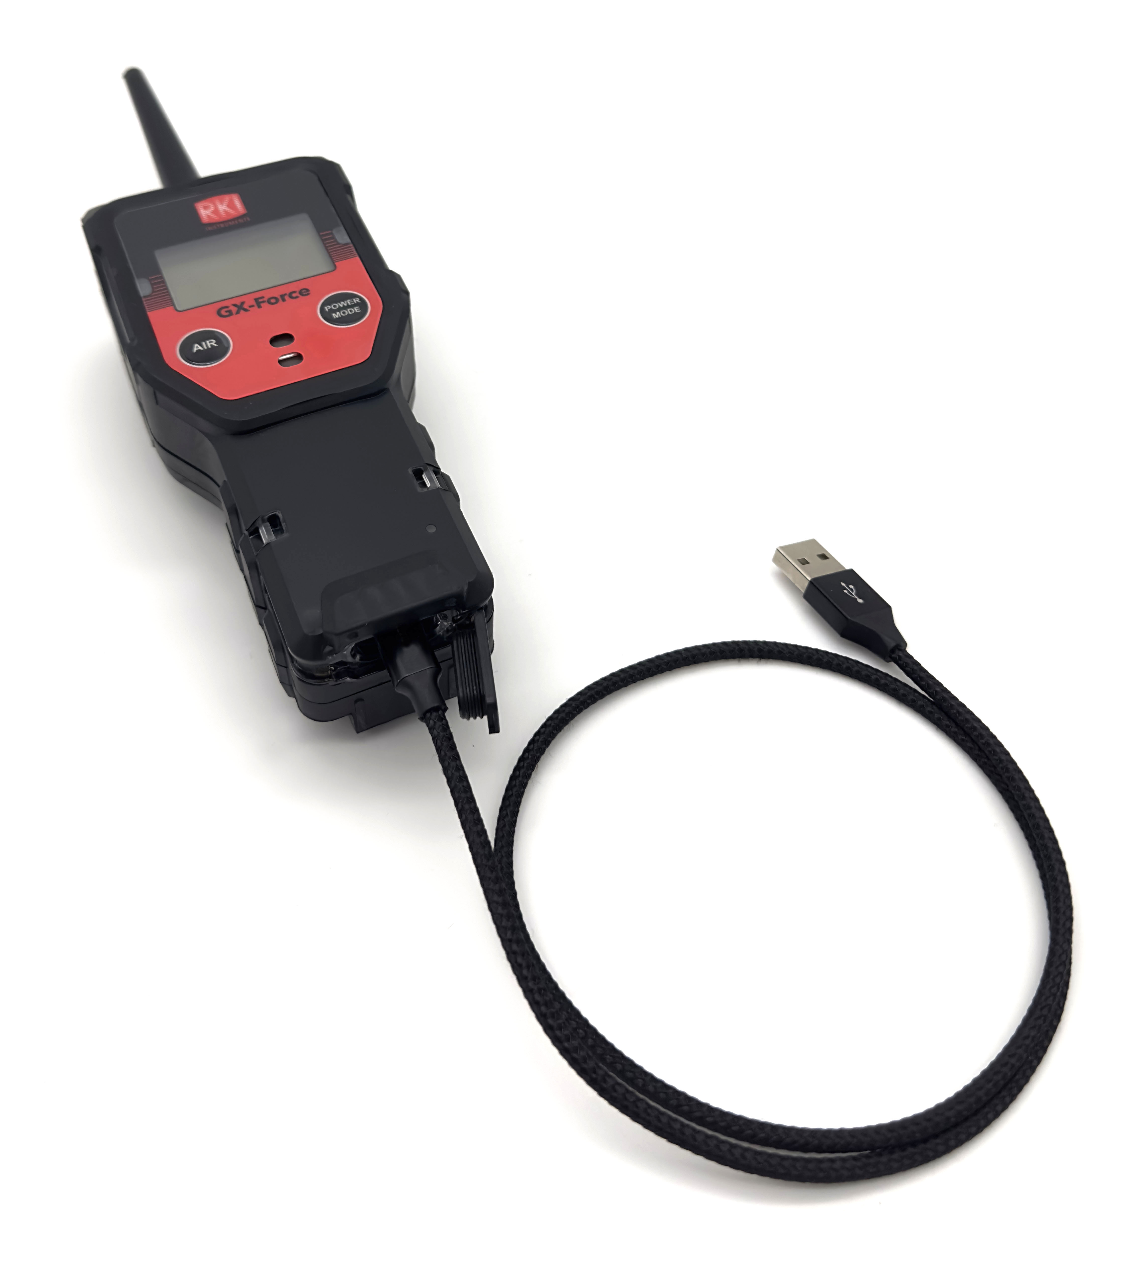
Adjusting Leak Check Settings
GX-Force
Open the GX-Force Setup program setup.exe file
and follow the on-screen installation guide
Connect the GX-Force to the computer using a Micro
USB Type C cable
Open the GX-Force Setup Program

Slide 26
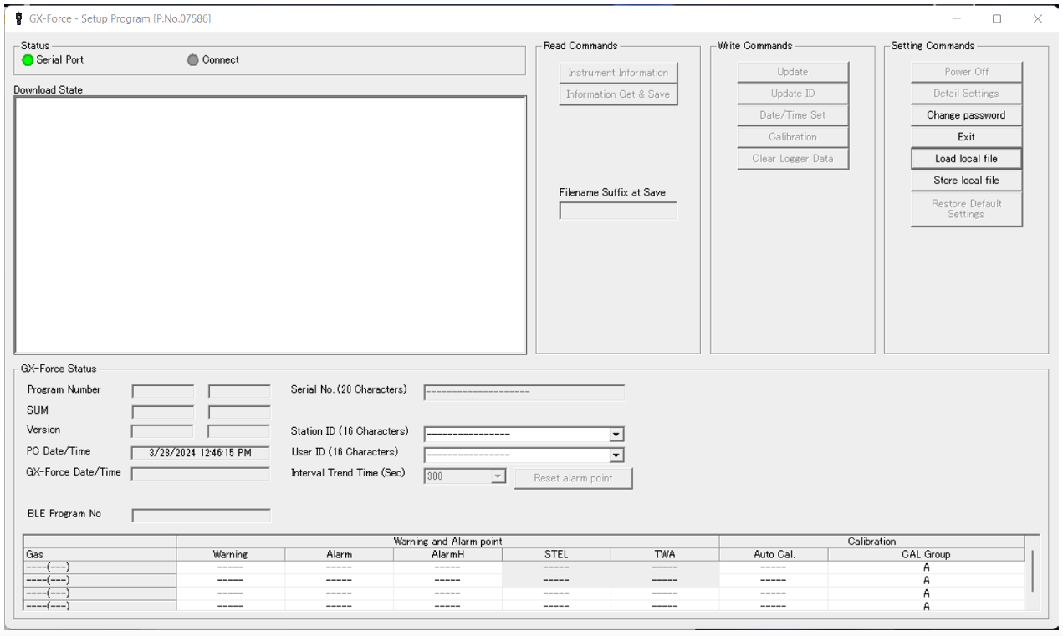
Adjusting Leak Check Settings
GX-Force
Enter 1939 into the password input
field. The following interface will appear.

Slide 27
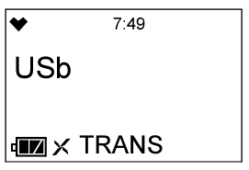
Adjusting Leak Check Settings
GX-Force
Press POWER MODE to turn on the instrument. The unit will begin communicating with the computer

Slide 28
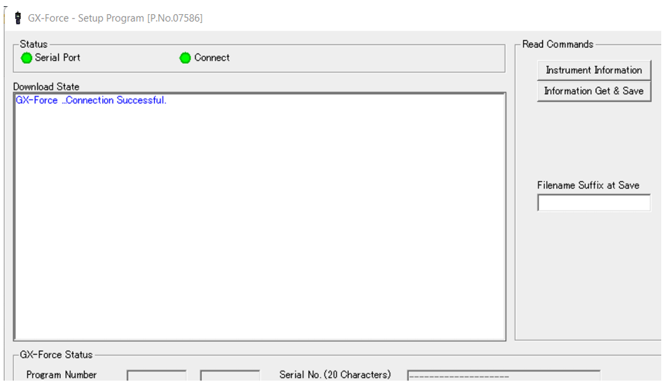
Adjusting Leak Check Settings
GX-Force
Both the instrument screen and status area in the Setup Program will update accordingly

Slide 29
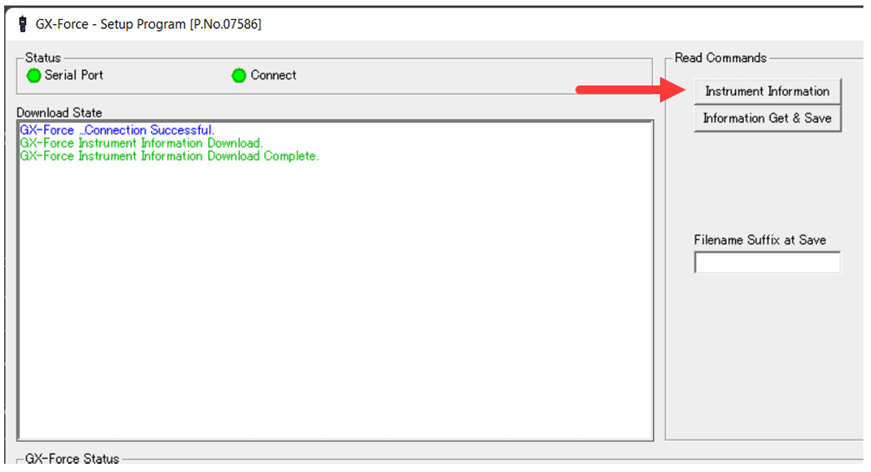
Adjusting Leak Check Settings
GX-Force
Click on the “Instrument Information” button in the GX-Force Program

Slide 30
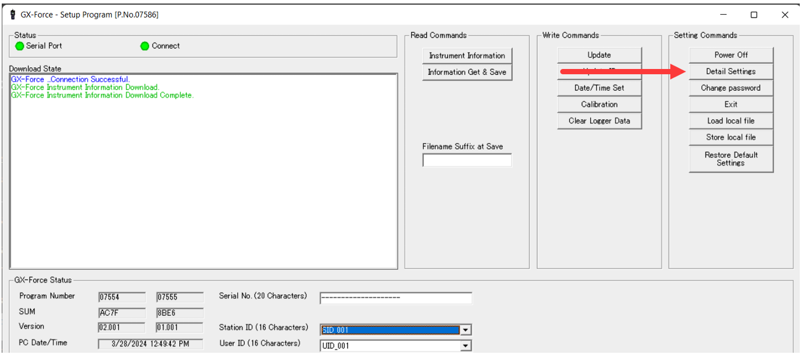
Adjusting Leak Check Settings
GX-Force
Click on the “Detail Settings” button to open the Parameters window

Slide 31
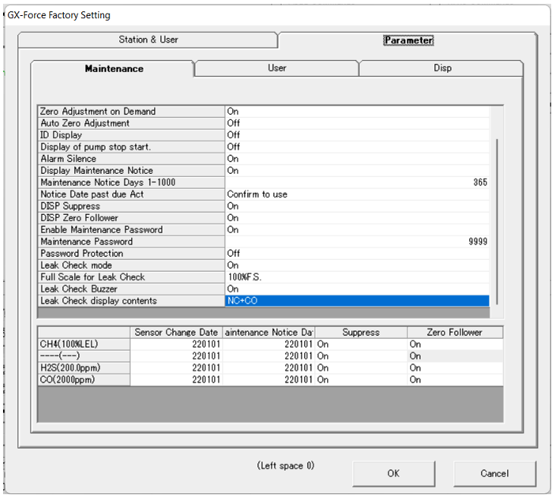
Adjusting Leak Check Settings
GX-Force
The parameter window displays the Maintenance Tab
To adjust the parameter, double click on the right column of the setting
NC (factory setting): Only the LEL channel displays in Leak Check Mode
NC+CO : The LEL and CO channels are displayed in Leak Check Mode
NC+O2 : The LEL and O2 channels are displayed in Leak Check Mode
NC+CO+O2 : The LEL, CO, and O2 channels are displayed in Leak Check Mode

Slide 32
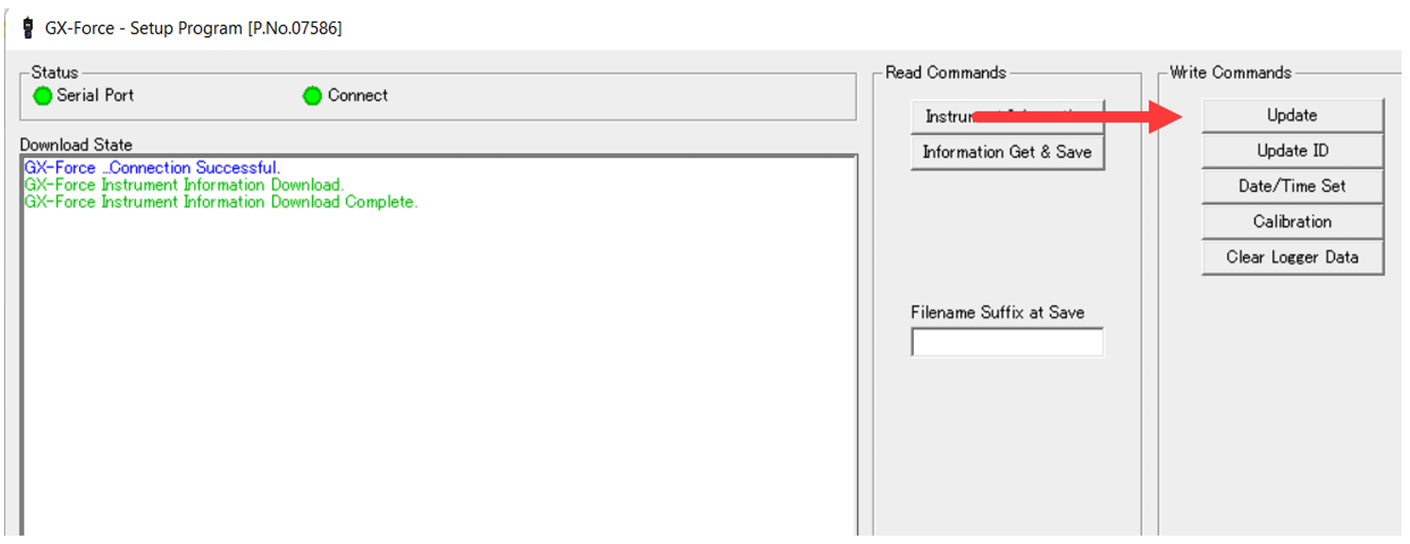
Adjusting Leak Check Settings
GX-Force
Press “Update” in the main Setup window to save all adjustments made to the instrument

Slide 33
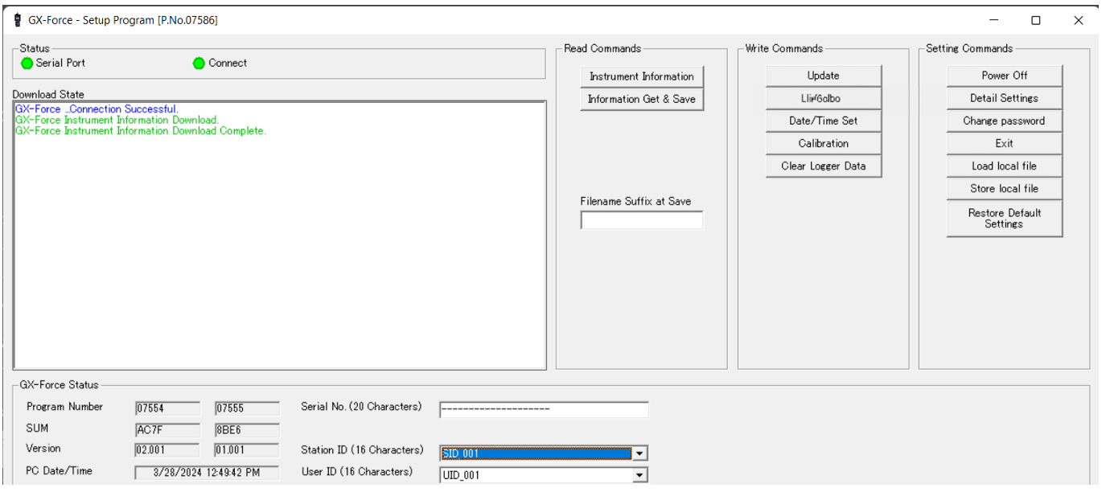
Adjusting Leak Check Settings
GX-Force
Click the “Power Off” button to power off the instrument

Slide 34
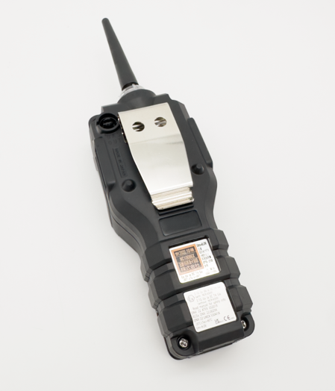
Filter & Sensor Replacement
GX-Force
Take the GX-Force to a non-static environment and turn it off if it is on.
Unscrew the four captive screws

Slide 35
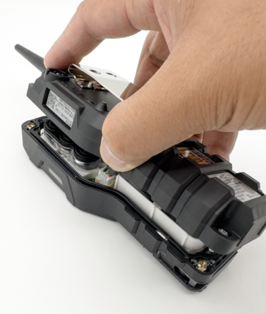
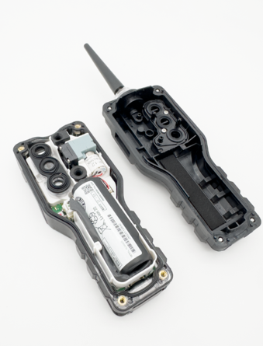
Filter & Sensor Replacement
GX-Force
Part # 21-1982
Lift up the Rear Case Assembly and set it aside

Slide 36
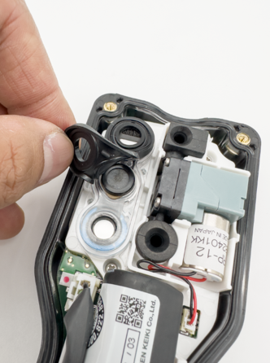
Filter & Sensor Replacement
GX-Force
Lift up the Filter Gasket, and replace
if needed. Part # 07-6064

Slide 37
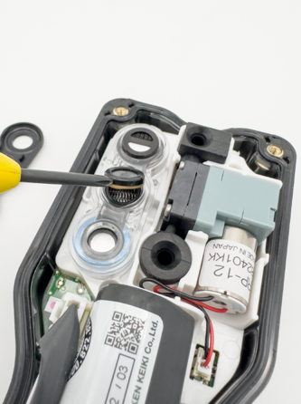
Filter & Sensor Replacement
GX-Force
Filter Part #’s
33-7130:
33-7131:
33-7132:
33-7133:
Scrubber disk filter for dual CO/H2S
Scrubber disk filter for LEL
Scrubber disk filter for CO and CO(-H2)
Humidity filter disk for H2S
Lift up the Sensor Filters, and replace
if needed

Slide 38
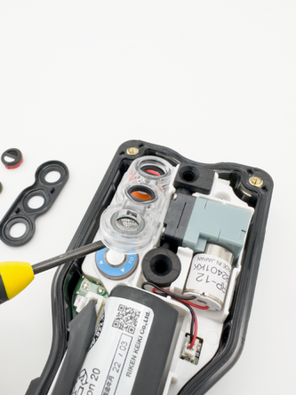
Filter & Sensor Replacement
GX-Force
Lift up the Sensor Retainer, and replace
if needed. Part # 21-1983

Slide 39
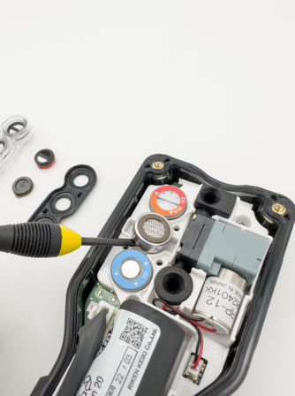
Filter & Sensor Replacement
GX-Force
Sensor Part #’s
ESR-A13i-H2S:
ESR-A1DP-COHS:
ESR-A13P-CO:
ESR-A1CP-CO-H:
ESR-X13P-OXY:
NCR-6309:
H2S Sensor
CO/ H2S Combo Sensor
CO Sensor
CO with H2 comp.
O2 Sensor
LEL Sensor
Lift up the Sensors, and replace
if needed

Slide 40
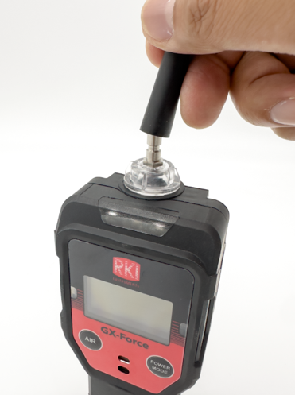
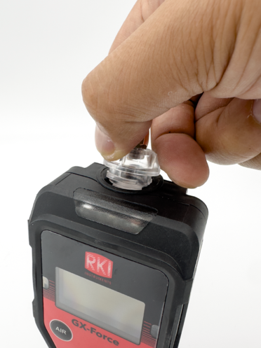
Filter & Sensor Replacement
GX-Force
Remove the Rubber Nozzle and replace
if needed. Part # 17-1001RK
Remove the Filter Holder (twist it counter
clockwise) and replace if needed.
Part # 21-1833RK

Slide 41
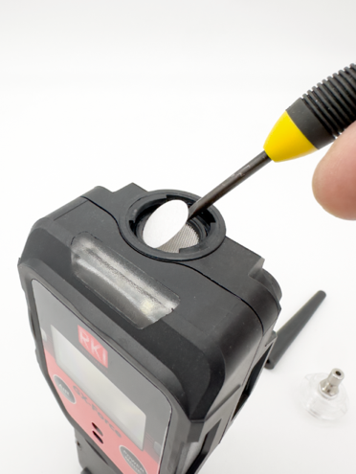
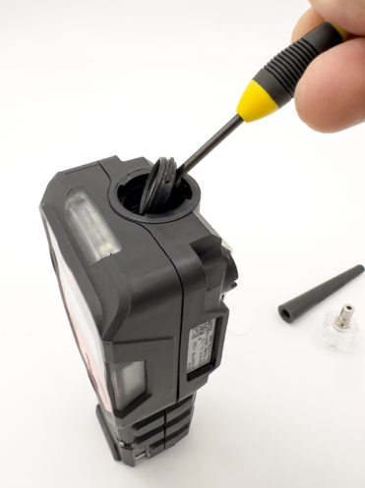
Filter & Sensor Replacement
GX-Force
Remove the Teflon Filter Disk and Wire Mesh Disk Filter
and replace if needed.
Part # 33-0159RK / 33-1112RK
Remove the Gasket and replace
if needed. Part # 07-2005RK

