Slide 1

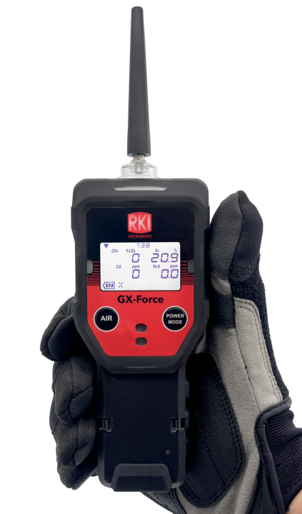
GX-Force
Portable Four Gas Monitor

Slide 2
GX-Force
Standard Features
2 Operating mode
  Normal and Leak Check
Internal sample pump with 100’ sample range
30 hours of operation (Lithium-ion battery)
USB-C charging and data connection
Lightweight design
Water and dust resistant design, IP67
Field replaceable sensors & filters
Impact resistant design
Intrinsically safe
Large LCD Auto-backlit display
3 year warranty

Slide 3
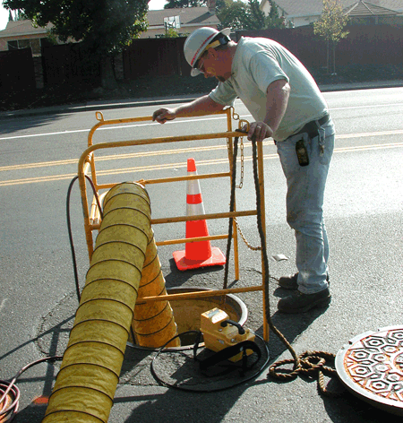

GX-Force
Normal Mode
Monitor LEL, O2, CO, H2S
Internal Sample Pump
Pull samples up to 100’
Maintain steady sample flow to sensors
Vibration, audible, and visual alarms

Slide 4
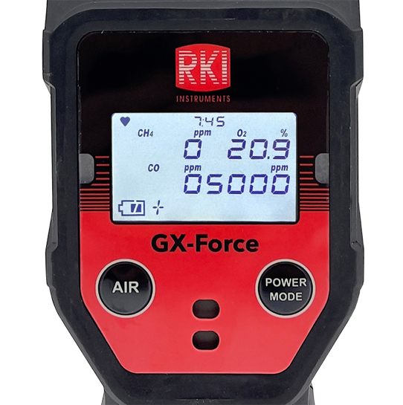
GX-Force
Leak Check Mode
PPM Leak detector, with 0–5000 ppm range
  Auto ranges to 0-100% LEL if reading gets too high
50 ppm increments
Accuracy
  +/- 20% (typically +/- 10%)
T90 response time in 10 seconds
CO & O2 display in leak check mode, ideal for residential investigations

Slide 5
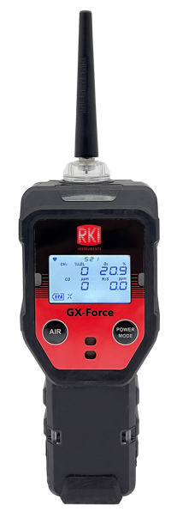
Physical Overview
GX-Force
Nozzle
Alarm LEDs
Filter Casing
LCD Display
AIR Button
POWER MODE Buttob
Buzzer opening
Wrist Strap Holes
Charging LED

Slide 6
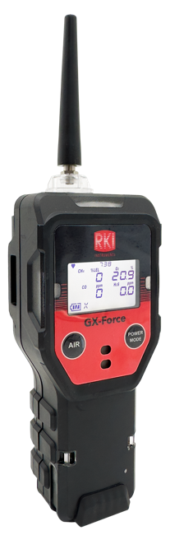


GX-Force
Easy-To-Grip Lightweight Design
IP67
  Functional after exposure to heavy dust, pressurized water, or submersion in water. Critical for harsh industrial environments.
Intrinsically, explosion, and flame-proof enclosure
  Designed for extreme environments
6.8” H
Concussion resistant – 10’ drop test
  Withstands brutal conditions from rugged environments
9.87 oz
Tapered design allows for better grip
1.85” D
2.5” W

Slide 7
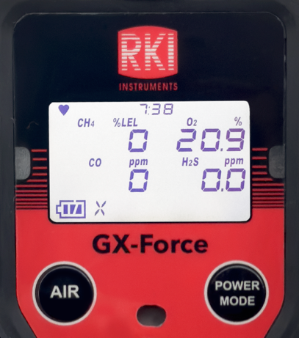
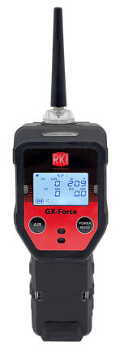
LCD Display With Auto Backlight
GX-Force
Heart Symbol
- Indicates the operation status
Clock
Gas display
Fan/Pump Icon
- Indicates that the pump
is active
Battery Icon
- Displays battery status
2 Button Operation
Easy to use interface with 2 glove-friendly buttons

Slide 8







GX-Force
Advanced Sensors
LEL
O2
Dual
CO/H2S
H2S
CO
CO(–H2)
Industry leading 3-Year Warranty for your peace of mind and support

Slide 9
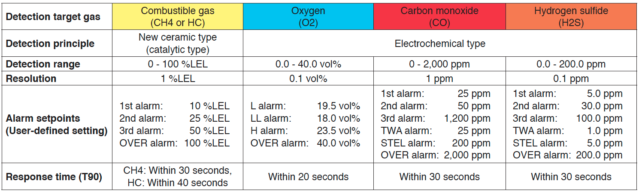
GX-Force
Sensors Specs

Slide 10
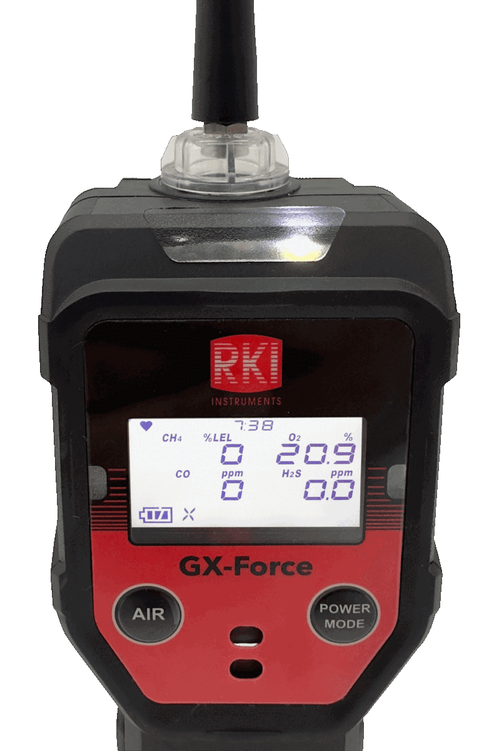
For jobs that require more lighting
GX-Force
LED Light

Slide 11
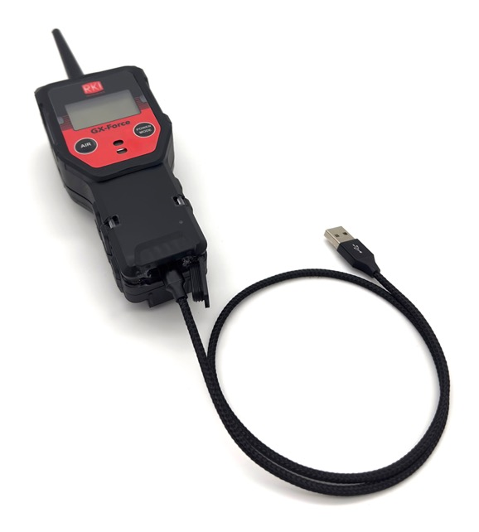
30 hours
Continuous operating time
GX-Force
Power Source
Lithium-ion battery - Rechargeable
8 hours to fully recharge via USB-C cable.
No need for bulky charging cradle.

Slide 12
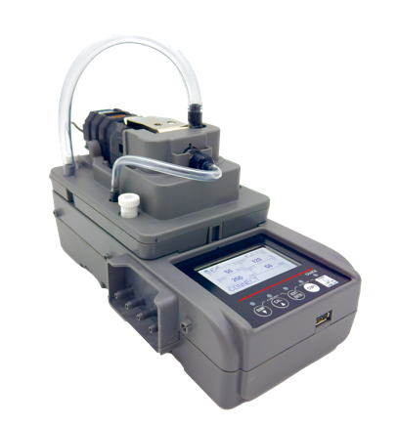
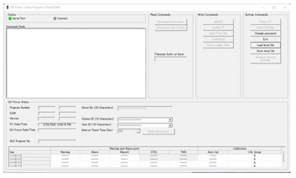
GX-Force
Universal Calibration Station
Stand Alone Station
Charging (Lithium-Ion Battery)
Calibration
Bump Test
3 Calibration gas ports
Save Bump Test and Calibration records
Bump test and calibration records copy to USB jump drive
SDM-Force
Multi Module System
Multiple connected to a PC (10 max)
Charging
Calibration
Bump Test
Configure GX-Force
3 Calibration gas ports
PC Controller Software
Includes PC software for viewing/archiving bump test and calibration records
  Archiving data to network location
  Software controlled data retrieval
  Automatic calibration/bump test option
Notes:
Part #: 81-SDMFRC101, List Price $1,595.

