Slide 1

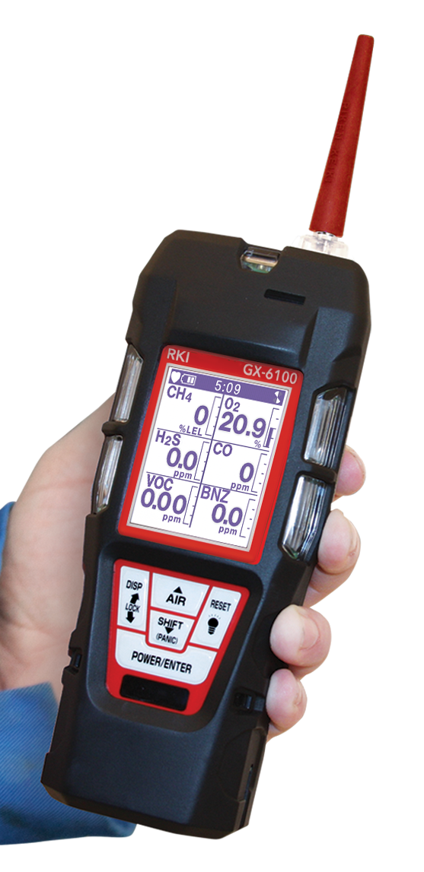
GX-6100
6 Gas Sample Draw
PID / IR / TC / MOS
& Super Toxic Sensors

Slide 2
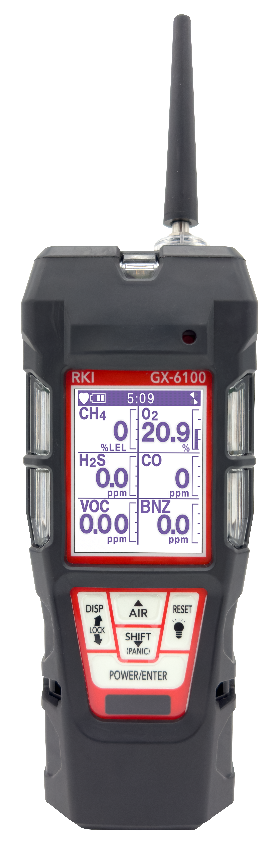
The GX-6100 delivers everything the
GX-6000 offered — AND SO MUCH MORE!
Next-generation handheld 6-gas detector
Advanced smart sensor technology
Longest battery runtime in its class
Enhanced alarms for maximum safety
Wireless connectivity for real-time alert sharing

Slide 3
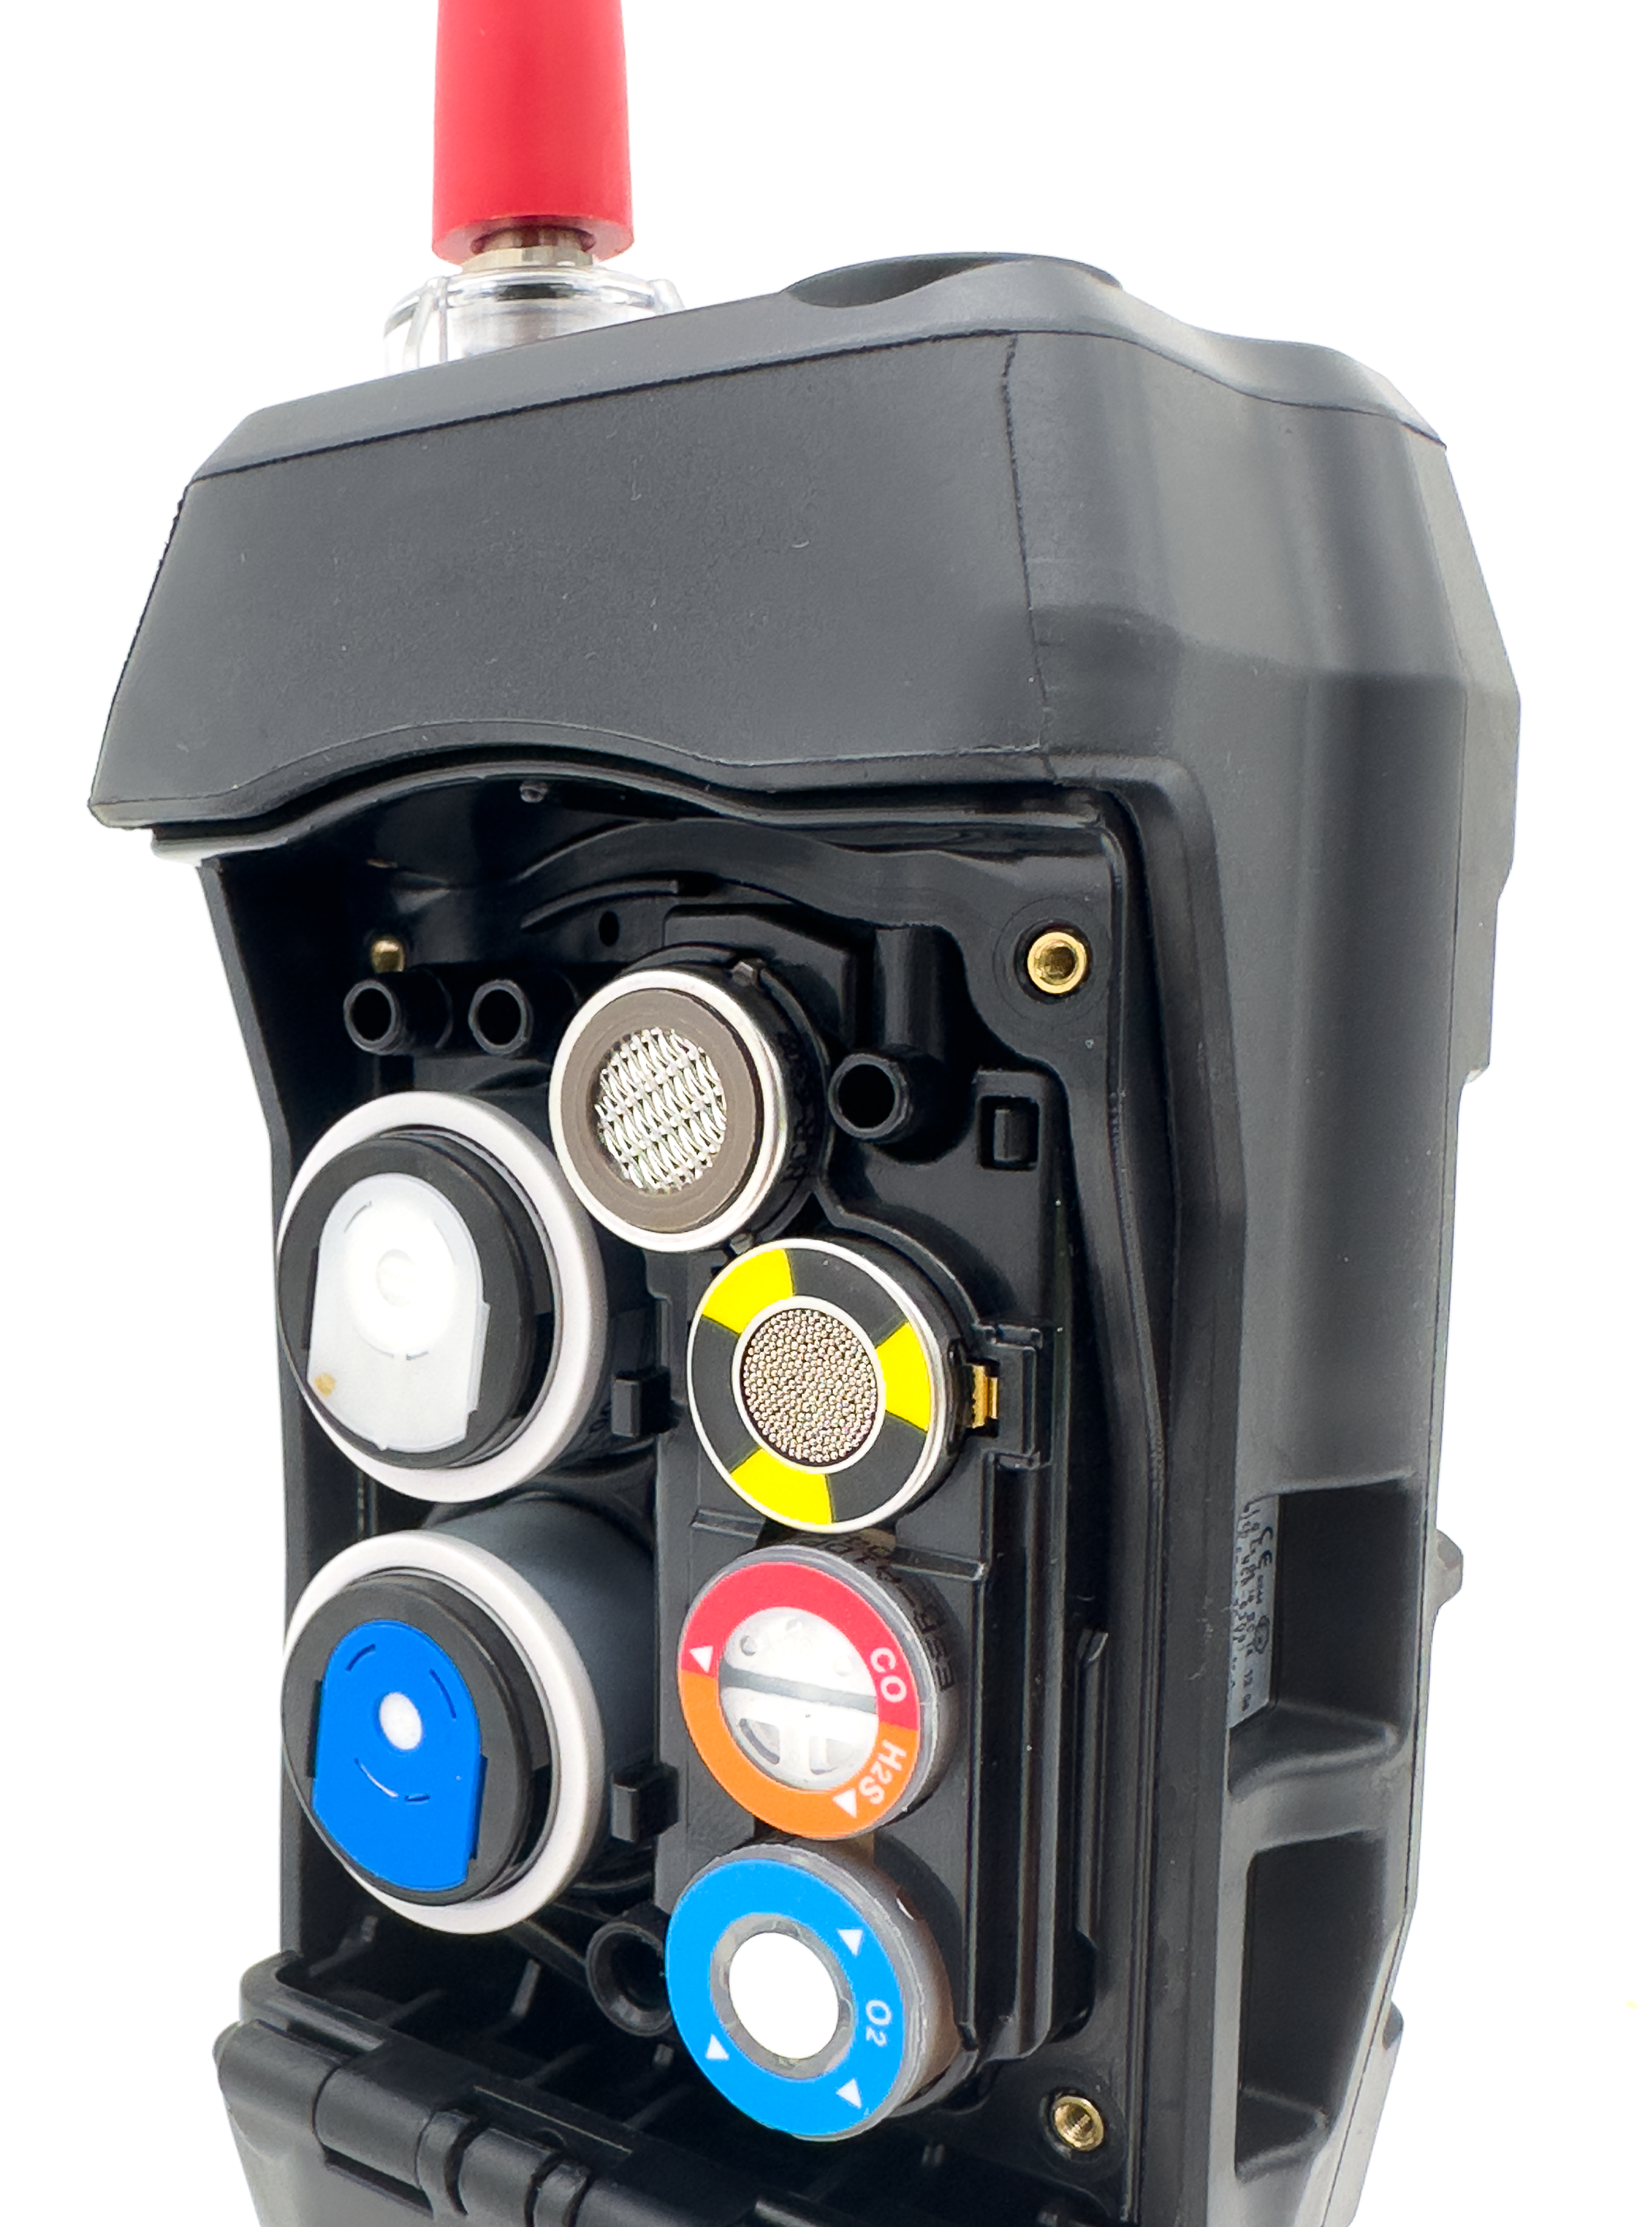
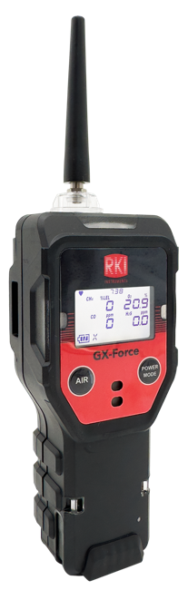
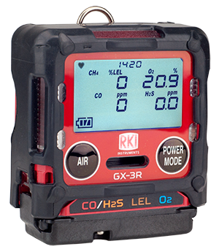
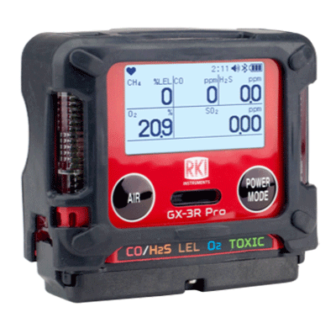
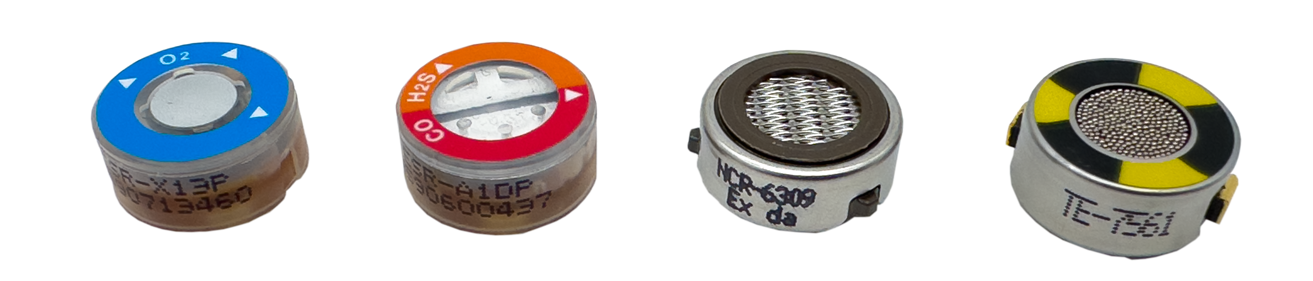
Sensor Technology
R sensors with 3-year warranty
  Interchangeable with the GX-3R, GX-3R Pro, and GX-Force
Smart sensors for wide gas detection range
  Humidity-resistant PID sensors
  Electrochemical sensors for toxic gases
  IR sensors for combustibles and CO2
TC sensors measure % volume combustibles
  Interchangeable with the GX-2003, GX-2012, and Gas Tracer
MOS sensors detect methane and isobutane in PPM
Dual
Sensor
6 Sensors slots for 7 gas channels

Slide 4
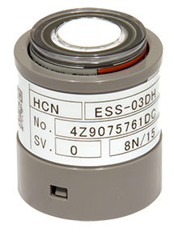
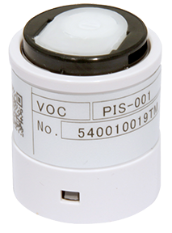
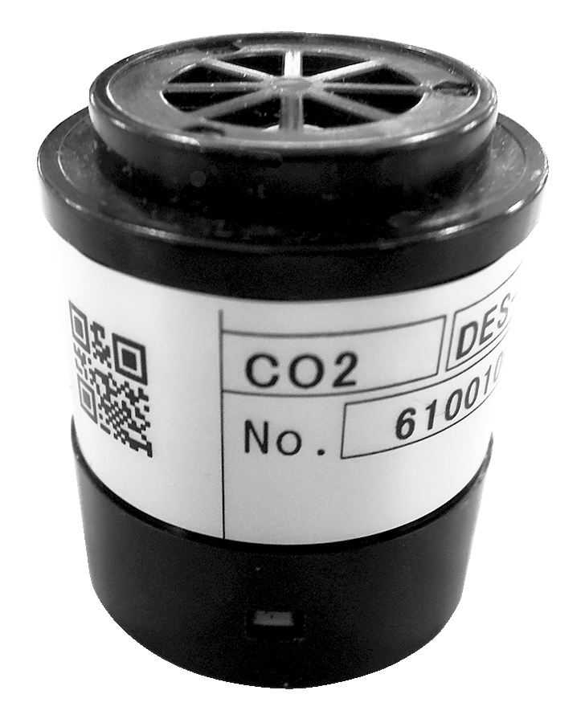
Sensor Technology
Smart Electrochemical (ESS-03DH-XXX)
Monitor a wide variety of toxic gases. Smart plug and play sensors are auto recognized and can be remotely calibrated
Photo Ionization Detection PID
Monitor low ppm VOC gases.
Infrared (DES-3311-1/2)
Monitor Combustible gases in inert environments. Monitor wide range of CO2.
O2 Sensor
Dual CO/H2S Sensor
LEL Sensor
TC / MOS Sensor
Detects:
  CO2, SO2, NO2, HCN, Cl2, NH3, PH3
Expanded combustible gas detection range:
  PPM
  % LEL
  % Vol.

Slide 5
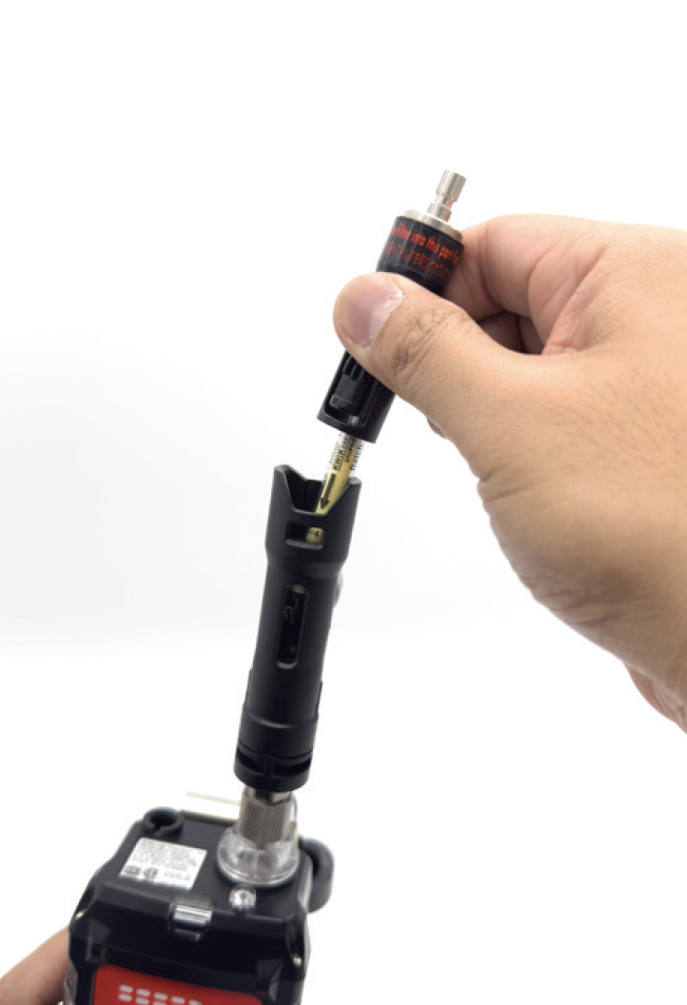
PID & VOC Library
4 PID lamp options:
  10.0 eV
  10.6 eV (low/high)
  11.7 eV
Dual PID configuration possible
Built-in library of 600+ VOCs
Favorites list: 30 VOCs
Recent VOC history:
  8 most recent
Benzene-specific mode with pre-filter tube

Slide 6
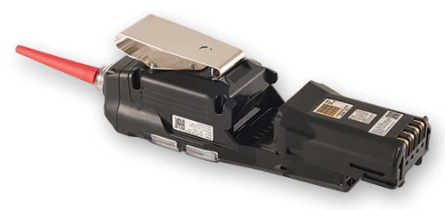
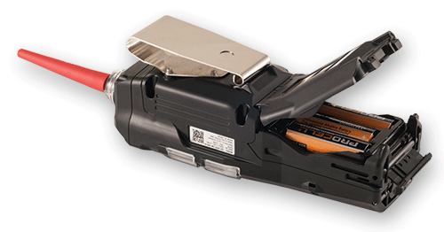
Power & Battery
Rechargeable
28 hours runtime with Li-ion battery pack
  Recharges in 6 hours
8 hours runtime with alkaline battery pack
Interchangeable, field-replaceable packs
Minimizes downtime during critical operations
Alkaline

Slide 7
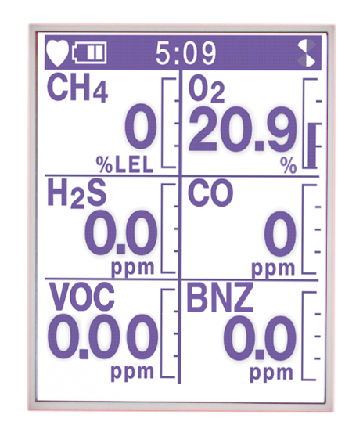
User Interface & Display
Large LCD with auto backlight
Auto display rotation for readability
Peak-bar display shows hazard spikes
Customizable order of gases displayed
Supports 15 additional languages for global use:
  Japanese, Korean, Chinese (simplified & traditional), Vietnamese, Italian, Spanish, Slovak, Czech, German, Turkish, French, Portuguese, Polish and Russian

Slide 8
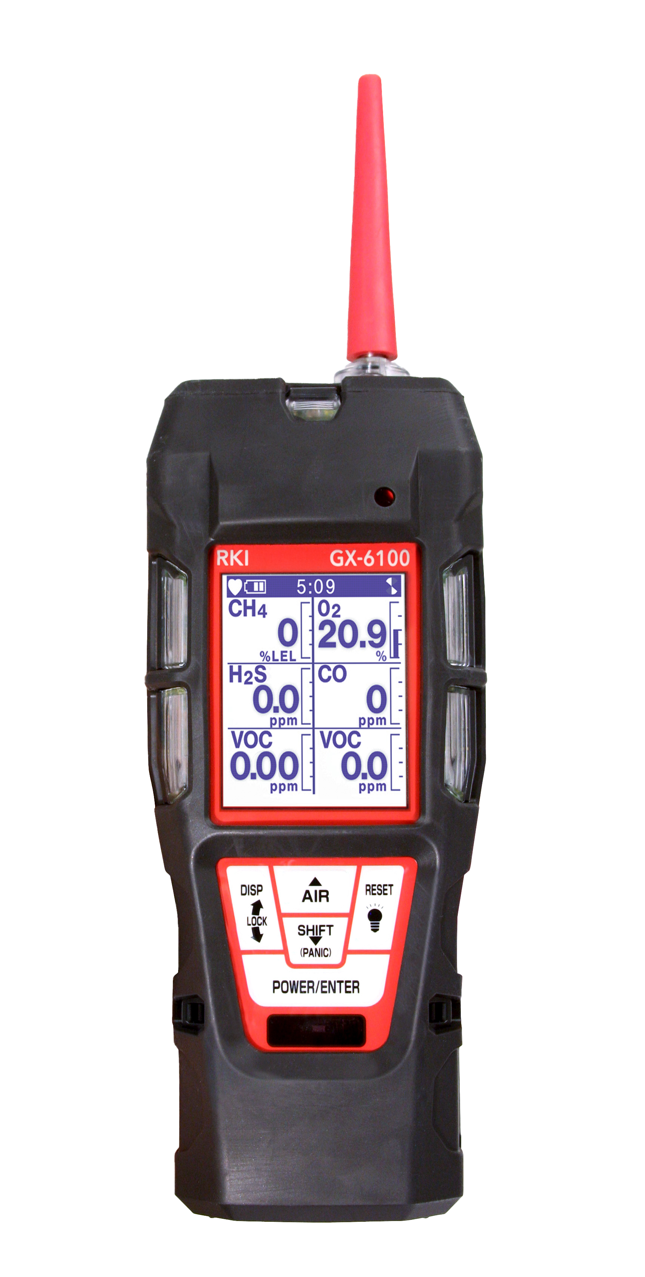

Alarm Systems
Gas alarms:
  Alarm 1, Alarm 2, Alarm 3, TWA, STEL
Panic alarm for emergencies
Man-down alarm detects immobility
LEL sensor protection mode
Visual alarms:
  5 LEDs on 3 sides
95 dB audible alarm + vibration alerts

Slide 9
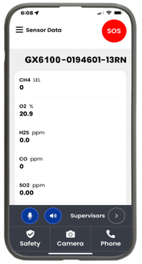



Bluetooth and RK Link
Bluetooth Low Energy for rapid alert sharing
Integrates with RK Link software

Slide 10
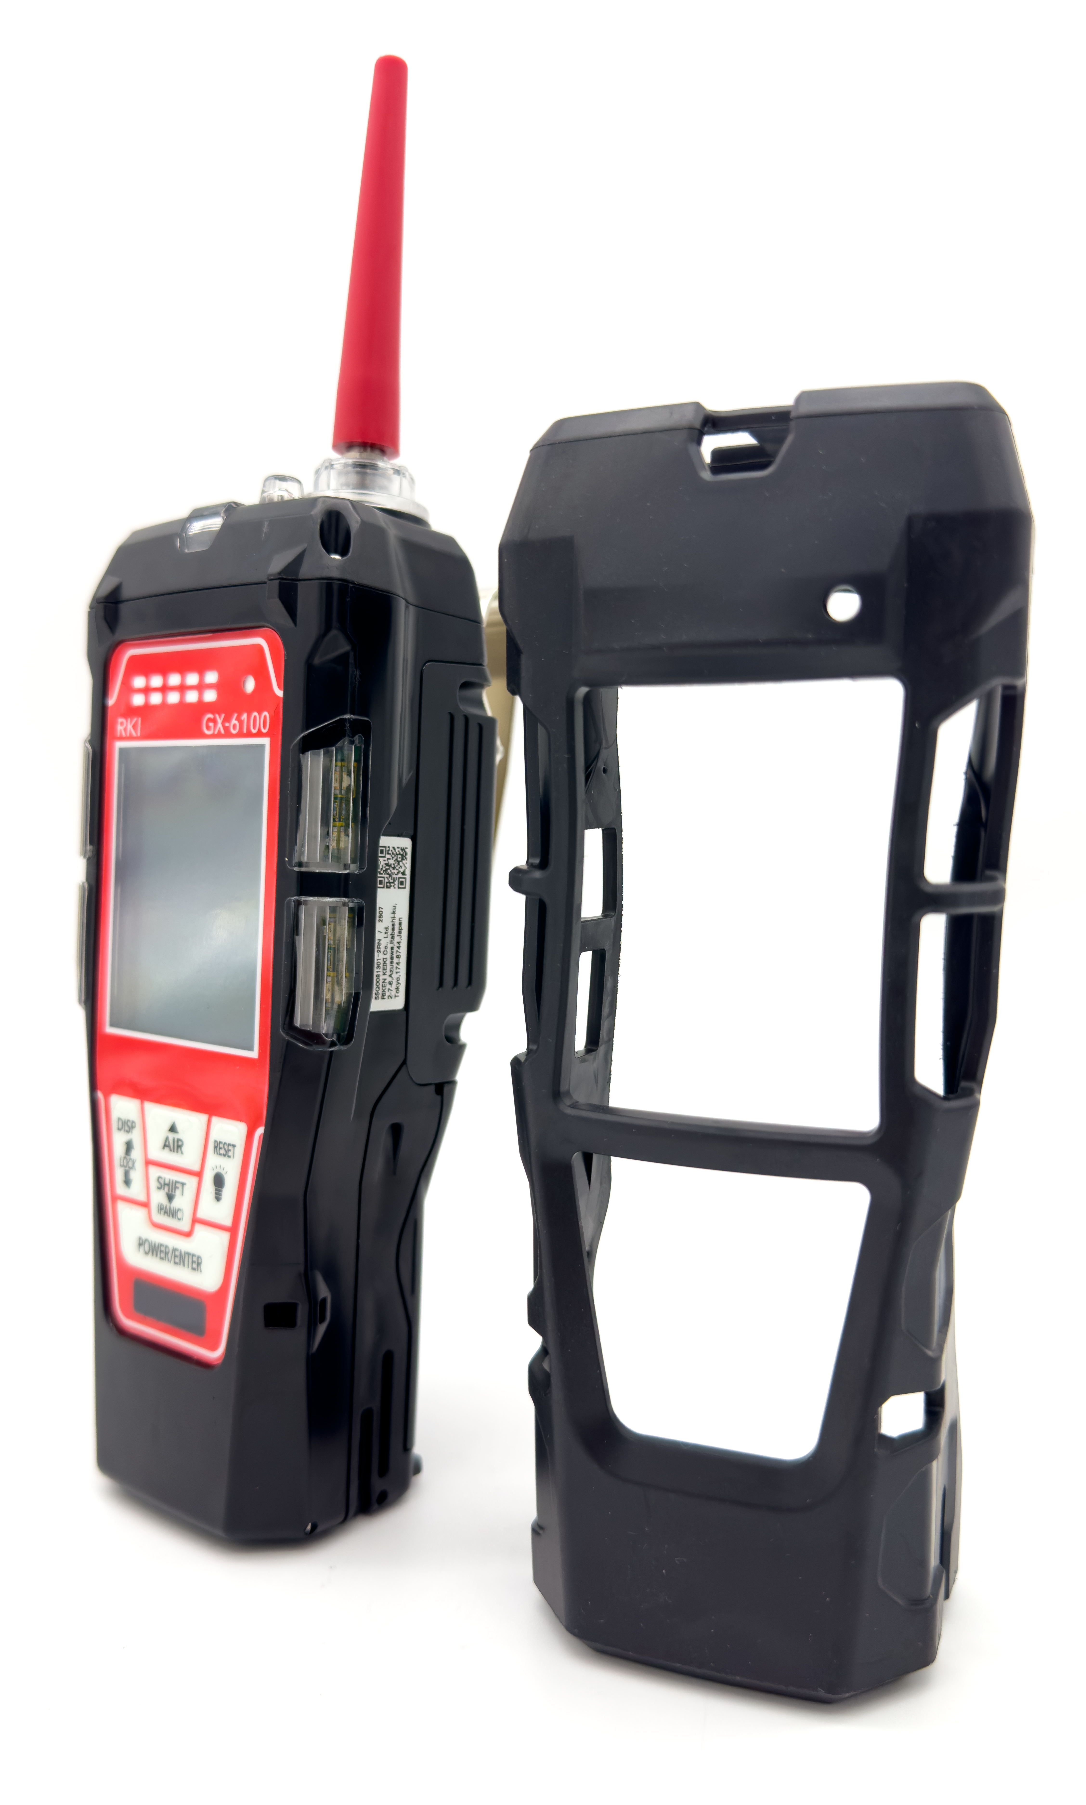
Durability
Impact-resistant removable rubber boot
Dust and water resistant enclosure (IP-67)
Field-replaceable sensors, filters, and pump
Temperature range:
  -20°C to +50°C
Explosion-proof approvals:
  ATEX, IECEx, TIIS

Slide 11
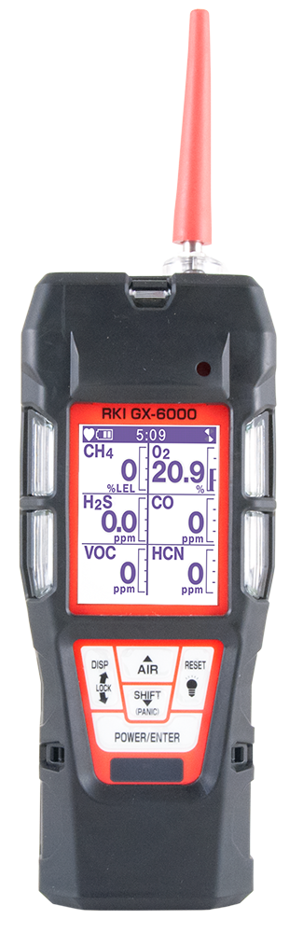
GX-6100 vs GX-6000
GX-6100
GX-6000
Battery life
28 hours ✅ | 14 hours
✅ | -
✅ | -
✅ | -
✅ | -
15 ✅ | 8
3 years ✅ | 2 years
CO(-H2)
TC Sensor
MOS Sensor
Bluetooth
Languages
Warranty

Slide 12
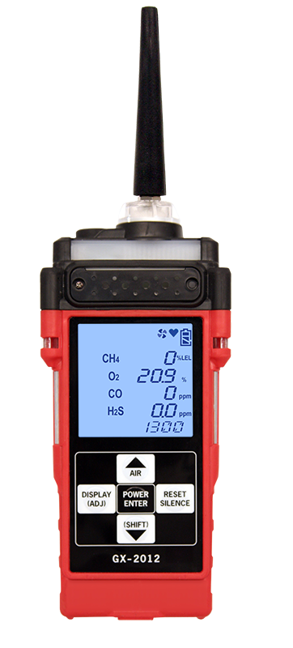
GX-6100 vs GX-2012
GX-6100
GX-2012
Gases
6 ✅ | 4
VOCs, CO2, SO2, NO2, HCN, PH3, Cl2 ✅ | Standard 4 gases plus TC
✅ | -
✅ | -
28 hours ✅ | 10 hours
✅ | Standard alarm
15 ✅ | English only
Additional Gases
Benzene
Bluetooth
Battery
Man-down / Panic Alarm
Languages

Slide 13

Applications
Confined Space Entry
Monitor LEL, O2, CO, AND H2S
Internal sampling pump for pre-entry
  Pull samples up to 100’
  Maintain steady sample flow to sensors
Audible, visual and vibration alarms
Man down alarm
Panic alarm

Slide 14
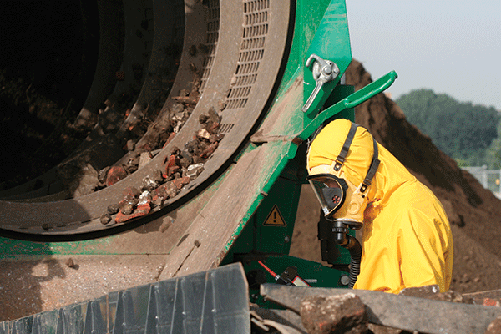
Applications
VOC Monitoring
10.6, 11.7 and 10.0 PID lamps available
PID library of over 600 VOCs
Two ranges available for 10.6 lamp
  0-40,000 ppb or 0-4,000 ppm
10.0 Lamp for Benzene Specific
11.7 Lamp for carbon tetrachloride, acrylonitrile, chloroform, methanol, and refrigerants (R-143, R-132A)
PID sensors can be combined

Slide 15
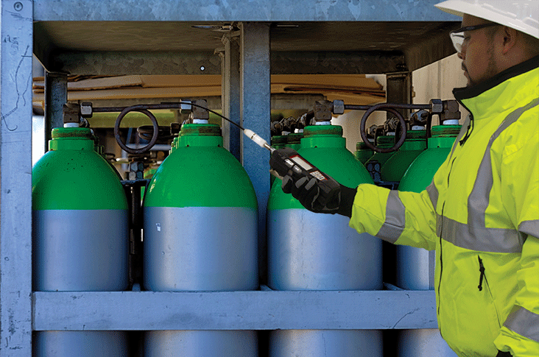
Applications
Leak Investigation
Provides ppm detection of combustible gas
Bar hole mode for tracking leak migration
Leak check mode with audible/visual feedback
  LED’s and alarm tones increase in frequency as gas concentration increases
Audible alarm silence
  Perform leak investigations without alarming residents
Man down alarm

Slide 16
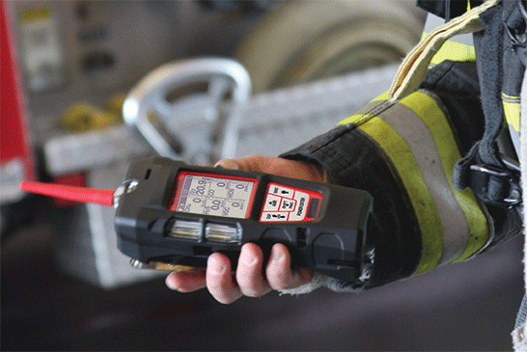
Applications
Fire Industry
Hazmat Perimeter / Safe Zone verification
Emergency response to toxic gas leaks
Confined space entry / rescue
Arson Investigation
Meth lab investigation

Slide 17
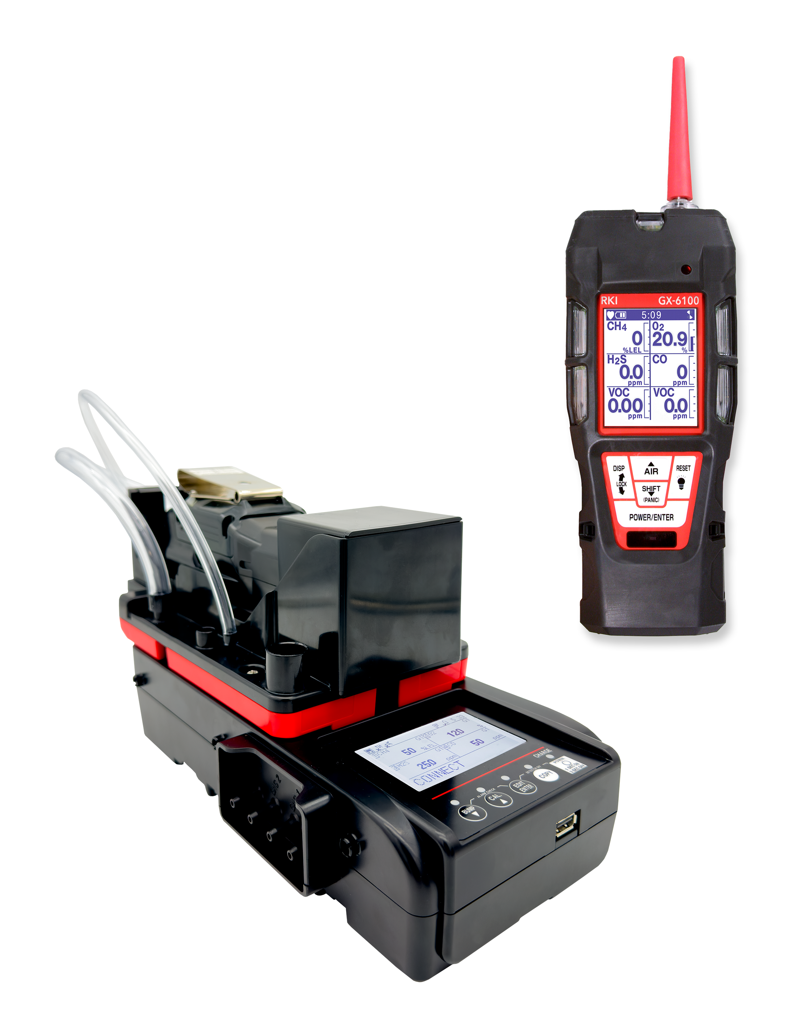
SDM-6100
  Available Q2 2026
  Stand alone station (no PC required)
  Bump, Calibrate, and Alarm test
  Charge
  Touch screen menu display
  Save calibration, bump tests, alarm history and exposure data to a USB drive or to a computer
  Automatically power on or off for scheduled maintenance
  Up to 3 ports for separate calibration gas cylinders

Slide 18
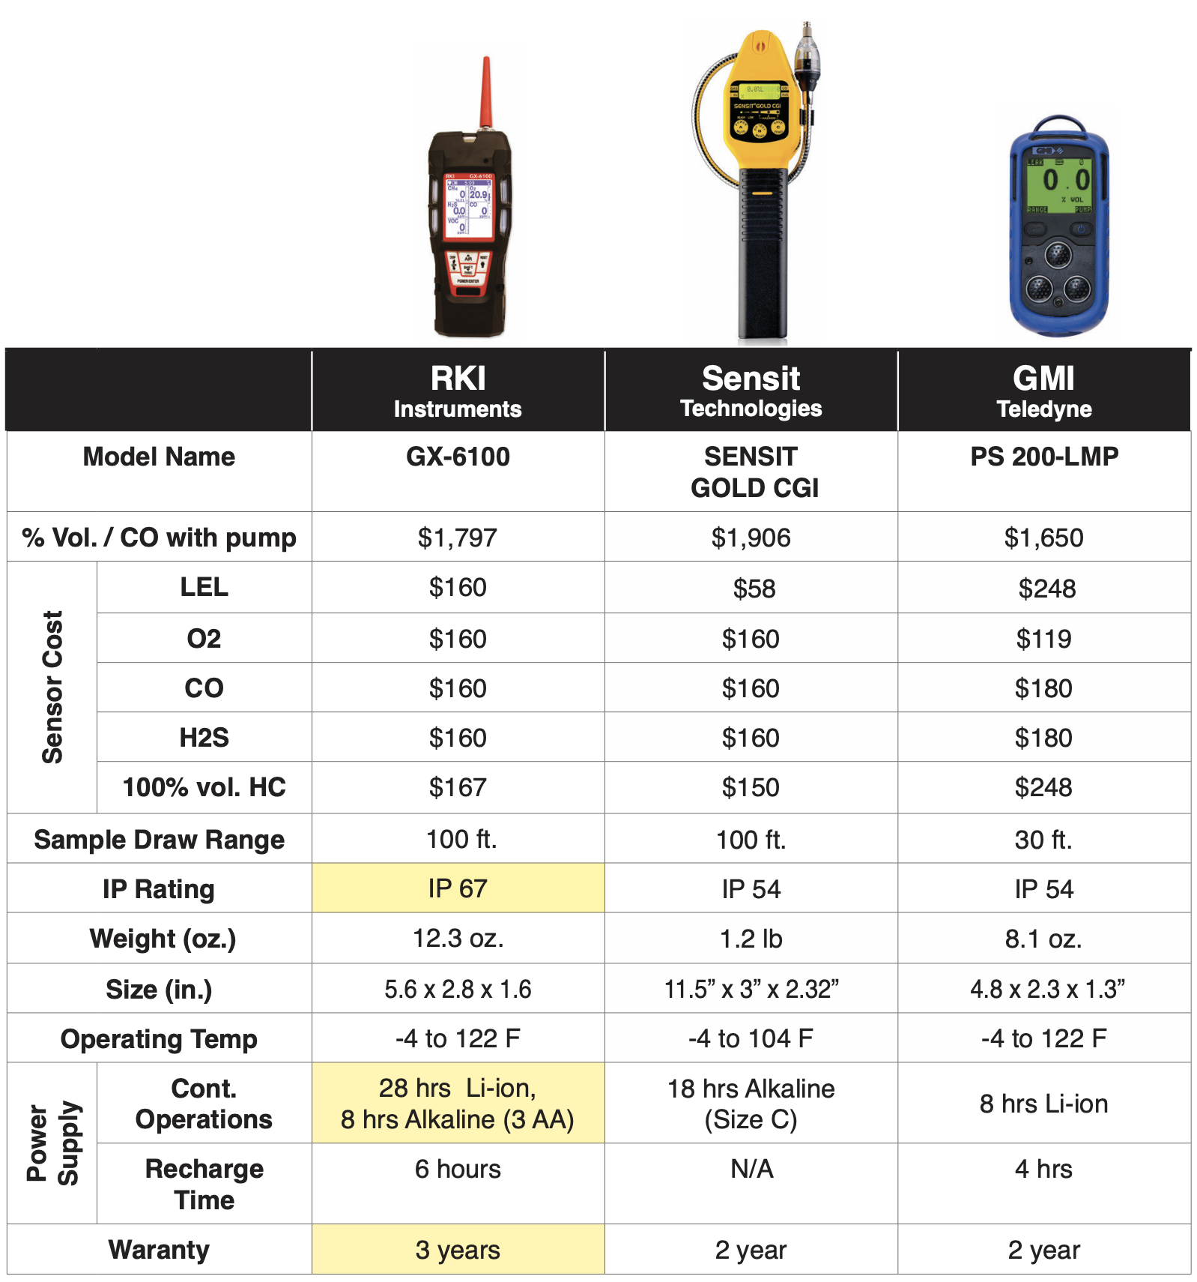
GX-6100 vs
Competitors

Slide 19
Questions?

