Slide 1
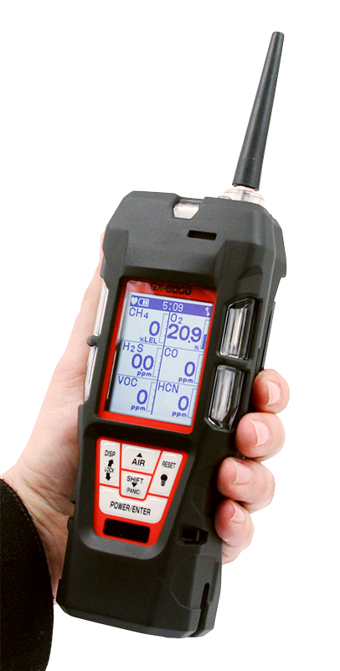
GX-6000
6 gas, sample draw with PID & Super Toxics

Slide 2

Monitor up to 6 Gases
H2S, CO, O2, LEL
2 smart sensor slots
  PID for VOC’s
  IR for CH4, HC, & CO2
  EC for NH3, Cl2, HCN, NO2, & SO2
PID library of more than 600 VOC’s
Accepts 10.6 and / or 10.0 PID lamps
40,000 ppb / 4,000 ppm ranges
10.0 Lamp for Benzene Specific
11.7 Lamp available
11.7 Lamp for carbon tetrachloride, acrylonitrile, chloroform, methanol, and refrigerants (R-143, R-132A)
PID sensors can be combined
Easily choose a target VOC
  User defined VOC list of 30
  Recently used VOC list last 8
6 operating modes
Normal
Leak check
Inert
Bar hole
Snap Log
Benzene Specific Mode
LCD display
Auto flip display
Peak bar graphs
Adjustable auto backlight
Customize order of gases
Single gas view with large font & auto sequence
LEL Protection mode
Shields LEL sensor from damaging VOC exposure

Slide 3
Smallest 6 gas sample draw
Lightweight & Ergonomic
High impact rubber boot
Ergonomic design fits comfortable in hand
Alarms
2 adjustable gas alarms per channel Plus STEL & TWA
Man Down alarm
Panic Alarm
4 alarm LED’s
Audible and vibration alarms
Trouble alarms for low flow, sensor connection, low battery, circuit error, & calibration
Intrinsically Safe
ATEX / IECEX
cCSAus
Interchangeable battery options
Lithium-ion pack operates 14 hours
  Complete recharge in 3 hours
Alkaline pack operates 8 hours
Weather & Dust Resistant
IP-67
9 Languages
English, German, Italian, French, Portuguese, Spanish, Japanese, Korean, Russian
LED Flashlight
On demand light source

Slide 4
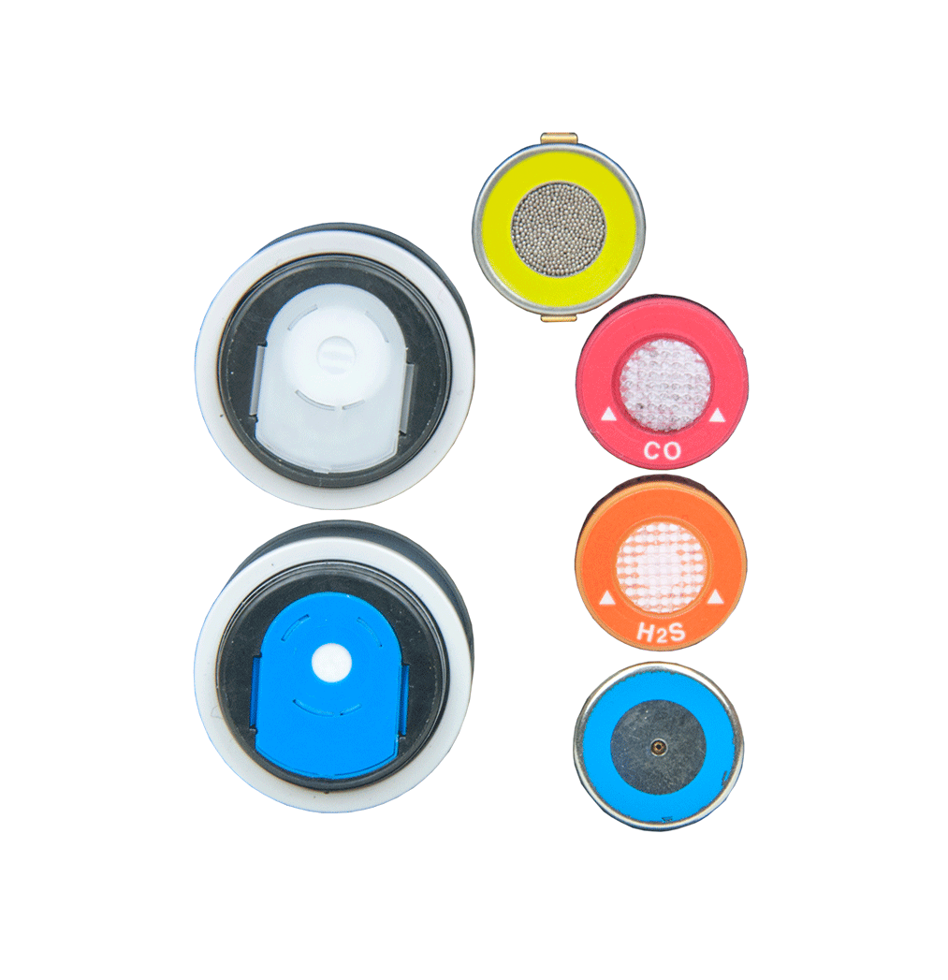
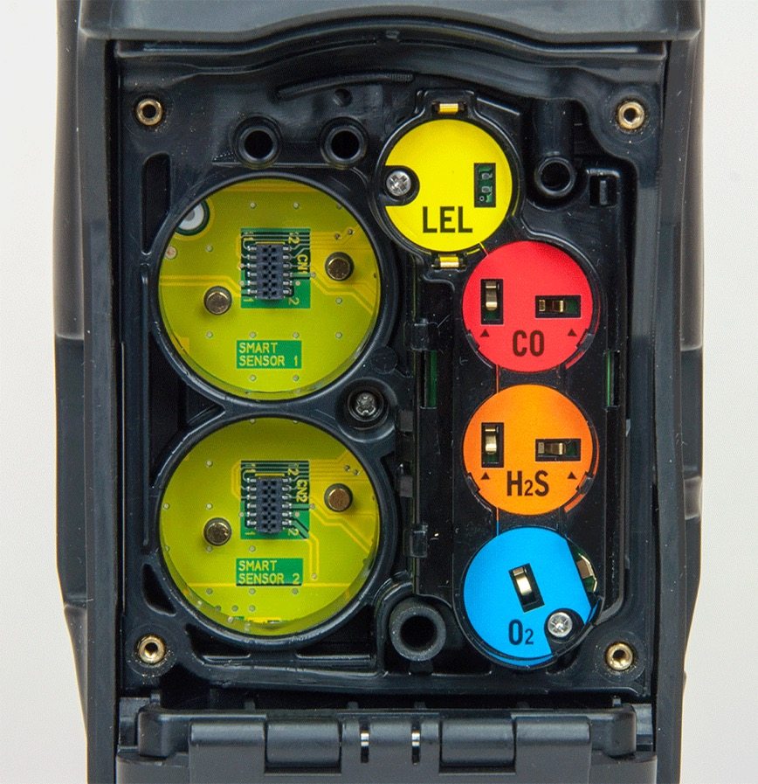
Sensors
Smart Sensor
Slots
Standard 4 Gas Sensors

Slide 5
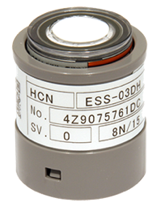
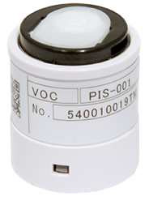
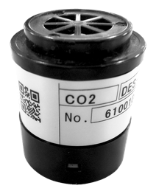
Smart Sensor Technology
Smart Electrochemical (ESS-03DH-XXX)
GAS | RANGE
Ammonia (NH3) | 0-400 ppm
Chlorine (Cl2) | 0-10ppm
Hydrogen Cyanide (HCN) | 0-15ppm
Nitrogen Dioxide (NO2) | 0-20 ppm
Sulfur Dioxide (SO2) | 0-99.9 ppm
Monitor a wide variety of toxic gases. Smart plug and play sensors are auto recognized and can be remotely calibrated
Photo Ionization Detection PID
GAS |  | RANGE
10.6 Lamp | 600 VOC’s | 0-40,000 ppb
 |  | 0-4,000 ppm
10.0 Lamp | Benzene Specific | 0.1-50 ppm
 | 300 VOC’s | 0-100 ppm
Monitor low ppm VOC gases.
Infrared (DES-3311-1/2)
GAS | RANGE
Carbon Dioxide (CO2) | 0-10,000 ppm 0-10% Vol.
Methane (CH4) | 0-100% LEL 0-100% Vol.
Hydrocarbons | 0-100% LEL 0-30% Vol.
Monitor Combustible gases in inert environments. Monitor wide range of CO2.
*Priority order for instruments using both Smart Sensor slots:
PID 10.6 eV low range
PID 10.0 eV benzene
PID 10.6 eV high range
CL2
All other sensors

Slide 6
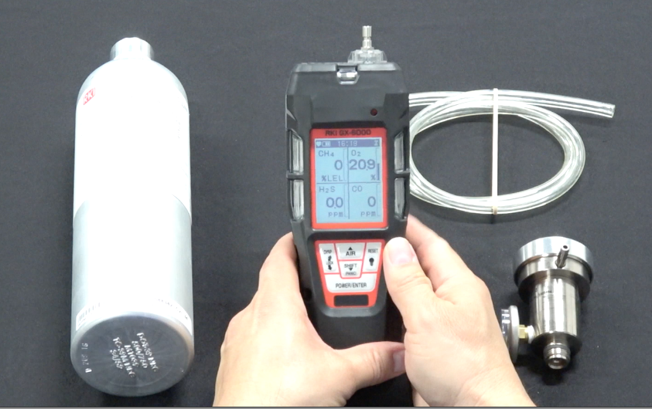
Calibration & Maintenance

Slide 7
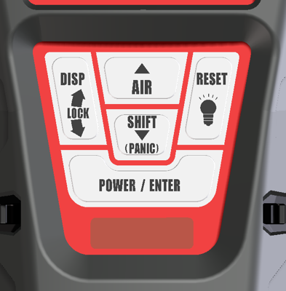
Calibration, Standard 4 Gas Unit
Press and hold POWER/ENTER button to turn on GX-6000

Slide 8

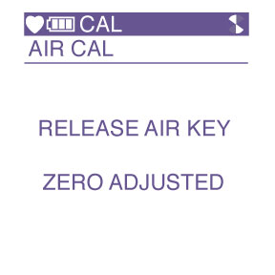
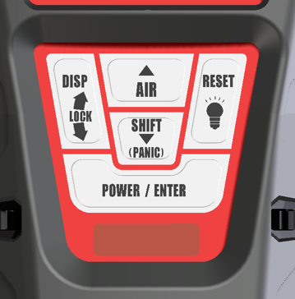
Calibration, Standard 4 Gas Unit
Once warmed up, perform an AIR adjustment by pressing and holding the AIR key until “RELEASE AIR KEY” is displayed.

Slide 9
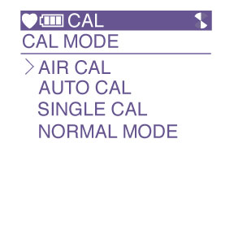
Calibration, Standard 4 Gas Unit
Briefly press and hold the SHIFT key then press the DISP key. “CAL” will be displayed at the top of the LCD indicating that the GX-6000 is in calibration mode.
-AIR CAL, AUTO CAL, SINGLE CAL and NORMAL MODE will be
displayed

Slide 10
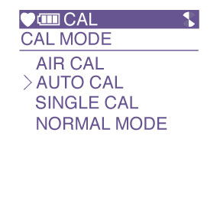
Calibration
Press the SHIFT key to select AUTO CAL then press the POWER/ENTER key.

Slide 11
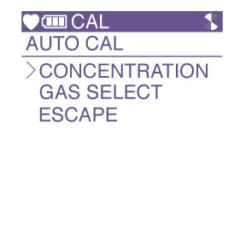
Calibration
You will now see CONCENTRATION, GAS SELECT and ESCAPE.

Slide 12
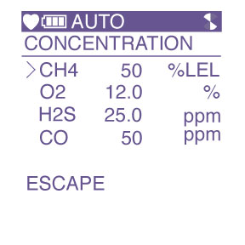
Calibration
Press the POWER/ENTER key to select CONCENTRATION to verify that the gas concentrations programmed in the instrument match the cylinder values.

Slide 13
Calibration
The cursor will be next to CH4. If the displayed value does not match the cylinder value, press the POWER/ENTER key to select CH4. The gas value will start blinking.

Slide 14
Calibration
Using the AIR or SHIFT keys, raise or lower the reading to match the gas value in the cylinder.
Once completed, press the POWER/ENTER key to set.

Slide 15

Calibration
Press the SHIFT key to scroll to the next gas.
Adjust as required. Once completed use the SHIFT key to scroll to ESCAPE then press the POWER/ENTER key.

Slide 16
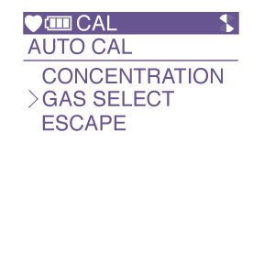
Calibration
Press the SHIFT key to select GAS SELECT.
Press the POWER/ENTER key.

Slide 17
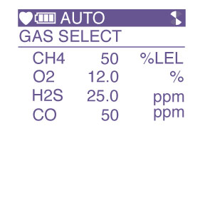
Calibration
All gases and calibration values will be displayed.

Slide 18
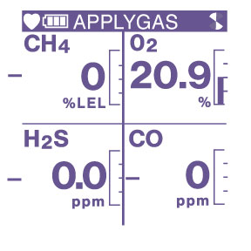
Calibration
Press the POWER/ENTER key and “APPLYGAS” will be flashing on the top of the LCD and all gases values will be flashing indicating that the instrument is ready for calibration gas.

Slide 19
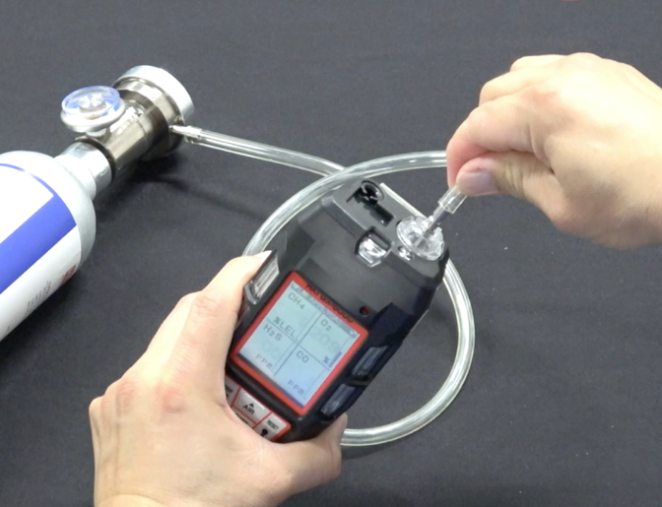
Calibration
Remove the rubber nozzle from the top of the instrument and attach tube from gas cylinder to inlet fitting. Note: Must use a demand flow regulator or gas bag.
Allow gas to flow for a maximum of two minutes.

Slide 20

Calibration
Once reading stabilizes, press the POWER/ENTER key to calibrate the unit. The unit will either “PASS” or “FAIL”

Slide 21
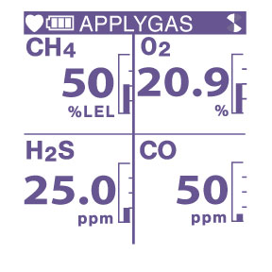
Calibration
Once completed, the GX-6000 will show you the calibrated values.

Slide 22
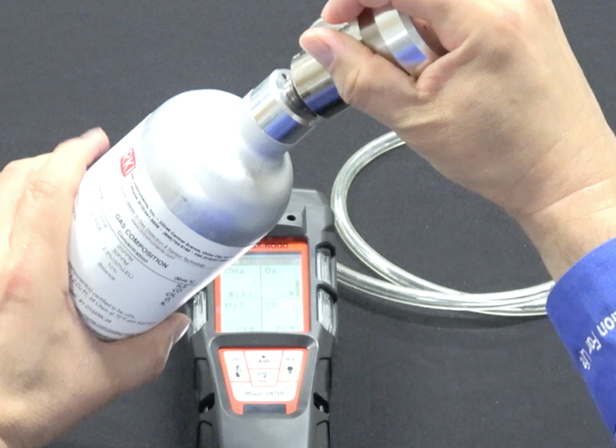
Calibration
Remove the tubing from the top of the GX-6000 and reattach the rubber nozzle.
Remove the demand flow regulator from the cylinder and store kit for future use.

Slide 23

Programming Modes

Slide 24
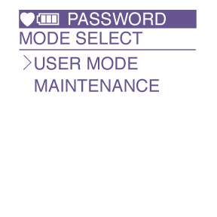
USER Mode
With the unit OFF, press and hold the AIR and SHIFT keys.
Press the POWER/ENTER key to turn on.
USER MODE and MAINTENANCE mode will be displayed.
Cursor will be next to USER MODE, press the POWER/ENTER key to select.

Slide 25
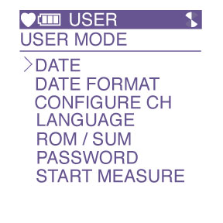
USER Mode
USER will be displayed on the top.
The following menu will be displayed:

Slide 26
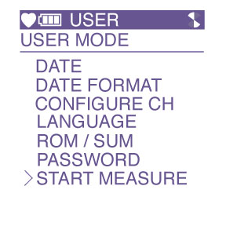
USER Mode
Using the AIR or SHIFT keys, select the function that you want and press the POWER/ENTER key to select.
When completed use the SHIFT key to scroll to START MEASURE to return to normal operation.

Slide 27

MAINTENANCE Mode
With the unit OFF, press and hold the AIR and SHIFT keys.
Press the POWER/ENTER key to turn instrument ON.
USER MODE and MAINTENANCE mode will be displayed.
Cursor will be next to USER MODE, press the SHIFT key to move cursor to MAINTENANCE, then press POWER/ENTER.

Slide 28
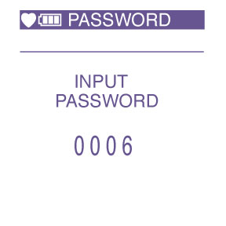
MAINTENANCE Mode
INPUT PASSWORD will be displayed.
The password is 0006
-press ENTER 3 times, and
AIR 6 times.
Enter the password then press POWER/ENTER.

Slide 29
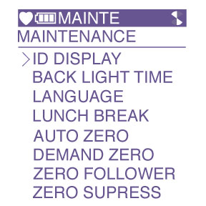
MAINTENANCE Mode
MAINTE will be displayed and the following menu will appear:

Slide 30
MAINTENANCE Mode
MAINTENANCE MODE CONTINUED

Slide 31
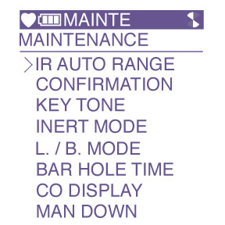
MAINTENANCE Mode
MAINTENANCE MODE CONTINUED

Slide 32
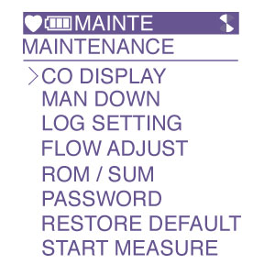
MAINTENANCE Mode
MAINTENANCE MODE CONTINUED

Slide 33
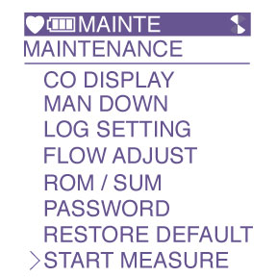
MAINTENANCE Mode
Use the SHIFT or AIR keys to select the feature you would like.
Press the POWER/ENTER key to select.
Once completed, use the SHIFT key to scroll to START MEASURE to return to normal operation.

Slide 34
MAINTENANCE Mode 2
With the unit OFF, press and hold the AIR and SHIFT keys.
Press the POWER/ENTER key to turn instrument ON.
USER MODE and MAINTENANCE mode will be displayed.
Cursor will be next to USER MODE, press the SHIFT key to move cursor to MAINTENANCE, then press POWER/ENTER.

Slide 35

MAINTENANCE Mode 2
INPUT PASSWORD will be displayed.
The password is 2014
-Enter the password then press POWER/ENTER.

Slide 36
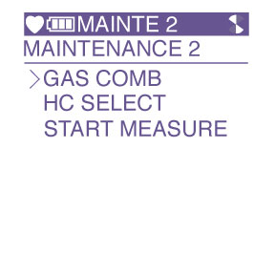
MAINTENANCE Mode 2
MAINTE 2 will be displayed and the following menu will appear:

Slide 37
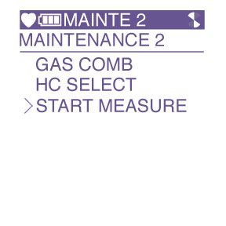
MAINTENANCE Mode 2
Use the SHIFT or AIR keys to select the feature you would like.
Press the POWER/ENTER key to select.
Once completed, use the SHIFT key to scroll to START MEASURE to return to normal operation.

Slide 38
Factory Mode
With the unit OFF, press and hold the AIR and SHIFT keys.
Press the POWER/ENTER key to turn instrument ON.
USER MODE and MAINTENANCE mode will be displayed.
Cursor will be next to USER MODE, press the SHIFT key to move cursor to MAINTENANCE, then press POWER/ENTER.
  Note: There are two modes selected by unique passwords.

Slide 39

Factory Mode
INPUT PASSWORD will be displayed.
Enter: 1994

Slide 40
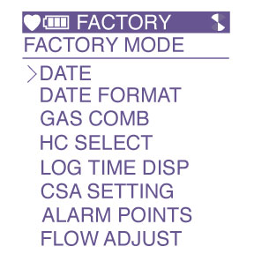
Factory Mode
FACTORY will be displayed and the following menu will appear:

Slide 41
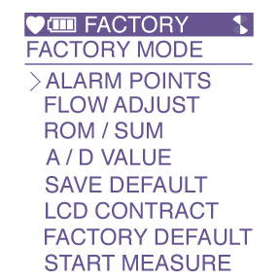
Factory Mode
FACTORY MODE CONTINUED

Slide 42
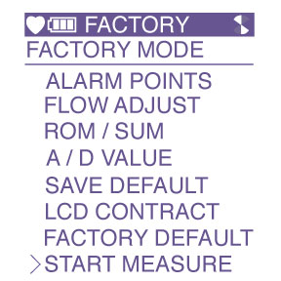
Factory Mode
Using the AIR or SHIFT key, scroll to the function that you want to view then press the POWER/ENTER key.
When completed, use the SHIFT key to scroll to START MEASURE then press the POWER/ENTER key to return to normal operation.

Slide 43
Keystrokes Summary
Calibration Mode
  Press SHIFT and then DISP
    From Normal Operation mode
User Mode
  Hold AIR & SHIFT and then POWER/ENTER
    With the unit off

Slide 44
Keystrokes Summary
Maintenance Mode
  Hold AIR & SHIFT and then POWER/ENTER
    With the unit off
  Password 0006 (Mode 1)
  Password 2014 (Mode 2)
Factory Mode
  Hold AIR & SHIFT and then POWER/ENTER
    With the unit off
  Password 1994

Slide 45
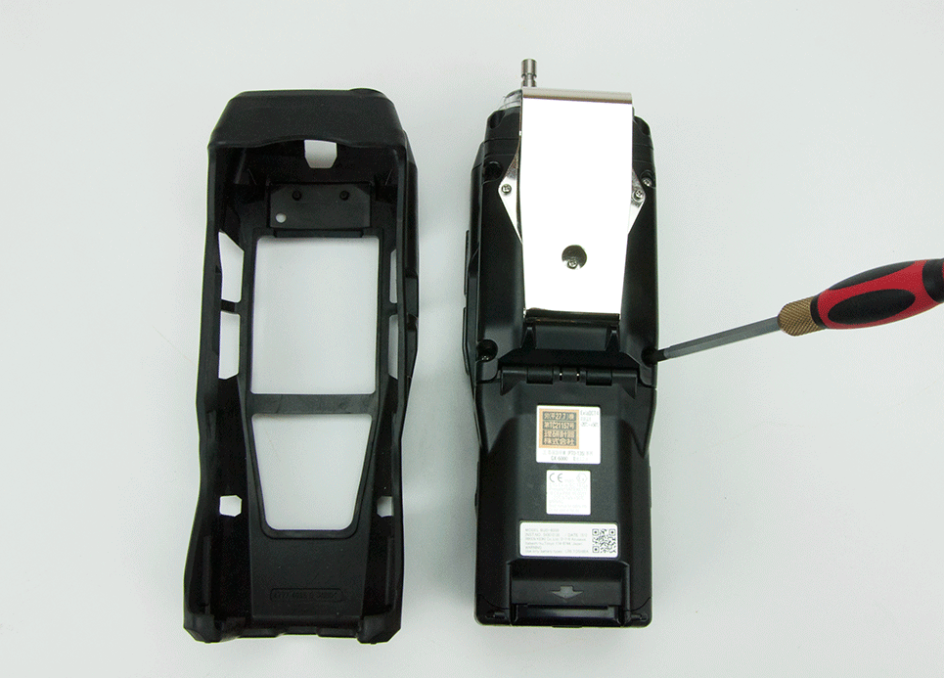
Sensor Replacement
Turn GX-6000 OFF
Remove rubber boot covering instrument
Loosen screws over flow chamber.
No need to remove the 3 belt clip screws.

Slide 46
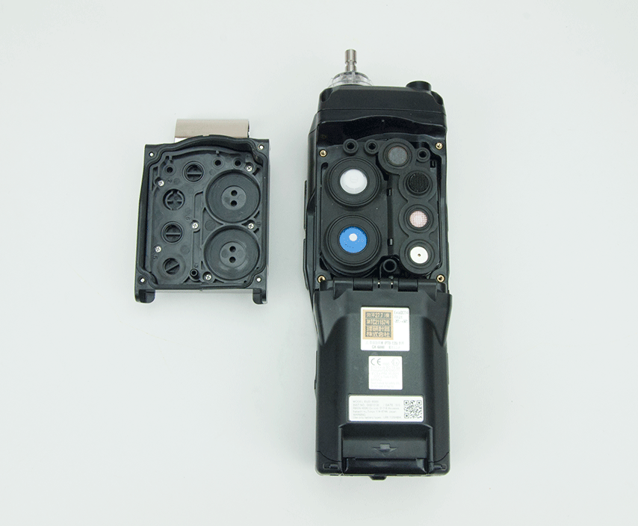
Sensor Replacement
Remove flow chamber exposing sensor gasket and scrubbers.

Slide 47
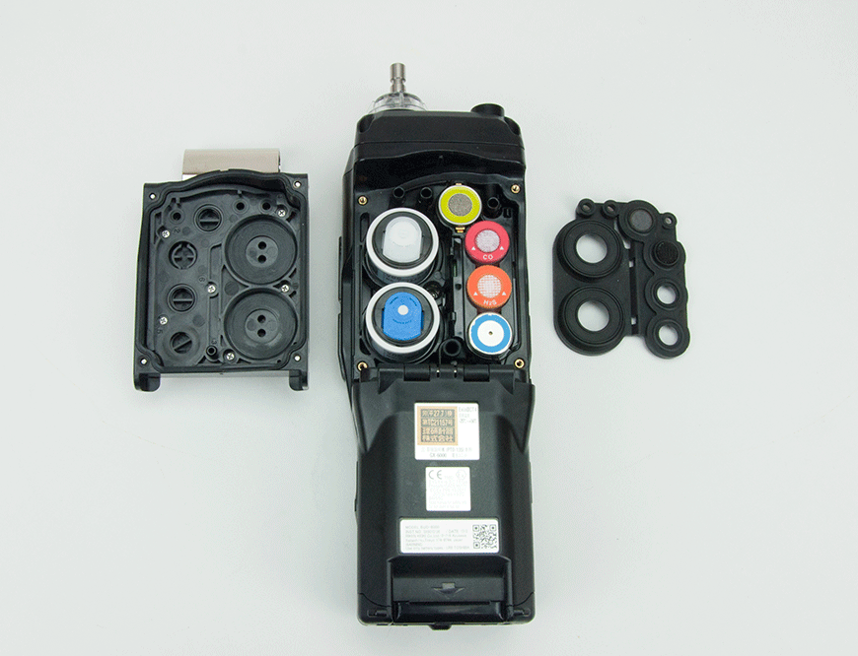
Sensor Replacement
Remove sensor gasket exposing sensors.
Remove and replace sensors as needed.

Slide 48
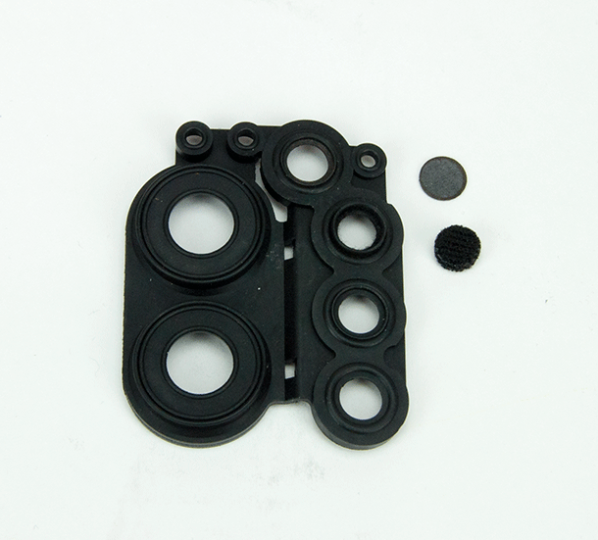
Replacement of Sensor Scrubbers
H2S scrubber for LEL sensor
  P/N 33-7114RK
H2S scrubber for CO sensor
  P/N 33-7102RK

Slide 49
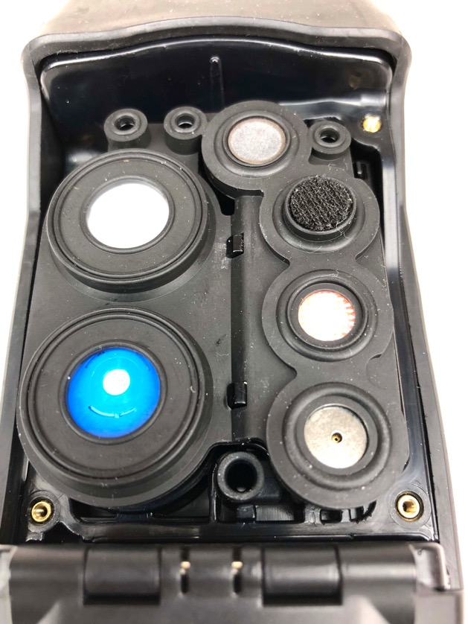
Replacing sensor scrubbers and gasket
CORRECT
Use fingers or a flat head screwdriver to align gasket underneath tabs.

Slide 50
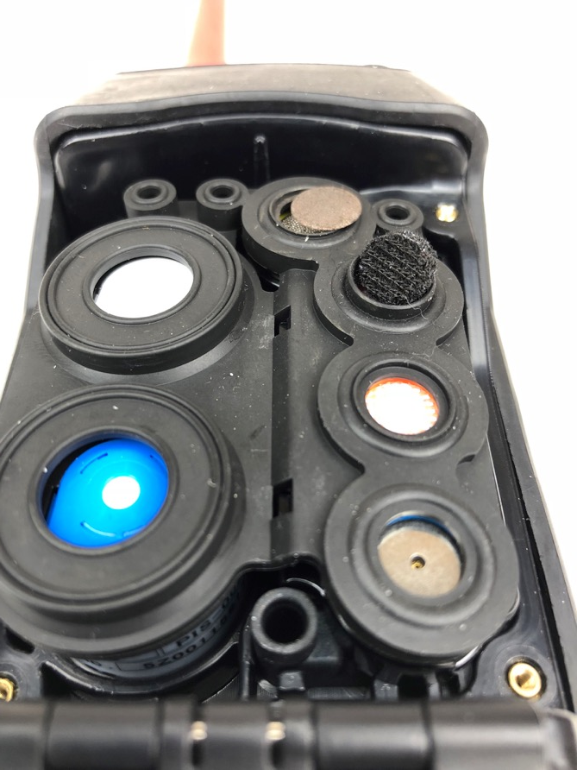
Replacing sensor scrubbers and gasket
INCORRECT
Notches not seated properly, and unaligned.
Sensor scrubbers not secured in place

Slide 51
Replacing sensor scrubbers and gasket
Verify these two ports are completely vertical and not canted at an angle. Otherwise, low flow may result.

Slide 52
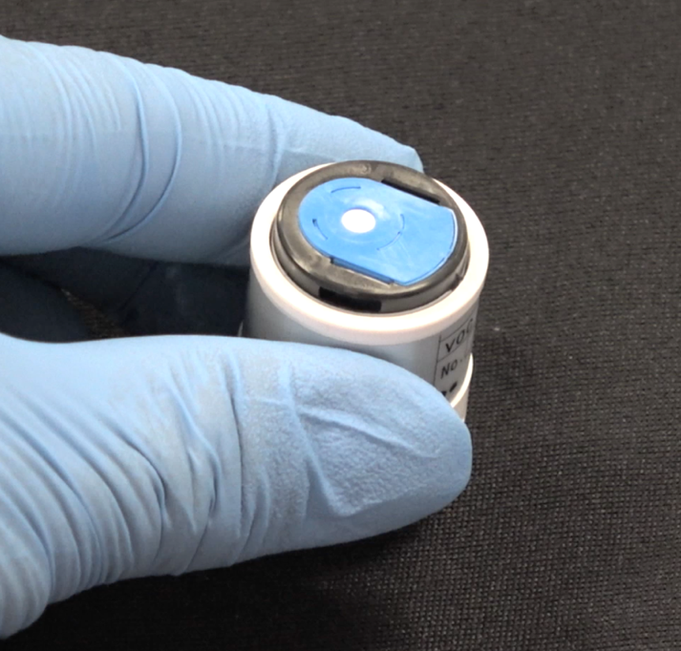
PID Lamp Cleaning
Locate PID sensor and remove it out of the sensor socket.
Place the PID sensor on a flat clean working surface
Wear gloves to prevent body oils from contaminating the sensor.

Slide 53
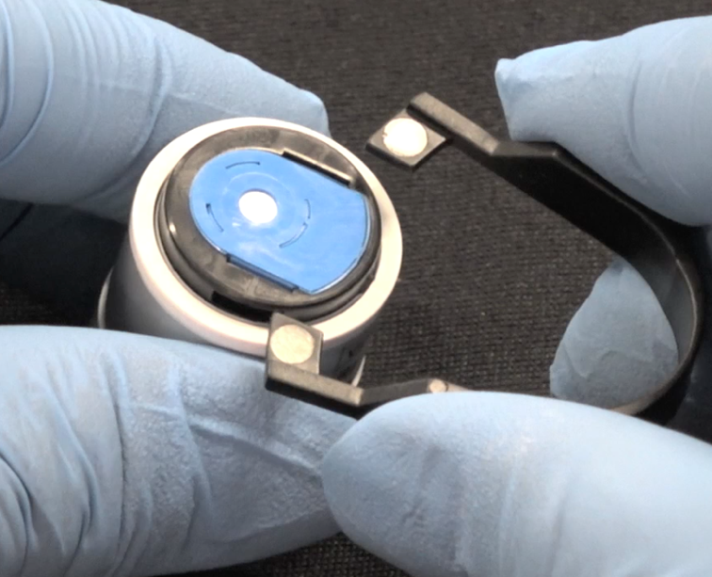
PID Lamp Cleaning
Locate the tabs on the electrode stack removal tool and insert them into the slots on the side of the PID sensor.

Slide 54
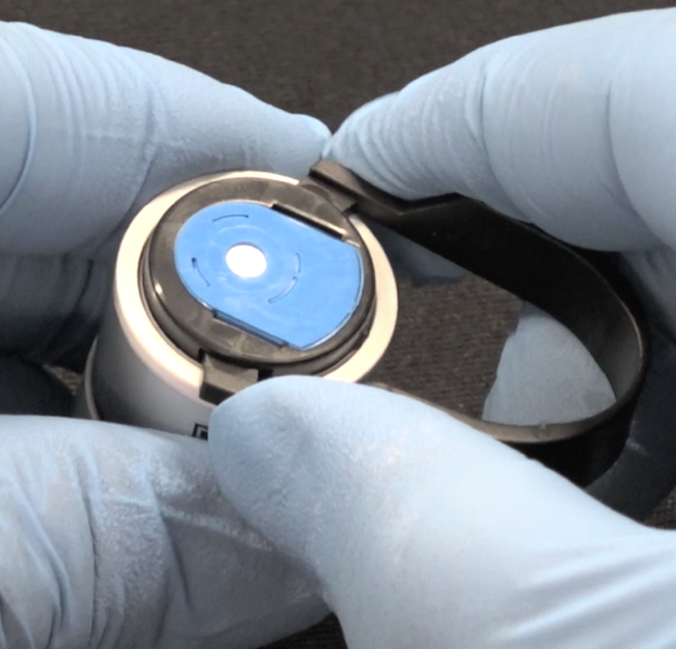
PID Lamp Cleaning
Squeeze the removal tool to push the tabs into the sensor slots until the electrode stack and lamp are released.

Slide 55
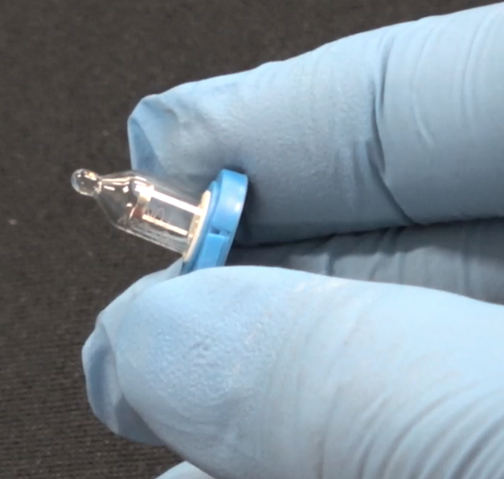
PID Lamp Cleaning
Handle with care once both the electrode stack and lamp are released.

Slide 56
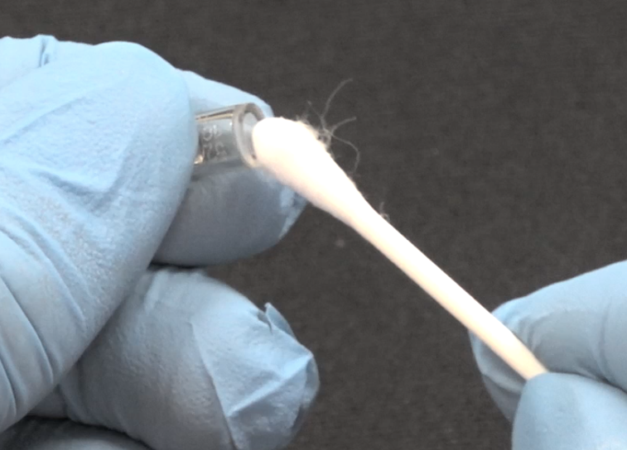
PID Lamp Cleaning
Collect a small amount of aluminum oxide powder on a cotton swab.
Use a circular motion, applying light pressure to clean the lamp window.
Note* Do not touch the lamp window with your fingers

Slide 57
PID Lamp Cleaning
Continue polishing until you hear a squeaking sound made by the cotton swab moving over the window surface. This usually occurs after about 15 seconds of polishing.

Slide 58
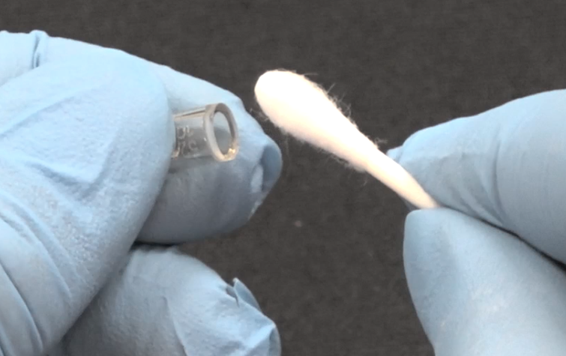
PID Lamp Cleaning
Remove the residual powder from the lamp window with a clean cotton swab. Take care not to touch the tip of the cotton swab that is used to clean the lamp as this may contaminate it with finger oil.

Slide 59
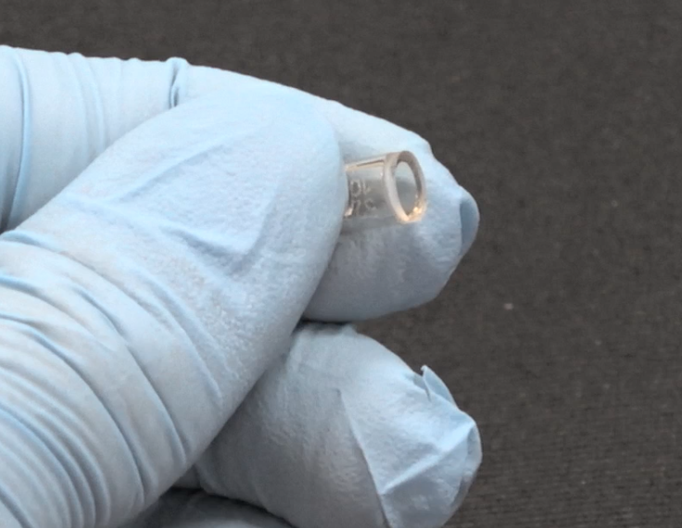
PID Lamp Cleaning
Ensure the lamp is completely dry and any visible signs of contamination are removed before installing.

Slide 60
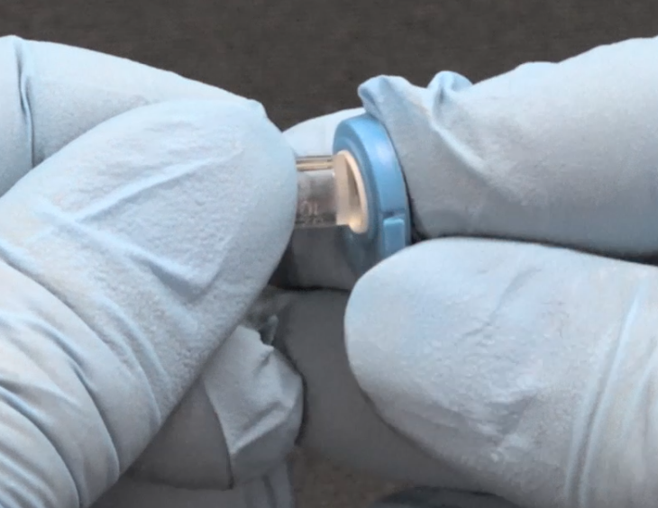
PID Lamp Cleaning
Insert the lamp back into the electrode stack.

Slide 61
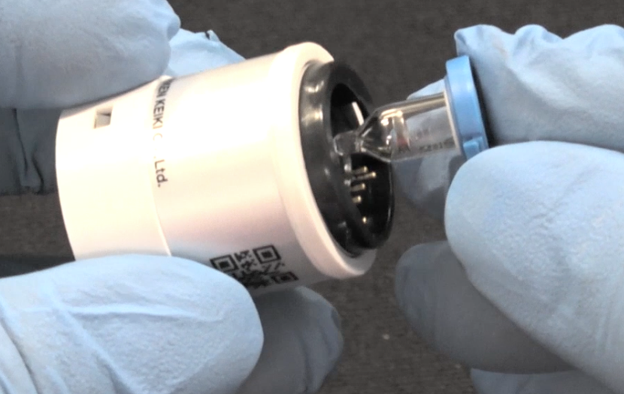
PID Lamp Cleaning
Return the electrode stack with the lamp firmly attached into the PID body.

Slide 62
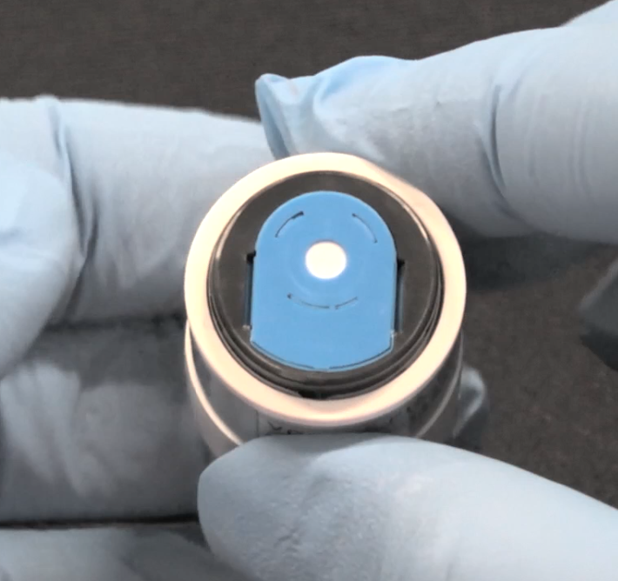
PID Lamp Cleaning
Line the electrode stack with the PID body and press down firmly until the top of the electrode stack is flush with the PID body.

Slide 63
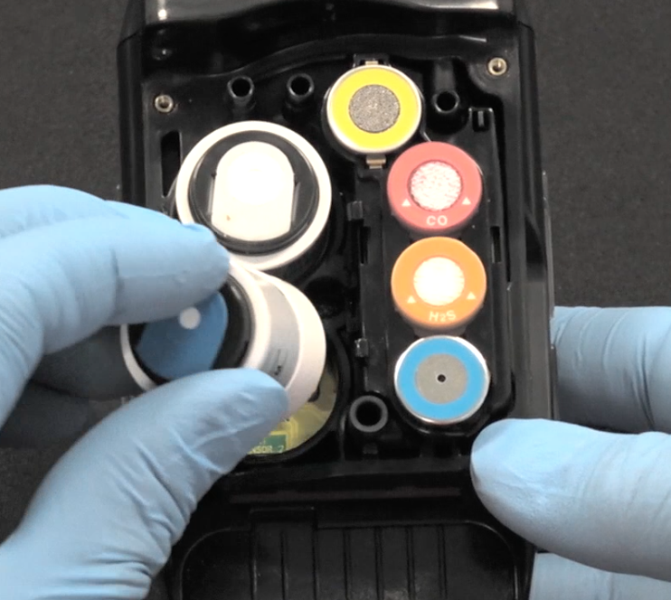
PID Lamp Cleaning
Return the PID sensor back into the sensor socket.

Slide 64

PID Lamp Cleaning
Cleaning Kit
  P/N 82-0300RK
Includes:
  Electrode stack removal tool
    P/N 82-0003RK
  Aluminum Oxide
    P/N 09-0001RK-01
  Finger cots
    P/N 08-5110RK
  Cotton swabs
    P/N 08-5100RK

Slide 65

Probe Filter Replacement

Slide 66

Probe Filter Replacement
Grasp each end of the clear probe body firmly and unscrew the two halves from each other.

Slide 67
Probe Filter Replacement
Hydrophobic Filter Disk
  P/N 33-0159RK
Particle Filter
  P/N 33-3013

Slide 68


Probe Filter Replacement
Replace both filters

Slide 69

Probe Filter Replacement
Screw both the top and bottom half of the probe securely and resume normal operation.

Slide 70
Turning On/Off Smart Sensor Channels
With the unit OFF, press and hold the AIR and SHIFT keys.
Press the POWER/ENTER key to turn instrument ON.
USER MODE and MAINTENANCE mode will be displayed.
Cursor will be next to USER MODE, press the SHIFT key to move cursor to MAINTENANCE, then press POWER/ENTER.

Slide 71
Turning On/Off Smart Sensor Channels
INPUT PASSWORD will be displayed.
The password is 2014
Enter the password then press POWER/ENTER.

Slide 72
Turning On/Off Smart Sensor Channels
MAINTE 2 will be displayed and the following menu will appear.
The cursor is next to GAS COMB, and press the POWER/ENTER key.

Slide 73

Turning On/Off Smart Sensor Channels
The Gas Combination Screen appears and all channels are displayed.

Slide 74

Turning On/Off Smart Sensor Channels
Move the cursor by pressing the SHIFT key next to SM1 (Smart Sensor 1) or SM2 (Smart Sensor 2) and press the POWER/ENTER key.
Use the AIR or SHIFT key to change the on/off setting.

Slide 75

Turning On/Off Smart Sensor Channels
When finished making changes, press the SHIFT key to move the cursor next to ESCAPE.
Press the POWER/ENTER key.

Slide 76
Turning On/Off Smart Sensor Channels
Move cursor to START MEASURE by pressing the SHIFT key and press the POWER/ENTER key.
Instrument will resume to normal operation mode.

Slide 77

Removing the Main PCB
Remove battery and sensor cover from instrument.
Remove rubber boot and scrubbers.
Remove the sensors including sensors that are installed into the Smart 1 and Smart 2 locations.

Slide 78

Removing the Main PCB
Unscrew the four Phillips screws securing the top of the detector.
Remove the top exposing the pump.
Grasp the pump and remove it from the unit.

Slide 79

Removing the Main PCB
Remove screw as shown.

Slide 80

Removing the Main PCB
Pull sensor chamber out and remove ribbon connector from main circuit board.

Slide 81

Removing the Main PCB
Lift second chamber as shown

Slide 82

Removing the Main PCB
Chamber and ribbon cable have been removed.
Remove rubber joint for pressure sensor. P/N 07-6039

Slide 83

Removing the Main PCB
All parts removed.

Slide 84

Removing the Main PCB
Gently slide circuit board towards the top of the instrument to remove.
Take care not to damage battery spring contacts.

Slide 85

Removing the Main PCB
Main PCB with LCD shown.
Buzzer facing up.

Slide 86

Removing the Main PCB
LCD connector has a lock that needs to be released before ribbon cable can be removed.
Memory battery shown can be easily replaced.
P/N 49-1050RK

Slide 87

Removing the Main PCB
LCD P/N 51-1139
Clean LCD before installing to remove any fingerprints.

Slide 88
Removing the Main PCB
Main PCB, Component side.
P/N 57-1286

Slide 89

Removing the Main PCB
Main PCB, sensor side shown.
Differential Pressure switch.

Slide 90

Pump Replacement
Using a small Phillips screwdriver, loosen the four screws on the top.
Pull to separate.

Slide 91

Pump Replacement
Grasp pump cable and unplug from PCB.
Remove pump from top.
Rebuild or replace as needed.

Slide 92

Li-ion Battery Replacement
Slide battery release tab in the direction of the arrow and push to release battery pack.
Pull up to remove battery pack.

Slide 93

GX-6000 Exploded View

Slide 94

Questions?

