Slide 1
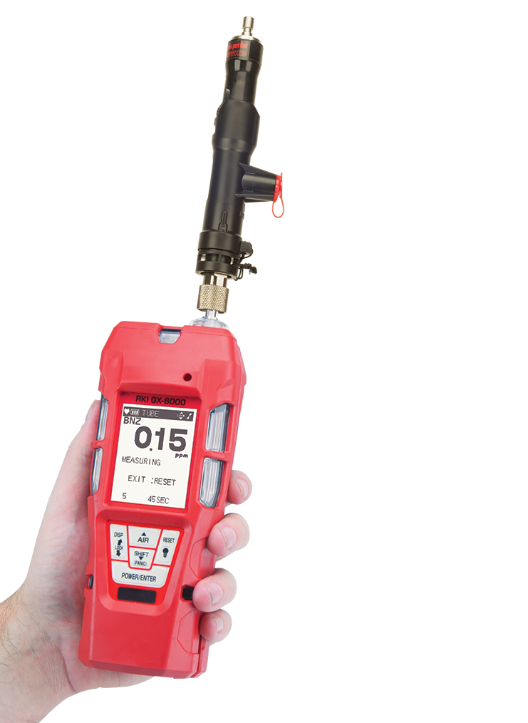
GX-6000
Benzene
Service Training

Slide 2
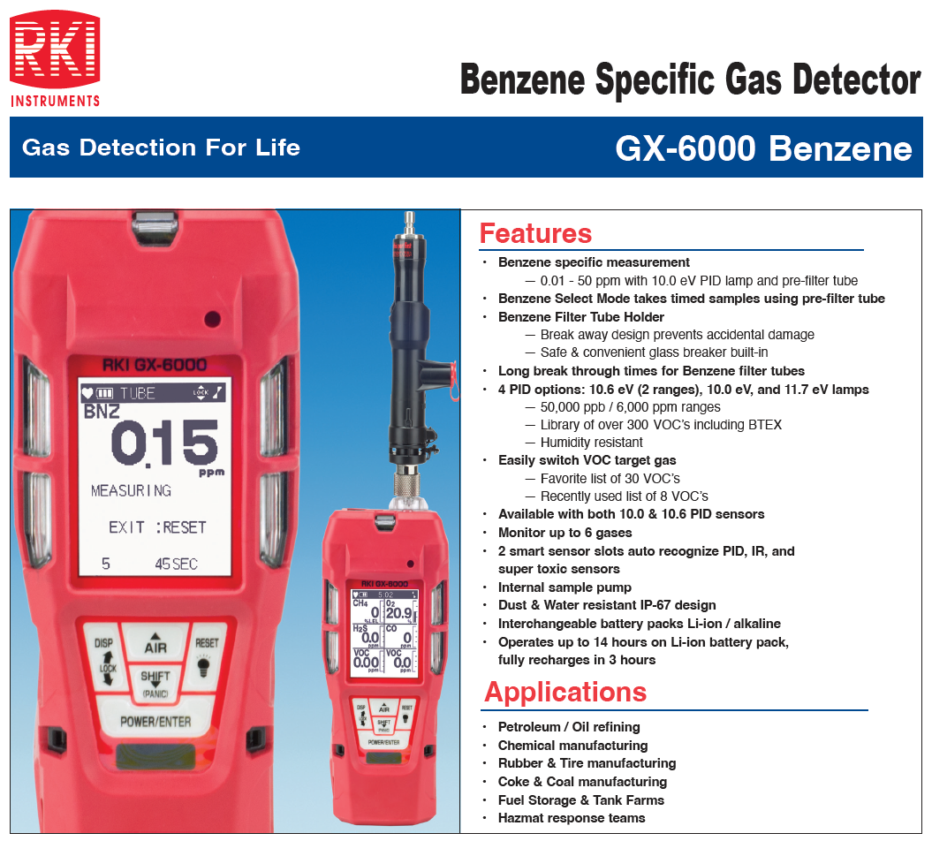

Slide 3
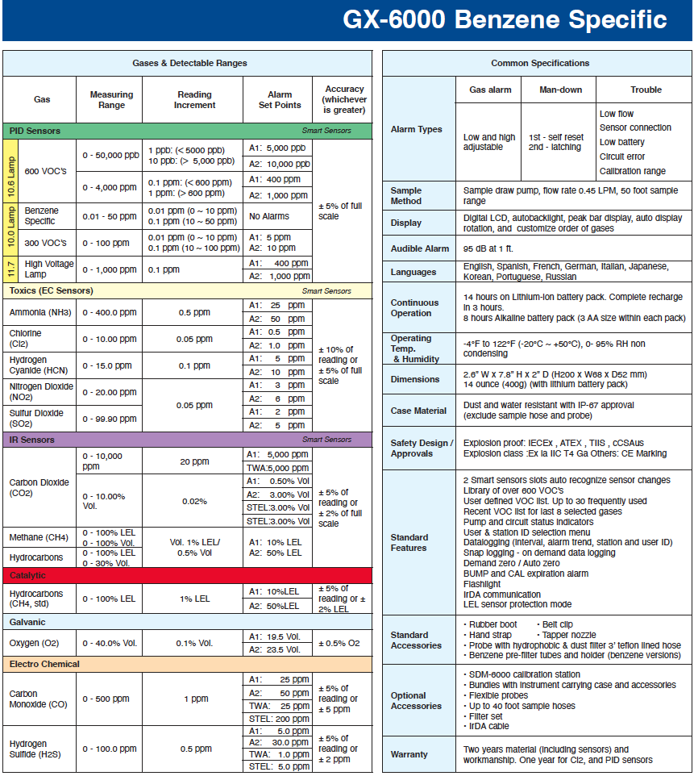

Slide 4
Calibration Equipment
5 ppm Benzene Cylinder
10 ppm Isobutylene
Benzene tube, and tube holder
Demand flow regulator
Tubing

Slide 5
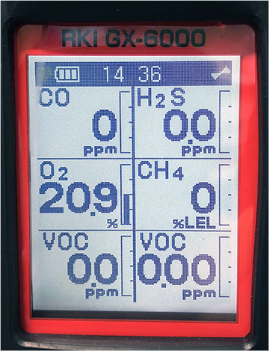
User Mode
Turn on the meter normally by pressing POWER/ENTER.

Slide 6
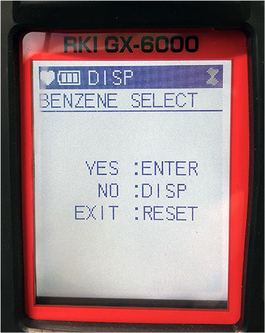
User Mode
Press DISPLAY button once.
Press ENTER to go into the Benzene mode.

Slide 7
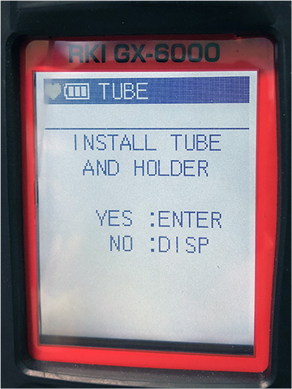
User Mode
Install the benzene tube into the holder and place it on the inlet and press ENTER.

Slide 8
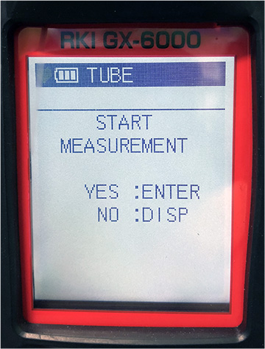
User Mode
Press ENTER again to start the measurement.

Slide 9
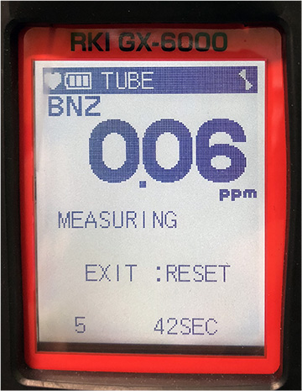
User Mode
The monitor will countdown and will give you the latest reading at the end of the cycle. (the countdown time varies depending on ambient temp)

Slide 10
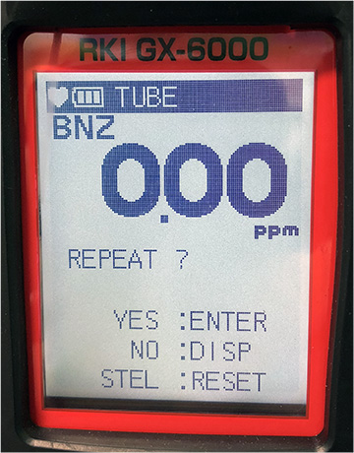
User Mode
After the test is done, it will ask you if you want to repeat the measurement.

Slide 11
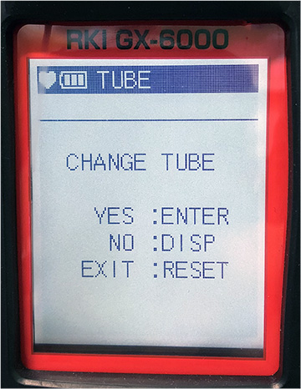
User Mode
Every measurement it will prompt you to change the tube.

Slide 12
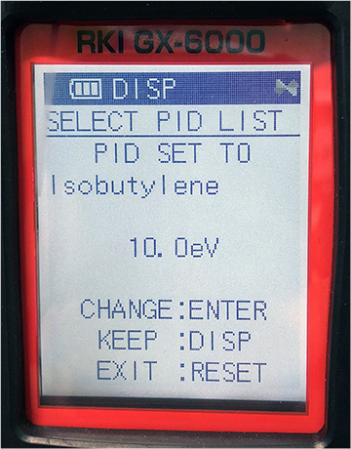
PID Library 10.0 eV
In normal mode, press DISPLAY button twice.
Press POWER/ENTER to change the gas that is set to. (factory setting on isobutylene)

Slide 13
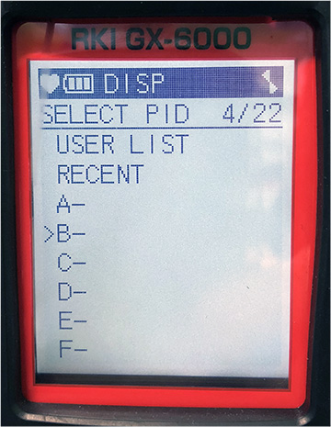
PID Library 10.0 eV
To set it to Benzene, scroll down to letter B for Benzene.

Slide 14
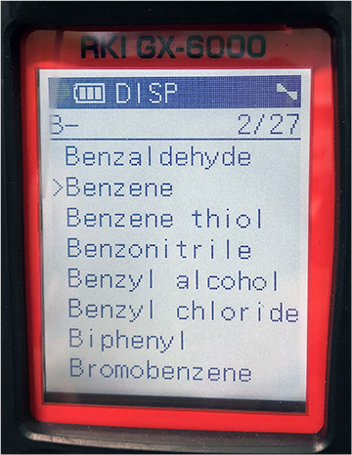
PID Library 10.0 eV
Choose Benzene from the gas list and press POWER/ENTER.

Slide 15
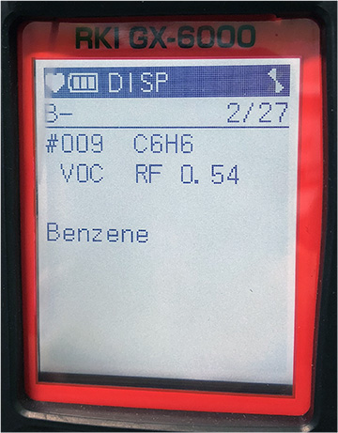
PID Library 10.0 eV
Press POWER/ENTER to confirm.

Slide 16
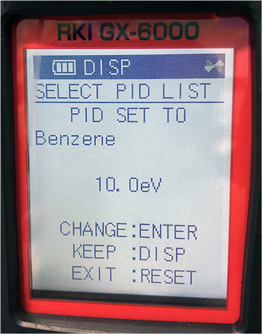
PID Library 10.0 eV
You should now see the PID set to Benzene.
Press RESET to return back to normal mode.

Slide 17
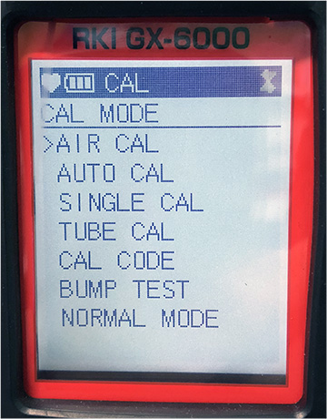
Calibration –Benzene Gas
To get in to calibration mode press and hold SHIFT+DISPLAY while in normal mode
Scroll to Air Cal and follow the screen-prompt to do a fresh air adjust. (Make sure you are in fresh air environment)

Slide 18
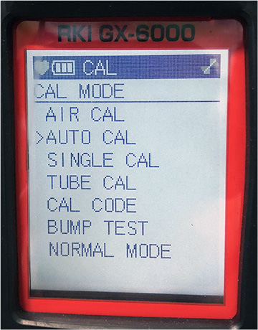
Calibration – Benzene Gas
If fresh air passes scroll down to Auto Cal, and press POWER/ENTER

Slide 19
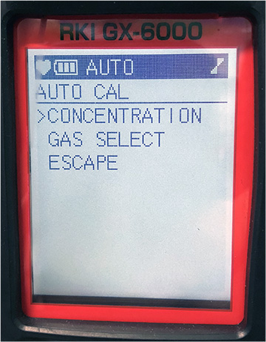
Calibration – Benzene Gas
Scroll down to concentration and press POWER/ENTER.

Slide 20
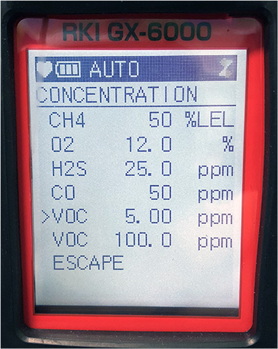
Calibration – Benzene Gas
Make sure your concentration matches your benzene cylinder. (5ppm)
(If your PID for benzene is in smart sensor 1, it should be the one immediately after the 4 gas)
If the concentration does not match, press POWER/ENTER on the selected gas and press the UP and DOWN button to adjust to the desired value
Scroll down to escape when the desired values are met

Slide 21
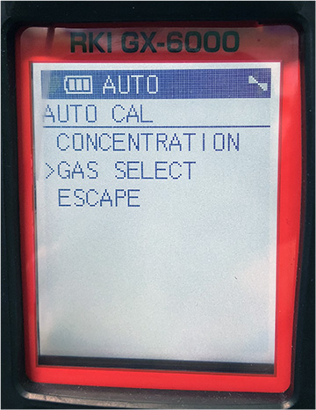
Calibration – Benzene Gas
Scroll down to gas select and press POWER/ENTER

Slide 22
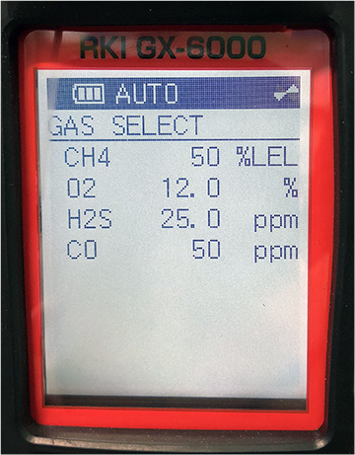
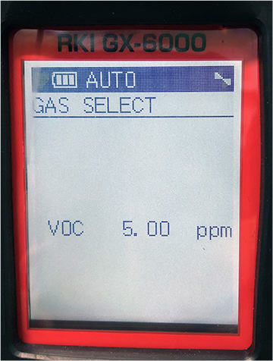
Calibration – Benzene Gas
Scroll down until you see VOC 5ppm and press POWER/ENTER
This is the value that you adjusted in the concentration menu

Slide 23
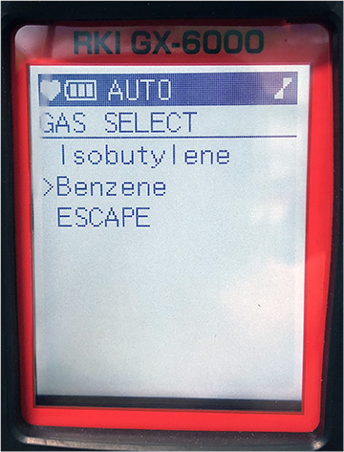
Calibration – Benzene Gas
Choose benzene on the gas select screen (make sure you have benzene gas) and press POWER/ENTER to start the calibration

Slide 24
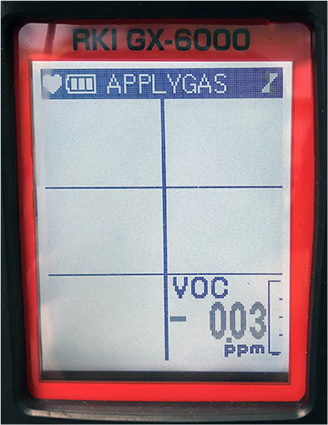
Calibration – Benzene Gas
Apply your gas using the 5ppm benzene cylinder and demand flow regulator into the inlet, and wait for the reading to stabilize.
Once the reading is stable, press POWER/ENTER to confirm the calibration.
You should get a pass or a fail.

Slide 25
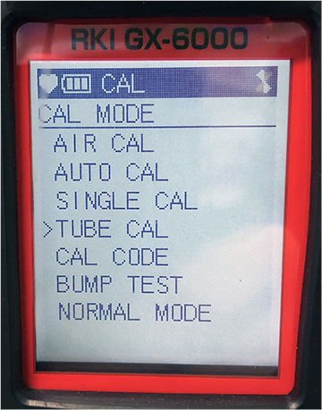
Calibration – Benzene Gas
Once it passes the Auto Cal, it will automatically go back to Cal Mode, scroll down to Tube Cal and press POWER/ENTER.

Slide 26
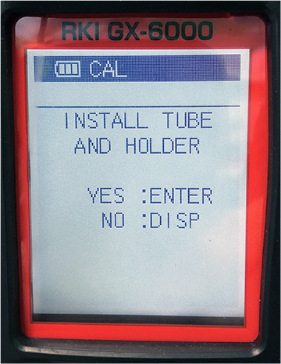
Calibration – Benzene Gas
It will prompt you to install tube holder and press POWER/ENTER to confirm.

Slide 27
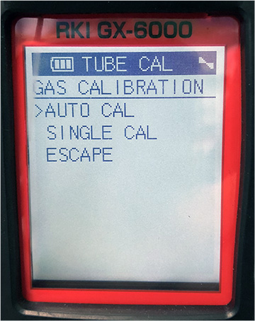
Calibration – Benzene Gas
Choose Auto Cal on the menu and press POWER/ENTER.

Slide 28
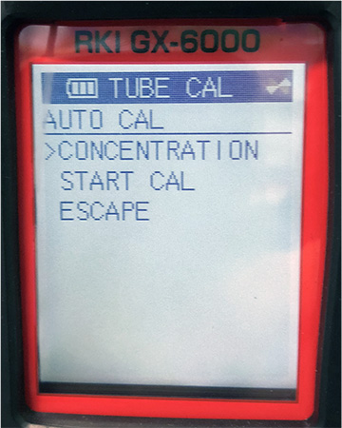
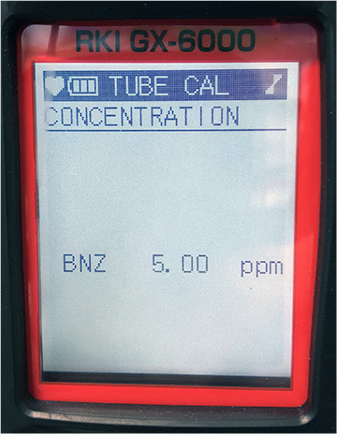
Calibration – Benzene GAs
Choose concentration and press power enter.
Scroll down until you see BNZ (Benzene) 5 ppm.
(Make sure it matches your cylinder) and press POWER/ENTER to calibrate that channel.
Get your cylinder and demand flow regulator ready right after you press the POWER/ENTER button

Slide 29
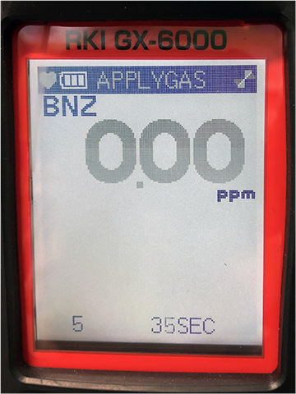
Calibration – Benzene Gas
Once you press power enter the monitor will countdown.
Apply the gas in to the meter.
Wait for the meter to countdown and either you’ll get a pass or a fail.

Slide 30
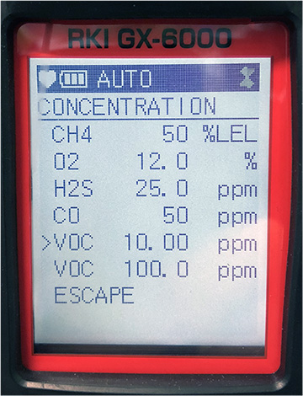
Calibration – Isobutylene Gas
In calibration mode scroll down to Auto Cal and press POWER/ENTER.
Scroll down to concentration and choose VOC (the position of the sensor varies depending on your configuration)
Change the value to 10ppm if it is set to a different value

Slide 31
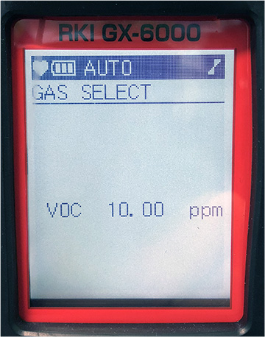
Calibration – Isobutylene Gas
Scroll down to escape, choose gas select and press POWER/ENTER.
Scroll down to voc 10 ppm and press POWER/ENTER.

Slide 32
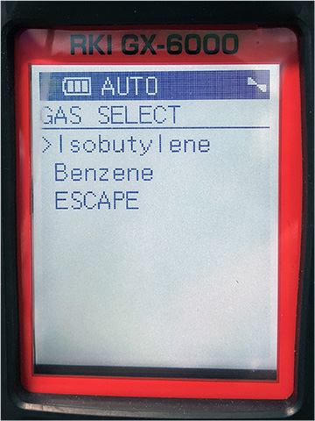
Calibration – Isobutylene Gas
Choose isobutylene and press POWER/ENTER to start the calibration.
Apply the gas and wait for the readings to stabilize
Once they are stable press POWER/ENTER to confirm the calibration

Slide 33
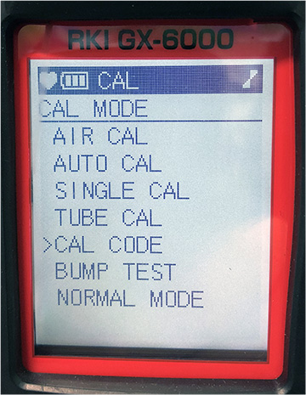
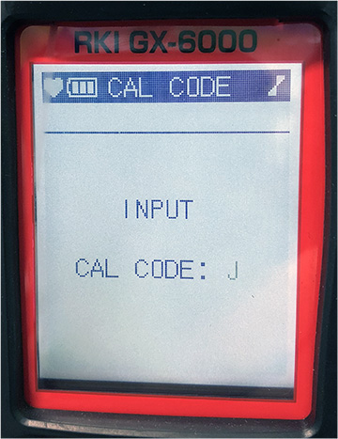
Calibration – Isobutylene Gas
After performing the auto calibration for isobutylene, in calibration mode scroll down to Cal Code and input the Cal Code that you have in your benzene tube box.(example in the photo is cal code J)

