Slide 1
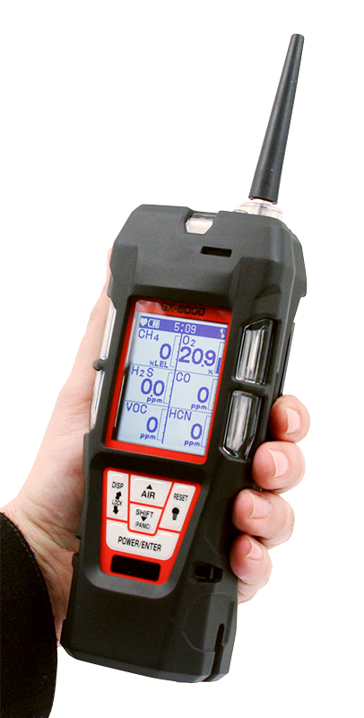
GX-6000
6 gas, sample draw with PID & Super Toxics
Removing Main PCB

Slide 2
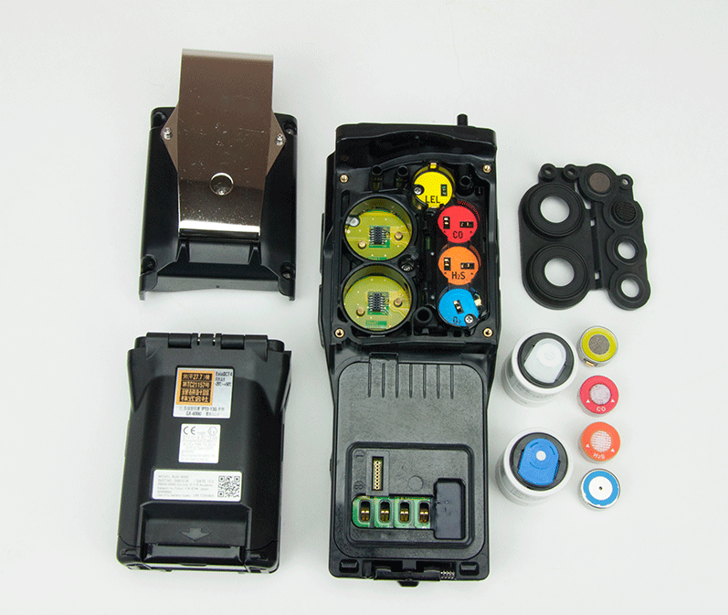
Removing the Main PCB
Remove battery and sensor cover from instrument.
Remove rubber boot and scrubbers.
Remove the sensors including sensors that are installed into the Smart 1 and Smart 2 locations.

Slide 3
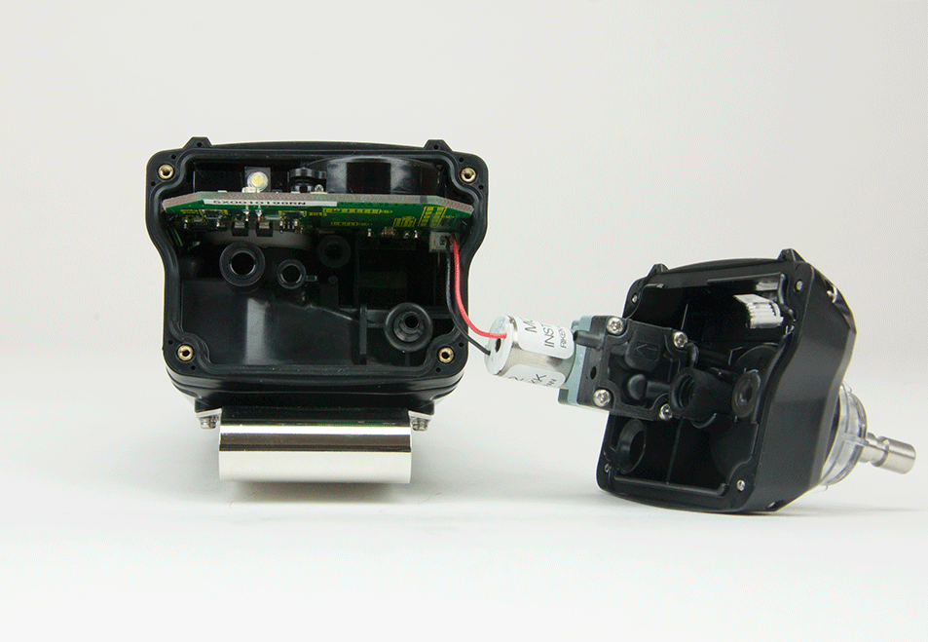
Removing the Main PCB
Unscrew the four Phillips screws securing the top of the detector.
Remove the top exposing the pump.
Grasp the pump and remove it from the unit.

Slide 4
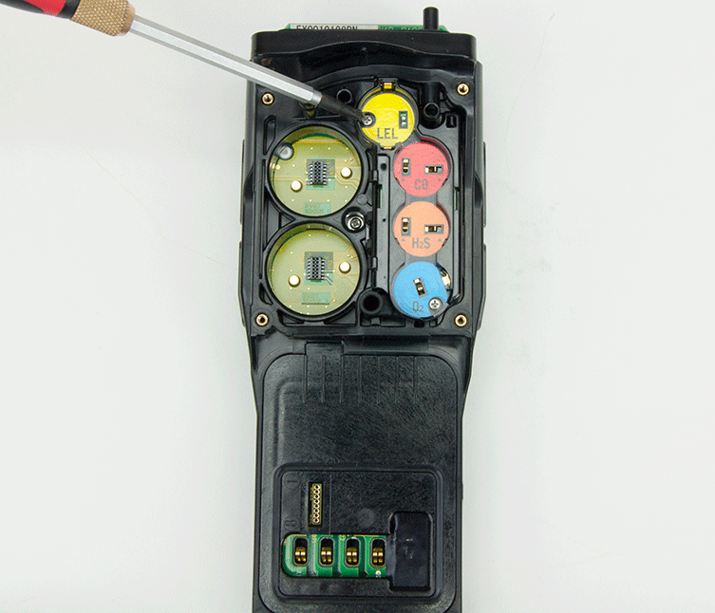
Removing the Main PCB
Remove screw as shown.

Slide 5
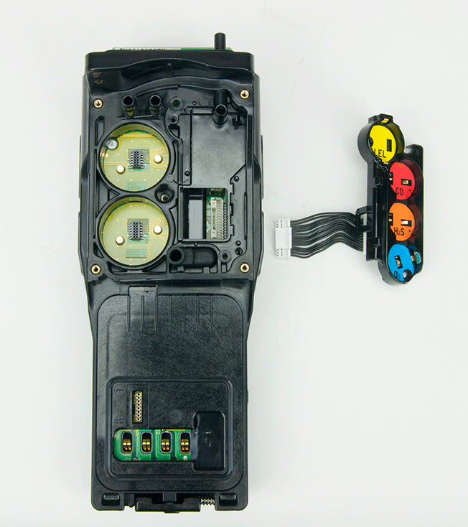
Removing the Main PCB
Pull sensor chamber out and remove ribbon connector from main circuit board.

Slide 6
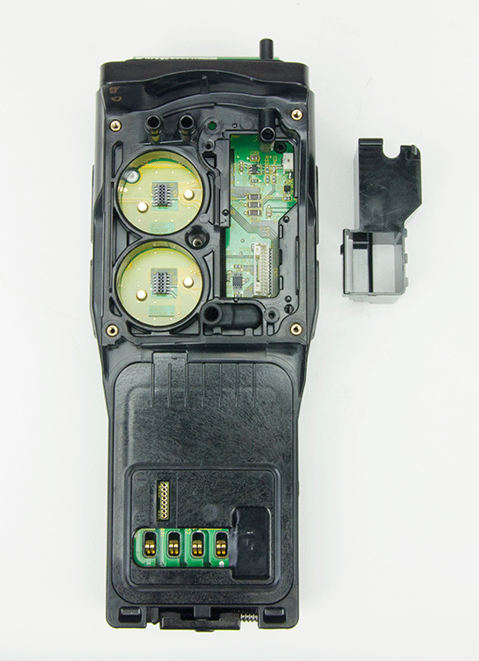
Removing the Main PCB
Lift second chamber as shown

Slide 7
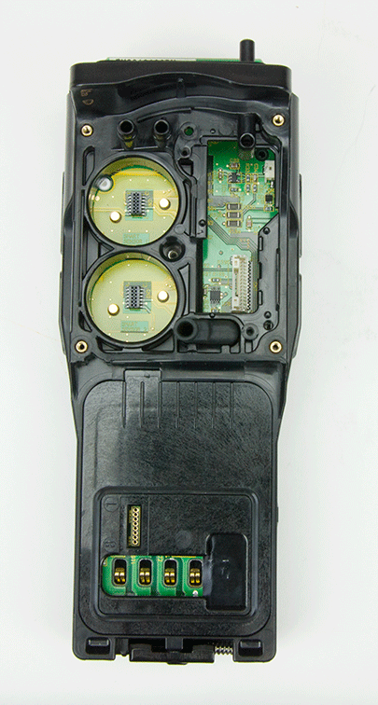
Removing the Main PCB
Chamber and ribbon cable have been removed.
Remove rubber joint for pressure sensor. P/N 07-6039

Slide 8
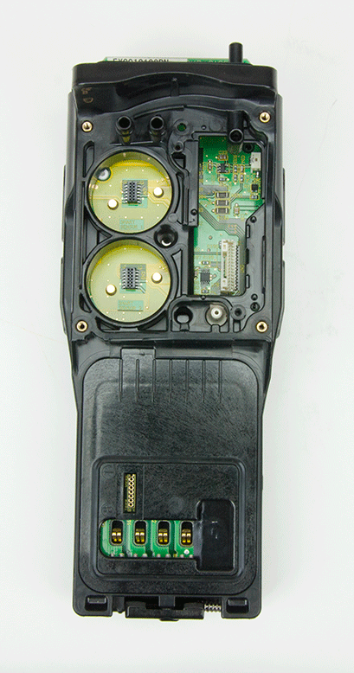
Removing the Main PCB
All parts removed.

Slide 9
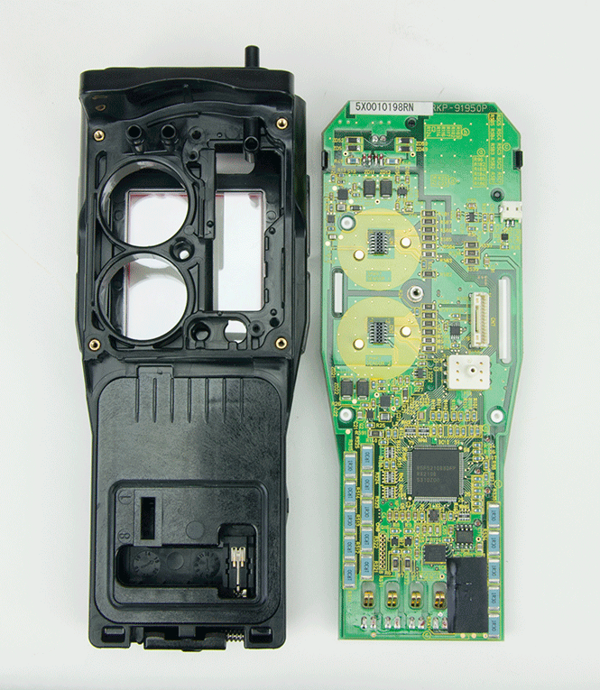
Removing the Main PCB
Gently slide circuit board towards the top of the instrument to remove.
Take care not to damage battery spring contacts.

Slide 10
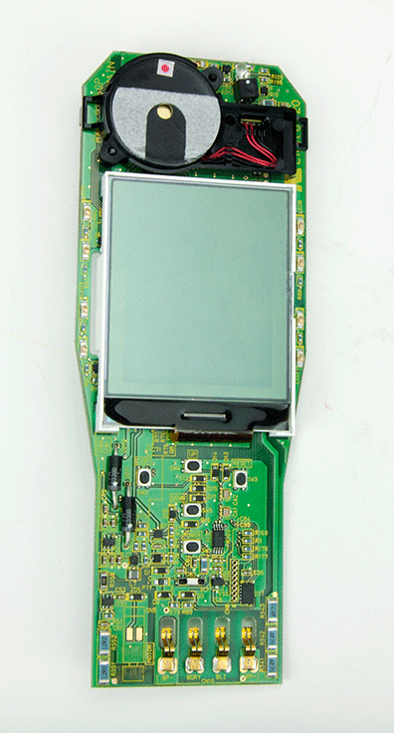
Removing the Main PCB
Main PCB with LCD shown.
Buzzer facing up.

Slide 11
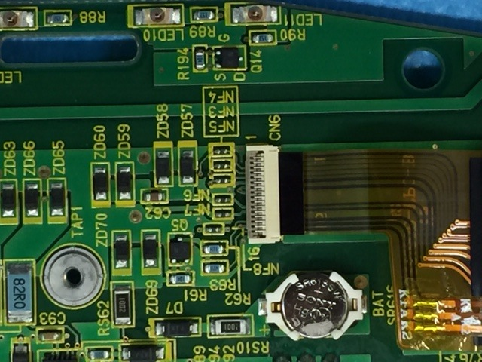
Removing the Main PCB
LCD connector has a lock that needs to be released before ribbon cable can be removed.
Memory battery shown can be easily replaced.
P/N 49-1050RK

Slide 12
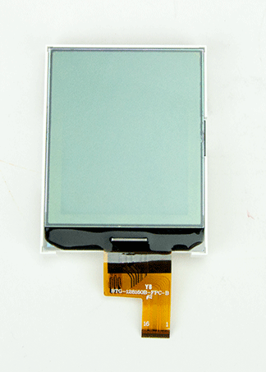
Removing the Main PCB
LCD P/N 51-1139
Clean LCD before installing to remove any fingerprints.

Slide 13
Removing the Main PCB
Main PCB, Component side.
P/N 57-1286

Slide 14
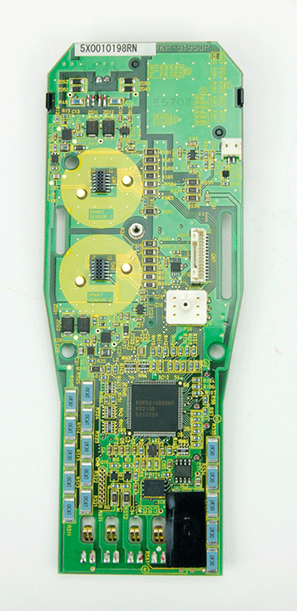
Removing the Main PCB
Main PCB, sensor side shown.
Differential Pressure switch.

Slide 15
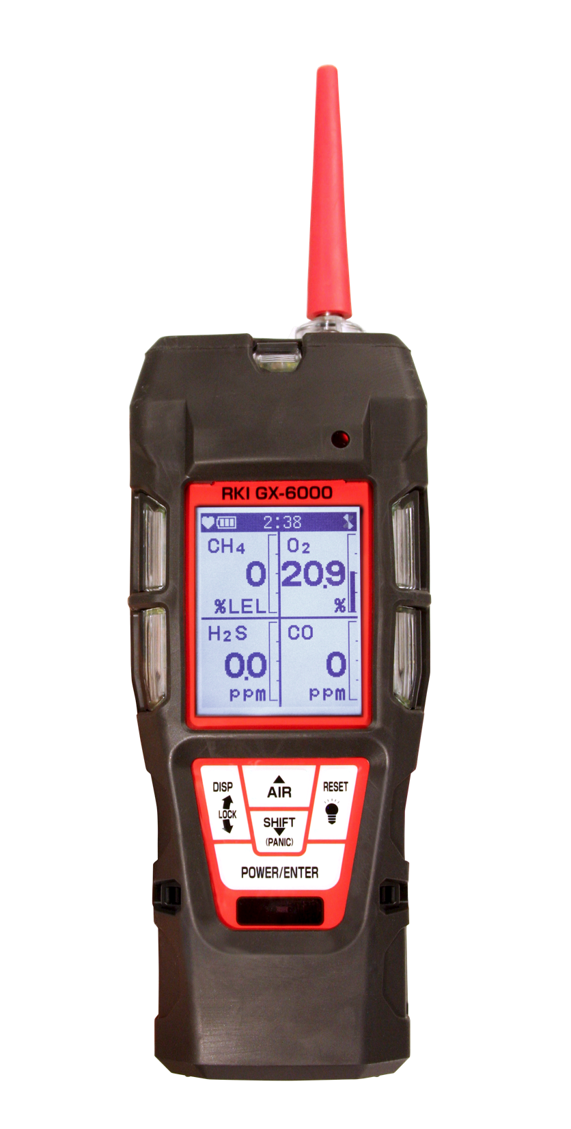
Questions?

