Slide 1

GX-6000
6 gas, sample draw with PID & Super Toxics
Factory Mode

Slide 2
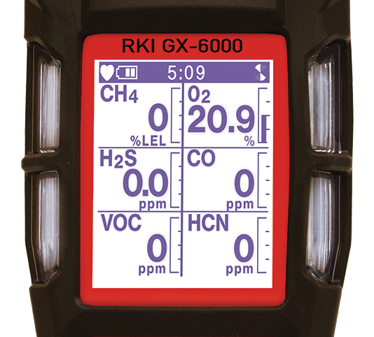
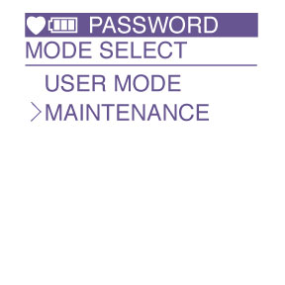
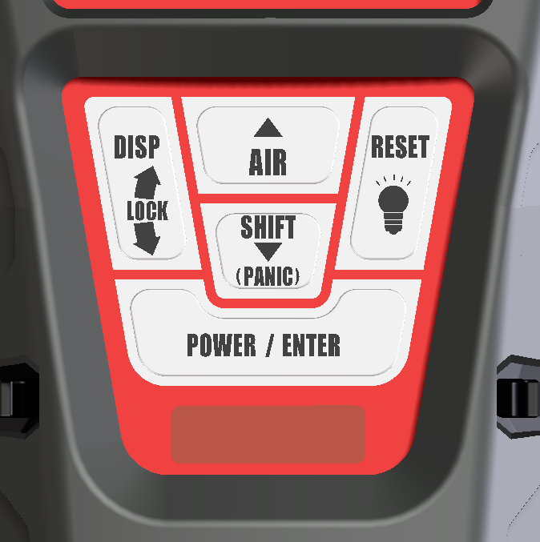
Factory Mode
With the unit OFF, press and hold the AIR and SHIFT keys.
Press the POWER/ENTER key to turn instrument ON.
USER MODE and MAINTENANCE mode will be displayed.
Cursor will be next to USER MODE, press the SHIFT key to move cursor to MAINTENANCE, then press POWER/ENTER.
  Note: There are two modes selected by unique passwords.

Slide 3
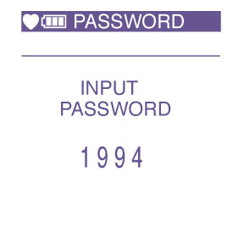
Factory Mode
INPUT PASSWORD will be displayed.
Enter: 1994

Slide 4
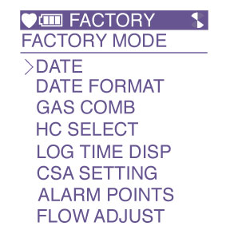
Factory Mode
FACTORY will be displayed and the following menu will appear:

Slide 5
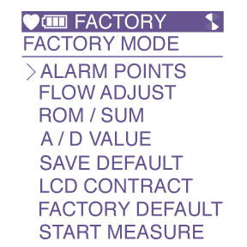
Factory Mode
FACTORY MODE CONTINUED

Slide 6
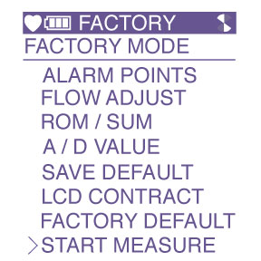
Factory Mode
Using the AIR or SHIFT key, scroll to the function that you want to view then press the POWER/ENTER key.
When completed, use the SHIFT key to scroll to START MEASURE then press the POWER/ENTER key to return to normal operation.

Slide 7
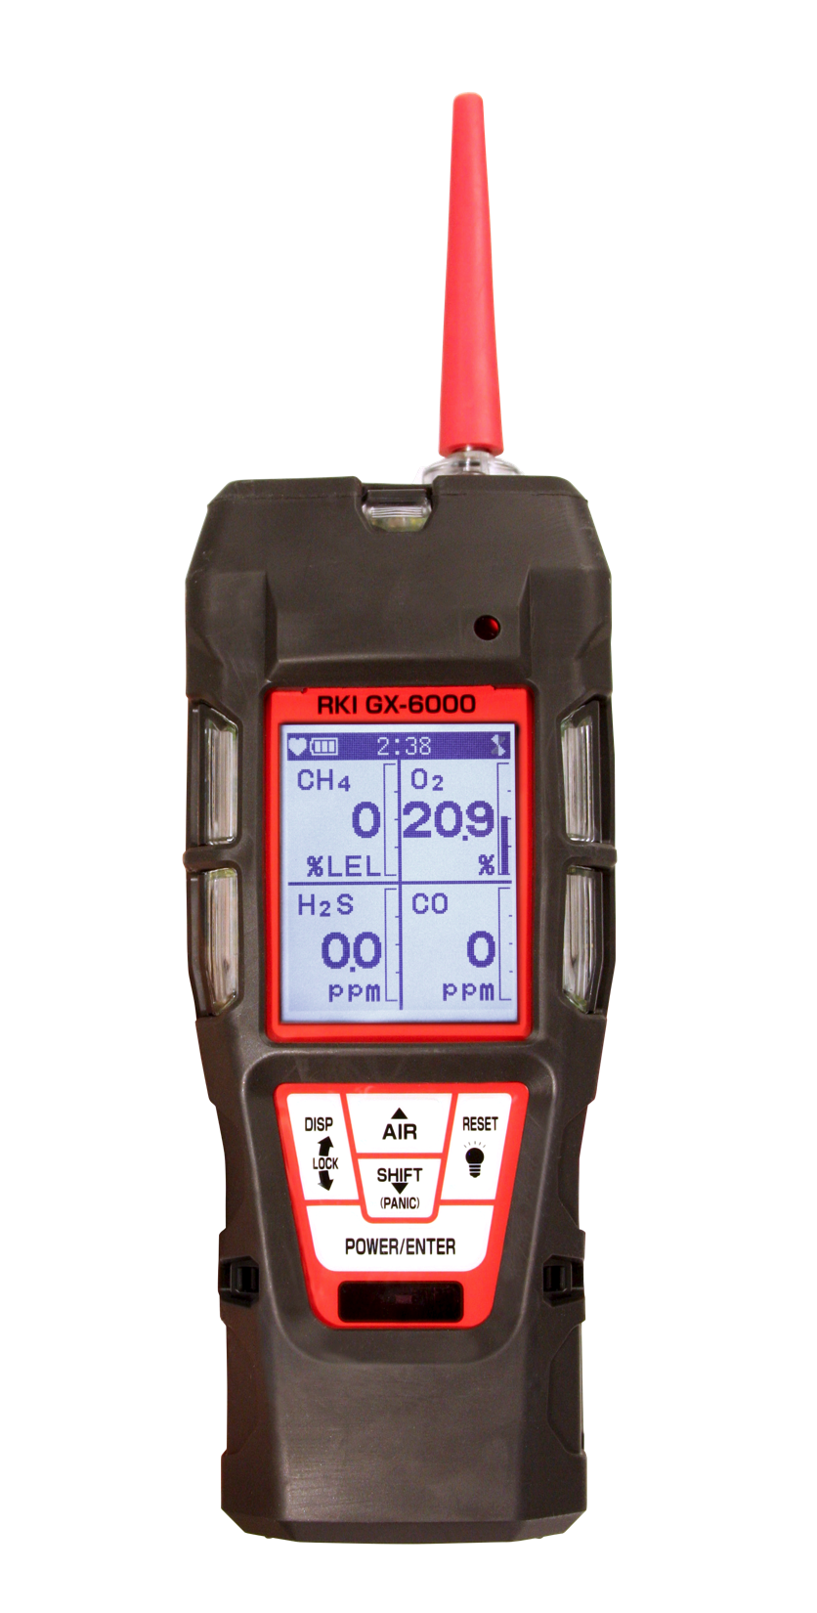
Questions?

