Slide 1
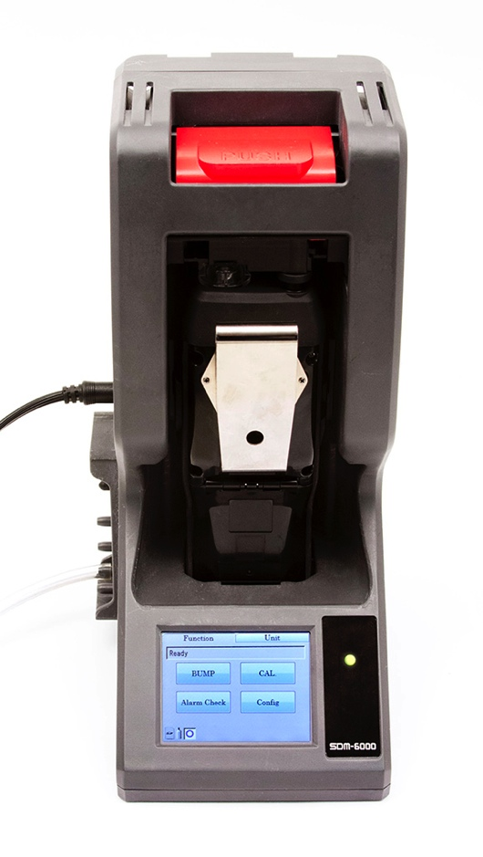
SDM-6000 Docking Station
Available in 2015
  Stand alone station (no PC required
  Charge
  Bump, Calibrate, and Alarm tests
  Touch screen menu display
  Save calibration, bump tests, alarm history and exposure data to an SD memory card or to a computer
  Automatically power on or off for scheduled maintenance
  Up to 3 ports for separate calibration gas cylinders
Notes:
Can be connected up to 10 units

Slide 2
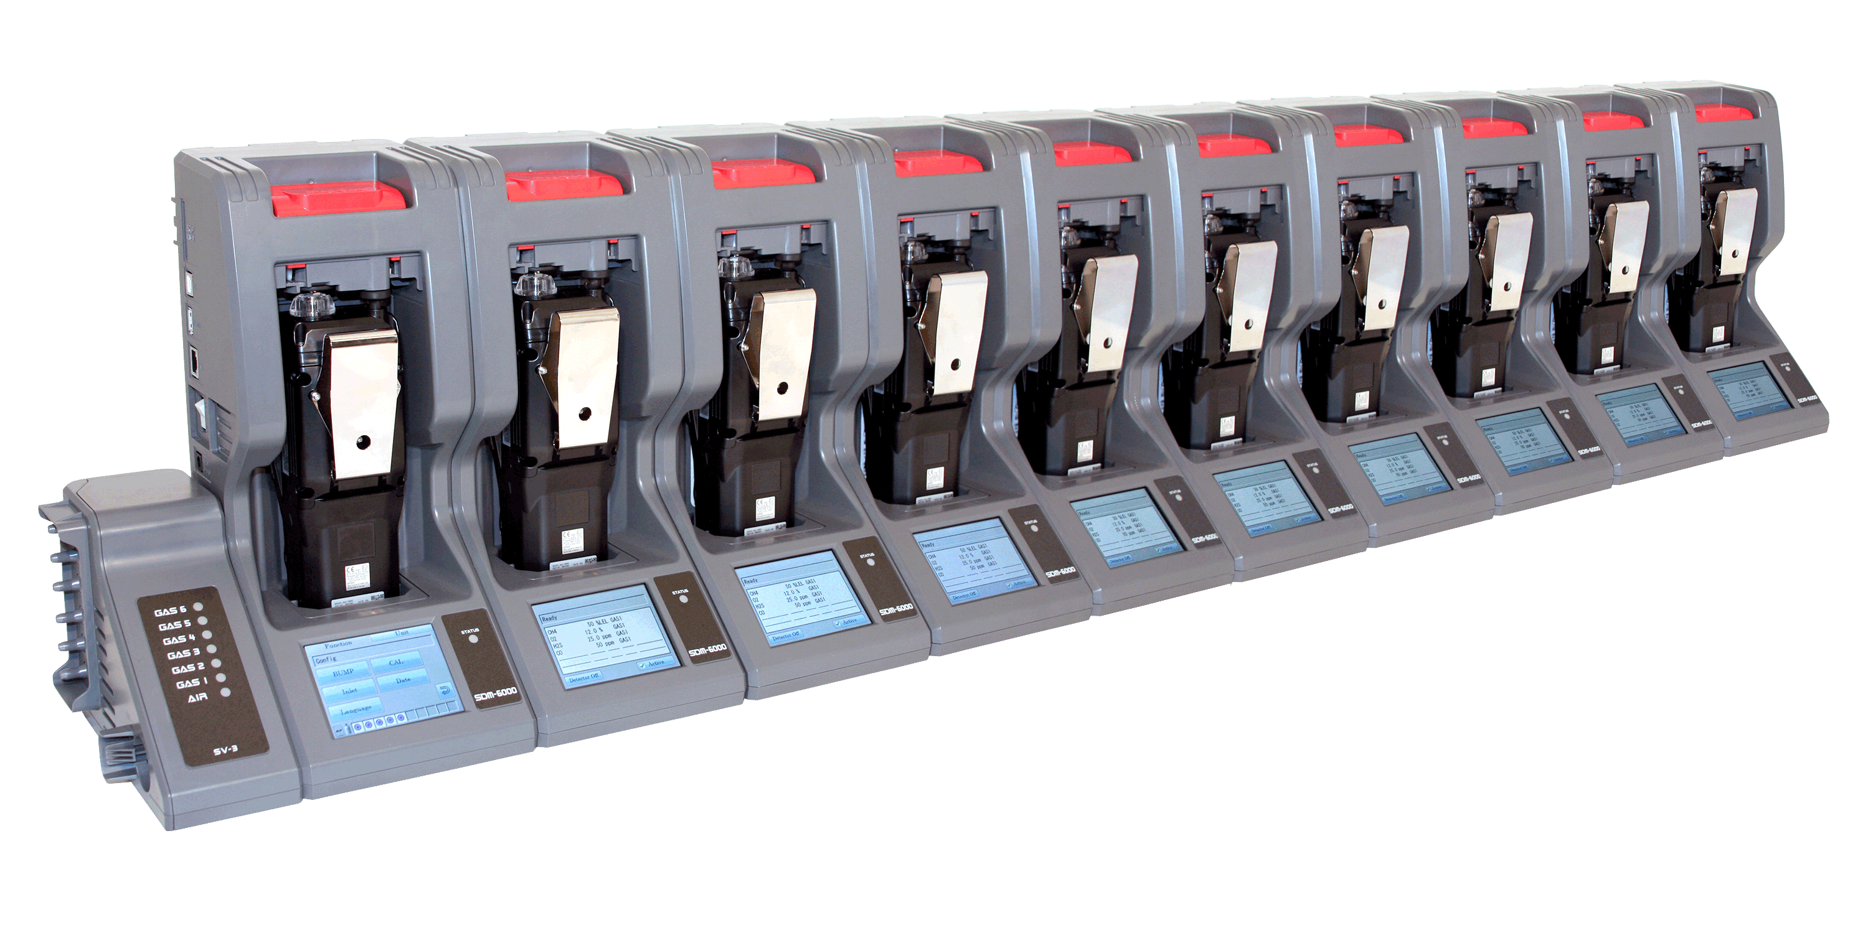
Multi Module System with PC Controller
  Manage up to 10 instruments with one power source, calibration source, and computer
  Configure GX-6000 parameters
  SV-3 unit expands calibration ports up to 6 ports
Notes:
Can be connected up to 10 units

Slide 3
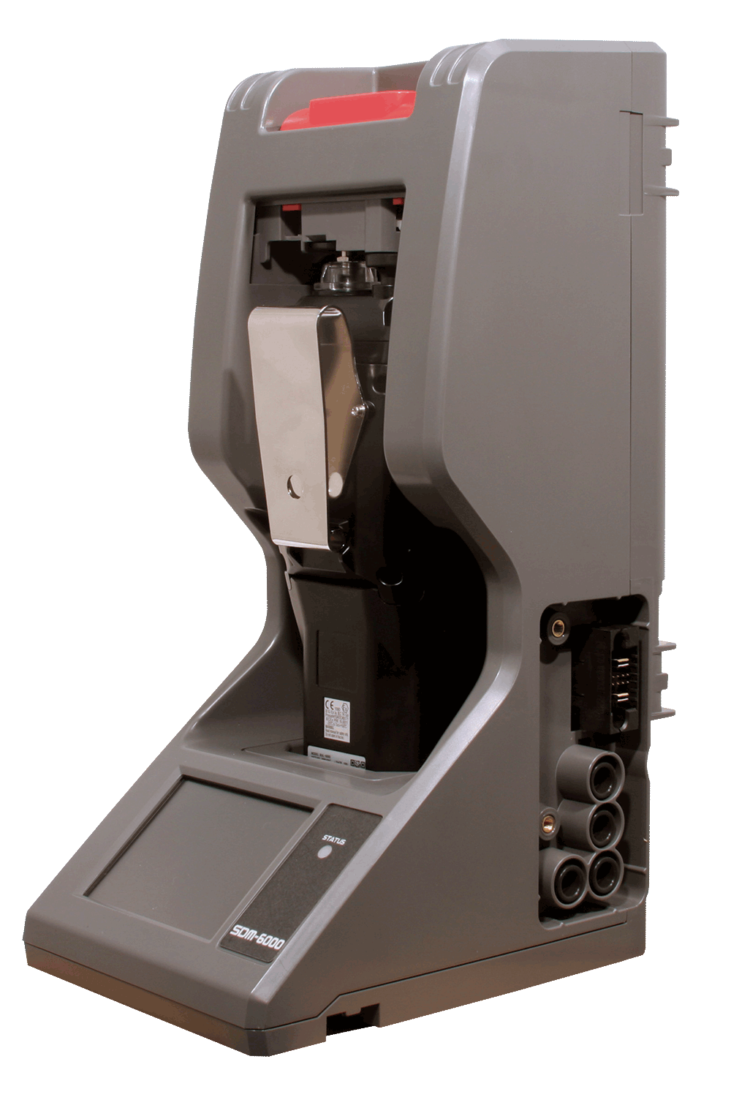
  Easily connects to adjacent docks
  Automatically distributes power, calibration gas, and data once connected
  DIN Rail wall mount
  Local print out of calibration/bump and alarm test results

Slide 4
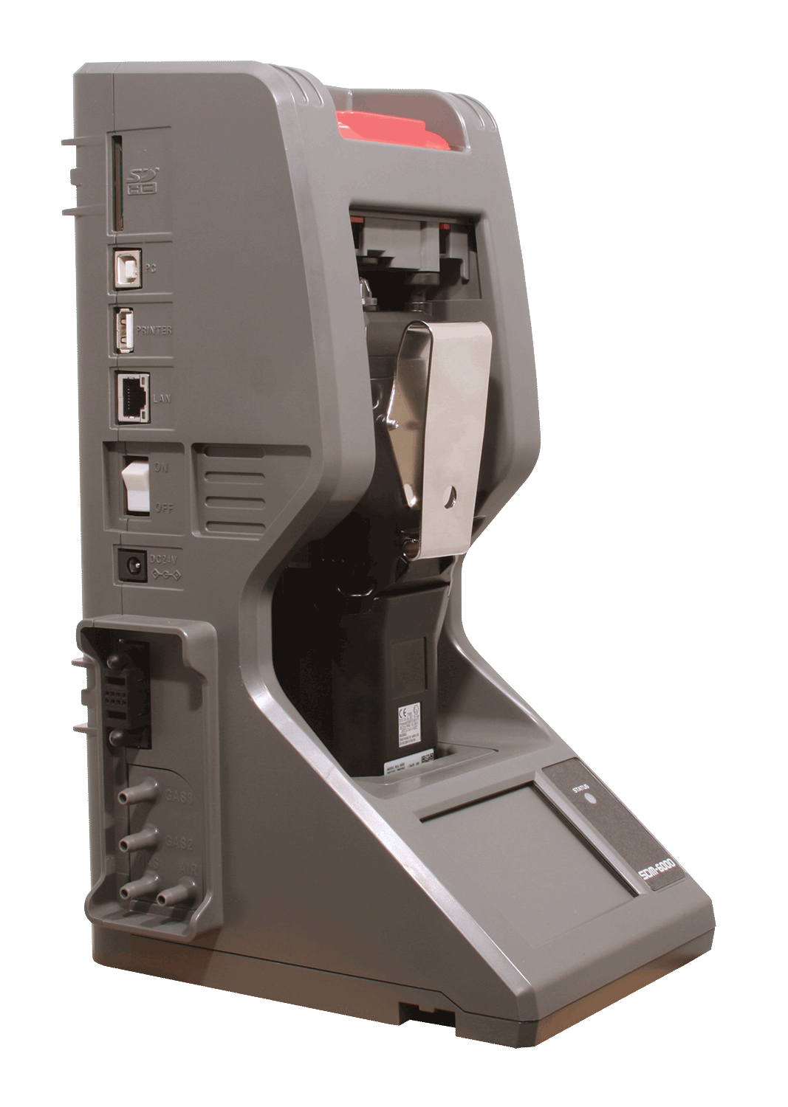
SD / SDHC Memory card slot
USB PC connection
USB Printer connection
LAN connection
Power Switch
AC adaptor
Power/Data Joint Connector
3 calibration gas ports
1 fresh air port

