Slide 1
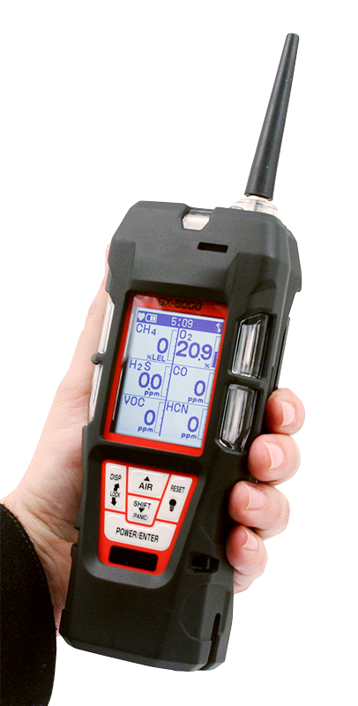
GX-6000
6 gas, sample draw with PID & Super Toxics

Slide 2

Features
Monitor up to 6 gases
4 standard micro-sensors
2 smart sensor slots for PID, IR, & Super Toxics
Library of over 600 VOC’s
Internal Sample Pump
New Features
  Man-down alarm
  LED flashlight
  Panic alarm
  180 degree auto display rotation

Slide 3
Features
New Features
Lightweight
High impact rubber boot
Ergonomic design fits comfortable in hand
IP 67 Protection Rating
Operating Hours
Rechargeable – 14 hours
Alkaline – 8 hours

Slide 4
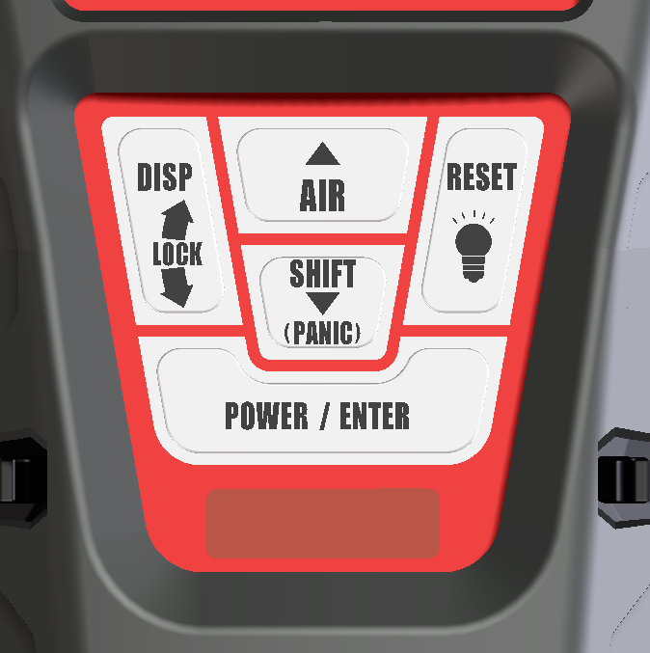
Control Panel
Glove friendly buttons can be operated with one hand
Functionality of each button is very similar to other RKI gas detectors (like GX-2012)
New functions are easily identifiable
  LED light
  Panic alarm
  Auto display rotation

Slide 5
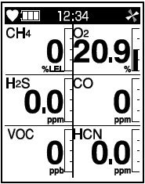
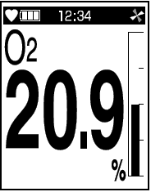
LCD Display Options
Multi-gas view displays all 6 channels
Single gas view shows one channel in large scale with auto scrolling for each channel
Auto rotation when instrument is turned upside down

Slide 6
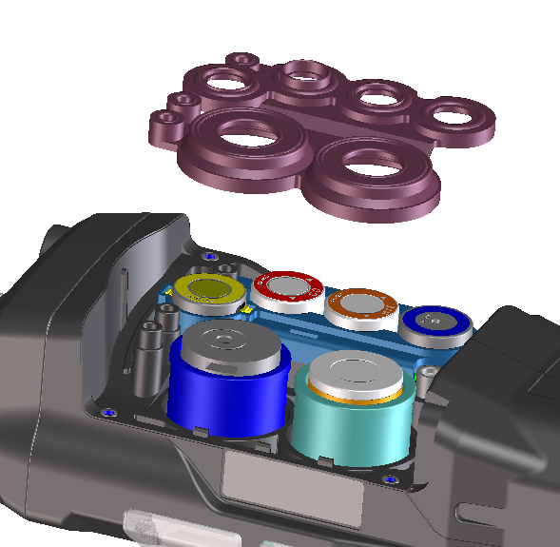
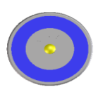
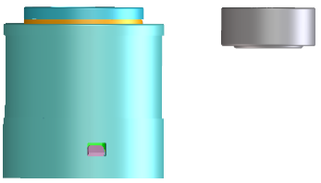
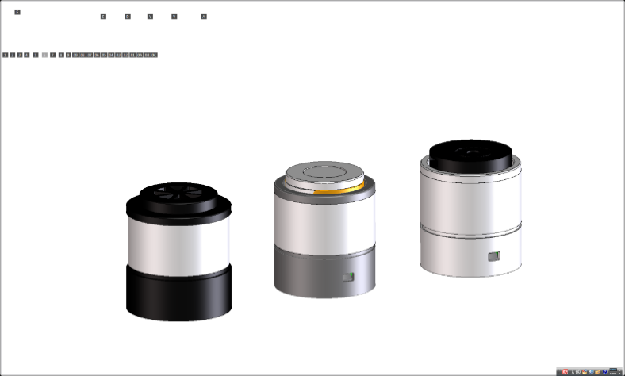
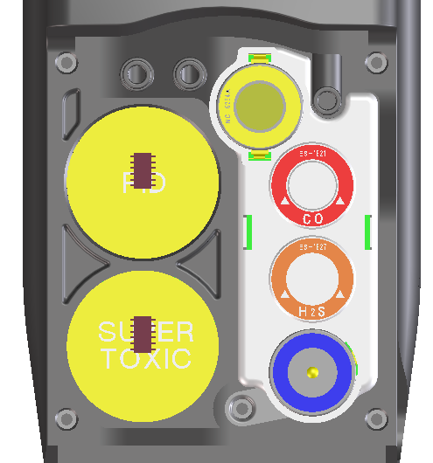
Sensors
Standard 4 gas sensors
CH4 or HC …..NC-6264A
O2 …..OS-BM2
H2S ..…ES-1827i
CO …..ES-1821
Smart sensors
PID …..PIS-00x (White)
ES …..ESS-03xx (Grey)
IR …..DES-3311-x (Black)
*Any two “smart” sensors can be combined in GX-6000, as long as PID sensor is located in the first position of gas through path.

Slide 7

Smart Sensor Gases
PID
Library of over 600 target gases
Iso-Butylene (C4H8) will be calibration gas standard.
EC
SO2 0-6 ppm
NO2 0-9 ppm
HCN 0-15 ppm
NH3 0-75 ppm*
NH3 0-400 ppm*
Cl2 0-3 ppm*
Cl2 0-10 ppm*
IR
CO2 0-5% vol*
HC 0-100% LEL*
HC 0-30% vol*
CH4 0-100% LEL*
CH4 0-100% vol*
CO2 0-5000 ppm*
CO2 0-10000 ppm*
*Sensors currently under development.

Slide 8
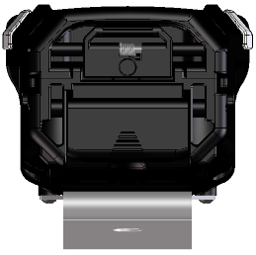
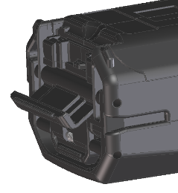
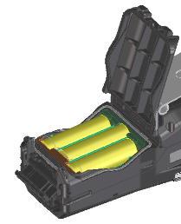

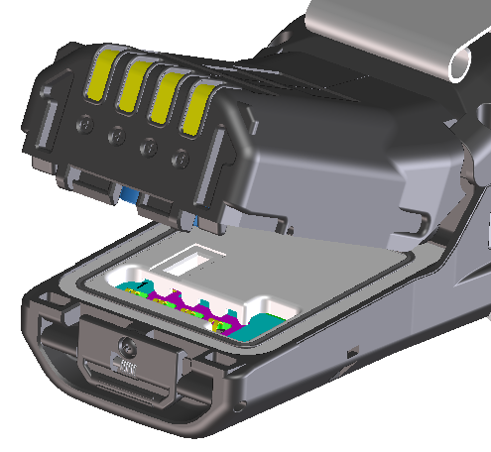
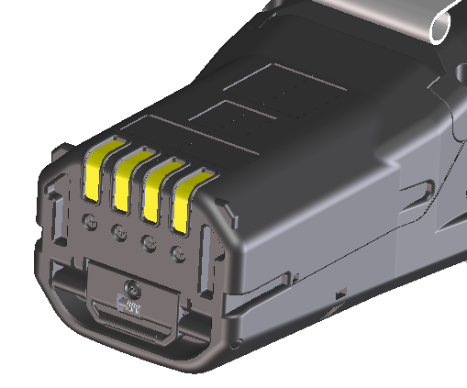
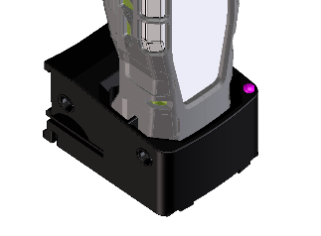
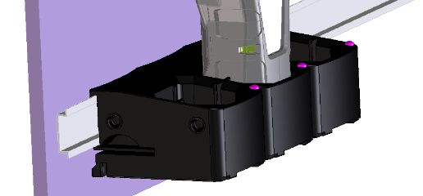
Power Supply
Alkaline
BUD-6000
AA size battery x 3 pieces
More than 8 hours operation
Rechargeable
BUL-6000
More than 14 hours operation
Battery charger BC-6000

Slide 9
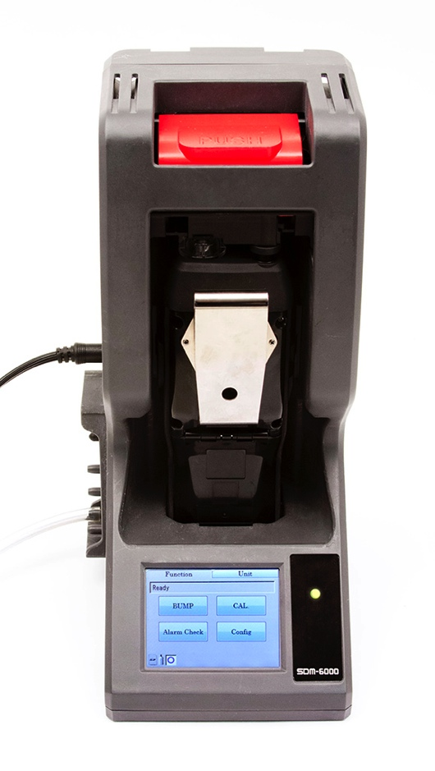
SDM-6000 Docking Station
Docking station can be connected to single PC (up to 10 units).
Available in December of 2015
Notes:
Can be connected up to 10 units

Slide 10
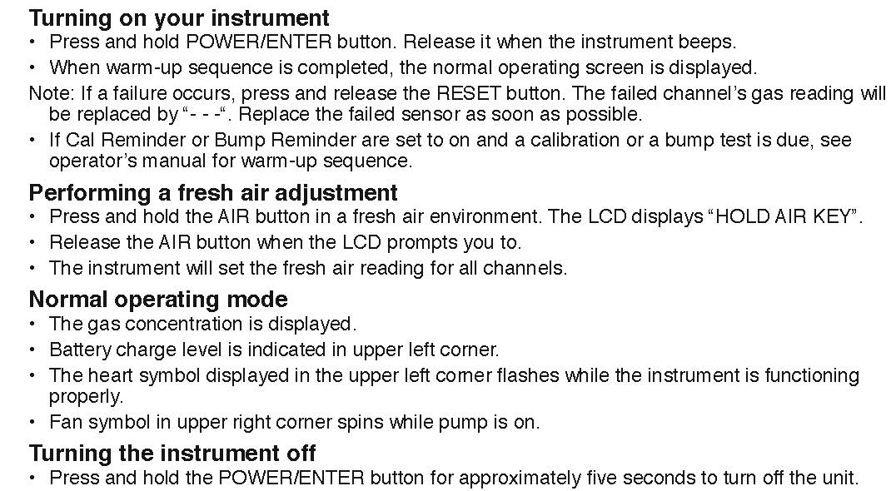
Quick Reference Card
Notes:
Can be connected up to 10 units

Slide 11
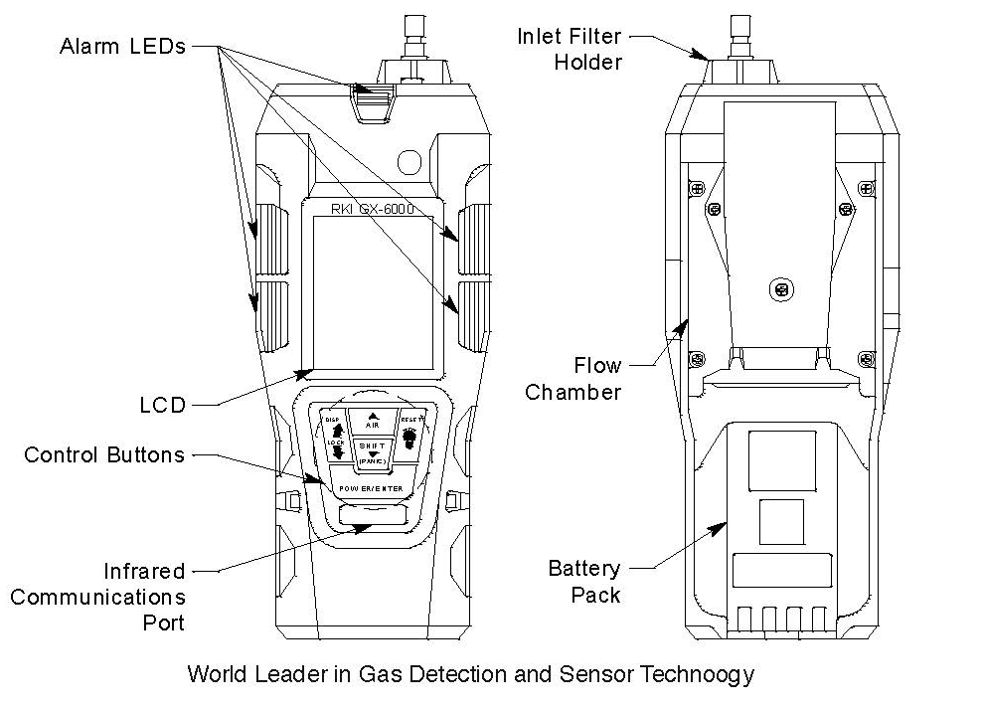
Quick Reference Card
Notes:
Can be connected up to 10 units

Slide 12

Calibration & Maintenance

Slide 13
Calibration, Standard 4 Gas Unit
Turn the GX-6000 on and allow to warm up.
Once warmed up, perform an AIR adjustment by pressing and holding the AIR key until “Release Air Key” is displayed.
Briefly press and hold the SHIFT key then press the DISP key. CAL will be displayed at the top of the LCD indicating that the GX-6000 is in the calibration mode.
  AIR CAL, AUTO CAL, SINGLE CAL and NORMAL MODE will be displayed.

Slide 14
Calibration
Press the SHIFT key to select AUTO CAL then press the POWER/ENTER key.
You will now see CONCENTRATION, GAS SELECT and ESCAPE.
Press the ENTER key to select CONCENTRATION to verify that the gas concentrations programmed in the instrument match the cylinder values.

Slide 15
Calibration
The cursor will be next to CH4. If the displayed value does not match the cylinder value, press the ENTER key to select CH4. The gas value will start blinking.
Using the AIR or SHIFT keys, raise or lower the reading to match the gas value in the cylinder.
Once completed, press the POWER / ENTER key to set.
Press the SHIFT key to scroll to the next gas.

Slide 16

Calibration
Adjust as required. Once completed use the SHIFT key to scroll to ESCAPE then press the POWER / ENTER key.
Press the SHIFT key to select GAS SELECT. Press the ENTER key.
All gases and calibration values will be displayed.

Slide 17
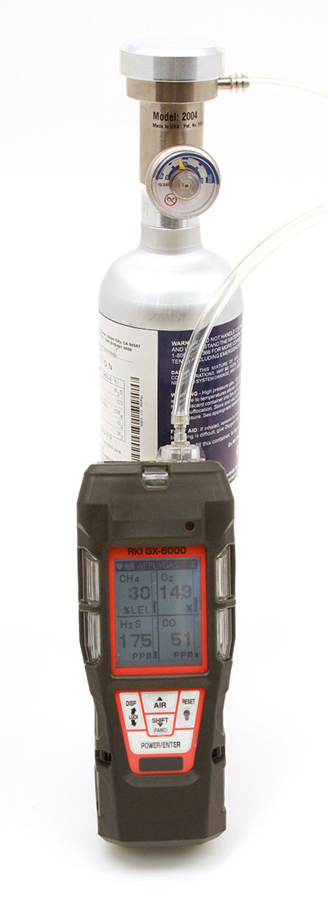
Calibration
Press the ENTER key and “APPLYGAS” will be flashing on the top of the LCD and all gases values will be flashing indicating that the instrument is ready for calibration gas.
Remove the red rubber tube from the top of the instrument and attach tube from gas cylinder to inlet fitting. Note: Must use a demand flow regulator or gas bag.
Allow gas to flow for a maximum of two minutes.

Slide 18
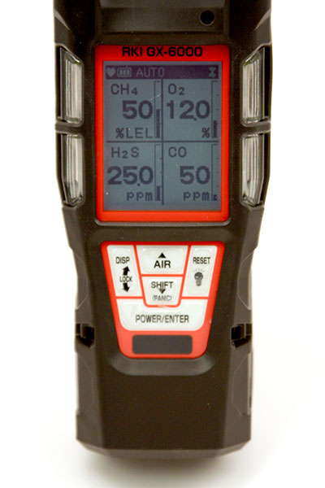
Calibration
Once reading stabilizes, press the POWER / ENTER key to calibrate the unit.
Once completed, the GX-6000 will show you the calibrated values.
Remove the tubing from the top of the GX-6000 and reattach the rubber tube.
Remove the demand flow regulator from the cylinder and store kit for future use.

Slide 19
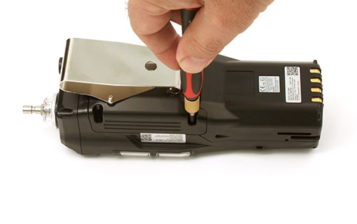
Sensor Replacement
Turn GX-6000 OFF
Remove rubber boot covering instrument
Loosen screws over flow chamber.

Slide 20
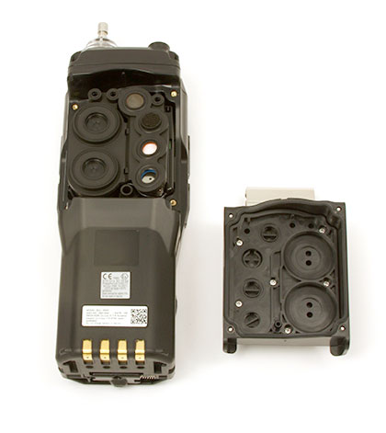
Sensor Replacement
Remove flow chamber exposing sensor gasket and scrubbers.

Slide 21
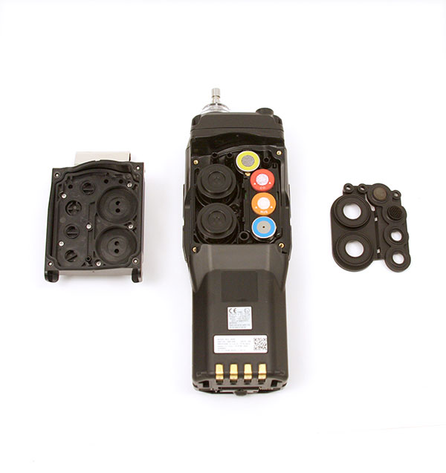
Sensor Replacement
Remove sensor gasket exposing sensors.
Remove and replace sensors as needed.

Slide 22

Replacement of Sensor Scrubbers
H2S scrubber for LEL sensor, P/N 33-7114RK
H2S scrubber for CO
sensor, P/N 33-7102RK

Slide 23
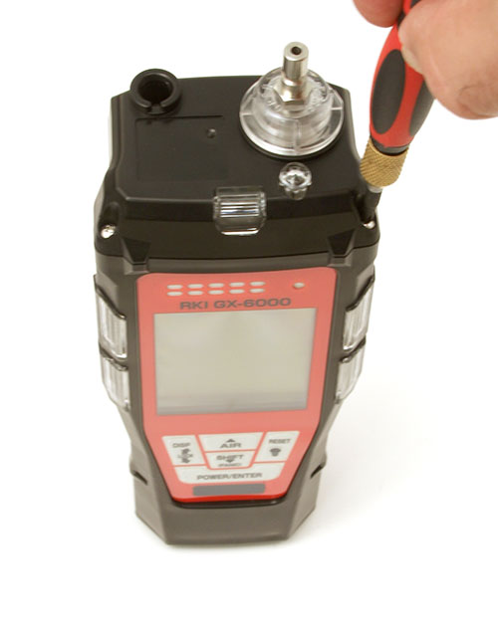
Pump Replacement
Using a small Phillips screwdriver, loosen the four screws on the top.
Pull to separate.

Slide 24
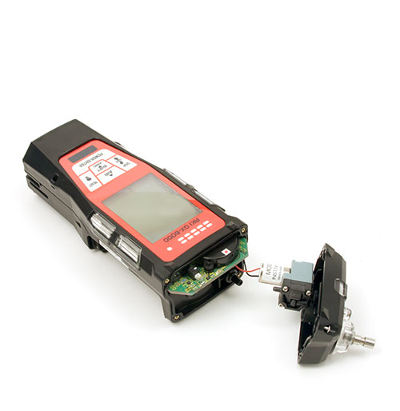
Pump Replacement
Grasp pump cable and unplug from PCB.
Remove pump from top.
Rebuild or replace as needed.

Slide 25
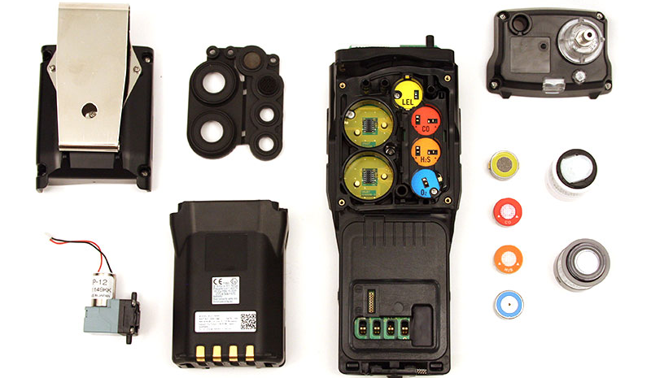
GX-6000 Exploded View

Slide 26
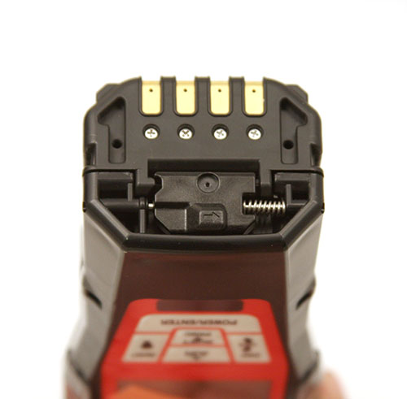
Li-ion Battery Replacement
Slide battery release tab in the direction of the arrow and push to release battery pack.
Pull up to remove battery pack.

Slide 27

Programming Modes

Slide 28
USER Mode
With the unit OFF, press and hold the AIR and SHIFT keys.
Press the POWER key to turn ON.
USER MODE and MAINTENANCE mode will be displayed.
Cursor will be next to USER MODE, press the POWER key to select.
USER will be displayed on the top.

Slide 29
USER Mode
The following menu will be displayed:
  DATE
  DATE FORMAT
  CONFIGURE CH
  LANGUAGE
  ROM/SUM
  PASSWORD
  START MEASURE

Slide 30
USER Mode
Using the AIR or SHIFT keys, select the function that you want and press the POWER/ENTER key to select.
When completed use the SHIFT key to scroll to START MEASURE to return to normal operation.

Slide 31
MAINTENANCE Mode
With the unit OFF, press and hold the AIR and SHIFT keys.
Press the POWER key to turn instrument ON.
USER MODE and MAINTENANCE mode will be displayed.
Cursor will be next to USER MODE, press the SHIFT key to move cursor to MAINTENANCE, then press POWER/ENTER.
INPUT PASSWORD will be displayed.

Slide 32
MAINTENANCE Mode
The password is 0006
Enter the password then press POWER/ENTER.
MAINTE will be displayed and the following menu will appear:
  DATE
  DATE FORMAT
  GAS CALIBRATION

Slide 33
MAINTENANCE Mode
MAINTENANCE MODE CONTINUED
  CAL SETTING*
  BUMP SETTING*
  ALARM SETTING*
  PUMP OFF DISP
  ID DISPLAY
  BACK LIGHT TIME
  LANGUAGE
  LUNCH BREAK
  AUTO ZERO

Slide 34
MAINTENANCE Mode
MAINTENANCE MODE CONTINUED
  DEMAND ZERO
  ZERO FOLLOWER
  ZERO SUPPRESS
  IR AUTO RANGE
  CONFIGURATION
  KEY TONE
  INERT MODE
  L./B. MODE
  BAR HOLE TIME

Slide 35
MAINTENANCE Mode
MAINTENANCE MODE CONTINUED
  CO DISPLAY
  MAN DOWN*
  LOG SETTING*
  FLOW ADJUST
  ROM/SUM
  PASSWORD
  RESTORE DEFAULT
  START MEASURE

Slide 36
MAINTENANCE Mode
Use the SHIFT or AIR keys to select the feature you would like.
Press the POWER/ENTER key to select.
Once completed, use the SHIFT key to scroll to START MEASUREMENT to return to normal operation.

Slide 37
Factory Mode
With the unit OFF, press and hold the AIR and SHIFT keys.
Press the POWER key to turn instrument ON.
USER MODE and MAINTENANCE mode will be displayed.
Cursor will be next to USER MODE, press the SHIFT key to move cursor to MAINTENANCE, then press POWER/ENTER.
  Note: There are two modes selected by unique passwords.

Slide 38
Factory Mode
INPUT PASSWORD will be displayed.
Input: 1994. You will see the following menu:
FACTORY
  DATE
  DATE FORMAT
  GAS COMB
  HC SELECT
  LOG TIME DISP
  CSA SETTING

Slide 39
Factory Mode
Maintenance Mode
  ALARM POINTS
  FLOW ADJUST
  ROM/SUM
  A/D VALUE
  SAVE DEFAULT
  LCD CONTRAST
  FACTORY DEFAULT
  START MEASURE

Slide 40
Factory Mode
Using the AIR/SHIFT key, scroll to the function that you want to view then press the POWER/ENTER key.
When completed, use the SHIFT key to scroll to START MEASURE then press the POWER/ENTER key to return to normal operation.

Slide 41
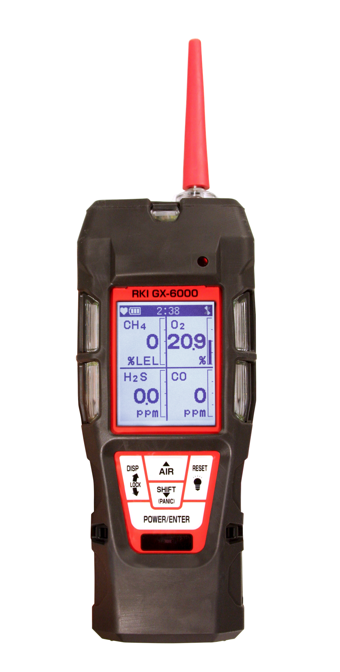
Questions?

