Slide 1
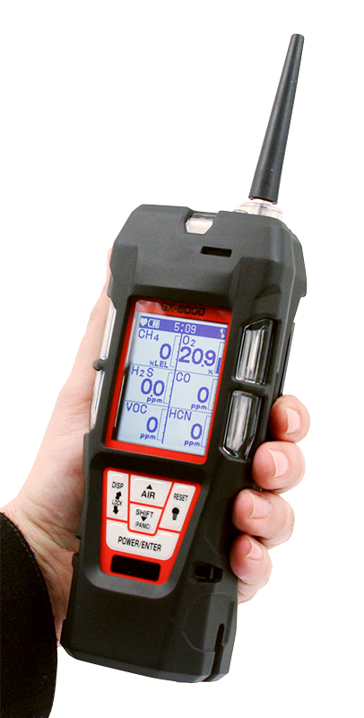
You Have Choices
Introducing
GX-6000
6 gas, sample draw with smart PID, IR & super toxics

Slide 2

Monitor up to 6 Gases
H2S, CO, O2, LEL
2 smart sensor slots
  PID for VOC’s
  IR for CH4, HC, & CO2
  EC for NH3, Cl2, HCN, NO2, & SO2
LCD display
Auto flip display
Peak bar graphs
Adjustable auto backlight
Customize order of gases
Single gas view with large font & auto sequence
5 operating modes
Normal
Leak check
Inert
Bar hole
Snap Log
Alarms
2 adjustable gas alarms per channel
Man Down alarm
4 alarm LED’s
Audible and vibration alarms
Trouble alarms for low flow, sensor connection, low battery, circuit error, & calibration
PID library of more than 600 VOC’s
50 ppm / 6,000 ppm ranges
Easily choose a target VOC
  User defined VOC list of 30
  Recently used VOC list last 8
LEL Protection mode
Shields LEL sensor from damaging VOC exposure
Internal Sample Pump
50’ sampling range

Slide 3
Smallest 6 gas sample draw
Lightweight & Ergonomic
High impact rubber boot
Ergonomic design fits comfortable in hand
Custom Unit Identification
User & Station ID selection Menu
Assign multiple users to select within one instrument
Internal Sample Pump
50’ sampling range
Weather & Dust Resistant
IP-67
Interchangeable battery options
Lithium-ion pack operates 14 hours
  Complete recharge in 3 hours
Alkaline pack operates 8 hours
9 Languages
English, Germany, Italian, French, Portuguese, Spanish, Japanese, Korean, Russian

Slide 4
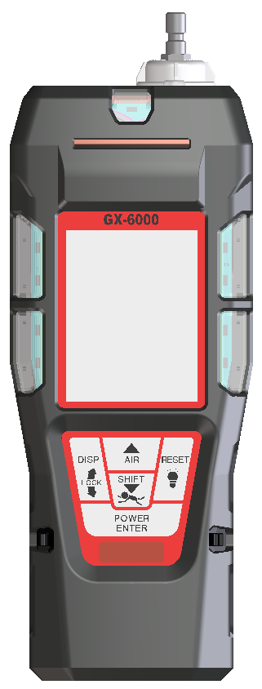
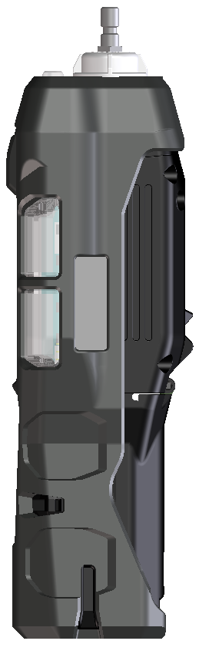
Compact & lightweight
Dimensions
7.87” (H) x 2.67” (W) x 2.04” (D)
GX-2012 = 6.81” x 2.79” x 1.69”
Weight
Approx. 400g / 14.1 ounce
GX-2012 : 360g / 12.7 ounce
7.87”
2.67”
2.04”

Slide 5
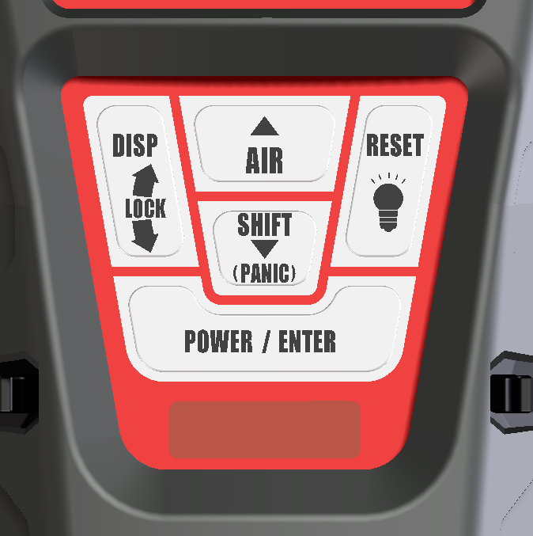
Control Panel
Glove friendly buttons can be operated with one hand
Functionality of each button is very similar to other RKI gas detectors (like GX-2012)
New functions are easily identifiable
  LED light
  Panic alarm
  Auto display rotation

Slide 6
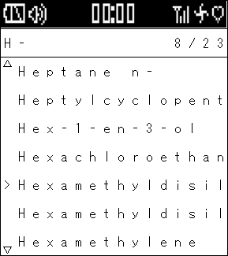
LCD Display
Display Examples
Full dot-matrix user-friendly LCD.
One of 9 languages can be selected by software.
  English, Germany, Italian, French, Portuguese, Spanish, Japanese, Korean, Russian

Slide 7
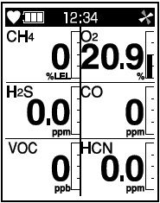
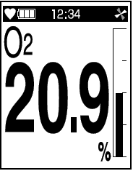
LCD Display Options
Multi-gas view displays all 6 channels
Single gas view shows one channel in large scale with auto scrolling for each channel
Auto rotation when instrument upside down

Slide 8
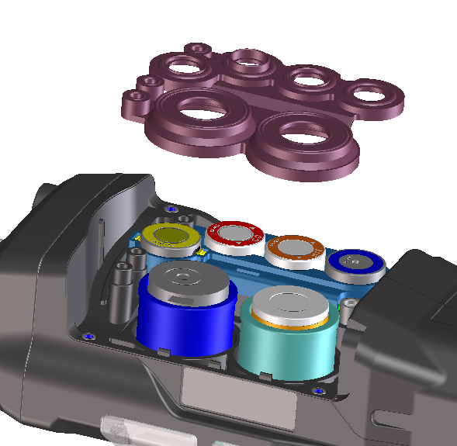
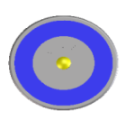
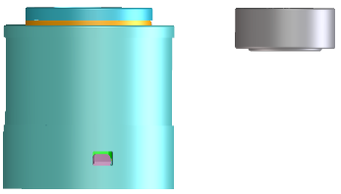
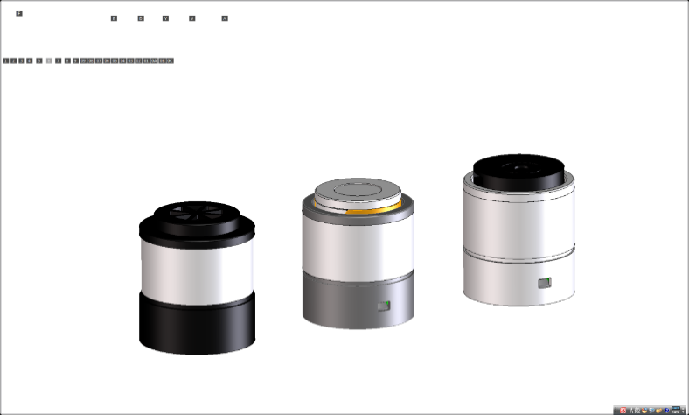
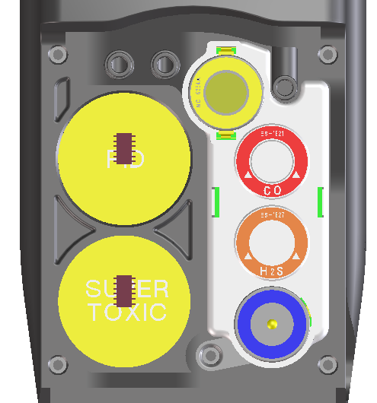
Sensors
Standard 4 gas sensors
CH4 or HC …..NC-6264A
O2 …..OS-BM2
H2S ..…ES-1827i
CO …..ES-1821
Smart sensors
PID …..PIS-00x (White)
ES …..ESS-03xx (Grey)
IR …..DES-3311-x (Black)
*Any two “smart” sensors can be combined in GX-6000, as long as PID sensor is located in the first position of gas through path.

Slide 9

Smart Sensor Gases
PID
Library of over 600 target gases
Iso-Butylene (C4H8) will be a standard calibration gas.
EC (in order of development)
SO2 0-6 ppm
NO2 0-9 ppm
HCN 0-15 ppm
NH3 0-75 ppm
NH3 0-400 ppm
Cl2 0-3 ppm
Cl2 0-10 ppm
IR
CO2 0-5% vol
HC 0-100% LEL
HC 0-30% vol
CH4 0-100% LEL
CH4 0-100% vol
CO2 0-5000 ppm
CO2 0-10000 ppm
*New sensors will be considered after development of above sensors.

Slide 10
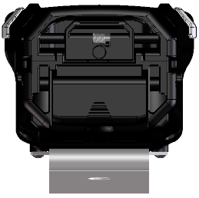
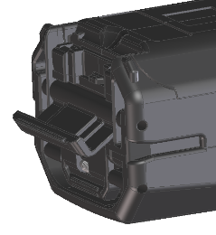
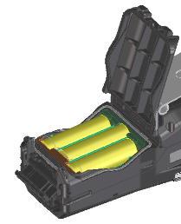
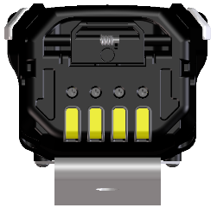
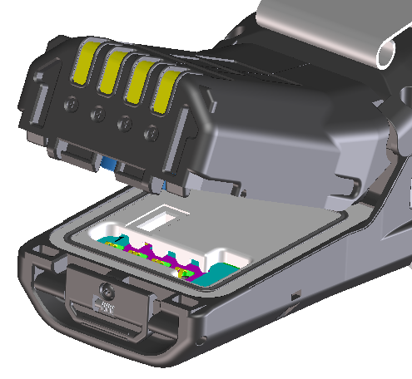
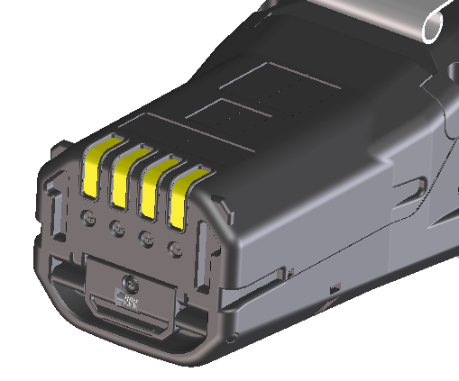
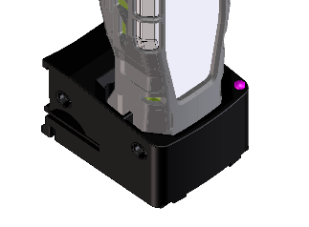
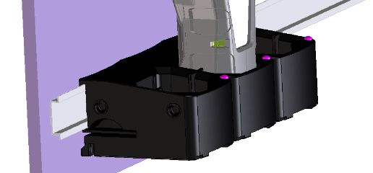
Power Supply
Alkaline
BUD-6000
AA size battery x 3 pieces
More than 8 hours operation
Rechargeable
BUL-6000
More than 14 hours operation
Battery charger BC-6000

Slide 11
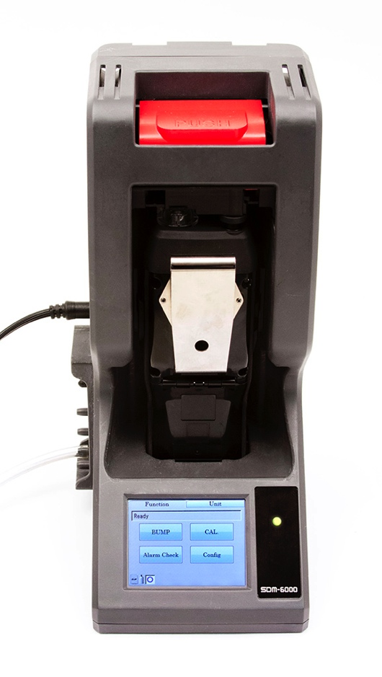
SDM-6000 Docking Station
  Stand alone station (no PC required
  Charge
  Bump, Calibrate, and Alarm tests
  Touch screen menu display
  Save calibration, bump tests, alarm history and exposure data to an SD memory card or to a computer
  Automatically power on or off for scheduled maintenance
  Up to 3 ports for separate calibration gas cylinders
Notes:
Can be connected up to 10 units

Slide 12
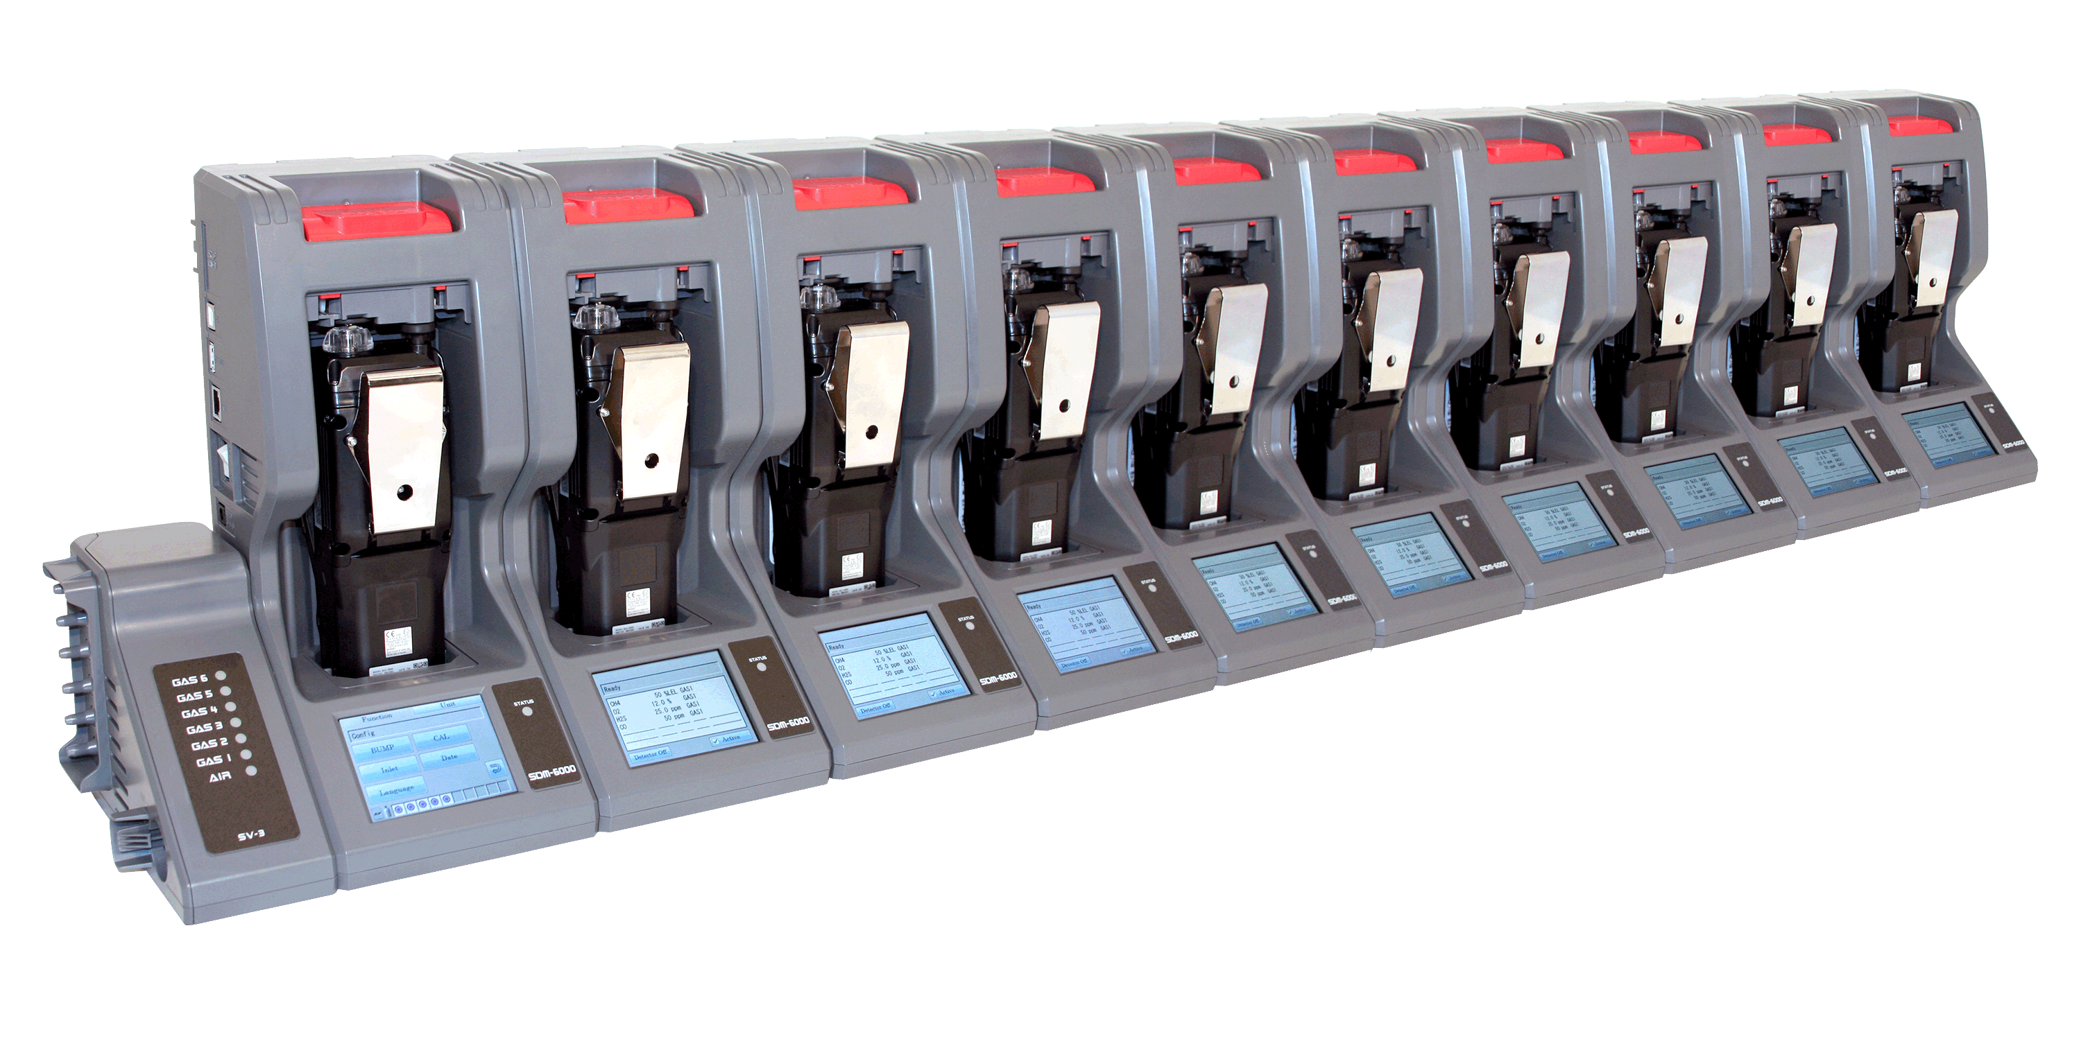
Multi Module System with PC Controller
  Manage up to 10 instruments with one power source, calibration source, and computer
  Configure GX-6000 parameters
  SV-3 unit expands calibration ports up to 6 ports
Notes:
Can be connected up to 10 units

Slide 13
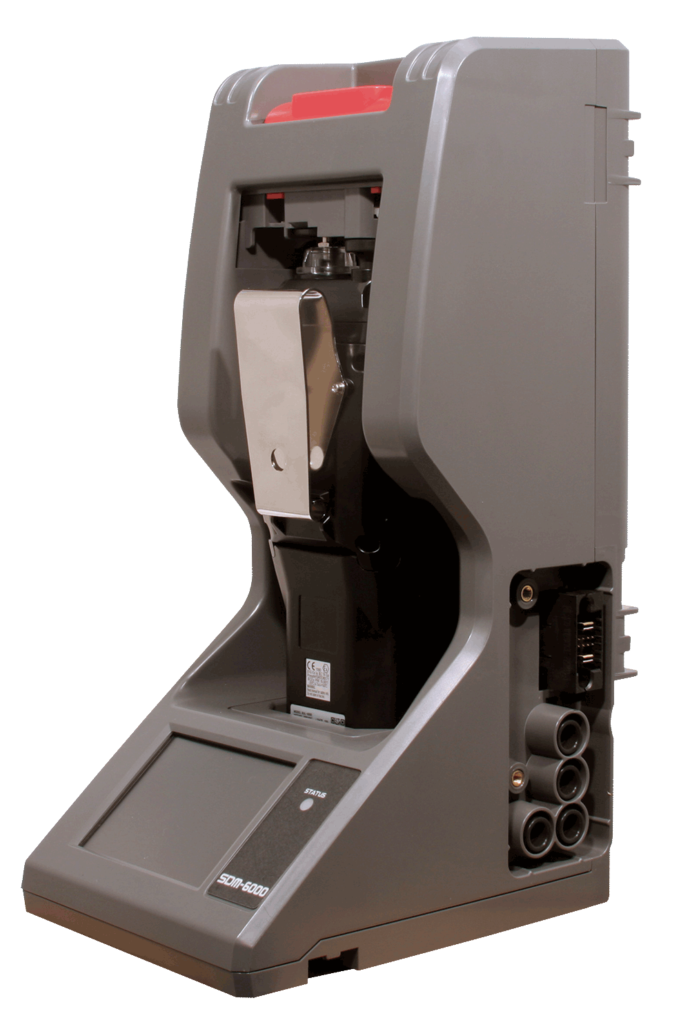
  Easily connects to adjacent docks
  Automatically distributes power, calibration gas, and data once connected
  DIN Rail wall mount
  Local print out of calibration/bump and alarm test results

Slide 14
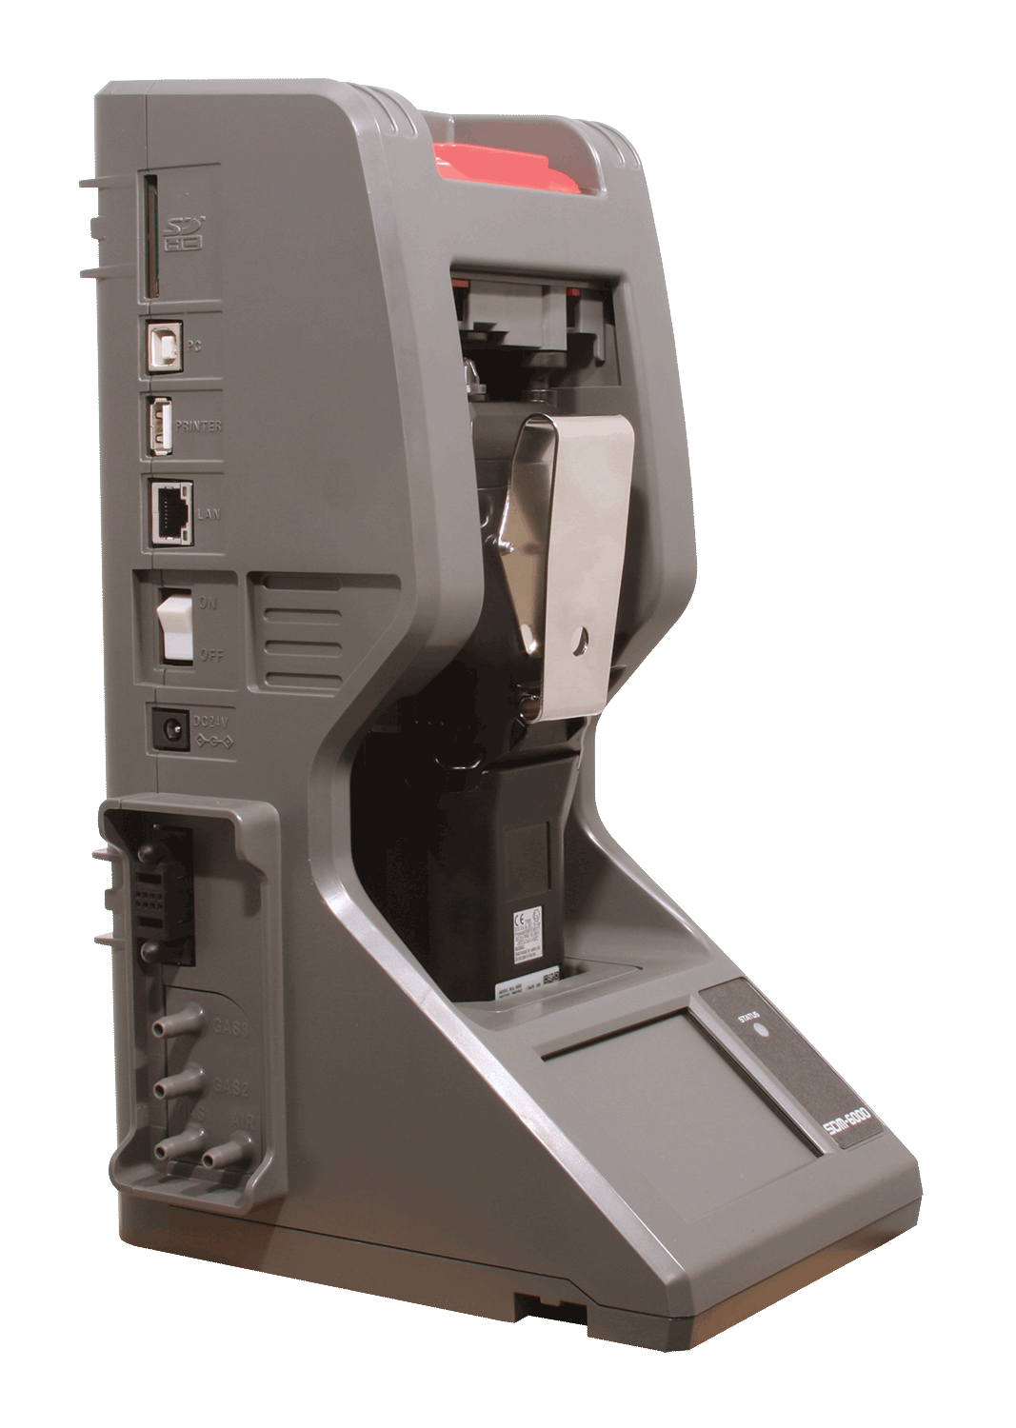
SD / SDHC Memory card slot
USB PC connection
USB Printer connection
LAN connection
Power Switch
AC adaptor
Power/Data Joint Connector
3 calibration gas ports
1 fresh air port

