Slide 1
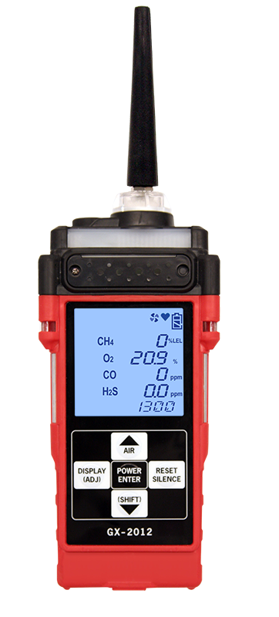
GX-2012
Confined Space Sample Draw Monitor

Slide 2
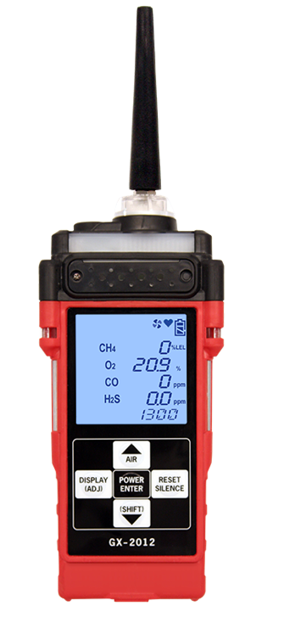
GX-2012
Tapered Nozzle
Buzzer
(more than 95dB)
Alarm Lamp 1
LCD
Alarm Lamp 3
Alarm Lamp 2
IrDA

Slide 3
GX-2012 Features
Monitors Lel, And % Volume Methane, Oxygen, Carbon Monoxide And Hydrogen Sulfide
0-100% Volume Methane Optional
Auto-ranging Display Of % By Volume And % Lel
Internal Sample Drawing Pump
With Up To 50 Foot Range
Vibration, Visual, And Audible Alarms
Automatic Backlight During Alarms
Calibration Reminder With Lock
Out Option
Lithium Or Alkaline Power Source (Interchangeable)
Quick Charge (Fully Charged In 90 Minutes)
Glove Friendly Large Buttons
Alarm Latching Or Non-latching
High Impact Protective Rubber Over Molding
Up To 600 Hours Of Data Logging With Alarm Trends
Auto Calibration Or Single Calibration
Twa And Stel Readings With Lunch-break Mode
Intrinsically Safe, Csa, C/Us Classified, Atex/IECEX Approval
IP-66 Water And Dust Resistant
2 Year Warranty

Slide 4
Specifications
GX-2012 Model
Gas Detected | Combustible Gases (Methane as Standard) | % Volume Methane | Oxygen (O2) | Hydrogen Sulfide (H2S) | Carbon Monoxide (CO)
Detection Principle | Catalytic Combustion | Thermal Conductivity | Galvanic Cell | Electrochemical Cell
Detection Range | 0-100% LEL | 0-100% Vol. | 0-40% Vol. | 0-100 ppm | 0-500 ppm
Accuracy Statement (whichever is greater) | ± 5% of reading or ± 2% LEL | ± 5% of reading or ± 2% of full scale | ±0.5% O2 | ± 5% of reading or ± 2ppm H2S | ± 5% of reading or ± 5ppm CO
Sampling Method | Internal sample pump, flow rate monimal 0.5 LPM, includes hydrophobic filter
Display | Digital LCD with 7 segments, auto backlight during alarm
Preset Alarms (User Adjustable) | 1st Alarm 10% LEL 2nd Alarm 50% LEL Over Alarm 100% LEL | N/A | 1st Alarm 19.5% 2nd Alarm 23.5% Over Alarm 40.0% | 1st 10ppm 2nd 30ppm TWA 10ppm STEL 15ppm Over 100ppm | 1st 25ppm 2nd 50ppm TWA 25ppm STEL 200ppm Over 500ppm
Alarm Types | Gas Alarms: 1st and 2nd (user adjustable), STEL, TWA and Over Trouble Alarms: Sensor connection, low battery, low flow, circuit trouble and calibration error
Alarm Methods | Gas Alarms: Flashing lights, two tone buzzer, and vibration Trouble Alarms: Flashing lights, trouble displayed, intermittent buzzer, and vibration

Slide 5
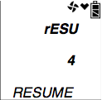
Turning On the Unit, Normal Mode
Press and briefly hold down the POWER ENTER button. Release the button when you hear a beep.
If LNCH BRK is turned on, the Resume Data log Screen displays
  Press and release the POWER ENTER button to continue accumulating time-weighted average (TWA), PEAK readings, and time in operation from the last time the GX-2012 was used. The short-term exposure limit [STEL] reading is reset each time the GX-2012 is turned on.
  Press and release the DISPLAY(ADJ) button to
  reset the accumulation of these measurements.
  If you do not press the POWER ENTER or DISPLAY
  (ADJ) button within 5 seconds, the GX-2012
  automatically resumes accumulating the TWA,
  PEAK readings, and time in operation.

Slide 6
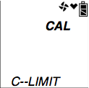
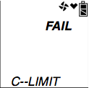
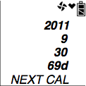
Turning On the Unit, Normal Mode
If CL RMNDR is turned on, the screen that appears next depends on how CL EXPRD is set in the Maintenance Mode Menu
  If the unit is due for calibration and CL EXPRD is set to CONFIRM the alarm LED’s and buzzer will pulse several times. After this, press the RESET SILENCE button until you hear a beep to continue.
  If the unit is due for calibration and CL EXPRD is set to NOT USE the GX-2012 cannot be used until a calibration has been performed either by selecting AUTO CAL or ONE CAL in the Maintenance Mode menu.
  If calibration is not due or CL EXPRD is set to NO EFFECT, then a screen appears for a few seconds indicating when the next calibration is due.

Slide 7
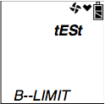
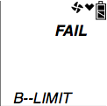
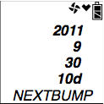
Turning On the Unit, Normal Mode
If BP RMNDR is turned on, the screen that appears next depends on how BP EXPRD is set in the Maintenance Mode Menu
  If the unit is due for a bump test and BP EXPRD is set to CONFIRM the alarm LED’s and buzzer will pulse several times. After this, press the RESET SILENCE button until you hear a beep to continue
  If the unit is due for a bump test and BP EXPRD is set to NOT USE the GX-2012 cannot be used until a bump test has been performed by selecting BUMP in the Maintenance Mode menu.
  If a bump test is not due or BP EXPRD is set to NO EFFECT, then a screen appears for a few seconds indicating when the next bump test is due.

Slide 8
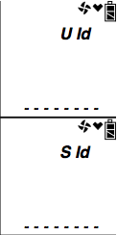
Turning On the Unit, Normal Mode
If ID DISP is turned on, the User ID Screen displays for a few seconds and then the Station ID Screen displays for a few seconds.

Slide 9
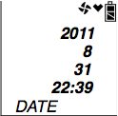
Turning On the Unit, Normal Mode
The Date/Time Screen appears for a few seconds.

Slide 10
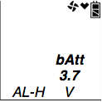
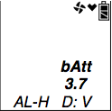
Turning On the Unit, Normal Mode
The Battery Level and Alarm Pattern Screen appears next.
  AL -- H indicates latching (hold) alarms and AL -- A indicates self- resetting (automatic) alarms. The number shown indicates the voltage of the batteries (A fully charged lithium ion battery pack will display 3.7 V).
  If the unit is powered by alkaline (dry cell) batteries, a “D” will appear in front of the “V” in the lower right corner.

Slide 11
Turning On the Unit, Normal Mode
The display then indicates the following items for about a second each:
Full scale values for all channels
Warning set point (low gas alarm) for all channels
Alarm set point (high gas alarm) for all channels
STEL alarm set point for the CO and H2S channels
TWA alarm set point for the CO and H2S channels

Slide 12
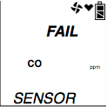
Turning On the Unit, Normal Mode
If the GX-2012 experiences a sensor failure during start up, a screen indicating which sensor failed displays
  press and release the RESET SILENCE button to acknowledge the failure. The gas reading for the failed sensor will be replaced by “---”. Replace the failed sensor as soon as possible

Slide 13
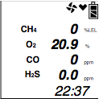
Turning On the Unit, Normal Mode
The GX-2012 is now operating in Normal Mode and monitoring for gas in Measuring Mode.

Slide 14
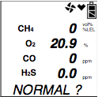
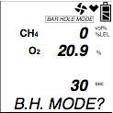
Turning On the GX-2012 in Normal Mode With All Modes Active
The following description of the GX-2012 start up sequence assumes that the following menu items in Maintenance Mode are turned on: LB MODE:
  Press and briefly hold down the POWER ENTER button. The Normal Mode Select Screen displays
  You can use the AIR▲ or (SHIFT)▼ button to scroll to the Bar Hole Mode Select Screen. You can also use the AIR▲ or (SHIFT)▼ buttons to move back and forth between the two screens.
  With the Normal Mode Select Screen displayed, press and release the POWER ENTER button and continue with the startup sequence as described in the previous section.
  To exit Normal Mode and return to the Mode Select Screen, press and hold the (SHIFT)▼ button for 5 seconds while in the Normal Operation Screen.

Slide 15
Performing a Fresh Air Adjustment
Before using the GX-2012, it is recommended to set the fresh air readings for the target gases by performing a fresh air adjustment. This will set the combustible gas, CO, and H2S channels to zero and the OXY channel to 20.9%
  Find a fresh-air environment. This is an environment free of toxic or combustible gases and of normal oxygen content (20.9%).
  Turn on the unit.
  Press and hold the AIR▲ button. The display prompts you to hold the AIR▲ button.
  Continue to hold the AIR▲ button until the display prompts you to release the AIR▲ button. The GX-2012 will count down from 8 on an auto ranging combustible gas channel as it sets the fresh air reading for all channels. Once the countdown has finished, start up is complete and the unit is ready for monitoring.

Slide 16
Display Mode
To enter Display Mode, press and release the DISPLAY (ADJ) button while in Measuring Mode. To scroll from one screen to the next press and release the DISPLAY (ADJ) button
  Each screen displays for 20 seconds. If you do not press the DISPLAY (ADJ) button to scroll to the next screen or press the POWER ENTER button to enter an item within 20 seconds, the GX-2012 returns to Measuring Mode

Slide 17
Display Mode
In the Display Mode, you can:
set the combustible gas channel range (if unit has % LEL and % Vol Sensors)
  Can select the display units for the combustible channel as % LEL/% volume auto ranging or % volume
display peak readings
  The Peak Screen displays the highest (lowest for O2) concentrations detected since the GX-2012 was turned on
display STEL and TWA readings (H2S and CO only)
  The STEL reading is the average reading during the last 15 minutes
  The TWA reading is the average reading during the last 8 hours
display full scale, warning, alarm, STEL, and TWA (H2S and CO only) values
  The Alarm Points Screen allows you to view each channel’s alarm settings for full scale, warning, alarm, STEL (for CO and H2S only),and TWA (for CO and H2S only). The bottom line of the screen will alternate between ALARM--P, NO /DISP, and YES/ENT.
  Pressing and releasing POWER ENTER while in a settings screen will cause the instrument to simulate that condition. The buzzer, LEDs, and vibration will activate. Press and release POWER ENTER again to stop the simulated alarm.
display time in operation
display the date and time

Slide 18
Display Mode
display remaining log time
  remaining log time screen displays the time remaining until the data logger memory is full
Factory Set

Slide 19
Display Mode
clear the data logger
  Allows user to clear the data logger storage
turn the pump on or off
  pump can be turned on and off in this screen (only if activated, default is “OFF”)
select a user ID
  The screen displays only if ID DISP in the Maintenance Mode menu is set to “ON”
  Each ID contains 8 characters
  The bottom l of the screen alternates between YES/ENT., the current user ID, and NO /DISP. Uppercase letters, numbers, asterisks (*), dashes (-), and a blank space are available characters. The GX-2012 can store 128 user IDs.

Slide 20
Display Mode
select a station ID
  After entering Display Mode and proceeding to the Station ID screen, press and hold the POWER ENTER button. The bottom line of this screen alternates between YES/ENT., the current station ID, and NO /DISP.
  Use the AIR▲ and (SHIFT)▼buttons to scroll through the 128 possible station IDs.
  Press the POWER ENTER button to select a station ID.
display snap logging data

Slide 21
Snap Logging
Snap Logging Function
  Logging a instantaneous value of measuring
  Can store up to 256 cases
Press and hold the ▲AIR and (SHIFT)▼ buttons until you hear a beep.
The following screens will scroll through.
  The first screen displays what snap log ID will be given to this particular set of data.
  The second screen displays the year, month, day, and time of the snap log.
  The third screen displays the gas concentrations that will be saved in this snap log.

Slide 22
Snap Logging
To take a snap log of the data, press and release the POWER ENTER button. The unit will display END along the bottom of the screen before returning to the Normal Operation Screen.
To exit the set of screens without taking a snap log, press and release the DISPLAY (ADJ) button.
The unit will immediately return to the Normal Operation Screen.
The data recorded by snap logs can be viewed in Display Mode.

Slide 23
Display Mode
turn peak bar function on or off
  allows user to turn the peak bar on or off
  If the function is turned on, the peak bar appears along the left side of the screen during Normal Operation and on the Peak Screen in Display Mode. It shows the peak readings for each channel in bar graph format

Slide 24
Alarm Types and Indications
Alarm Type | Visual Indications | Other Indications
Low Alarm (Concentrations of gas rises above the Warning level, or falls below the Low Alarm level for O2) | WARNING appears below the gas list Reading for the gas in alarm flashes Alarm LED arrays flash Backlight turns on | Buzzer sounds alternating between a low and high pitch Vibrator pulses
High Alarm (Concentration of gas rises above the Alarm level, or rises above the High Alarm level for O2) | ALARM appears below the gas list Reading for the gas in alarm flashes Alarm LEDs flash faster than warning indication Backlight turns on | Buzzer sounds alternating between a low and high pitch faster than warning indication Vibrator pulses faster than warning indication
TWA of STEL (Concentration of CO or H2S rises above the TWA or STEL alarm point setting) | TWA or STEL appears below the gas list Alarm LED arrays flash Backlight turns on | Buzzer sounds alternating between a low and high pitch at the same rate as the warning indication Vibrator pulses at the same rate as warning indication
Over Range | Gas reading replaced by brackets flashing at same rate as alarm indication Alarm LEDs flash at the same rate as alarm indication Backlight turns on OVER appears below the gas | Buzzer sounds alternating between a low and high pitch at the same rate as the alarm indication Vibrator pulses at the same rate as alarm indication

Slide 25
Alarm Types and Indications
Alarm Type | Visual Indications | Other Indications
Low Flow* | The display indicates FAIL LOW FLOW The Alarm LEDs flash | Buzzer sounds a double pulsing tone (two pulses in quick succession)
Low Battery Warning* | Battery icon blinks | None
Dead Battery Alarm* | Gas reading replaced by FAIL Fan Symbol disappears BATTERY displayed along bottom of the screen Alarm LED arrays flash | Buzzer sounds a double pulsing tone (two pulses in quick succession)
Clock Failure* | FAIL CLOCK appears on the display Alarm LED arrays flash | Buzzer sounds a double pulsing tone (two pulses in quick succession)
System Failure* | FAIL SYSTEM appears on the display Alarm LED arrays flash | Buzzer sounds a double pulsing tone (two pulses in quick succession) A failure code appears
Microprocessor Failure* (Note: the unit will not operate if this alarm occurs) | Heart indicator is steadily on or not on at all | None
*This alarm can also occur in Bar Hole Mode

Slide 26
GX-2012
Maintenance & Factory Modes

Slide 27
Using Maintenance Mode
Take the GX-2012 to a non-hazardous location, and turn it off if it is on.
Press and hold the AIR▲ and (SHIFT)▼ buttons, then press and hold the POWER ENTER button. When you hear a beep, release the buttons. The unit will prompt you for a password.
Enter the password by using the AIR▲ and (SHIFT)▼ buttons to select each password number and then pressing and releasing POWER ENTER to enter it and move on to the next one.
  A password is always needed to enter Maintenance Mode even if the PASSWORD menu item in Maintenance Mode has been turned off (factory setting). The factory set password is 2102. You may change this password by entering the PASSWORD menu item in Maintenance Mode.

Slide 28
Maintenance Mode
Once you enter Maintenance Mode, MAINTENANCE will appear along the top of the screen. The Date Screen displays.
Use the AIR▲ or (SHIFT)▼ button to move through the menu item screens.

Slide 29
MAINTENANCE MODE
DATE – updating the date and time settings
AIR CAL – perform a fresh air adjustment
AUTO CAL – allows calibration of the standard four gases (LEL, O2, CO & H2S)
ONE CAL – allows calibration for a single sensor
BUMP - The BUMP menu item will not appear unless BUMP DSP is set to “ON” (the factory setting is “OFF”).
LNCH BRK - on/off
  With LNCH BRK “OFF” (factory setting), the GX-2012 automatically starts new TWA and PEAK reading collection and resets the time in operation at startup
  With LNCH BRK “ON”, the Resume Measurements Screen displays during startup. From this screen, you can choose to continue accumulating TWA and PEAK readings and the time in operation from the last time the GX-2012 was used or start collecting new readings and reset the time in operation.
LATCHING - latching/non-latching
  With LATCHING set to ON (factory setting), the GX-2012 remains in alarm condition until the alarm condition passes and the POWER ENTER button is pressed.
  With LATCHING set to OFF, the GX-2012 automatically resets an alarm when the alarm condition passes.
ALM SLNC - on/off
  With ALM SLNC set to ON (factory setting), pressing and releasing the RESET SILENCE button silences the buzzer when the GX-2012 is in alarm. The LEDs continue to flash and the display continues to show the alarm until the reset button is pushed after the alarm condition has passed.
  With ALM SLNC set to OFF, you cannot silence the buzzer. If an alarm condition occurs, and you enter Display Mode, the buzzer will not be silenced and the LEDs will continue to flash until the reset button is pushed after the alarm condition has passed.
LG INTVL - interval trend time setting
  10 minutes, 5 minutes (factory set), 3 minutes, 1 minute, 30 seconds, 20 seconds, or 10 seconds

Slide 30
MAINTENANCE MODE
ALARM--P - alarm point setting
DLOG DSP - data logger clear screen display setting
BUMP DSP - bump feature setting
  If “OFF”, the bump menu item in Calibration Mode and Maintenance Mode does no appear. In addition, the BUMP—SET, BP INTVL, BP RMNDR, and BP EXPRD menu items will not display in Maintenance Mode (the factory setting is OFF)
POFF DSP - When set to ON, the Pump Off Screen appears in Display Mode and the user can turn off the pump in order to conserve battery power. If set to OFF (factory setting), the Pump Off Screen does not appear in Display Mode and the user cannot turn the pump off.
BUMP -- SET - used to adjust the bump test parameters
  Press and release the POWER ENTER button. The values displayed are for GAS TIME, CHECK (bump test tolerance), CAL TIME, and AUTO CAL. The cursor on the left of the screen shows which setting is associated with the parameter shown at the bottom of the screen. Use the AIR or (SHIFT) buttons to scroll up or down along the list

Slide 31
MAINTENANCE MODE
To update the GAS TIME setting, with the cursor next to the gas time and with GAS TIME displayed along the bottom of the screen, press POWER ENTER. The factory setting is 30 seconds. The value will begin to flash. Use the AIR or (SHIFT)␣buttons to select a new gas time (30, 45, 60, and 90 seconds). Then press POWER ENTER.
To update the bump test tolerance, use the (SHIFT) button to scroll to the CHECK value. The factory setting is 30%(optional values are10, 20, 30, 40, and 50%).This is the bump test tolerance value and is represented as a percentage. If the bump test reading differs more, the bump test will fail (10, 20, 30, 40, and 50%). Then press POWER ENTER.
To update the CAL TIME setting, use the (SHIFT) button to scroll to the CAL TIME value. The factory setting is 90 seconds (can select either 90 or 120 second.
To update the AUTO CAL setting, use the (SHIFT)␣button to scroll to the AUTO CAL value. The factory setting is ON. With AUTO CAL set to ON, if a bump test fails, the unit will automatically begin a calibration. If AUTO CAL is set to OFF and a bump test fails, nothing will happen.

Slide 32
Maintenance Mode
BEEP. SET – updating the confirmation beep setting
  With BEEP. SET set to ON, the GX-2012 beeps once every 5 minutes to verify that it is operating.
  With BEEP. SET set to OFF (factory setting), the GX-2012 does not sound a confirmation beep.
OVER WRT - data logging over write setting
  With OVER WRT set to ON (factory setting), the GX-2012 writes over the oldest data with new data when the data logger memory is full.
  With OVER WRT set to OFF, the GX-2012 stops saving data to the data logger when the data logger memory is full.
CL INTVL - calibration interval setting
  The minimum setting is 1 day and the maximum setting is 255 days (The factory setting is 90 days).
CL RMNDR - calibration remainder on/off
  If “ON” (factory setting), the GX-2012 will give an indication at start up if it is due for calibration
CL EXPRD - calibration expired performance setting
  Confirm, Not Use of No Effect (if CL RMNDR is set to “ON”)

Slide 33
MAINTENANCE MODE
C--CHECK - calibration reminder 4 gas/ALL setting
BP INTVL – minimum setting is 0 days and the maximum setting is 30 days
BP RMNDR – With BP RMNDR set to ON, the GX-2012 will give an indication at start up if it is due for bump testing. The type of indication will depend on the BP EXPRD setting
BP EXPRD – CONFIRM, NOT USE, or NO EFFECT
B--CHECK - BUMP reminder 4 gas/ALL setting
ID DISP - on/off
  If ID DISP set to “ON”, the User ID Screen and Station ID Screens display during start up and in Display Mode (The ID’s can be updated in Display Mode).
  If ID DISP set to “OFF” (factory setting), the User ID Screen and Station ID Screens do not display during start up or in Display Mode.
BCK LGHT - back light lighting time setting
  The minimum setting is 0 seconds; the maximum setting is 255 seconds (the factory setting is 30 seconds).
AUTOZERO - on/off
  If “ON”, the GX-2012 will automatically perform a fresh air adjust when it is turned on (the factory setting is “OFF”).
DEMAND Z - Demand Zero on/off
  allows you to manually perform a fresh air adjust in normal operation by pressing the AIR▲ button (the factory setting is ON).
L./B. MODE - LB Mode setting
  If “OFF” (factory setting), the GX-2012 will automatically enter Normal Mode when it is turned on.
  If “ON” you will be prompted to choose between Normal Mode and Bar Hole Mode when it is turned on.
B.H. TIME - Bar Hole measuring time setting
  30 seconds, 45 seconds or 60 seconds

Slide 34
MAINTENANCE MODE
ROM/SUM - firmware version that is loaded in the instrument and the firmware checksum
PASSWORD - password setting on/off
  If “ON”, the GX-2012 prompts you for a password when you enter Calibration Mode
  If “OFF” (factory setting), no password is required to enter Calibration Mode.
FLOW ADJ - low flow set point adjustment

Slide 35
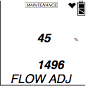
Setting the Flow Adjustment
Entering Maintenance Mode
  Press and hold the AIR and SHIFT buttons, then press the POWER ENTER button and release all when the unit beeps
  First screen will prompt you for the password- Enter 2102
  Press ENTER
Use the Air key to scroll through the menu items
Select FLOW ADJUSTMENT by pressing ENTER
Two values will be displayed
  The top value is a percentage
  The bottom value is the current low flow alarm point (this is the value we are most concerned with)

Slide 36
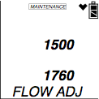
Setting the Flow Adjustment
Using the AIR or SHIFT buttons set this value as close to 1500 (it can be higher or lower) then press the ENTER. The pump will turn back on
The pump will turn on and two new values will be displayed. The top will be a reference value and the bottom will reflect the pump’s current draw.
Connect a flow meter to the inlet of the instrument and adjust it to 0.6 SCFH ± 0.1 SCFH. This will be the low flow set point. You do not need to adjust anything at the instrument. Once the desired low flow set point is set.
Press and release the POWER ENTER button.
Use the SHIFT buttons to select START MEASURMENT to exit

Slide 37
Maintenance Mode
START - start measurement

Slide 38
Using Factory Mode
Take the GX-2012 to a non-hazardous location, and turn it off if it is on.
Press and hold the RESET/SILENCE, (SHIFT)▼ and DISPLY/(ADJ)buttons, then press and hold the POWER ENTER button. When you hear a beep, release the buttons. The unit will prompt you for a password.
Enter the password (1994) by using the AIR▲ and (SHIFT)▼ buttons to select each password number and then pressing and releasing POWER ENTER to enter it and move on to the next one.

Slide 39
Using Factory Mode
Once you enter Factory Mode, MAINTENANCE will appear along the top of the screen. The Date Screen displays.
Use the AIR▲ or (SHIFT)▼ button to move through the menu item screens.

Slide 40
Factory Mode
DATE – updating the date and time setting
GAS COMB - allows the user to turn on/off gas channels
HC SEL. - Select the name of the combustible
  (CH4, i-C4H10)
HC RANGE - Select the range of the combustible
  LEL, VOL, Auto ranging
LATCHING - latching/non-latching
L./B. MODE - LB Mode setting
B.H. TIME - Bar Hole measuring time setting
ZR FLLWR - on/off

Slide 41
Factory Mode
ALM SLNC - on/off
LNCH BRK - on/off
LG INTVL - Interval trend time setting
DLOG DSP - data logger clear screen display setting
BUMP DSP - bump feature setting
ROM/SUM - ROM Number
A/D VAL
FLOW ADJ -low flow set point adjustment

Slide 42
Factory Mode
DSP AL--P - Full scale/Alarm point (alarm test)
DEFAULT
START - Start Measurement

Slide 43
GX-2012 & Gas Tracer
Bump Test & Calibration

Slide 44
Bump Testing
From Measuring Mode, enter Calibration Mode by pressing and holding the (SHIFT)▼ button, then pressing the DISPLAY(ADJ) button and releasing both.
  If the unit prompts you for the password, enter it by using the AIR▲ and (SHIFT)▼ buttons to select each password number and then pressing and releasing POWER ENTER to confirm it and move on to the next number. The factory set password is the same as the factory set password for Maintenance Mode: 2102.
  Note: The PPM sensor in the Gas Tracer needs to be calibrated and bump tested separately. The PPM CAL menu item must be used.

Slide 45
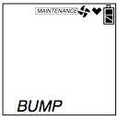
Bump Testing
MAINTENANCE will appear along the top of the screen
Use the AIR▲ or (SHIFT)▼ buttons to display the BUMP menu item. Press the POWER/ENTER button.

Slide 46
Bump Testing
The gases will then be displayed
Press the POWER/ENTER button to continue
Connect the tubing from the demand flow regulator to the inlet fitting of the unit.
At the end of the countdown, if the bump test passed, PASS will be displayed. If the bump test failed and auto calibration is on, the unit will automatically begin performing a calibration.
Once the calibration has ended, the unit will display the results.
With the BUMP menu option displayed, press the (SHIFT)▼ button until the NORMAL menu option is displayed.

Slide 47
Calibration Procedures
GX-2012 & Gas Tracer

Slide 48
Auto Calibration Mode
From Measuring Mode, enter Calibration Mode by pressing and holding the (SHIFT)▼button, then pressing the DISPLAY(ADJ) button and releasing both
If the unit prompts you for the password, enter it by using the ▲AIR and (SHIFT)▼ buttons to select each password number and then pressing and releasing POWER ENTER to confirm it

Slide 49
Auto Calibration Mode
MAINTENANCE will appear along the top of the screen once you have entered Calibration Mode. The first item in the calibration menu, AIR CAL, displays.

Slide 50
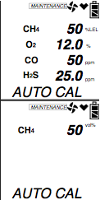
Auto Calibration Mode
Use the ▲AIR and (SHIFT)▼buttons to display the AUTO CAL menu item, press and release the POWER ENTER button to display the calibration values screen.
  Use the ▲AIR or (SHIFT)▼ buttons to view the vol% calibration concentration.
The gas concentrations displayed in the calibration values screen must match the gas concentrations listed on the 4-gas calibration cylinder.

Slide 51
Auto Calibration Mode
If one or more concentrations do not match, continue with the following:
To adjust the values on the screen, hold down the (SHIFT)▼ button, then press the DISPLAY(ADJ) button and release both.
  The units for the combustible gas channel begin to flash
If necessary, use the ▲AIR and (SHIFT)▼ buttons to set the correct combustible gas units (vol% or %LEL)
Press and release the POWER ENTER button.
  The combustible gas channel’s calibration value will flash
If necessary, use the ▲AIR and (SHIFT)▼ buttons to set the correct combustible gas calibration value
Press ENTER when finished.
Use the ▲AIR button to scroll to the oxygen channel settings.
  There are no units to change for the remaining channels so only the calibration gas value will blink when you press ENTER.
NOTE: The RKI Four Gas Cylinder typically contains 12% O2 by volume. Be sure to set the “OXY” reading to agree with the concentration listed on the cylinder’s label, not zero
Repeat steps above to set the correct values for the remaining channels. Use the ▲AIR button to scroll through the different channels. After the last channel is set, use the ▲AIR button to scroll to ESCAPE and press ENTER.

Slide 52
Auto Calibration Mode
With the calibration values screen displayed, press the POWER/ENTER button. AUTO CAL begins to flash and the current gas readings are displayed.
  If you want to exit back to the main menu without completing a calibration, press and release the DISPLAY (ADJ) button.
You may only calibrate either the standard 4 gases or the % volume combustible gas sensor at a time.
Once you are finished, you are returned to the initial AUTO CAL screen and must begin the auto calibration process again.

Slide 53
Auto Calibration Mode
Connect the tubing from the gas cylinder to the inlet fitting of the instrument. Allow the gas to flow for one minute.
Press and release the POWER/ENTER button to set the calibration to the programmed values.
If all channels passed calibration, PASS displays along the bottom of the screen, then the calibration menu displays.
If any of the sensors cannot calibrate to the proper value, FAIL displays along the bottom of the screen and the GX-2012 lists the sensor(s) that failed to calibrate. The buzzer and alarm lights activate.
  Press and release the RESET SILENCE button after the buzzer and lights stop to reset the alarm and return to the calibration menu. Attempt to calibrate again. If the failure continues, investigate the cause.
Disconnect the tubing from the inlet fitting of the unit.
Unscrew the demand flow regulator from the calibration cylinder.
If you have a 5 sensor unit and wish to calibrate the %volume sensor, go back to the first step and repeat the process. If you are finished calibrating, use the (SHIFT)▼ button to navigate to the NORMAL menu item, then press and release the POWER ENTER button to return to Measuring Mode

Slide 54
Single Calibration Mode
While in the calibration menu, use the ▲AIR or (SHIFT) ▼ button to navigate to the ONE CAL menu option.
Press and release the POWER/ENTER button to display the single calibration menu.
Use the ▲AIR or (SHIFT)▼ button to display the channel you want to calibrate (in this example the combustible gas % LEL sensor). If you have a 5 sensor unit, pressing the ▲AIR button will display %vol and allow you to calibrate that sensor.
Press and release the POWER/ENTER button. The single calibration screen displays for the sensor you selected. The gas reading flashes.
Connect the tubing from the demand flow regulator to the inlet fitting of the instrument. Allow the calibration gas to flow for one minute.
If necessary, use the ▲AIR and (SHIFT)▼ buttons to adjust the reading to match the concentration listed on the calibration cylinder.
Press and release the POWER ENTER button to save the span value. The LCD will indicate that the calibration has ended, then the single calibration menu displays.
Disconnect the tubing from inlet fitting.
Repeat previous steps for any other channels you want to calibrate. Make sure you use an appropriate calibration cylinder for each channel.
After the last channel is calibrated, disconnect the calibration tubing from the inlet fitting, then unscrew the demand flow regulator from the calibration cylinder.
Use the ▲AIR and (SHIFT)▼ buttons to scroll to ESCAPE in the ONE CAL menu.
With the ONE CAL menu option displayed, press the (SHIFT)▼ button until the NORMAL menu option is displayed.
Press and release the POWER ENTER button to return to Measuring Mode.

Slide 55
GX-2012
Disassembly

Slide 56
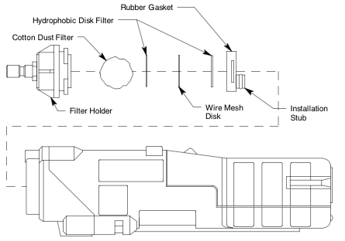
Replacing the Inlet Filters
Verify that the GX-2012 is off
Locate the clear plastic filter holder at the top of the unit
Grasp the filter holder and turn it 1/4 turn counterclockwise
Pull the filter holder away from the case.
  Inspect the cotton dust filter and replace if dirty
There is a cotton ball filter, two hydrophobic disk filters and wire mesh disk located in the case. They are retained by the wire mesh disk
Remove the old hydrophobic filters and/or wire mesh disk from the gasket
  A hydrophobic filter is located on both sides of the wire mesh disk
Assemble in reverse order

Slide 57
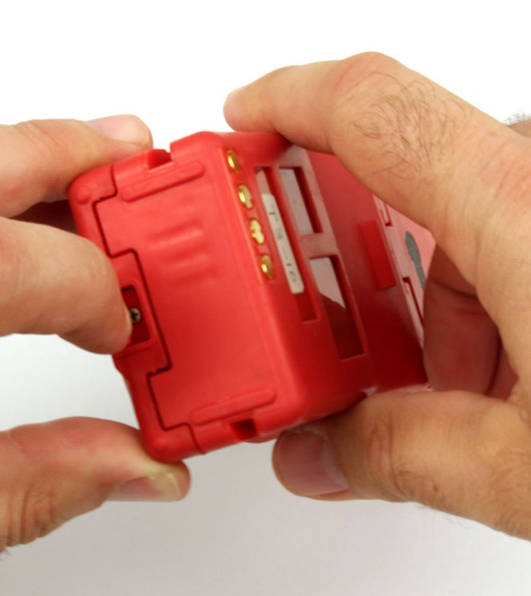
Replacing the Batteries
Turn off the GX-2012
Push the latch on the bottom of the GX-2012 toward the front of the instrument to release the battery pack
Slide

Slide 58
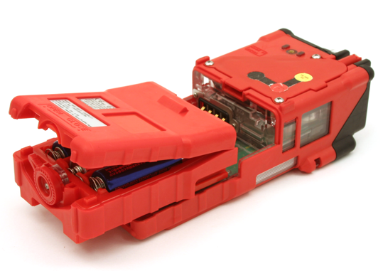
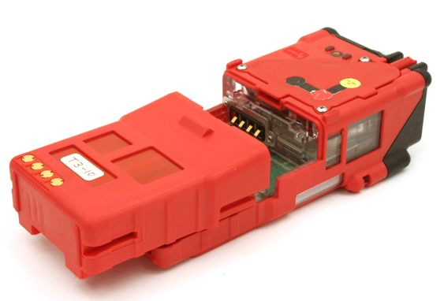
Replacing the Batteries
Alkaline Battery Pack
Slide the battery pack away from the instrument
Insert a new battery pack
  Push the battery pack into the instrument until you hear a click.
Li-Ion Battery Pack

Slide 59
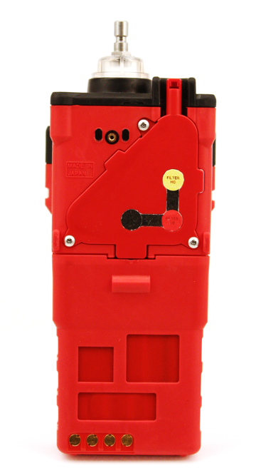
Replacing the Sensors
Use a screwdriver to remove the three screws holding the flow chamber
Grab the exhaust tube and pull it gently away from the unit to slide the flow chamber out of the unit

Slide 60
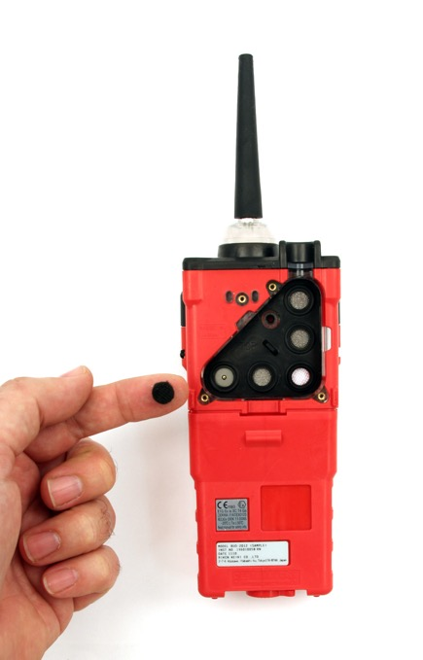

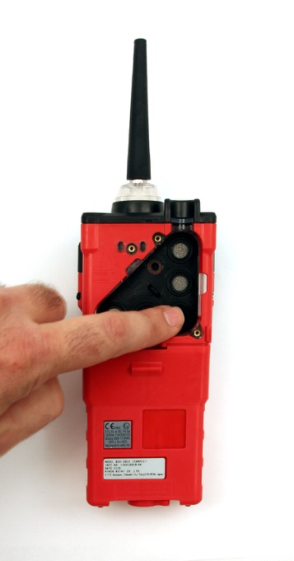
Replacing the Scrubber Filters
Place the charcoal filter over the CO sensor

Slide 61
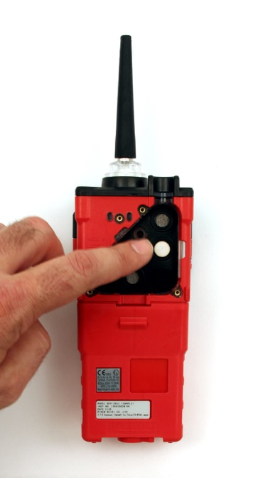
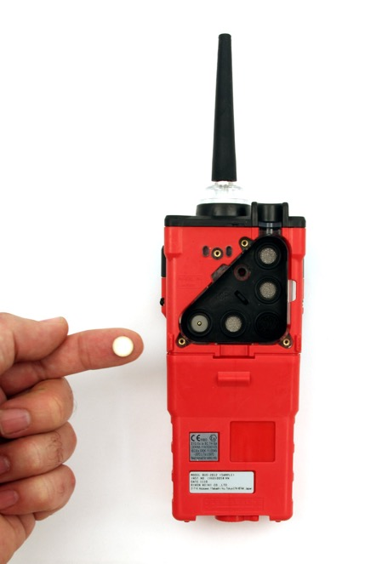
Replacing the Scrubber Filters
Place the H2S Scrubber over the LEL sensor

Slide 62
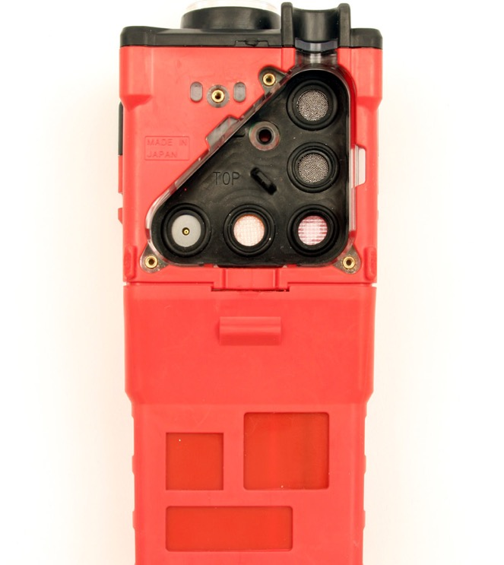
Replacing the Sensors
Gently pull the tab of the sensor gasket to remove it. Be sure not to lose any of the scrubber filters that are currently installed. Note: the sensors will be exposed.
Sensor Filters
Tab

Slide 63
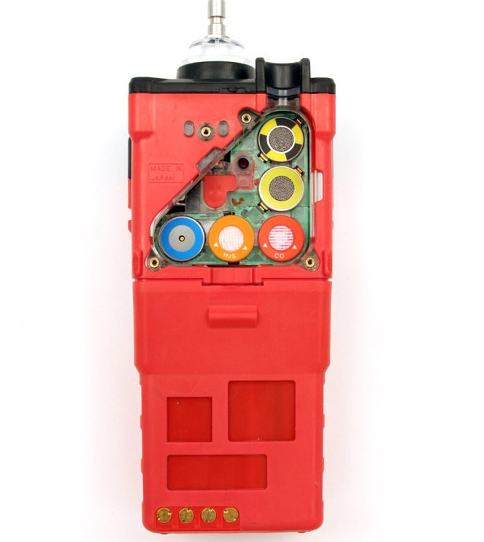
Replacing the Sensors
Remove the sensors from their sockets

Slide 64
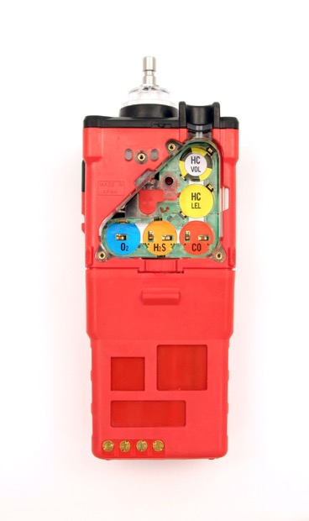
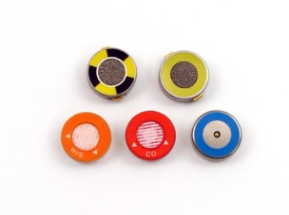
Replacing the Sensors
GX-2012 Sensors
%Volume
Methane
Thermal Conductivity
%LEL
Catalytic
Oxygen
Hydrogen Sulfide
Carbon Monoxide
Carefully insert the replacement sensor in the correct key color coded socket

Slide 65
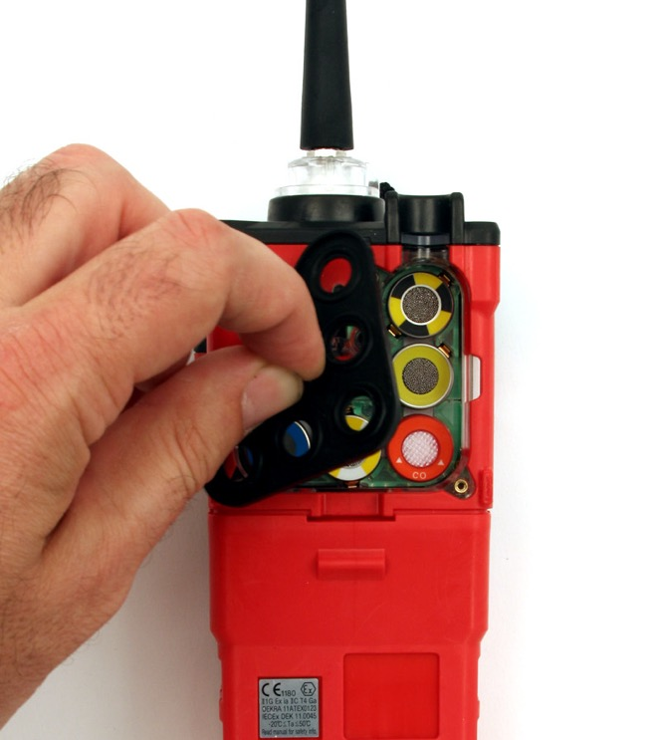
Replacing the Sensors
Place the sensor gasket and filters back into the chamber ensuring that it seals with the sensors and the edge of the chamber
Ensure that the sensor filters are in place
Place the flow chamber in position over the sensor area and press it into the case until it is flush with the back of the case
Place the sensor gasket and filters back into the chamber ensuring that it seals with the sensors and the edge of the chamber.

Slide 66
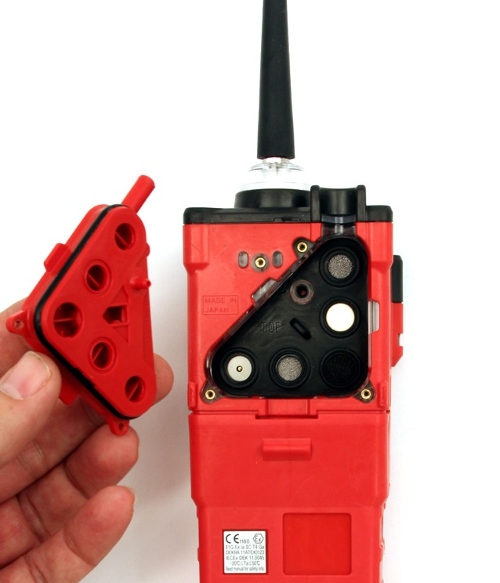
Replacing the Sensors
Place the flow chamber in position over the sensor area and press it into the case until it is flush with the back of the case.
Tighten the top screw of the flow chamber completely.
Place the belt clip into position and tighten the three screws retaining it

Slide 67
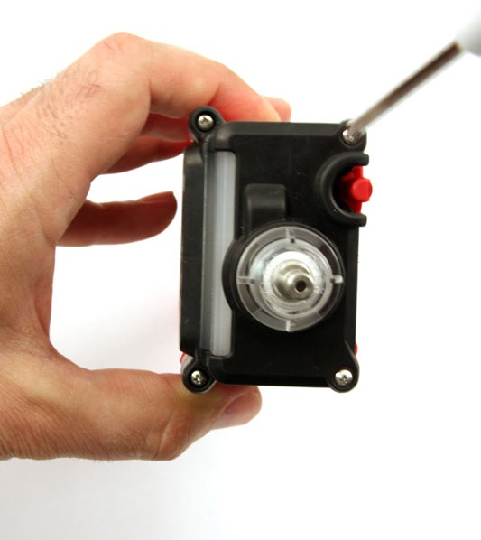
Replacing the Pump
Unscrew the 4 screws in the top of the unit

Slide 68
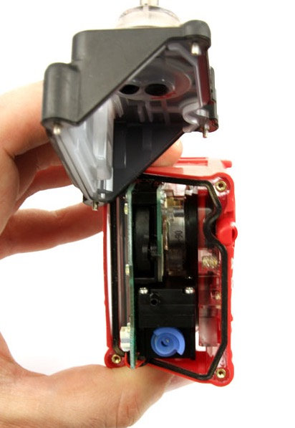
Replacing the Pump
Take off the top cover by pulling straight up

Slide 69
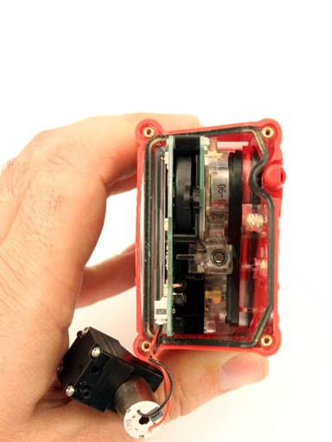
Replacing the Pump
Grasp the pump and gently pull it out of the unit (Note: it is still connected to the board by wires)
Grasp the pump wires and unplug connector
Point at which the pump is connected to the board

Slide 70
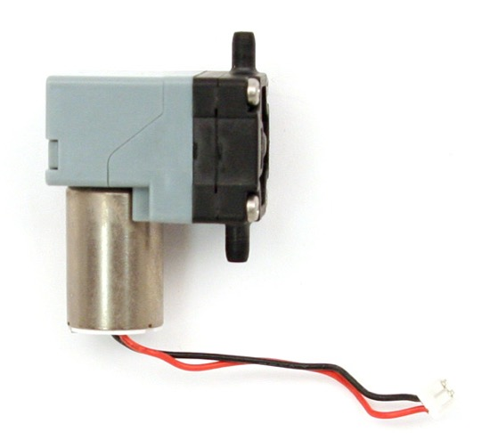
Replacing the Pump
Replace diaphragm or replace the pump
Assemble in reverse order
Disconnected Pump

Slide 71
Replacing the LCD Screen
Use a screwdriver to remove the three screws holding the flow chamber
Grab the exhaust tube and pull it gently away from the unit to slide the flow chamber out of the unit

Slide 72
Replacing the LCD Screen
Remove the sensors from their sockets

Slide 73
Replacing the LCD Screen
Unscrew the 4 screws in the top of the unit

Slide 74
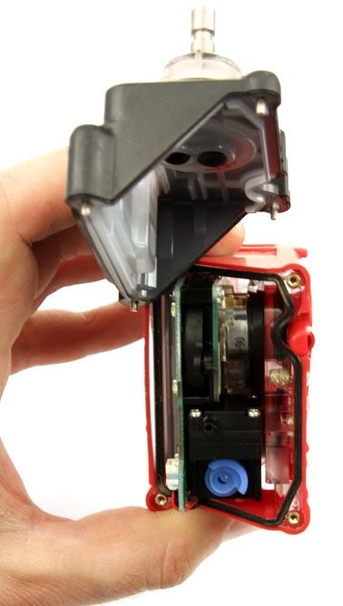
Replacing the LCD Screen
Take off the top cover by pulling straight up

Slide 75

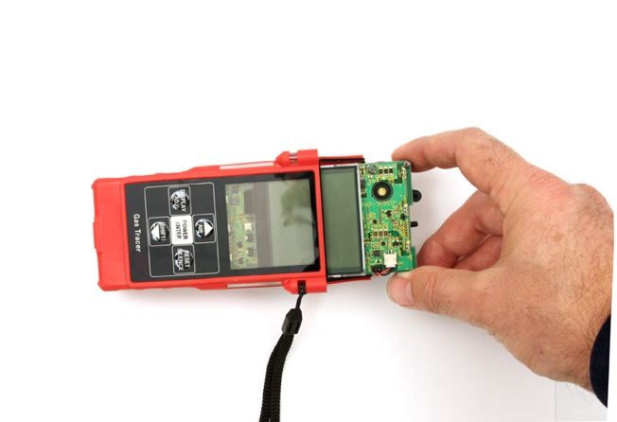
Replacing the LCD Screen
Pull
Once the top is off the unit, gently pull the board out of the top of the unit

Slide 76
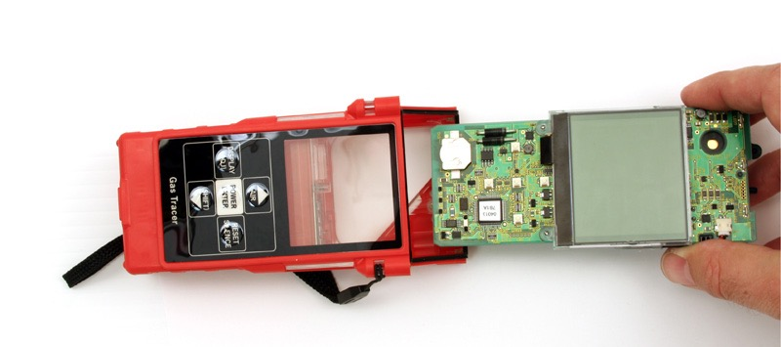
Replacing the LCD Screen
The board should slide out easily

Slide 77
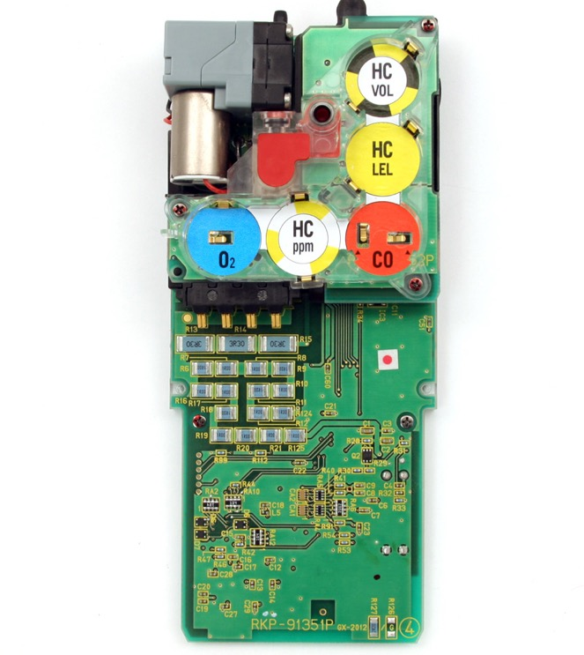
Replacing the LCD Screen
Unscrew the 2 screws holding in the bottom of the LCD screen
Next locate the two tabs on the side of the board, underneath the sensor board
Use a flat head screw driver to gently pry the tabs off the main board
Tabs
Tabs
Screw
Screw

Slide 78
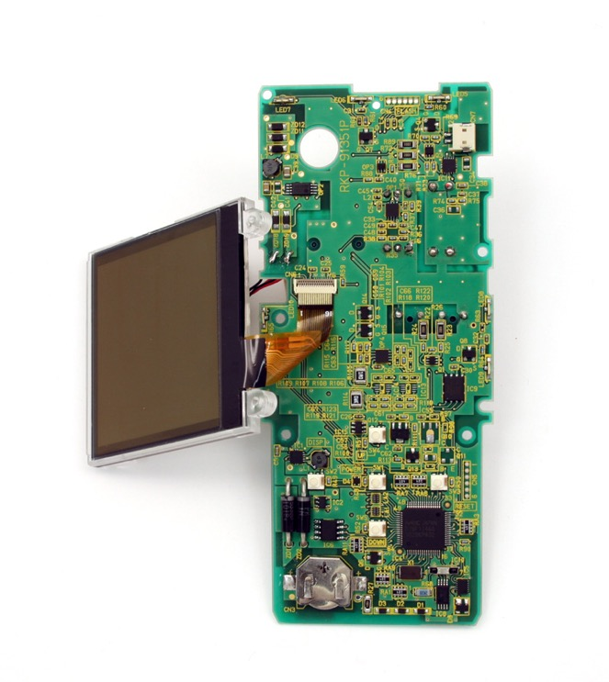
Replacing the LCD Screen
The next step is to remove the ribbon cable and install the new LCD
Assemble in the reverse order
Slide Latch up to release ribbon cable pins

Slide 79
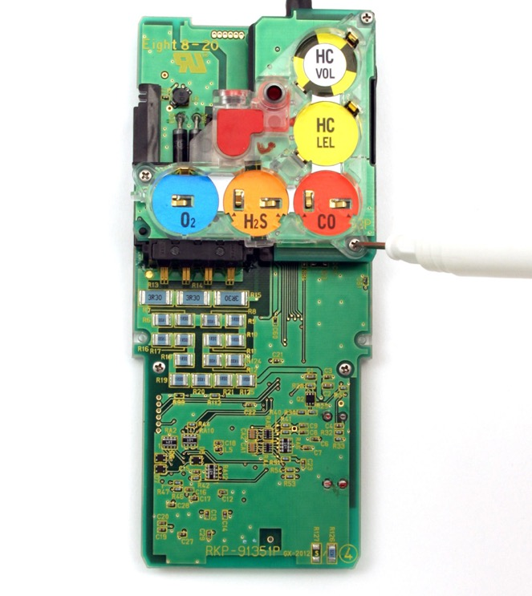
Replacing the Sensor Board
Unscrew the 3 screws holding in the Sensor board

Slide 80
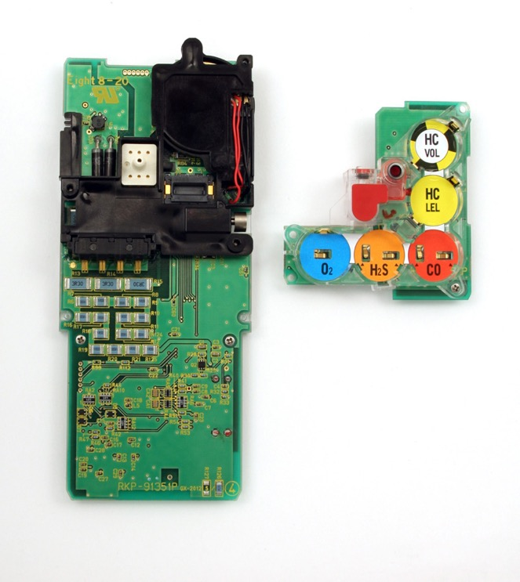
Replacing the Sensor Board
The next step is to remove the sensor board and install new one
Assemble in the reverse order

Slide 81
Questions?

