Slide 1
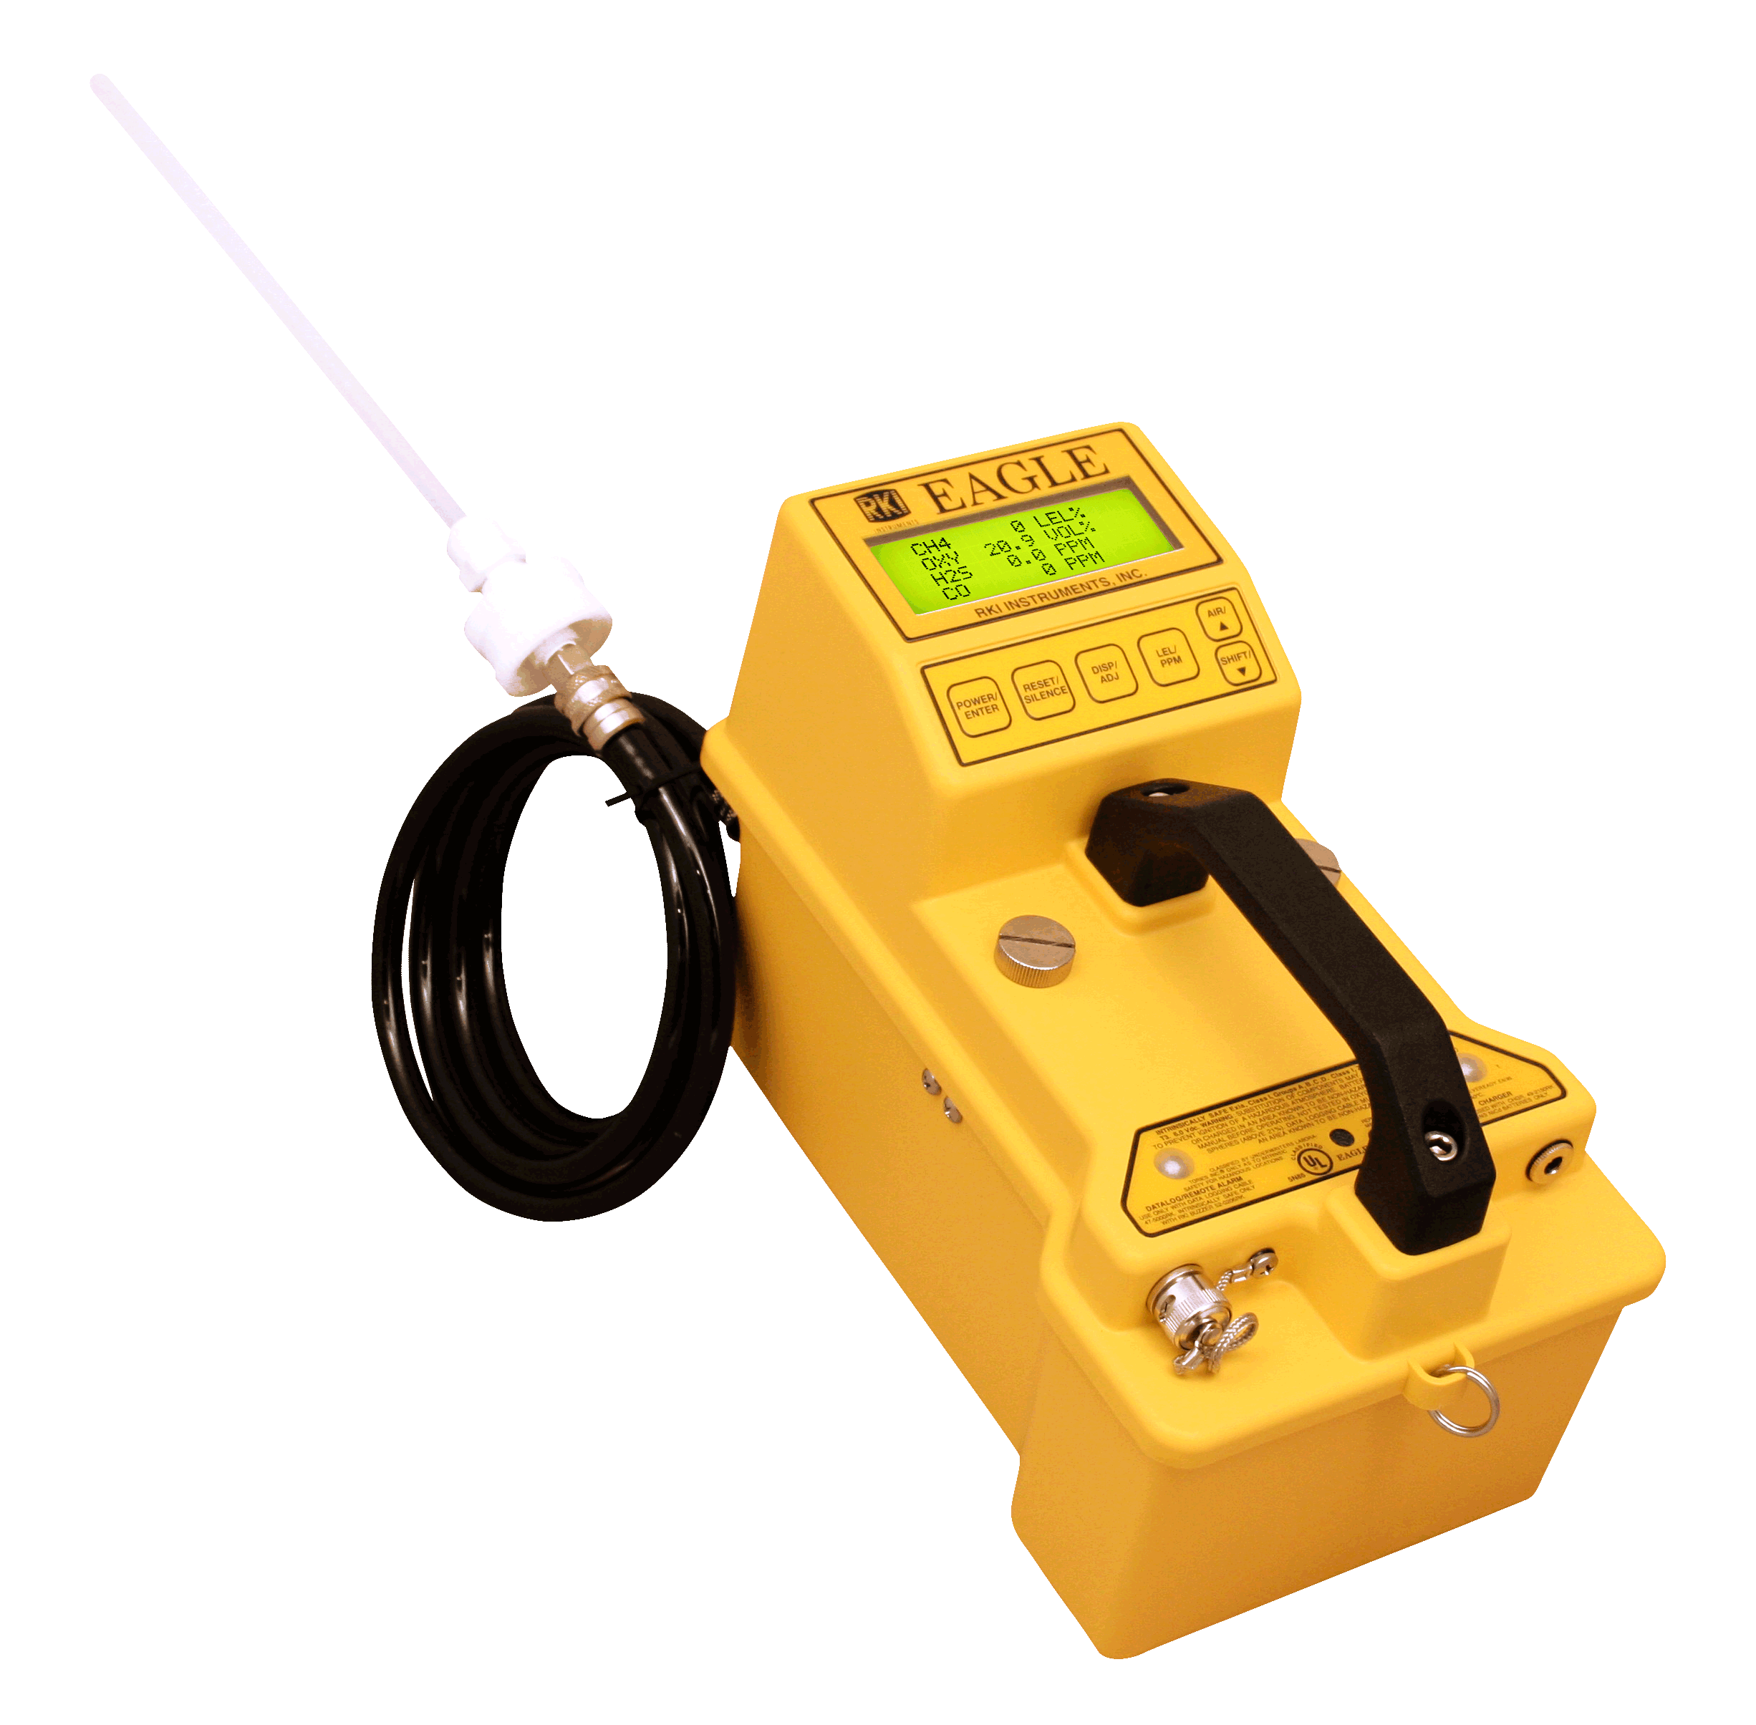
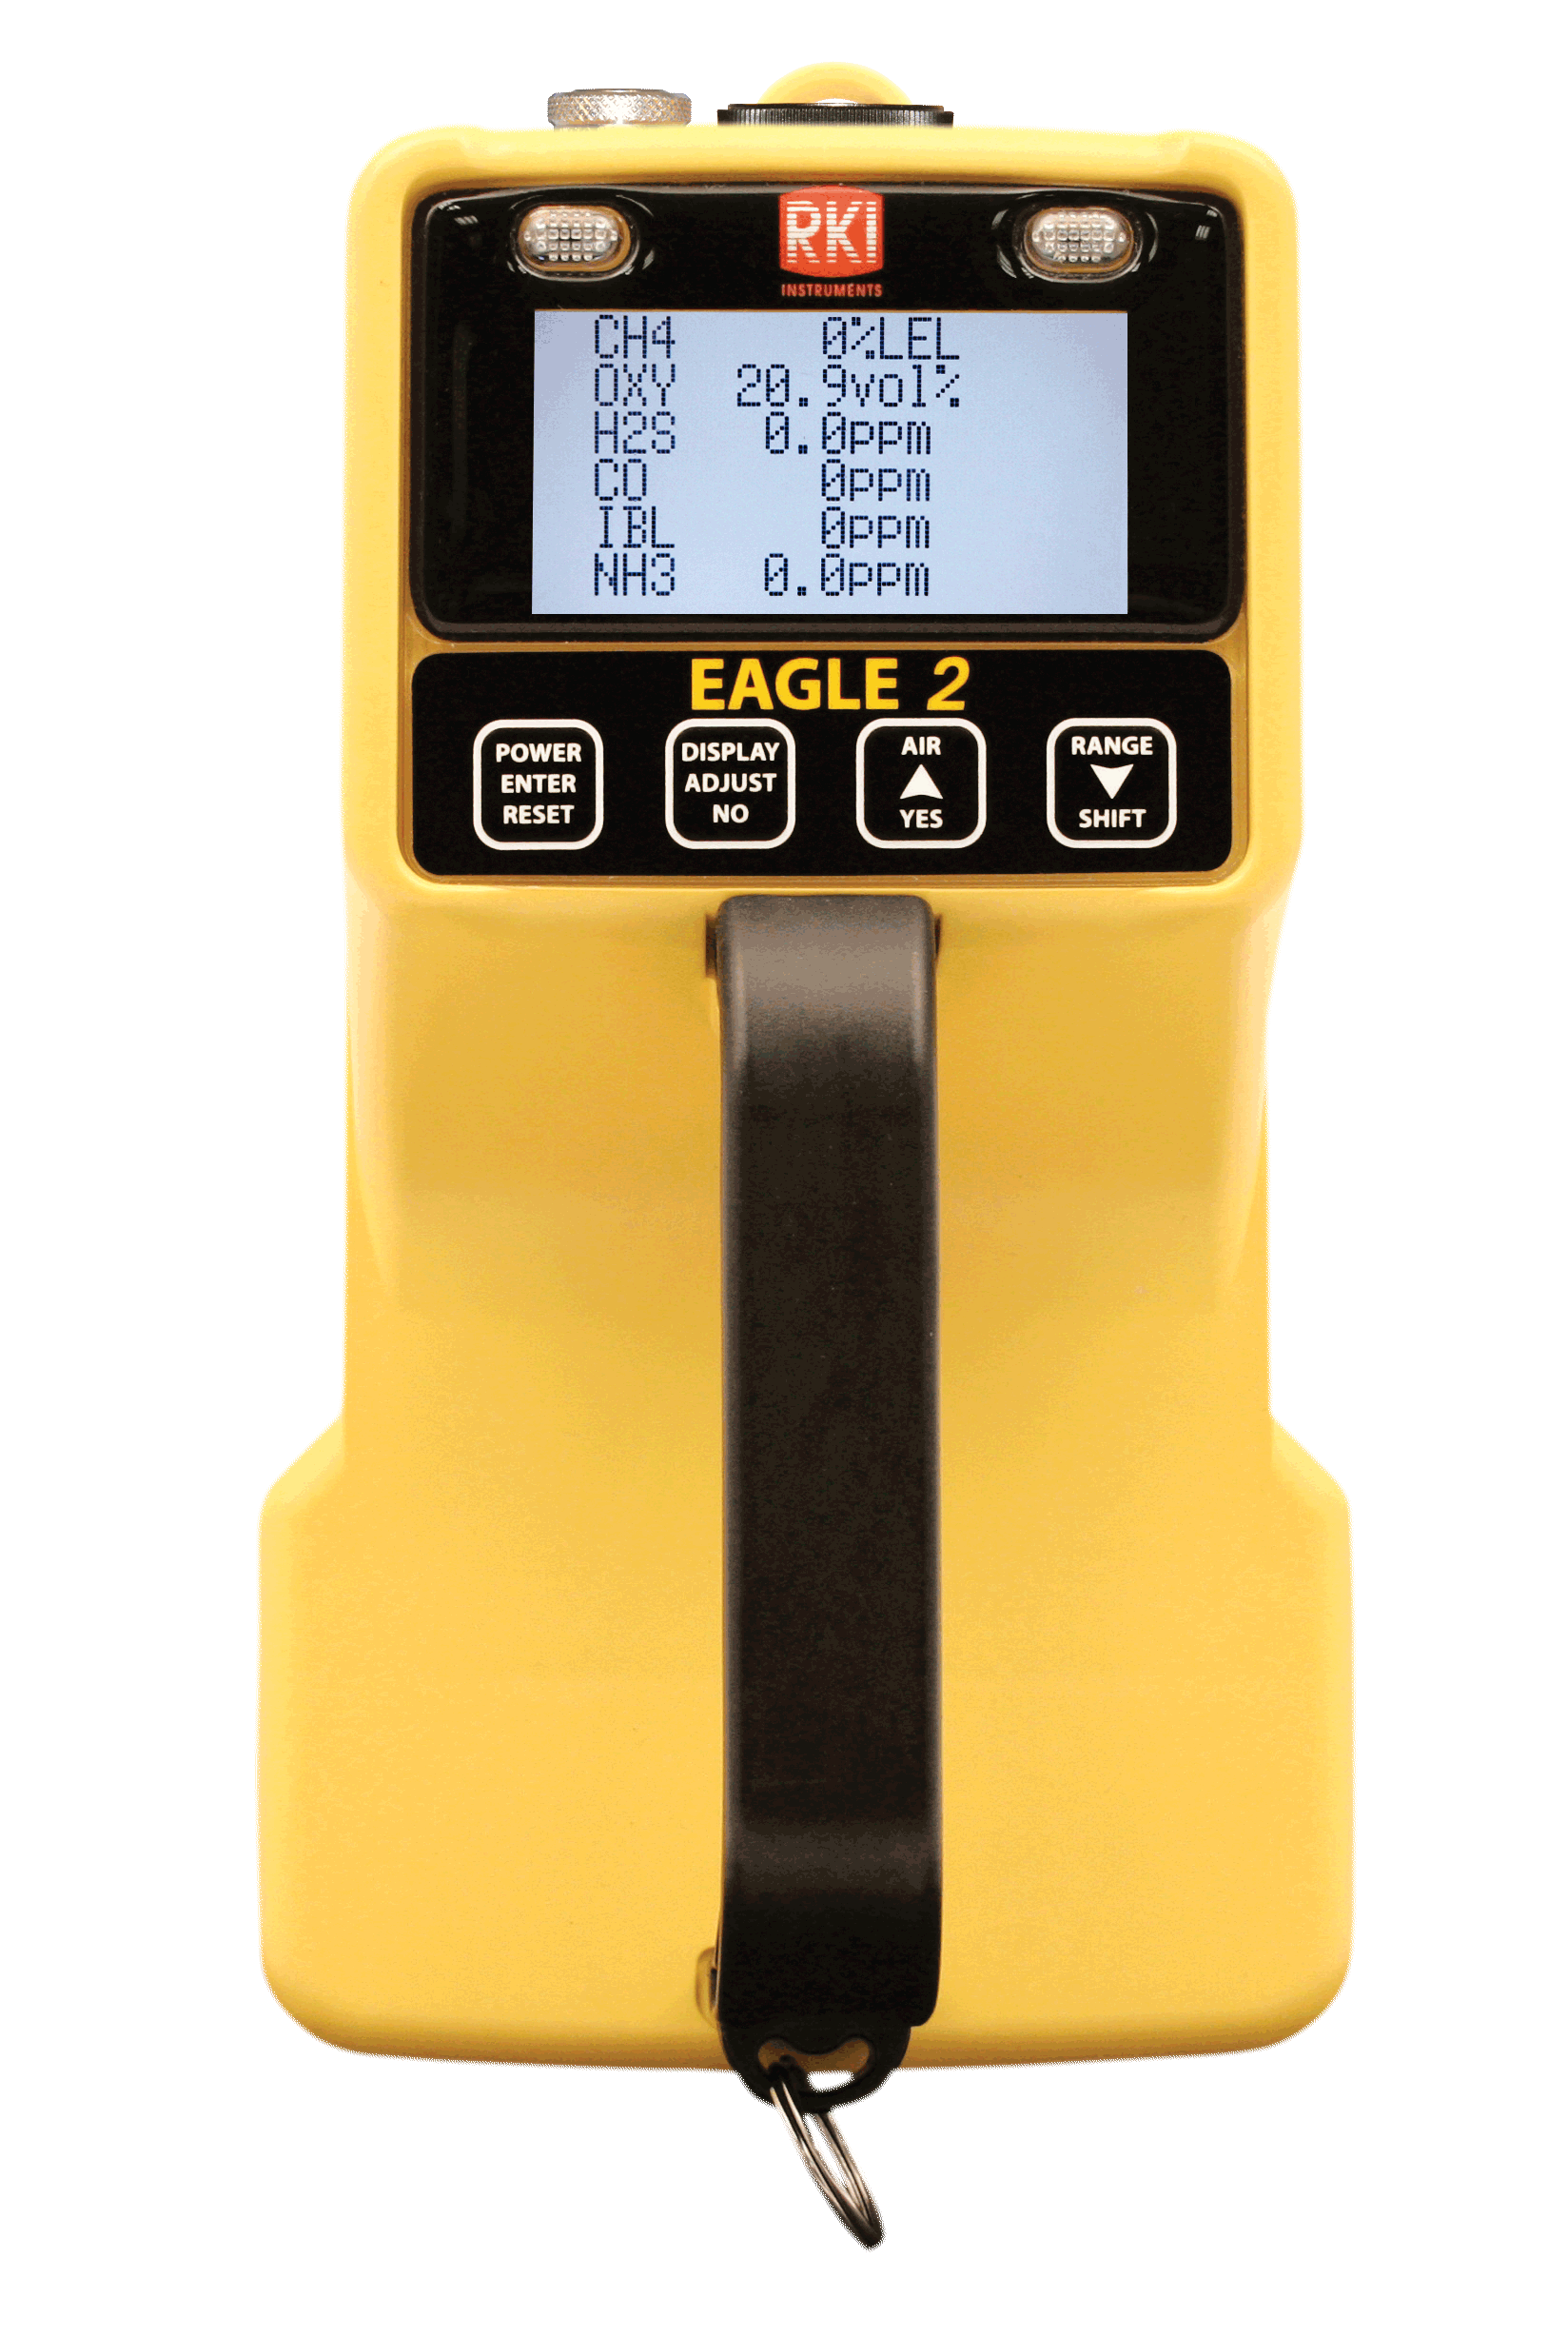
EAGLE vs EAGLE 2

Slide 2
Common Features
One to six gases
Push button PPM / LEL monitoring
Internal sample pump with 125’ range
Glove friendly buttons

Slide 3
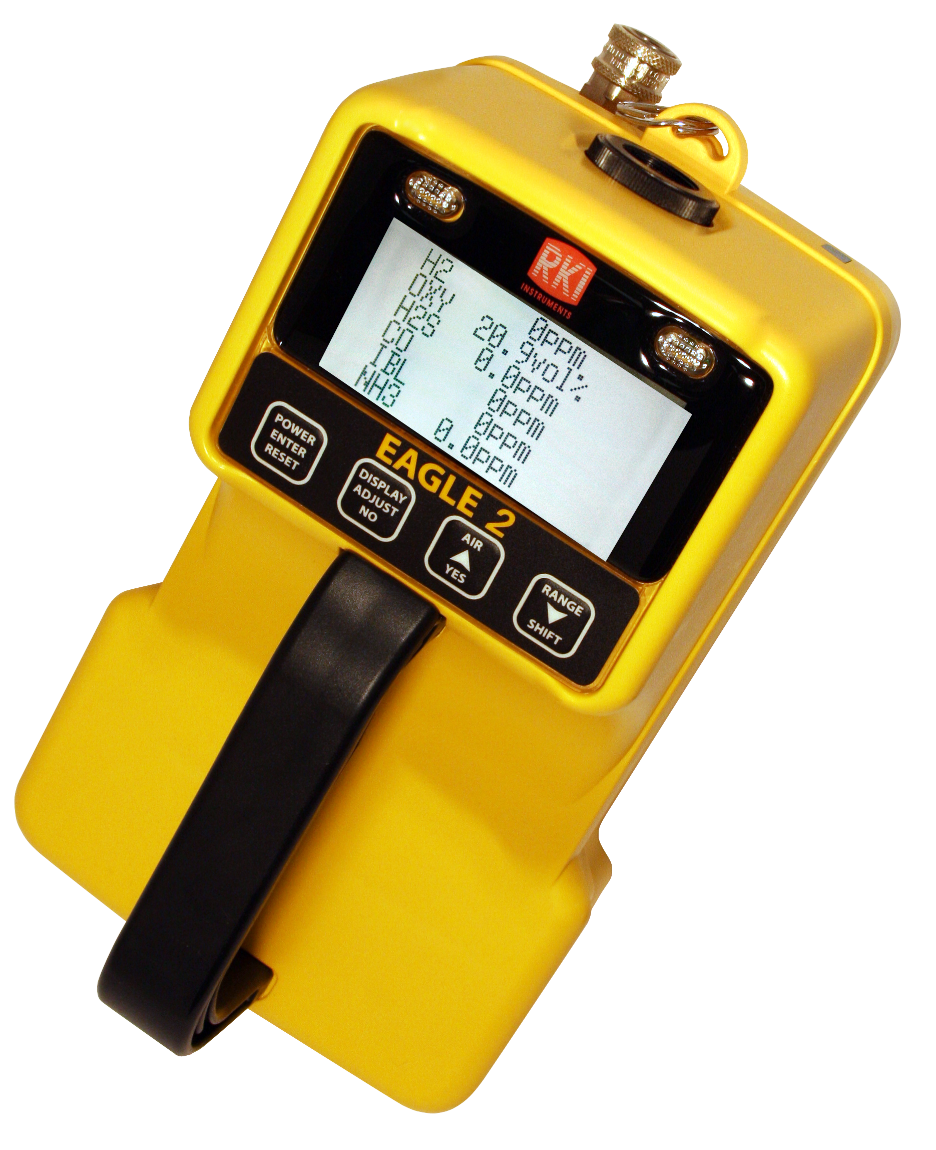
Feature Differences
EAGLE 2
3 Operation modes: normal, leak check, & bar hole sampling
3 Smart sensor slots
TC sensor available for volume CH4 & H2
PID sensor
5 languages

Slide 4
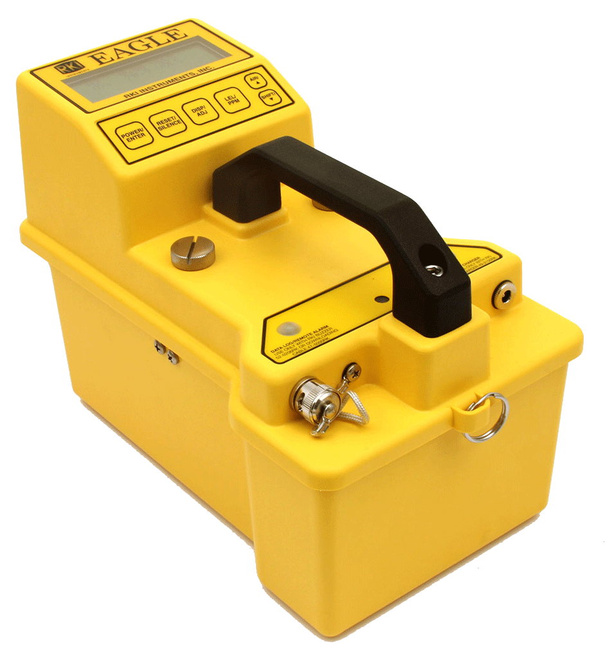
Feature Differences
EAGLE
Over 400 configurations available
Toxic gases: ClO2, HF, F2, HCl, H2Se, NO2, NO, O3, SiH4

Slide 5
Confined Space Gases

Slide 6
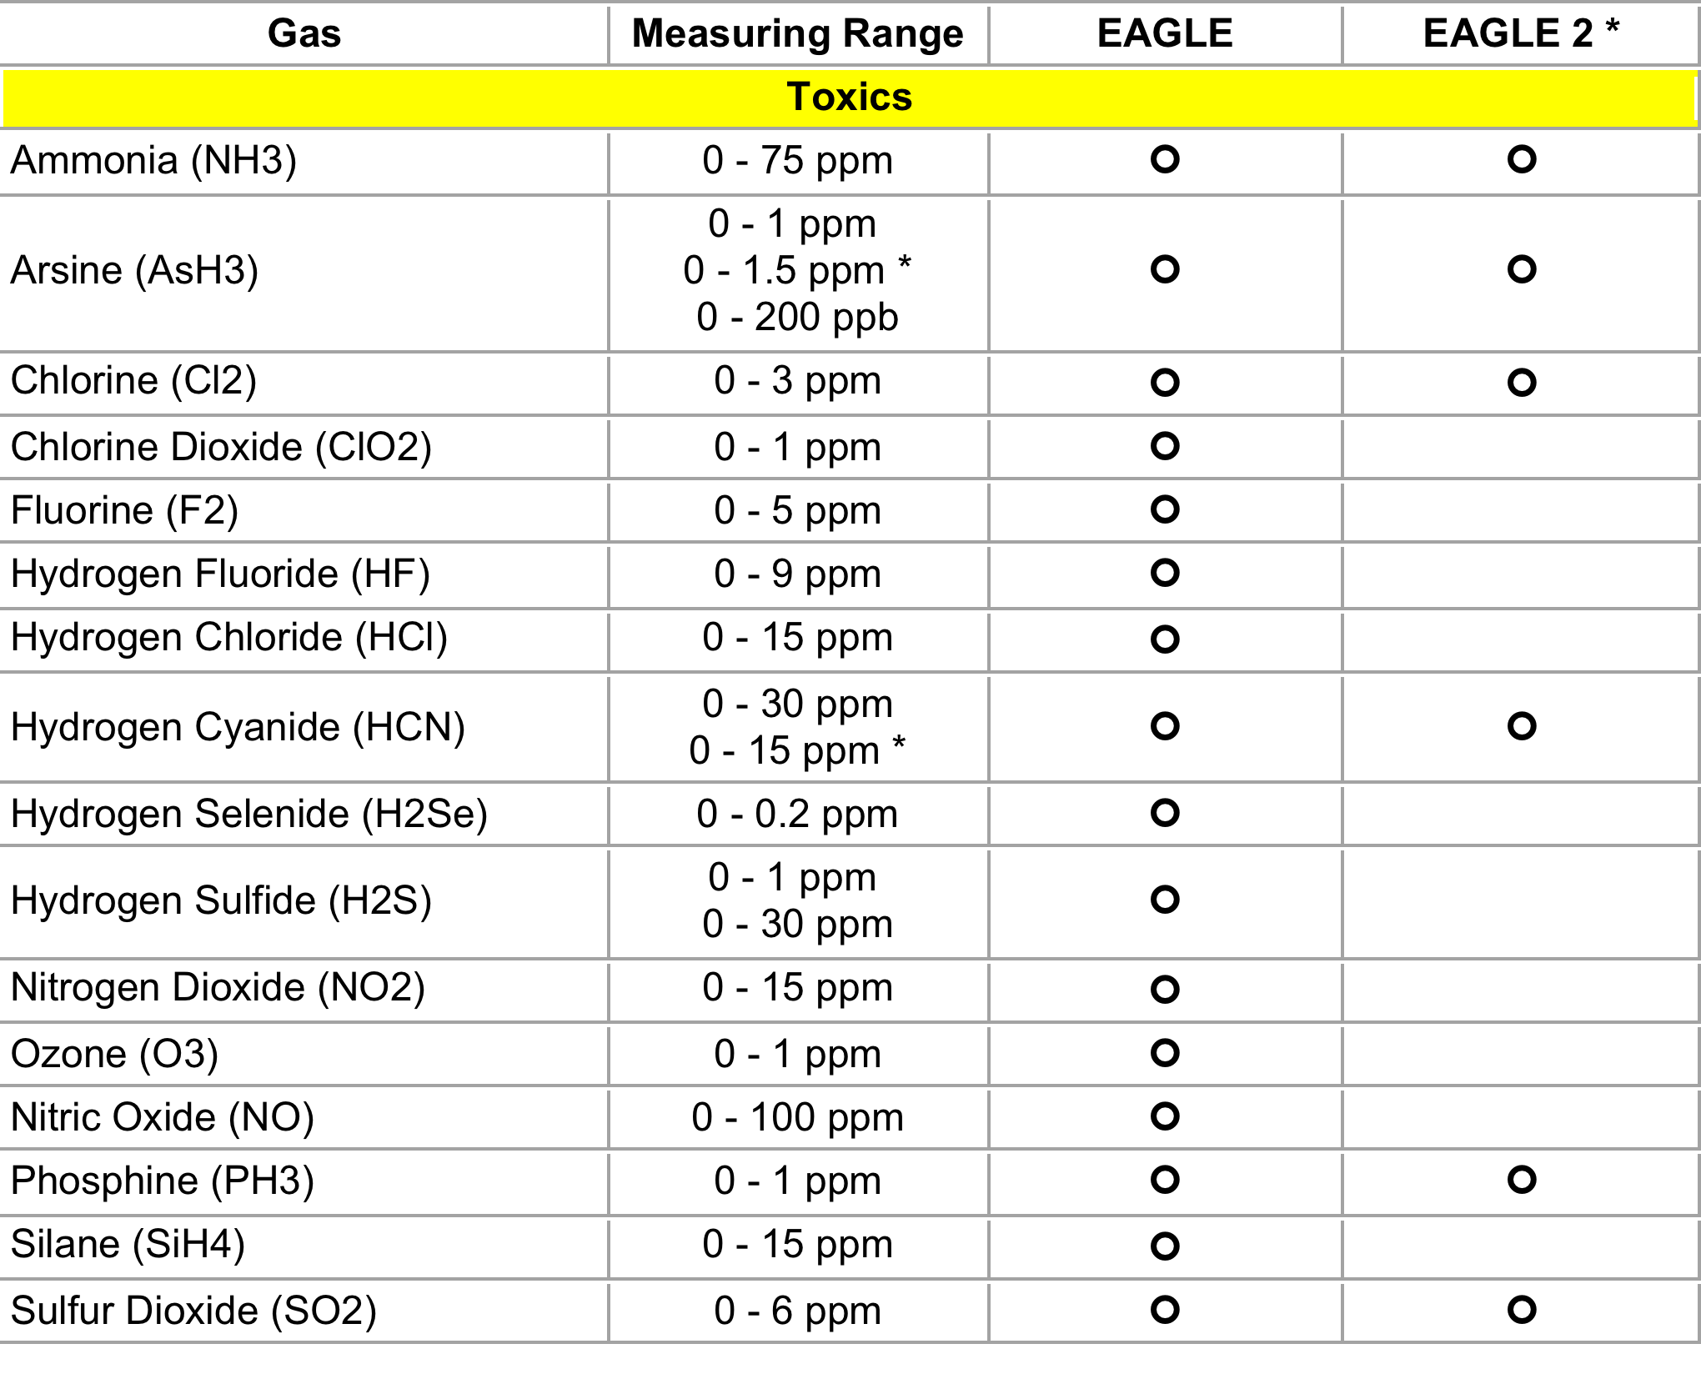
Toxic Gases

Slide 7
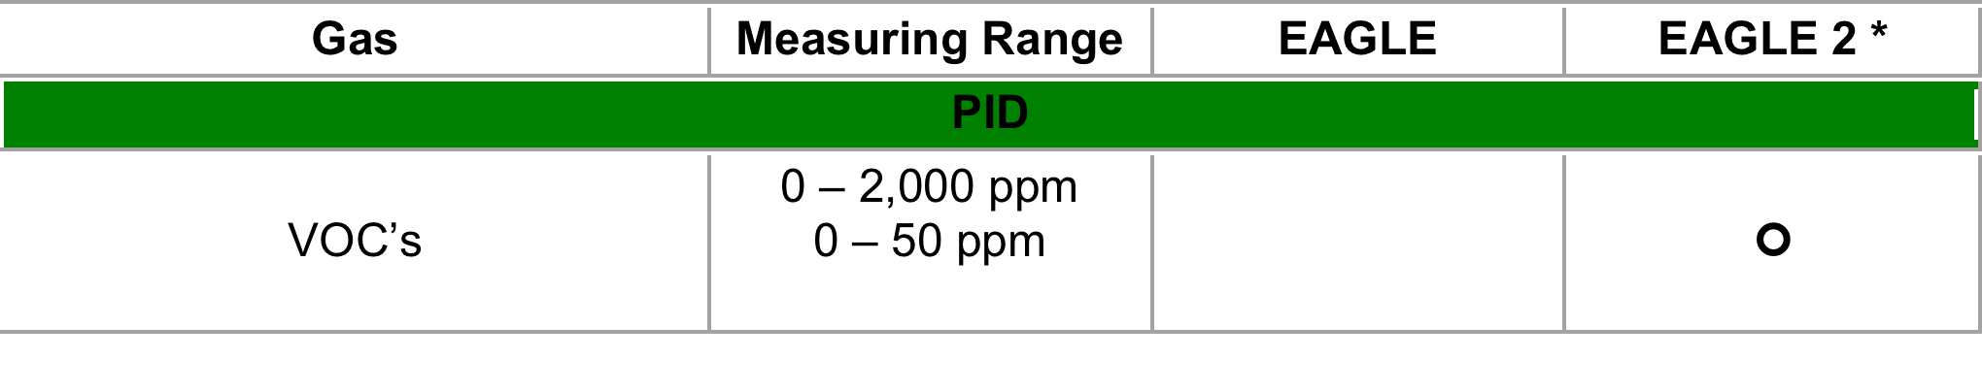
VOC Gases

Slide 8
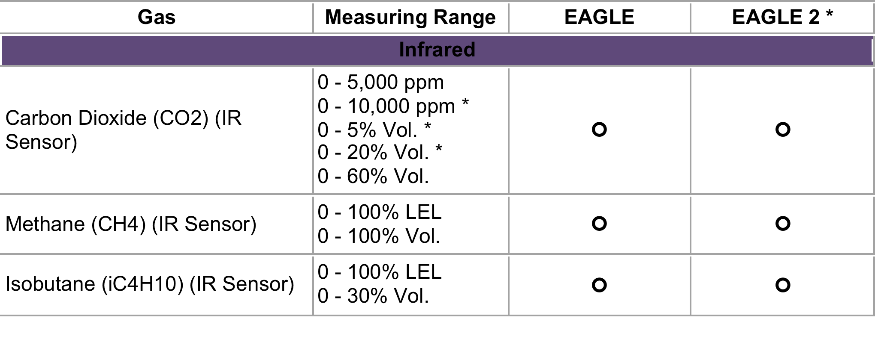
Infrared Gases

Slide 9
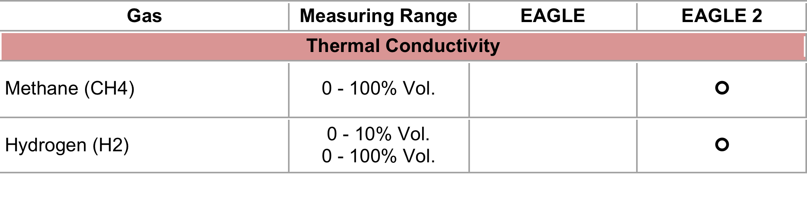
% volume Hydrogen

