Slide 1
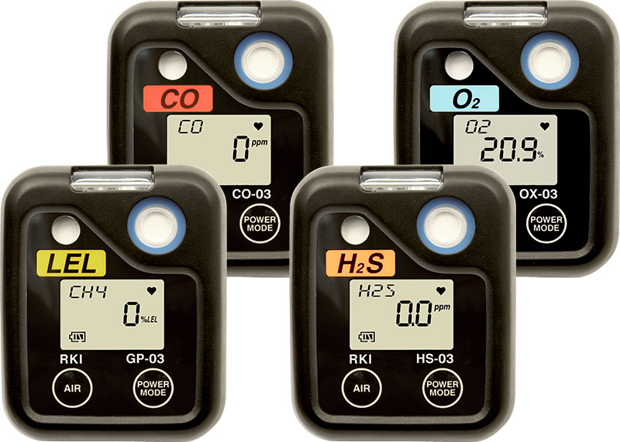
03 Series
Personal Single Gas Monitor

Slide 2
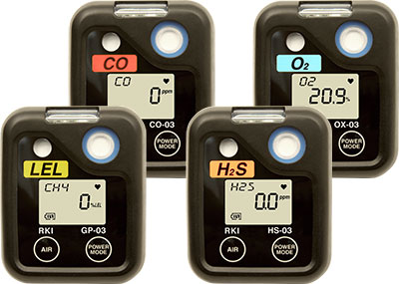
03 Series
Lower Cost
Smaller / Lighter
Sustainable
New Design
IP67
Datalogging
3,000 Hours Operation*

Slide 3
03 Series Features
Hazardous Material
Mines
Tunnels
Refineries / Petrochemical
Water / Wastewater Treatment
Worker Safety
Chemical Plants
Fire Services
Pharmaceuticals
Utilities

Slide 4
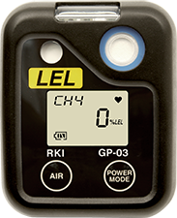
03 Series Features
Bright LED alarm
Protective hydrophobic sensor filter
Data logging
IR port
Loud audible alarm
2 preset alarms (adjustable)
Large auto backlit LCD display
Impact-resistant rubber boot
Glove friendly buttons

Slide 5
03 Series Features
Hands free gas monitoring
4 Gases to choose from LEL, CO, H2S, or O2
Vibration, visual and audible alarms standard
Operates 3,000/alkaline
2,000 hrs. Ni-MH
(GP-03 35 alkaline /30 hrs on /Ni-MH)
Datalogging (180 hours by 5 min. interval)
Peak Hold, STEL & TWA
Fast, accurate response with digital LCD display
Pocket size and lightweight
Impact and water resistant
Automatic backlight during alarm
Low battery alarm
Replaceable rubber boot
3 Year warranty H2S & CO
2 Year warranty LEL & O2

Slide 6
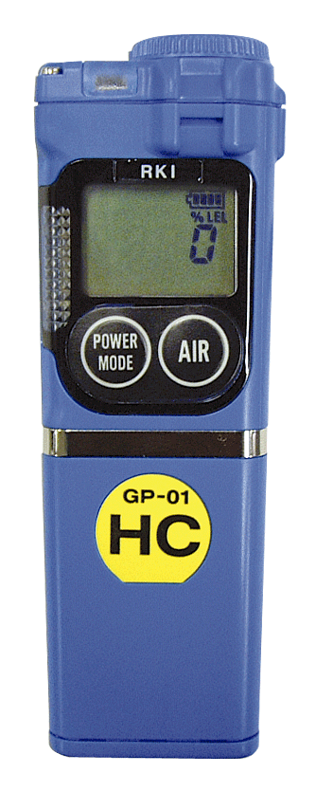
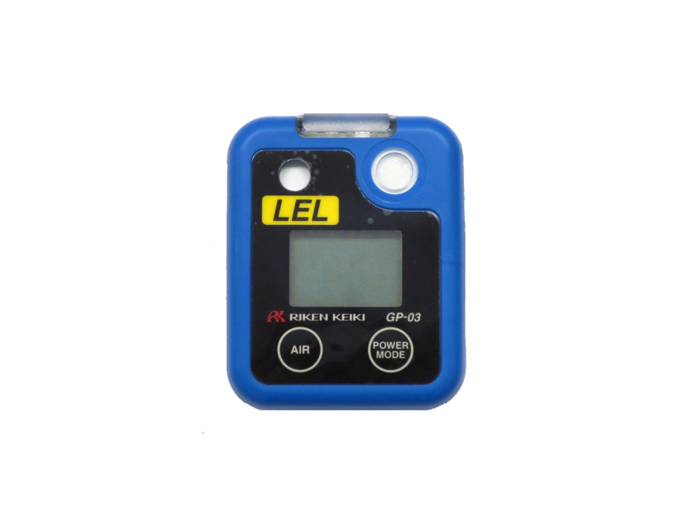
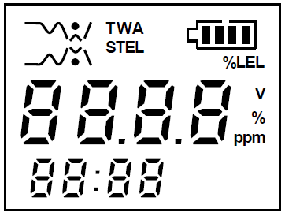
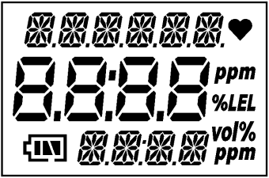
03 Series Display Advances
01 series
03 series
14 segments, 6 digits
＋
7 segments, 4 digits
＋
14 segments, 4 digits
＋
Character
7 segments , 4 digits
＋
7 segments, 4 digits
＋
Character
Concentration
Gas name / Message
Battery
Clock / Message

Slide 7
03 Series Improvements
01 Series |  | 03 Series
Alkaline dry cell (2-AAA size) or Ni-Cd battery pack (Optional accessory) (※GP-01: Ni-Cd battery pack is standard) | Power | Alkaline dry cell (2-AAA size) or AAA size Ni-MH battery (Eneloop)
GP-01 (Alkaline) ： Approx. 25h | Continuous Operation | GP-03 (Alkaline) ： Approx. 35h
GP-01 (Ni-Cd) : 12h |  | GP-03 (Ni-MH) : 30h
OX, CO, HS-01 (Alkaline) : 3000h |  | OX, CO, HS-03 (Alkaline) : 3000h
OX, CO, HS-01 (Ni-Cd) ： Approx. 700h |  | OX, CO, HS-03 (Ni-MH) ： Approx. 2000h
Backlight LCD, Peak hold | Functions | Backlight LCD, Peak hold Data logging, CAL alarm, BUMP alarm
-10～+40℃ (HS-01: -20～+40℃) | Operating temp. | -20～+50℃
－ | Ingress Proof rating | IP67
ExiadⅡBT3 (OX-01: ExiadⅡBT3X) | Safety rating | ExiaⅡCT4 (Ni-MH: ExiaⅡCT3)

Slide 8
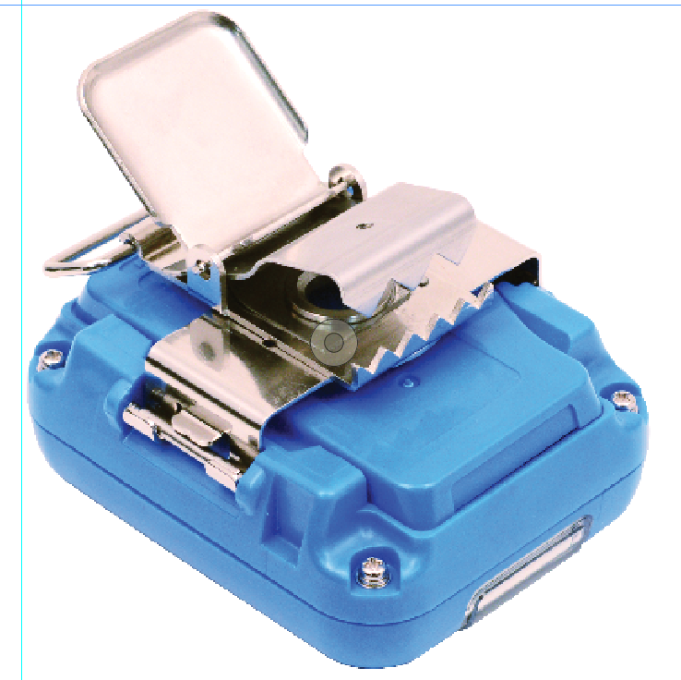
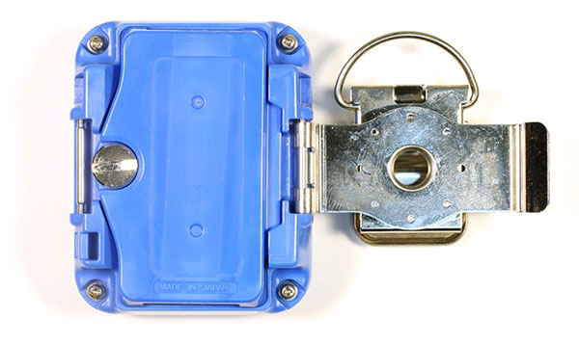
03 Series Features
^{Alligator Clip}
^{(belt clip available)}
^{Battery Cover}

Slide 9
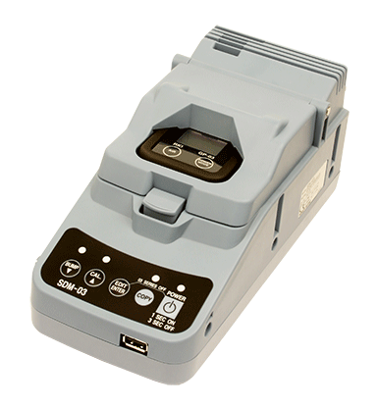
03 Series Cal Station
Stand-alone station (no PC Required)
Charge
Calibrate
Bump Test
Save Bump Test and Calibration records
Transfer bump and cal records with a USB jump drive
Includes PC software for viewing / archiving

Slide 10
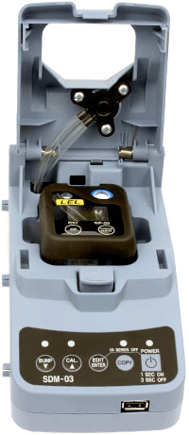
03 Series Multi - Station
Multiple modules connected to a PC (10 max)
Charge/Bump/Calibrate
Automatic calibration/bump test option
Configure instrument parameters
Archive Bump Test and Calibration records
Archive data to centralized network location
Software controlled data retrieval
Windows 7 compatible

Slide 11
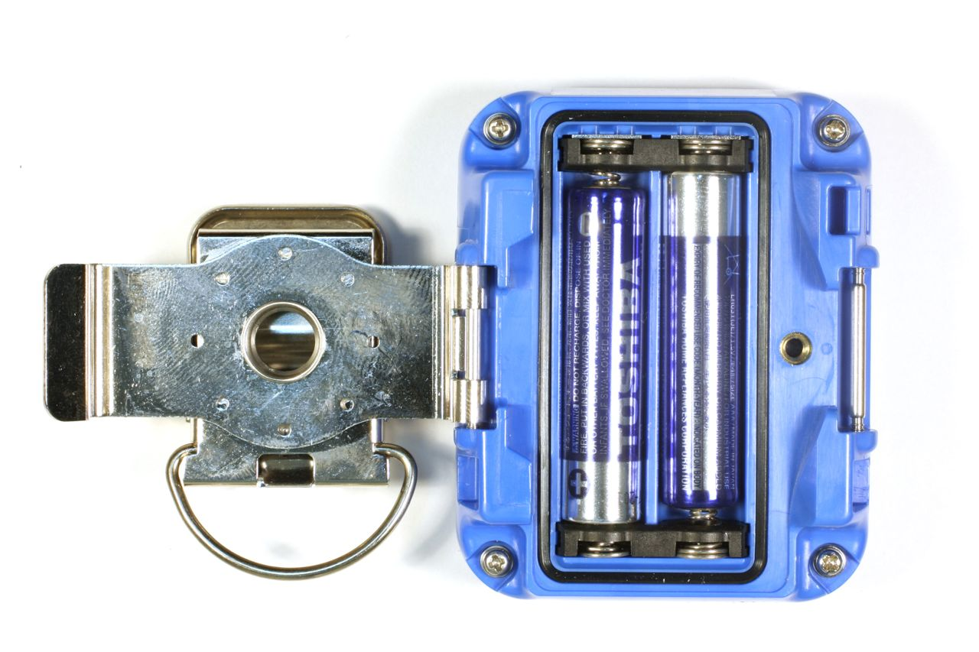
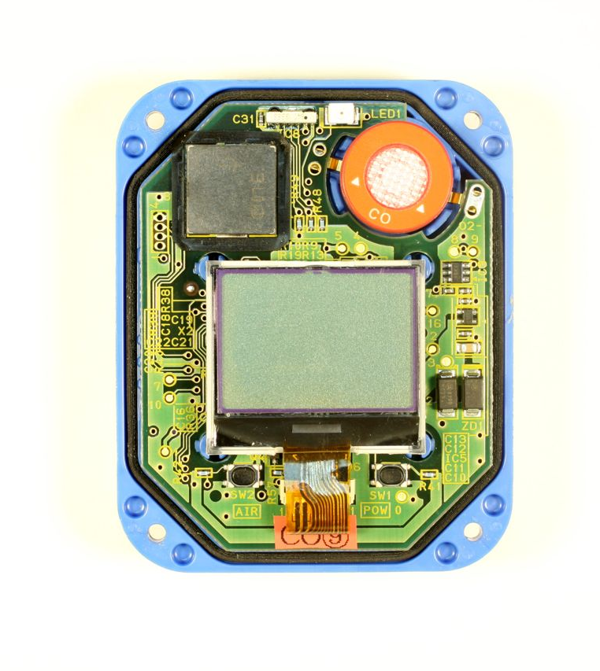
03 Series Service
^{Easy to replace batteries}
^{Battery Cover}
^{Replaceable filters}

Slide 12
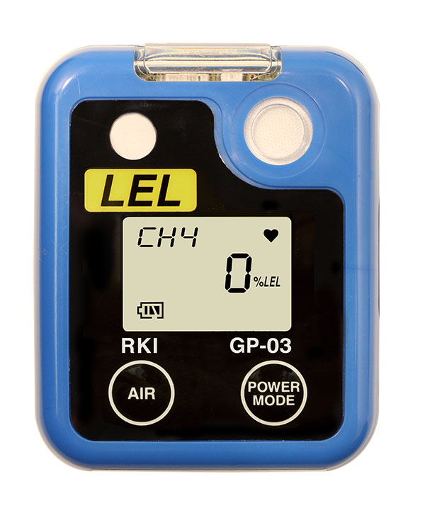
GP-03 Series Pricing
$320 List Price Alkaline
$380 List Price
Ni-MH
2 year warranty
30% distributor discount

Slide 13
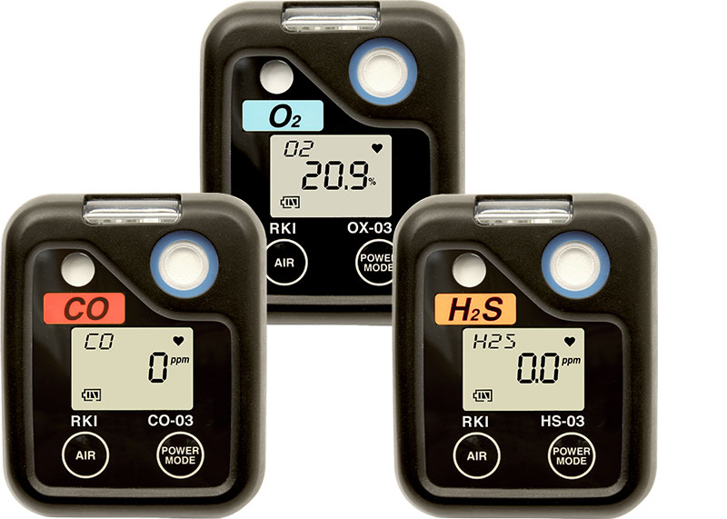
03 Series Pricing
$280 List Price Alkaline
3 year warranty
CO/HS-03
2 year warranty OX-03
OX-03
2 year warranty
CO-03 and HS-03
3 year warranty

