Slide 1
T2A
How to install panel widening ring

Slide 2
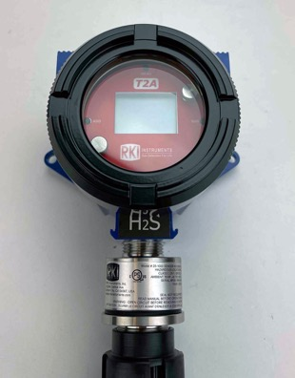
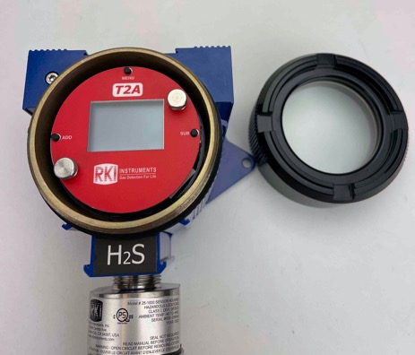
Remove the enclosure lid

Slide 3
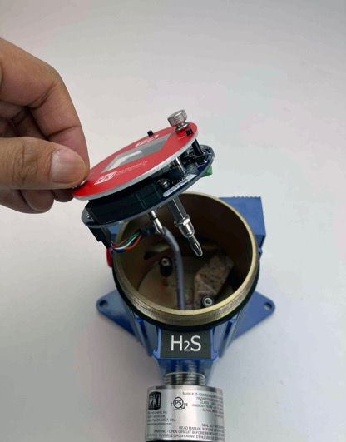
Pull the panel off as shown

Slide 4
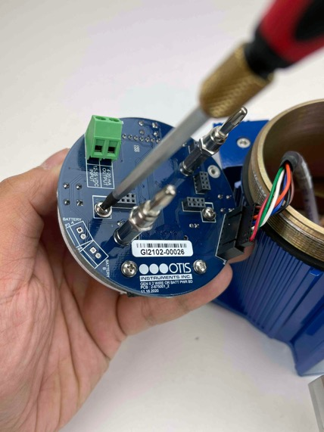
Remove the two upper screws behind the circuit board to remove the front red panel

Slide 5
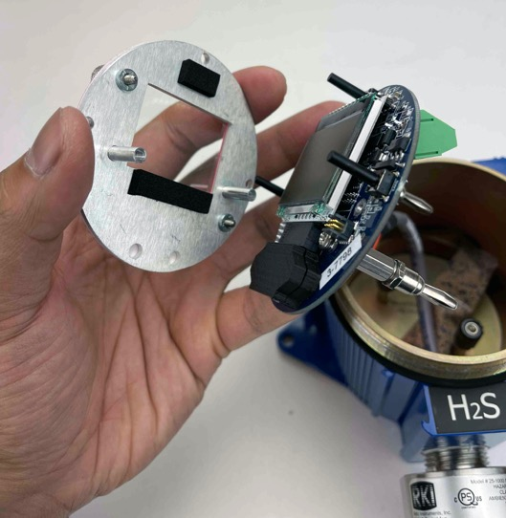
Separate the front red panel from the
circuit board

Slide 6
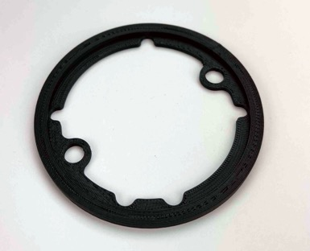
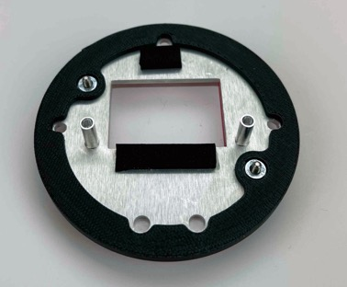
Align the black widening ring properly to the front red panel as shown above

Slide 7
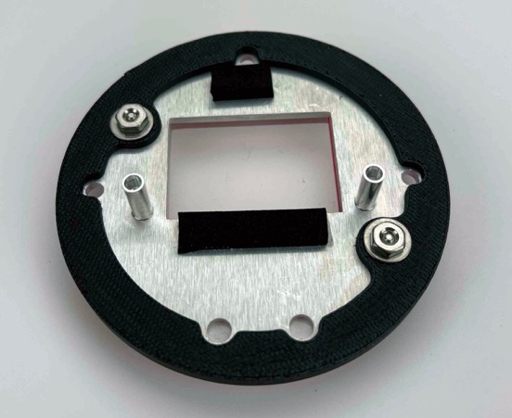
Tighten the two bolts with washer and nut

Slide 8
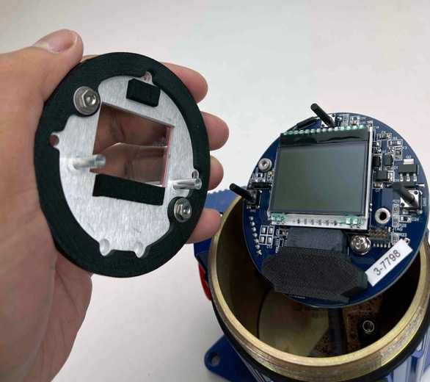
Align the three buttons on the circuit board to the back of the red panel

Slide 9
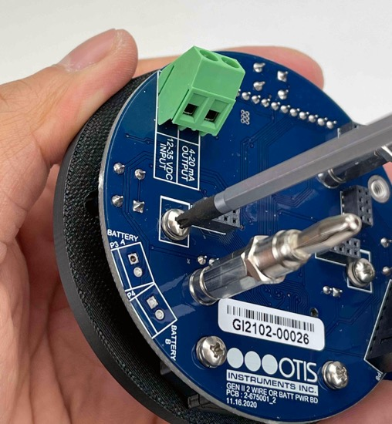
Reinstall the upper screws

Slide 10
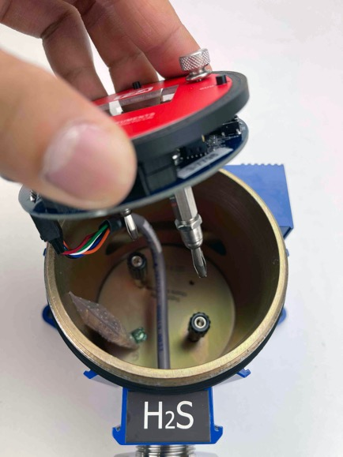
Align the two prongs to the back of the unit and push down until firmly seated

Slide 11
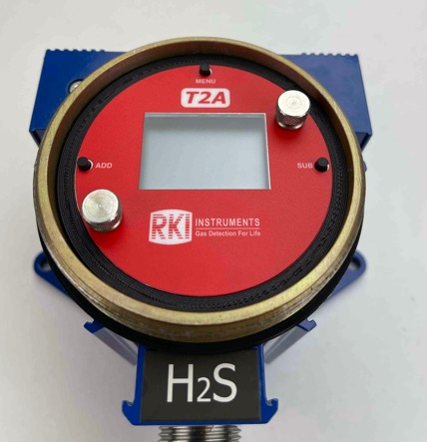

Reinstall the enclosure lid

