Slide 1
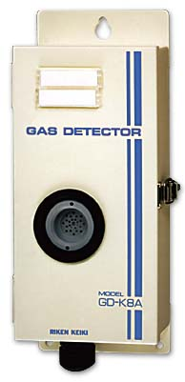
GD-K8A
Toxic Diffusion
Sensor/Transmitter

Slide 2
Features & Benefits
^{Diffusion style head}
^{Low profile design}
^{Quick response sensors}
Many toxic sensors to choose from
3 to 5 year typical sensor life
^{Easy maintenance}
^{Selective for target gas}
^{Low cost of ownership}

Slide 3

GD-K8A Applications
^{Semiconductor manufacturing}
^{Petrochemical plants}
^{Refineries}
Water & wastewater treatment plants
^{Pulp & paper mills}
Gas, telephone, & electric utilities
^{Steel}
^{Automotive}
^{Refrigeration}
^{Food Storage}
^{Power Plants}
^{General Leak Detection}

Slide 4
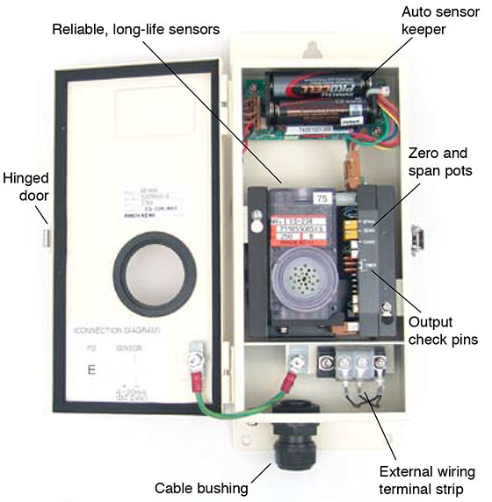
Physical Features

Slide 5
GD-K8A Detectable Gases
Contact RKI for gases or ranges not listed

Slide 6
GD-K8A Specifications

