Slide 1
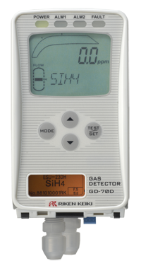
GD-70D series
Solar Cell, Semiconductor & LCD Factories
Improved Function
Environmentally
Friendly Design
Global Standard

Slide 2
Concept
GD-70D has been developed to fulfill all the customer’s wants and needs
Universal design
1) Basic components consists of:
* Main PCB, Sensor assembly and Pump unit
2) Easy maintenance from front access. No tools required.
3) Large LCD (White-color backlight)
4) No need for daily check. Auto flow adjustment and self diagnosis.
Improved Function
Compact and Renewable
5) Power-saving technology
6) Simple Operation
7) Smaller size and weight
8) Recyclable sensor/amplifier module
Environmentally Friendly
Design
International Certificate
9) RoHS/CE marking
Global standard

Slide 3
Features for GD-70D
1. Common platform for all detection methods
2. Universal Main unit for all sensor types
3. Multifunctional intelligent Sensor unit
4. No internal tubing (Main unit) / No Coil (Pump unit)
5. Front access, no tools required for easy replacement of sensor & pump
6. Large size LCD (Easily viewable)
7. Various communication method available (4-20mA, NT and POE)
8. Reduced maintenance through enhanced firmware functions
9. Small Footprint
10. Simple upgrade from existing units
11. Environmentally Friendly
12. Global standard certificate

Slide 4
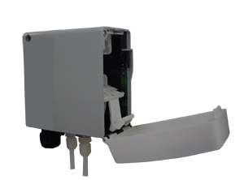
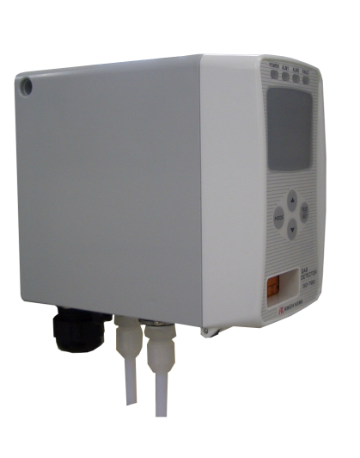
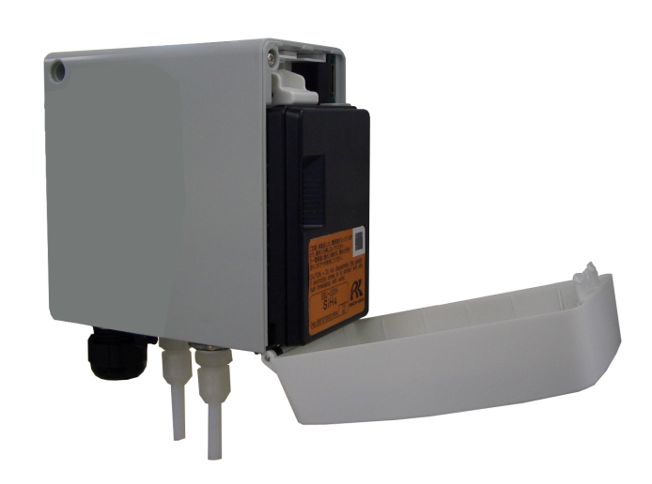
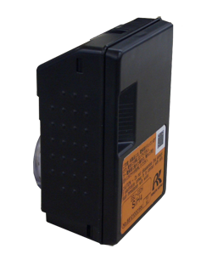

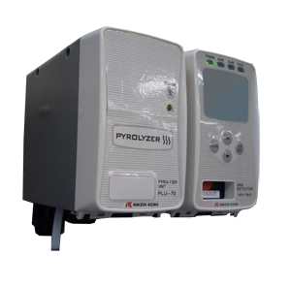
Upgraded Function
1. Common platform for all detection methods
GD-70D consists of three independent modules: main unit, sensor unit and pump unit.
a) Main unit
b) Sensor unit
c) Pump Unit
Pyrolyzer (PLU-70D)
Connecting pyrolyzer (PLU-70D)
to GD-70D, TEOS & NF3 can be
measured.
Temperature for PLU-70D is
automatically controlled.
Signal converter (SD-70SC)
Setting Signal converter the
(SD-70SC) & GD-70D can be
Networked.

Slide 5
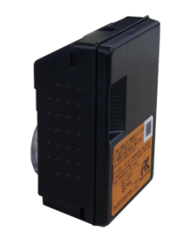
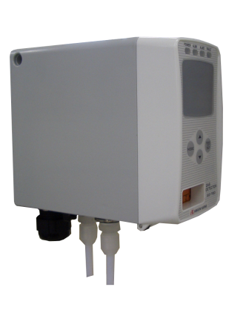

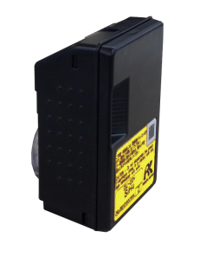
Upgraded Function
2. Universal Main unit
Main unit can be used with all sensor units with various detection principles
Converting from SiH4 to H2 is simple!
Just remove the SiH4 sensor unit and replace with an H2 sensor unit.
①Remove
SiH４ Sensor unit (ESU)
②Set
SiH4 Detector
H2 Detector
Various network systems available:
GD-70D : 4-20 mA DC
GD-70D-NT ：NT
GD-70D-ET ：PoE
H2 Sensor unit (SGU)
The GD-70D has functions that will not allow the insertion of incorrect sensor units. Every sensor unit has a unique identification which prevents installation error.

Slide 6
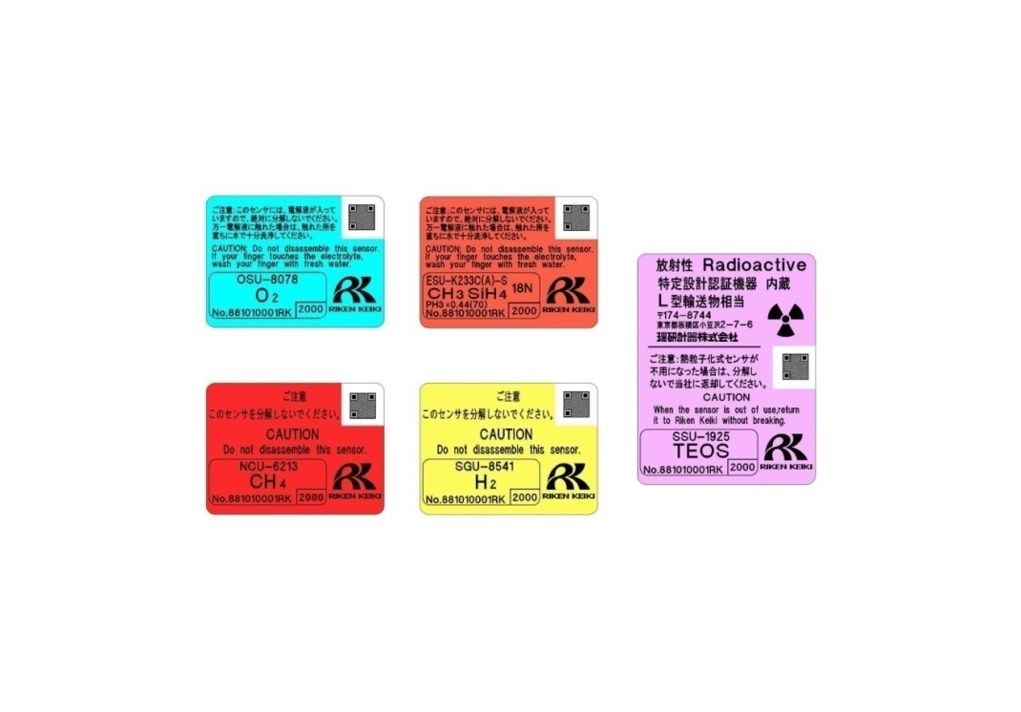


Upgraded Function
3. Multifunctional Intelligent Sensor Unit
Each sensor has onboard CPU and provides multiple functions
Available Sensor Units
There are five different detection technologies available.
Each sensor unit can monitor and control measuring status.
In the event of an alarm, its measuring status can be memorized by the sensor.
Electro Chemical
Semiconductor
Galvanic Cell
New Ceramic
Pyrolysis-Particle

Slide 7
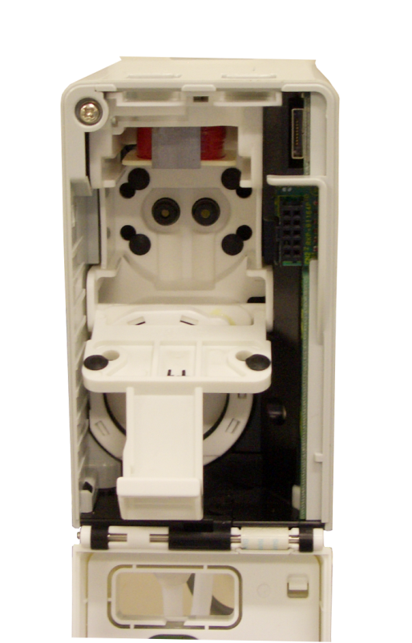
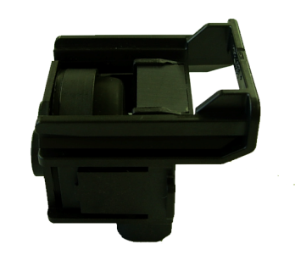
Upgraded Function
4. No internal tubing and no pump coil to replace
The diaphragm is built in Pump unit for GD-70D
The magnetic coil is built in to the Main Unit.
There are no tubes inside Main Unit to simplify maintenance
Main Unit
Pump Unit
Connection for
Pump unit
Magnet coil is built in Main unit.
Connection for
Sensor unit
Diaphragm is easy to replace and built in to the pump unit.

Slide 8
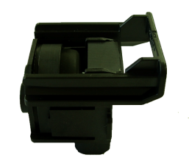
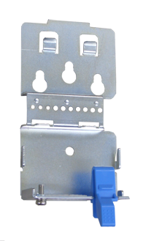
Upgraded Function
5. Front access for easy maintenance
Sensor Unit/Pump unit can be removed easily with one touch of button.
Remove and attach items with one touch of a button
Pump unit
Wall mounting bracket
Main unit
Sensor unit

Slide 9
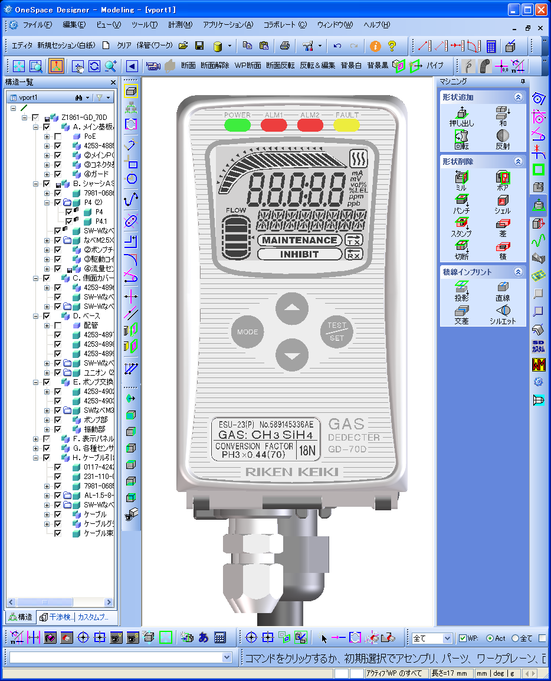
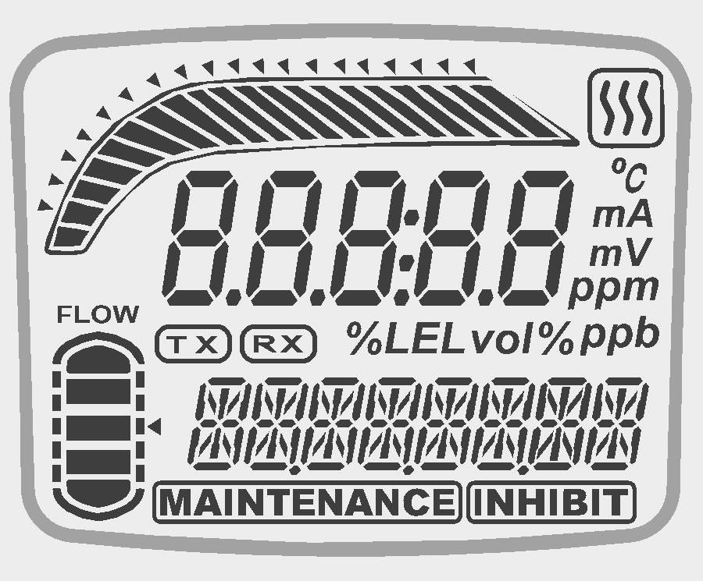
Upgraded Function
6. Large size LCD
GD-70D has a large easy-to-read LCD that displays all information such as measuring gas, gas concentration, flow level and connecting devices.
Dual display for gas concentration : Analog bar graph and digital readouts
Control switch
Alarm lamps
Fault
Power lamp
Pyrolyzer connection
Alarm point
Display for gas Concentration
Gas Concentration
Units of Measure
Communication
status
Flow rate
Measuring gas
(automatic adjustment)
Inhibit
(Offline: Communication for PC.)
Name plate for Sensor unit
Maintenance status
Notes:
9

Slide 10
Upgraded Function
7. Reduced maintenance through enhanced
troubleshooting firmware functions
・Automatic flow rate control
GD-70D can automatically control flow rate to preset flow level, which makes gas measuring stabilized.
Automatically adjusted
Flow UP
Flow DOWN
Lower flow rate
Preset flow rate
Over flow rate
・Self-diagnosis function
GD-70D continuously monitors various measuring status in detail.
・Data logging functions
Event history, Alarm history, Calibration history, Alarm trend with 1 sec interval
Notes:
10

Slide 11



Global Standard
11. Global standard
CE marking
RoHS
IEC Standard
Notes:
11

Slide 12
Specifications
Main Unit
Model | GD-70D | GD-70D-NT | GD-70D-ET
Communication | 4-20mADC | DC power line communication | POE Method
Detection principle | Different type depending upon sensor unit and detectable gas (See table on back page for list of sensor types and detectable gases)
Sampling method | Sample-drawing（Auto-Adjustment of flow rate)
Display | Large LCD （White back light）
 | ・Gas Concentration
 | ・Flow rate / Communication status / Pyrolizer status / Character display
 | ・Measuring gas / Error code / Content of error / Character message display
Display | 1ST alarm： red / 2nd alarm： red / Fault alarm：yellow
External Output | 1st alarm / 2nd alarm / Trouble alarm ：Relay contact output for each alarm
Self diagnosis | ・System failure
 | ・Sensor failure
 | ・Flow failure
 | ・Communication failure(NT / ET)
Date logging function | ・Event history / Alarm history
 | ・Calibration history
 | ・Alarm trend （180 sec Before / after 1st alarm）
Operating conditions | 0-40℃ （Without rapid change） ・30-70%RH （non-condensing）
Operational Setting | All operational setting are user adjustable by using the front panel
Power requirement | DC 24V±10% Approx. 5W （Including Sensor unit） |  | POE standard arrangement
Dimensions | 70(W) × 120(H) × 150(D)
Weight | Approx. 0.9Kg (2.0 lbs) Including sensor unit
Mounting | Wall-mounting base plate by 3 screws
Sample Tubing | 4 x 6 mm PTFE tubing recommended. Ppfalf union fittings provided as standard accessories.
Cable | Cable type varies depending on communication method （Cable gland optional）
Notes:
12
12

Slide 13





Specifications
Sensor Unit
Model | ESU | SGU | SSU | OSU | NCU
Detection Principle | Electrochemical Cell | Semiconductor | Pyrolysis-Particle | Galvanic Cell | New Ceramic
Identification Marking
Self-diagnosis Function | ・Sensor trouble ・System failure
Date-logger Function | ・Event history / Alarm history ・Calibration history ・Alarm trend （60 sec Before / After 1st alarm）
Notes:
13
13

Slide 14
Specifications
Pyrolyzer Unit
Model | PLU-70
Application | Measuring NF3 / TEOS gases
Usage | Used by connecting to “GD-70D”(Main unit)
Display | ・LED (Green color)
 | - Normal：light-on / Warming-up ：flashing 1sec interval / Trouble： flashing 0.2 sec interval
Self-Diagnosis Function | ・Pyrolyzer unit trouble
 | ・Fan trouble
 | ・System trouble
Operational Temp. & Humidity | ・0-40℃ （Without rapid change） ・30-70% RH （non-condensing）
Operational Settings | Operational setting are user adjustable by using the front panel (Main unit).
Power Supply | DC 24V±10% Approx.36W (MAX)
Dimension | 70(W) × 120(H) × 150(D) (2.8”W x 4.7”H x 5.9”D)
Weight | Approx. 1.2Kg (2.6 lbs)
Mount-Type | Wall-mounting base plate by 3 screws
Sampling Tubing | 4 x 6 mm PTFE tubing recommended. PP half union fittings provided as standard accessories.
Cable | Cable type varies depending on communication method （Cable gland optional）
Notes:
14
14

Slide 15
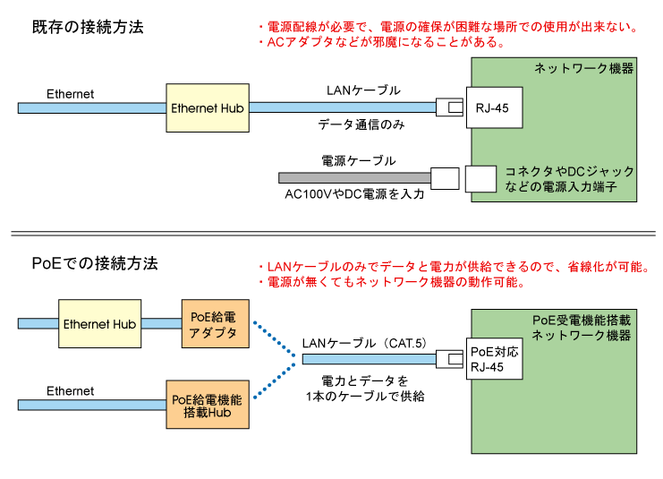
Power over Ethernet
PoE（Power over Ethernet） is a technology that can supply electricity to the detector through LAN cable, （IEEE802.3af）
With this PoE technology, data communication and electricity are available through one piece of LAN cable. Therefore, Detector (GD-70D) can be set without external power source, such as AC adaptor.
GD-70D requires less wiring and cost than units with additional power source（※CAT.5 LAN cable is necessary for PoE connection.
Conventional connection
Gas detector(GD-70D) will become Ethernet terminal unit!
LAN cable
(Data only)
Ethernet
Cable for
Power-supply
• Cable cut-down
（Line for electricity not required）
• Labor cost reduced
（Only RJ-45 connection required）
• Material cost reduced
（Cable for construction reduced）
AC100V / DC24V
PoE connection
Poe
LAN cable (CAT.5)
Ethernet
Supplying “data” and “electricity” through one LAN-cable.
Poe Hub
Notes:
15
15

Slide 16




GD-70D Fresh Air
Press and hold “mode” for 3 seconds.
Press “SET”
Press “SET” to perform the zero adjustment
The menu displays “ZERO OK” if pass, or “ZERO NG” for fail
Notes:
16

Slide 17
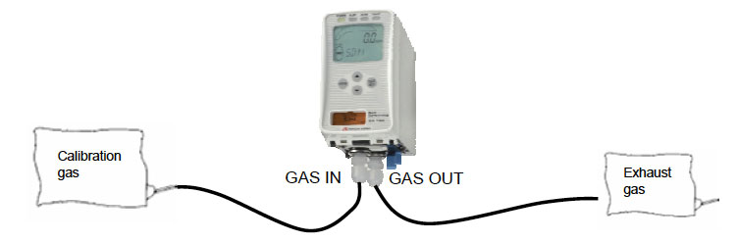

GD-70D Calibration
Press and hold “mode” for 5 seconds.
Press mode until 2-2.SPAN is displayed
Press the Set to select SPAN
Notes:
17

Slide 18

GD-70D Calibration
Press and hold “mode” for 5 seconds.
Press the down arrow to select 1-8.M MODE
Press the Set to select 1-8.M MODE
Notes:
18

Slide 19


GD-70D Calibration
Then press the SET key again for three seconds.
2.0 GAS TEST
Perform a test with the gas. Similar to the detection
mode, the reading changes and the alarm lamp
lights up after the gas is introduced, but the contact
is not activated.
Notes:
19

Slide 20


GD-70D Calibration
2-1. ZERO
Perform the zero adjustment.
2.2 GAS TEST
Perform a test with the gas. Similar to the detection
mode, the reading changes and the alarm lamp
lights up after the gas is introduced, but the contact
is not activated.
Press Set to begin Span Adjustment
Notes:
20

Slide 21


GD-70D Calibration
Allow gas to flow, and then press the SET key
when the reading is
stabilized
Make Span Adjustment
Because the reading will be fixed, select the
introduced gas concentration by pressing the
▲ or ▼ key. Select the number, and then press
the SET key. (20.9 vol% in the oxygen deficiency
alarm specification)
Notes:
21

Slide 22


GD-70D Calibration
Span adjustment completed
To record the adjustment result, press the SET key.
(Press the MODE key to cancel this menu.)
The menu automatically returns to 2-2.SPAN
Notes:
22

