Slide 1
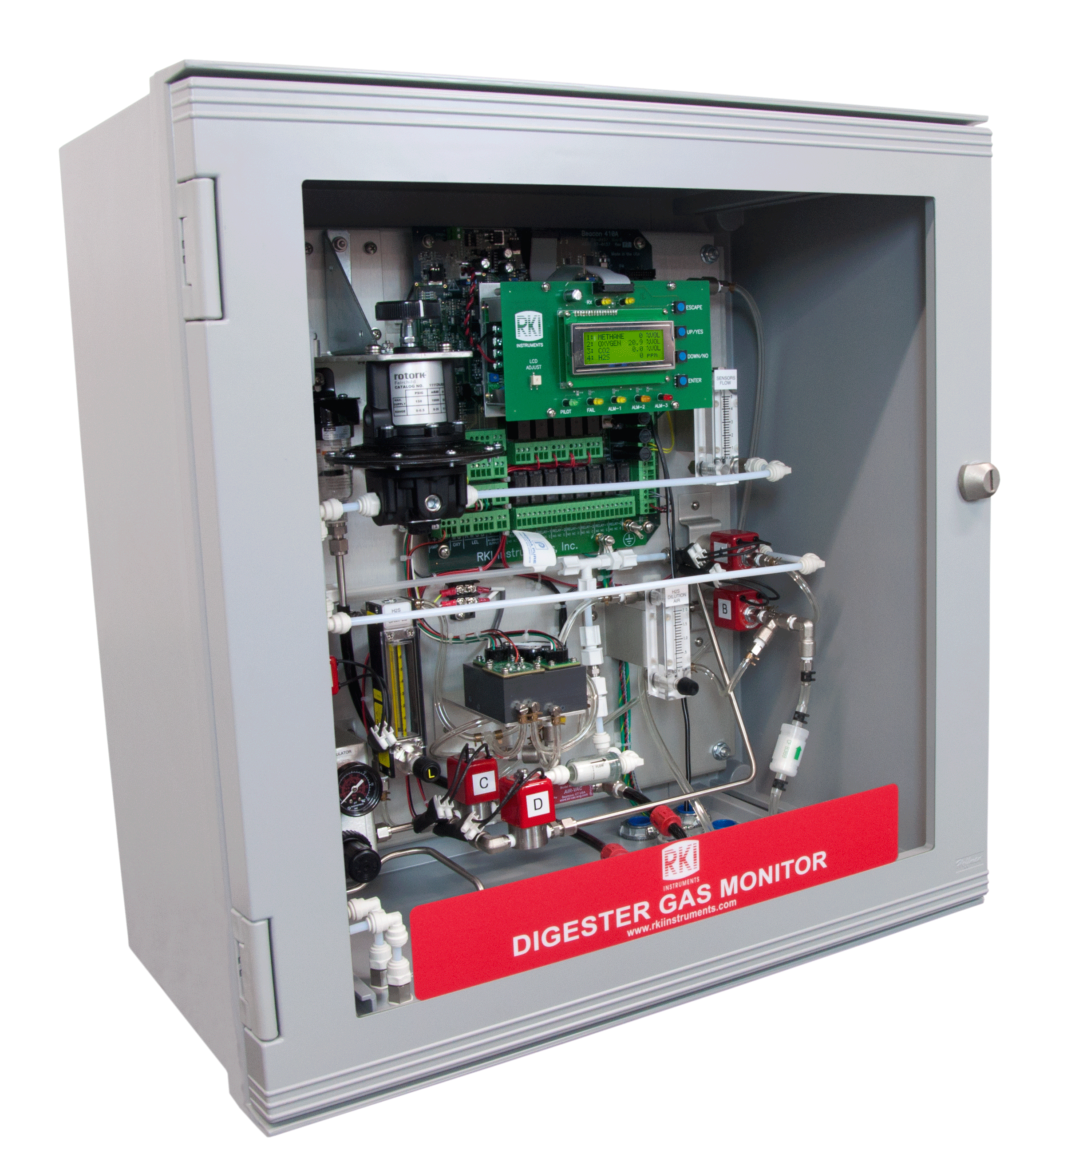
Digester Gas Monitor System

Slide 2
Detectable Gases
Accurately measure high levels of H2S
Up to 4 sensors
  Methane 0-100% Volume
  CO2 0-50% Volume
  Oxygen 0-25% Volume
  H2S 0-1000 PPM 0-3,000 or 5,000 optional

Slide 3
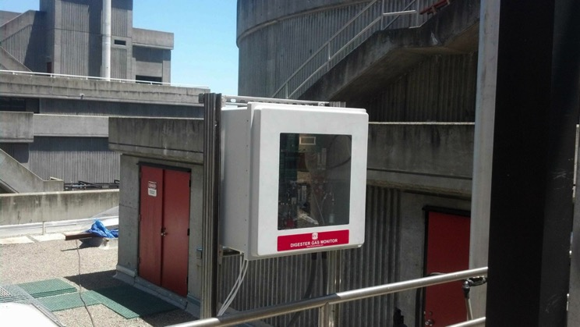
Features and Benefits
Sample system handles high humidity
100 ft. sample range
Self draining moisture trap
Nafion sample dryer
Automatic back-flush of sampling system
Long life air aspirator (no moving parts)
Corrosion resistant design, NEMA 4X enclosure

Slide 4
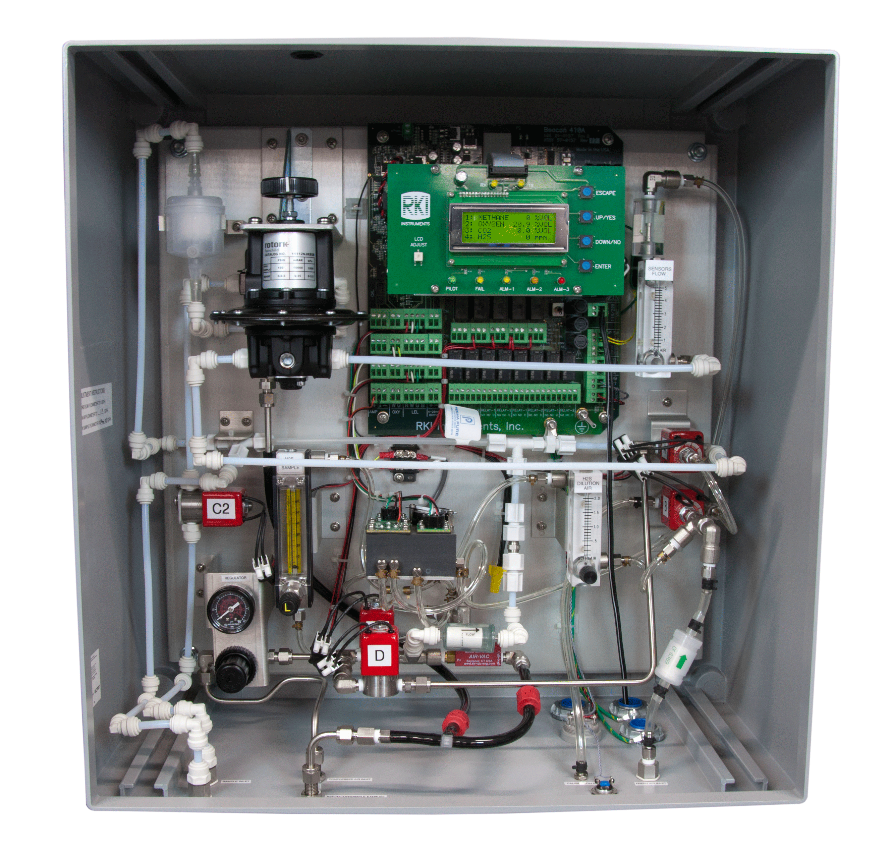
Features and Benefits
Three-stage moisture/humidity control
High range H2S detection (up to 5000 ppm)
Infrared sensors for methane and CO2 detection
Automatic zero adjustment
Rugged aspirator-based sampling system
Low pressure regulator for sample

Slide 5
Features and Benefits
Optional horn/strobe
User adjustable cycle interval from 15 minutes to 24 hours
Durable IR sensors for methane and CO2 detection
Long-life partial pressure O2 sensor

Slide 6
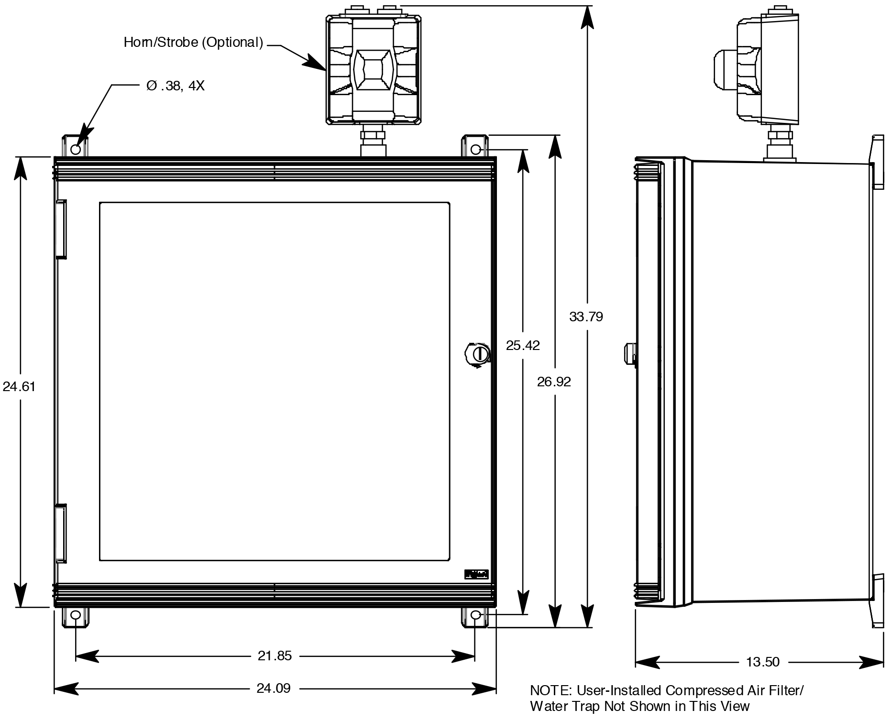
Mounting the Digester Gas Monitor

Slide 7
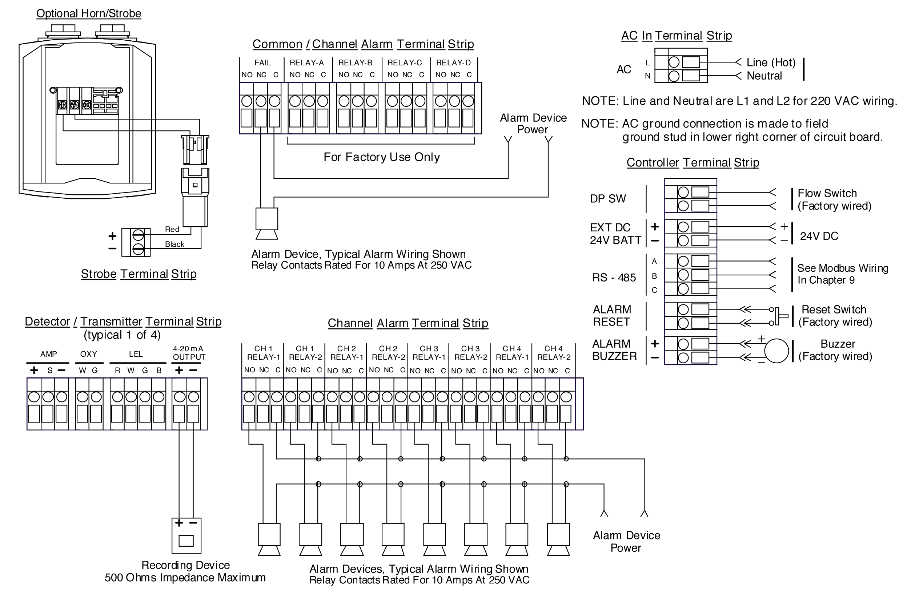
Wiring the Digester Gas Monitor

Slide 8
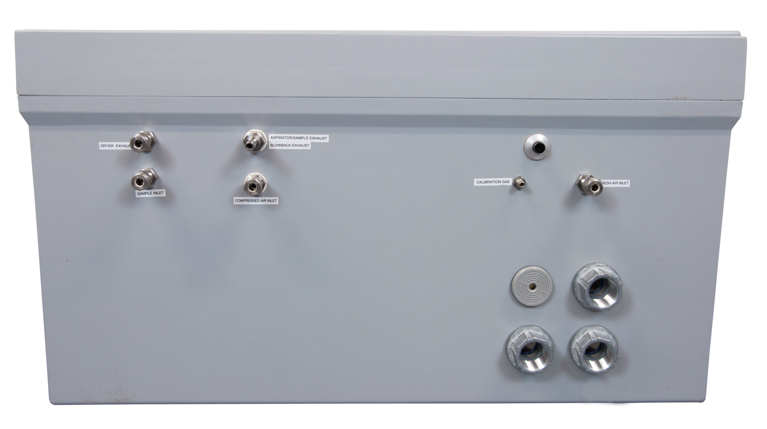
Attaching sample, compressed air, and exhaust lines
Aspirator / Sample
Blow Back Exhaust
Calibration Gas Inlet
Reset Switch, Push Button
Dryer
Exhaust
Fresh Air
Inlet
Digester
Sample
Conduit Hub, ¾”
Compressed Air Inlet
Buzzer

Slide 9
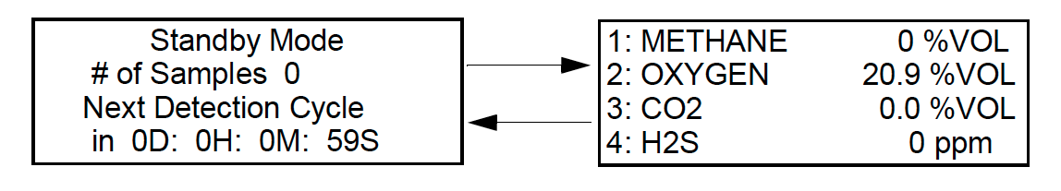
Starting Up the
Digester Gas Monitor
Toggle power switch to turn monitor on.
After warm-up countdown, the following will appear on the display.

Slide 10
Adjusting Flow Rates
Adjust flow rate to sensors
Main flow- Use the knob on the pressure regulator to set sensor flowmeter (upper right) to 3.0 SCFH

Slide 11
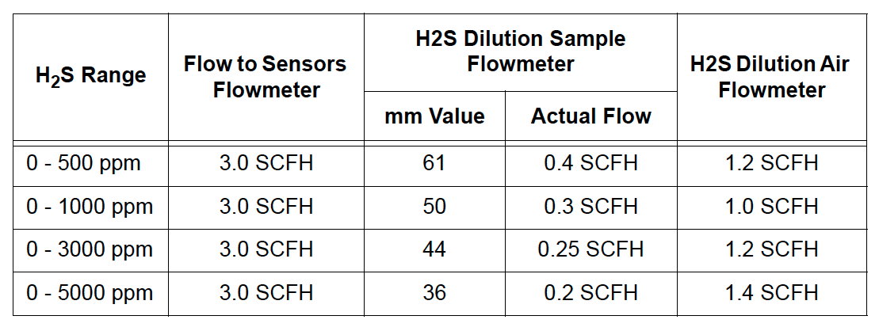
Adjusting Flow Rates
Adjust flow rate to sensors
H2S sample and dilution air: Adjust H2S sample and air flowmeters to the levels shown below for range 0-1000 ppm H2S.

Slide 12
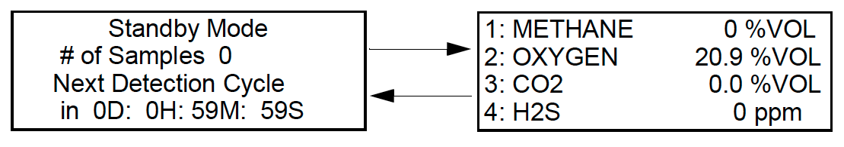
Normal Operation

Slide 13
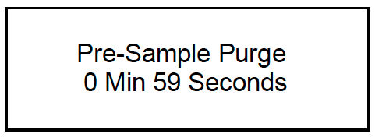
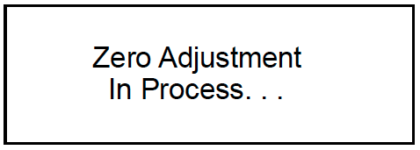
Detection Cycle
Each cycle uses a maximum of 63 liters of compressed air. This section describes the sequence of a detection cycle.
1. A 60 second pre-sample fresh air purge is performed.
2. A fresh air adjustment is performed on all installed sensors.

Slide 14
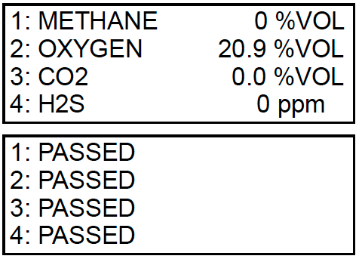
Detection Cycle cont’d
3. The fresh air readings will be displayed followed by the result of the fresh air adjustment.

Slide 15
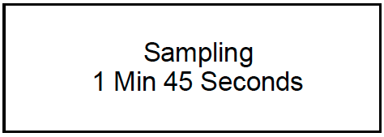
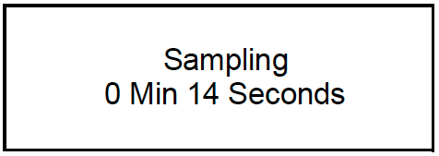
Detection Cycle cont’d
4. A 105 second sampling period is performed.
5. The H2S reading is taken after 90 seconds. The solenoids will click and the flow to the sensors will be stopped for 15 seconds to allow for a stabilization period. The countdown will continue on the display.

Slide 16
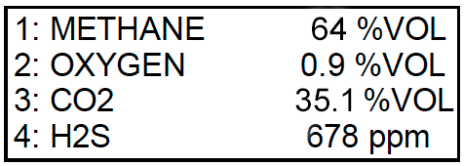
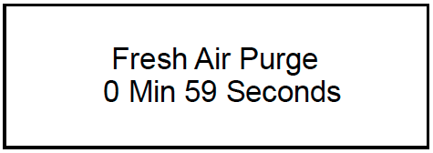
Detection Cycle cont’d
6. At the end of the stabilization period, the methane, oxygen, and carbon dioxide readings will be taken. The gas readings for all channels will then be displayed for 5 seconds.
7. A 60 second post-sample purge will then be performed to clear the Digester Gas Monitor of any residual sample.

Slide 17
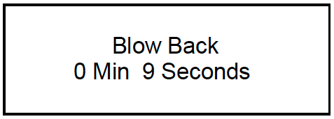
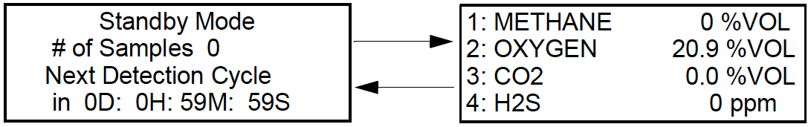
Detection Cycle cont’d
8. A 10 second blowback period follows the post-sample purge. The blowback clears the hydrophobic filter and the water trap of any contaminants.
9. Once the blow back operation is complete, the Digester Gas Monitor will return to Standby Mode. The gas readings displayed will be the last recorded gas readings at the end of the sample period described in step 4.

Slide 18
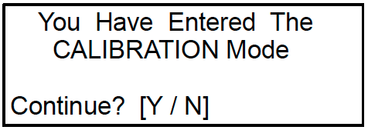
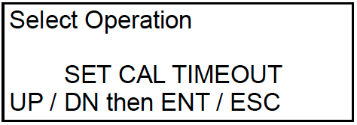
Calibration Mode
1. While in Standby Mode, simultaneously press and hold the ENTER and UP/YES buttons for approximately 3 seconds to enter Calibration Mode. Release the buttons when the You Have Entered The CALIBRATION Mode…message displays and asks if you want to continue in the Calibration Menu.
2. To exit Calibration Mode, press and release the DOWN/NO button The Digester Gas Monitor will return to Standby Mode
If you want to continue in Calibration Mode, press and release the UP/YES button to continue and display the Select Operation screen. The SET CAL TIMEOUT item will be displayed.

Slide 19
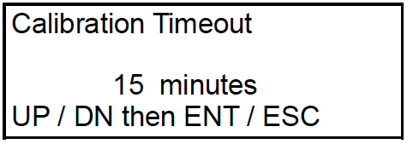
Calibration Timeout Setting
With SET CAL TIMEOUT displayed, press and release the ENTER button. The Calibration Timeout Screen appears.

Slide 20
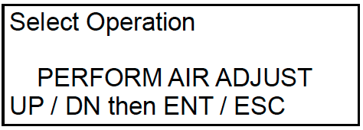
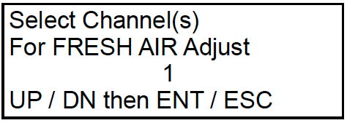
Performing a Fresh Air Adjustment
1. Use the UP/YES or DOWN/NO button to display PERFORM AIR ADJUST on the Select Operation Screen.
2. Press and release the ENTER button. The Select Channel(s) screen appears.

Slide 21
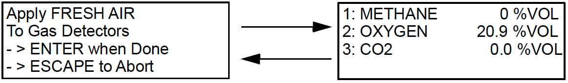
Performing a Fresh Air Adjustment
cont’d
3. Use the UP/YES or DOWN/NO button to scroll through the channel combination choices and select all 4 channels for air adjust.
Press and release the ENTER button to accept the displayed choice and continue with the air adjustment. The Digester Gas Monitor will begin to draw sample through the Fresh Air Inlet. The display will alternate between the two screens shown above.
4. If necessary, adjust the pressure regulator so that flow through sensor flowmeter is 3.0 SCFH

Slide 22
Performing a Fresh Air Adjustment
cont’d
5. Wait about one minute, then press and release Enter button. After a few seconds you will see message AIR ADJUST PASS or AIR ADJUST Fail. If PASS, proceed to Gas Adjustment.

Slide 23
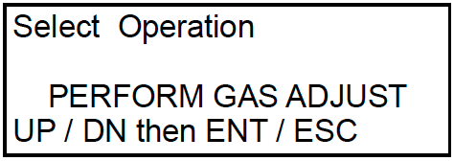
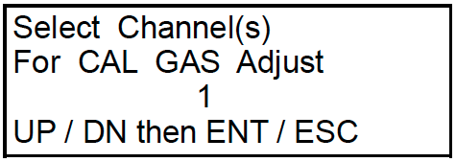
Performing a Gas Adjustment
1. Use the UP/YES or DOWN/NO button to display PERFORM GAS ADJUST on the Select Operation Screen.
2. Press and release the ENTER button. The Select Channel(s) screen appears.

Slide 24
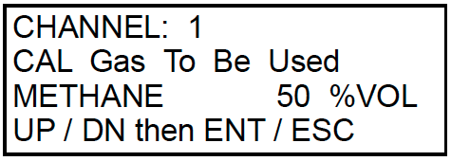
Performing a Gas Adjustment cont’d
3. Use the UP/YES or DOWN/NO button to scroll through the channel combination choices and select Channels 1, 2, and 3, assuming you are using a 3-gas span gas containing CO2, CH4, and balance N2.
4. Press and release the ENTER button to accept the displayed choice and continue with the gas adjustment. The display will show the calibration gas concentration that the Digester Gas Monitor expects you to use for the gas adjustment for the first selected channel.

Slide 25
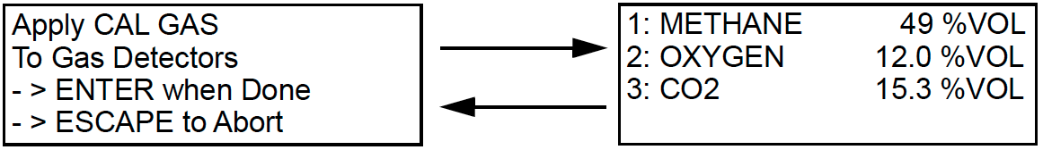
Performing a Gas Adjustment cont’d
5. Use the UP/YES and DOWN/NO buttons to make the displayed concentration match the calibration gas concentration, then press and release the ENTER button to accept it. The display will show the expected calibration gas concentration for the next selected channel.
Repeat step above for each selected channel. When the last selected channel’s calibration gas concentration has been accepted, the Digester Gas Monitor will begin to draw sample through the Calibration Gas Fitting. The two screens above will alternate.

Slide 26
Performing a Gas Adjustment cont’d
Attach the calibration gas cylinder for the selected channels using the demand flow regulator. The Digester Gas Monitor will begin to draw sample through the Calibration Gas Fitting. The two screens above will alternate. Check sensor flow and if necessary reset to 3.0 SCFH using pressure regulator knob.

Slide 27
Performing a Gas Adjustment cont’d
6. Once the gas readings have stabilized (about one minute), press ENTER button to perform calibration. Display will show PASS or FAIL, and then return to Perform Gas Adjust Screen. Remove calibration gas from calibration gas inlet fitting.
Press yes button and then use up or down button to select channel 4 (H2S)

Slide 28
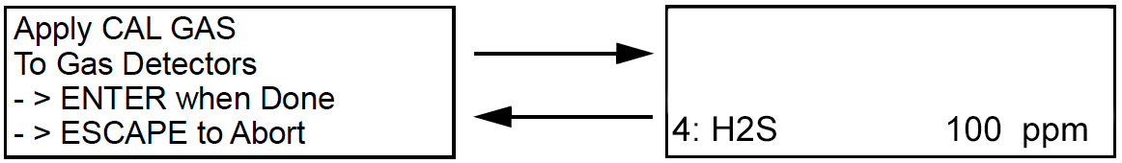
Performing a Gas Adjustment cont’d
7. Connect the H2S cylinder to the calibration gas inlet fitting
8. Use the UP/YES and DOWN/NO buttons to make the displayed concentration match the calibration gas concentration, then press and release the ENTER button to accept it. The display will show the expected calibration gas concentration for the next selected channel.
When the calibration gas concentration has been accepted, the Digester Gas Monitor will begin to draw sample through the Calibration Gas Fitting. The two screens above will alternate.

Slide 29
Performing a Gas Adjustment cont’d
Check the flow rate on the H2S air and dilution flowmeters and adjust if necessary. Once the gas readings have stabilized (about one minute), press ENTER button to perform calibration. Display will show PASS or FAIL, and then return to Perform Gas Adjust Screen. Remove calibration gas from calibration gas inlet fitting.
Press Escape to exit calibration mode.
Once unit has returned to normal operation, press and hold ENTER button to manually start another cycle. Check flow rate during sampling mode on all flowmeters and adjust if necessary.

Slide 30
Questions?

