Slide 1
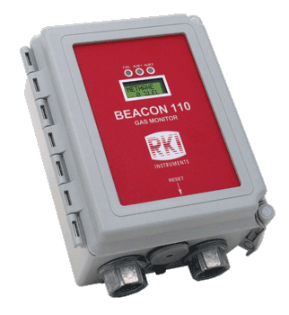
Beacon 110
Single Channel Wall Mount Controller

Slide 2
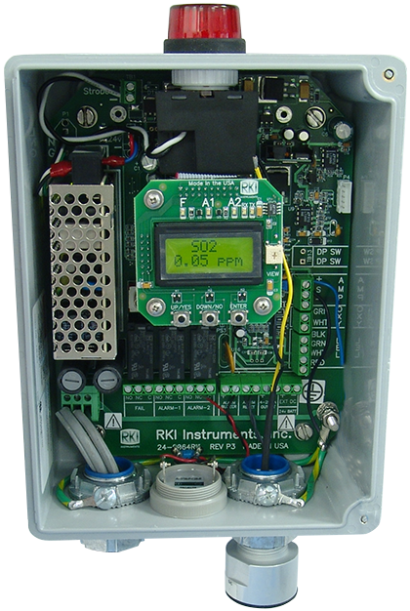
Internal Components
Optional Strobe
Alarm 3 LEDs
Alarm 1
Alarm 2
Fail
PCB Control Switches
UP/YES
DOWN/NO
ENTER
On/Off toggle switch
94 dB Buzzer Alarm
Alarm Reset Switch
Backlit LCD Display
Simultaneous readout of the gas type and concentration
Compact NEMA-4X weather resistant enclosure
Accepts any 4-20 mA transmitter or direct connect sensors for LEL / O2 / H2S / CO / CO2
2 programmable alarm levels per channel

Slide 3
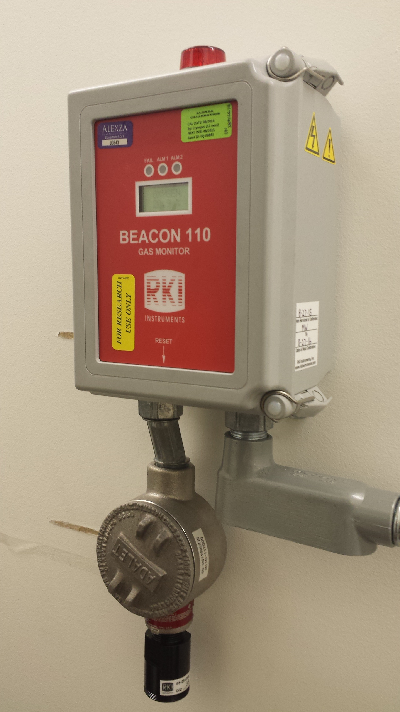
Calibration
Internal amp setup
  Sensor wired directly to controller.
  Gas applied directly to sensor.
  Adjustments made at controller.

Slide 4
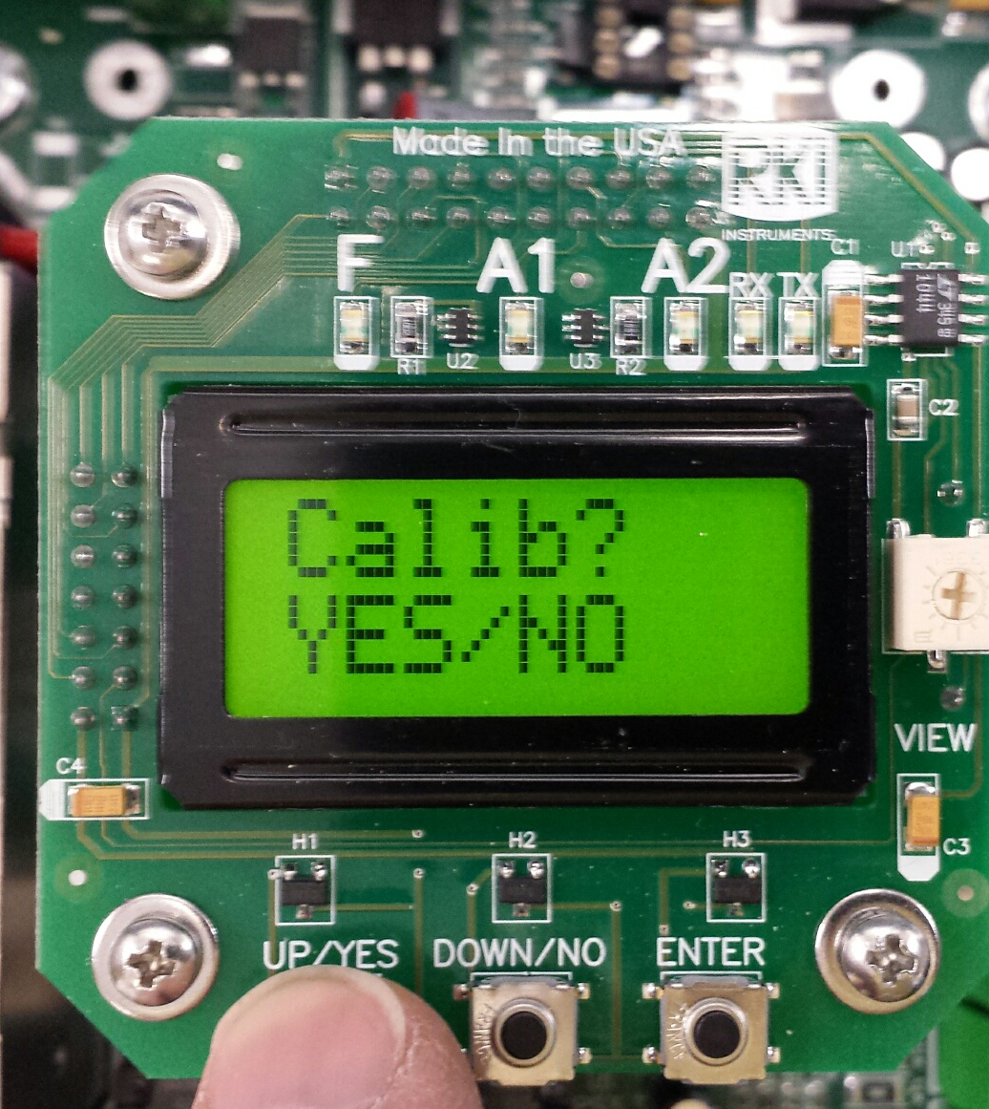
Calibration Mode
Press and hold the UP/YES Button to enter the calibration mode menu.
Press the YES button to proceed.

Slide 5
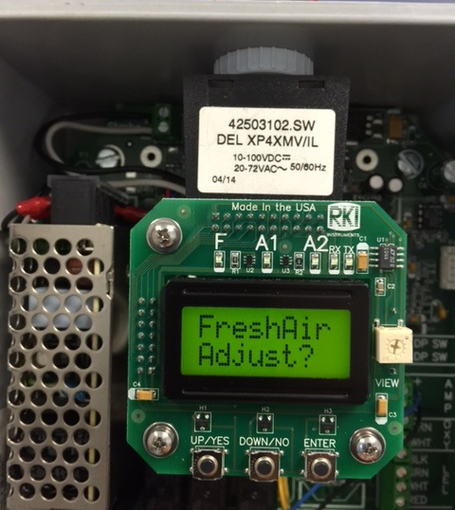
Fresh Air Adjustment
Confirm that atmosphere is fresh before making fresh air adjustment.
Apply Zero Air to sensor if atmosphere is suspect.

Slide 6
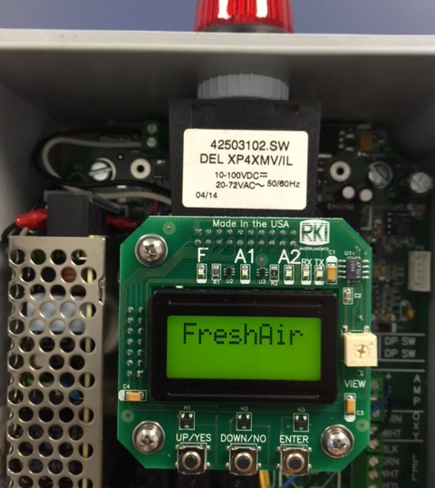
Fresh Air Adjustment
Allow sensor to stabilize when supplying Zero Air.

Slide 7
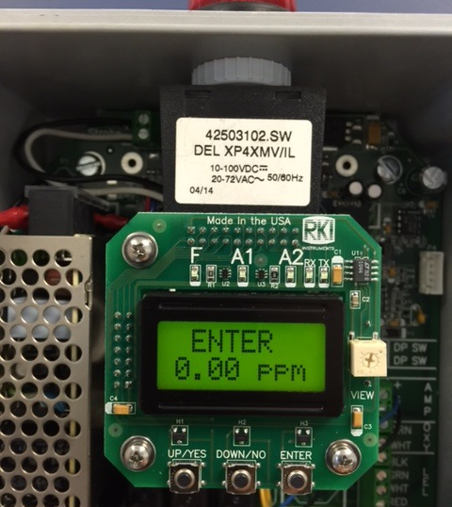
Fresh Air Adjustment
Press the ENTER button when reading has stabilized and to complete the fresh air adjustment.

Slide 8
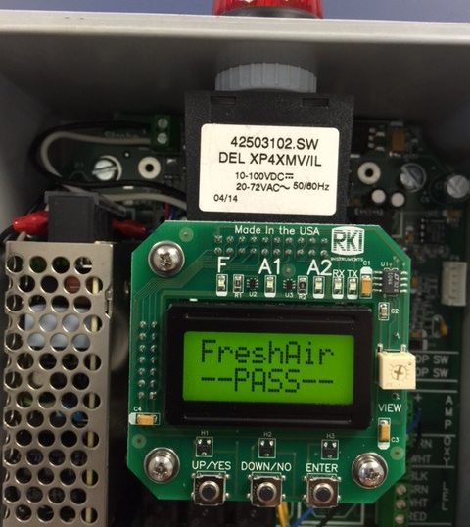
Fresh Air Adjustment
If Fresh Air adjustment is successful, PASS will be displayed. If not, FAIL will be displayed.
Check sensor and test gas.

Slide 9
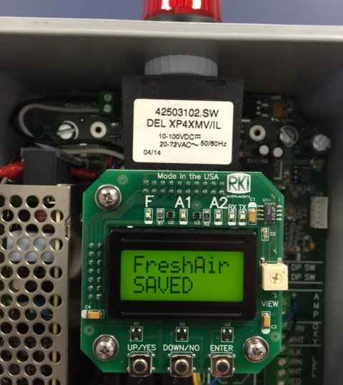
Fresh Air Adjustment
The new fresh air setting will be saved in memory.

Slide 10
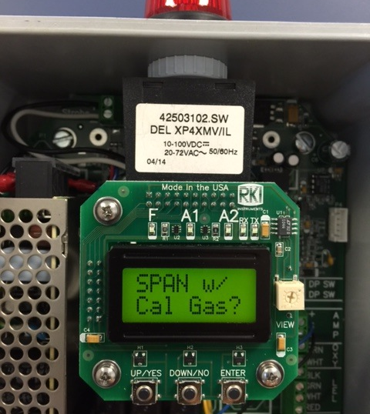
Gas Adjustment
Upon completion of Air Adjustment, the Beacon 110 will prompt you if you would like to SPAN with Gas.
Press YES to continue.

Slide 11
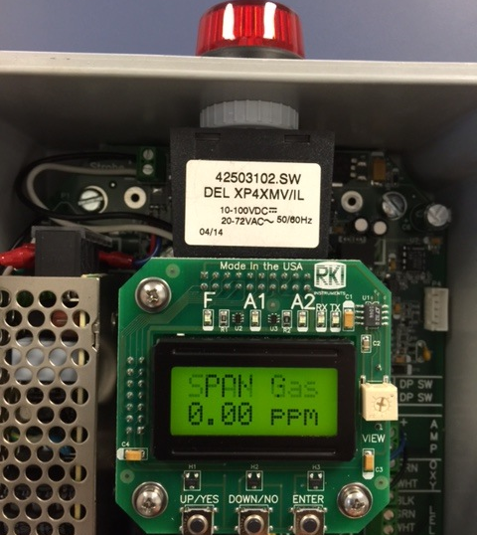
Gas Adjustment
Assemble calibration kit.
Attach calibration cup to sensor.

Slide 12
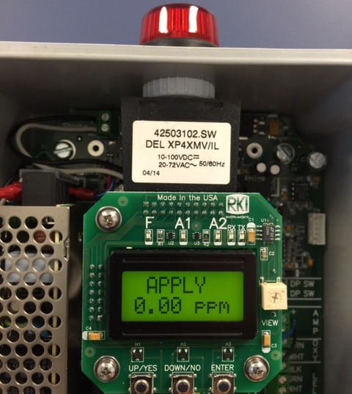
Gas Adjustment
Apply Span gas to detector.

Slide 13
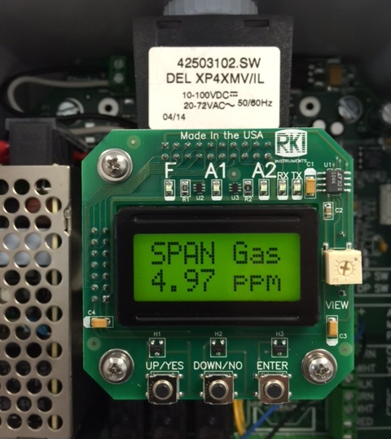
Gas Adjustment
Allow reading to stabilize.
Maximum of two minutes.

Slide 14
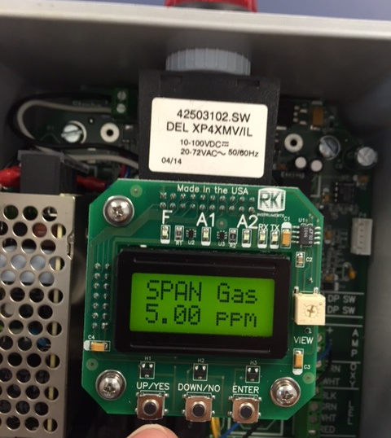
Gas Adjustment
Using UP or DOWN button, adjust span to proper setting then press the ENTER button to complete.

Slide 15
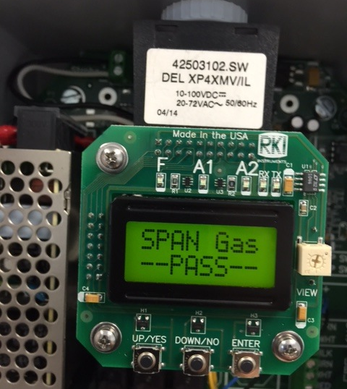
Gas Adjustment
PASS will be displayed if calibration is successful.

Slide 16
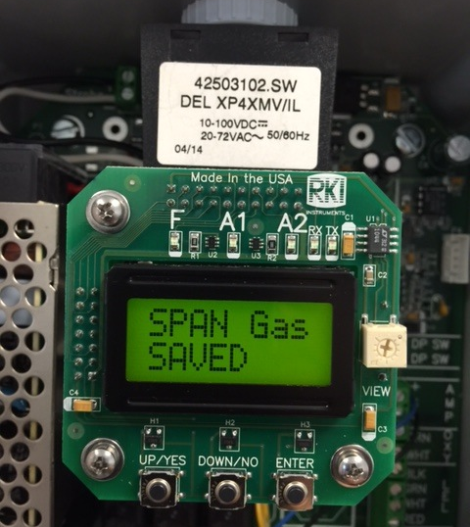
Gas Adjustment
Calibration data will be saved.

Slide 17
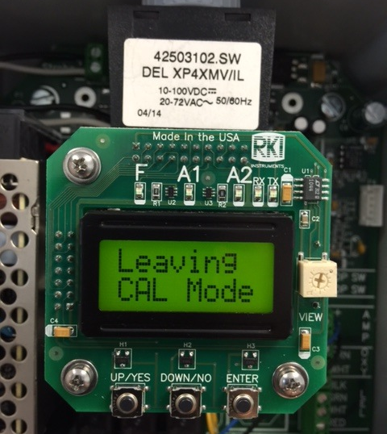
Gas Adjustment
When calibration is complete, it will leave the calibration mode allowing time for the sensor to return to normal condition.

Slide 18
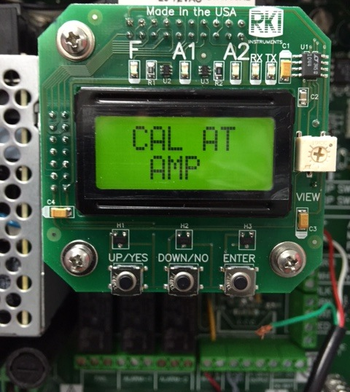
Gas Adjustment
If the Beacon 110 is set up with a remote amp transmitter, “CAL AT AMP” will be displayed.

Slide 19
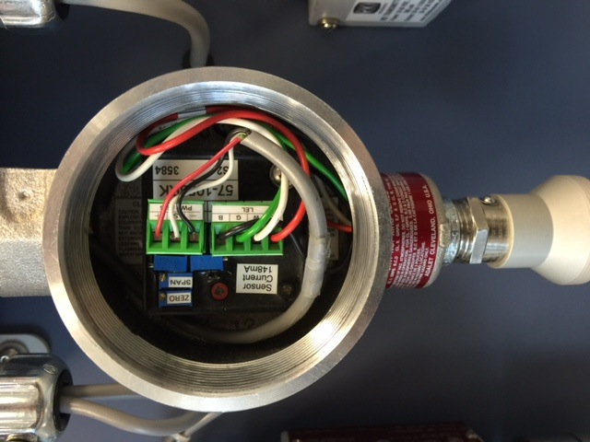
Gas Adjustment
Calibrate detector as needed.
DMM, small flat blade screwdriver and calibration kit are required.

Slide 20
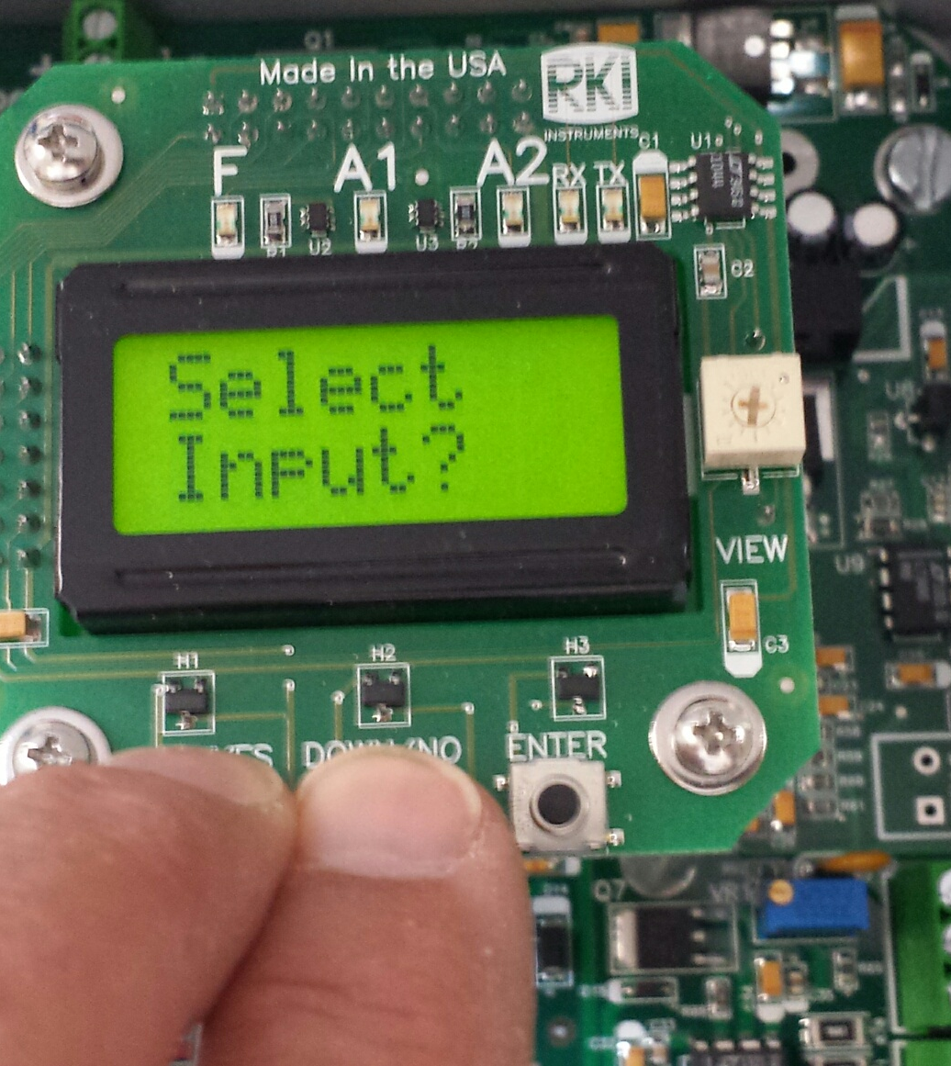
Select Input Mode
Press and hold the UP/YES and DOWN/NO buttons to enter the Select Input mode.
This allows selection of the proper input type such as:
  O2 DIR
  TOX DIR
  LEL DIR
  4-20 mA transmitter

Slide 21
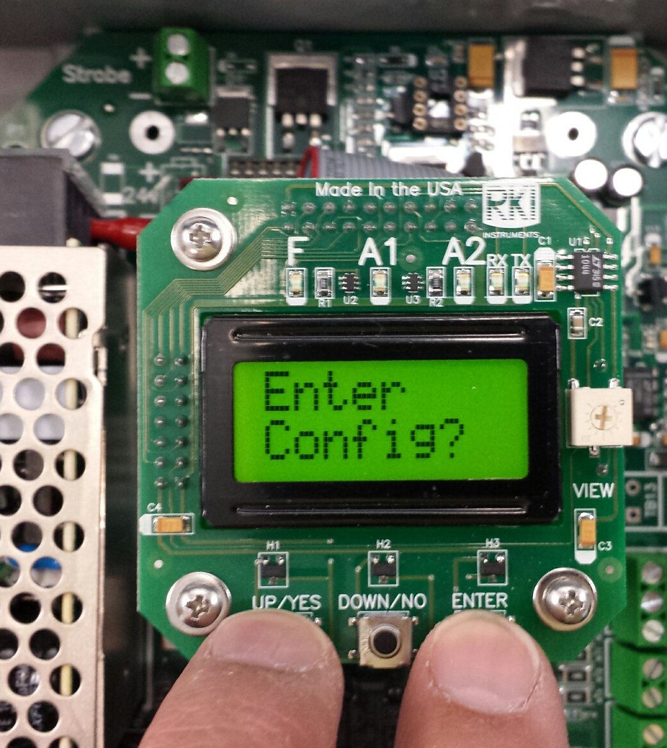
Configuration Mode
Press and hold the UP/Yes and ENTER buttons to enter the Config Mode.
This mode is used for setting all internal parameters.

Slide 22
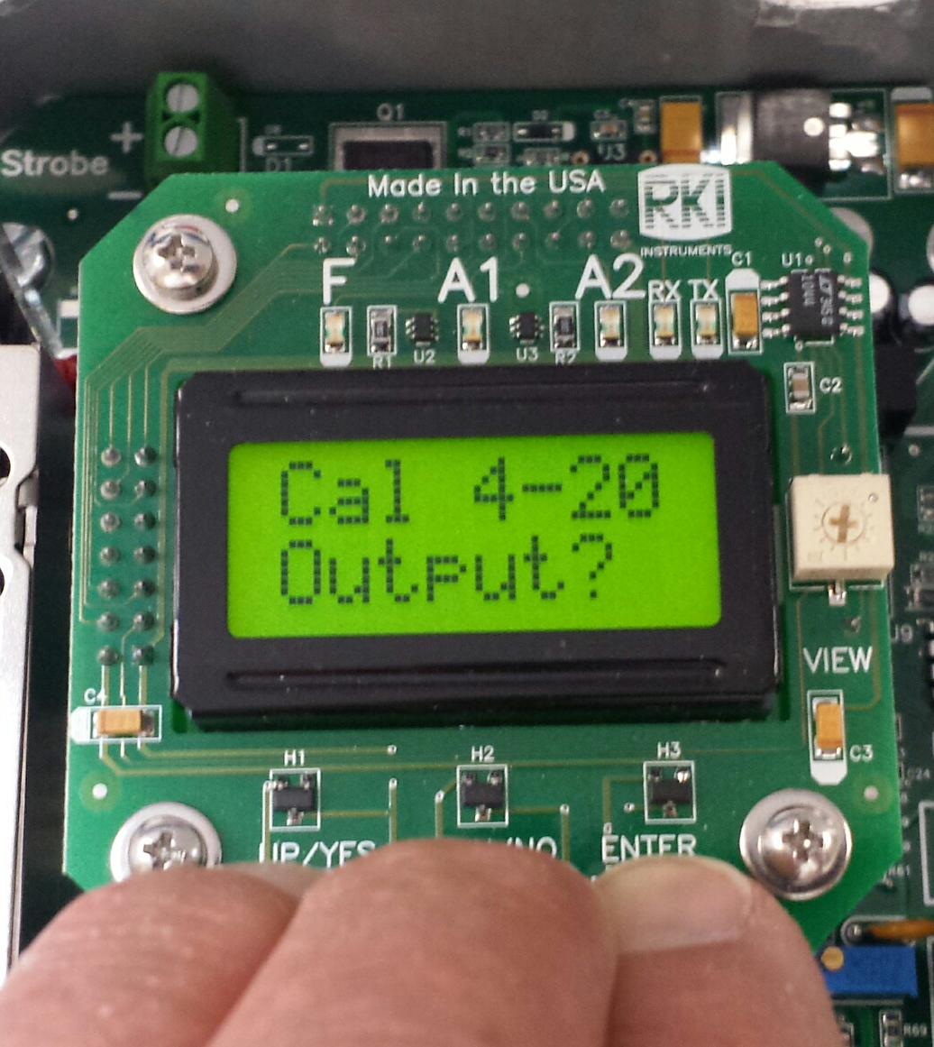
Cal 4-20mA Mode
Press and hold the UP/YES, DOWN/NO and ENTER buttons to enter the Cal 4-20 Mode.
This mode is used for fine tuning the 4-20 mA output.

Slide 23
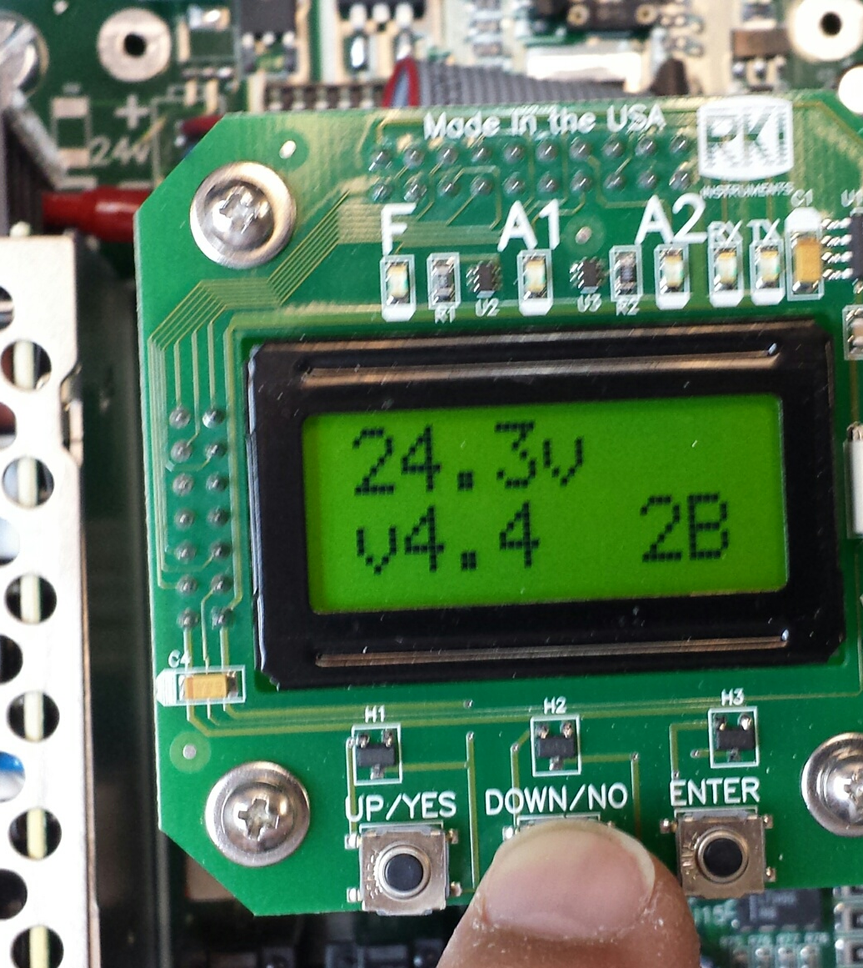
Input Voltage and Firmware
Push and hold the DOWN/NO button to view the input voltage and firmware version.

Slide 24
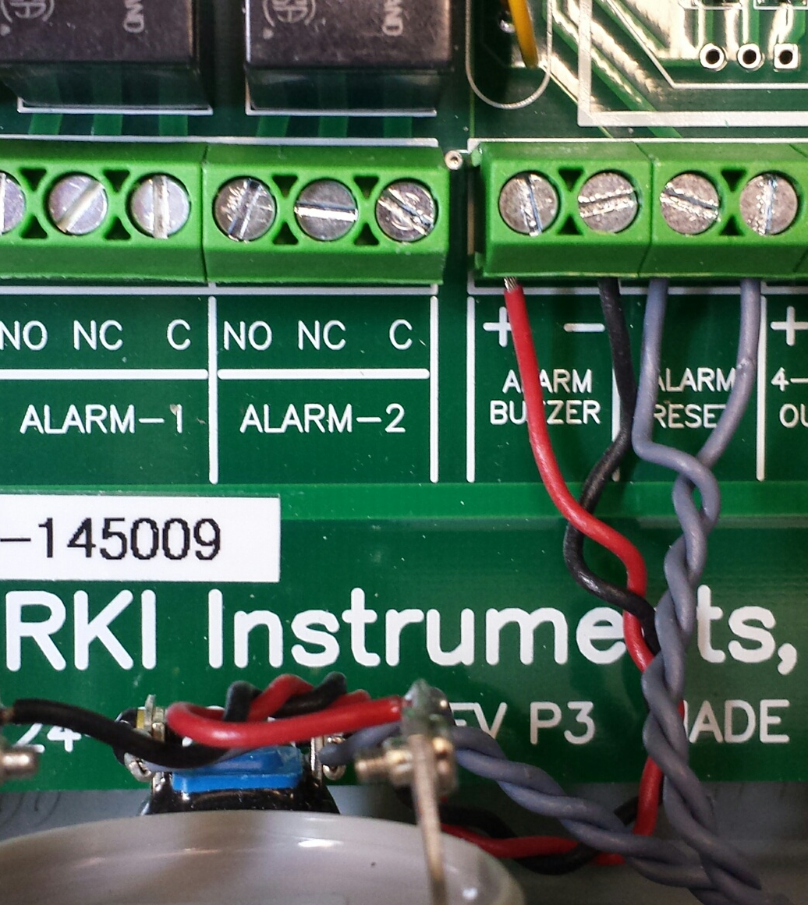
Terminal Connections
Form C contacts for Alarm-1, Alarm-2, and Fail relays.
  Common, Normally Open and Normally Closed contacts
  Note: Fail Relay is normally energized in normal operation, de-energized in fail condition.

Slide 25

Questions?

