Slide 1
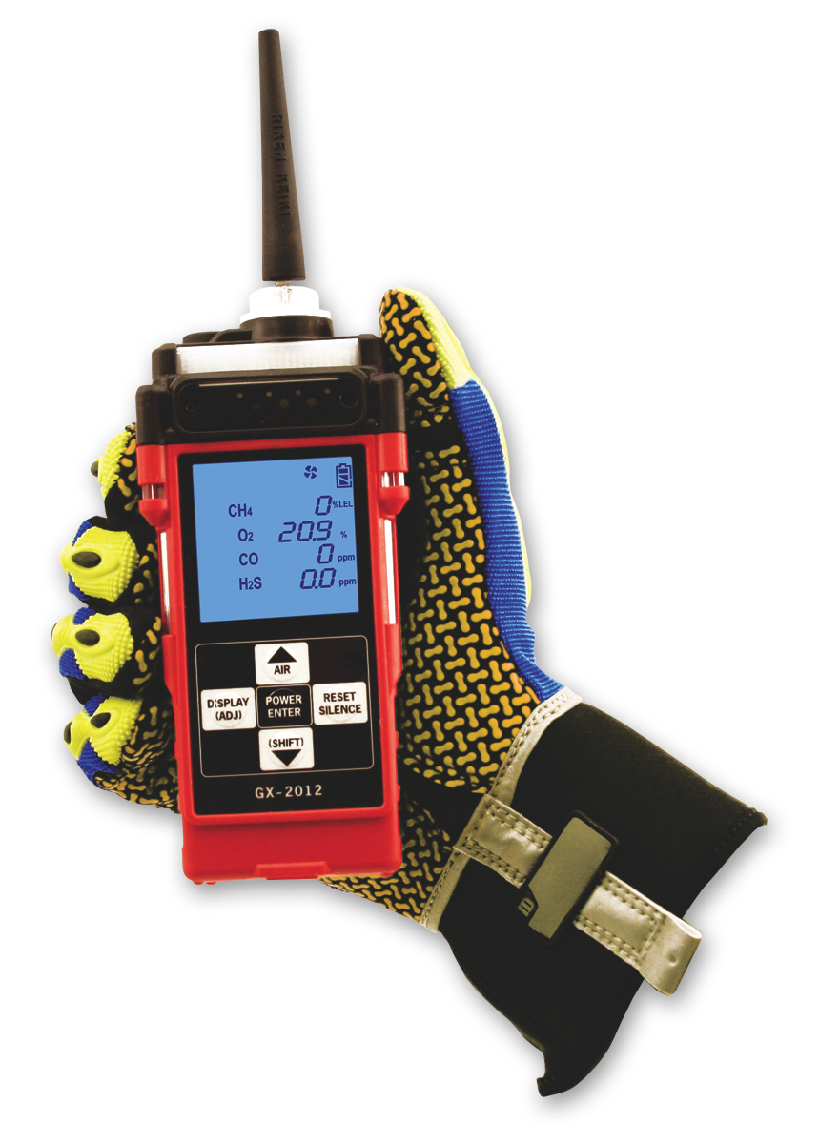
Setting Flow Alarm

Slide 2
Setting Flow Alarm
Entering Maintenance Mode
  Press and hold the AIR and SHIFT buttons, then press the POWER ENTER button and release all when the unit beeps
  First screen will prompt you for the password- Enter 2102
  Press ENTER

Slide 3
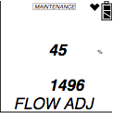
Setting Flow Alarm
Use the Air key to scroll through the menu items
Select FLOW ADJUSTMENT by pressing ENTER
Two values will be displayed
  The top value is a percentage
  The bottom value is the current low flow alarm point (this is the value we are most concerned with.)

Slide 4
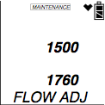
Setting Flow Alarm
Using the AIR or SHIFT buttons to set value as close to 1500 then press the ENTER.
The pump will turn on and two new values will be displayed. The top will be a reference value and the bottom will reflect the pump’s current draw.
Connect a flow meter to the inlet of the instrument and adjust it to 0.6 SCFH ± 0.1 SCFH. This will be the low flow set point.
Press the POWER ENTER button to set the trip point.
Use the SHIFT button to select START MEASURMENT then press POWER to exit.

