Slide 1

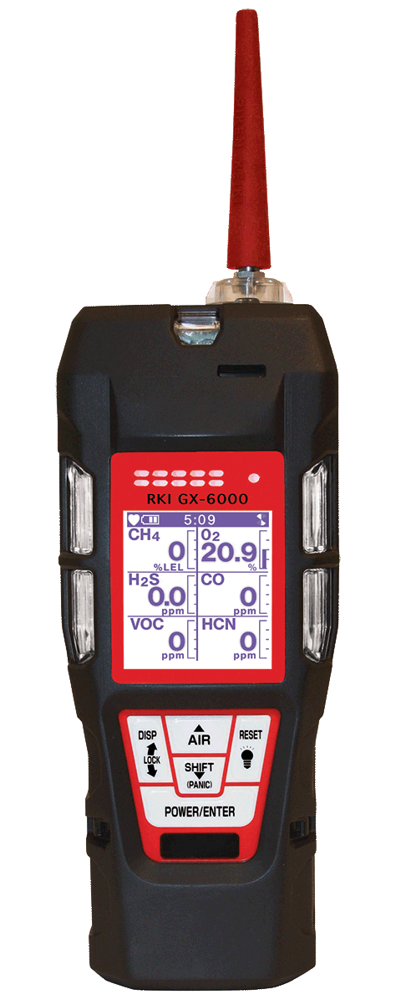
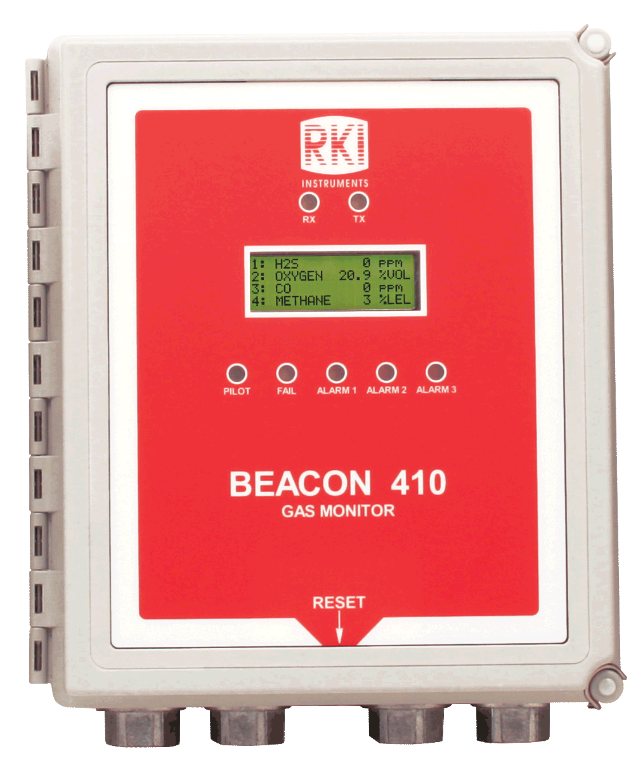
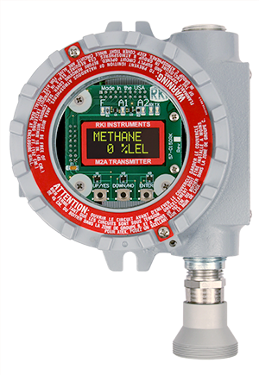
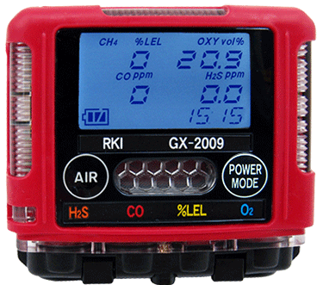

Slide 2
Distributor Partnership Program
Stocking distributor: provide immediate delivery
  Increased sales
Service Center: provide immediate local instrument service, calibration and repair parts.
  Increased profits
Regional RKI Representative provide ongoing partner service center/distributor product training.
  Increased confidence
RKI business culture is unlike any other gas detection manufacture in the industry. We provide the highest quality product, immediate and exceptional customer service and technical support (USA).
  Increased reliability
RKI believes in working with partner distributors to develop their markets by provide you with orders (not sales leads) from area end-users.
  Increased team loyalty and trust.

