Slide 1


Slide 2

First Catalytic LEL Sensor
1926

Slide 3
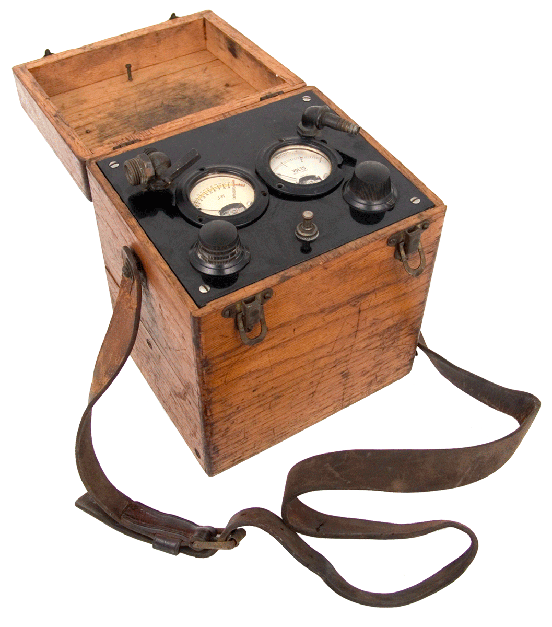
First LEL Monitor introduced in 1927
Model B

Slide 4
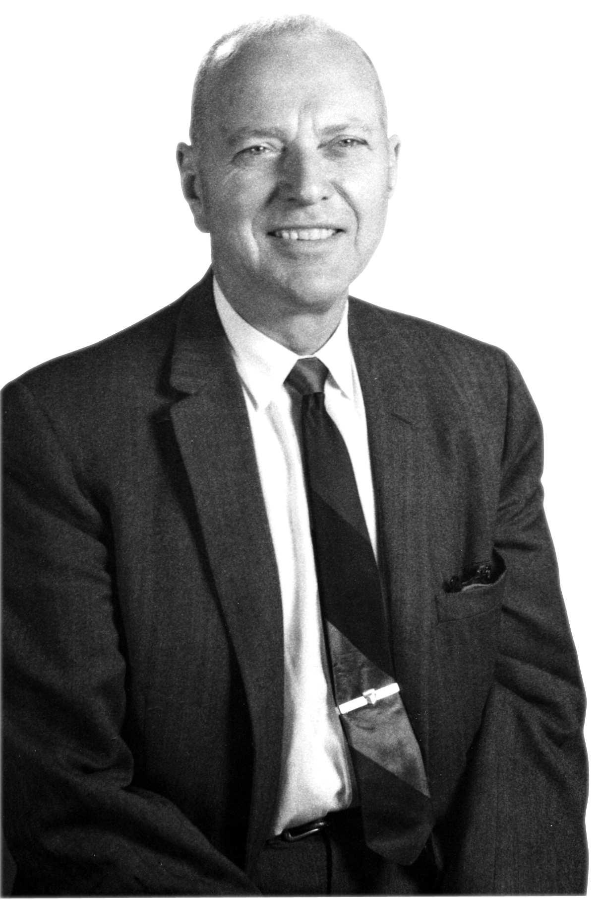
Dr. Oliver Johnson
Developed first catalytic LEL sensor in 1926
Founder of JW Instruments
JW Instruments purchased by Bacharach
Ken Johnson’s father
Bob Pellissier’s grandfather
Notes:
Bacharach acquires JW Instruments in 1965.

Slide 5
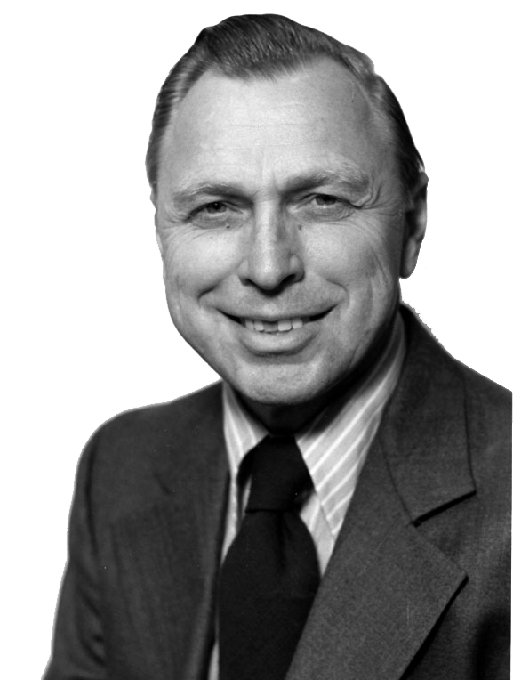
Ken Johnson
Founder of GasTech
Designed many instruments with JW Instruments and GasTech
Established the Riken Keiki relationship

Slide 6


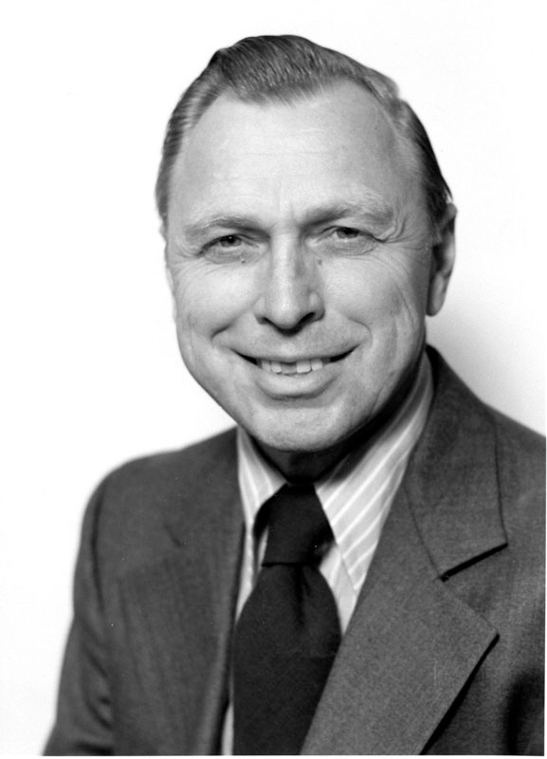
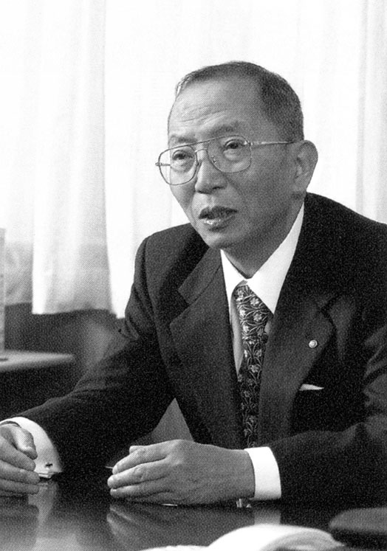
1971
Ken Johnson
Yoshio Nakajima

Slide 7
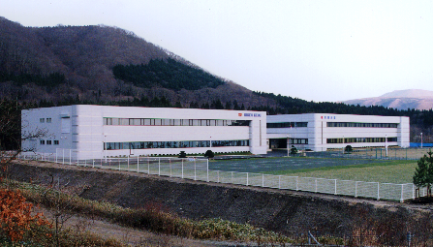

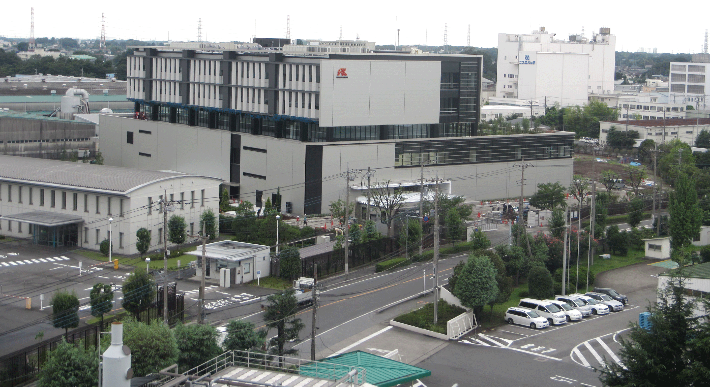
World leader in gas detection and sensor technology for over 75 years.
Sensors are made not purchased.
Over 1,000 employees.
RKI is the North American supplier of all Riken products.
Part owners of RKI Instruments.
Notes:
33 Service branches
22 Sales offices
Because of Riken’s ownership, RKI will not be acquired by another competitor

Slide 8
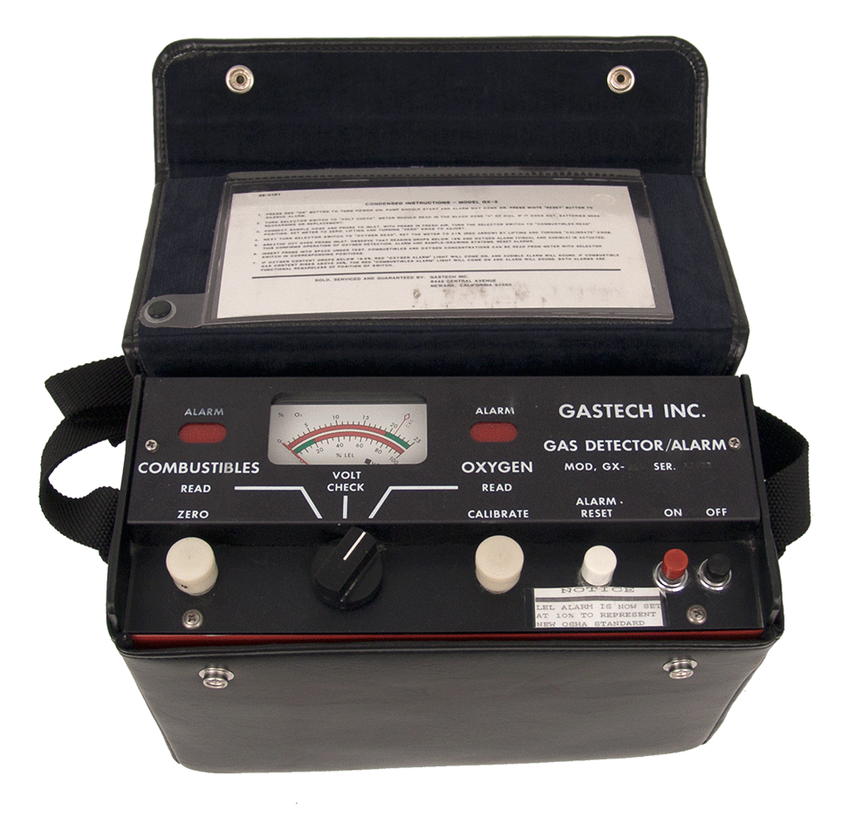
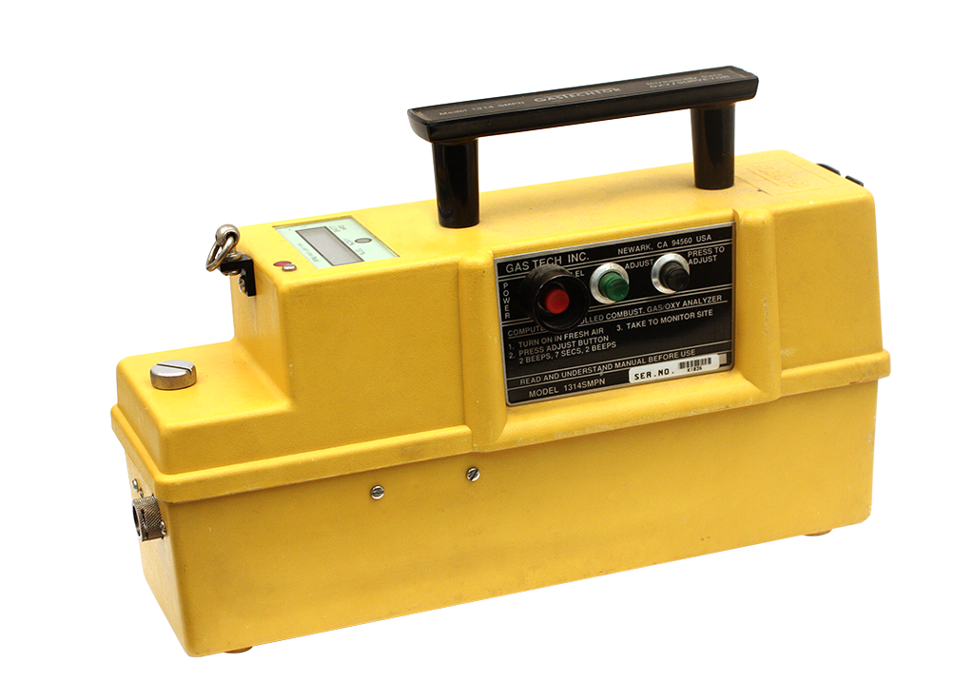
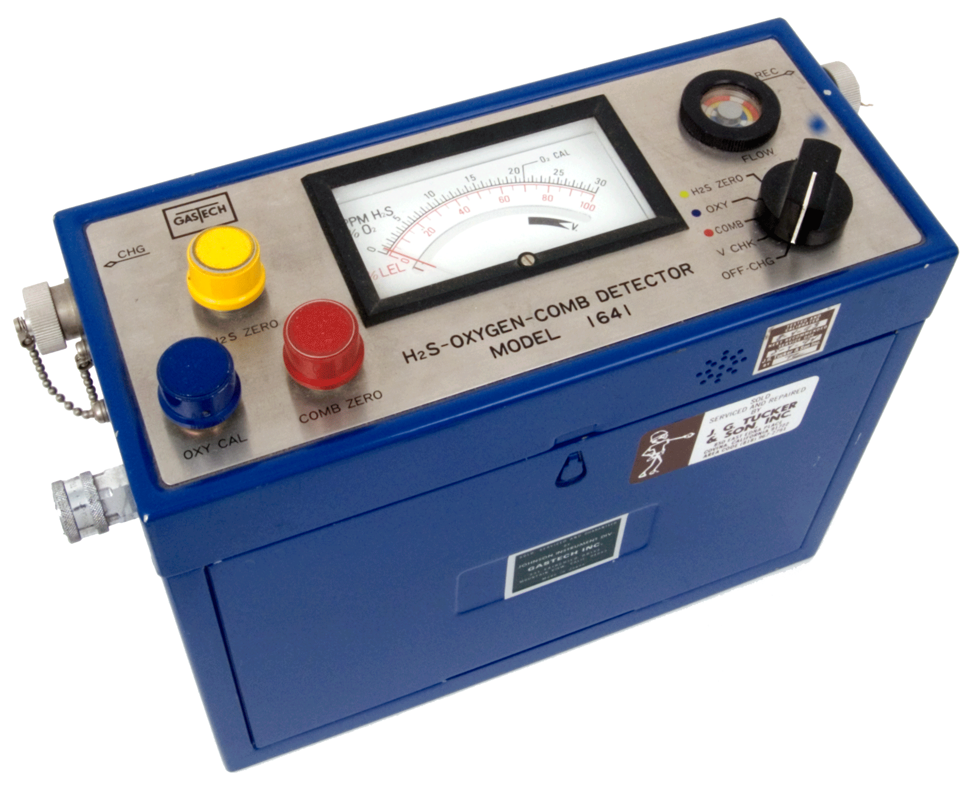

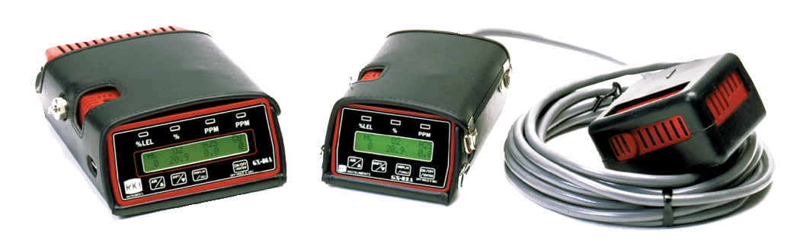

1971
1992
Notes:
The golden era:
GasTech and Riken Keiki both have similar philosophies of customer and employee focus.
First 3 gas monitor, Model 1641
First 4 gas belt worn monitor, GX-86
List price for a 4 gas monitor was $2,095
Instruments were larger
Customer applications were more relevant than compliance

Slide 9

1992
Notes:
GasTech is sold to Thermo Scientific
Ken Johnson leaves GasTech to start KWJ Engineering
Large culture change occurs within GasTech. Profits became higher priority.
- new GasTech management under Thermo direction became profit driven.
- decided to design and develop without Riken Keiki to lower costs
Riken product sales went from 60% of GasTech business down to 18%

Slide 10
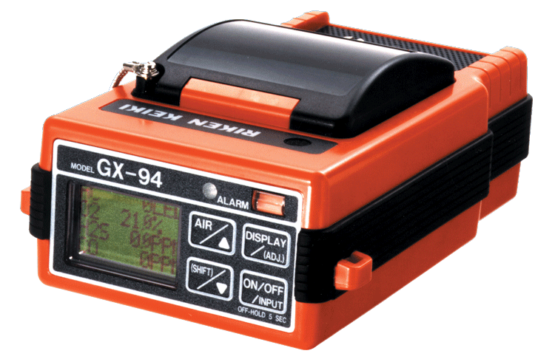

1992
1994
Notes:
Riken remains committed to Thermo GasTech.
GX-94 becomes a defining moment.
GasTech management decides not to carry the GX-94, and the Riken relationship ends
Riken Keiki go into business with Bob Pellissier and Sandra Gallagher and create RKI Instruments

Slide 11
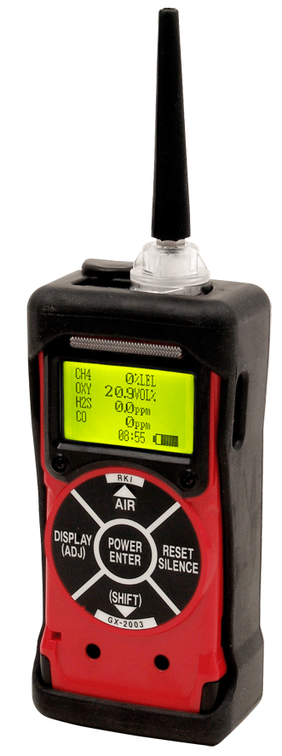
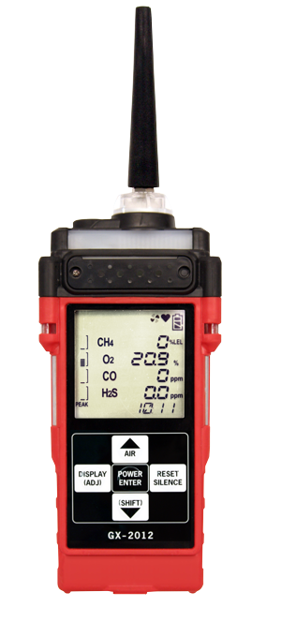
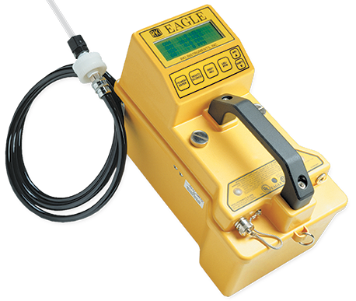
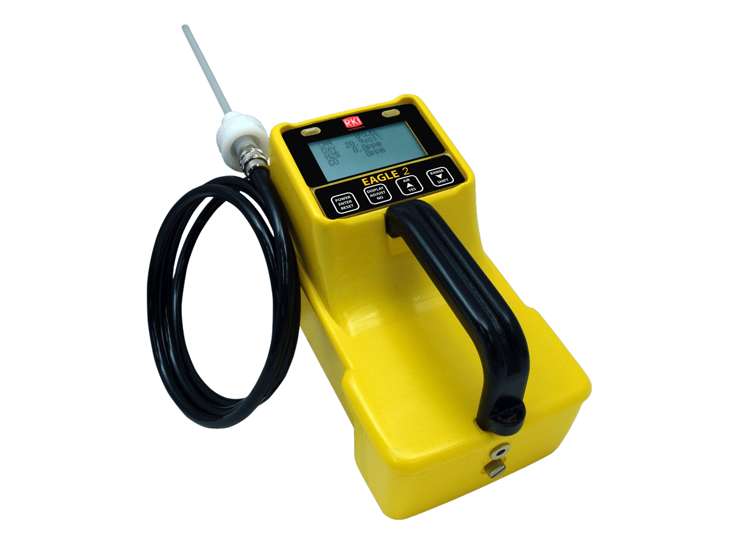

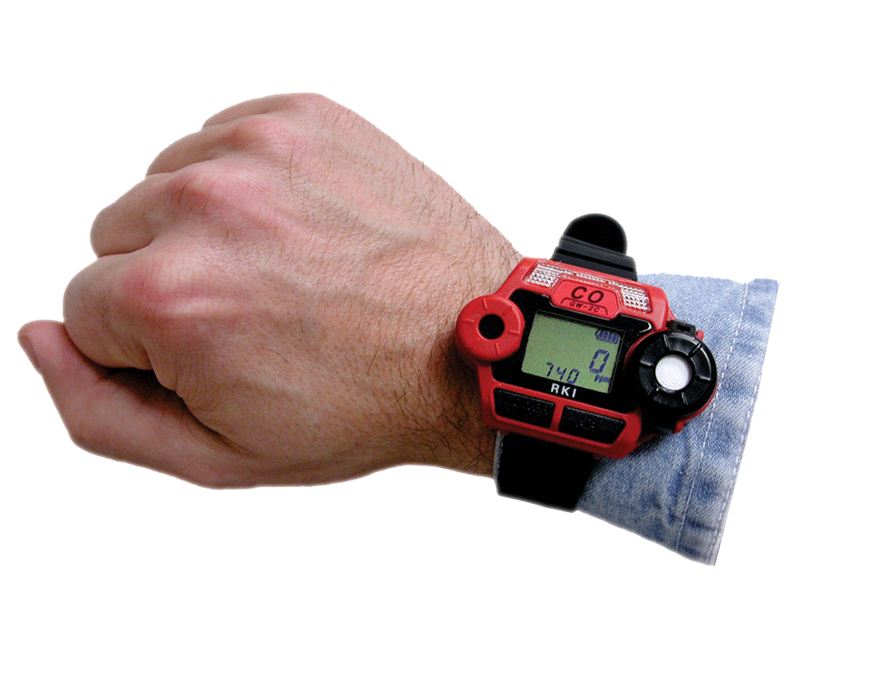
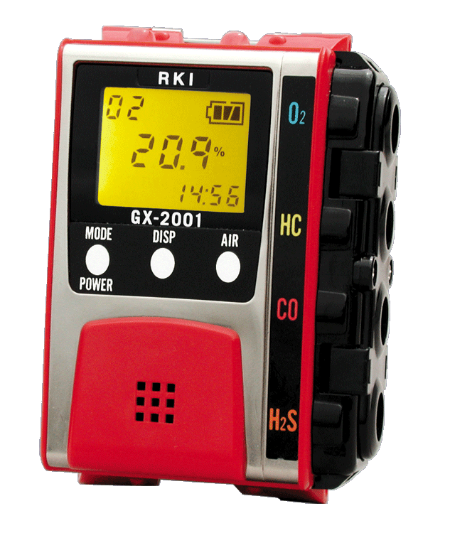
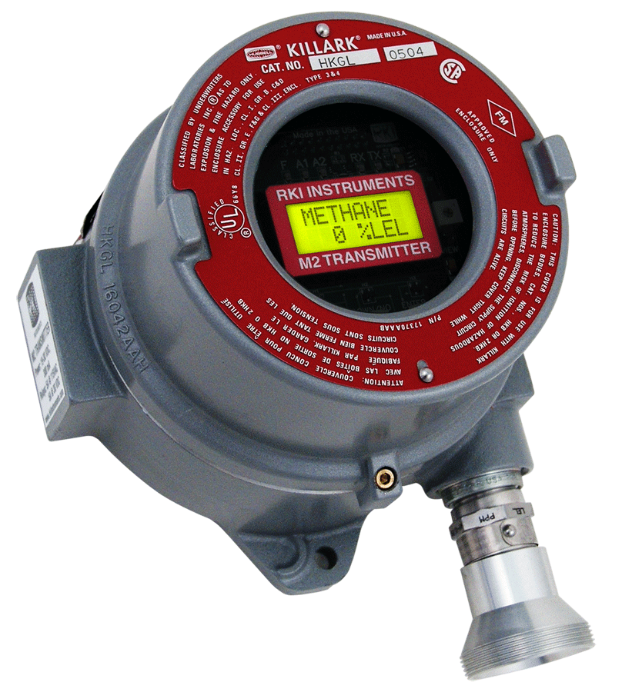

1994
2014
Notes:
New age in gas detection:
The internet is invented
List price for a 4 gas monitor drops down to $695
Competitors begin sourcing from China
Compliance becomes more important motivator to customers
Competitive acquisitions
Riken refuses to source from China or jeopardize quality in order to lower prices
Many GasTech Employees matriculate to RKI
GasTech facilities are closed
Thermo Scientific discontinues all GasTech products
RKI milestones
First 6 gas monitor, Eagle
First wrist worn monitor, Gaswatch
Worlds smallest gas monitor

Slide 13

70 employees

Slide 14
11 Years
Average years of gas detection experience per employee

