Slide 1
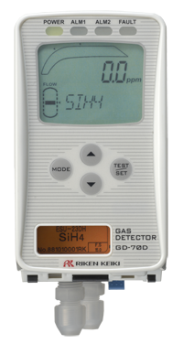
GD-70D series
Solar Cell, Semiconductor & LCD Factories
Improved Function
Environmentally
Friendly Design
Global Standard

Slide 2
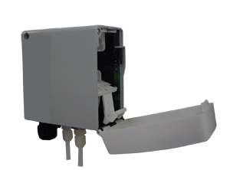
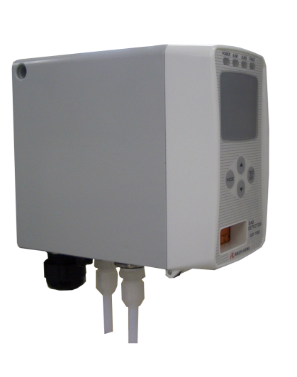
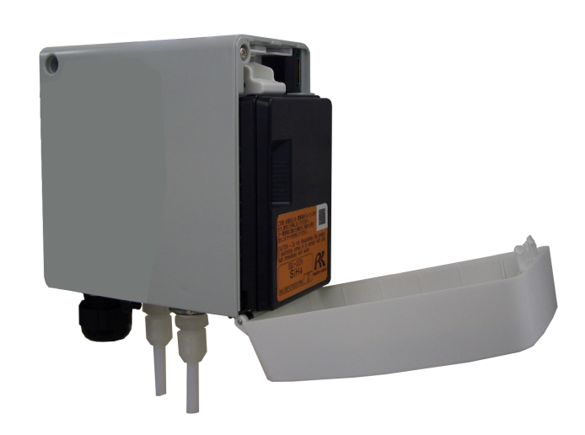
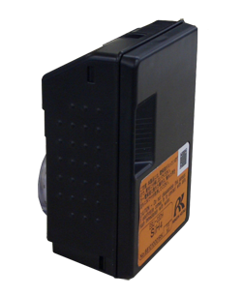
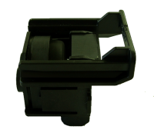
Main Components
Parts are easily replaceable
GD-70D consists of three independent modules: main unit, sensor unit and pump unit.
a) Main unit
b) Sensor unit
c) Pump Unit
Pump p/n 30-1020RK

Slide 3
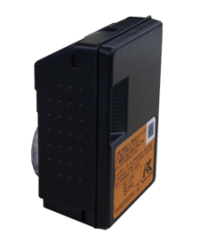
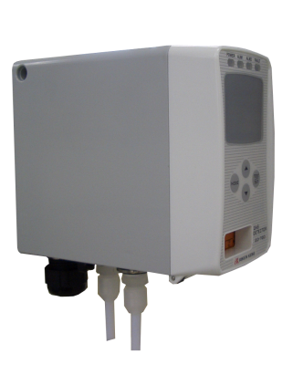

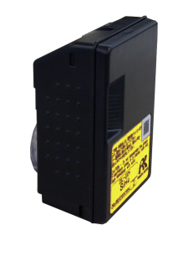
Accessibility
Smart sensor technology
Main unit can be used with all sensor units with various detection principles
Converting from SiH4 to H2 is simple!
Just remove the SiH4 sensor unit and replace with an H2 sensor unit.
①Remove
SiH４ Sensor unit (ESU)
②Set
SiH4 Detector
H2 Detector
Various network systems available:
GD-70D : 4-20 mA DC
GD-70D-NT ：NT
GD-70D-ET ：PoE
H2 Sensor unit (SGU)
The GD-70D has functions that will not allow the insertion of incorrect sensor units. Every sensor unit has a unique identification which prevents installation error.

Slide 4
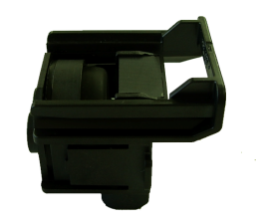
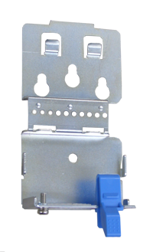
Accessibility
Front access for easy maintenance
Sensor Unit/Pump unit can be removed easily with one touch of button.
Remove and attach items with one touch of a button
Pump unit
Wall mounting bracket
Main unit
Sensor unit

Slide 5
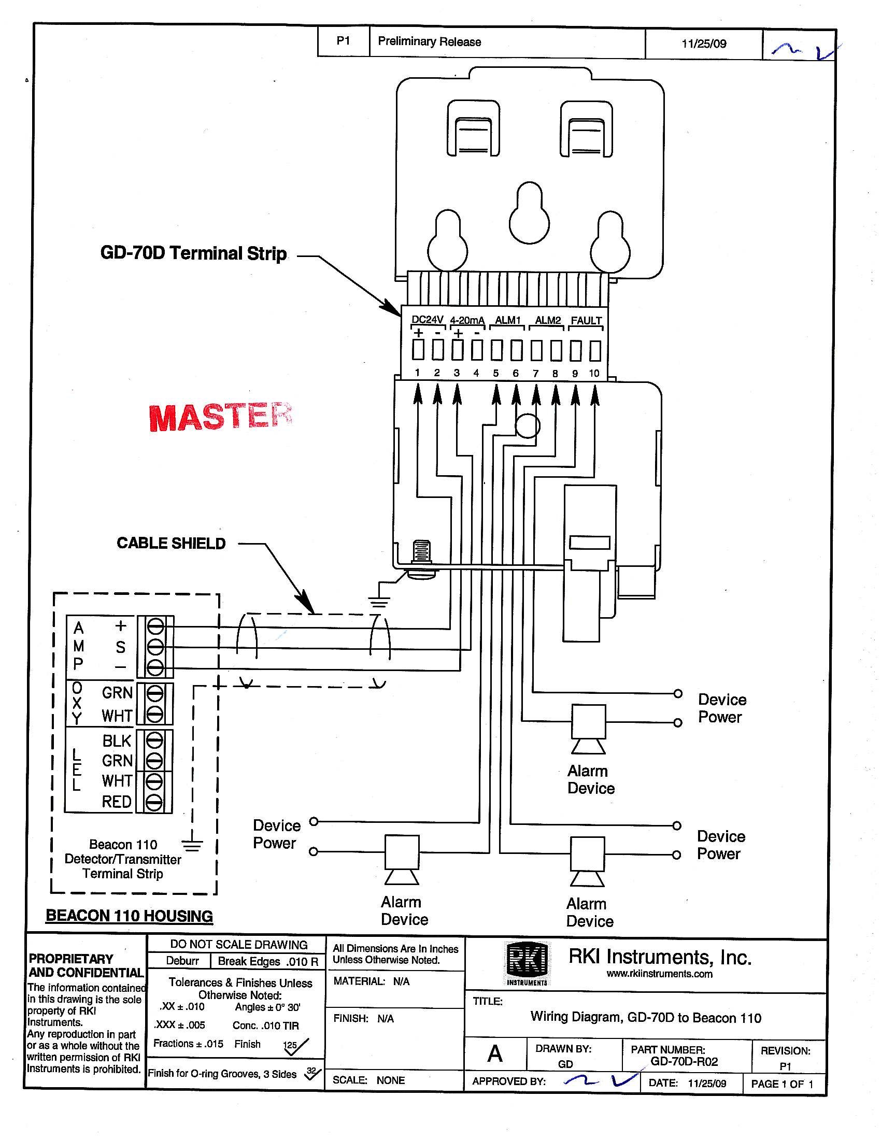
Wiring to a Beacon Controller

Slide 6
Specifications
Main Unit
Model | GD-70D | GD-70D-NT | GD-70D-ET
Communication | 4-20mADC | DC power line communication | POE Method
Detection principle | Different type depending upon sensor unit and detectable gas (See table on back page for list of sensor types and detectable gases)
Sampling method | Sample-drawing（Auto-Adjustment of flow rate)
Display | Large LCD （White back light）
 | ・Gas Concentration
 | ・Flow rate / Communication status / Pyrolizer status / Character display
 | ・Measuring gas / Error code / Content of error / Character message display
Display | 1ST alarm： red / 2nd alarm： red / Fault alarm：yellow
External Output | 1st alarm / 2nd alarm / Trouble alarm ：Relay contact output for each alarm
Self diagnosis | ・System failure
 | ・Sensor failure
 | ・Flow failure
 | ・Communication failure(NT / ET)
Date logging function | ・Event history / Alarm history
 | ・Calibration history
 | ・Alarm trend （180 sec Before / after 1st alarm）
Operating conditions | 0-40℃ （Without rapid change） ・30-70%RH （non-condensing）
Operational Setting | All operational setting are user adjustable by using the front panel
Power requirement | DC 24V±10% Approx. 5W （Including Sensor unit） |  | POE standard arrangement
Dimensions | 70(W) × 120(H) × 150(D)
Weight | Approx. 0.9Kg (2.0 lbs) Including sensor unit
Mounting | Wall-mounting base plate by 3 screws
Sample Tubing | 4 x 6 mm PTFE tubing recommended. Ppfalf union fittings provided as standard accessories.
Cable | Cable type varies depending on communication method （Cable gland optional）
Notes:
6
6

Slide 7
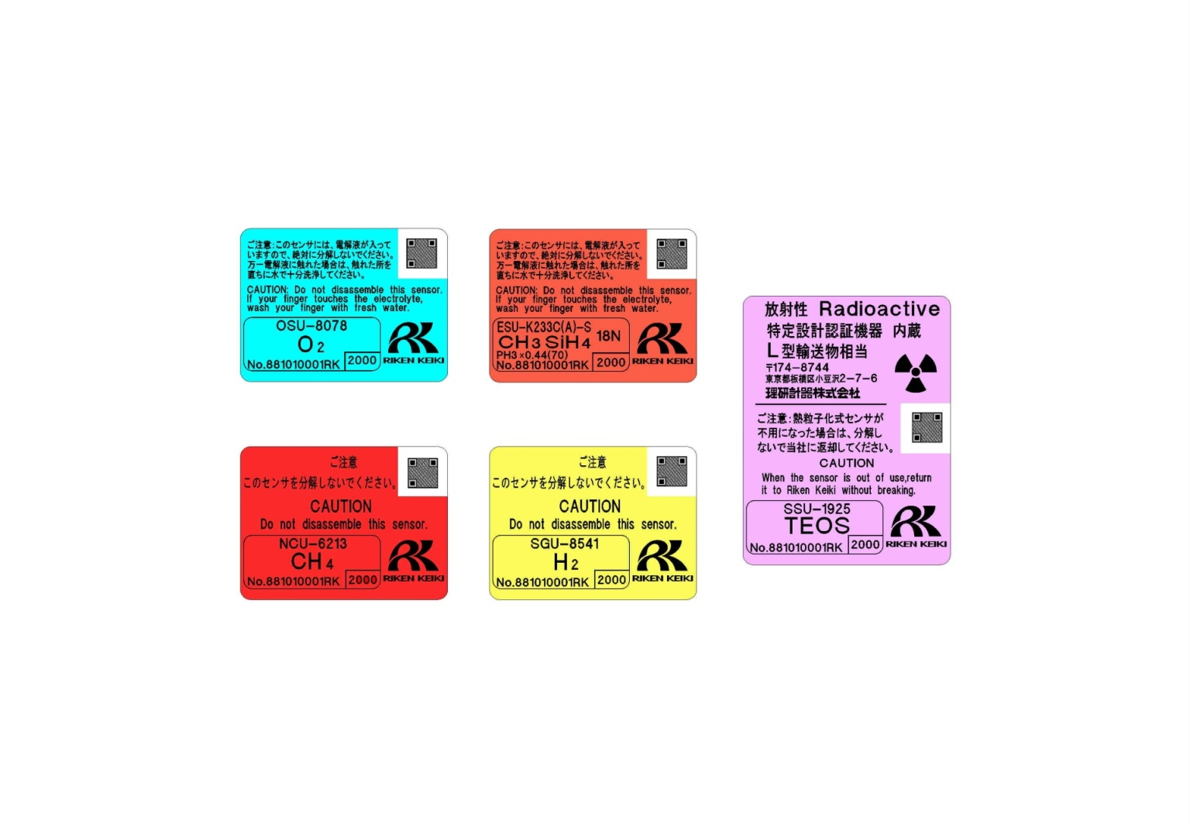




Specifications
Sensor Unit
Model | ESU | SGU | SSU | OSU | NCU
Detection Principle | Electrochemical Cell | Semiconductor | Pyrolysis-Particle | Galvanic Cell | New Ceramic
Identification Marking
Self-diagnosis Function | ・Sensor trouble ・System failure
Date-logger Function | ・Event history / Alarm history ・Calibration history ・Alarm trend （60 sec Before / After 1st alarm）
Notes:
7
7

Slide 8
Specifications
Pyrolyzer Unit
Model | PLU-70
Application | Measuring NF3 / TEOS gases
Usage | Used by connecting to “GD-70D”(Main unit)
Display | ・LED (Green color)
 | - Normal：light-on / Warming-up ：flashing 1sec interval / Trouble： flashing 0.2 sec interval
Self-Diagnosis Function | ・Pyrolyzer unit trouble
 | ・Fan trouble
 | ・System trouble
Operational Temp. & Humidity | ・0-40℃ （Without rapid change） ・30-70% RH （non-condensing）
Operational Settings | Operational setting are user adjustable by using the front panel (Main unit).
Power Supply | DC 24V±10% Approx.36W (MAX)
Dimension | 70(W) × 120(H) × 150(D) (2.8”W x 4.7”H x 5.9”D)
Weight | Approx. 1.2Kg (2.6 lbs)
Mount-Type | Wall-mounting base plate by 3 screws
Sampling Tubing | 4 x 6 mm PTFE tubing recommended. PP half union fittings provided as standard accessories.
Cable | Cable type varies depending on communication method （Cable gland optional）
Notes:
8
8

Slide 9




GD-70D Fresh Air
Press and hold “MODE” for 3 seconds.
Press “SET”
Press “SET” to perform the zero adjustment
The menu displays “ZERO OK” if pass, or “ZERO NG” for fail
Notes:
9

Slide 10
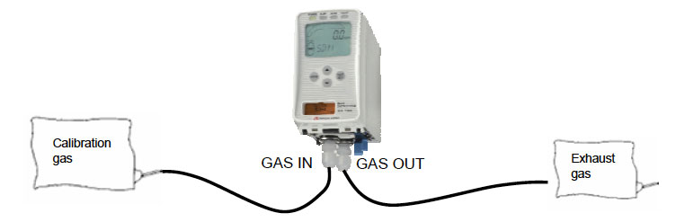

GD-70D Calibration
Press and hold “MODE” for 5 seconds.
Press mode until 2-2.SPAN is displayed
Press the SET to select SPAN
Notes:
10

Slide 11

GD-70D Calibration
Press and hold “MODE” for 5 seconds.
Press the DOWN ARROW to select 1-8.M MODE
Press the SET to select 1-8.M MODE
Notes:
11

Slide 12


GD-70D Calibration
Then press the SET key again for three seconds.
2.0 GAS TEST
Perform a test with the gas. Similar to the detection
mode, the reading changes and the alarm lamp
lights up after the gas is introduced, but the contact
is not activated.
Notes:
12

Slide 13


GD-70D Calibration
2-1. ZERO
Perform the zero adjustment.
2.2 GAS TEST
Perform a test with the gas. Similar to the detection
mode, the reading changes and the alarm lamp
lights up after the gas is introduced, but the contact
is not activated.
Press SET to begin Span Adjustment
Notes:
13

Slide 14


GD-70D Calibration
Allow gas to flow, and then press the SET key
when the reading is
stabilized
Make Span Adjustment
Because the reading will be fixed, select the
introduced gas concentration by pressing the
▲ or ▼ key. Select the number, and then press
the SET key. (20.9 vol% in the oxygen deficiency
alarm specification)
Notes:
14

Slide 15


GD-70D Calibration
Span adjustment completed
To record the adjustment result, press the SET key.
(Press the MODE key to cancel this menu.)
The menu automatically returns to 2-2.SPAN
Notes:
15

Slide 16
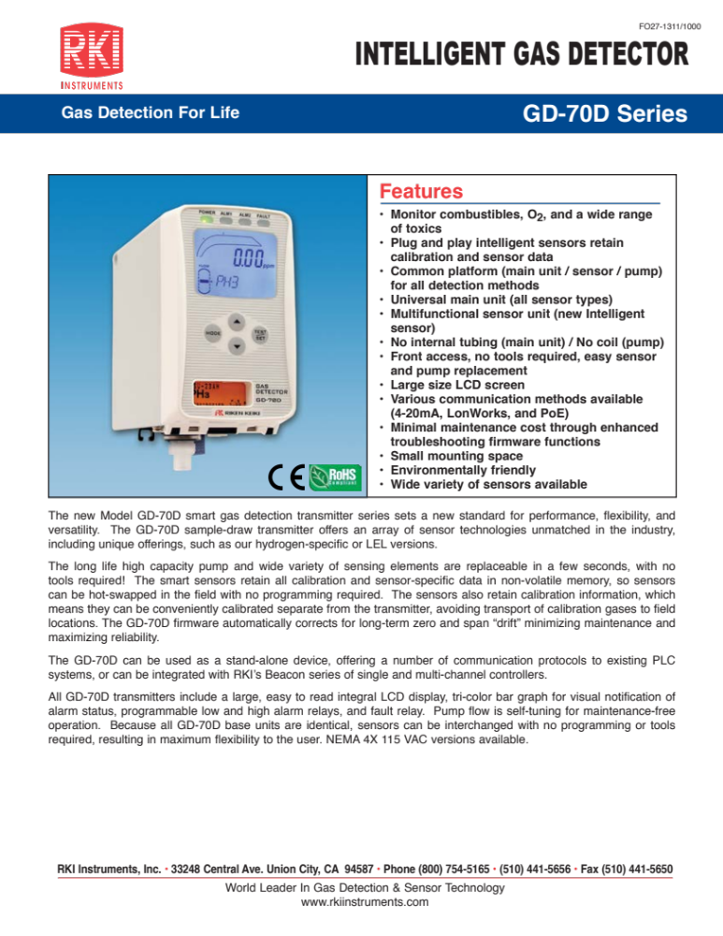

Slide 17
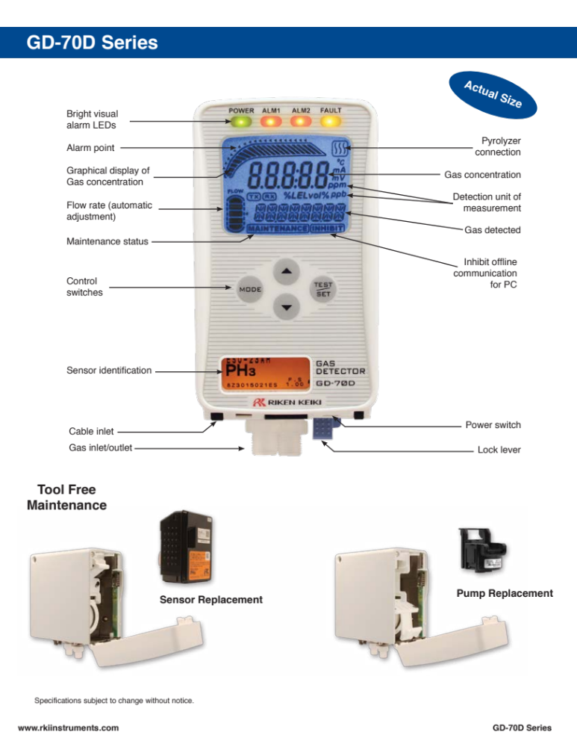

Slide 18
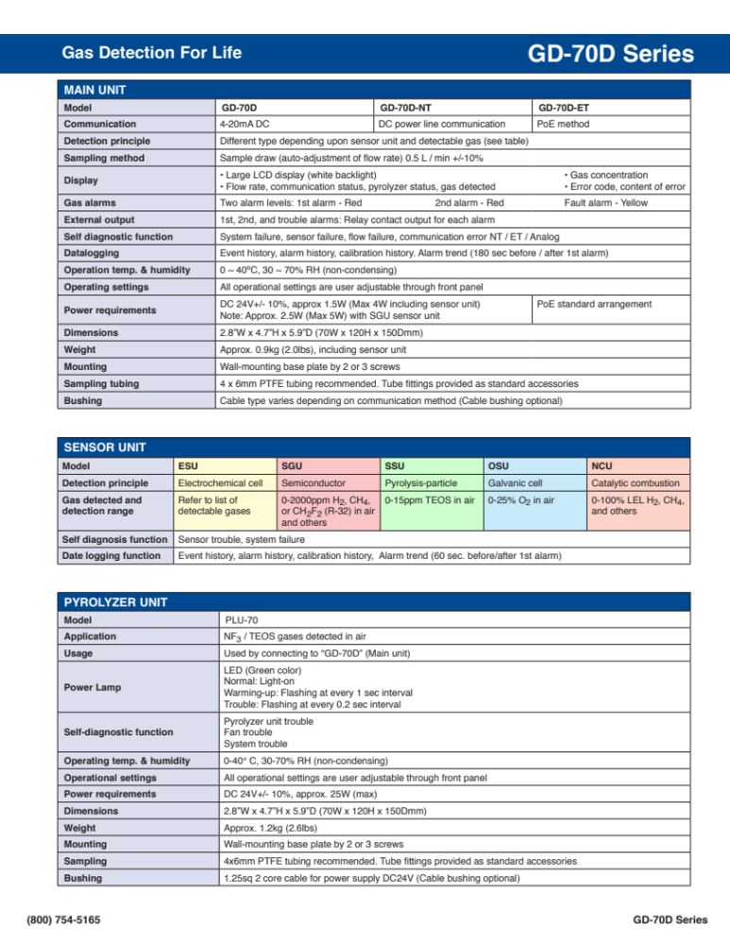

Slide 19
