Slide 1
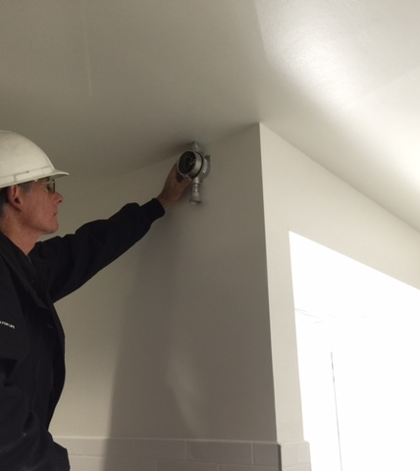
S-2 Gas Transmitters

Slide 2
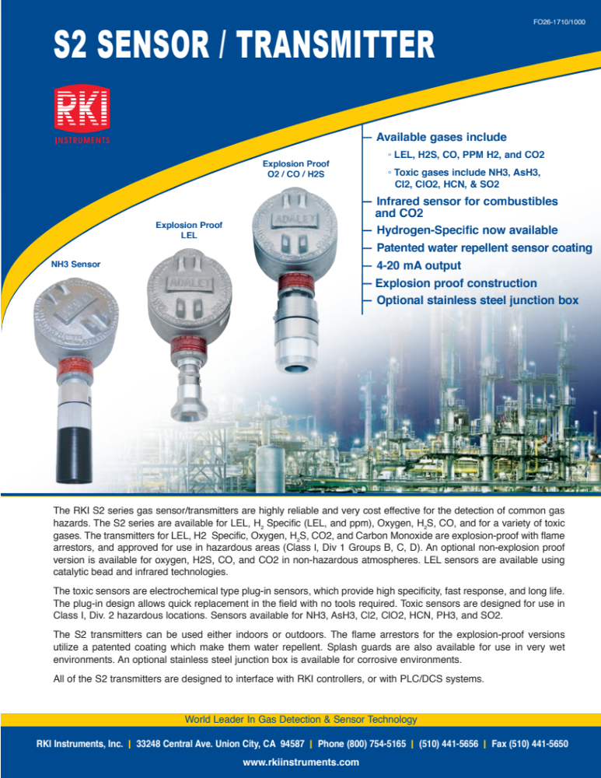

Slide 3
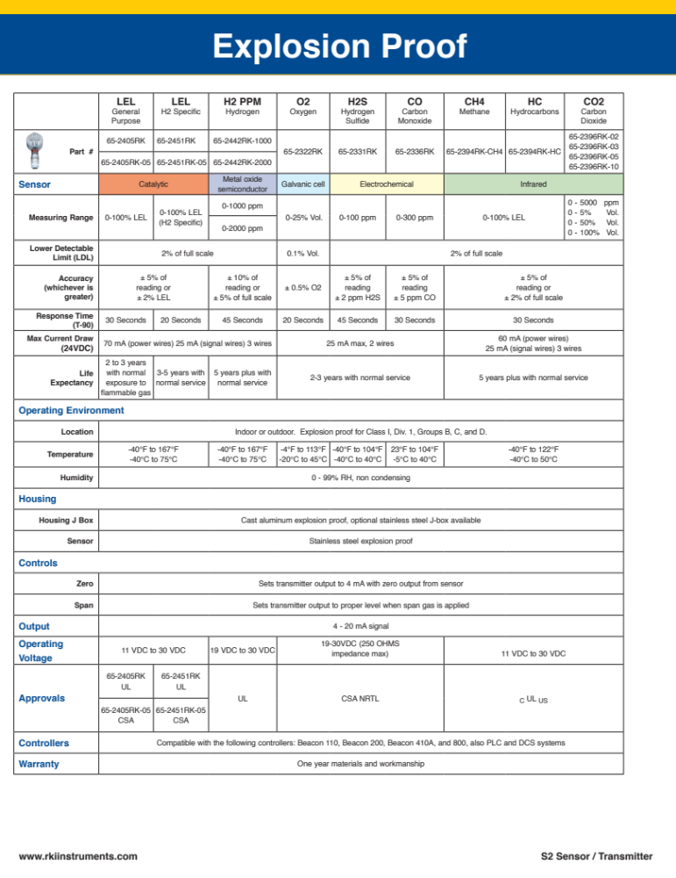

Slide 4
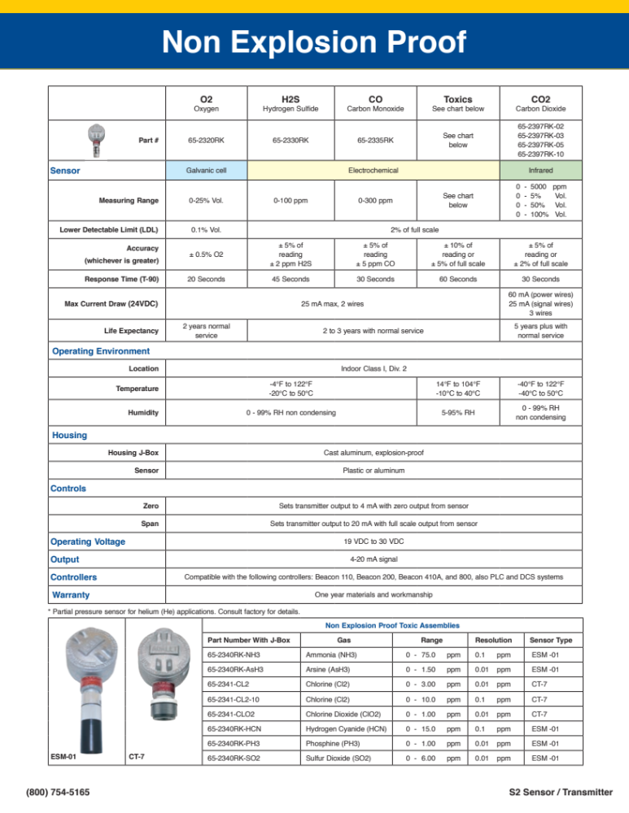

Slide 5
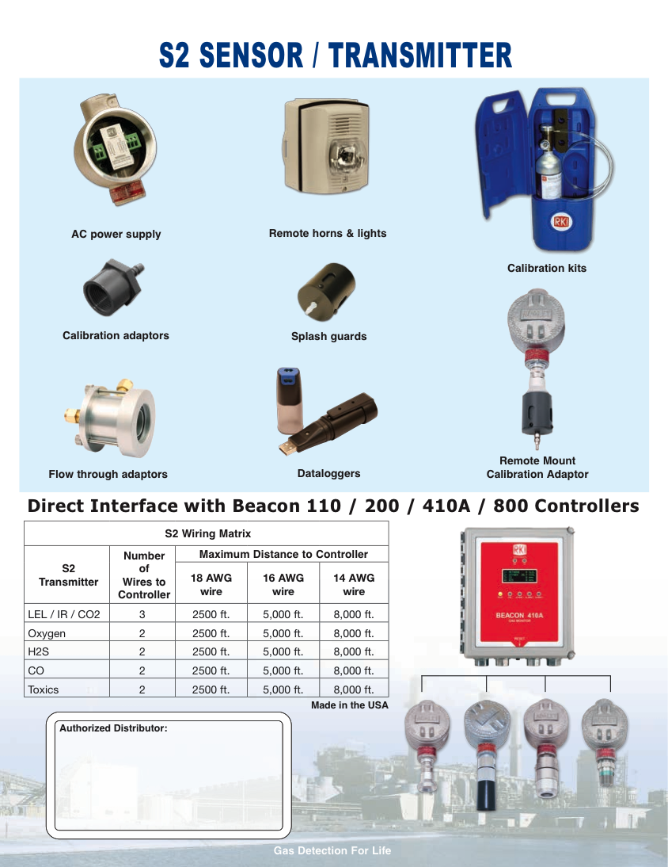

Slide 6
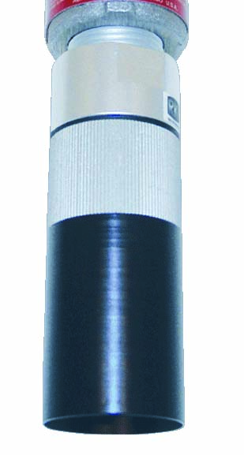
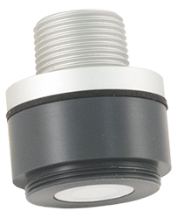
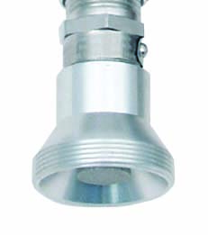
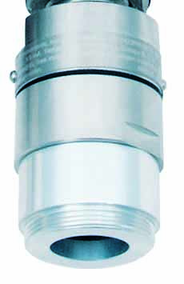
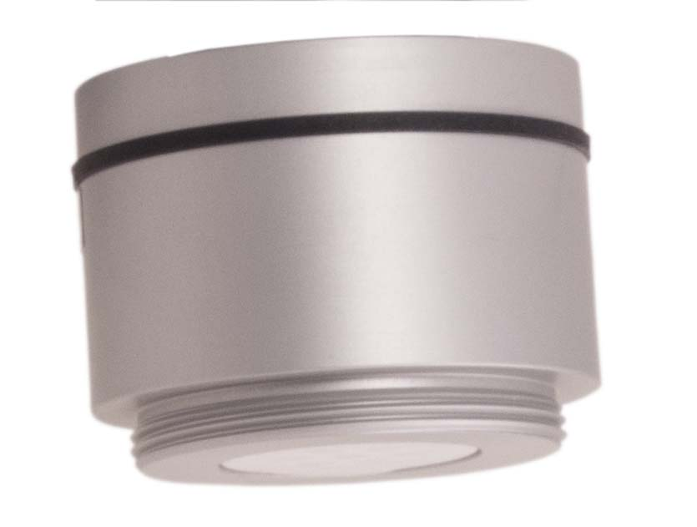
Sensors
CT-7
LEL
ESM
CO2
O2/H2S/CO

Slide 7
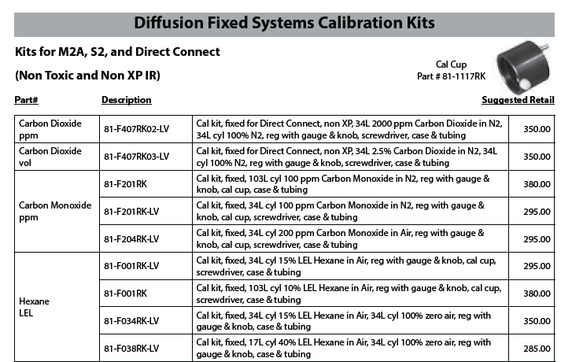
Calibration Kits
Pg. 165 of Price Book

Slide 8
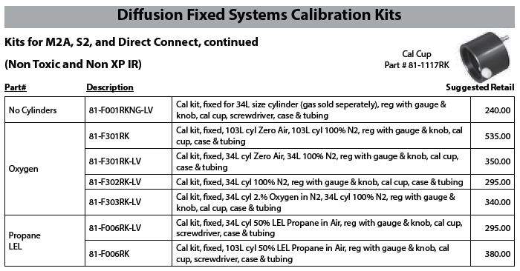
Calibration Kits
Pg. 166 of Price Book

Slide 9
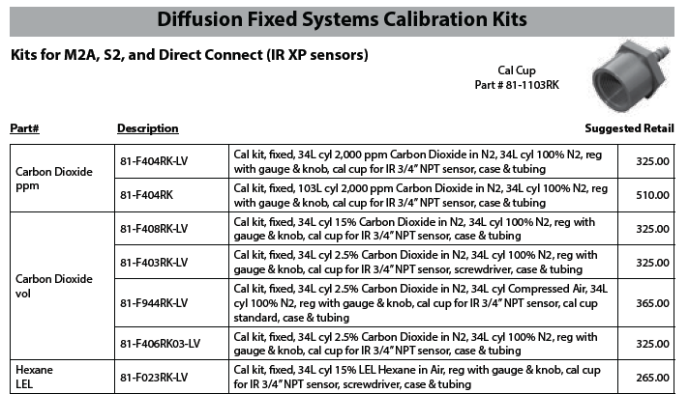
Calibration Kits
Pg. 167 of Price Book

Slide 10
S-2 Transmitters
S-Transmitters are a family of transmitters
  4-20mA communication
  Potted to protect electronics
  Provided in explosion proof housing
  Sensor may connect directly to the amplifier or may attach to a preamplifier
  Can be used on any RKI Controller or wired directly to a PLC or DCS

Slide 11
S2 Transmitters
Available gas/detector:
  LEL (Cat & IR)
  CO2 (IR, 5000ppm, 5% Vol, 50% Vol, 100% Vol)
  O2 (Capillary & Partial Pressure)
  H2 (Cat, MOS and TC)
Available gas/detector:
  H2S
  CO
  SO2
  PH3
  NH3

Slide 12

LEL/CO2 Detector Wiring

Slide 13
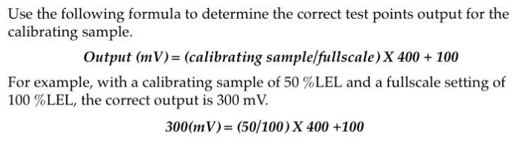
Calibration Formula
Use the following formula to determine the correct test points output for the calibrating sample.
Output (mV)=(calibrating sample/fullscale) x 400 + 100
For example, with a calibrating sample of 50% LEL and a fullscale setting of 100% LEL, the correct output is 300 mV.
300(mV) = (50/100) x 400 + 100
For oxygen sensor heads
Zero span is 100 mV
Span adjust is 434 mV

Slide 14

S-2 Transmitter Wiring
Note: Some S-2 transmitters are two wire devices, wiring only to + and S.

Slide 15
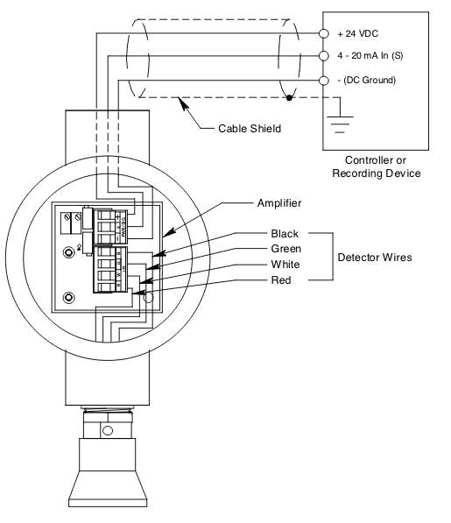
S-2 Transmitter, 3-Wire

Slide 16
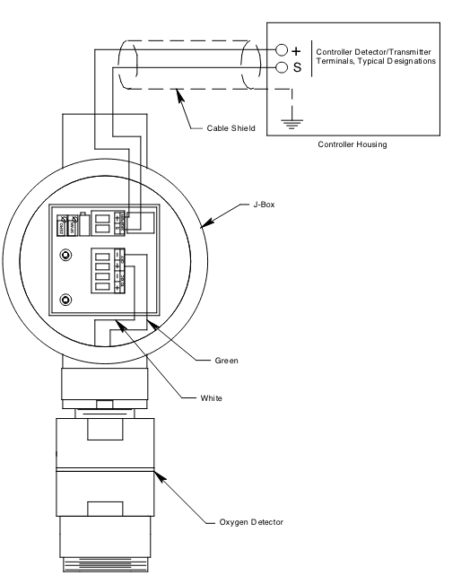
S2 Transmitter, 2-Wire

Slide 17
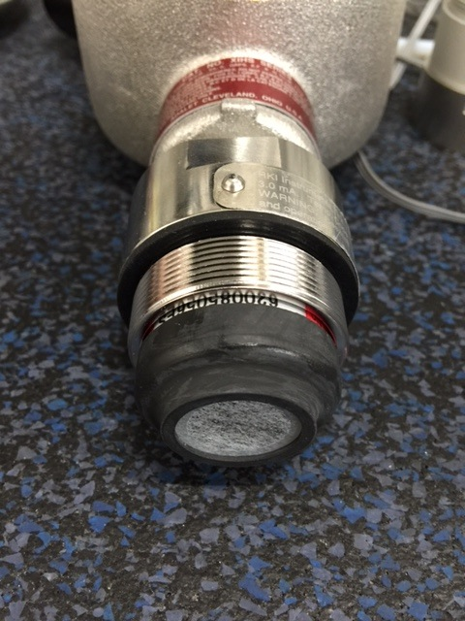
S2 CO Transmitter
CO Detector uses a charcoal filter to scrub out hydrogen sulfide and heavy hydrocarbons
Change filter if CO sensor responds to H2S or when replacing the sensor.

Slide 18
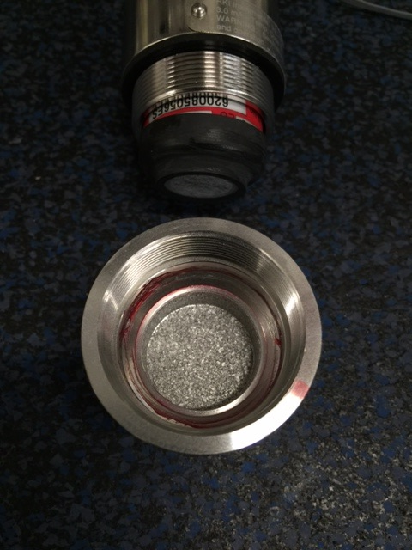
S2 CO Transmitter
Detector cap is lubricated to keep charcoal filter retainer from sticking

Slide 19
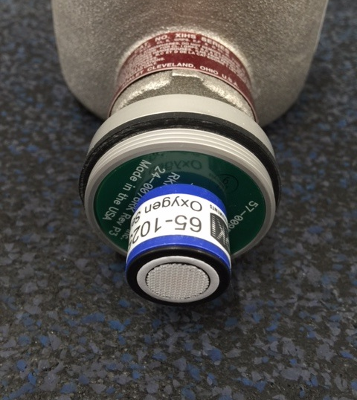
S2 Oxygen Transmitter
Non Explosion Proof transmitter has plug in capillary O2 sensor.
Average life span is two years.

Slide 20
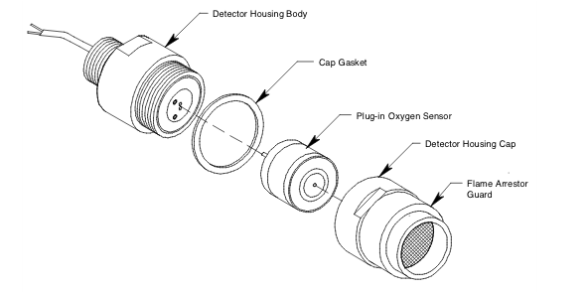
S-2 Transmitter, O2 Det. Assy.

Slide 21
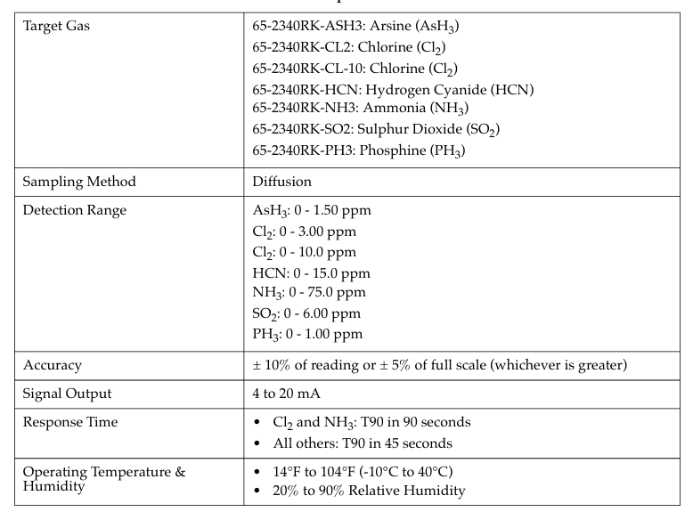
S-2 Transmitter, Toxic Gas

Slide 22
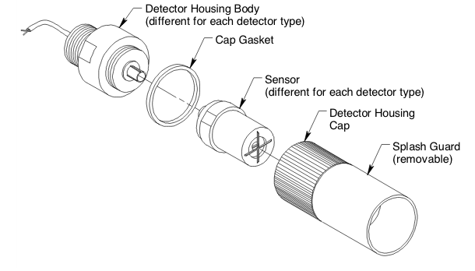
ESM-01 Detector Assy.

Slide 23
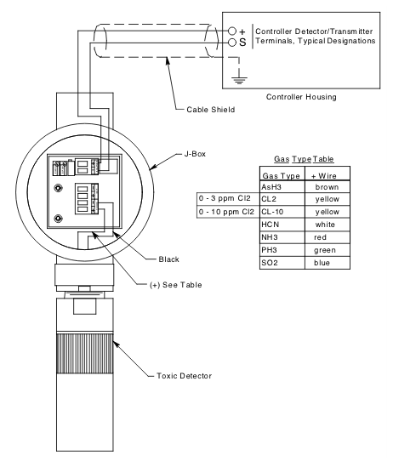
S-2 ESM-01Wiring

Slide 24
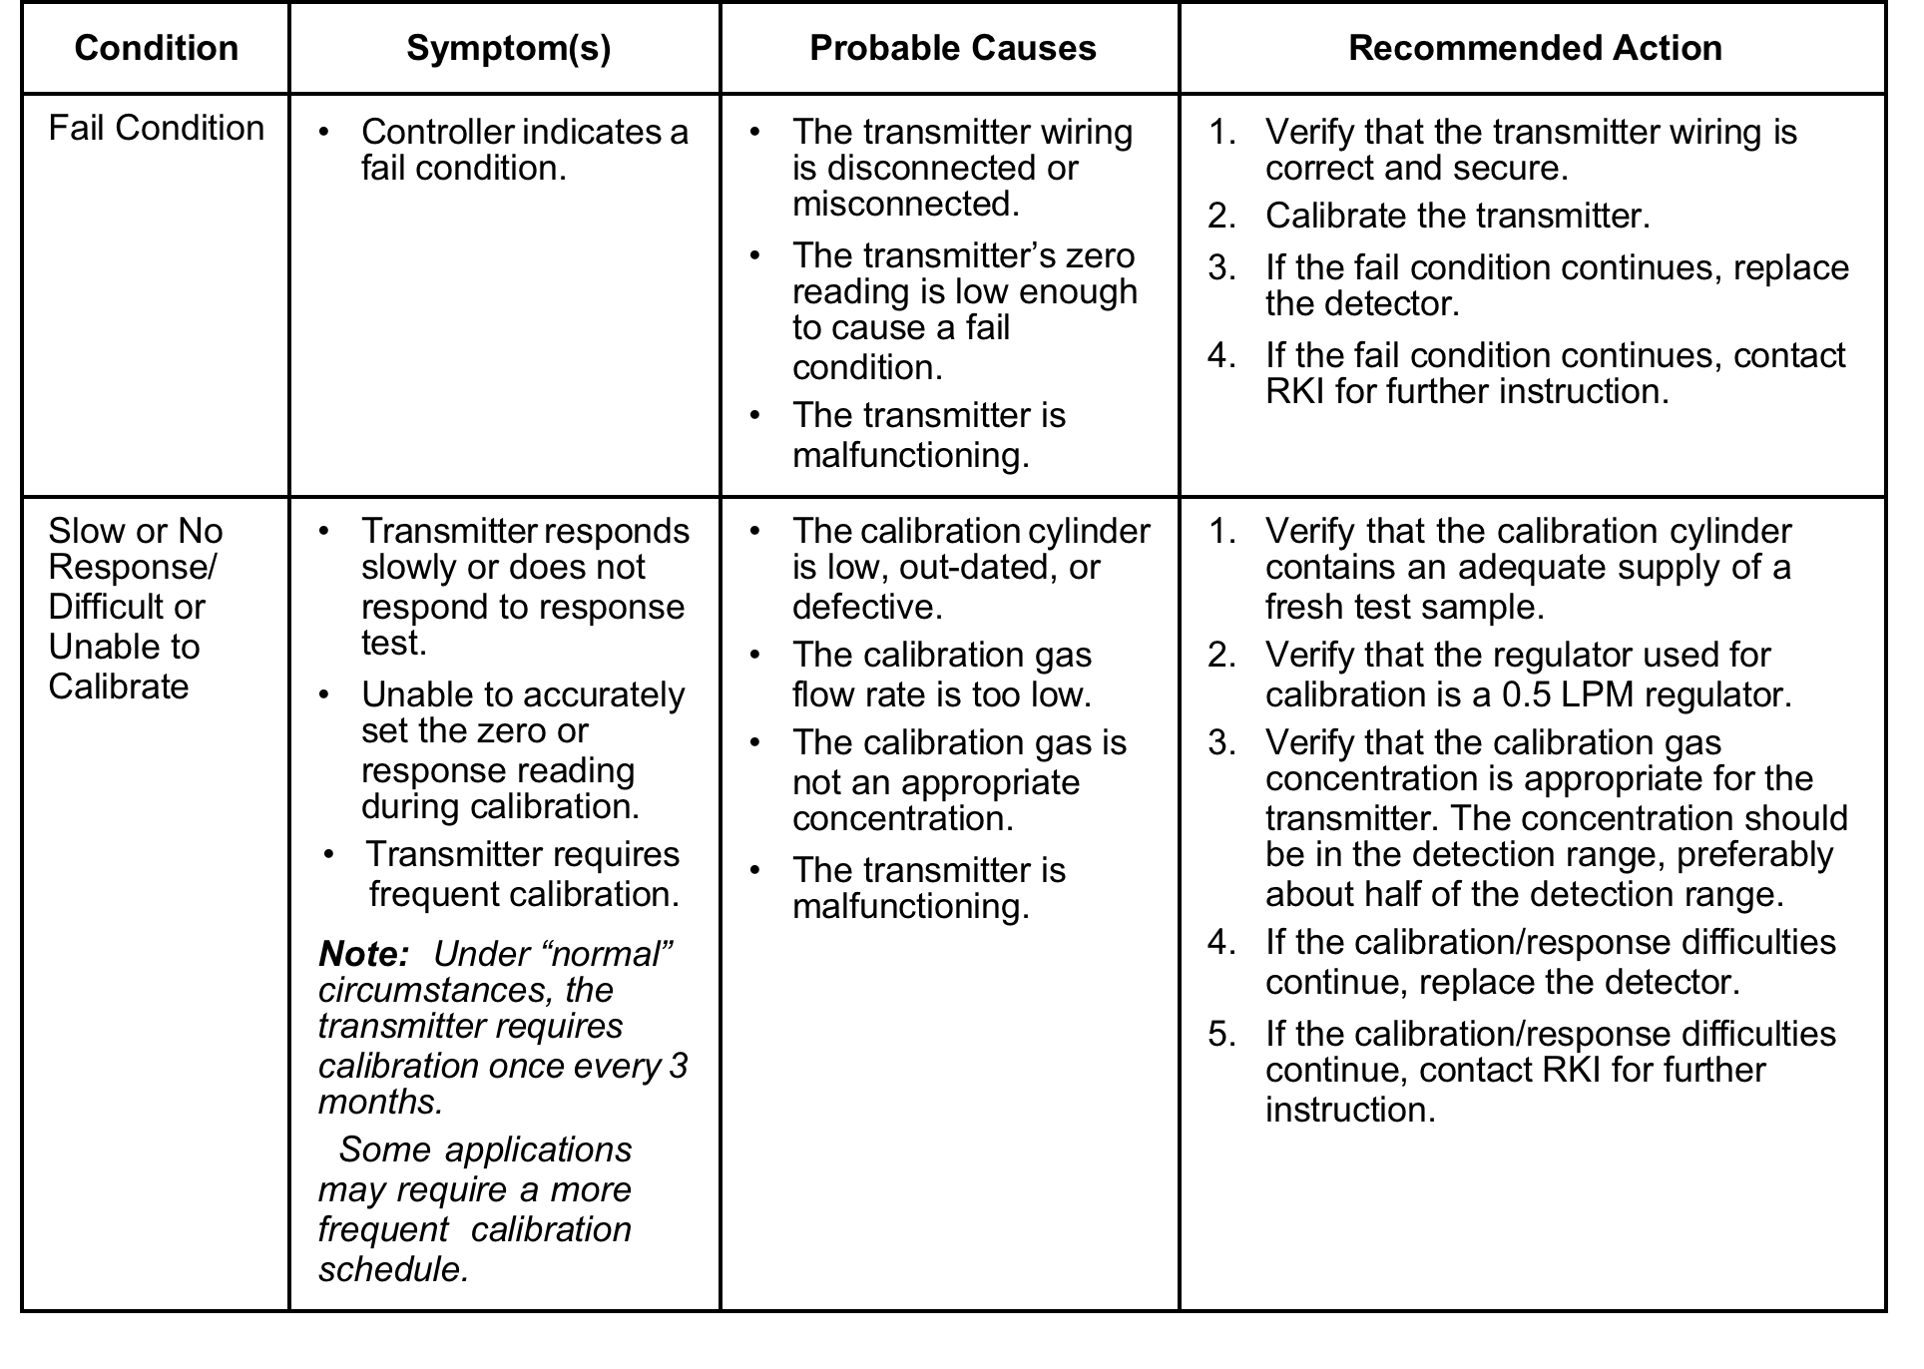
S2 Transmitter Troubleshooting

Slide 25
