Slide 1
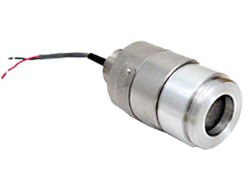
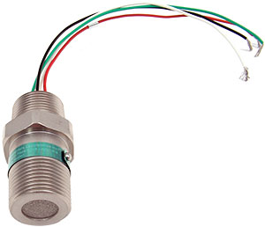
Direct Connect Detectors

Slide 2
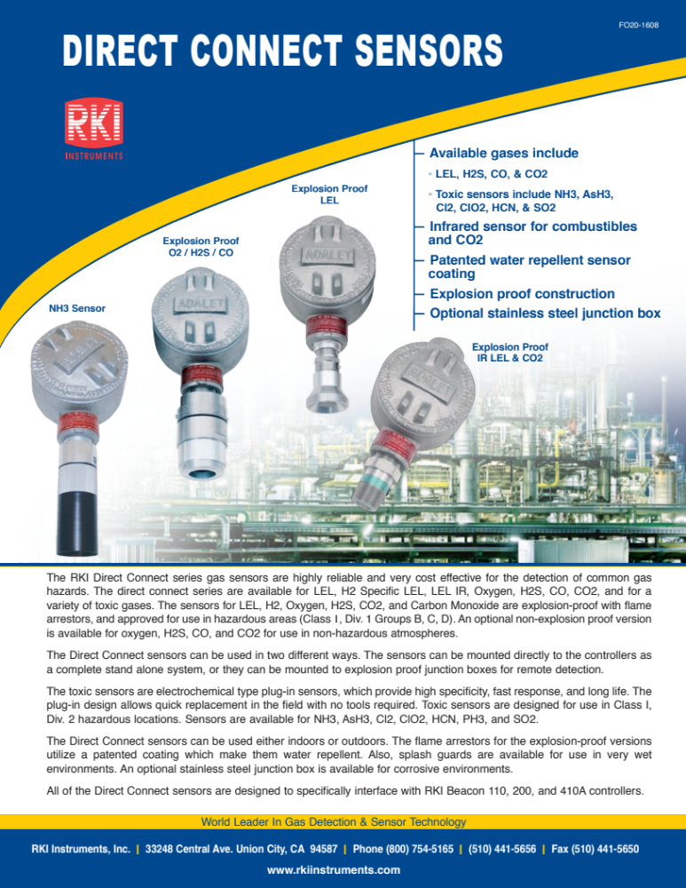

Slide 3
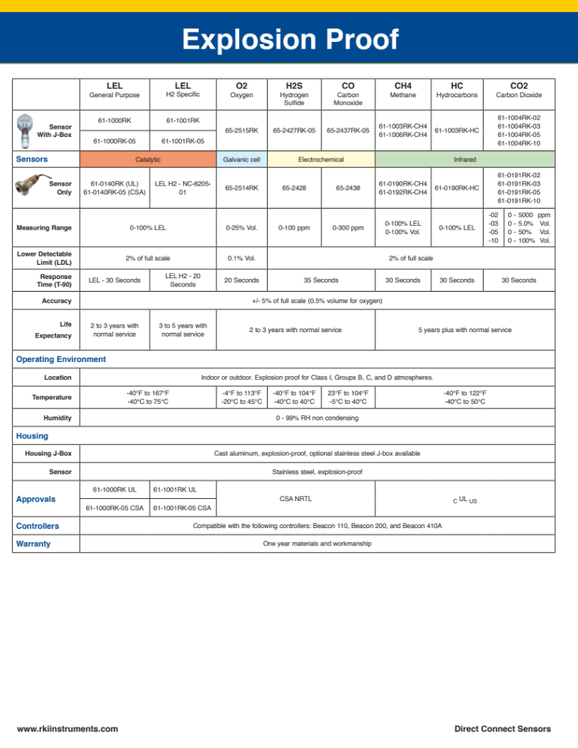

Slide 4
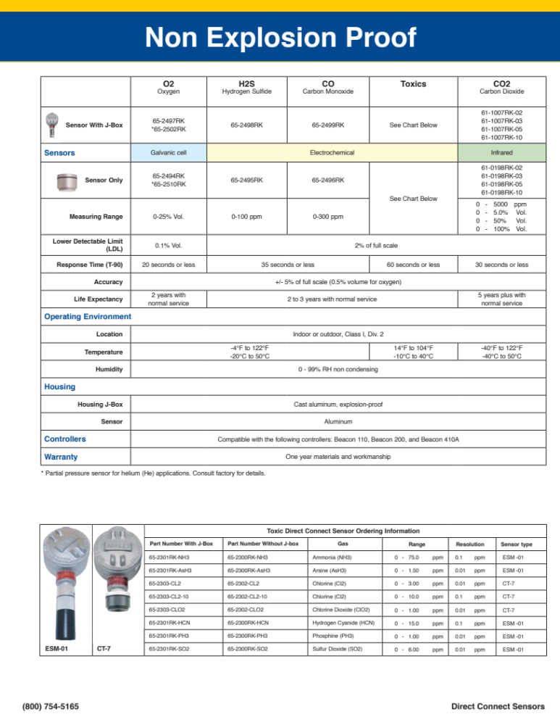

Slide 5
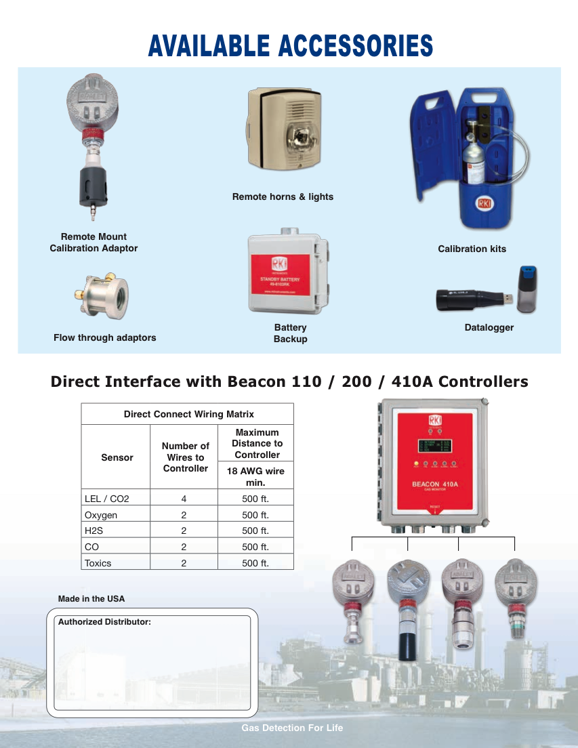

Slide 6
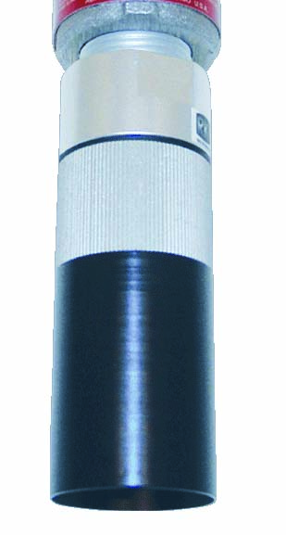
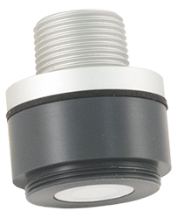
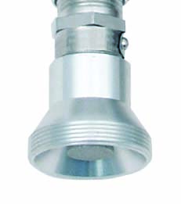
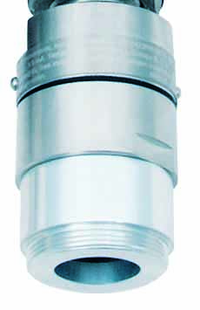
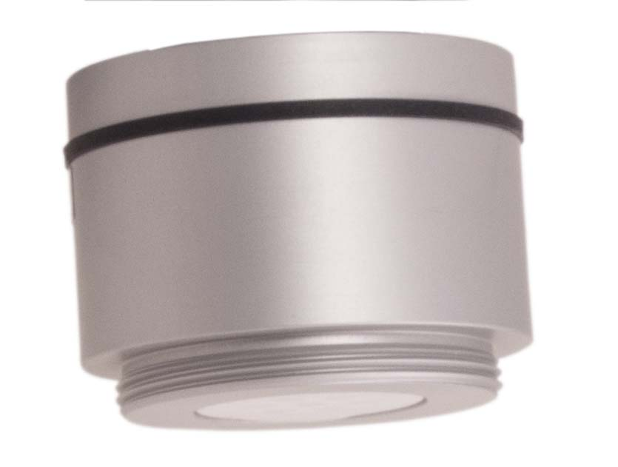
Sensors
CT-7
LEL
ESM
IR LEL/CO2
O2/H2S/CO

Slide 7
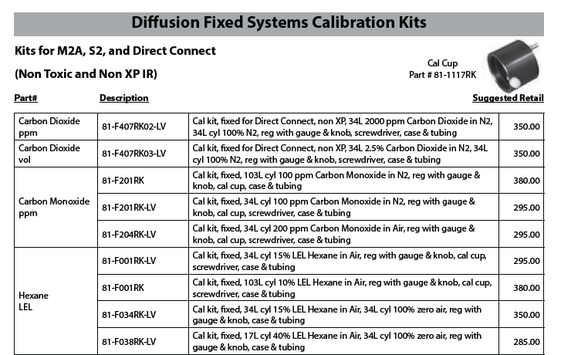
Calibration Kits
Pg. 165 of Price Book

Slide 8
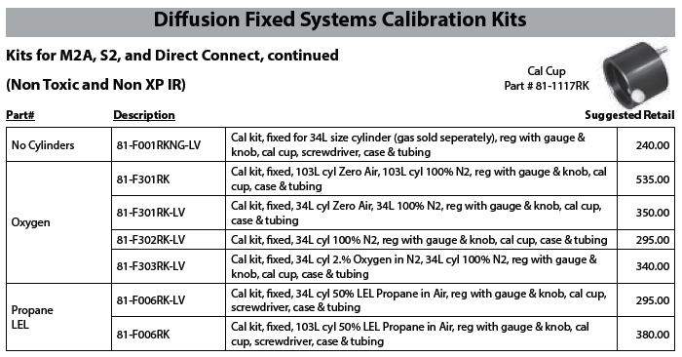
Calibration Kits
Pg. 166 of Price Book

Slide 9
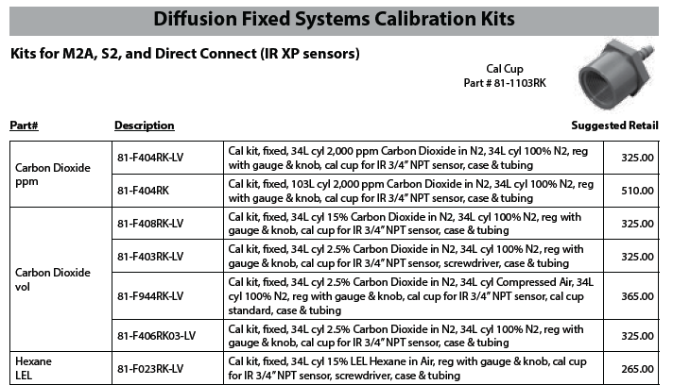
Calibration Kits
Pg. 167 of Price Book

Slide 10
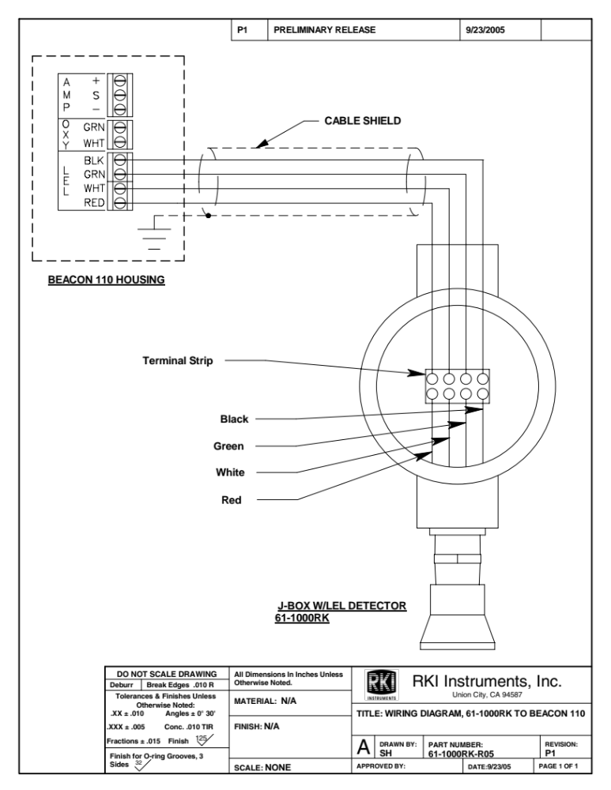
LEL Wiring Diagram

Slide 11
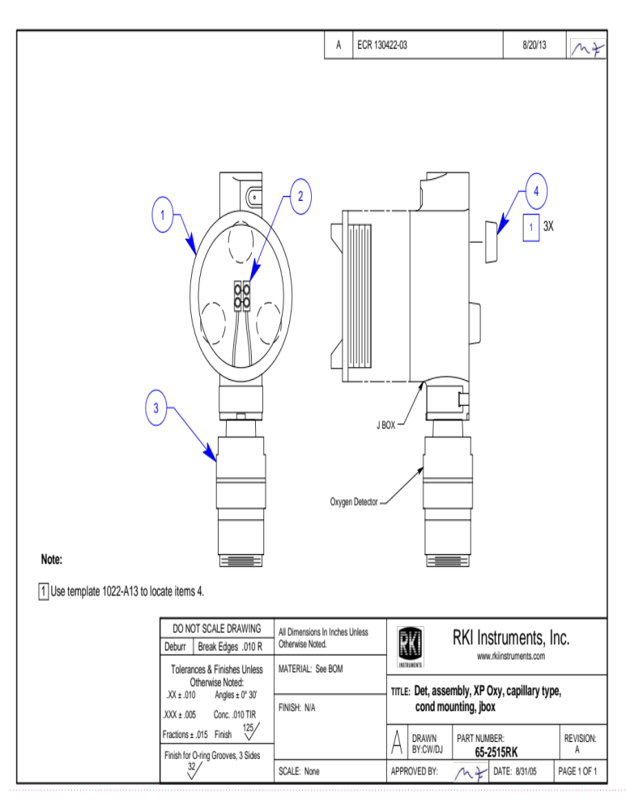
O2 Wiring Diagram

Slide 12
Direct Connect Detectors
Does not require external transmitter
Can only be used on the following:
  Beacon 110
  Beacon 200
  Beacon 410
  RM-5000
Calibration performed at the Controller
Lower cost alternative
Limited wire length depending on type of detector

Slide 13
Direct Connect Detectors
Combustibles
  Catalytic Bead LEL
  Infrared LEL/Vol
  Thermal Conductivity
Oxygen
  Capillary
  Partial Pressure
Toxic Gas
  H2S
  CO
  NH3
  Cl2
  CO2 (5000ppm, 5%Vol, 50% Vol., 100% Vol.
  PH3
  SO2
  HCN

Slide 14
Direct Connect Detectors
Can be one piece such as a catalytic bead detector or can be composed of several parts including:
  Preamp
  Sensor
  Splashguard/flame arrestor (type dependent)
Preamp
  Processes the signal from the sensor
Sensor
  Device that detects the gas
Splashguard/Flame Arrestor
  Protects the sensor
  Maintains XP rating

Slide 15
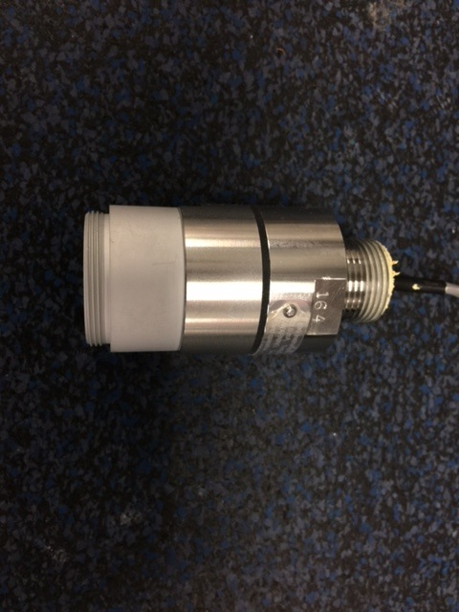
Direct Connect Detector
Preamp
Body
Flame Arrestor

Slide 16
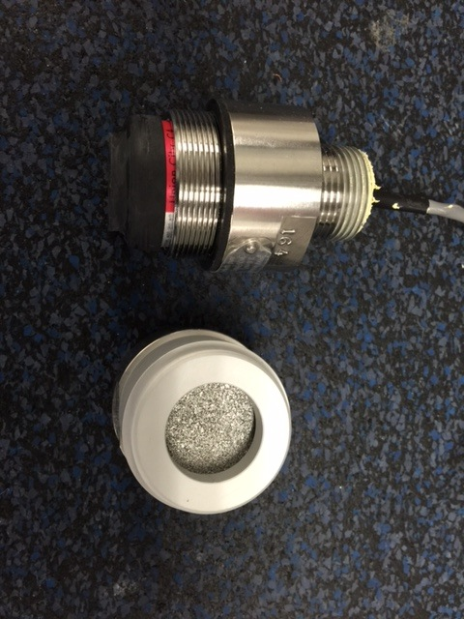
Direct Connect Detector
CO detector with flame arrestor removed
Rubber cap holding charcoal filter
  Charcoal filter unique to CO detector
  Removes some heavy HC’s and H2S

Slide 17
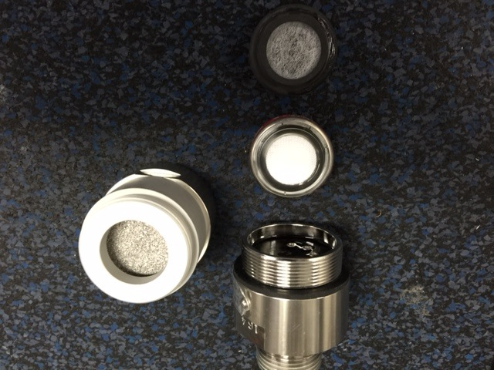
Direct Connect Detector
All components of a CO Direct Connect detector shown.
  Sensor
  Charcoal Filter
    Lubricate grommet to prevent sticking on flame arrestor cap.

Slide 18
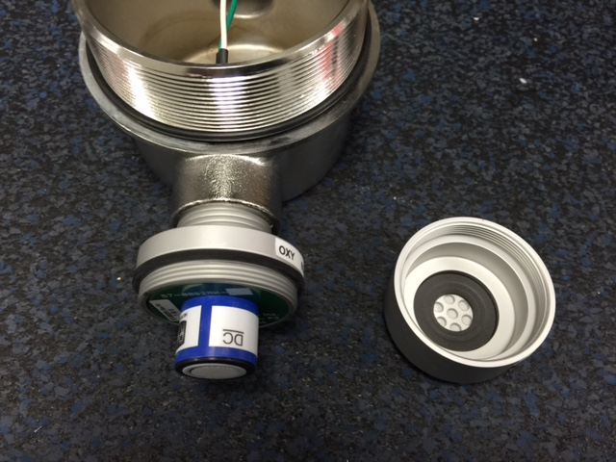
Direct Connect Detectors
Oxygen direct connect detector shown screwed into explosion proof housing.
Cover removed from sensor assembly
Hydrophobic membrane in cap

Slide 19
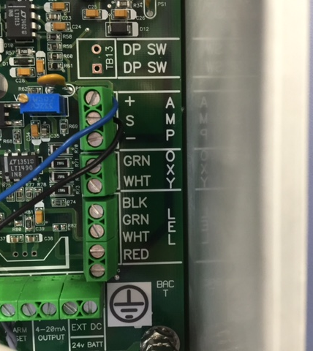
Preamp Type Wiring
Detectors with preamps
  Wired to S and + terminals as shown.

Slide 20
Oxygen Detector Wiring
Oxygen detector wires are color coded Green and White.
The White wire is Positive.

Slide 21
LEL Detector Wiring
LEL detectors are wired by wire color
  Black
  Green
  White
  Red

Slide 22
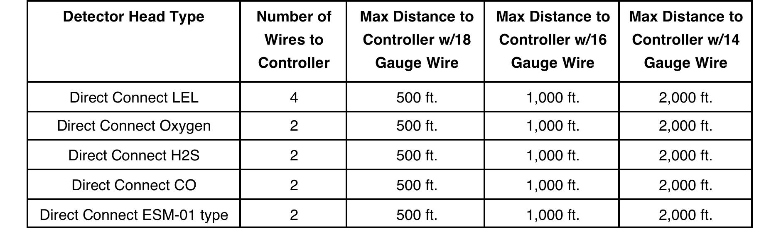
Wiring Distance

Slide 23
Troubleshooting
For direct connect detectors that are one integral piece, replace the detector with a known good one and see if that corrects the problem.

Slide 24
Troubleshooting
If the detector is composed of a sensor and preamp, replace the sensor first, if this does not correct the problem then replace the preamp.
If replacing the preamp does not correct the problem, remove the detector assembly from the field and wire it directly to the controller.

Slide 25
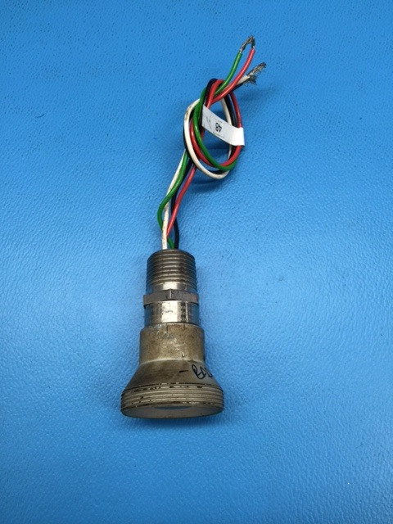
Troubleshooting
Catalytic Bead Detector
  Replace the detector if you experience the following:
    Unable to zero
    Unable to span
    Unstable output
    Erratic operation
    Contaminated

Slide 26
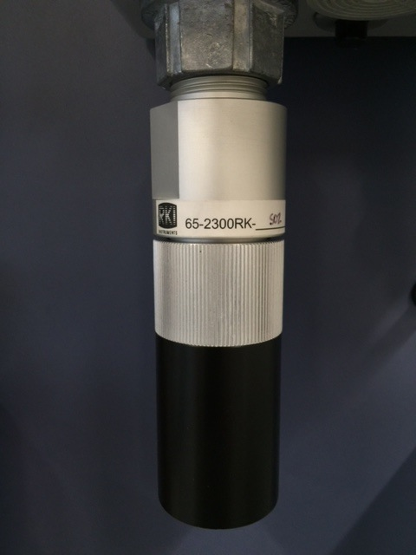
ESM-01 Detectors
ESM-01 Detector assembly consists of the following:
  Housing with Preamp
  Housing bottom
  Splash Guard

Slide 27
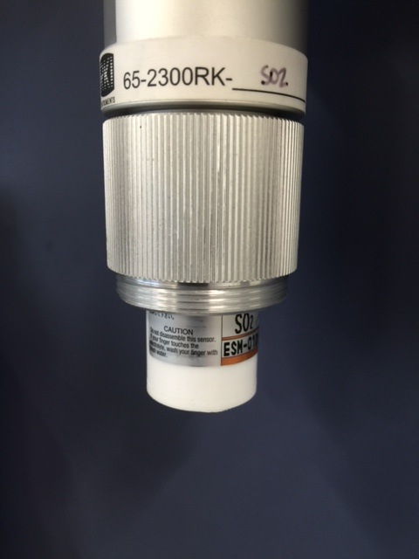
ESM-01 Detector
Splashguard removed with bottom of sensor exposed.

Slide 28
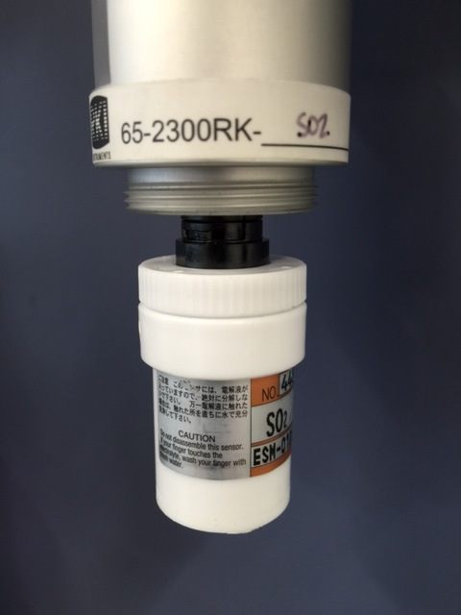
ESM-01 Detector
ESM-01 Detector with housing bottom removed
Sensor exposed
Unique Preamps for each type of sensor.

Slide 29
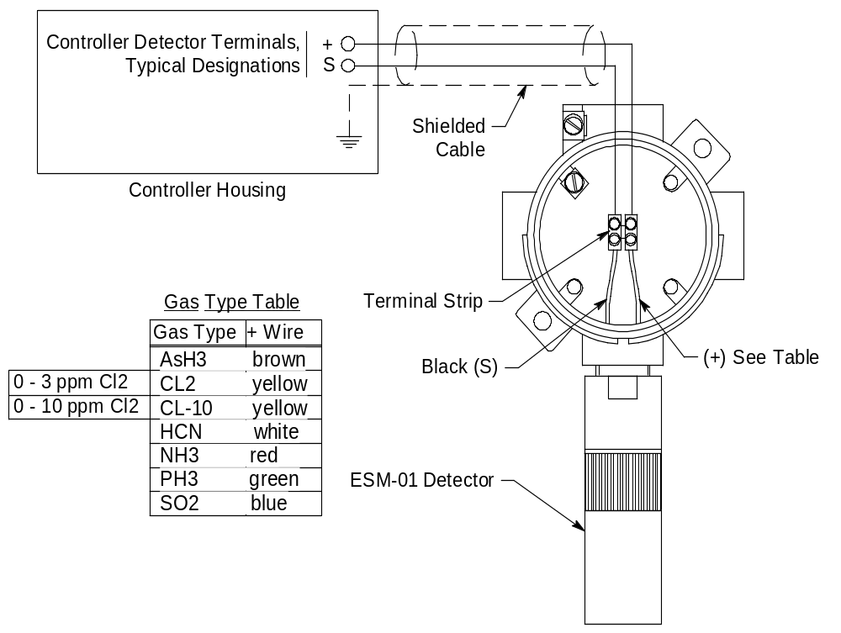
Wiring ESM-01 Detector Assy.

Slide 30

Questions?

