Slide 1
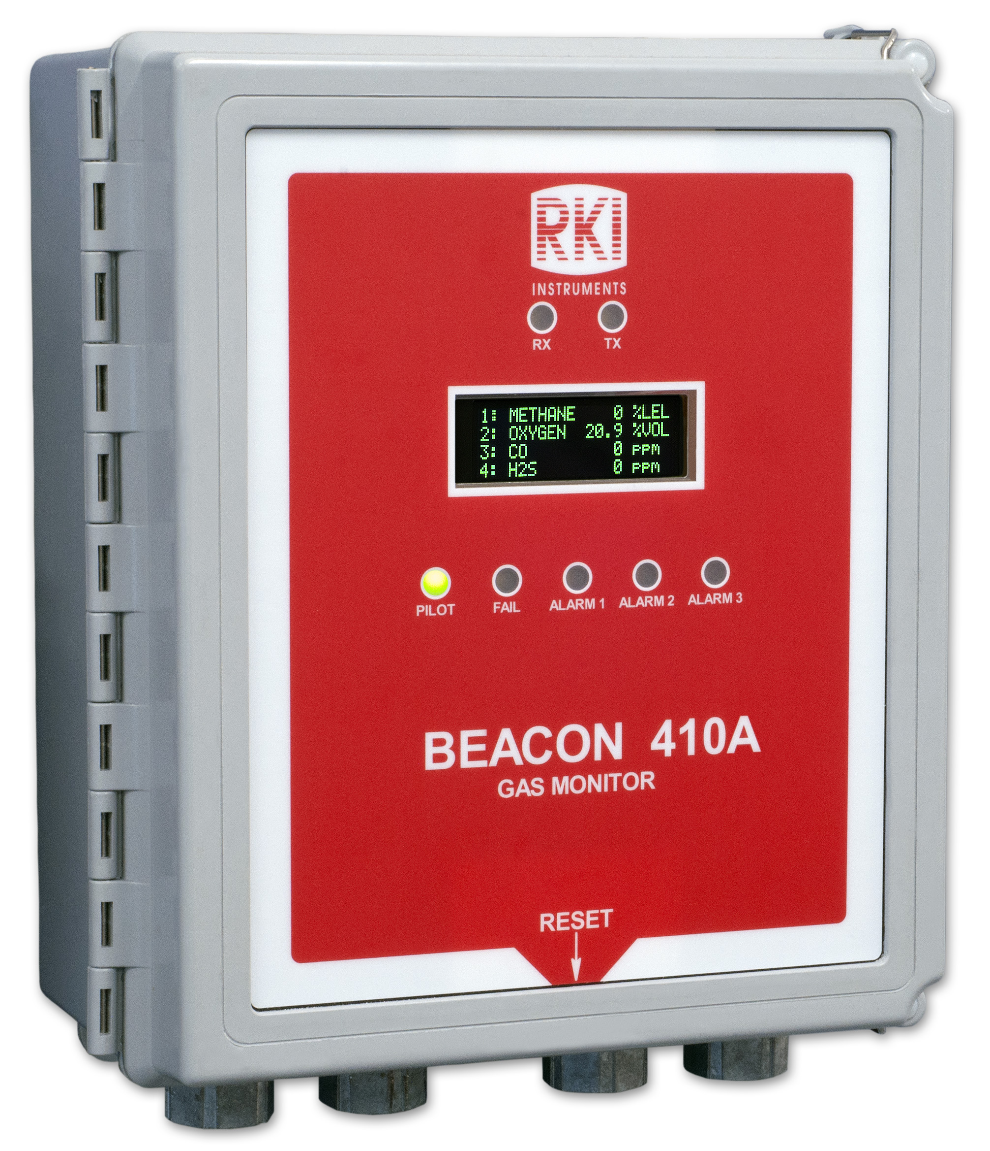
Beacon 410A
4 Channel Wall Mount Gas Detection Controller

Slide 2
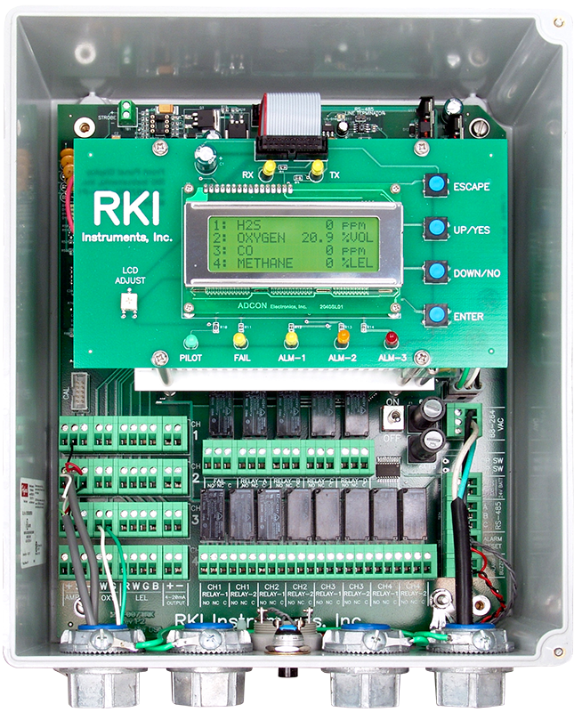
Beacon 410A Features
Backlit LCD Display
4 Channels Displayed Simultaneously
NEMA-4X weather resistant enclosure
Accepts any 4-20 mA transmitter or direct connect sensors for LEL / O2 / H2S / CO / CO2
3 programmable alarm levels per channel
PCB Control Switches
ESCAPE
UP/YES
DOWN/NO
ENTER
Alarm LEDs
Alarm 1, yellow
Alarm 2, orange
Alarm 3, red
Fail, yellow
On/Off toggle switch
94 dB Buzzer Alarm
Alarm Reset Switch

Slide 3
Beacon 410A Operation
The Beacon 410A is a fixed-mounted, continuous-monitoring controller. This multiple channel gas monitor is capable of detecting gas at up to four locations. The display screen simultaneously displays the gas readings of all active channels. Both direct connect (internal amplifier type) detector heads and 4 - 20 mA transmitter (remote amplifier type) detector heads ay be used with the Beacon 410A.
The Beacon 410A includes audible and visual alarms that warn you of hazardous gas conditions. The alarm circuits include up to three levels of gas alarms. The fail circuit alerts you to failures in the detector heads or Beacon 410A.

Slide 4
Beacon 410A Operation
During normal operation, the Beacon 410A simultaneously displays the current gas reading, unit of measure, and target gas for each active channel.
The PILOT light is on during normal operation indicating that the Controller is receiving incoming power.
The Reset switch may be used to view and reset the minimum and maximum gas readings for all active channels.

Slide 5
Alarm Indications
Condition | Cause | Visual Indications | Audible Indications
Alarm 1 | Increasing (decreasing for O2) gas reading at or above the alarm 1 set point | Alarm 1 LED on Gas reading alternates with Alarm-1 message Strobe (if installed) activates | Pulsing Tone
Alarm 2 | Increasing gas reading at or above the alarm 2 set point | Alarm 2 LED is on Gas readings alternates with ALARM 1 and ALARM-2 messages Strobe (if installed) activates | Pulsing Tone
Fail | Disconnected or misconnected detector head wiring Display reading at -10% of full scale or lower Defective component | Fail LED is on Fail message replaces gas reading Strobe (if installed) activates | Pulsing Tone
Low Power | No AC power and DC power source (primary or backup) less than 21.5 volts. | Fail LED is on SUPPLY VOLTAGE IS TOO LOW LOW POWER STANDBY message and actual voltage of incoming DC power | None

Slide 6
Beacon 410A Calibration
The Beacon 410A can support both direct connect (internal amp) and 4-20 mA transmitter (remote amp) detector heads.
• Direct connect detector heads only.
  If all the active channels are direct connect detector heads, then all calibration adjustments are made at the Beacon 410A after calibration gas is applied to the detectors.
• 4-20 mA transmitter detector heads only.
  If all the active channels are 4 - 20 mA transmitter detector heads, then all calibration adjustments are made at the detector head when calibration gas is applied to the detectors.

Slide 7
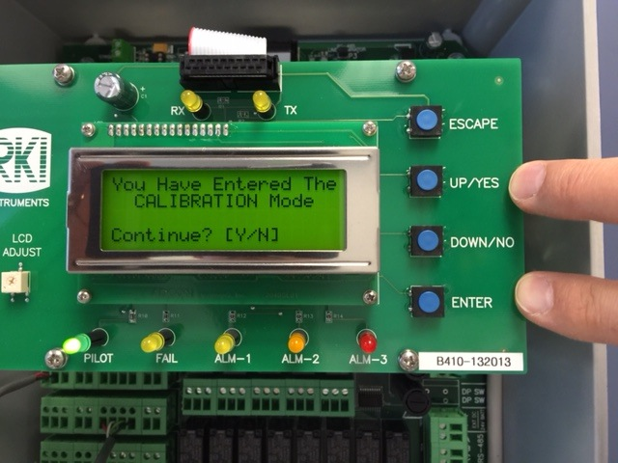
Calibration Mode
Press and hold the UP/YES and ENTER buttons to enter into the calibration mode.
Press YES to continue.

Slide 8
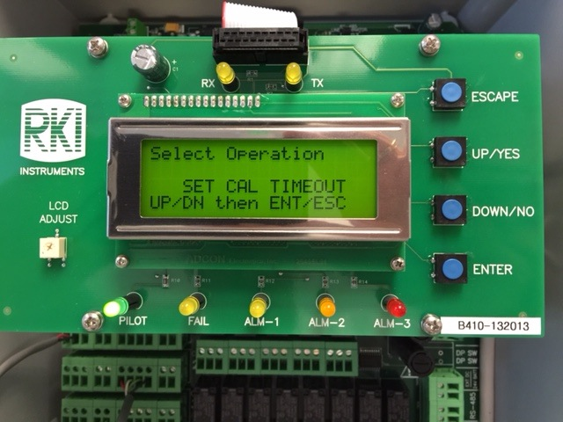
Calibration Mode
Set Cal Timeout from 5 minutes to 240 minutes.
Press ENTER button to continue.

Slide 9
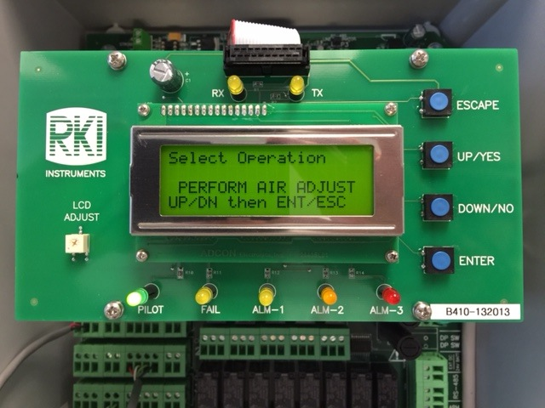
Calibration Mode
Perform Air Adjust
Select channel you would like to Air adjust.
You can select any combination of the four sensors attached.

Slide 10

Calibration Mode
When Perform Gas Adjust is displayed, press the ENTER button to continue.
Apply gas to the channels selected.

Slide 11
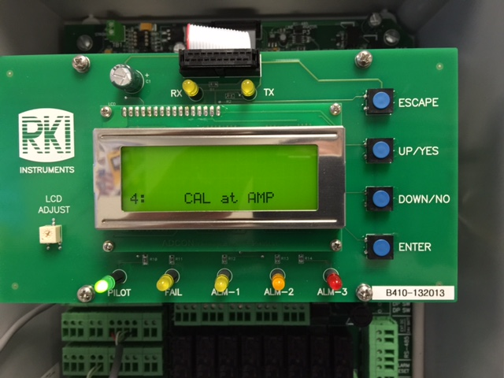
Calibration Mode
For 4-20mA transmitters, calibration must be done at the amplifier.

Slide 12
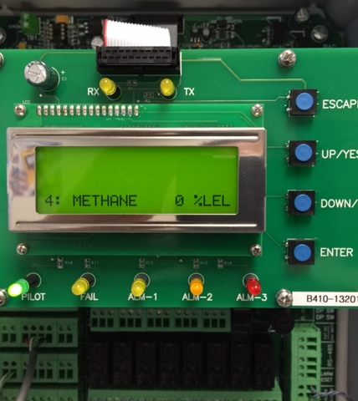
Calibration Mode
Gas reading will be displayed.

Slide 13
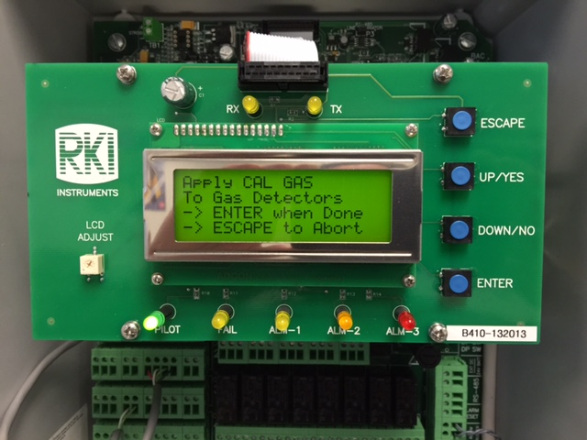
Calibration Mode
The display will prompt you to apply calibration gas.
Once done with the calibration at the amplifier, press the ENTER button to continue.

Slide 14
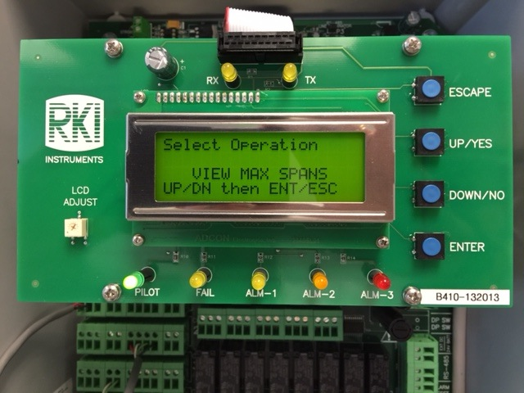
Calibration Mode
To view max spans, press and hold the ENTER button.

Slide 15
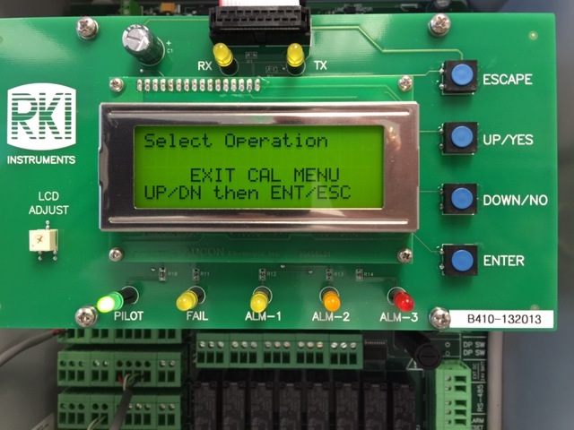
Calibration Mode
Once completed, press the ENTER button to EXIT calibration mode.

Slide 16

Beacon 410A Calibration
(direct connect sensor)
To perform a fresh air adjustment for the selected channels, do the following:
Use the UP/YES or DOWN/NO button to display PERFORM AIR ADJUST on the Select Operation Screen.
Press and release the ENTER button. The Select Channel(s) screen appears.

Slide 17

Beacon 410A Calibration
(direct connect sensor)
Use the UP/YES or DOWN/NO button to scroll through the channel combination choices and select the channel or channels that you will air adjust.
Press and release the ENTER button to accept the displayed choice and continue with the air adjustment. The display will alternate between the top two screens shown below. In the example below, channels 1, 2, 3, and 4 have been selected for an air adjust.

Slide 18
Beacon 410A Calibration
(direct connect sensor)
After performing a fresh air adjustment
Press and release the ENTER button to accept the displayed choice of channel and continue with the gas adjustment. The display will show the calibration gas concentration that the Beacon 410A expects you to use for the gas adjustment for the first selected direct connect type channel.
Use the UP/YES and DOWN/NO buttons to make the displayed concentration match the calibration gas concentration, then press and release the ENTER button to accept it. The display will show the expected calibration gas concentration for the next selected direct connect type channel.
Repeat for each selected direct connect channel.

Slide 19
Beacon 410A Calibration
(Calibrating a 4-20 mA detector head)
If any of the displayed channels is a 4 - 20 mA type detector head, the gas name and concentration will alternate with CAL at AMP.
For a 4 - 20 mA type detector head, adjust the detector head’s gas response at the detector head.
Verify that the detector head is in a fresh-air environment. (If necessary, use a zero-emission air cylinder, also known as zero air, to introduce a fresh-air sample when adjusting the zero reading below.)
Adjust the detector head’s zero (fresh air reading for oxygen) reading. See the detector head’s instruction manual for instructions on how to adjust the zero reading (fresh air reading for oxygen).

Slide 20
Beacon 410A Calibration
(Calibrating a 4-20 mA detector head)
Apply calibration gas to the detector head’s detector and adjust the detector head’s span reading (zero reading for oxygen). See the detector head’s instruction manual for instructions on how to adjust the span (zero reading for oxygen) reading.
Press the ENTER button to indicate that you are done calibrating.

Slide 21
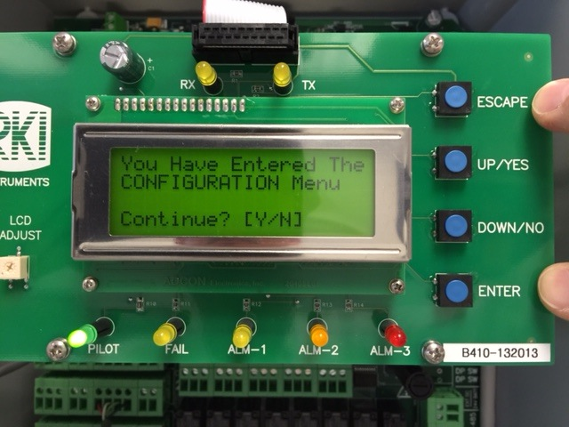
Configuration Menu
Press the ESCAPE and ENTER buttons to enter into Configuration menu.
Press YES to continue.

Slide 22
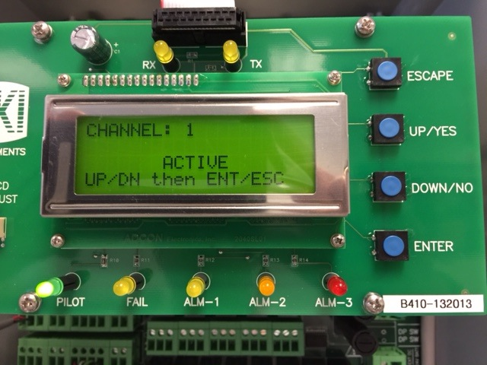
Configuration Menu
Select the channel you would like to view.
You can make the channel ACTIVE.

Slide 23
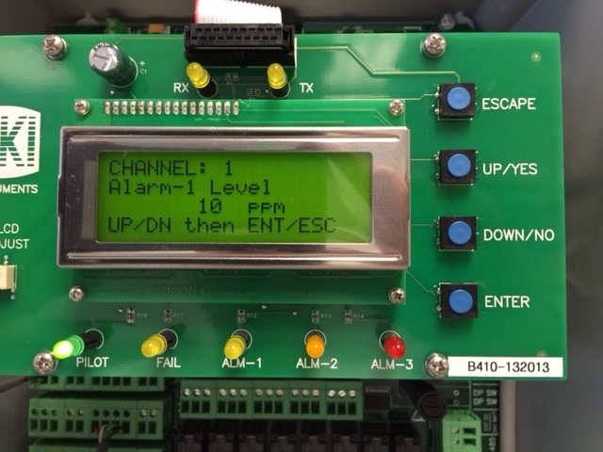
Configuration Menu
If ACTIVE is selected, you can step through all parameters for this channel using the ENTER button.
Adjust parameters using the UP or DOWN button

Slide 24
Channel Parameters
Parameters include:
  Alarm 1
    Alarm 1 LEVEL
    Alarm 1 INC/DEC
    Alarm 1 LATCHING
    Alarm 1 ON DELAY
  ALARM 2
    Alarm 2 LEVEL
    Alarm 2 INC/DEC
    Alarm 2 LATCHING
    Alarm 2 ON DELAY
  Alarm 3
    Alarm 3 LEVEL
    Alarm 3 INC/DEC
    Alarm 3 LATCHING
    Alarm 3 ON DELAY
  Relay 1 Assignment Alarm 1
  Relay 2 Assignment Alarm 2
  Noise Filter
  Deadband

Slide 25
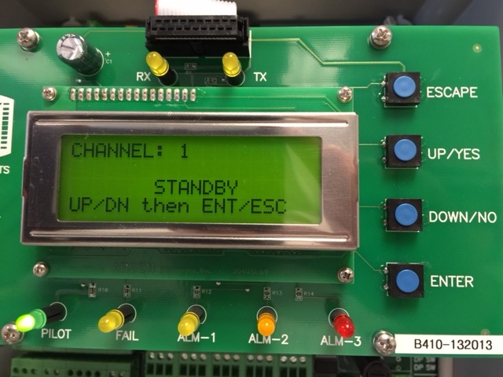
Configuration Mode
Channel can be placed in STANDBY mode.
All alarms are off line for this channel.
Sensor may be attached but not active.

Slide 26
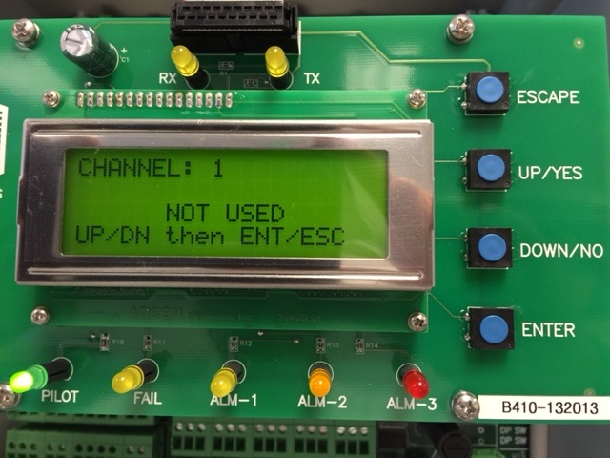
Configuration Mode
The channel can be set to NOT USED.
No sensor or transmitter would be wired to the panel.

Slide 27
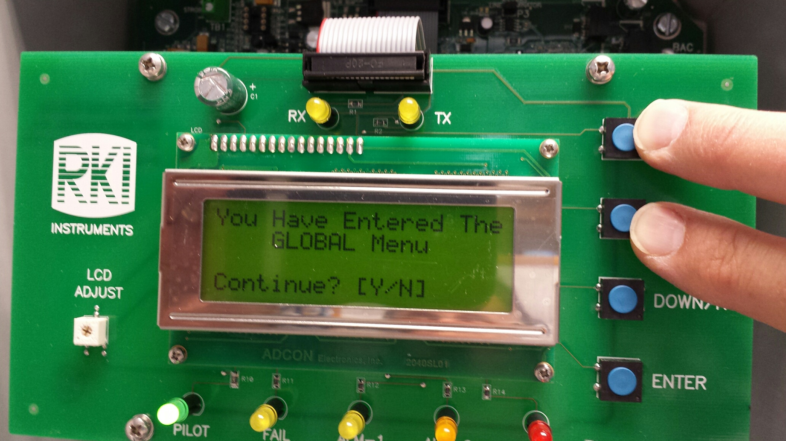
Entering Global Menu
Press and hold the ESCAPE and UP/YES buttons to enter into the global menu.

Slide 28
Global Menu Settings
Strobe
  No Strobe Installed
  Strobe Installed
Normal Relay States:
  Norm DE-ENERGIZED
  Norm ENERGIZED
Relays ABCD Used As:
  Common Alarm Relays
  Channel Alarm Relays
Buzzer Silence
  Can Silence Buzzer
  Can’t Silence Buzzer

Slide 29
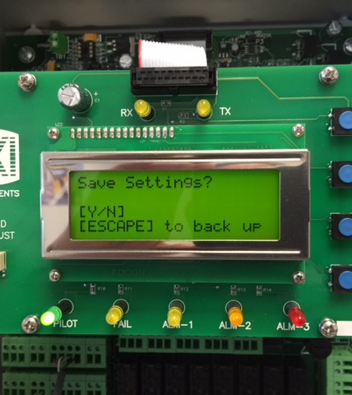
Global Menu
After all Global parameters are set, save settings by pressing the Yes button.

Slide 30
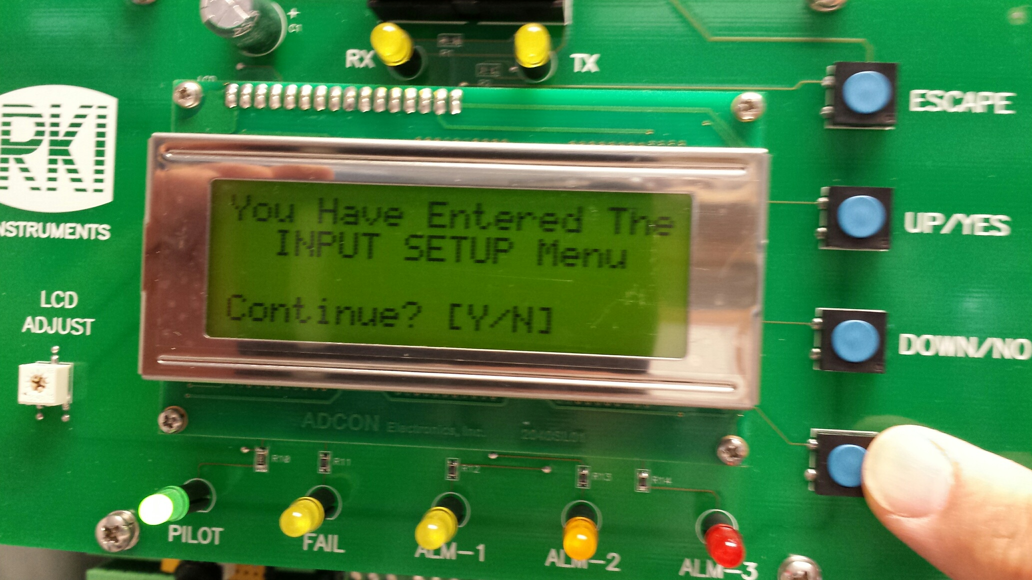
Input Set up Mode
With the Beacon 410A off, press and hold the ENTER button and turn the Beacon on.
Press the YES button to proceed.

Slide 31
Input Setup
Select Channel (1-4)
  Preamp Direct
  Oxygen Direct (25%)
  RWGB Direct (LEL)
  4-20mA XMTR
Gas Setup is displayed.
Set for the proper gas type.
Save Settings
  Select Yes/No

Slide 32
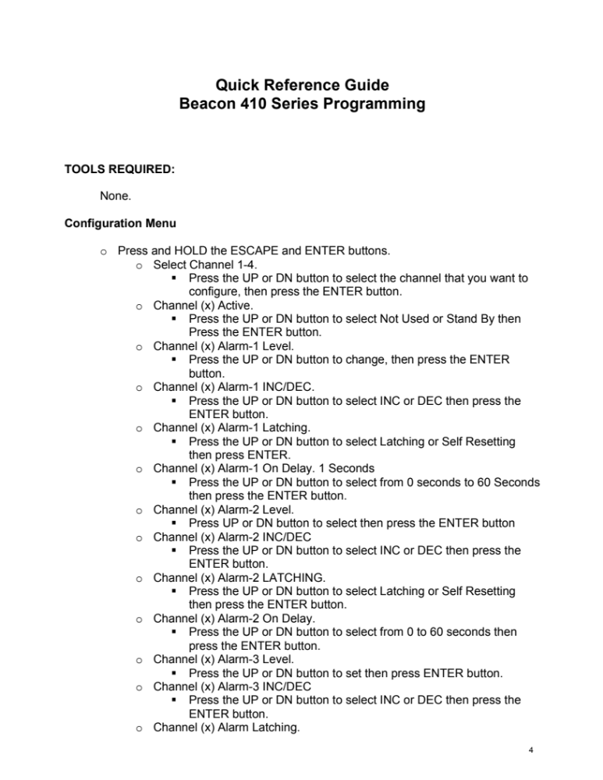

Slide 33
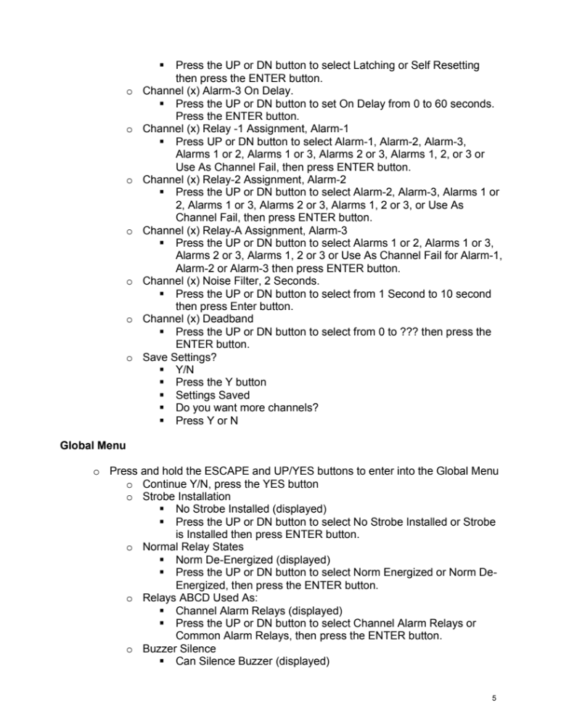

Slide 34
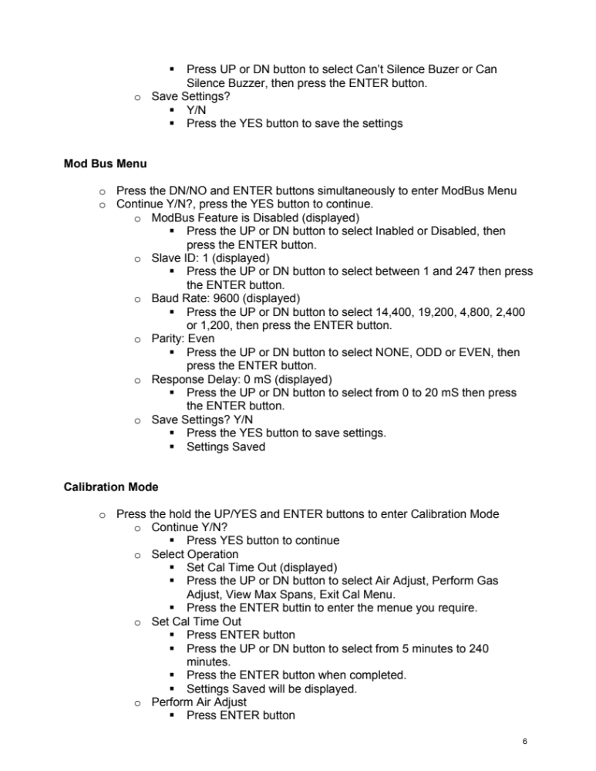

Slide 35
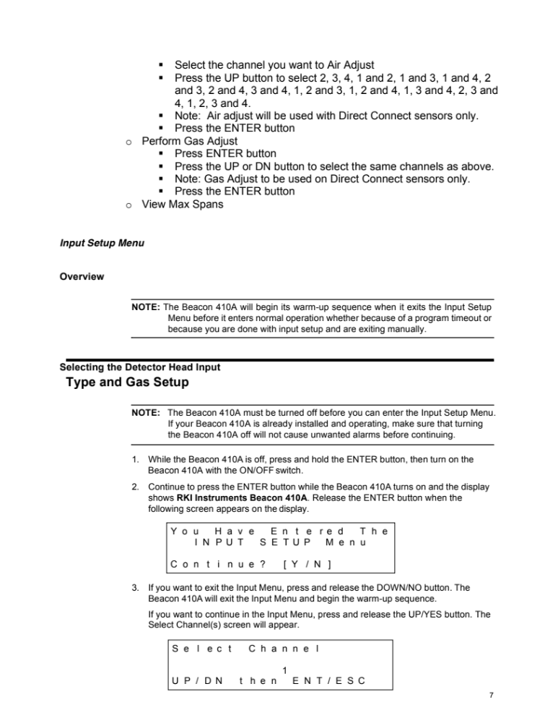

Slide 36
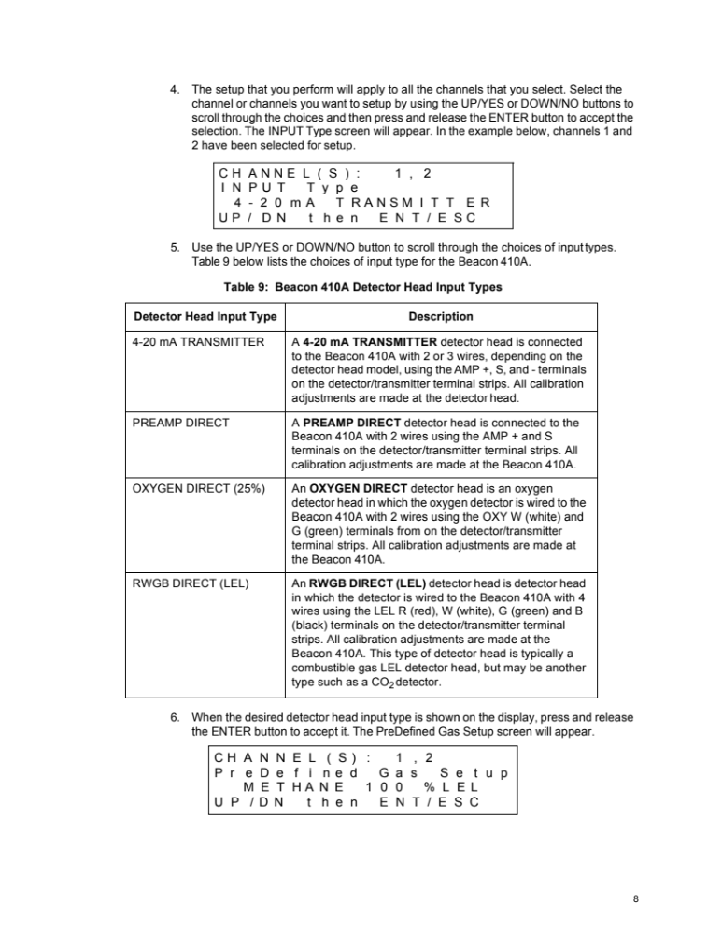

Slide 37
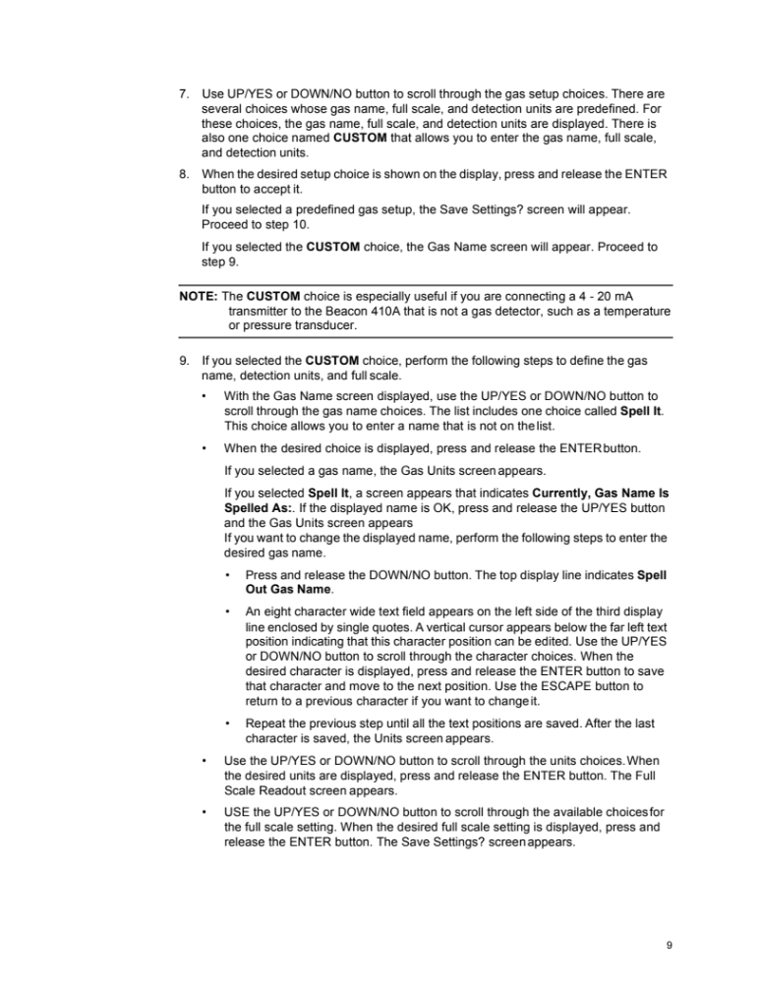

Slide 38
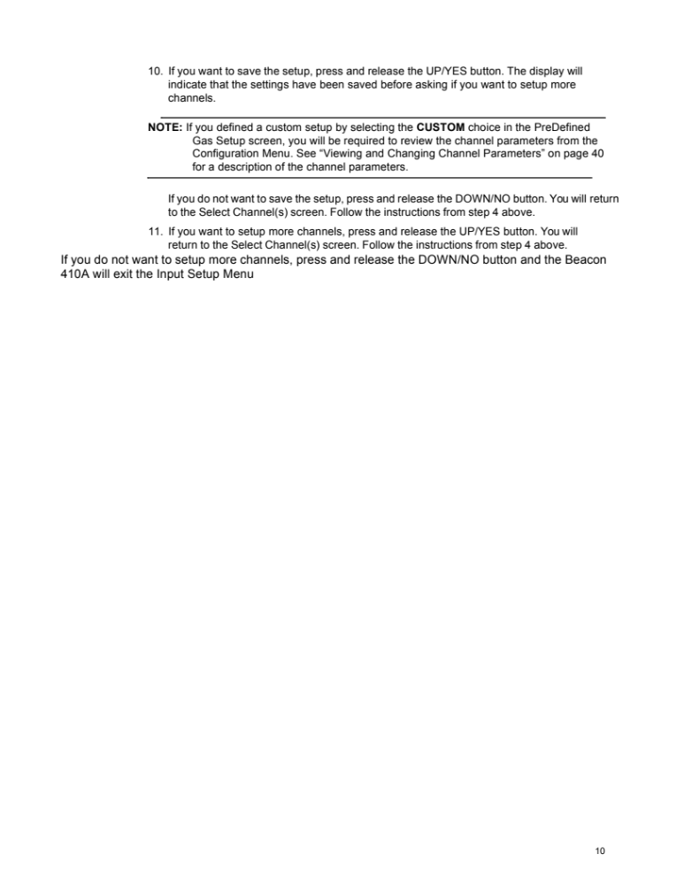

Slide 39

Questions?

