Slide 1
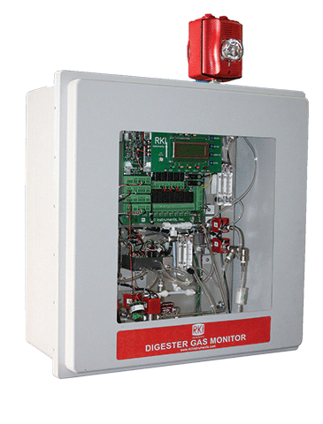
Digester Gas Monitor System

Slide 2
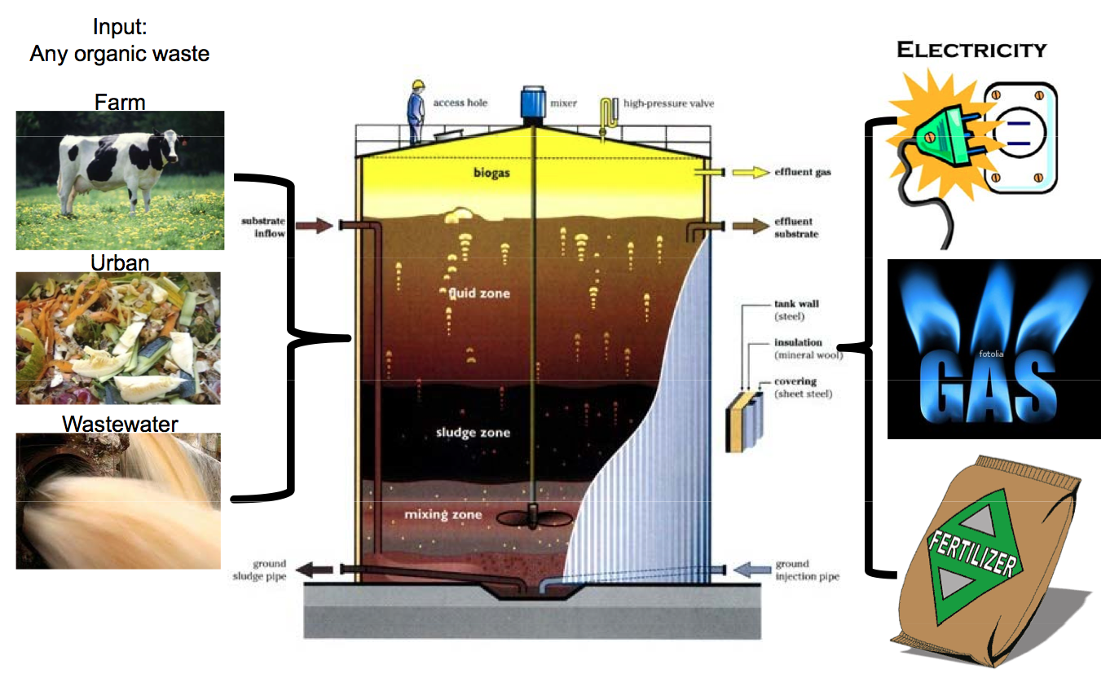
The big picture

Slide 3
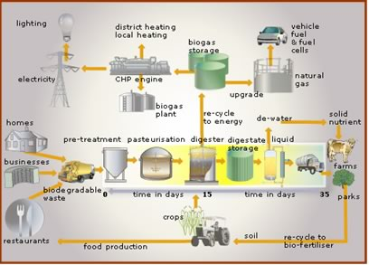
The big picture

Slide 4
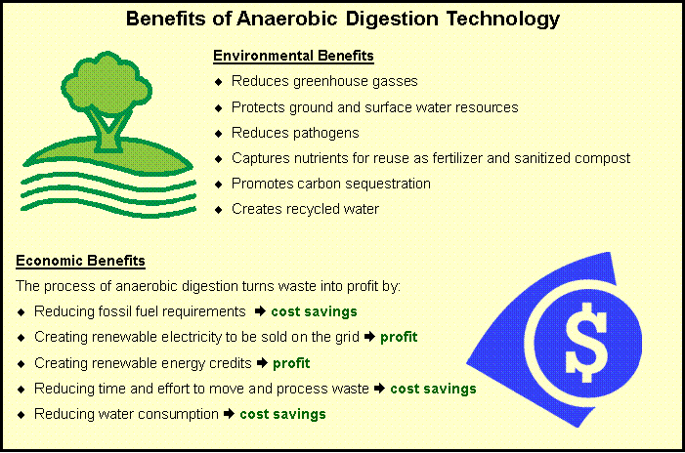

Slide 5
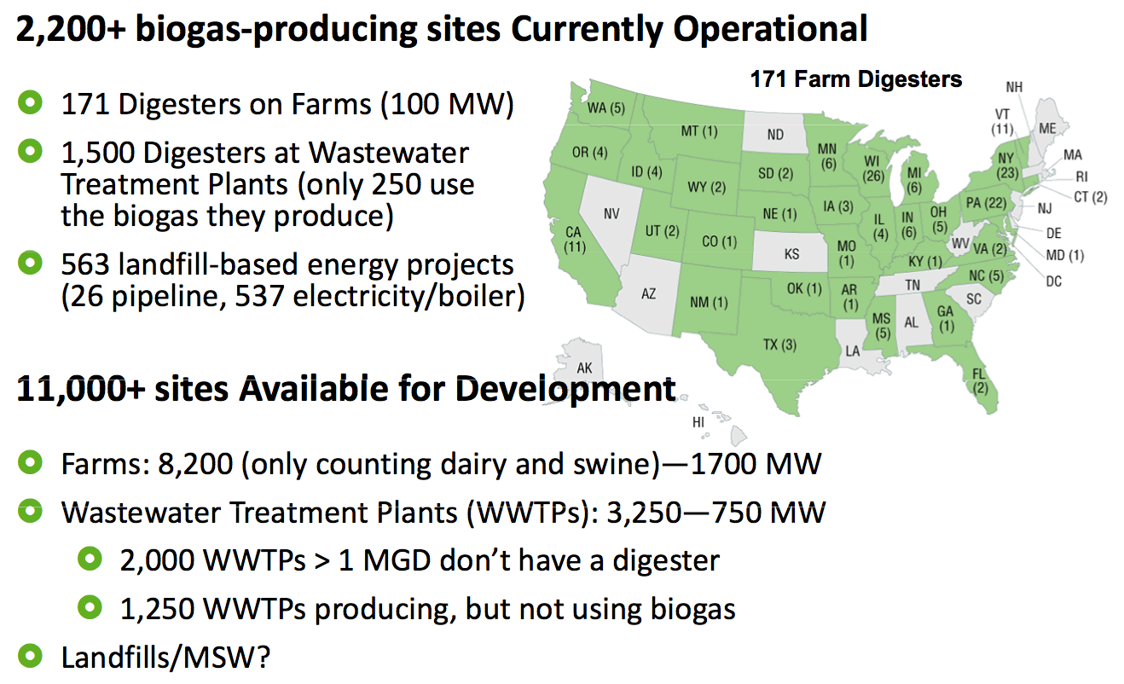

Slide 6
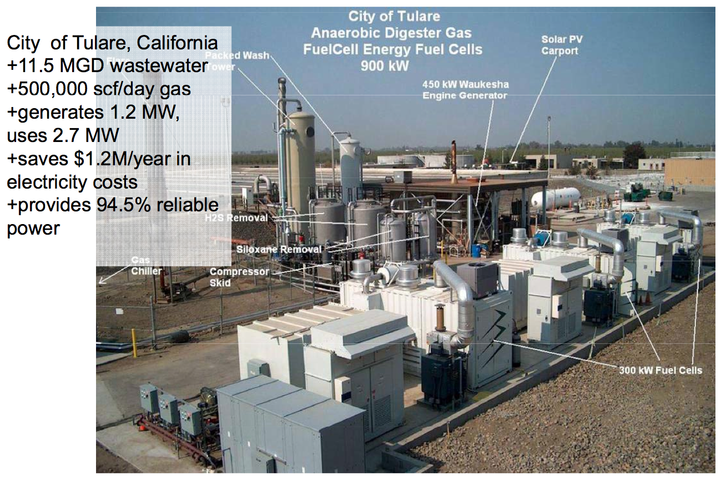

Slide 7
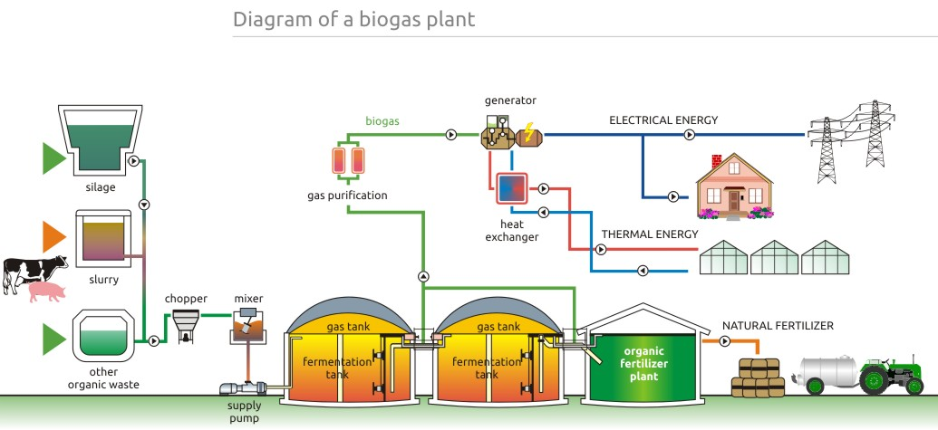
What is a biogas plant?

Slide 8
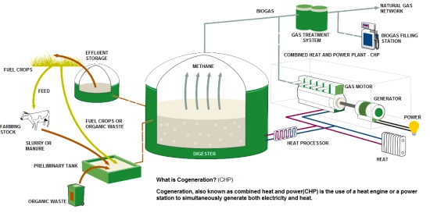
What is cogeneration?

Slide 9
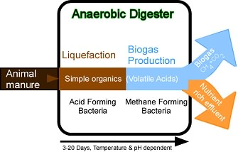
What is a digester?

Slide 10
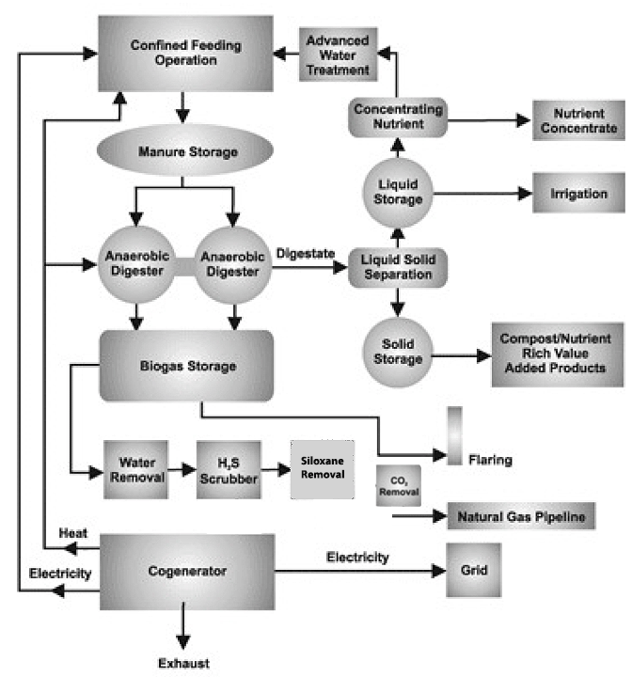
Gas treatment

Slide 11
Gas treatment
Pre Scrubber Digester
Post Treatment Aspirator

Slide 12
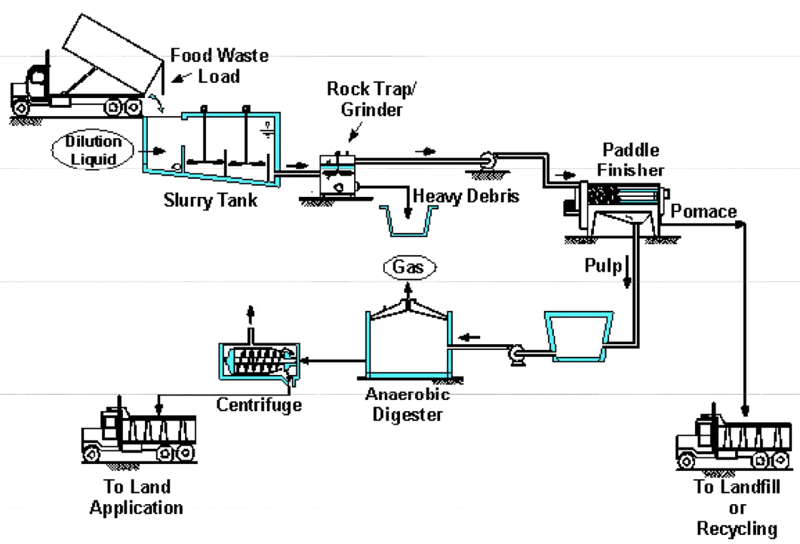
Food Waste Digester

Slide 13
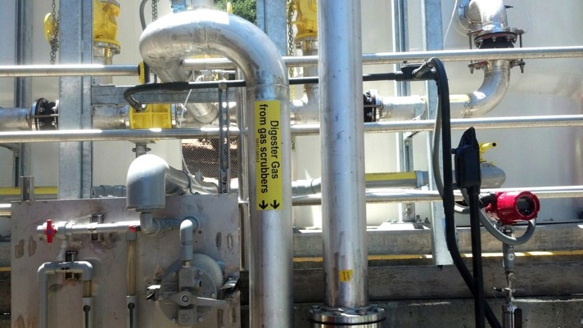
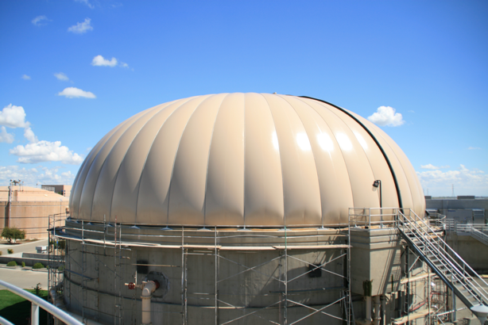
Applications
Wastewater treatment plants
Landfills
Dairy farms
Poultry processing
Agricultural waste
Animal farm “lagoons”
Food waste processors

Slide 14
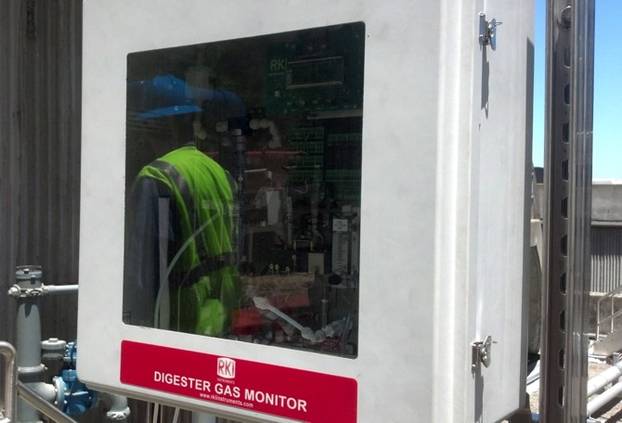
Reasons for monitoring
Customer wants to use digester-produced gas to run an engine to generate electricity
Gas is typically high humidity and high H2S content
H2S will damage engine, so level must be controlled, typically by scrubber
Customer will want to check H2S at intake and exhaust from scrubber

Slide 15
Reasons for monitoring
Customer may also want to detect methane level of gas, to determine quality
Customer may also want to detect O2 level of gas, to prevent an explosion, verify process, and make sure no air is leaking into process
CO2 content can also be checked

Slide 16
Detectable Gases
Accurately measure high levels of H2S
Up to 4 sensors
  Methane 0-100% Volume
  CO2 0-50% Volume
  Oxygen 0-25% Volume
  H2S 0-1000 PPM 0-3,000 or 5,000 optional

Slide 17
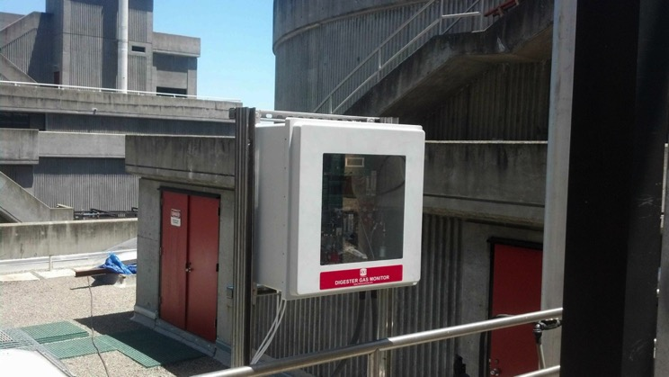
Features and Benefits
Sample system handles high humidity
100 ft. sample range
Self draining moisture trap
Automatic back-flush of sampling system
Long life air aspirator (no moving parts)
Corrosion resistant design, NEMA 4X enclosure

Slide 18
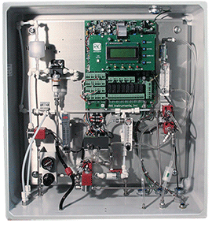
Features and Benefits
Three-stage moisture/humidity control
High range H2S detection (up to 5000 ppm)
Infrared sensors for methane and CO2 detection
Automatic zero adjustment
Rugged aspirator-based sampling system

Slide 19
Features and Benefits
Optional horn/strobe
User adjustable cycle interval from 15 minutes to 24 hours
Durable IR sensors for methane and CO2 detection
Long-life partial pressure O2 sensor

Slide 20
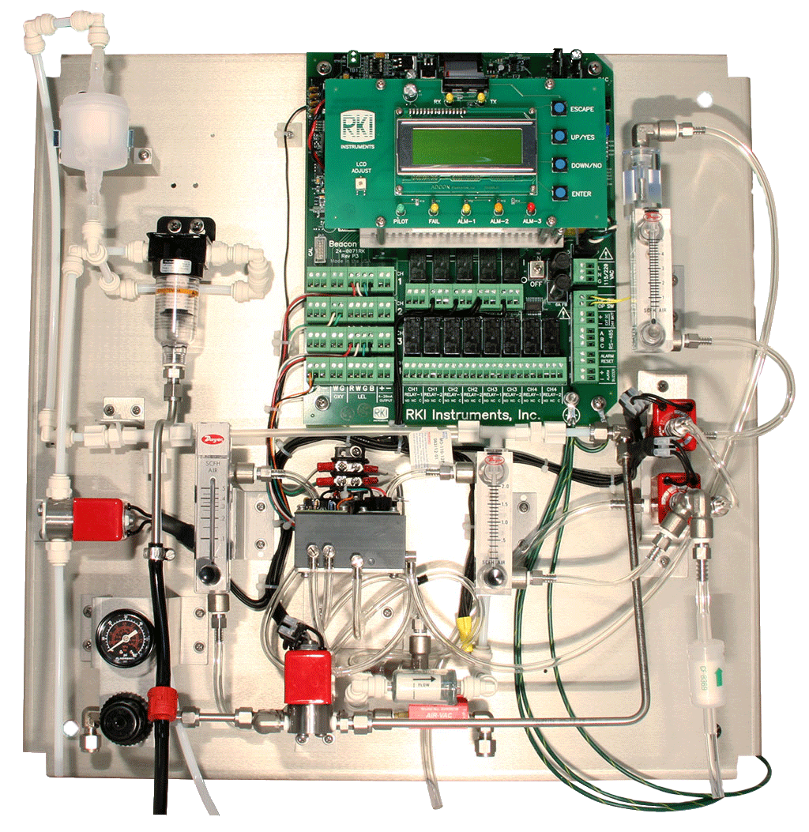
Component Detail

Slide 21
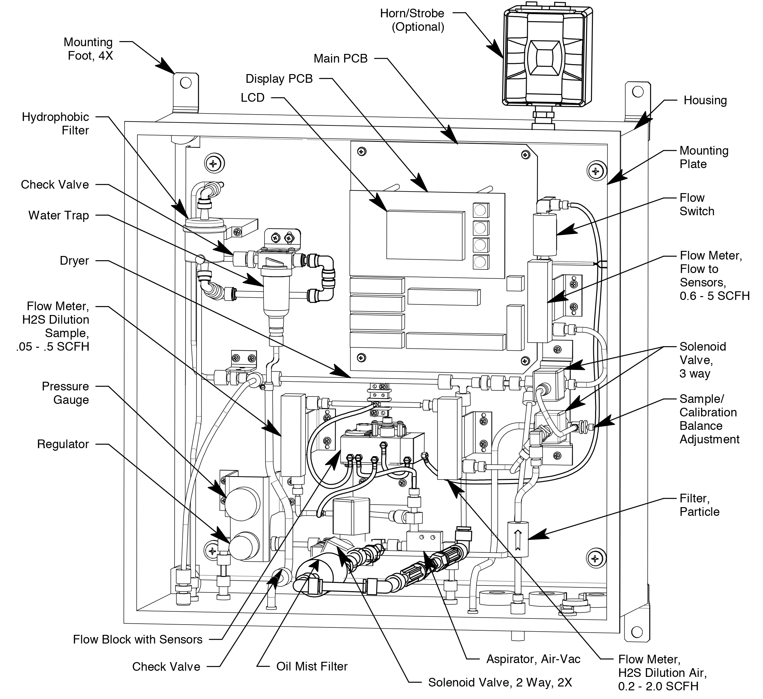
Component Detail

Slide 22
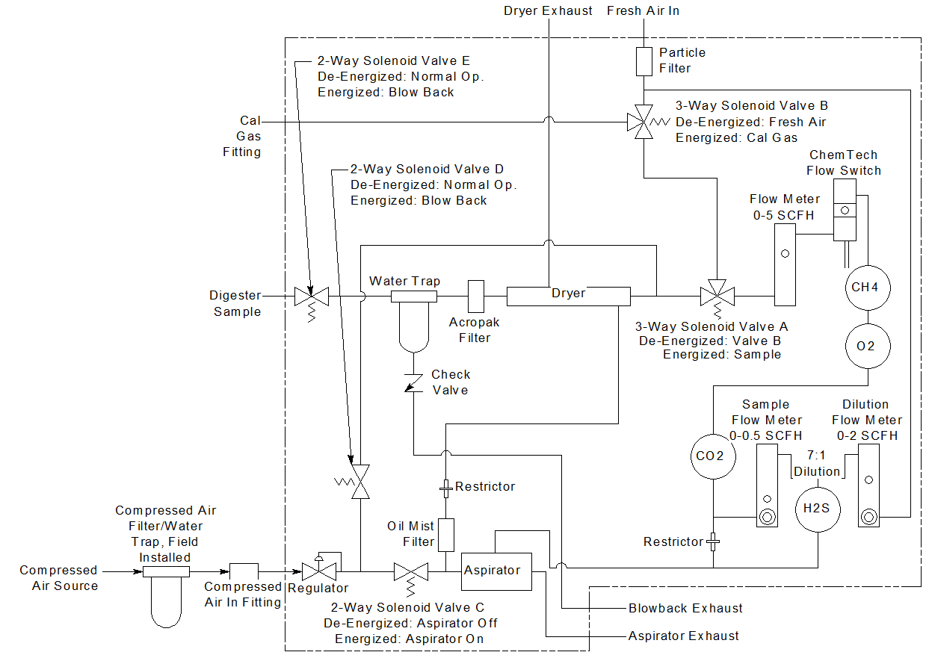
Flow Diagram

Slide 23
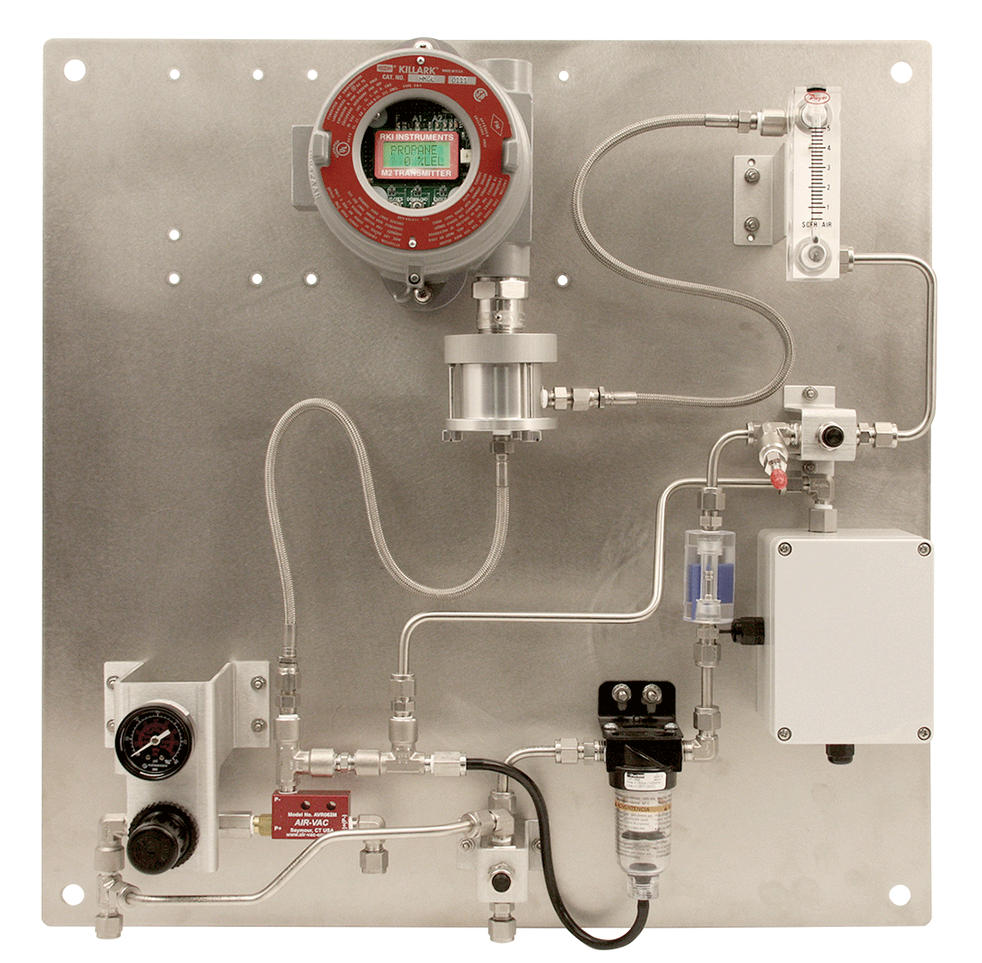
Post Treatment Panel
Monitor H2S Scrubber Exhaust for H2S
Alerts when it’s time to change H2S scrubber
Protects digester generator engine

Slide 24
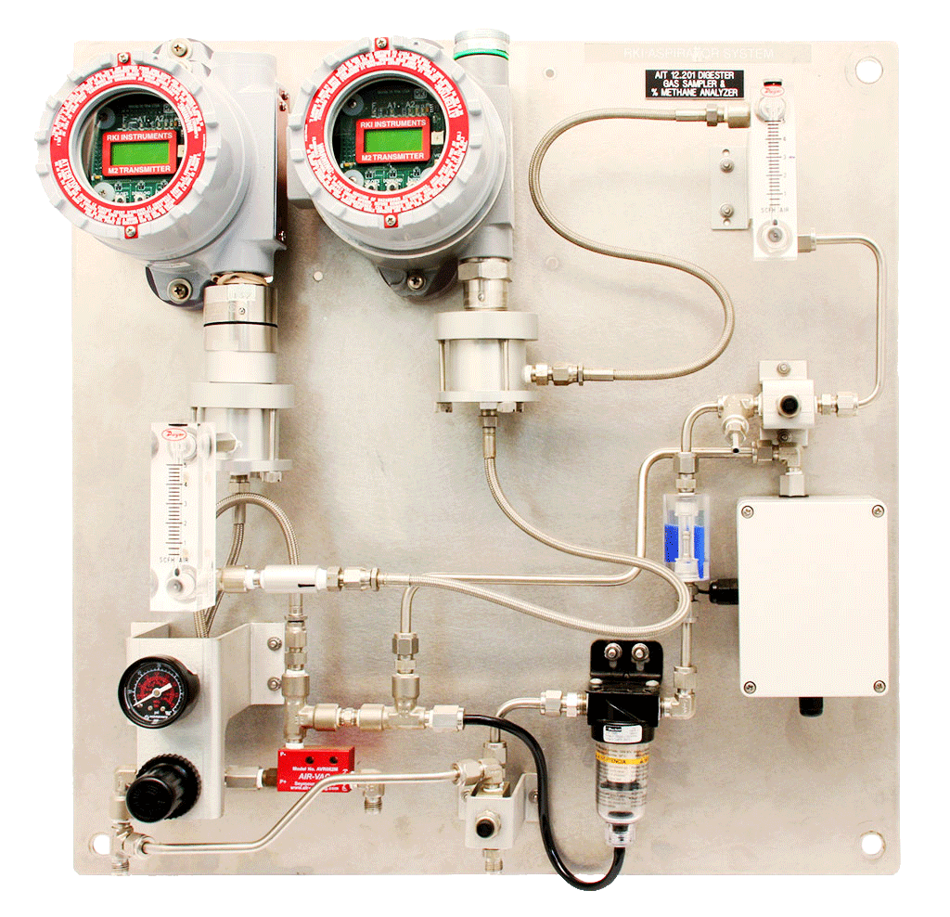
Post Treatment Panel Detail
M2 for CH₄
M2 for H₂S
Sample flow
Calibration valve
Dilution flow meter
Low flow switch
Regulator for compressed air supply
Water/particulate filter
(self draining)
Aspirator
Blow–out valve

Slide 25
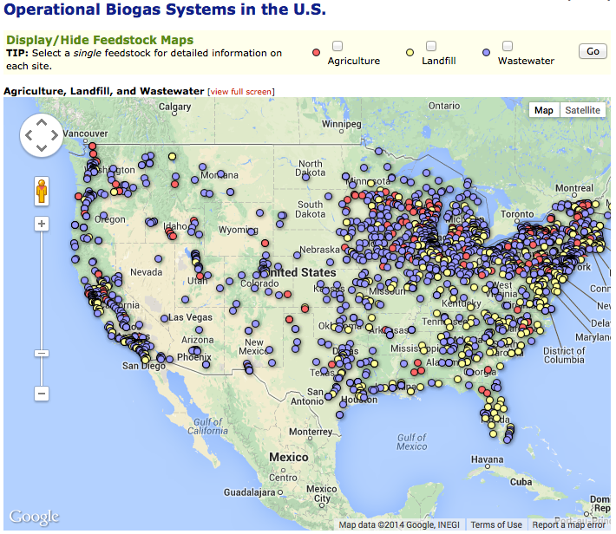
Web link to map of US Biogas Locations

Slide 26
Digester YouTube Video
Calibration
Click on the image

Slide 27
Questions?

