Slide 1
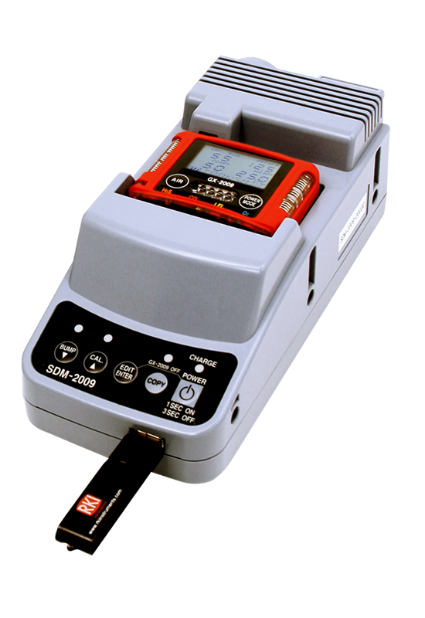
SDM-2009
Calibration
Station

Slide 2
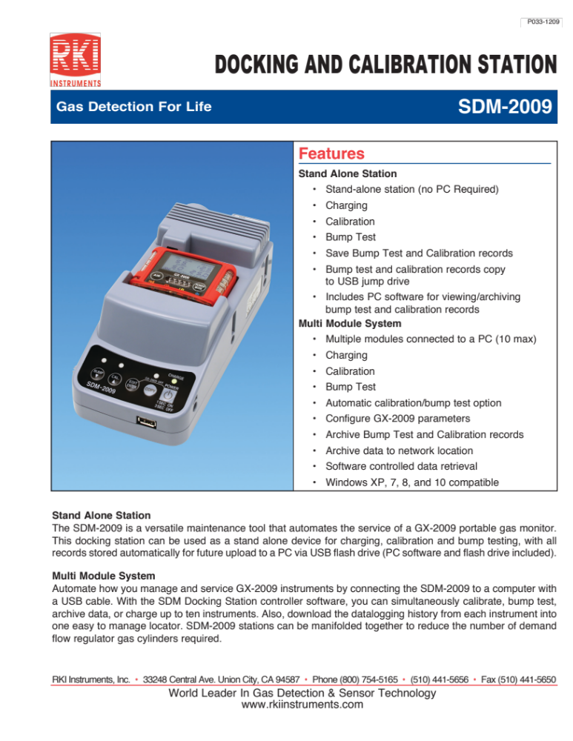

Slide 3
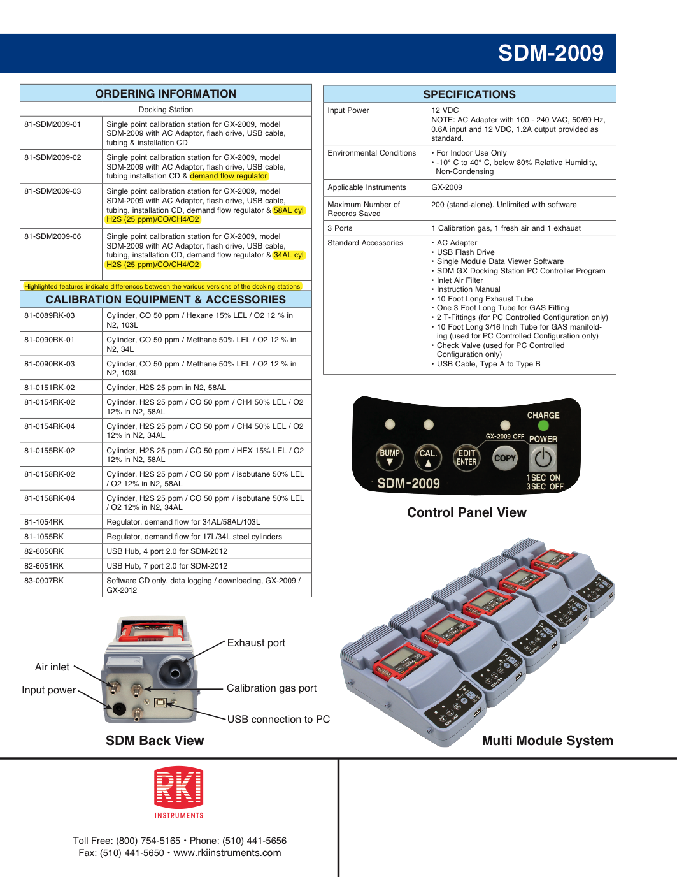

Slide 4
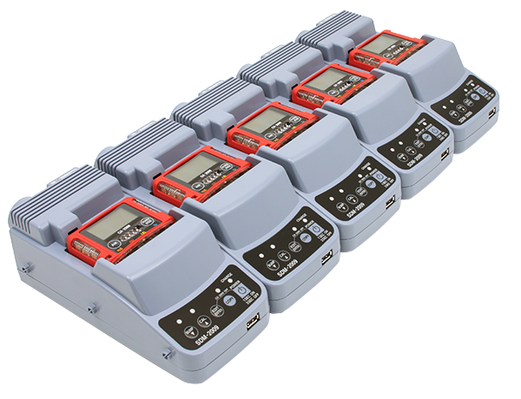
SDM-2009 Multi-module

Slide 5
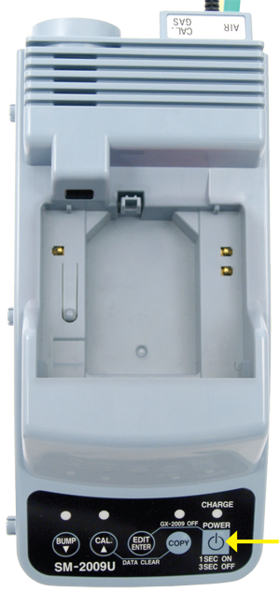
Turn Cal Station On
Press the “POWER” button on the Cal station.

Slide 6
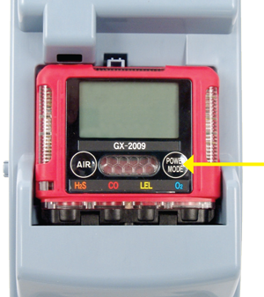
Turn Instrument On
Seat the GX-2009 into the cal station. Then turn on the GX-2009 by pressing the “POWER MODE” button on the gas monitor.
Note: Ensure sensor cover on detector and the docking station port is free of any mud or debris

Slide 7
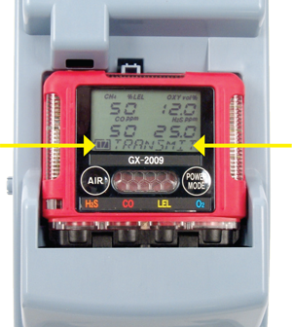
Instrument Connected
Once on, the display will show gas channels and a transmit message.
Note: Confirm calibration gas cylinder is connected to a demand flow regulator and then to the back of the Cal station. Make sure calibration gas concentrations match values shown on display.

Slide 8
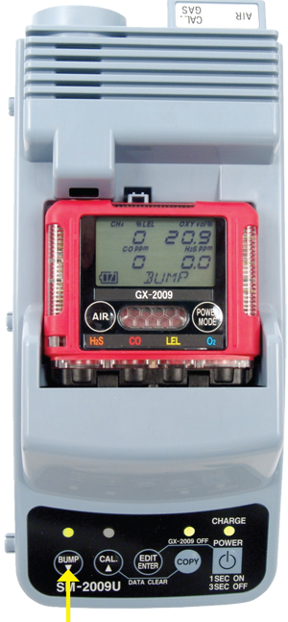
Bump Test
Press the “BUMP” button to start.

Slide 9
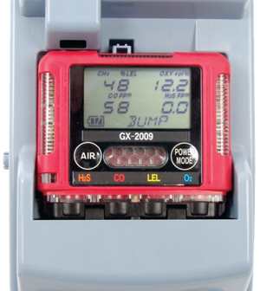
Bump Gas Reading
During bump test, the display shows current gas reading.

Slide 10
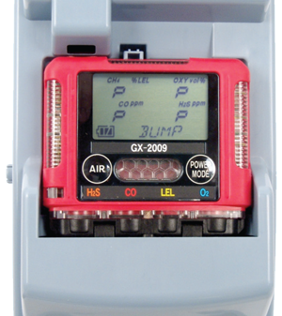
Bump Results
The BUMP LED will stop blinking and be on steadily green if the bump test passed or steadily red if the bump test failed. Display will show “P” for pass or “F” for fail for each sensor.

Slide 11
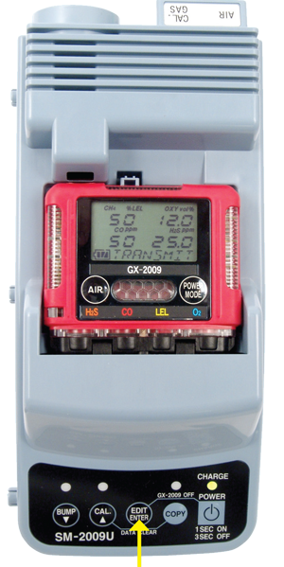
Return to Transmit Screen
Press the “EDIT/ENTER” button to return to the transmit screen.

Slide 12
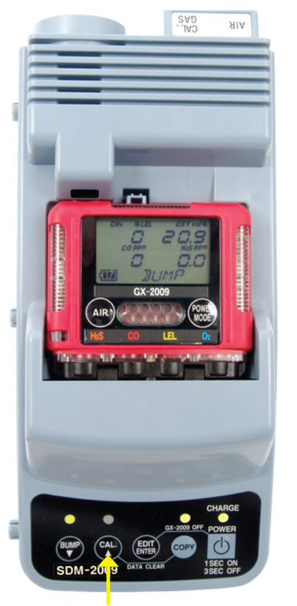
Calibrate
Press the “CAL” button to start calibration.

Slide 13
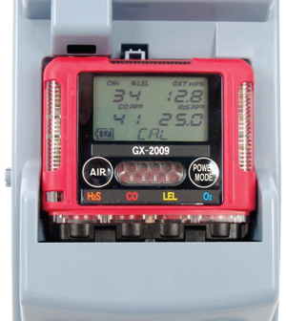
Calibration Gas Readings
During calibration, the display shows current gas readings. Typical calibration will take 3 minutes.

Slide 14
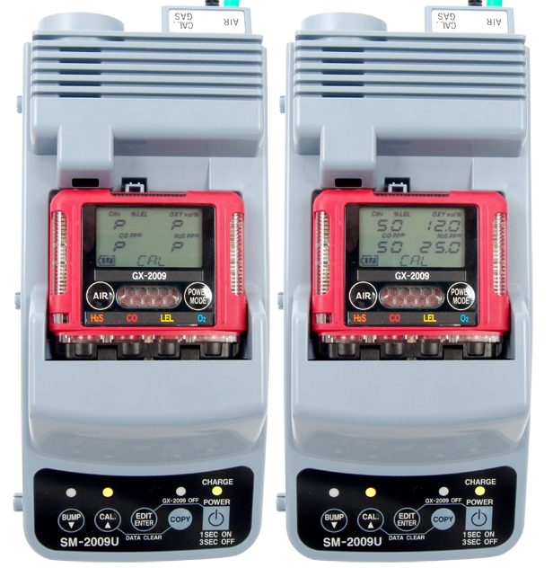
Calibration Results
Once calibration is complete, the display either shows a “P” for pass or an “F” for fail for each sensor. The display will alternate between the gas concentration and the letter P when the monitor passes calibration. The “CAL” LED lights in green when calibration is passed. “CAL” LED lights in red if there is a failure.

Slide 15
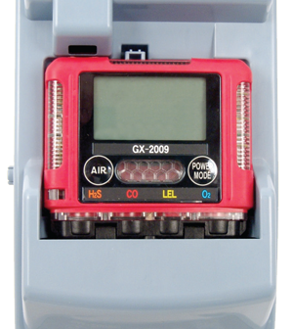
Turning GX-2009 Off
Turn off the GX-2009 gas monitor by pressing the SM-2009 “EDIT ENTER” and “POWER” buttons simultaneously. The instrument can now be removed from the calibration station.
Warning: Do not remove the GX-2009 before turning it off, and do not use the GX-2009’s power button to power it down.

Slide 16
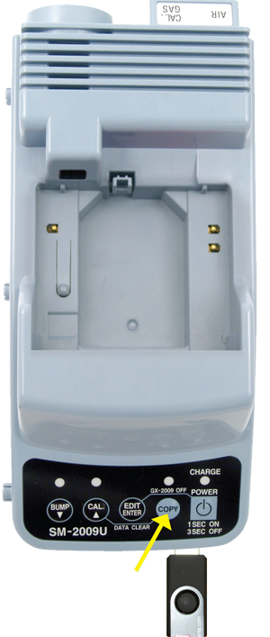
Data Transfer To USB Flash Drive
With USB flash drive installed and unit powered on, press and release the COPY button. The COPY LED will become solid red while the records in the calibration station’s memory are copied to the flash drive. In addition, the flash drive’s LED will begin to blink.

Slide 17
Data Transfer To USB Flash Drive
When the LED stops blinking, the copy operation is complete. Remove the flash drive from the USB port.
Transfer data to PC with Calibration Station software, following the instructions in the Operator’s Manual.

