Slide 1
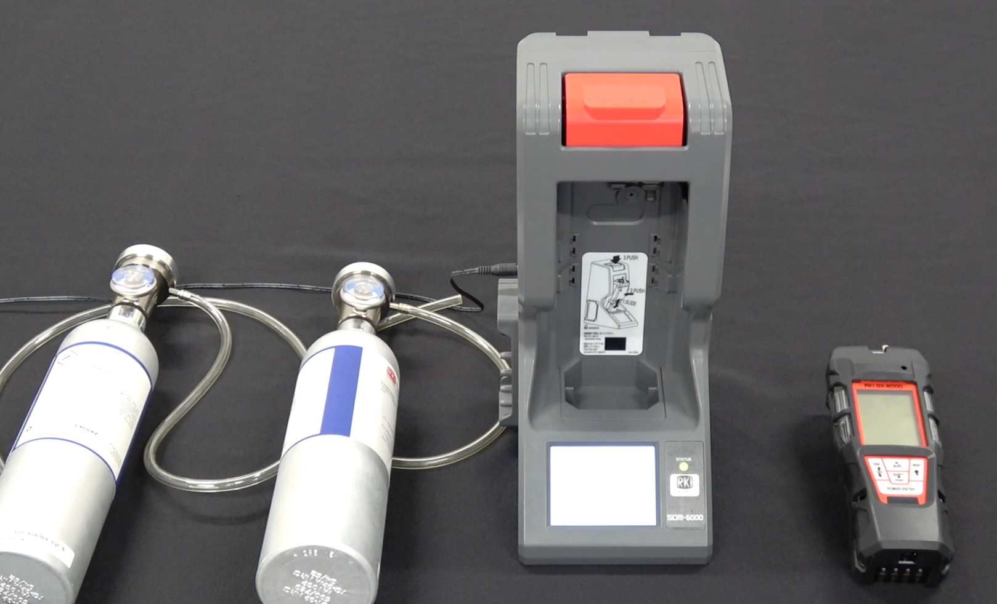
SDM-6000
Bump and Calibration
LEL / O2 / H2S / CO with Benzene & High Range PID

Slide 2
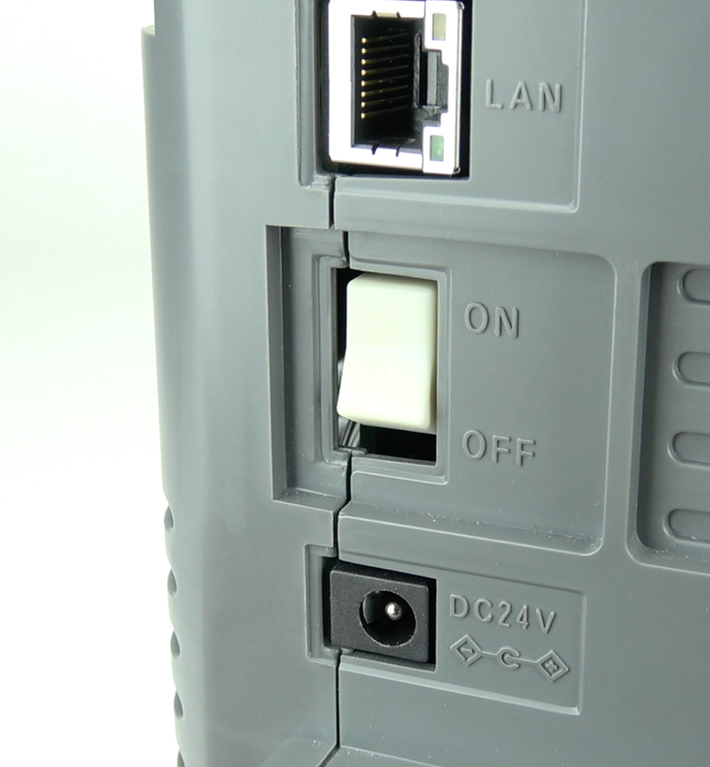
Setup
Turn on the SDM-6000 using the ON/OFF toggle switch on the side

Slide 3
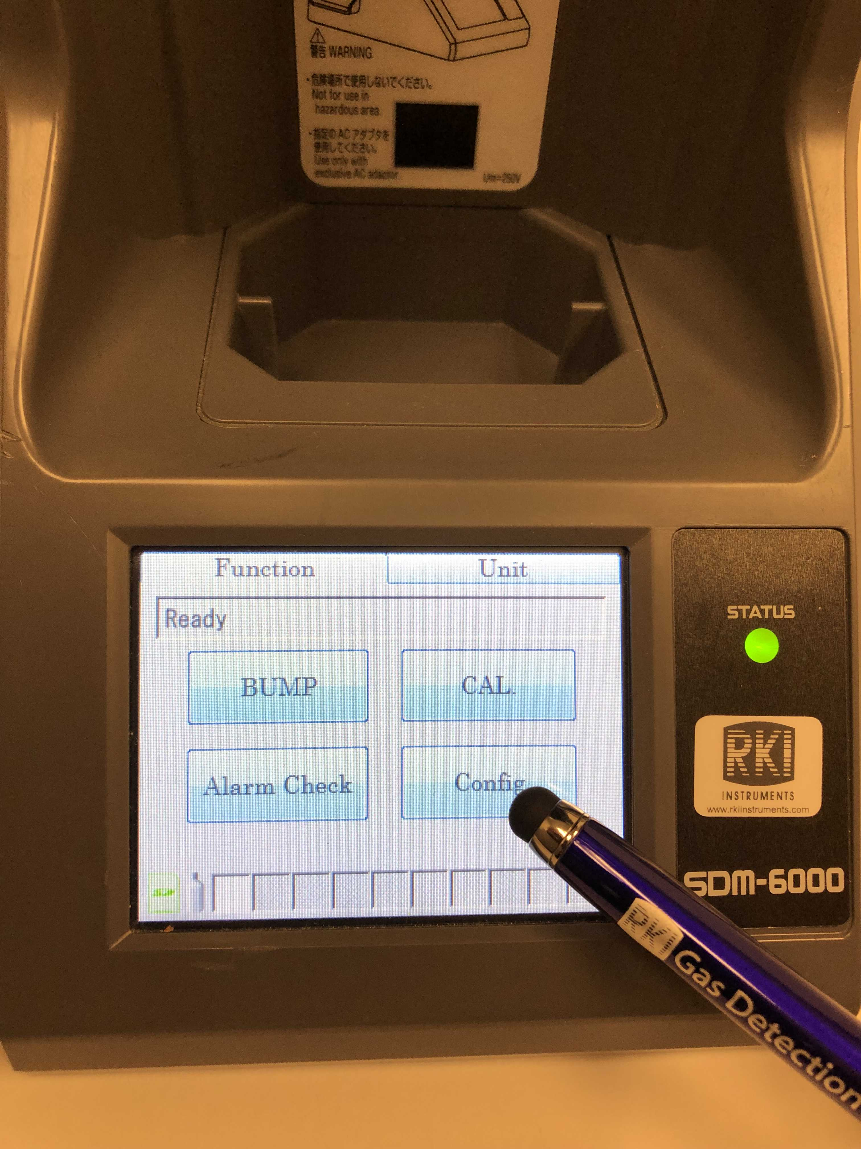
Setup
To set up the gas inlets, go to CONFIG on the function menu

Slide 4
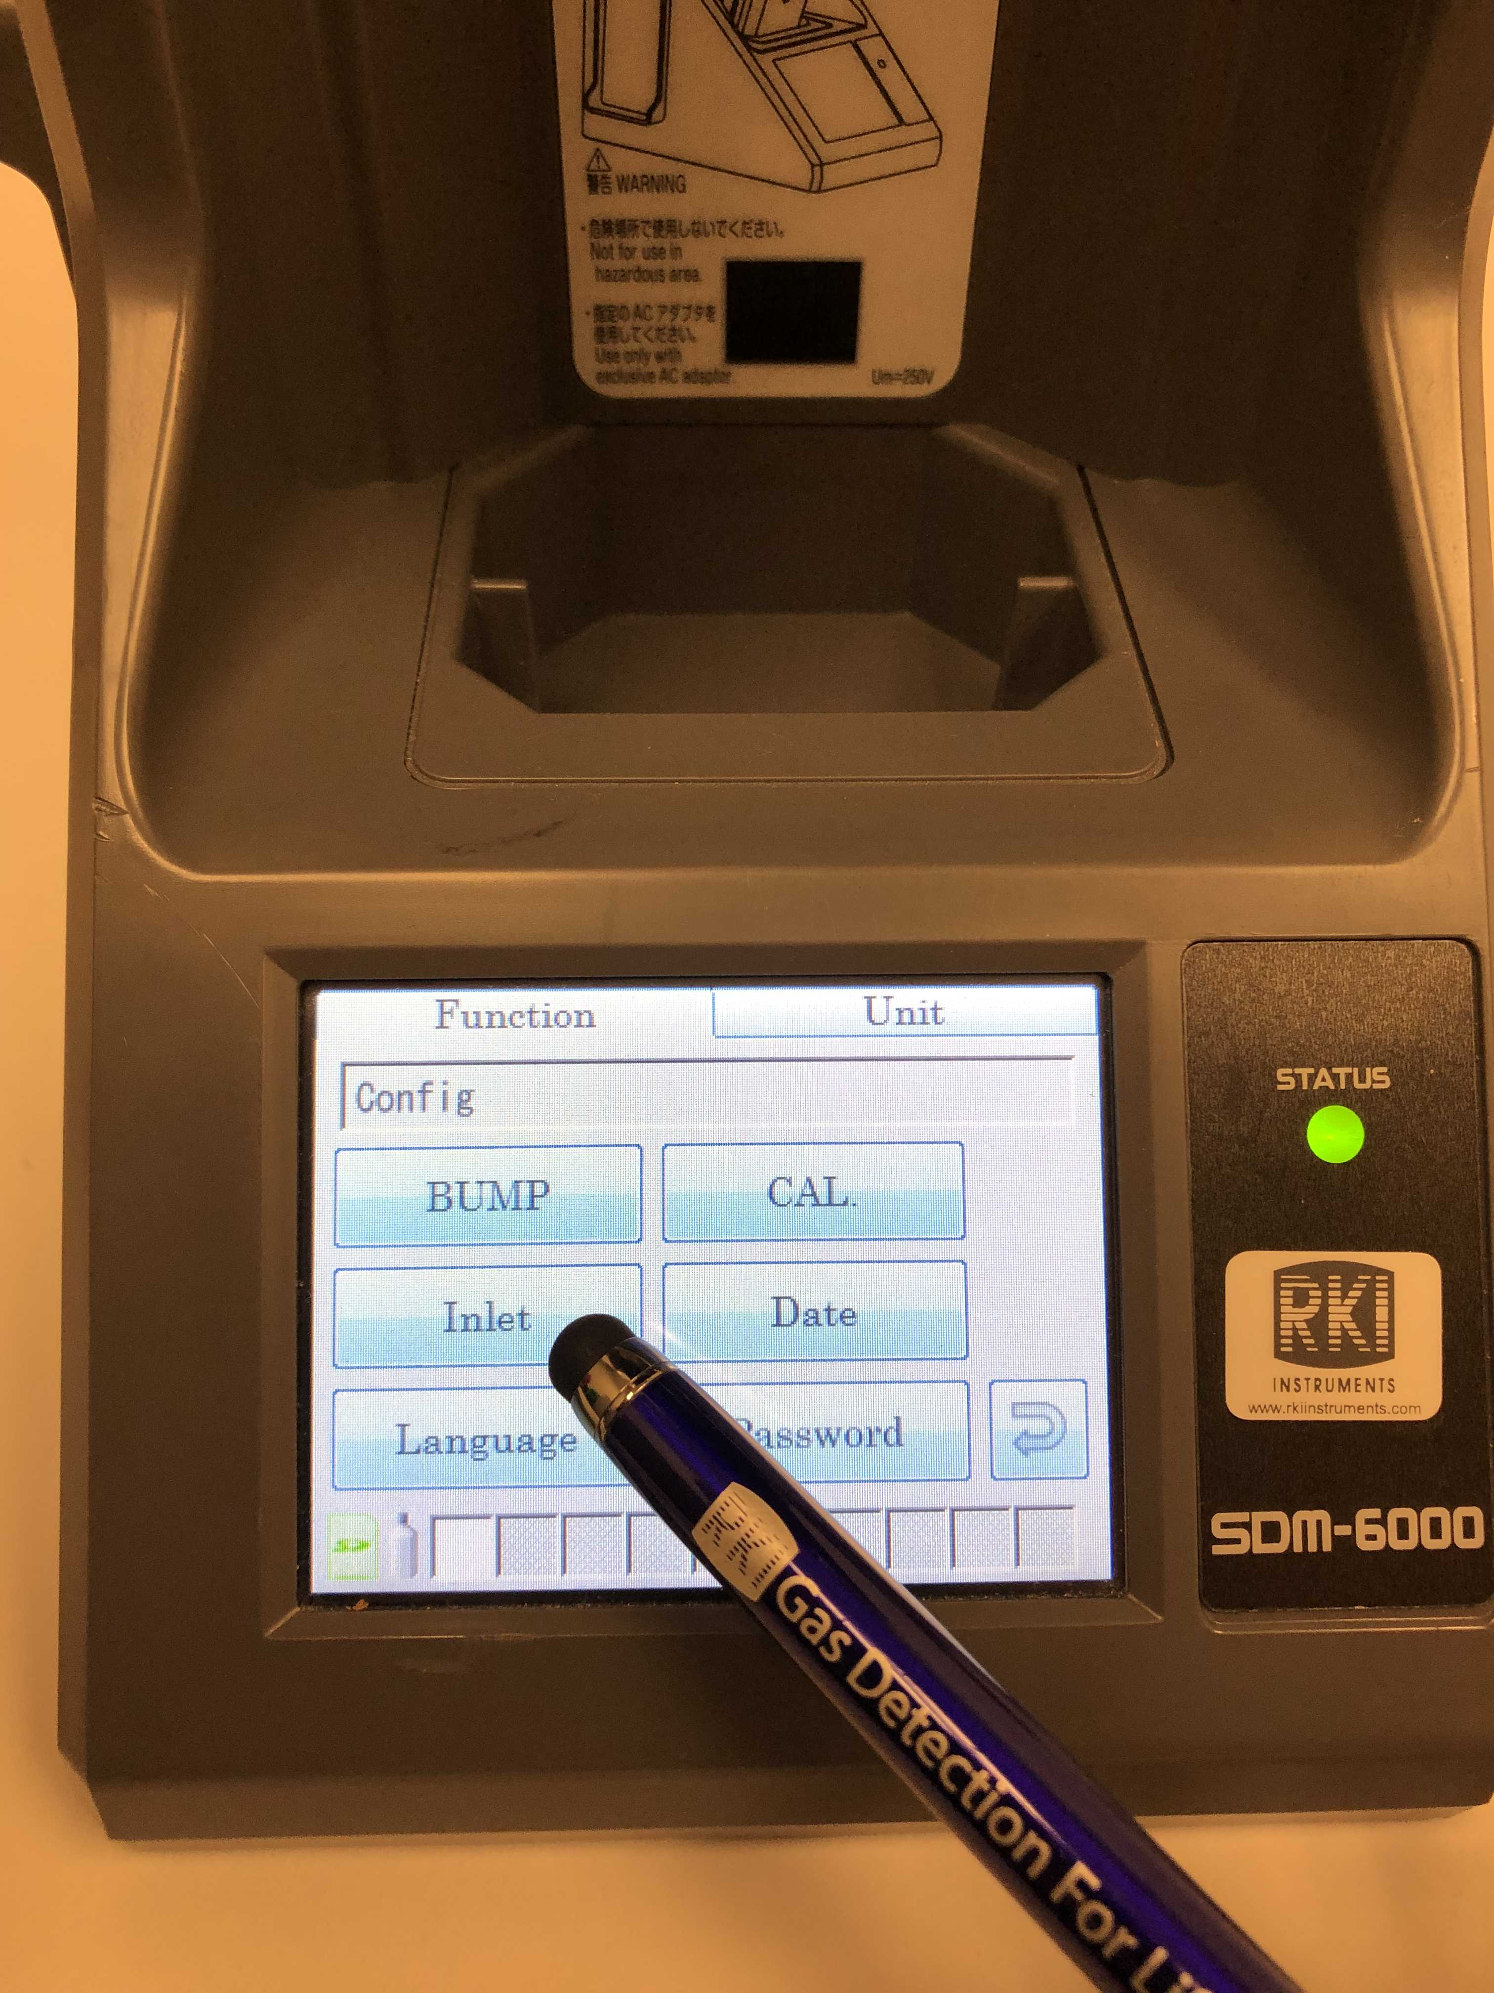
Setup
Tap on the INLET icon

Slide 5
Setup
Make sure the concentrations on the screen matches your cylinders, if not then make appropriate changes by clicking on the gas name and the arrow on the right side. This will bring up a menu where you can change the gas concentrations
Take note of the gas inlet number and make sure “Actual Gas” and “Active” are both checked

Slide 6
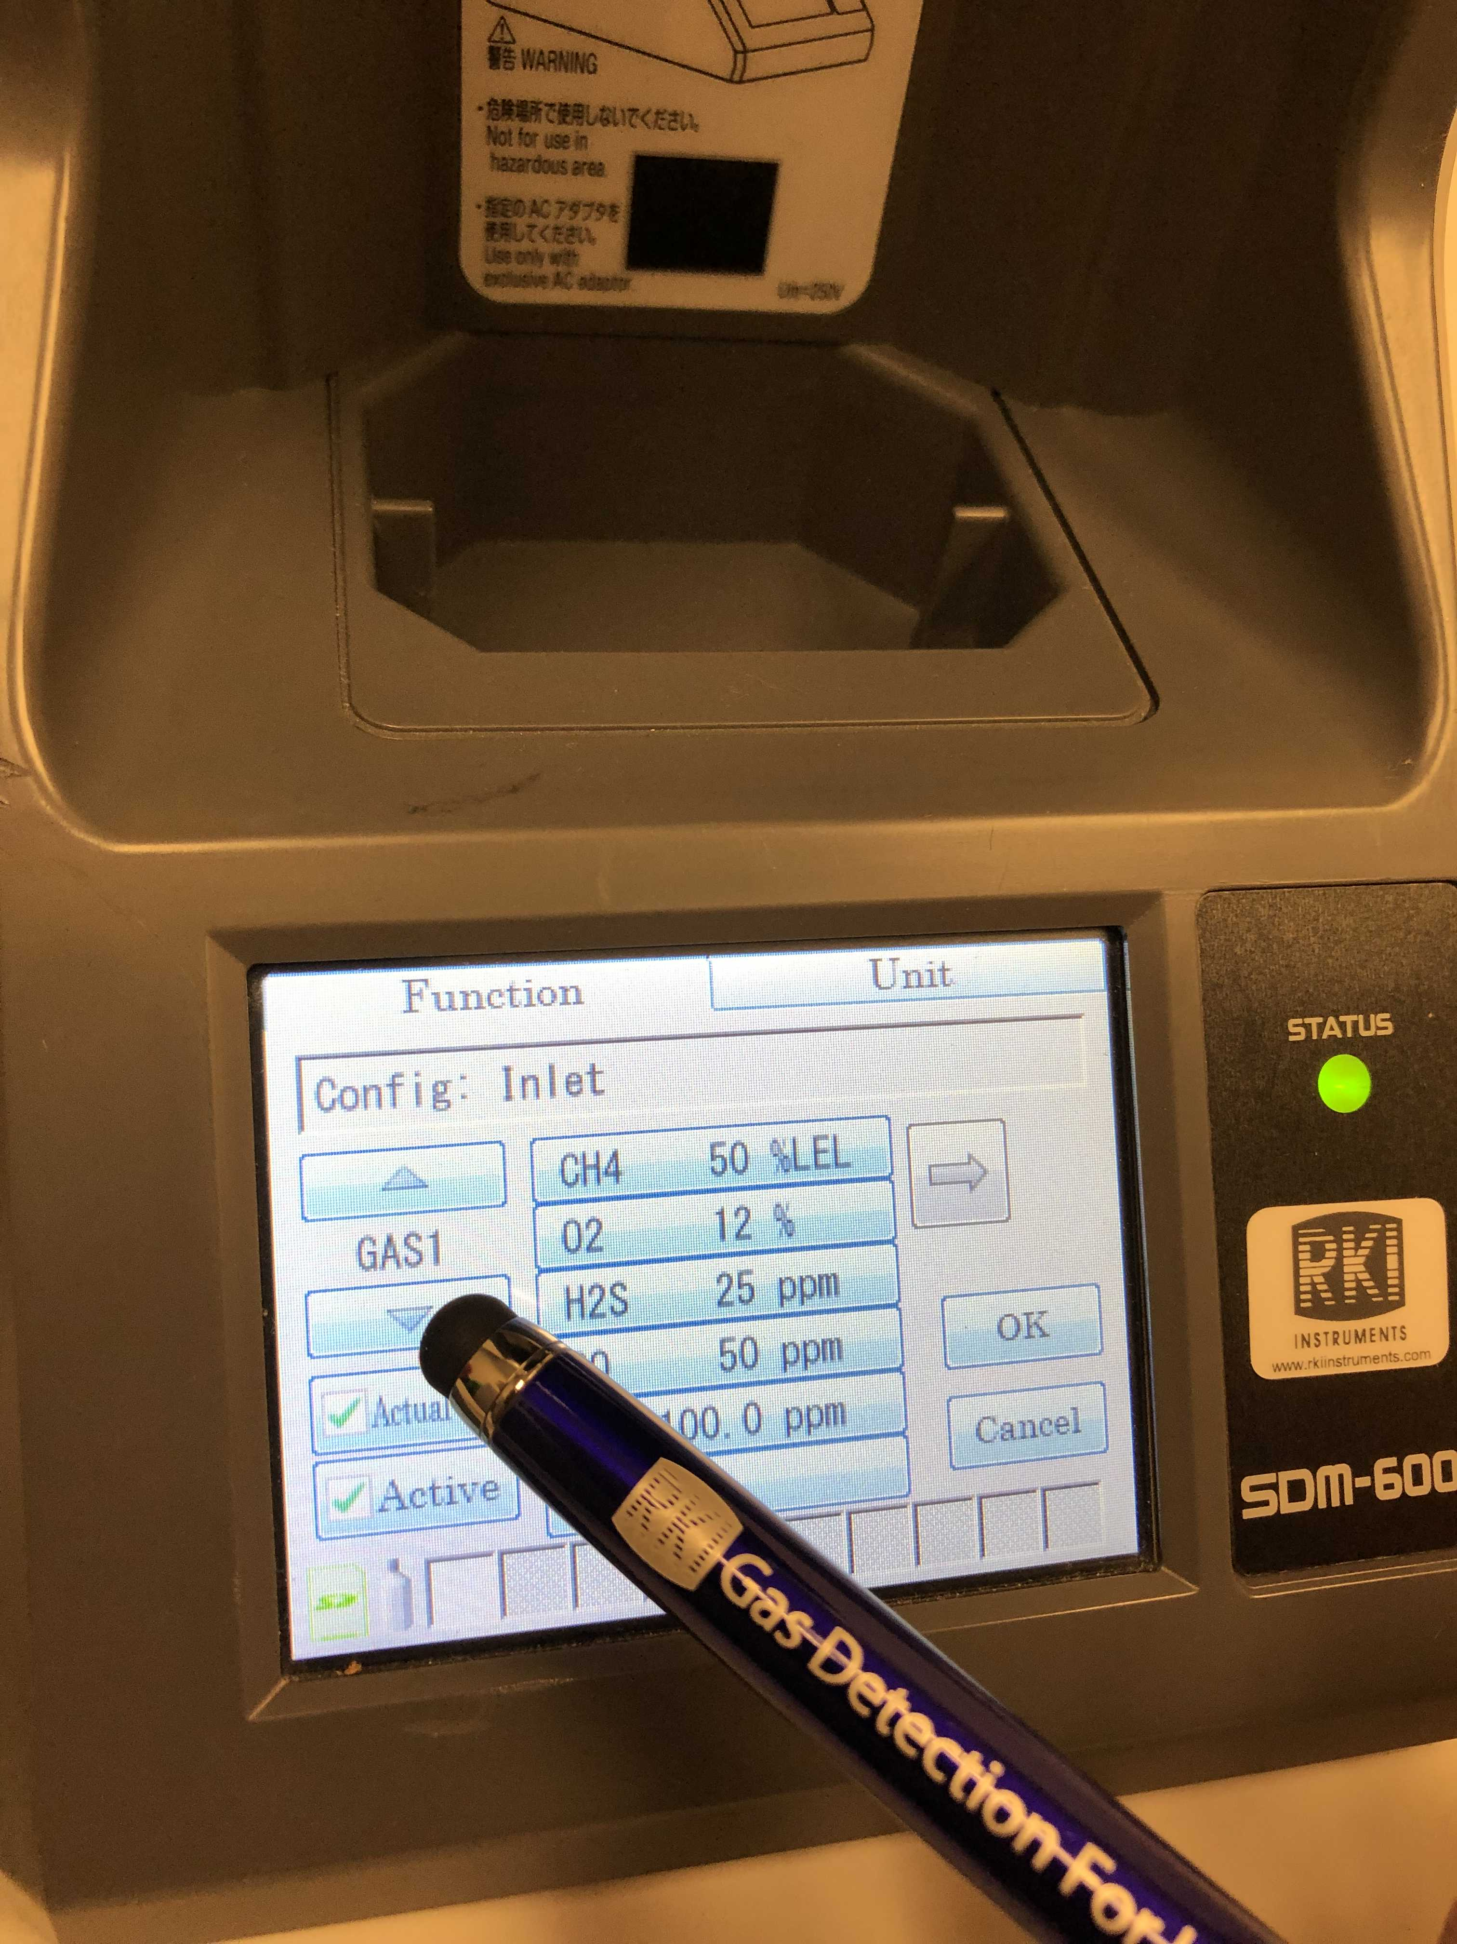
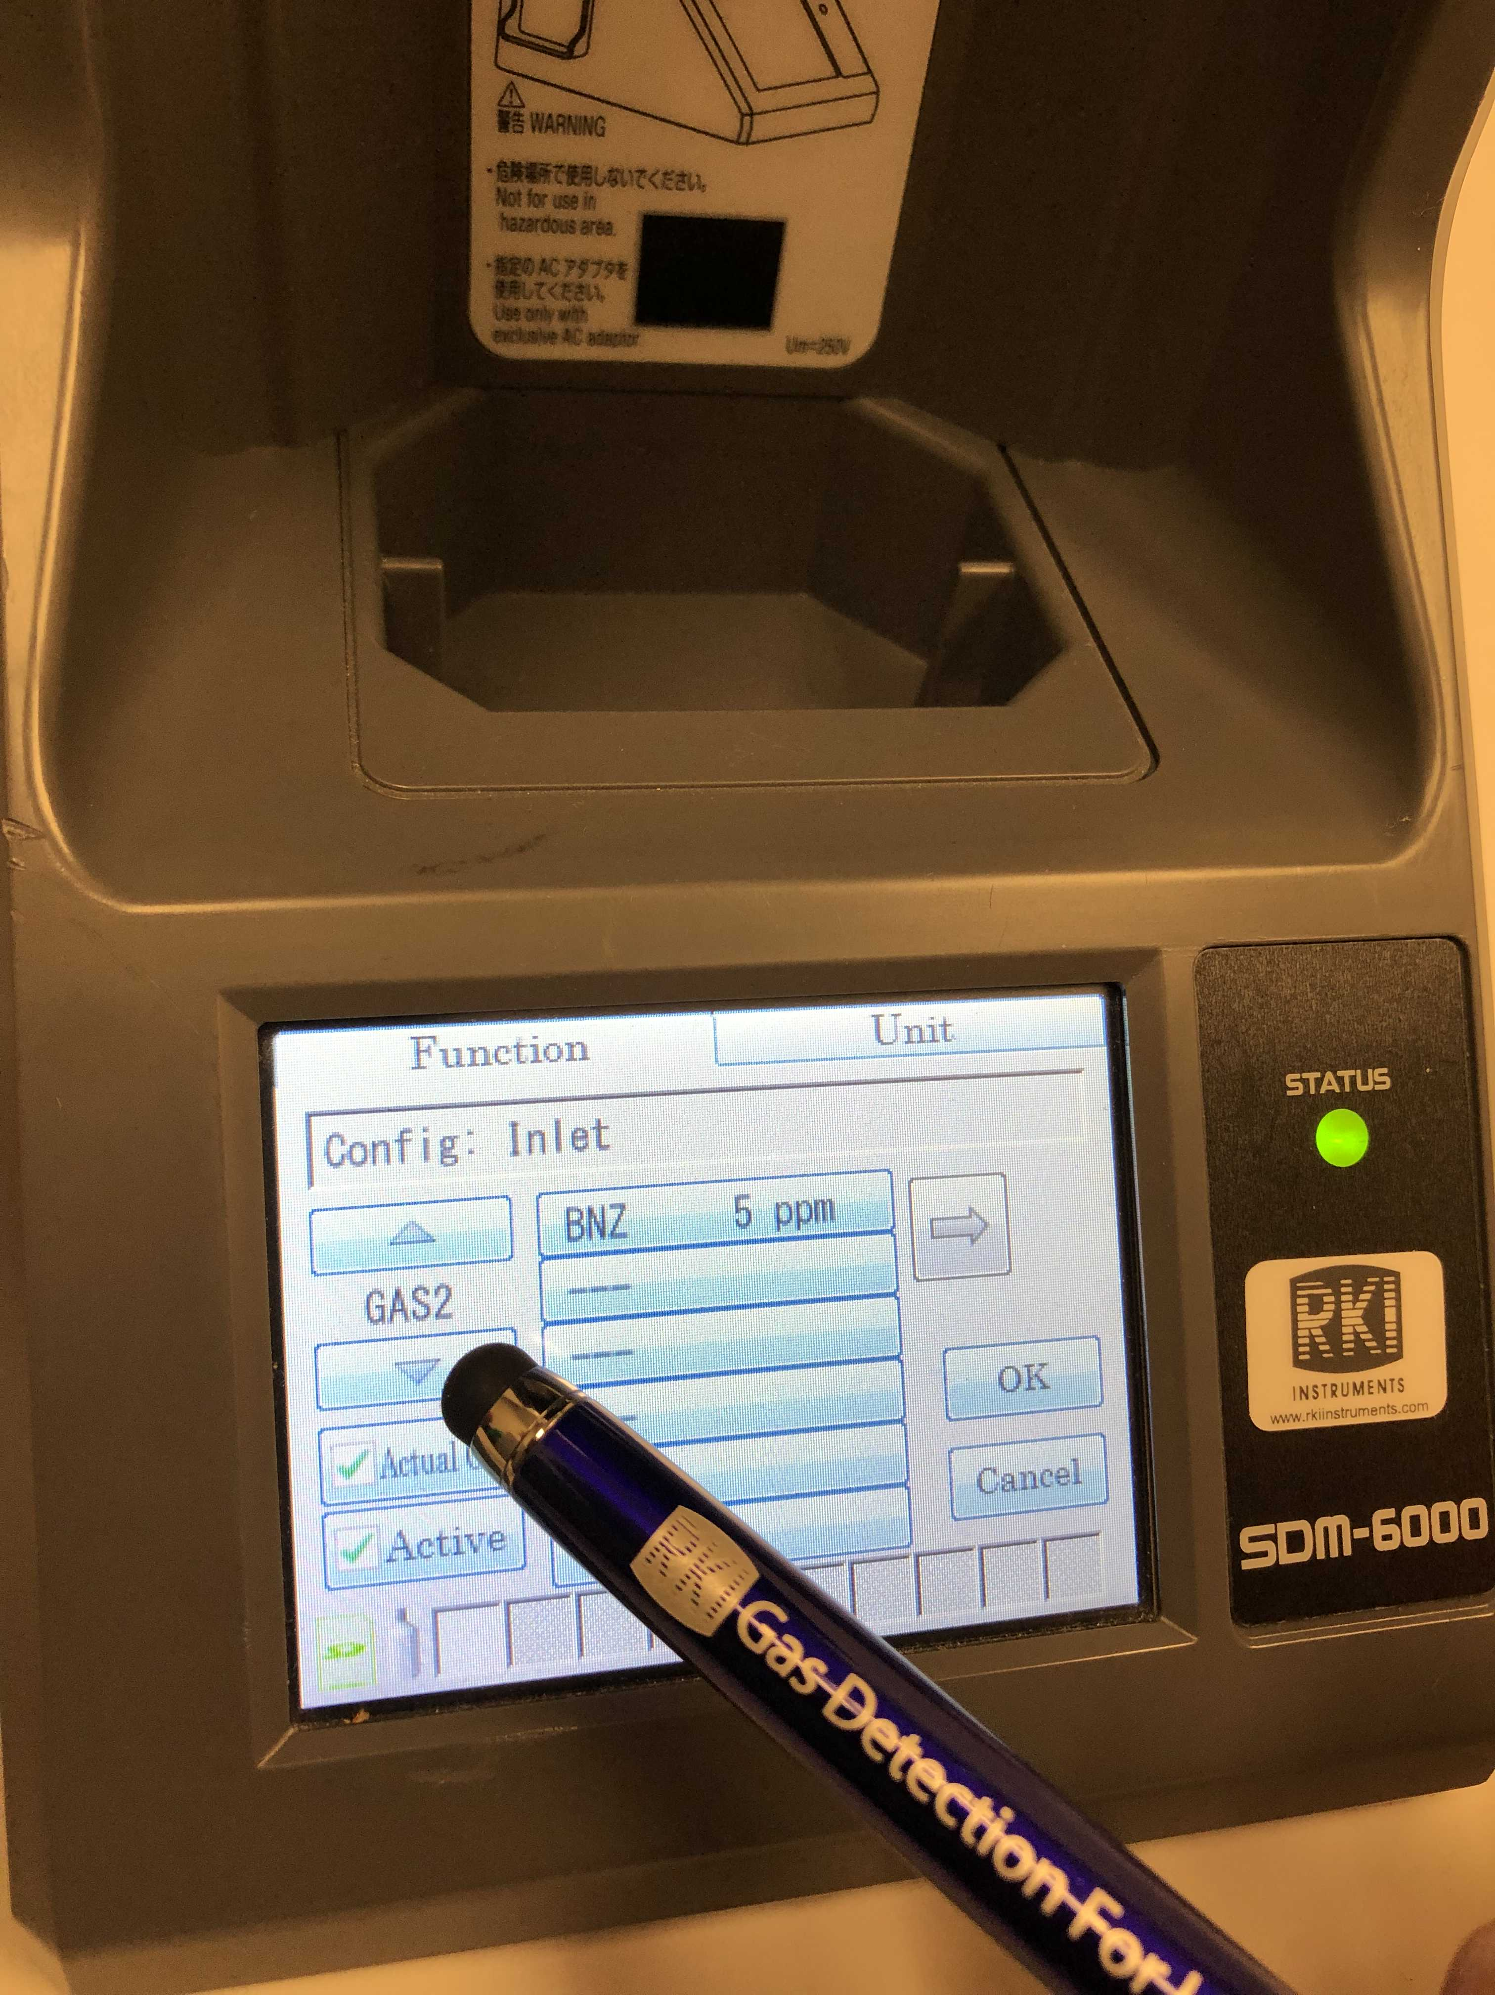
Setup
Scroll down using the down button to GAS 2
Make sure that the cylinder you are using matches the concentration on GAS 2, and make sure “Active” and “Actual Gas” are checked

Slide 7
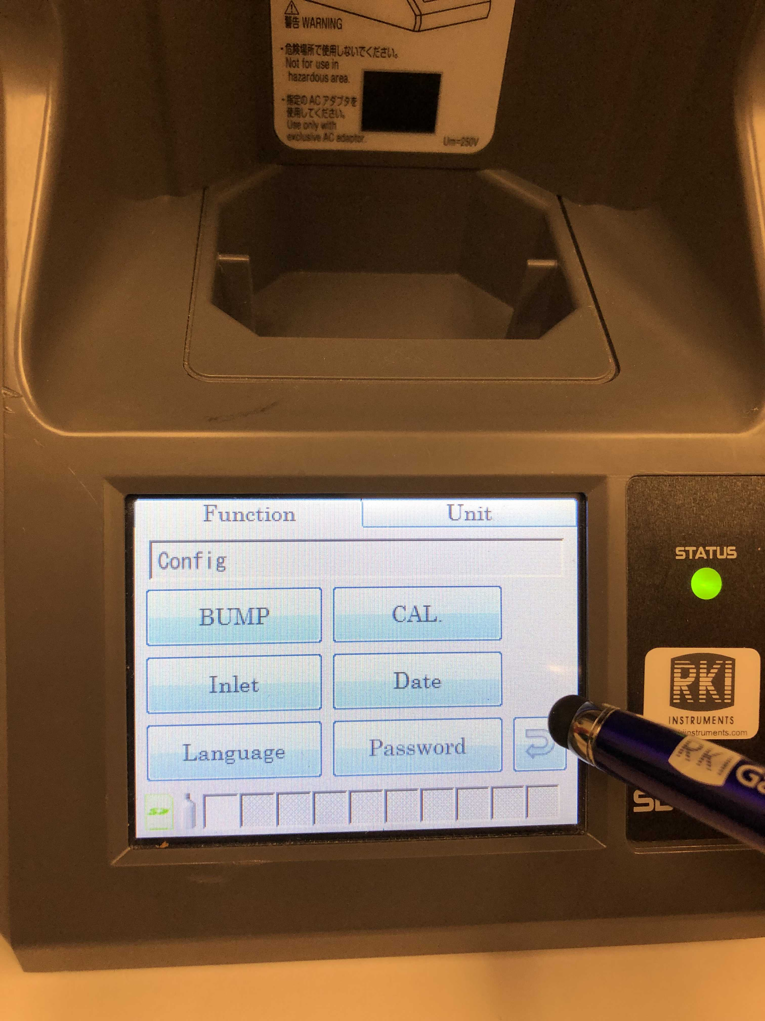
Setup
Tap OK to confirm
Tap the back button to return to the main function menu

Slide 8
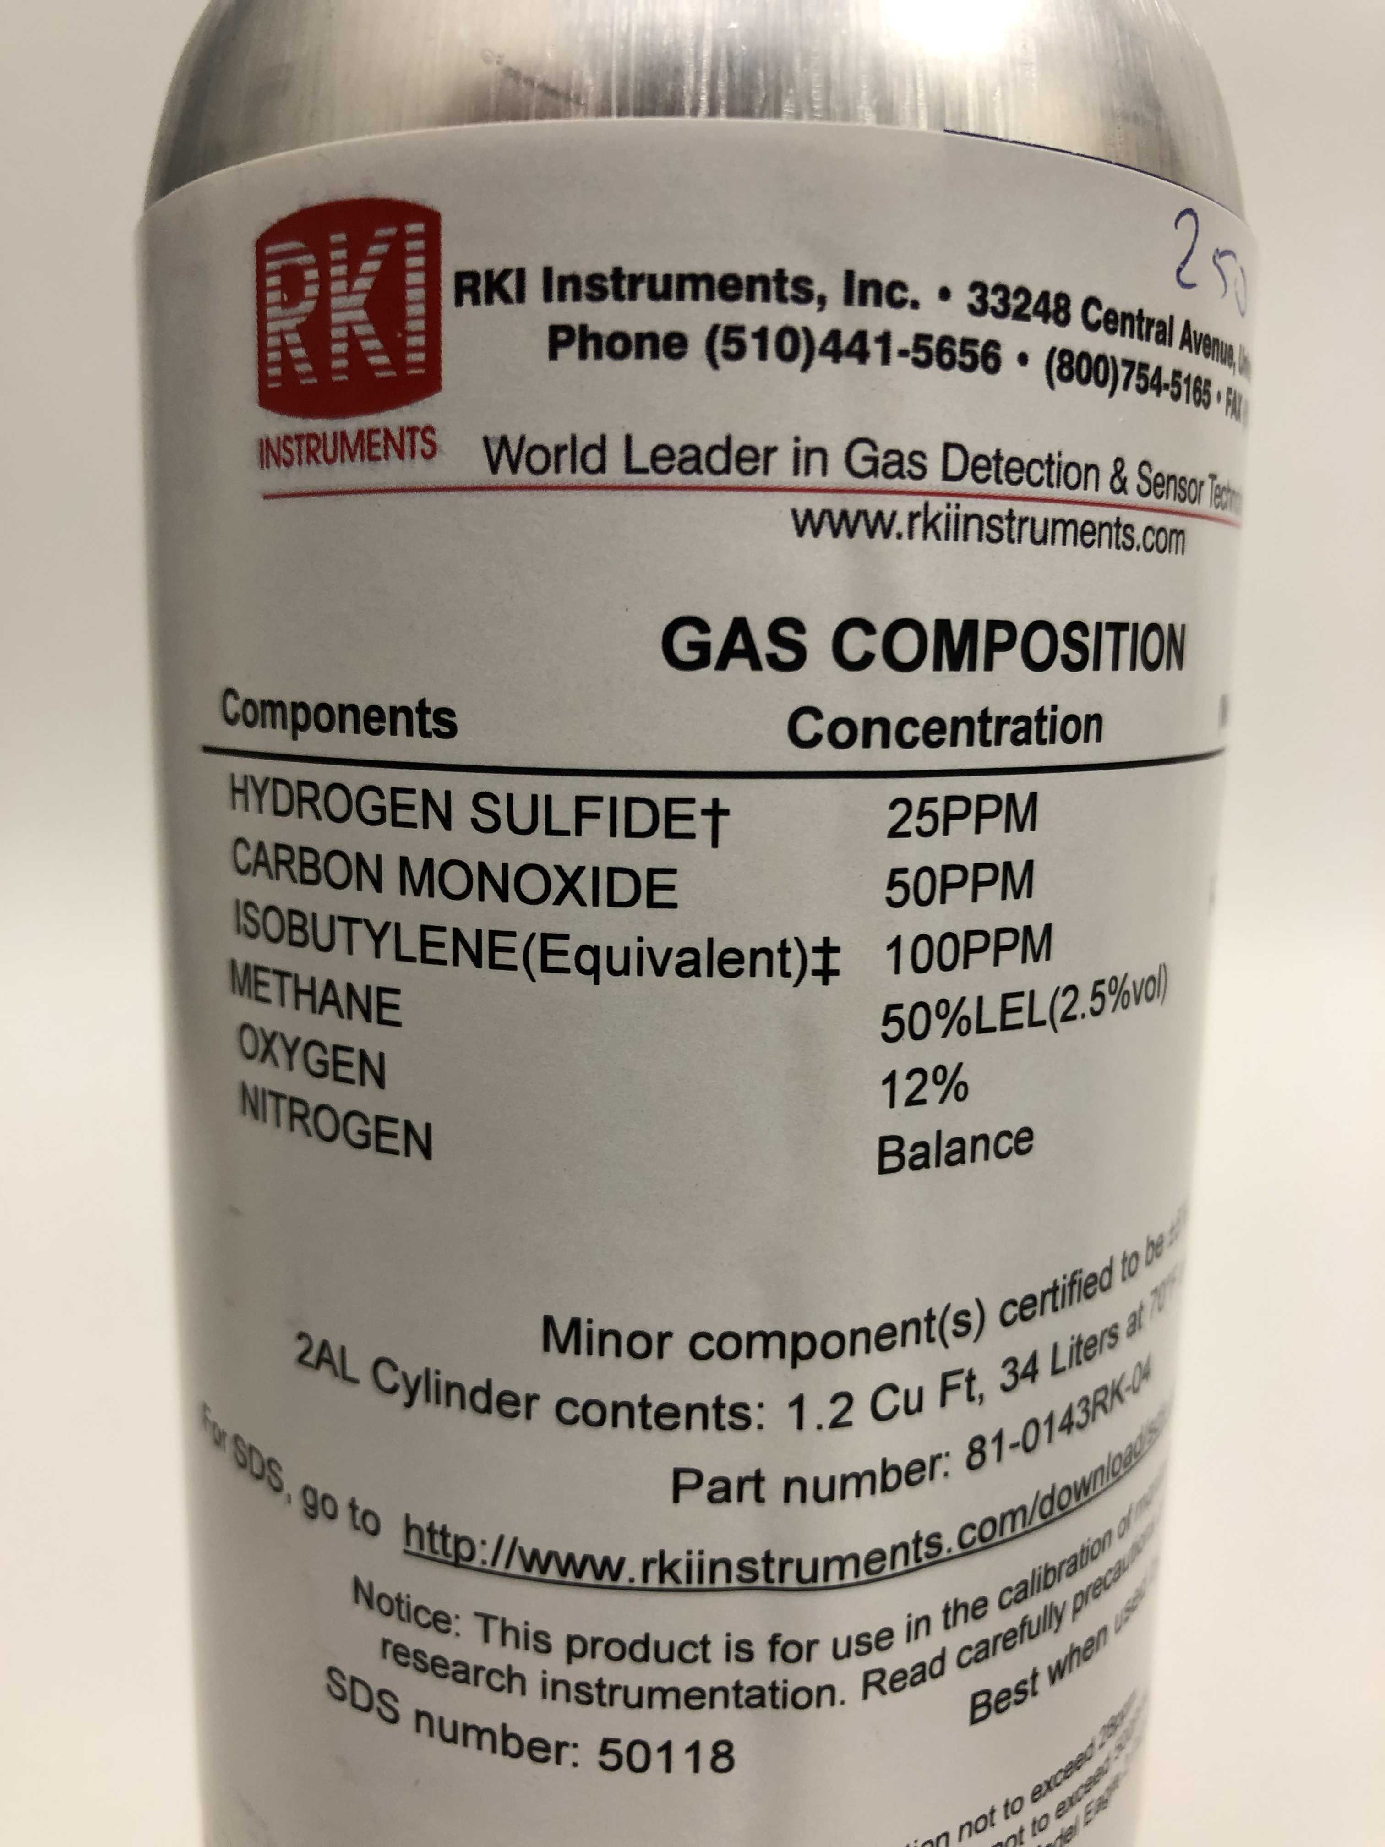
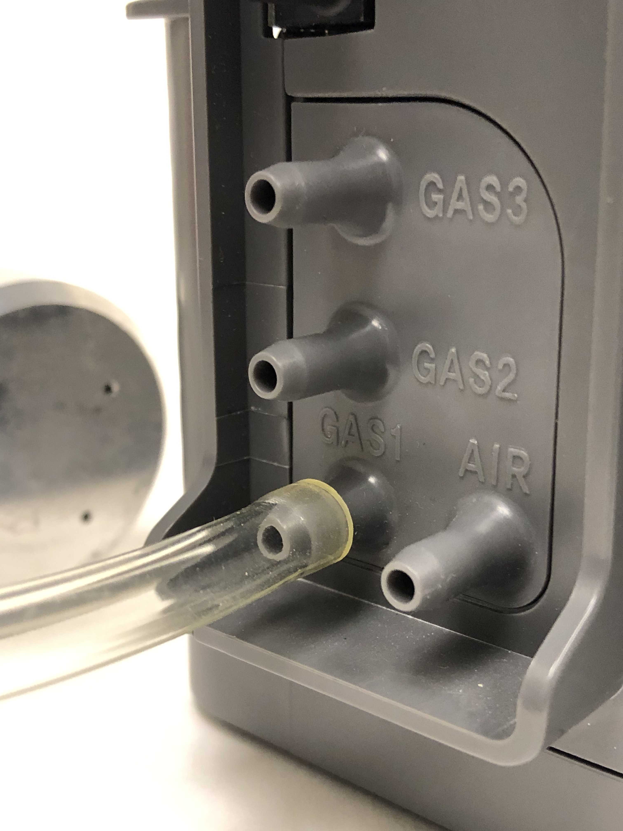
Setup
Insert the 5-Gas mixed cylinder into GAS 1 port, as was configured earlier.

Slide 9
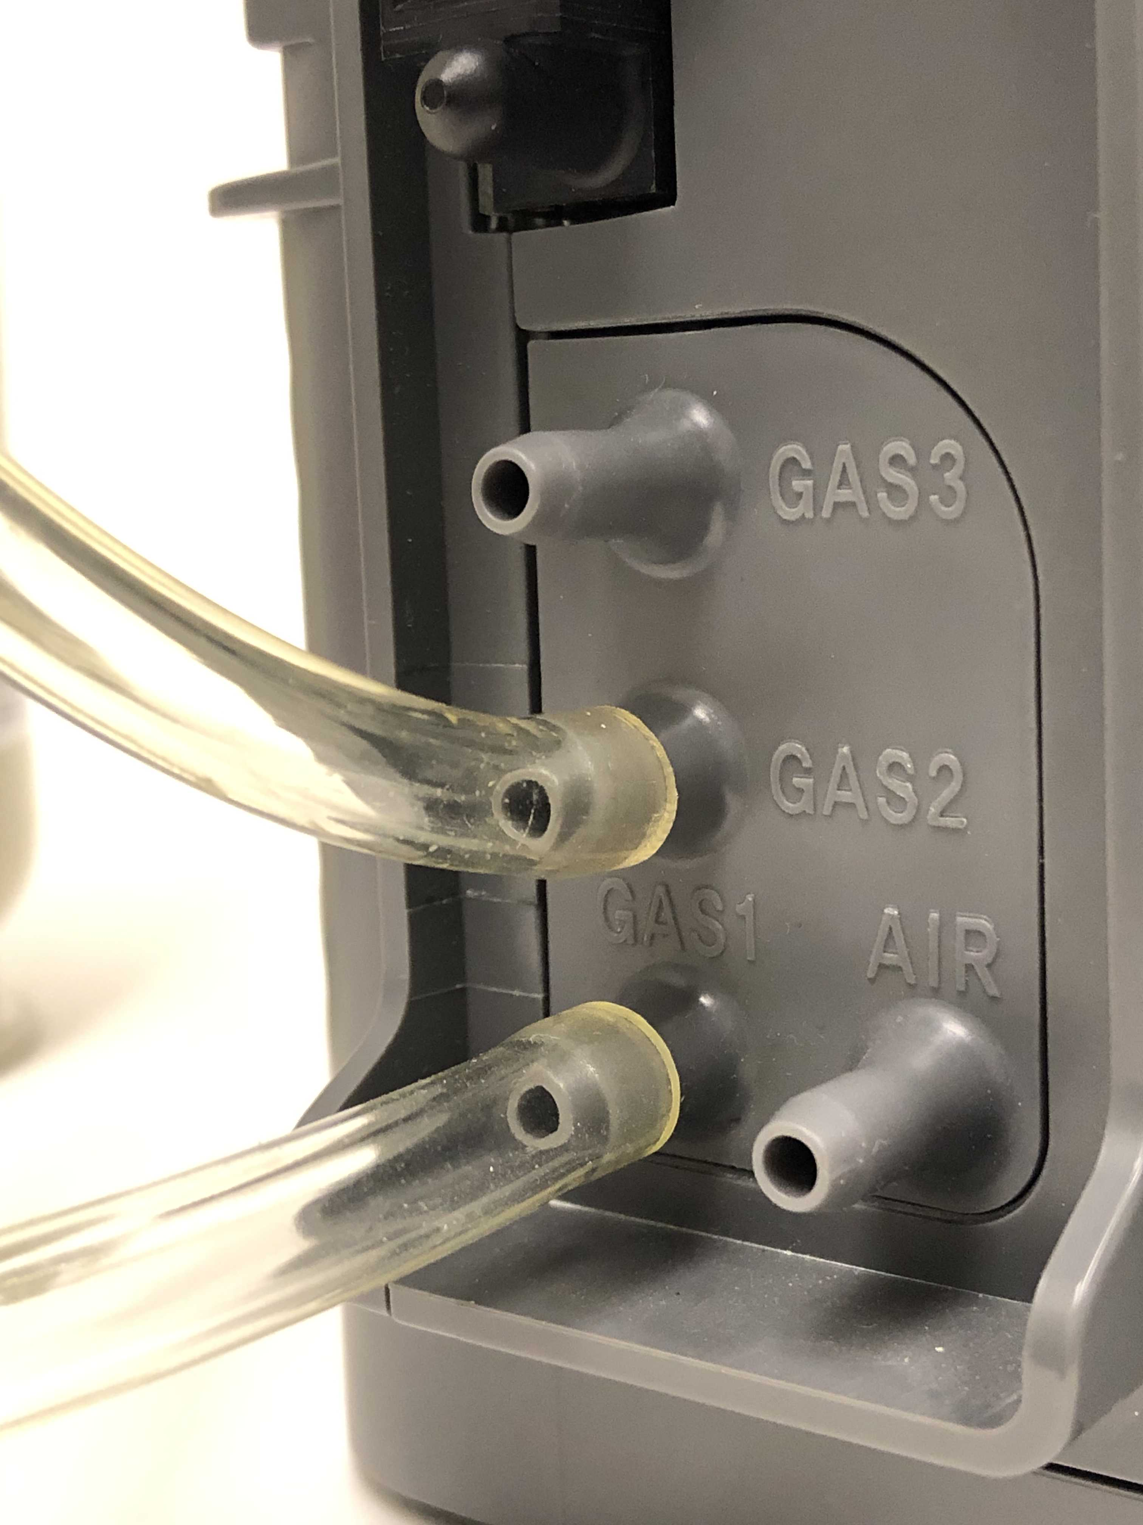
Setup
Insert the Benzene Cylinder into GAS 2 port as configured in the inlet setup

Slide 10
Setup
Your setup should look like this.
Please make sure to use demand flow regulator as shown on the image.

Slide 11
Setup
With the GX-6000 turned off, insert the unit into the docking station
Press the big red button.

Slide 12

Setup
The status box as shown in the bottom of the picture, should have a
(which means that the unit is connected)
A red background indicator as in the picture means that the unit is due for a calibration.

Slide 13
Indicator Background Colors
Background Color | Meaning
White | If no icon is showing, indicates that corresponding SDM-6000 is operating normally. If icon is showing, indicates that corresponding SDM-6000 is operating normally and connected instrument is not due for calibration, inlet assignments are correct, and gas/in gas out cover is engaged
Orange | Calibration is due in 10 days or less on connected instrument
Red | Calibration is due on connected instrument
Yellow | Inlet assignment error for connected instrument
Dark Grey | Gas in/gas out cover not engaged on connected instrument

Slide 14
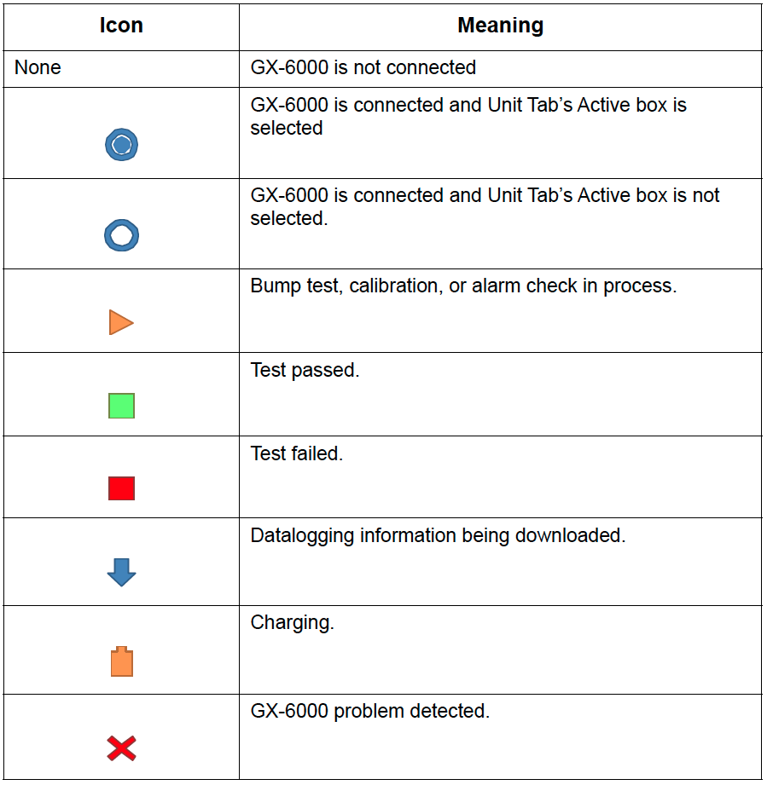
Indicator Icons

Slide 15
Bump
Tap on the BUMP icon to
perform a bump test.
Unit will begin with “AIR Flush”

Slide 16
Bump
Tap on the UNIT tab to view actual gas readings.

Slide 17
Bump
Unit will go through:
-AIR Flush
-GAS1 Bump
-GAS2 Bump
-AIR Purge
-and lastly the Result

Slide 18
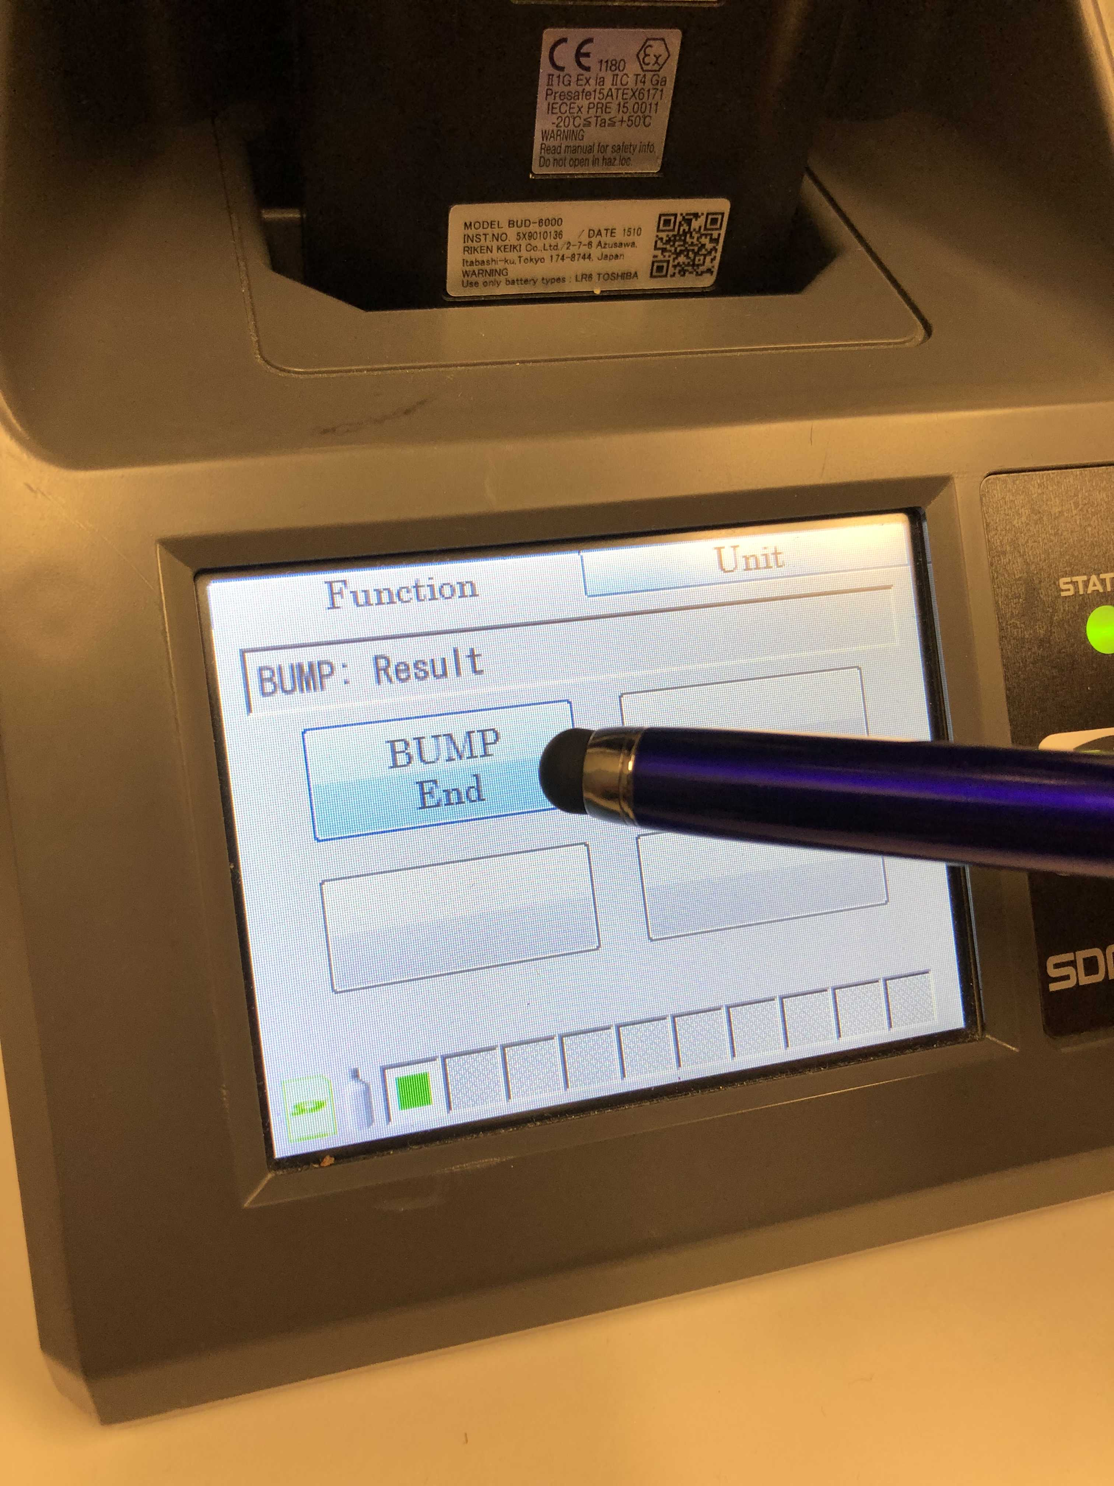
Bump
When the BUMP passes, you will get a green square on the status bar on the bottom left.
The unit will turn off automatically after a set amount of time (depends on your preferred settings) or you can go to the function tab and manually end the bump test by pressing the bump end button

Slide 19
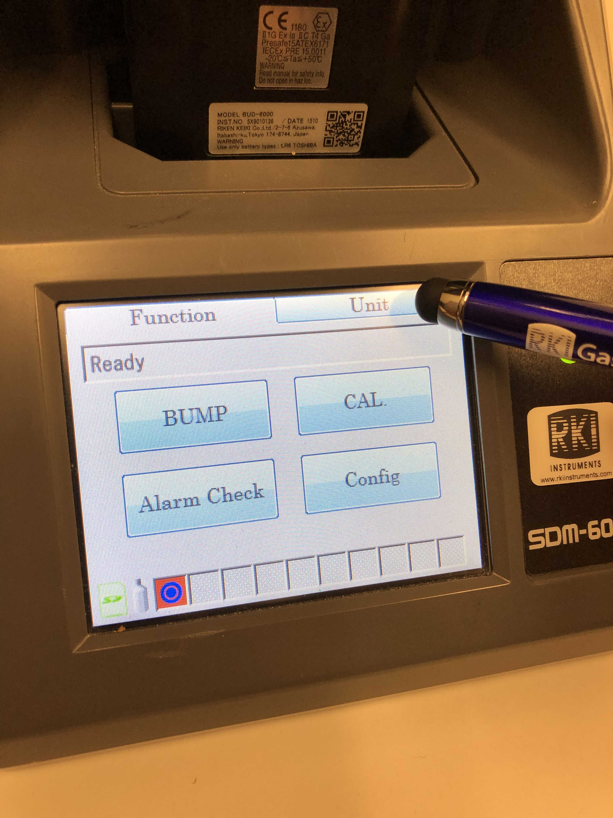
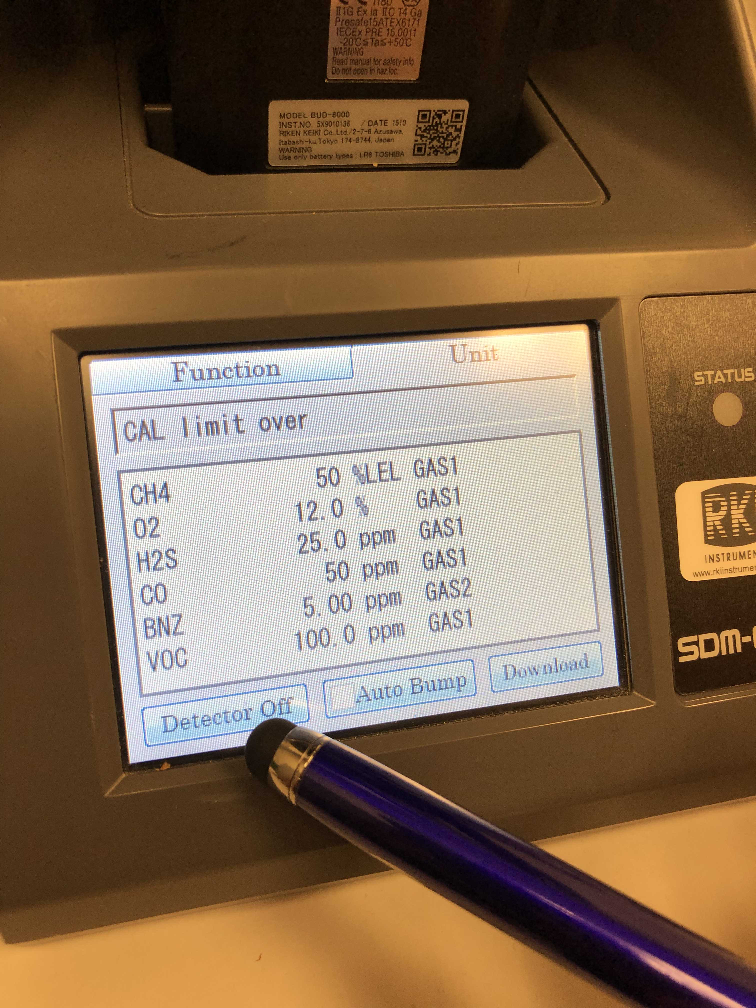
Bump
Once the bump test is done, go into the UNIT tab to make sure that the detector is off by pressing the ON/OFF action button on the lower left hand side. (If the unit is not off already)
Detector Off: Means to turn off the detector (this means it’s on)
Detector On: This will turn the detector on (this means the unit is initially off)
*It’s an action button

Slide 20
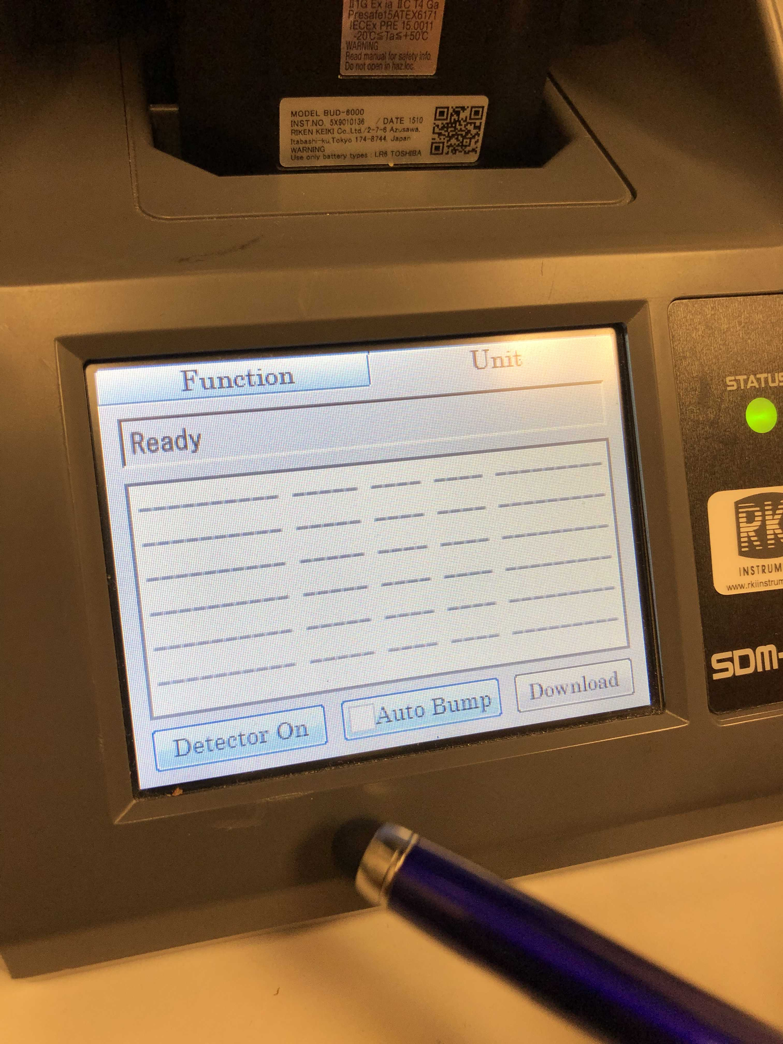
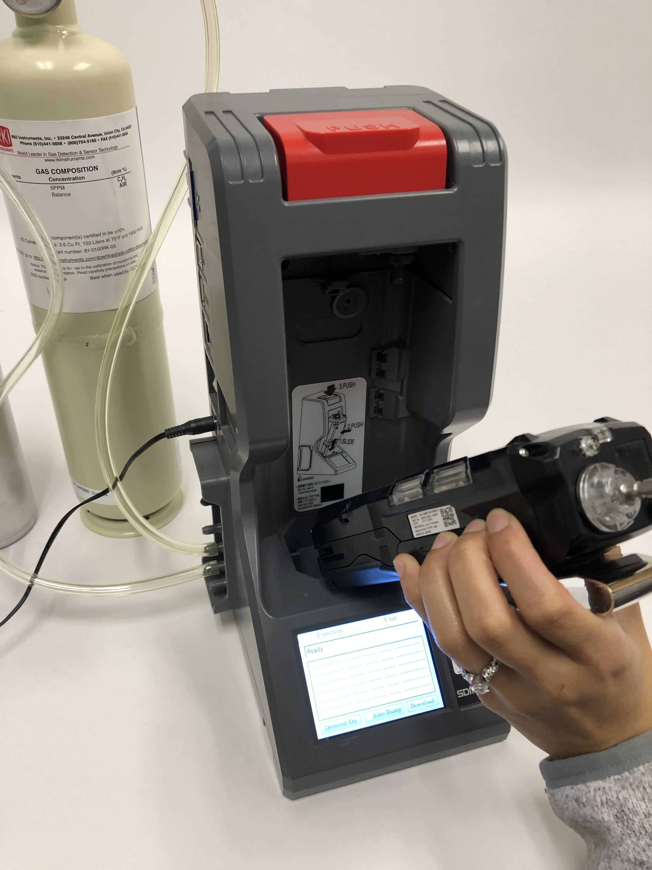
Bump
Once the unit is off, you can remove the GX-6000 out of the docking station and put another unit in.

Slide 21
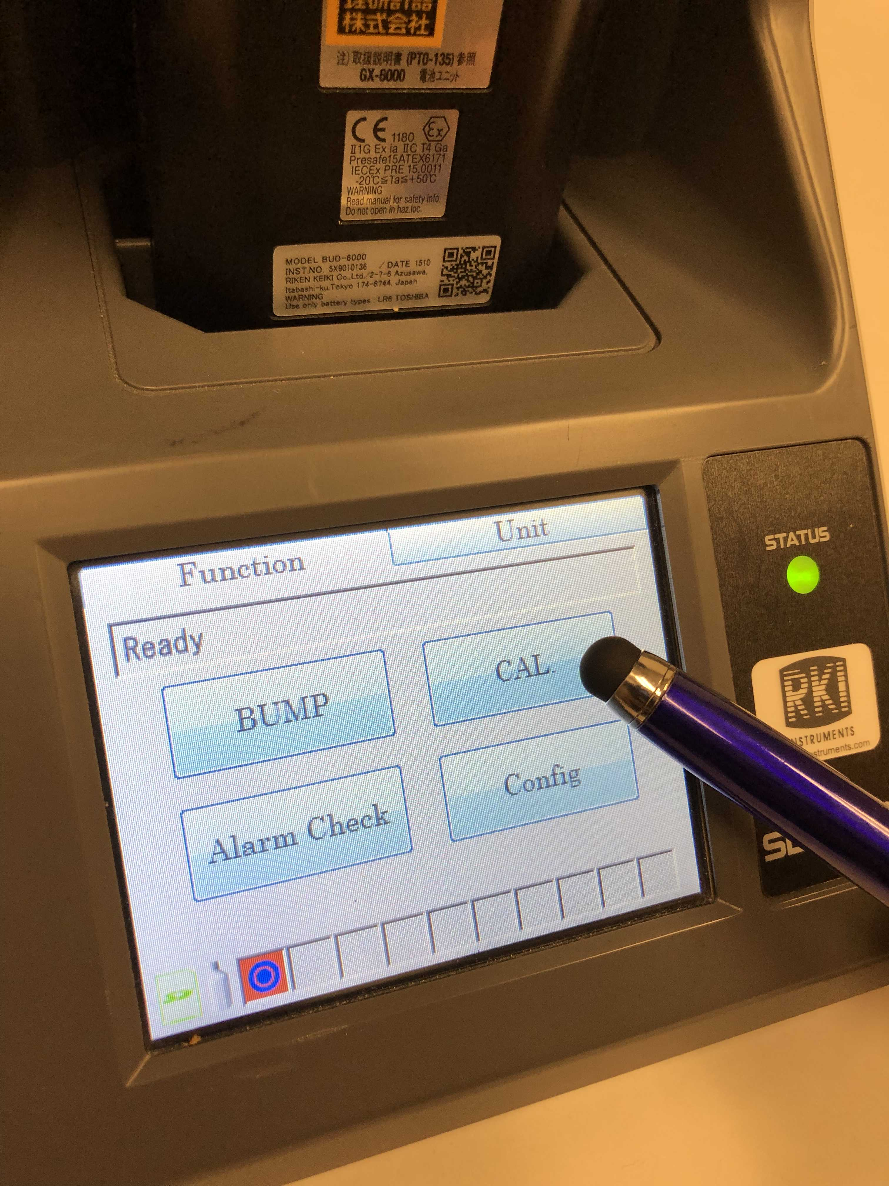
Calibration
With the GX-6000 turned off, install it into the docking station and press the red button on top.
To perform a calibration, tap on the CAL icon

Slide 22
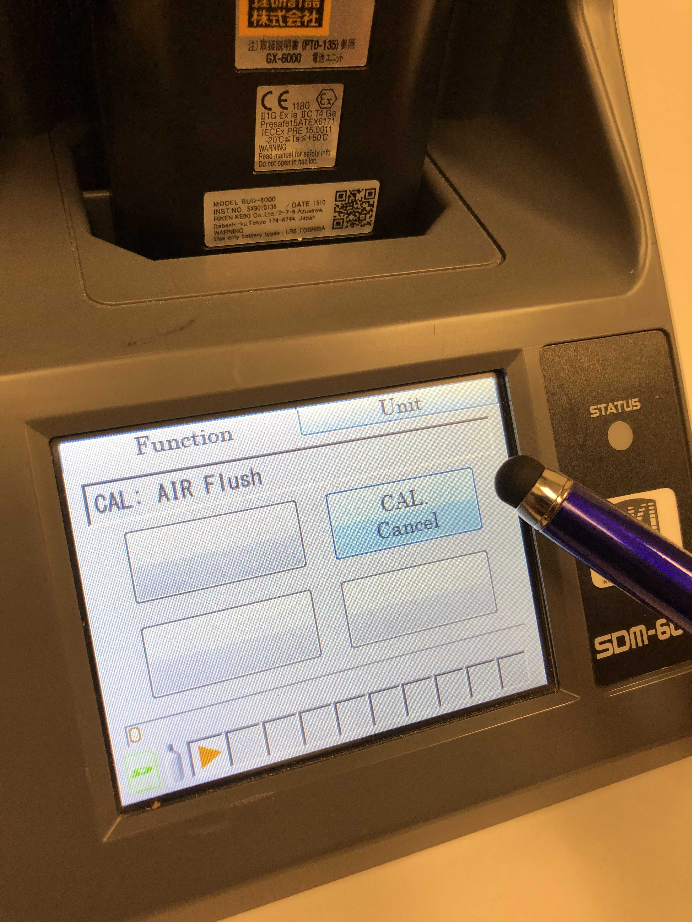
Calibration
The unit will perform a calibration and should you need to cancel the calibration you can just tap on the CAL Cancel icon anytime

Slide 23
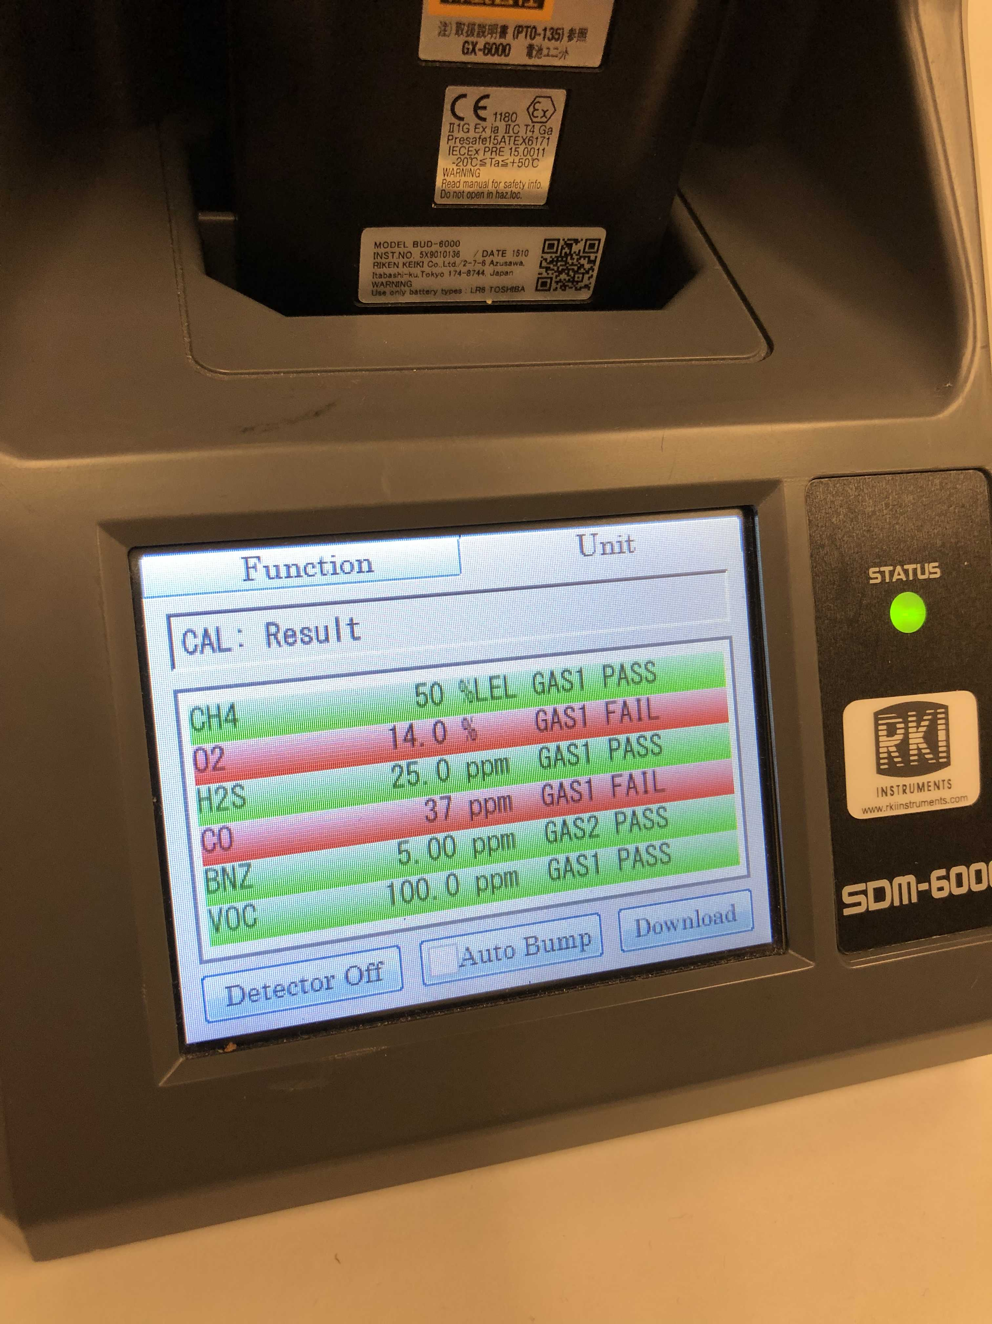
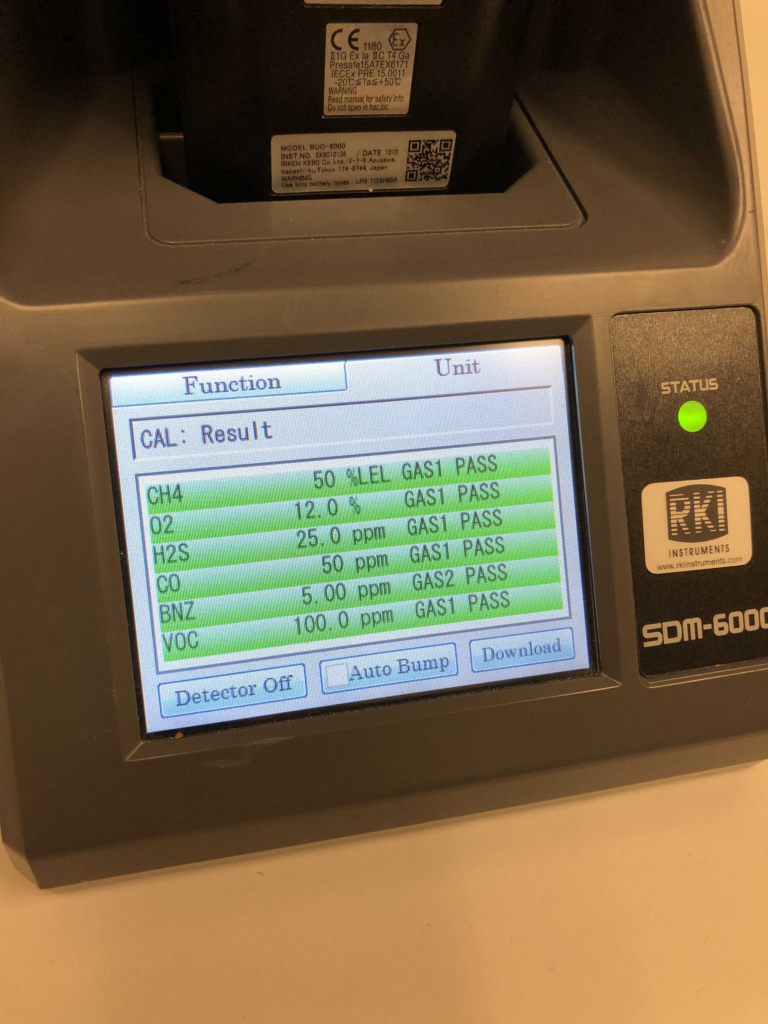
Calibration
FAILED
PASSED
This is what the screen will look like if some of the sensors fail. You will see red highlight on the failed sensors.
Ex: the O2 and CO failed
This screen shows a successful calibration. All of the sensors that have passed are highlighted green

Slide 24
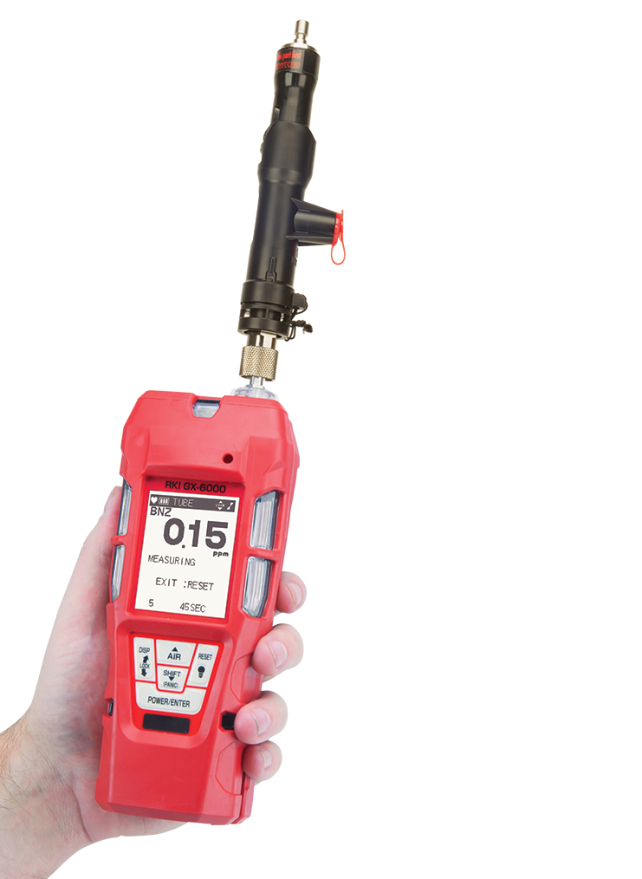
GX-6000
Benzene
Tube Calibration

Slide 25
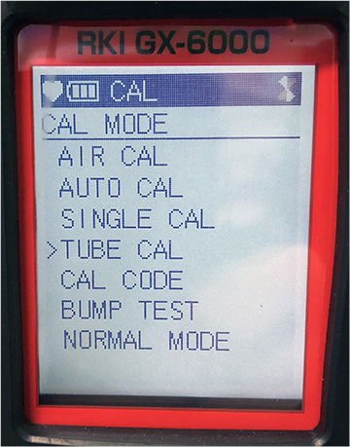
Tube Calibration - Benzene
Once it passes the Auto Cal in the dock station, perform a tube calibration.
To get in to calibration mode press and hold SHIFT+DISPLAY while in normal mode

Slide 26
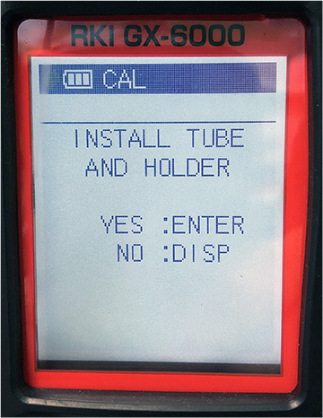
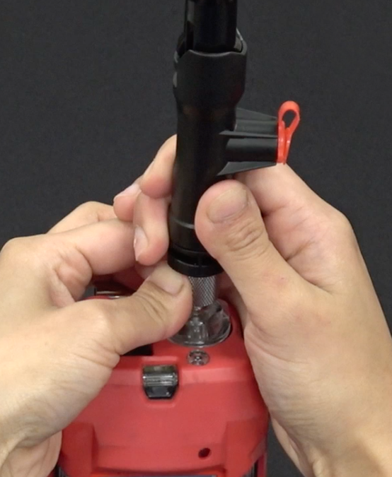
Tube Calibration - Benzene
It will prompt you to install tube holder and press POWER/ENTER to confirm.

Slide 27
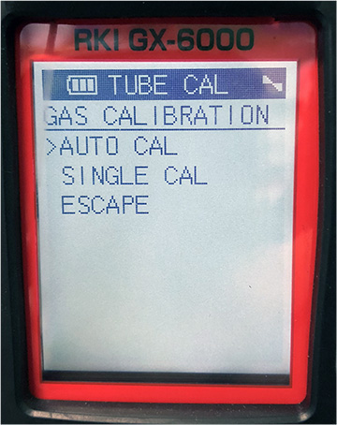
Tube Calibration - Benzene
Choose Auto Cal on the menu and press POWER/ENTER.

Slide 28
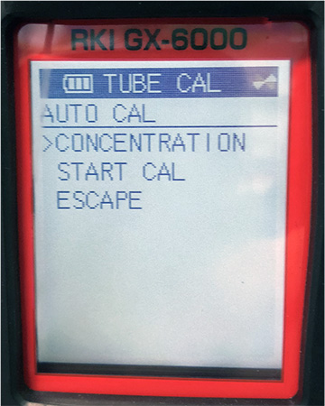
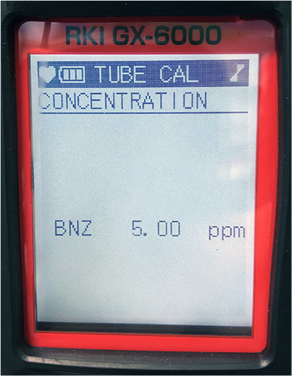
Tube Calibration - Benzene
Choose concentration and press POWER/ENTER.
Scroll down until you see BNZ (Benzene) 5 ppm.
(Make sure it matches your cylinder) and press POWER/ENTER to calibrate that channel.
Get your cylinder and demand flow regulator ready right after you press the POWER/ENTER button

Slide 29
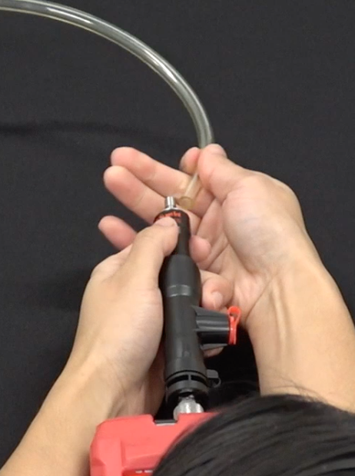
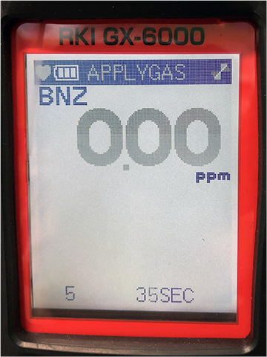
Tube Calibration - Benzene
Once you press POWER/ENTER the monitor will countdown.
Apply the gas in to the meter.
Wait for the meter to countdown and either you’ll get a pass or a fail.

