Slide 1
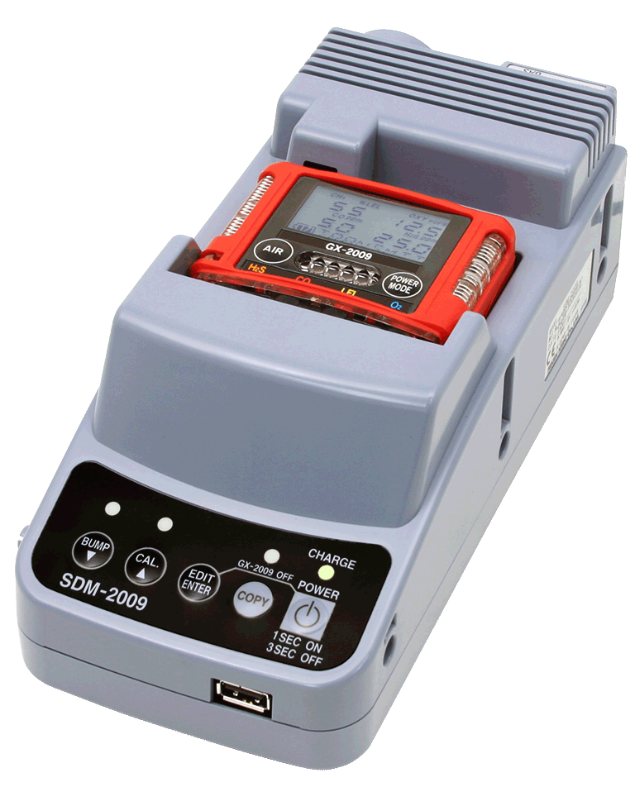
How to network SDM-2009’s
One Centralized data source

Slide 2
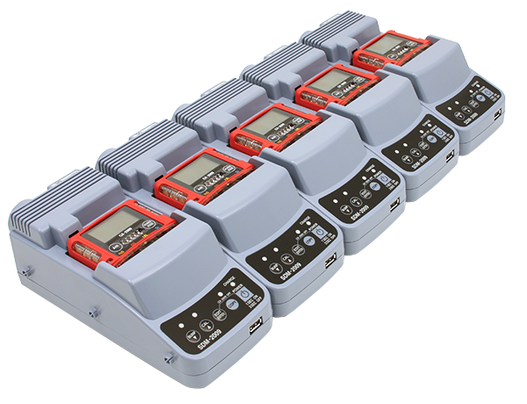
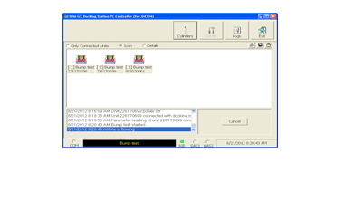

Instrument Shop
Install SDM-GX Software

Slide 3
Instrument Shop
USB
Connect up to 10 SDM-2009’s to the computer via USB cable

Slide 4

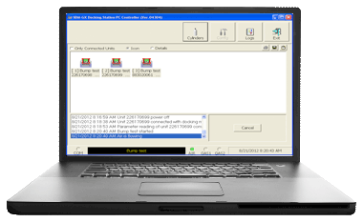
Instrument Shop
USB
Click on the Config button and enter admin password

Slide 5
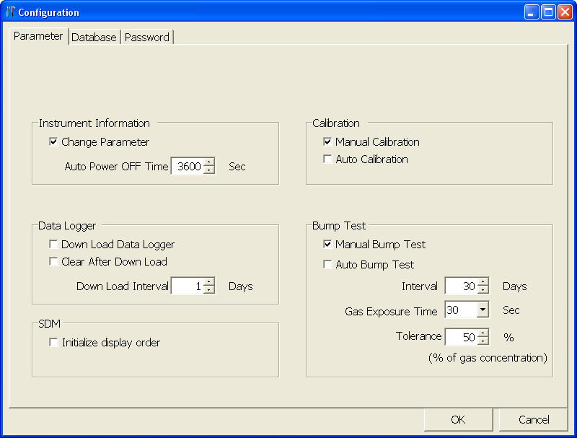
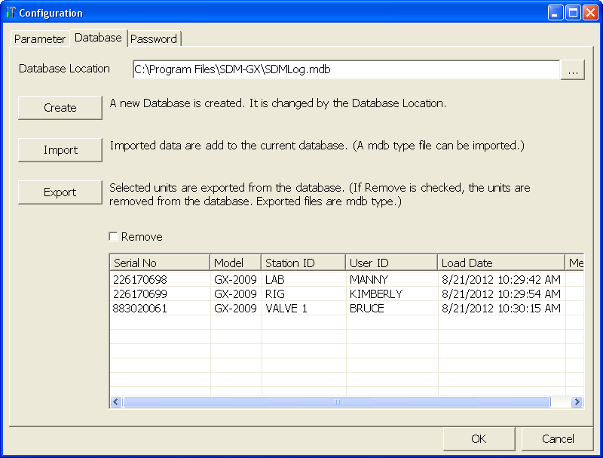
Instrument Shop
USB
Click on the Database Tab

Slide 6
Instrument Shop
USB
Click on the Create Button

Slide 7
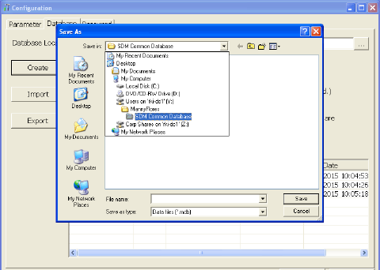
Instrument Shop
USB
Locate target network location for data file.

Slide 8
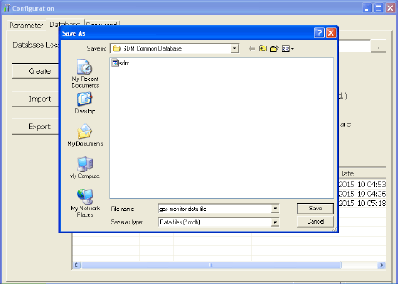
Instrument Shop
USB
Enter database file name and save.

Slide 9

Network
File Sharing Location
Instrument Shop
Gas monitors
data file
USB
Install the SDM-GX software for other locations

Slide 10
Network
File Sharing Location
Instrument Shop
Gas monitors
data file
USB
Max 10 SDM modules
per computer
IH Office
Repeat the Config steps to enter the same Database Location
USB
Max 10 SDM modules
per computer

Slide 11
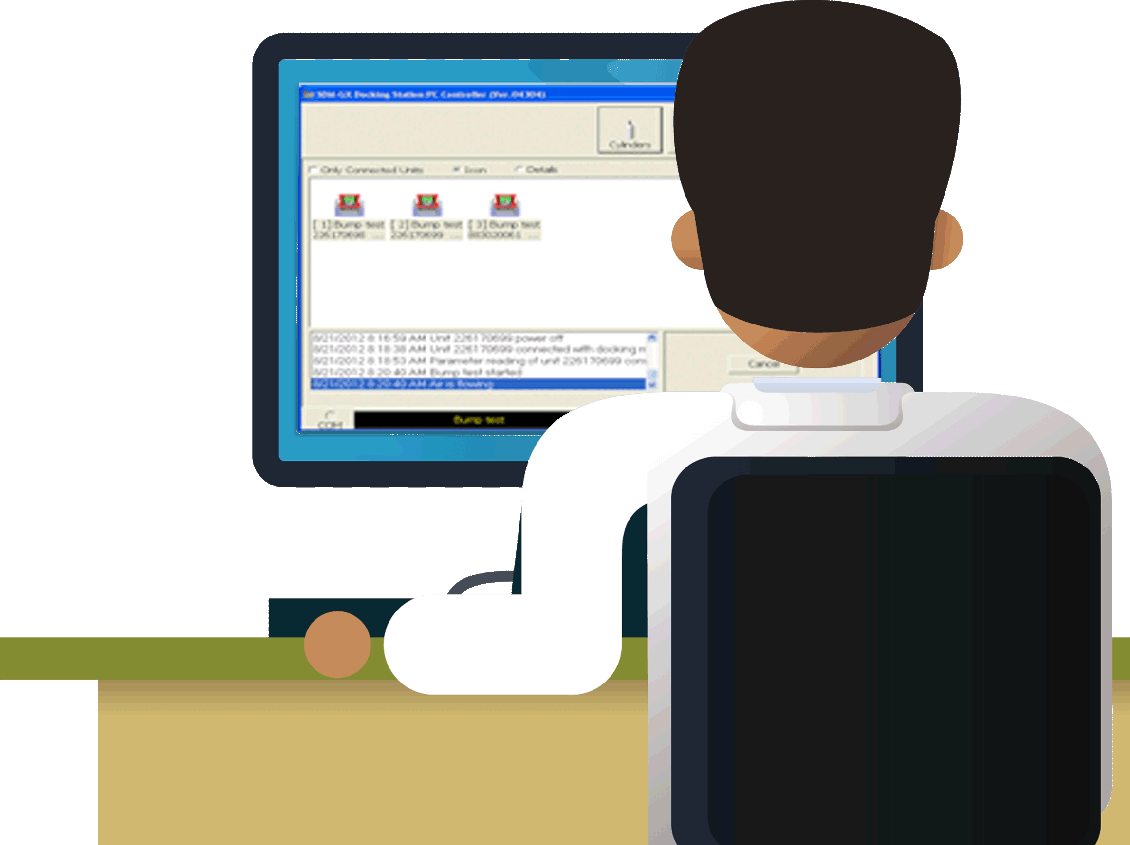
Network
File Sharing Location
Instrument Shop
Gas monitors
data file
USB
Max 10 SDM modules
per computer
Cal stations not needed to run software and see data file.
IH Office
USB
Max 10 SDM modules
per computer
Safety
Manager

