Slide 1
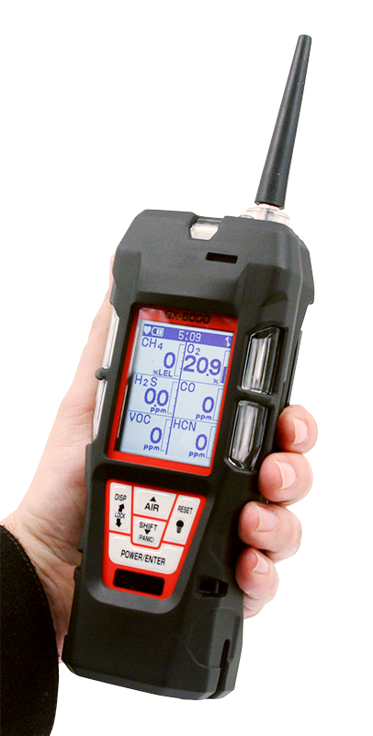
GX-6000
User Training
6 gas, sample draw with PID & Super Toxics

Slide 2
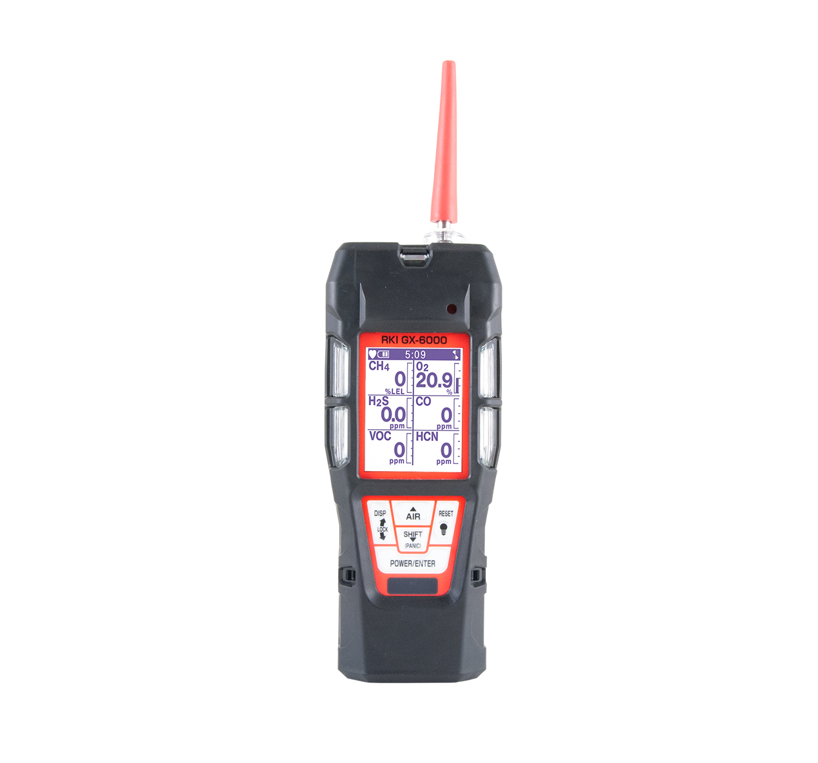
Monitor up to 6 Gases
H2S, CO, O2, LEL
2 smart sensor slots
  PID for VOC’s
  IR for CH4, HC, & CO2
  EC for NH3, Cl2, HCN, NO2, & SO2
PID library of more than 600 VOC’s
Accepts 10.6 and / or 10.0 PID lamps
50,000 ppb / 6,000 ppm ranges
10.0 Lamp for Benzene Specific
11.7 Lamp available Q4 2018
11.7 Lamp for carbon tetrachloride, acrylonitrile, chloroform, methanol, and refrigerants (R-143, R-132A)
PID sensors can be combined
Easily choose a target VOC
  User defined VOC list of 30
  Recently used VOC list last 8
6 operating modes
Normal
Leak check
Inert
Bar hole
Snap Log
Benzene Specific Mode
LCD display
Auto flip display
Peak bar graphs
Adjustable auto backlight
Customize order of gases
Single gas view with large font & auto sequence
LEL Protection mode
Shields LEL sensor from damaging VOC exposure

Slide 3
Smallest 6 gas sample draw
Lightweight & Ergonomic
High impact rubber boot
Ergonomic design fits comfortable in hand
Alarms
2 adjustable gas alarms per channel Plus STEL & TWA
Man Down alarm
Panic Alarm
4 alarm LED’s
Audible and vibration alarms
Trouble alarms for low flow, sensor connection, low battery, circuit error, & calibration
Intrinsically Safe
ATEX / IECEX
cCSAus
Interchangeable battery options
Lithium-ion pack operates 14 hours
  Complete recharge in 3 hours
Alkaline pack operates 8 hours
Weather & Dust Resistant
IP-67
9 Languages
English, German, Italian, French, Portuguese, Spanish, Japanese, Korean, Russian
LED Flashlight
On demand light source

Slide 4
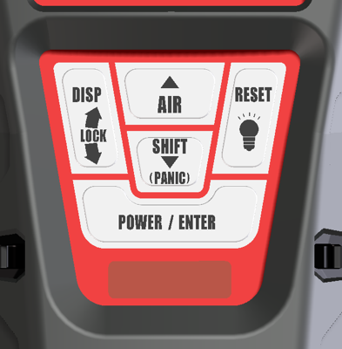
Turn on
Press and hold POWER/ENTER button until the instrument beeps, then release.
During the warm-up sequence a series of instrument information will be displayed.
When warm-up sequence is complete normal operating screen is displayed.

Slide 5
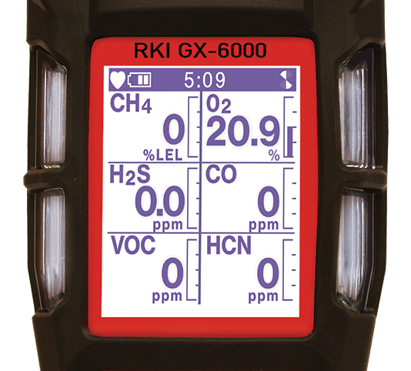
Normal Mode
Time
Battery charge level
Fan symbol indicates pump is function
Graphical peak readings
The heart symbol flashes while the instrument is functioning properly
Gas readings

Slide 6
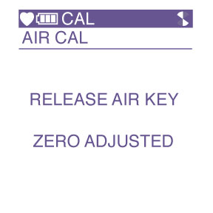
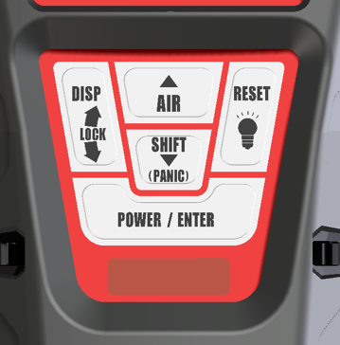
Fresh Air
Once warmed up, perform an AIR adjustment by pressing and holding the AIR key until “RELEASE AIR KEY” is displayed.

Slide 7

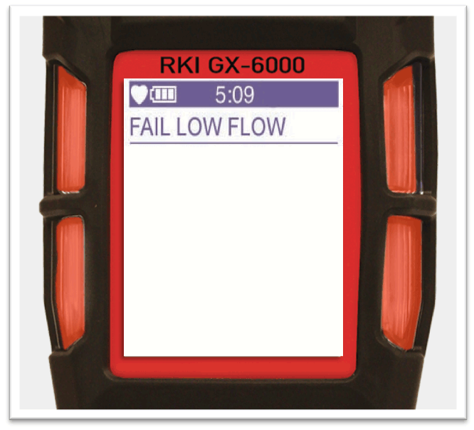
Low Flow Alarm
”Fail Low Flow” indicates blockage in the flow path.
Press the POWER/ENTER button to clear the audible and visual alarms.

Slide 8
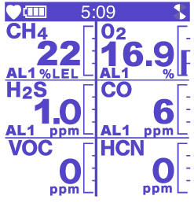
Gas Alarm
When the instrument goes into alarm indicating gas is present, immediately leave the area.
If latching is turned on, instrument will remain in alarm until normal conditions are met.
Press the POWER/ENTER button to clear the audible and visual alarms.
If latching is turned off, the user can disengage the alarm manually, regardless of hazard.

Slide 9
Turn off
Press and hold POWER/ENTER button to turn off the GX-6000

Slide 10
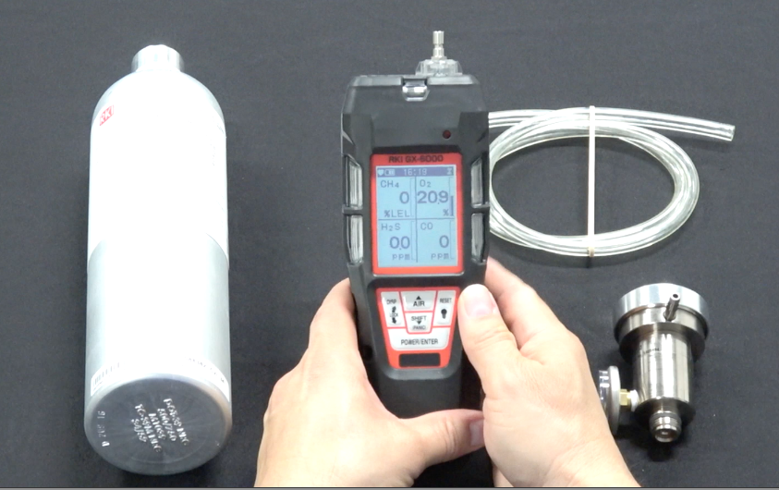

Calibration

Slide 11
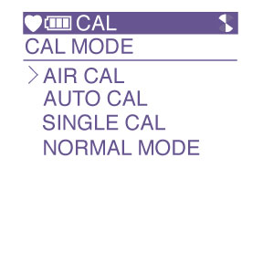
Calibration
In normal mode, briefly press and hold the SHIFT key then press the DISP key. “CAL” will be displayed at the top of the LCD indicating that the GX-6000 is in calibration mode.
-AIR CAL, AUTO CAL, SINGLE CAL and NORMAL MODE will be
displayed

Slide 12
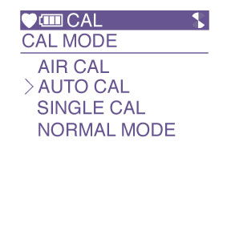
Calibration
Press the SHIFT key to select AUTO CAL then press the POWER/ENTER key.

Slide 13
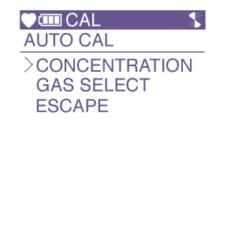
Calibration
You will now see CONCENTRATION, GAS SELECT and ESCAPE.

Slide 14
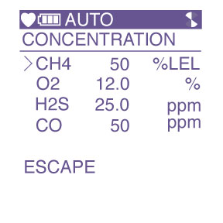
Calibration
Press the POWER/ENTER key to select CONCENTRATION to verify that the gas concentrations programmed in the instrument match the cylinder values.

Slide 15
Calibration
The cursor will be next to CH4. If the displayed value does not match the cylinder value, press the POWER/ENTER key to select CH4. The gas value will start blinking.

Slide 16
Calibration
Using the AIR or SHIFT keys, raise or lower the reading to match the gas value in the cylinder.
Once completed, press the POWER/ENTER key to set.

Slide 17

Calibration
Press the SHIFT key to scroll to the next gas.
Adjust as required. Once completed use the SHIFT key to scroll to ESCAPE then press the POWER/ENTER key.

Slide 18
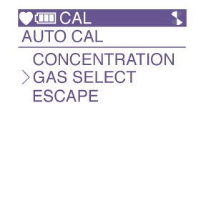
Calibration
Press the SHIFT key to select GAS SELECT.
Press the POWER/ENTER key.

Slide 19
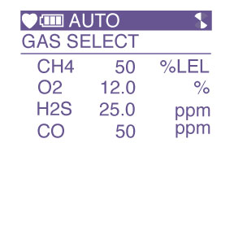
Calibration
All gases and calibration values will be displayed.

Slide 20
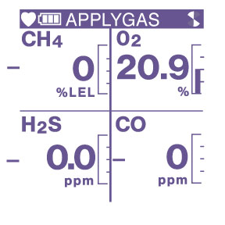
Calibration
Press the POWER/ENTER key and “APPLYGAS” will be flashing on the top of the LCD and all gases values will be flashing indicating that the instrument is ready for calibration gas.

Slide 21
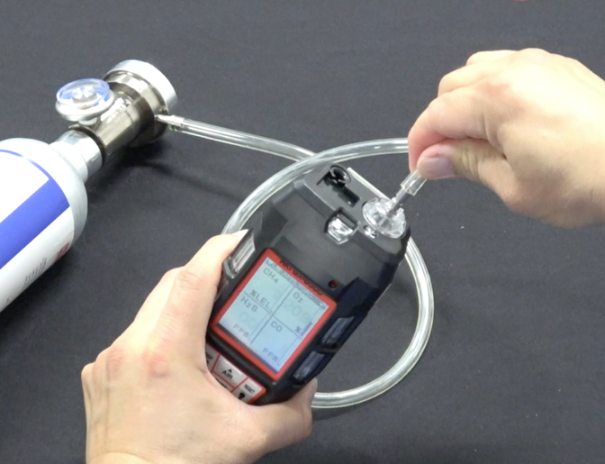
Calibration
Remove the rubber nozzle from the top of the instrument and attach tube from gas cylinder to inlet fitting. Note: Must use a demand flow regulator or gas bag.
Allow gas to flow for a maximum of two minutes.

Slide 22
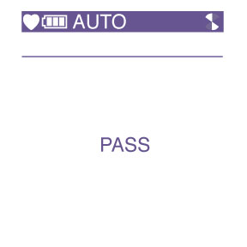
Calibration
Once reading stabilizes, press the POWER/ENTER key to calibrate the unit. The unit will either “PASS” or “FAIL”

Slide 23
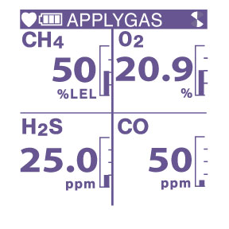
Calibration
Once completed, the GX-6000 will show you the calibrated values.

Slide 24
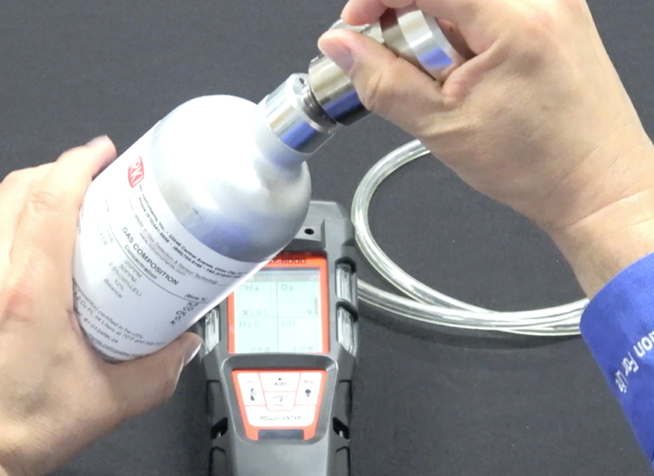
Calibration
Remove the tubing from the top of the GX-6000 and reattach the rubber nozzle.
Remove the demand flow regulator from the cylinder and store kit for future use.

Slide 25
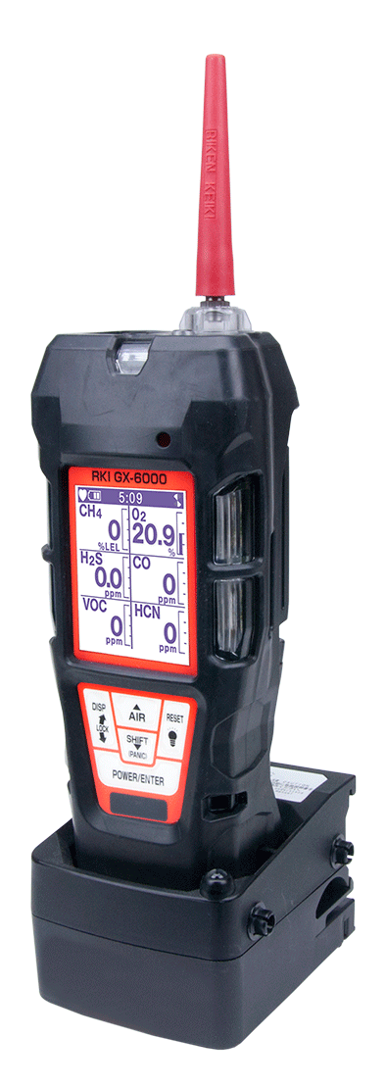
Charging the instrument
For GX-6000 with lithium-ion battery, place the instrument in the charging cradle. A full charge takes 3 hours and will power the instrument for 14 hours.

Slide 26
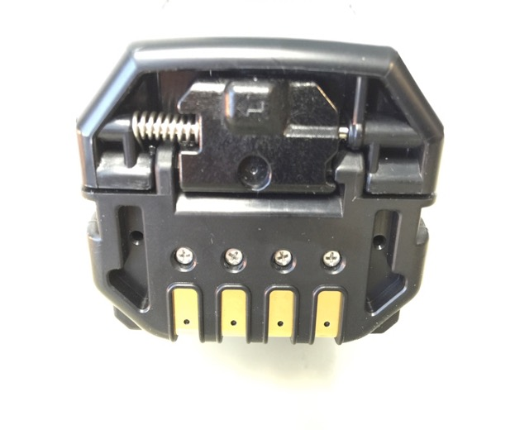
Li-ion Battery Replacement
Slide battery release tab in the direction of the arrow and push to release battery pack.
Pull up to remove battery pack.

Slide 27
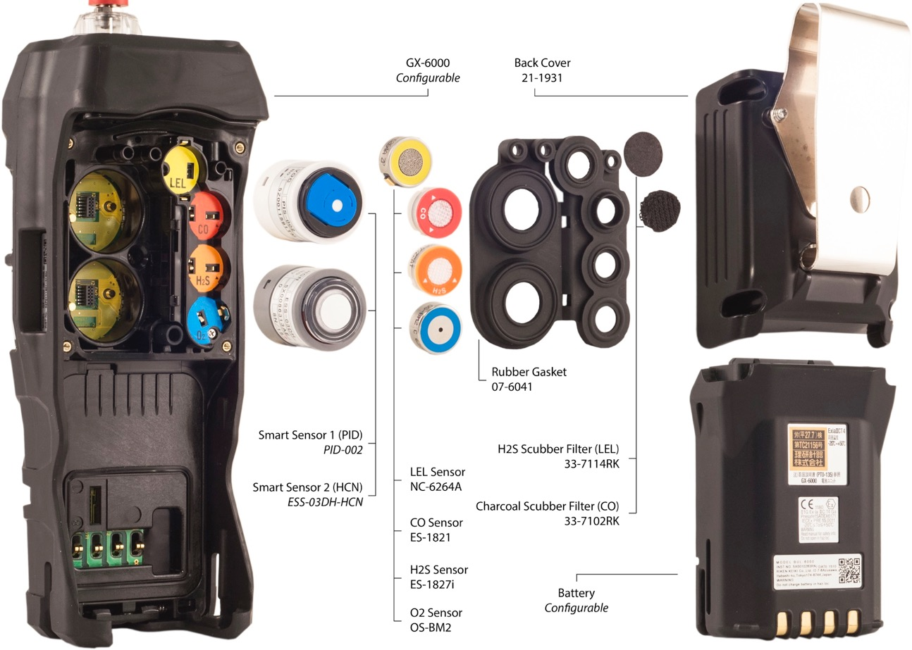
GX-6000 Exploded View

Slide 28
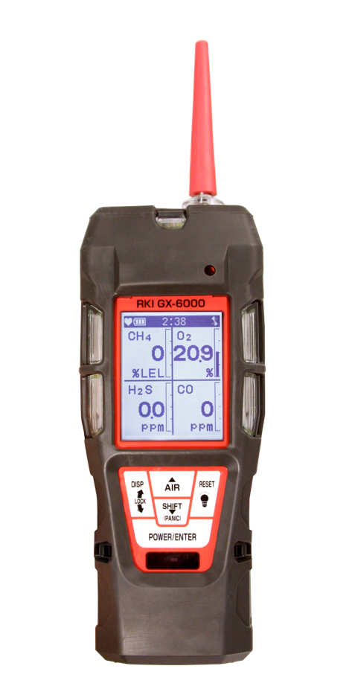
Questions?

