Slide 1
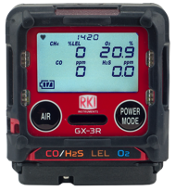
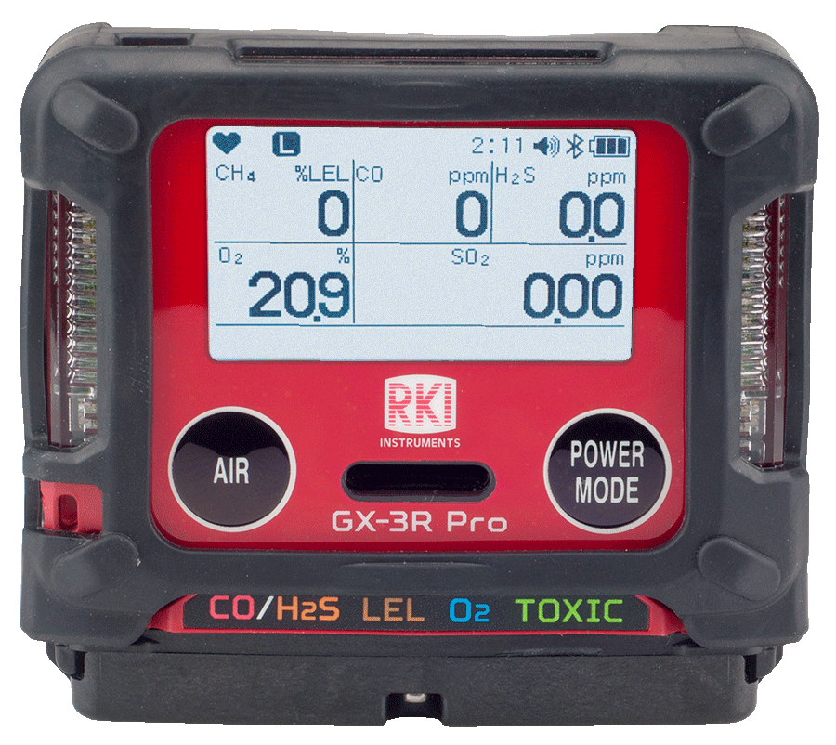
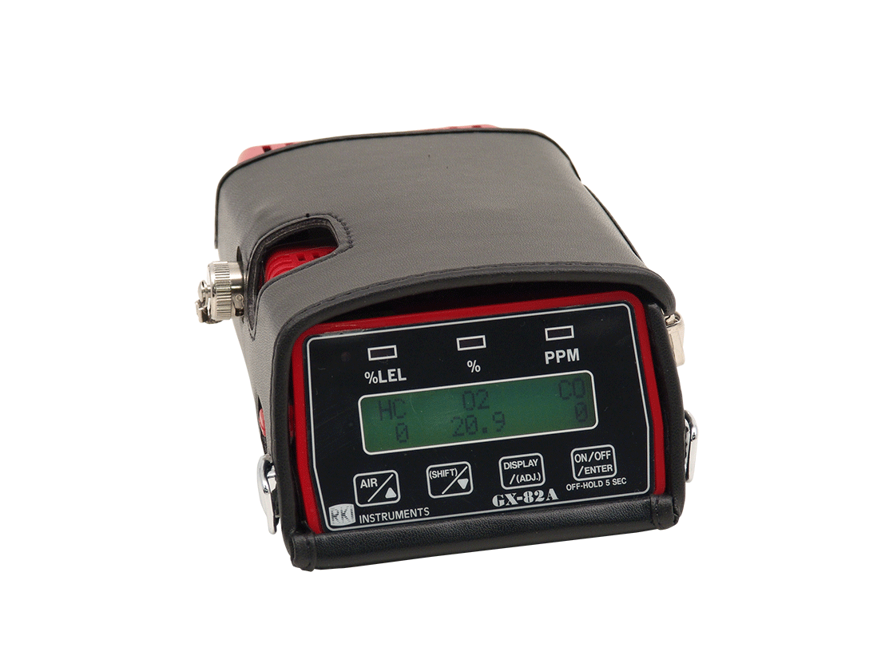
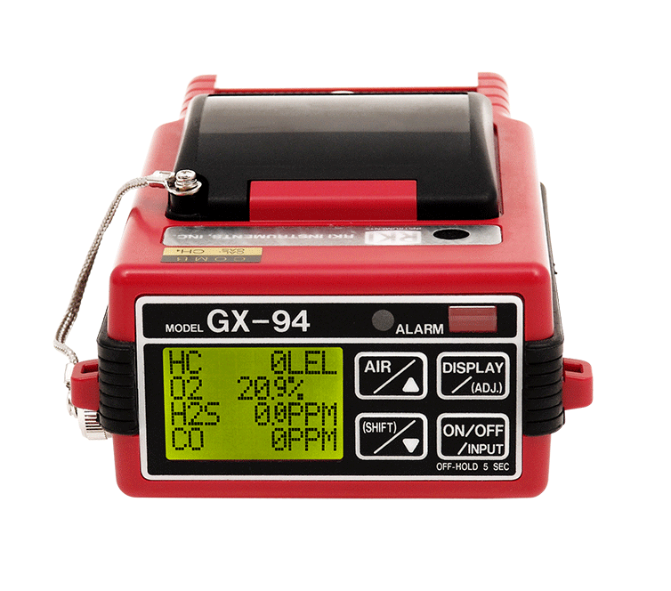
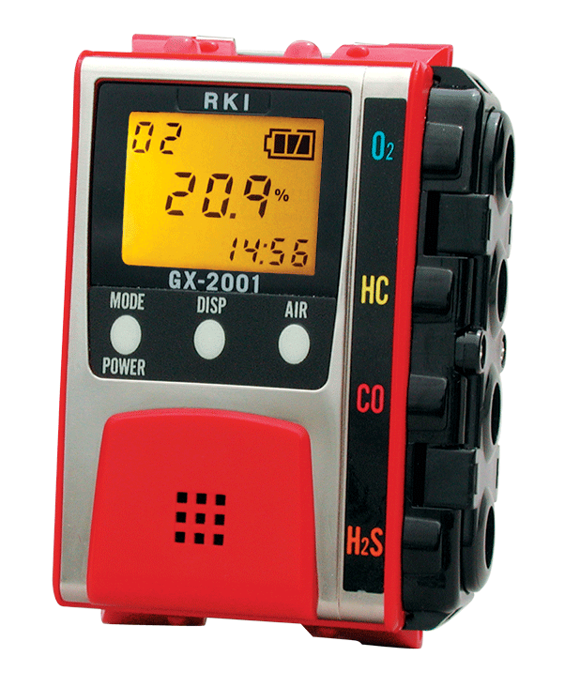
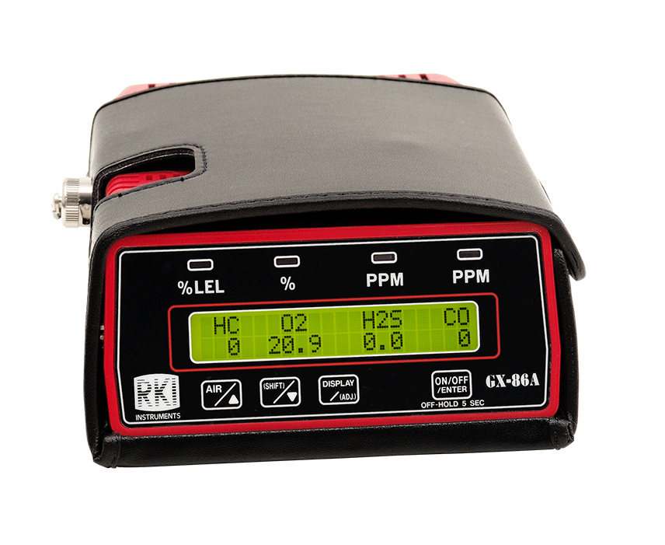
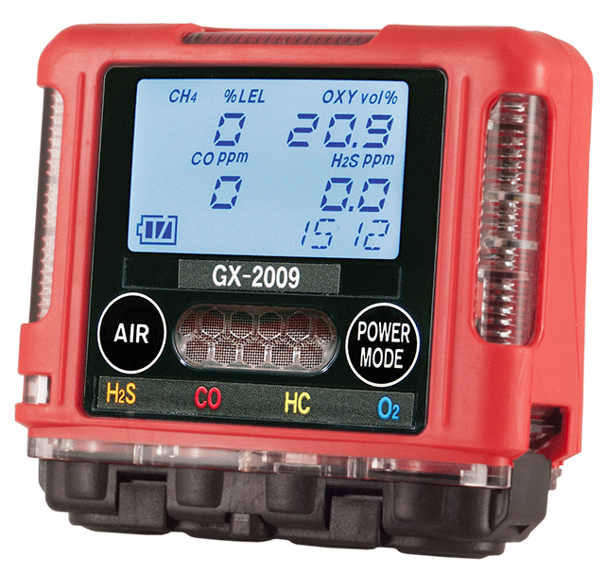
Next Generation of Gas Detection
GX-3R
GX-3R Pro
GX-82 (1982)
GX-86 (1986)
GX-94 (1994)
GX-2001 (2001)
GX-2009 (2009)

Slide 2
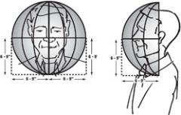


Considerations
Small & Light
Breathing Zone
OSHA (USA) recommends gas detection instruments be worn in the Breathing Zone.
A small and light instrument is important for workers to feasibly wear in the breathing zone.
Durability
Resistance to impact, dust, water, chemicals (solvent, silicone…etc), high-low temperature and “Long sensor life” are all important.

Slide 3


Considerations
Multi Functional
Ability to add a 5th Gas or man-down alarm.
Communication & Connectivity
Wireless communication is needed by some customers.

Slide 4
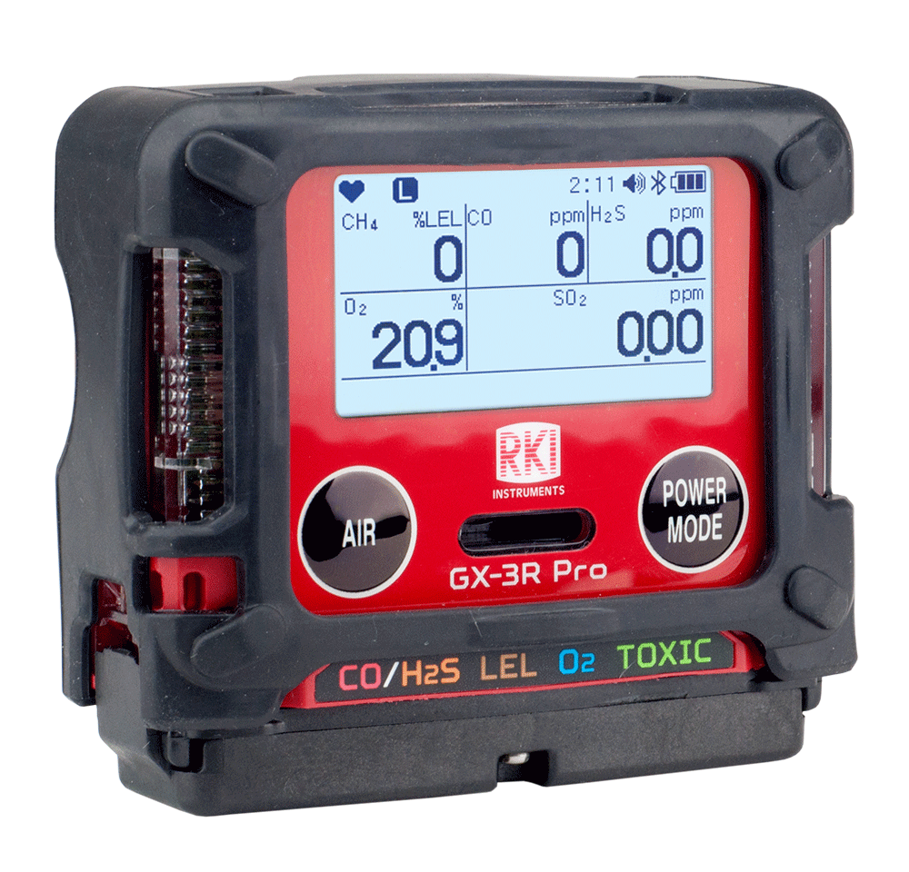
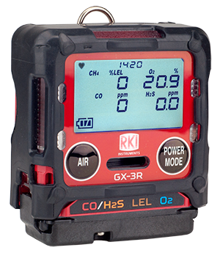
2 Versions - Depending on Need
Basic 4 Gas version
Advanced version
GX-3R
GX-3R Pro
Worlds smallest and lightest
Economical
3 year warranty
4 gas Plus
  Wireless communication with phone app
  Other toxic gas options
  Man-down alarm
  Alkaline/Rechargeable
  3 year warranty

Slide 5
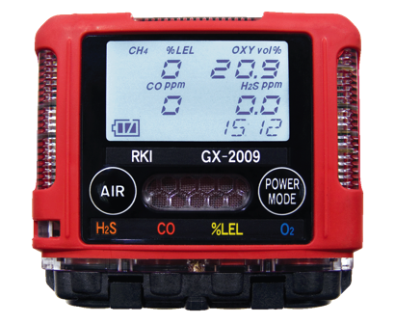
Advancements
Size & Weight
Smallest and Lightest Currently Available
3” x 2.7” x 1”
4.6 ounces
GX-2009

Slide 6
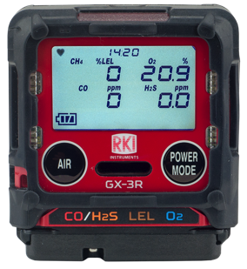
Advancements
Size & Weight
The NEW Smallest and Lightest Currently Available
2.4” x 2.7” x 1”
3.9 ounces
GX-3R

Slide 7
Advancements
Size & Weight
Advanced version same size as GX-2009
3” x 2.7” x 1”
4.6 ounces
GX-3R Pro

Slide 8

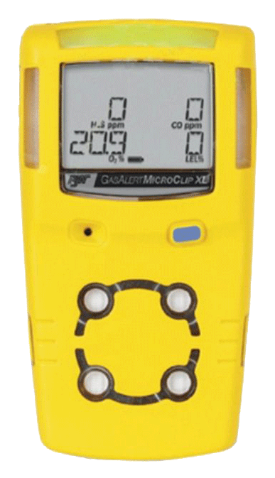
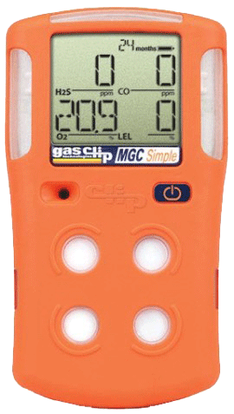
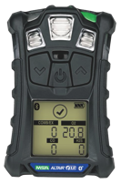
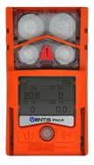
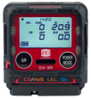
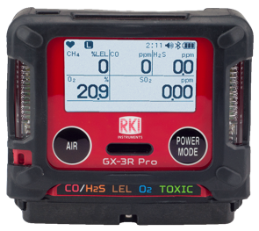
Comparison
Size & Weight
2.7” x 2.4” x 1”
3.9 ounces
2.7” x 3” x 1”
4.6 ounces
4.4” x 2.4” x 1.2
6.7 ounces
4.1” x 2.3” x 1.4”
7.05 ounces
4.7” x 2.7” x 1.2”
7.67 ounces
5” x 1.9” x 1.2”
7.8 ounces
4.4” x 3.0” x 1.4”
8.07 ounces

Slide 9
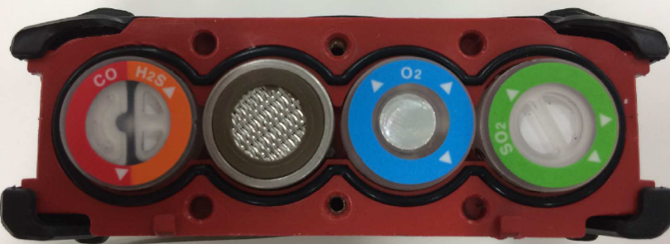
Advancements
Dual Sensor
4 Sensors slots for 5 gas channels
GX-3R Pro
CO/H2S
3 Sensors slots for 4 gas channels
GX-3R

Slide 10
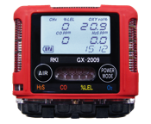
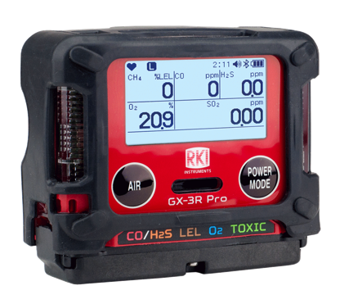
Advancements
Warranty
2 years sensors and instrument
GX-2009
GX-3R
3 years sensors and instrument
GX-3R Pro

Slide 11
Advancements
Durability
1 meter drop test
GX-2009
GX-3R
7 meter drop test, replaceable rubber boot
GX-3R Pro

Slide 12
Advancements
Familiar User Interface
2 button design
GX-2009
2 button design with similar operational menus
(bump testing & calibration simplified)
GX-3R
GX-3R Pro

Slide 13
Advancements
Operating Temperature Range
-4° to 122° F
GX-2009
GX-3R
-40° to 140° F
GX-3R Pro

Slide 14
Advancements
Continuous Operation Battery Life
20 hours, rechargeable
GX-2009
GX-3R
24 hours, rechargeable
Alkaline battery option
GX-3R Pro

Slide 15

Advancements
Water & Dust Resistant Ratings
IP 67
Dust, dirt, and sand resistant
Submersible in water 1 meter for up to 30 minutes
GX-2009
IP 68:
Dust, dirt, and sand resistant
Submersible in water > 1 meter for more than 30 minutes
GX-3R
GX-3R Pro

Slide 16
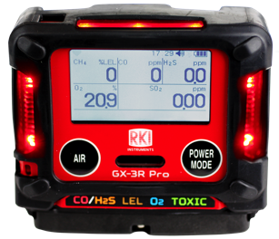
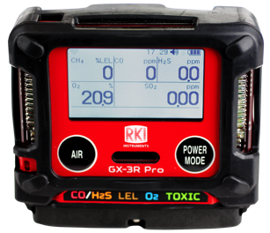
Advancements
Non Compliant Indicator
Non compliance indicator: LEDs flash once every 30 seconds
GX-3R
Non compliance: Operating instrument while bump test or calibration are past due
GX-3R Pro

Slide 17
Advancements
Wireless Communication
GX-2009
Not available
GX-3R
Bluetooth (BLE) with phone app
GX-3R Pro

Slide 18
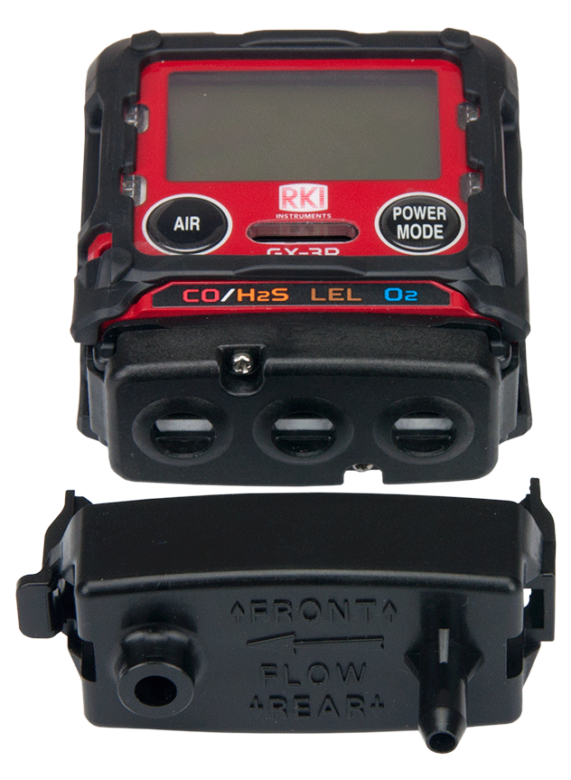
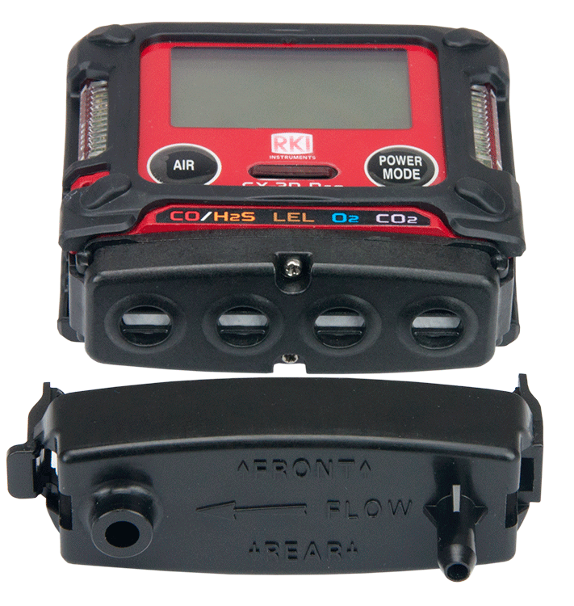
Cal Cup
Ships as standard
Sold Separately
GX-2009
GX-3R
Ships as standard
GX-3R Pro

Slide 19

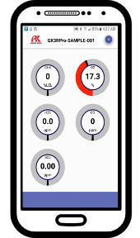






BLE Applications
Alarm Notification
Email Event Logs & Calibration History
Group Alarm Notifications (SMS)

Slide 20
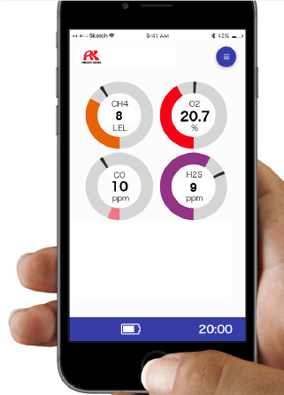
Phone App
Direct readings from instrument
Digital values
Graphical display
Alarm indications
Email or text alarm event notifications

Slide 21
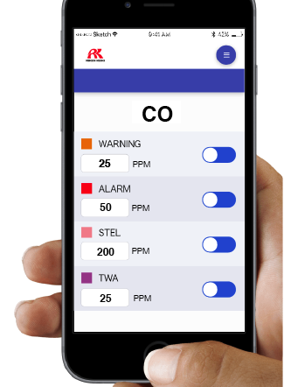
Phone App
Change instruments settings
  Alarm Settings
  Bump test settings
  User & Station ID’s

Slide 22
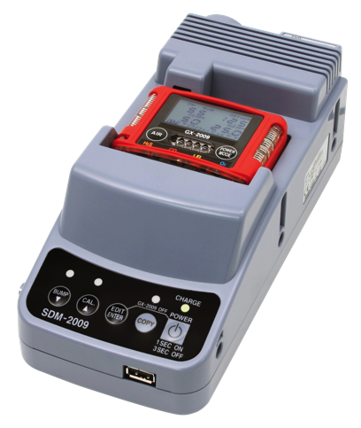
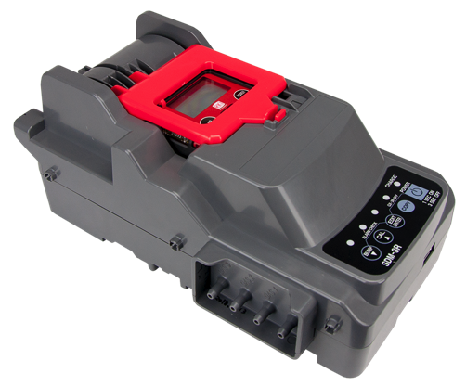
Calibration Stations

Slide 23
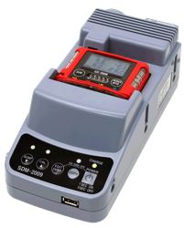
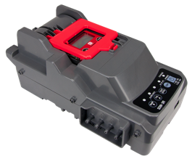
Advancements
Calibration Stations
Bump Time: 10 seconds
Gas Consumption: 450 ml / min
Output: USB drive / USB Cable to PC
SDM-2009
Bump Time: 10 seconds
Gas Consumption: 250 ml / min
  (Lowest gas usage per bump test available)
Output: Internal memory / LAN cable / USB Cable to PC
Accepts both GX-3R or GX-3R Pro
SDM-3R

Slide 24
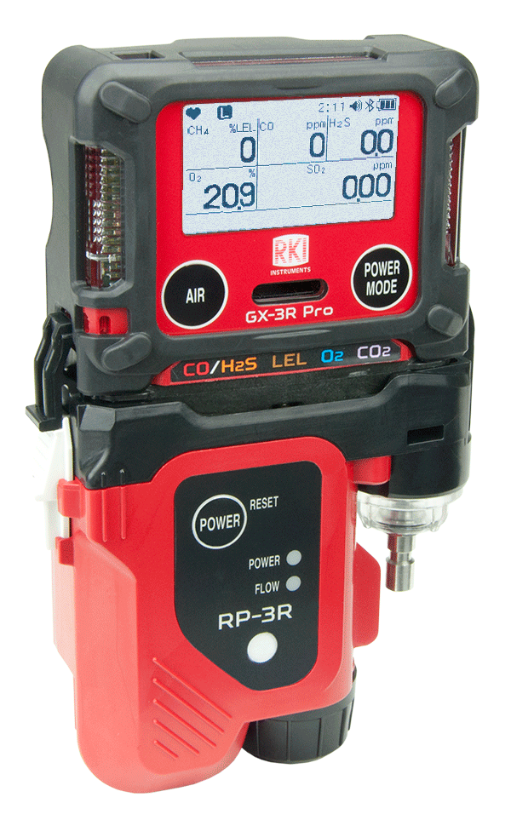
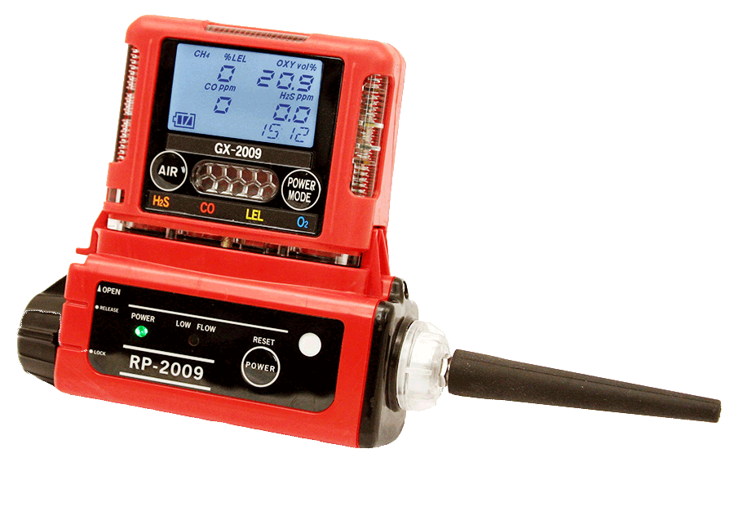
Clip-on Pump Unit

Slide 25
Advancements
Clip-on Pump Unit
Flow rate: 450ml / min
Distance to draw: ~10m
Operation time: 8h
Operation mode: Normal mode only
RP-2009
Flow rate: 500ml / min
Distance to draw: ~30m
Operation time: 10h
Operation mode: Normal mode / Eco Mode
RP-3R

