Slide 1
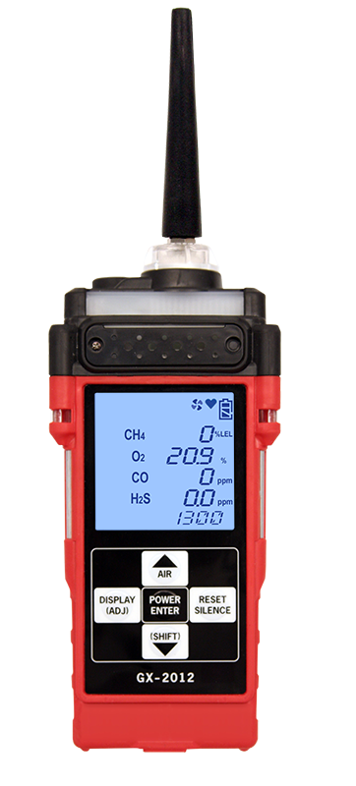
GX-2012
User Operation
Youtube Video

Slide 2
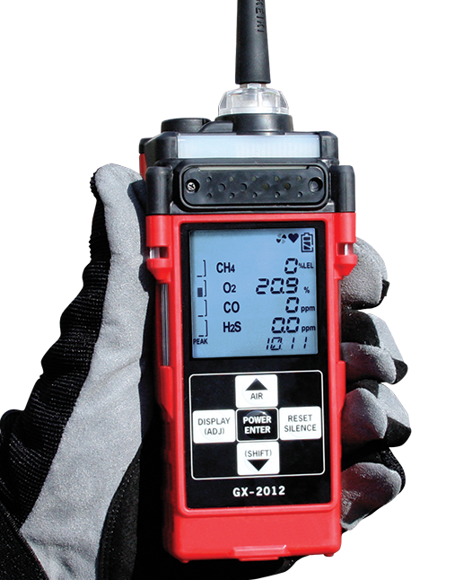
GX-2012 Features
Internal sample draw pump with 50’ range
3 bright visual alarm LED’s (top and sides)
Display gas measurements simultaneously
Peak level bar display
Glove friendly buttons
Combustible Display automatically switches
(%LEL / % volume)
95 db audible &
vibration alarm
Status indicators
  Pump activity
  Blinking heart
  Battery level
Time indicator
Datalogging standard
  Snap shot logging
  Bar hole logging
  Calibration and
  bump test

Slide 3
Startup Procedure
Press and briefly hold down the POWER ENTER button. Release the button when you hear a beep.
The Date/Time Screen appears for a few seconds.
The Battery Level and Alarm Pattern Screen appears next.
The GX-2012 is now operating in Normal Mode and monitoring for gas in Measuring Mode.

Slide 4
Fresh Air Adjustment
  Find a fresh-air environment.
  Turn on the unit.
Press and hold the AIR▲ button. The display prompts you to hold the AIR▲ button.
Continue to hold the AIR▲ button until the display prompts you to release the AIR▲ button.
Once the countdown has finished, start up is complete and the unit is ready for monitoring.

Slide 5
Display Mode
  To enter Display Mode, press and release the DISPLAY (ADJ) button while in Measuring Mode. To scroll from one screen to the next press and release the DISPLAY (ADJ) button
    Each screen displays for 20 seconds. If you do not press the DISPLAY (ADJ) button to scroll to the next screen or press the POWER ENTER button to enter an item within 20 seconds, the GX-2012 returns to Measuring Mode

Slide 6
Display Mode
  In the Display Mode, you can:
  set the combustible gas channel range
  Display peak readings
  Display STEL and TWA readings, H2S & CO
  Display full scale, warning, alarm, STEL, and TWA (H2S and CO only) values
  Display time in operation
  Display the date and time
  Display remaining log time
Clear the data logger turn the pump on or off
Select a user ID
Select a station ID
Display snap logging data

Slide 7
GX-2012
User Maintenance
Youtube Video

Slide 8
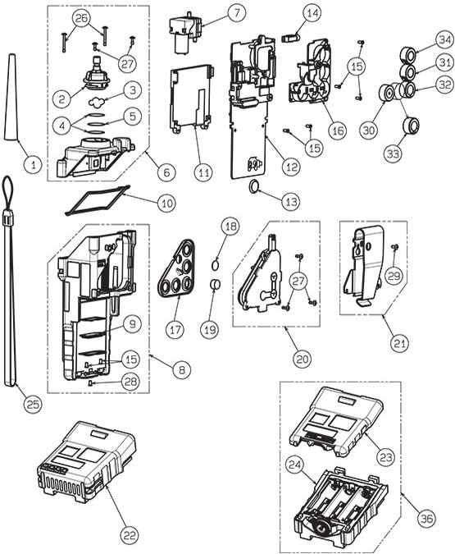
GX-2012 Parts List
1. 17-1001RK Tapered rubber inlet nozzle
2. 21-1833RK Filter holder, clear plastic
3. 33-1031RK Cotton balls, filters for probe,
4. 33-0159RK Teflon filter disc, 10 pieces
5. 33-1112RK Wire mesh disk filter, 10 pack
6. 21-1890RK Top cover assembly
7. 30-0022RK Pump replacement
8. 21-1889RK Main case assembly
9. 07-6024RK Battery pack gasket
10. 07-6025RK Main case gasket
11. 51-1125RK LCD display
12. 57-2043RK CPU PC board assembly
13. 49-1406RK Battery, lithium
14. 30-1053RK Vibration motor
15. 10-1090RK Tap tight screw M2x4.5 mm
16. 57-2041RK Sensor PC board assembly
17. 07-6026RK Sensor gasket
18. 33-7114RK Filter disk, H2S scrubber, 5 pack
19. 33-7102RK Filter, charcoal, for CO sensor
20. 21-1892RK Sensor cap assembly
21. 13-0118RK Belt clip
22. 49-1615RK Batter pack, lithium ion
23. 49-1616RK-01 Alkaline Battery pack w/cover
24. 49-1616RK-02 Alkaline Battery pack without cover with gasket

Slide 9
GX-2012 Parts List
25.13-0112RK Wrist strap
26. 10-1108RK Screw M2 x 16
27. 10-1093RK Screw M2 x 6 SUS304
28. 10-1091RK Screw M2 x 5 SUS
29. 10-1092RK Truss screw M2 x 5
30. OS-BM2 O2 sensor OS-BM2
31. NC-6264A LEL sensor NC-6264AS
32. ES-1821 CO sensor ES-1821
33. ES-1827I H2S sensor ES-1827I
34. TE-7561 VOL sensor TE-7561
35. SH-8641 PPM sensor SH-8641
36. 49-1616RK Alkaline Battery pack without batteries with gasket, GX-2012 / Gas Tracer

Slide 10
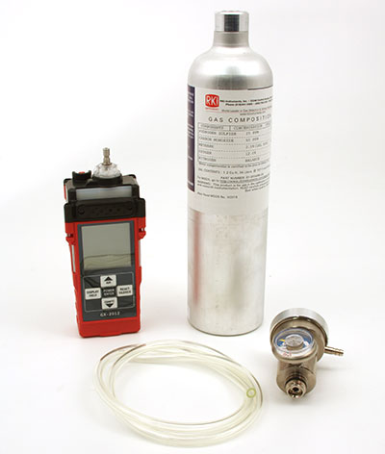
GX-2012 Calibration

Slide 11
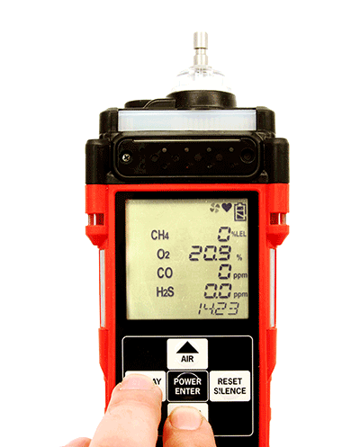
Accessing Calibration Mode
From Measuring Mode, enter Calibration Mode by pressing and holding the (SHIFT)▼button, then pressing the DISPLAY(ADJ) button and releasing both
  If the unit prompts you for the password, enter it by using the ▲AIR and (SHIFT)▼ buttons to select each password number and then pressing and releasing POWER ENTER to confirm it

Slide 12
Auto Calibration
MAINTENANCE will appear along the top of the screen once you have entered Calibration Mode. The first item in the calibration menu, AIR CAL, displays.
Use the ▲AIR and (SHIFT)▼buttons to display the AUTO CAL menu item, press and release the POWER ENTER button to display the calibration values screen.
  Use the ▲AIR or (SHIFT)▼ buttons to view the vol% calibration concentration.

Slide 13
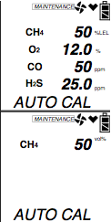
Auto Calibration
The gas concentrations displayed in the calibration values screen must match the gas concentrations listed on the 4-gas calibration cylinder.
With the calibration values screen displayed, press the POWER/ENTER button. AUTO CAL begins to flash and the current gas readings are displayed.

Slide 14
Auto Calibration
Connect the tubing from the gas cylinder to the inlet fitting of the instrument. Allow the gas to flow for one minute.
Press and release the POWER/ENTER button to set the calibration to the programmed values.
If all channels passed calibration, PASS displays along the bottom of the screen, then the calibration menu displays.
If any of the sensors cannot calibrate to the proper value, FAIL displays along the bottom of the screen and the GX-2012 lists the sensor(s) that failed to calibrate. The buzzer and alarm lights activate.
Press and release the RESET SILENCE button after the buzzer and lights stop to reset the alarm and return to the calibration menu. Attempt to calibrate again. If the failure continues, investigate the cause.

Slide 15
Auto Calibration
Disconnect the tubing from the inlet fitting of the unit.
Unscrew the demand flow regulator from the calibration cylinder.
If you have a 5 sensor unit and wish to calibrate the %volume sensor, go back to the first step and repeat the process. If you are finished calibrating, use the (SHIFT)▼ button to navigate to the NORMAL menu item, then press and release the POWER ENTER button to return to Measuring Mode

Slide 16
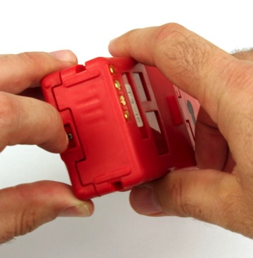
Battery Replacement
Turn off the GX-2012
Push the latch on the bottom of the GX-2012 toward the front of the instrument to release the battery pack
Slide the battery pack away from the instrument
Insert a new battery pack
Push the battery pack into the instrument until you hear a click.

Slide 17
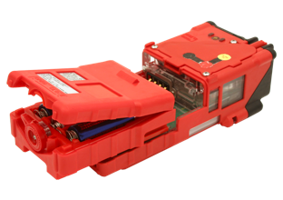
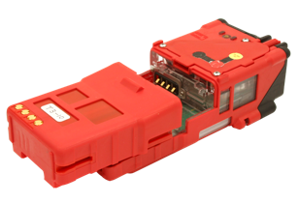
Battery Replacement
Alkaline Battery Pack
Li-Ion Battery Pack

Slide 18
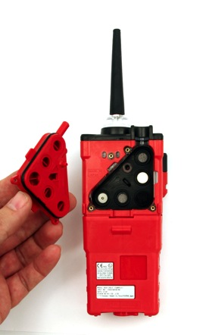
Sensor Replacement
Use a screwdriver to remove the three screws holding the flow chamber
Grab the exhaust tube and pull it gently away from the unit to slide the flow chamber out of the unit

Slide 19
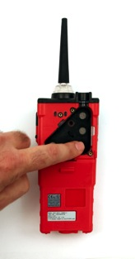
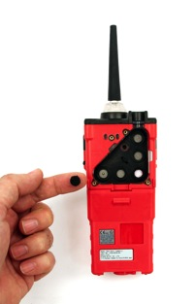
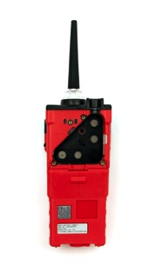
Scrubber Filters Replacement
Place the charcoal filter over the CO sensor

Slide 20
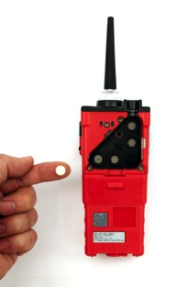
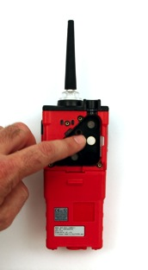
Scrubber Filters Replacement
Place the H2S Scrubber over the LEL sensor

Slide 21
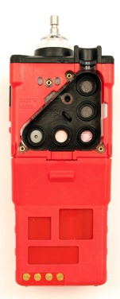
Sensor Replacement
Gently pull the tab of the sensor gasket to remove it. Be sure not to lose any of the scrubber filters that are currently installed.
Note: the sensors will be exposed.
Sensor Filters
Tab

Slide 22
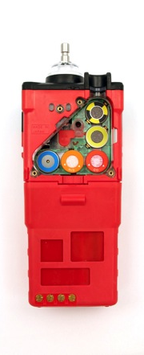
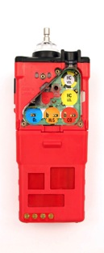
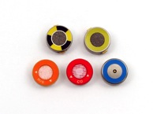
Sensor Replacement
Remove the sensors from their sockets
%LEL
Catalytic
%Volume
Methane
Thermal
Conductivity
Oxygen
Hydrogen Sulfide
Carbon Monoxide

Slide 23
Sensor Replacement
Ensure that the sensor filters are in place
Place the flow chamber in position over the sensor area and press it into the case until it is flush with the back of the case
Place the sensor gasket and filters back into the chamber ensuring that it seals with the sensors and the edge of the chamber.
Place the sensor gasket and filters back into the chamber ensuring that it seals with the sensors and the edge of the chamber

