Slide 1

Connected Worker Safety

Slide 2
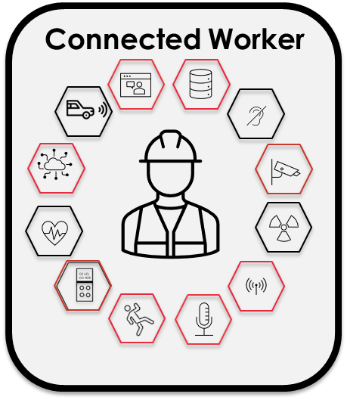
Connected Worker
Increased productivity through enhanced safety
Proactively change behaviors and optimize safety through data analytics
Gain operational insight into what barriers exist that affect productivity and modify them
Real time location monitoring of workers in duress leads to a safer workforce & reduced financial & medical burden
Increase worker efficiency with remote collaboration and workflow process management
Increased safety with nearby worker assistance mode & 24/7 live monitoring

Slide 3
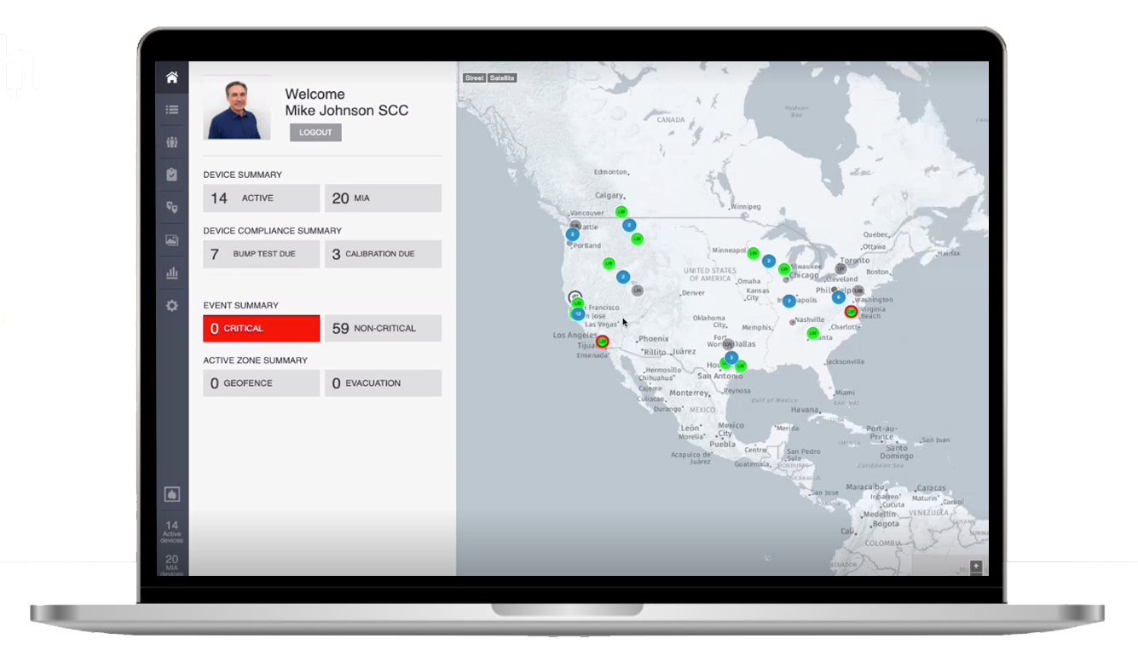

Enhanced Safety
Worker Incident Management
Quickly locate worker during gas release, panic, fall/no motion events via GPS and cloud enabled software.
Proactive safety management
Data analytics identifies incident trends and occurrences are proactively reduced through behavior change management.
Live monitoring
With experienced monitoring teams, already protecting fire and police services, help is on the way

Slide 4
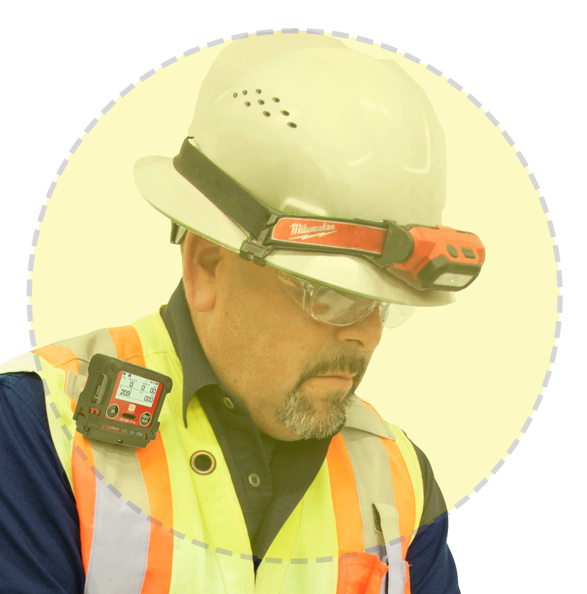
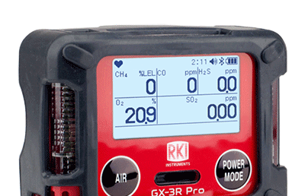
Enhanced Safety
Trustworthy alarms
With specialized alarm levels the system is trustworthy and alarm fatigue is reduced.
Local incident awareness
Immediately notify local personnel to incidents through the connected worker solution
Easy panic activation
Even when in jeopardy panic alarms are easily activated
Protection where required
With the smallest unit in the market category breath safely

Slide 5
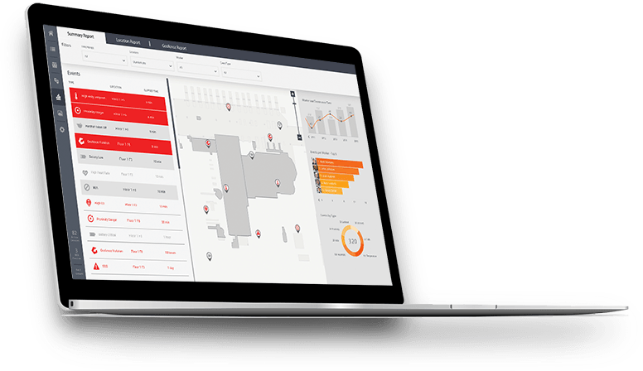
Increased Productivity
Remote Experienced Direction
Increase worker productivity with remote experienced personnel through the video and audio connected worker solution
Work process management
Workflows are streamlined when video and images are added for audits, maintenance and troubleshooting processes.
Increased worker efficiency
Use data analytics to understand what challenges teams face with productivity and create efficiency

Slide 6
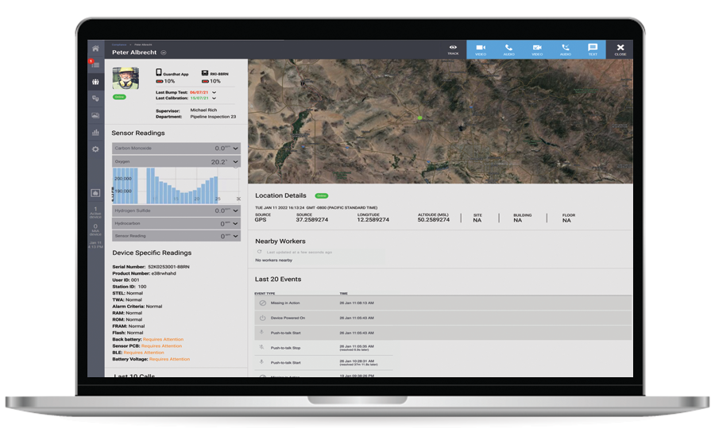
Increased Productivity
False alarm reduction
With specialized alarm levels expensive incorrect emergency response can be minimized and thousands can be saved
Reduced worker downtime
With the longest battery life in the category and replaceable alkaline battery options the work shift is secure.
Efficient Evacuation Drills
Utilizing zone technology around muster areas evacuation drills can be performed 90% faster saving $100s of thousands per year

Slide 7
Data Integration & Security
Privacy & Security
Data encryption - Proxy ID assignments
Right-to-be-forgotten - User consent process
SOC II Type 1 - SOC II Type 2
Integration
OT & IT software integrations via API and SDK with HMRS & EHS
Flexible deployment
on-premise or in the cloud with major cloud-based PaaS providers and in hybrid topologies tailored to your specific deployment scenarios.
Connectivity
LTE – Wi-Fi – BLE

Slide 8





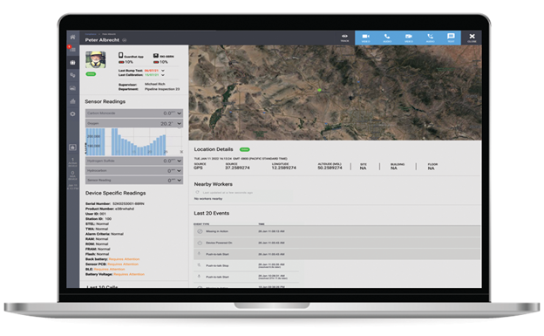



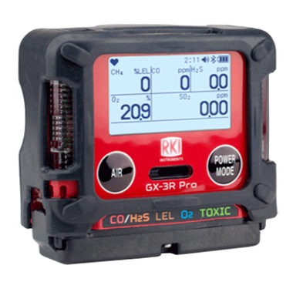
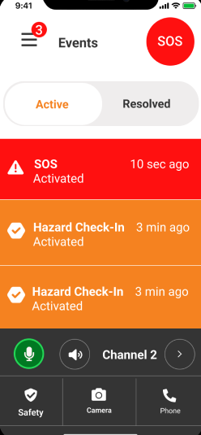









Connected worker solution
Proactive safety management
Data analytics identifies incident trends and coach workers on best safety practices.
Increased worker efficiency
Use data analytics to understand what challenges teams face with productivity and create efficiency

Slide 9
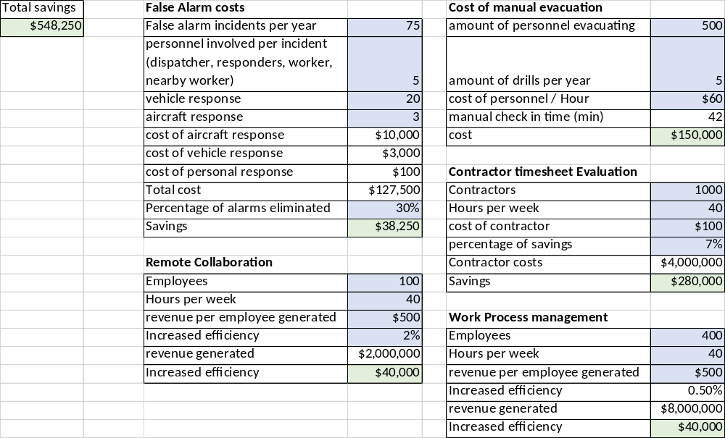
Value

Slide 10








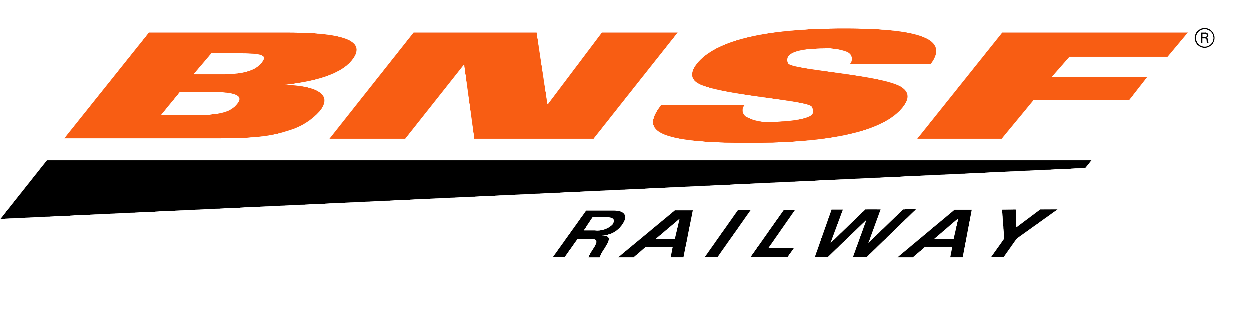







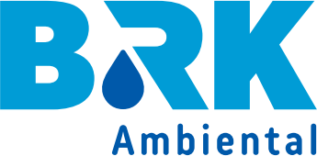














Trusted by

Slide 11


















Awards:2019-2022

Slide 12

Questions?

Slide 13


Slide 14
Appendix

Slide 15
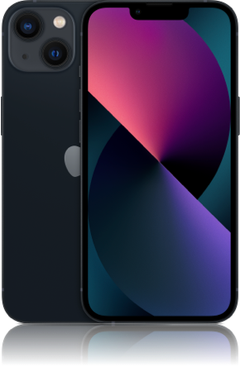
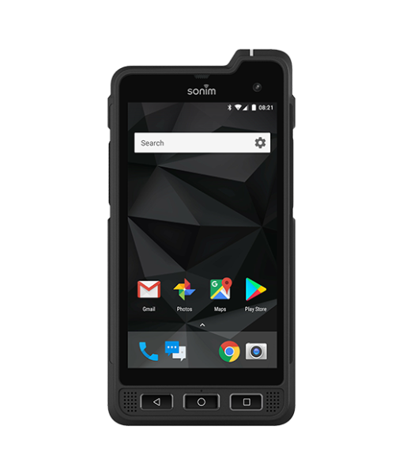
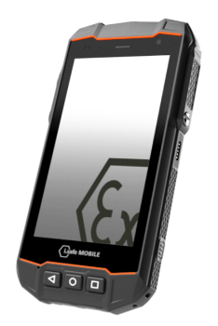

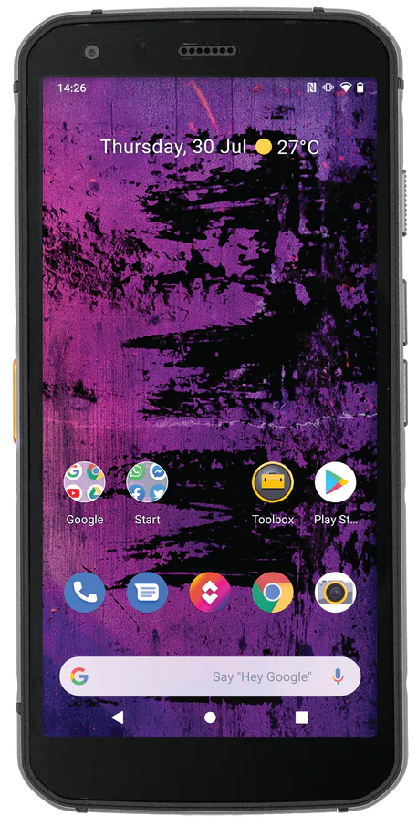
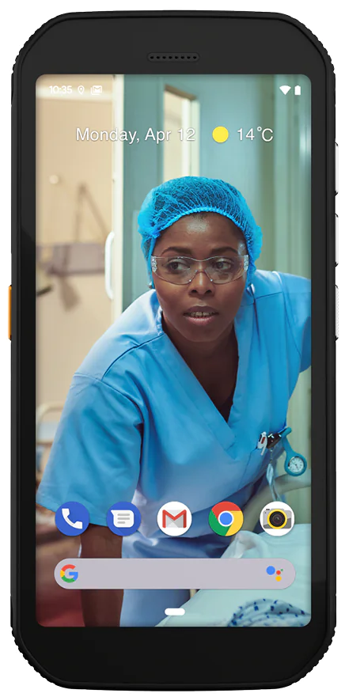
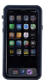
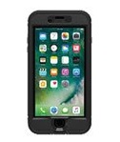
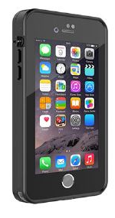
Device Compatibility
Iphone
11-13, and iOS 15.6 and up
Sonim XP8 & XP10
Android
Intrinsically Safe Device
i.Safe IS530
Android
Intrinsically safe device
Nokia XR20
Android
Cat
S62 Pro
Android
CAT
S42 H+
Android
Iphone
Intrinsically Safe cases
$700 -$850
https://intrinsicallysafestore.com/product-category/mobility/intrinsically-safe-cases/
https://www.xciel.com/rugged-iphones
https://www.orioncase.com/product-category/intrinsically-safe-mobile-device-cases
Iphone 12 IS case
$725
https://www.orioncase.com/product/iphone-12-case-c1d2
Iphone XR IS case
$685
https://www.orioncase.com/product/iphone-xr-case-c1d2
Iphone 11 IS case
$725
https://www.orioncase.com/product/iphone-11-case-c1d2

Slide 16
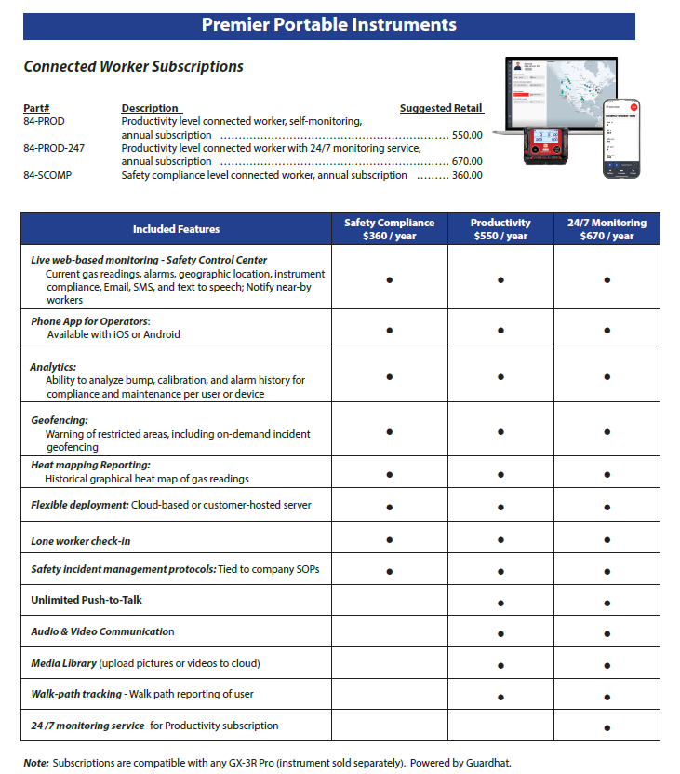
Pricing and part numbers

Slide 17



IIoP Privacy & Security
Designed for GDPR compliance
Data localization and sovereignty: Compliant with data localization requirements by leveraging dedicated instances, data lakes, and resources in every region we operate in
Apple and Google Play store privacy requirements
SOC II Type 1: achieved Dec. 2021
SOC II Type 2: achieved Dec. 2022
Compliance
End-to-end encryption: PSK on Wifi, LTE encryption, HTTPS encryption, SSL encryption, support a wide range enterprise encryption options (PEAP, MS-CHAPv2, etc)
Single tenancy and/or on-prem: Single tenant option for each customer and/or each site to enable full data isolation
Open-source monitoring: Vulnerability Scanning integrated in CI/CD pipeline and dynamically at runtime
Breach and uptime monitoring: Real time SOC monitored by full time staff to monitor all live instances and react in real time to any security concerns
Proxy ID assignments: Ability to associate devices anonymously to individuals, roles, or pseudonyms
Platform design considerations
Role based access control: Accessible via secure User ID, Password, and Encrypted Key as needed for higher levels of administration
Flexible consent process: Customer driven with all data owned by customer, Guardhat exists as a processor only
”Blackout” zone configuration: Ability to set geo-fences that limit or restrict any data capture from devices or people inside them
User controlled audio/video: Only the worker can activate the microphone or video functionality
User features and capabilities

Slide 18
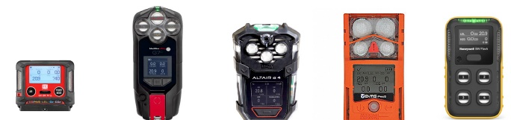
Competition
Solution Value | RKI GX-3R Pro | G7 Blackline safety | MSA Altair IO4 | ISC Ventis Pro 5 | Honeywell BW Flex
Worker incident Management with location | Yes | Yes | Yes | Yes | Yes
Remote collaboration with video, audio & text | Yes | Partial (Audio and text) | No | No | Partial (audio only through cell or Motorola radio)
Work process management | Yes | No | No | No | No
False Alarm reduction | Yes | Partial (Yellow alarm) | No | No | No
Biometrics, Collision avoidance, Radiation | Yes (optional) | No | No | No | No
Wear in breathing zone | Yes | Extremely difficult | Difficult | Difficult | Difficult
Worker Area restriction | Yes | No | No | No | limited
Worker Privacy | Yes | No | No | No | No
Flexible Data center options | In cloud or on premise | Cloud only | Cloud only | In cloud or on premise | In cloud or on premise
Worker productivity | Yes | Yes | No | (partial) | No
Worker incident local awareness | ,Yes | No | No | Yes with LENS | No
Low cost of ownership | Yes | No | No | No | No
Runtime | 23 hours Li-Ion or Alkaline | 18 hrs Li-Ion | 20 hrs Li-Ion & Alkaline | 18 hrs Li-ion | 15 hrs Li-ion
Size | 2.9 x 2.6 x 1.0” | 5.8 x 3.3 x 1.6” | 6.6 x 3.4 x 1.7” | 4.4 x 3.0 x 1.4” | 4.2 x 2.4 x 1.7
Weight | 4.58 oz | 14.5 oz | 16 oz | 8 oz | 6.7 oz

Slide 19
Increased productivity & Enhanced safety
Worker Incident Management
Quickly locate worker during gas release, panic, fall/no motion events via GPS and cloud enabled software.
Proactive safety management
Data analytics identifies incident trends and occurrences are proactively reduced through behavior change management.
Live monitoring
With experienced monitoring teams help is on the way
Trustworthy alarms
With specialized alarm levels the system is trustworthy and alarm fatigue is reduced.
Local incident awareness
Immediately notify local personnel to incidents through the connected worker solution
Easy panic activation
Even when in jeopardy panic alarms are easily activated
Protection where required
With the smallest unit in the market category breath safely
Remote Experienced Direction
Increase worker productivity with remote experienced personnel through the video and audio connected worker solution
Work process management
Work flows are streamlined when video and images are added for audits, maintenance and troubleshooting.
Increased worker efficiency
Use data analytics to understand what challenges teams face with productivity and create efficiency
False alarm reduction
With specialized alarm levels expensive incorrect emergency response can be minimized and thousands can be saved
Reduced worker downtime
With the longest battery life in the category and replaceable alkaline batteries the work shift is secure.
Efficient Evacuation Drills
Utilizing zone technology around muster areas evacuation drills can be performed 50% faster saving $100s of thousands per year

