Slide 1

Connected Worker Safety Solution
Playbook

Slide 2
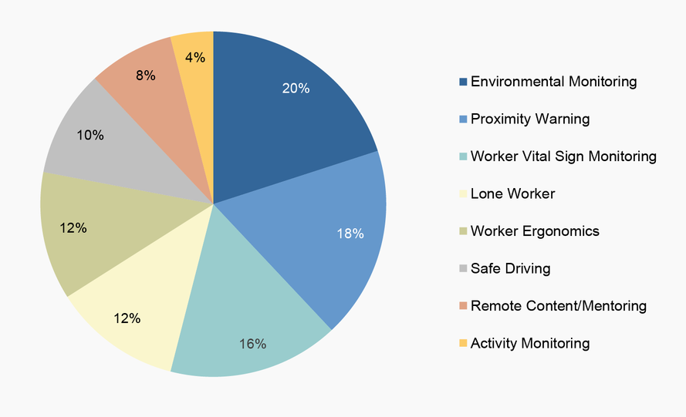
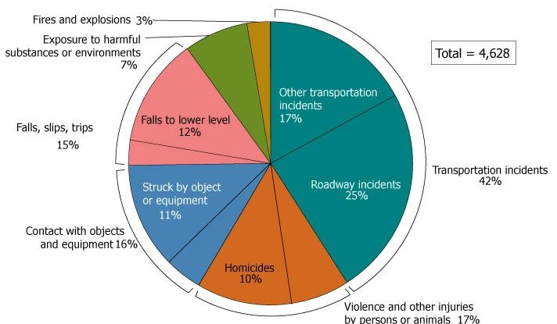
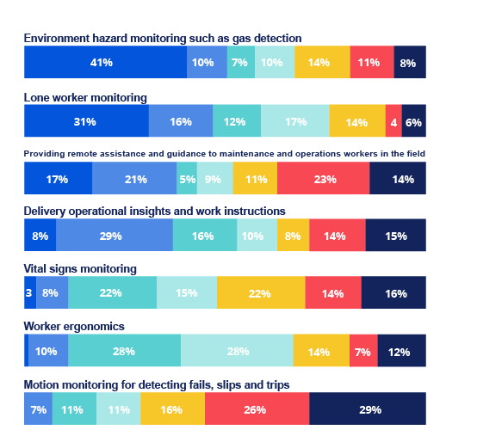
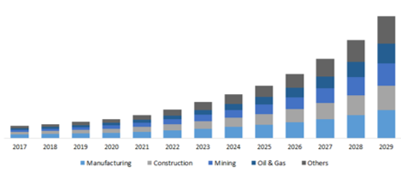
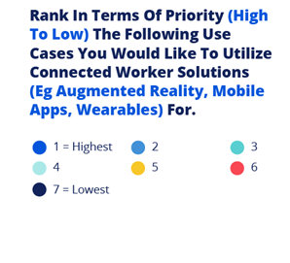
Connected Worker Market
Connected worker Device Market by use case
(Verdantix)
Fatal occupational injuries by Major event (OSHA)
Priority rank of connected worker user cases
(Verdantix)
US Connected worker Market size, by end use, 2017-2029 (USD Billion) (Polaris research)
$1.75B

Slide 3
Connected Worker Market - productivity drivers
Referred to as the “manufacturing skills gap”, this issue boils down to the manufacturing sector being unable to find workers who have the proper skills, knowledge, or expertise to take the open positions. The need to close the skills gap is perhaps one of the most pressing challenges for the manufacturing sector.

Slide 4



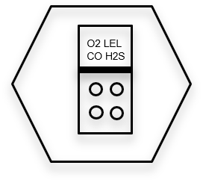











Key Decision maker & and Influencers
Near Miss - Incident - High risk environment
Worker Productivity – Process efficiency
Technology to productivity ROI
Ideal Connected Worker customer
Extremely safety focused
ASSP membership
Understands increased safety leads to higher productivity
Has Digital Transformation group
Experienced near miss or fatality
Increased insurance premium
Values productivity through technology
Safety Plus
Safety
Safety Manager
IH
Safety officer
Emergency Response manager
Safe Operations
Public and worker welfare
Safety compliance
Report of findings or events
Productivity
Operations Manager
Facility manager
COO
Digital Transformation
Efficient operations and Cost savings
Efficient operation/no downtime
Low cost of ownership
Safely operate and maintain plant
Compliance to permits
Compliance

Slide 5
Decision Maker and Influencer
Operations manager / COO
Key Decision Maker
Focus: Efficient operations and Cost savings
What they value:
-Efficient operation/no downtime
-Low cost of ownership
-Safely operate and maintain plant
-Compliance to permits
HSE Manager / Safety Officer / IH
Key Influencer
Focus: Safe Operations
What they value:
-proactive approach driving to zero incidents
-Public and worker welfare
-Plant safety
-Safety compliance
-Report of findings or events
Digital Transformation / IT
Key influencer:
Focus: Utilizing digital technologies to improve efficiency, productivity, customer experience, and competitiveness.
What they value:
They are extremely concerned about data ingestion and that the data is encrypted.
They would like a flexible structure that can be expanded with minimal changes
Union / HR
Key influencer:
Focus: Concerned about worker safety and privacy .
What they value:
A solution that will protect workers and will not jeopardize their privacy
A safer solution will encourage new workers to come to the corporation

Slide 6

Solution Value
Safety
Proactive safety management
Worker incident management (gas, fall, Panic, Biometric Collision Avoidance) with location
Worker incident local awareness
Lone worker monitoring
Evacuation Management
Worker area restriction
Quick incident investigation
Compliance auditing
Productivity
Low cost of operation
Remote collaboration with video, audio & text
Work process management
Real time information & documentation
Worker efficiency management
False alarm reduction
Remote CSE
Lower downtime from improved product design
Data
Data Encryption
Cybersecurity compliance
  SOC II Type 1
  SOC II Type 2
Audio, Visual, text, Gas, fall, worker location data Integration
Data Analytics
Worker privacy
Flexible data center options (cloud / on premise)
Application Programming interface integration
Software Development kit
Connected safety solution expansion

Slide 7

Distribution
Solution based distribution
For distributors that are comfortable with solution selling they will be able to meet directly with end users
Product based distribution
For distributors that are more comfortable with product selling its recommended that a joint call is set with RKI representative
The key value to the safety distributor is that offering connected safety solutions will solve customer problems better than the connected safety detector manufacturers they represent today

Slide 8
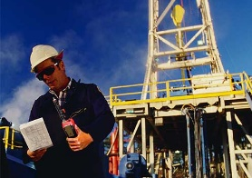
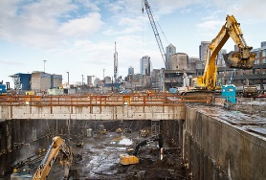
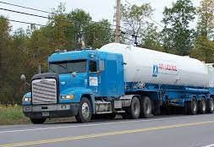
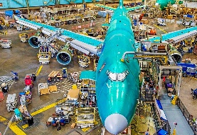
Target Industries and Applications
Companies that use the most cell phones for their employees for productivity & communications like transportation and construction
Corporations with industrial Wi-Fi network on site
Remote areas with good cell phone coverage like outdoors
Industries or Applications with most common releases of gas and highest gas dangers like Oil & Gas, Utilities, Steel
Lone workers like in Oil & Gas, Utilities, Transportation
Workers at height in Oil & Gas & Steel plants
Industries with highest safety incidents Construction, transportation & manufacturing
Markets with lowest productivity Metal manufacturing, Gas Utilities, Chemicals
Oil & Gas
Construction
Transportation
Manufacturing
Notes:
A corporation or field site that values connected worker is segmented more based on the risks that they expect or the issues that they have encountered
There are some criteria that can be used to identify good industrial targets

Slide 9



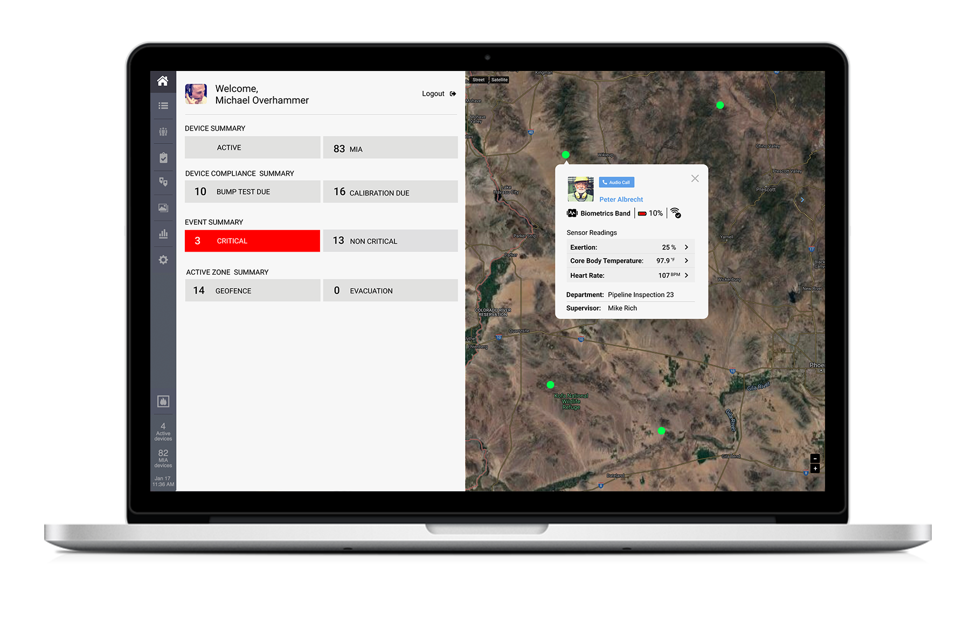


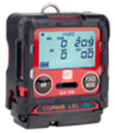




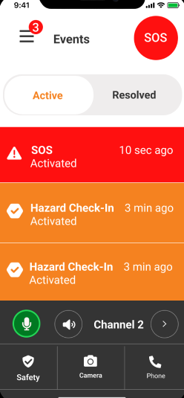






End to end solution
ALERT
DATA
DATA
ALERT
1
2
3
4
5
Frontline worker wearing a RKI device and SCC App
Data shared over
Cellular or WIFI network
Aggregated, contextualized, analyzed in the Guardhat platform
On premise or in the cloud
Aggregated data and alerts shared via
Intranet or Internet
Notification received via SCC, Email, SMS, Phone

Slide 10
Target corporations & Managers
If the corporation has a digital transformation group and safety officer its more likely they will be interested in connected worker
ASSP membership indicates they have a higher level of safety and would be a good fit
Sites where major incidents have occurred or lawsuits
Corporations with high ESG (Environmental, social, governance) goals will also typically have high HSE targets
Social – This includes activities focused on Employee Relations, Working Conditions, Health and Safety, Data Security, Diversity, and Community Relations.
https://www.investors.com/news/esg-companies-list-top-100-esg-stocks-2022/

Slide 11

The Sale
Gather all decision makers and influencers into the same meeting to review the value each one will receive
Operations is key decision maker so they need to receive the most value
Focus on the key needs from each member of the group without going into the full offering – keep it simple !
Don’t bring in IT at the beginning, possibly not digital transformation either as they can be a barrier if IT language / value not transferred properly
As the flexibility of the software is superior to competition IT and digital transformation will be a big ally
Bring in Gaurdhat – when digital transformation or IT gets involved

Slide 12
Barriers of Adoptance
Challenge | Solution
The area requires Intrinsically safe equipment | Intrinsically safe phone running the SCC app, intrinsically safe iPad or iPhone case
The decision maker does not understand the value of the solution | Show value calculator and value of solution
The company does not have a group that can effectively do monitoring | Offer RKI 3rd party monitoring solution
Connected solutions are too expensive | Show value of solution for productivity and safety
Union does not want worker tracked | Utilizing privacy methods through guard hat solution - assure them worker is protected when needed but data is private
I don’t want my data going off site | On premise solution
As a IT, digital transformation or innovation manager I see value in this solution but I don’t have budget | Focus on safety group that has gas detector budget & include the digital groups in conversation for extra value as well as operations from a productivity standpoint
Cell phone signal loss | Industrial WIFI on site as back up. The gas detector will still work as well as monitoring for falls during an outage. The safety solution is supplementary
Existing connected safety program caused unexpected costs | show all pricing with no hidden fees. show value calculators
Emergency response team is not close enough for worker incident | The incident will be replicated on the app for workers that are nearby “nearby worker feature” so they can help assist with the incident
Worker is in extremely remote location and only satellite will work | ISC and Blackline have a solution. RKI does not have this solution today.

Slide 13
Safety Discussion
 | Safety Manager / IH | Emergency Response Manager | Questions to ask
Proactive safety management | Through data analytics review understand what incident trends occur to create a proactive safety environment | Understand where incidents are occurring, what are the trends to better prepare your teams to be proactive | Are you struggling keeping up with safety incidents. Would you like to move to a more proactive approach.
Worker incident Management | Your workers are better protected knowing that they can be quickly located when an event occurs | Quickly locate an isolated worker during a panic alarm, gas alarm, fall/no motion or other optional incidents | Have you had near miss incidents where a worker was injured but no one was around to assist
False Alarm reduction | With three alarm levels and the first alarm being a warning trust in the system is increased and workers want to use the device | Costly false alarms are highly reduced with 3 alarm states | How many false alarms does your team mange and how much time and money is wasted
Worker incident local management | When an alarm is activated all devices in the area activate so local workers can assist with the incident | When an alarm is activated all devices in the area activate so local workers can assist with the incident | Have you had near miss incidents where a worker was injured and there were other workers near but they were not aware
Lone worker monitoring | Keep track of lone workers and understand if incidents are occurring in near real time | Keep track of lone workers and understand if incidents are occurring in near real time | Have you had situations where emergency response teams are deployed but there was not an issue
Evacuation management | Monitor workers as they evacuation to make sure they are safe | Monitor workers as they evacuation to make sure they are safe | Have you had situations where workers are evacuating but they are severely delayed so emergency response teams are deployed without a real issue being present

Slide 14
Safety Discussion
 | Safety Manager / IH/ Emergency response manager | Questions to ask
Wear in breathing zone | Is the device you use today too bulky to properly protect the worker | Does your workforce need to wear their gas monitor too far away from the breathing zone as its too bulky
Worker Area restriction | Restrict contractors or guests from certain work areas. | Have you had situations where guests or contractors entered a restricted area and you were liable
Runtime | With the longest runtime in its category the GX-3R Pro can be always worn and protecting the worker during their shift event in extreme weather conditions | Do you have situations where workers are not protected because of their gas detector battery life. Does cold weather severely deplete your gas detector battery
Quick incident investigation | With Bump, Calibration and all data log information brought into one central location investigations can be performed more quickly | How many hours do you spend investigating an incident
Easy compliance auditing | With Bump and Calibration information brought into one central location compliance auditing can be performed more quickly | How many hours does it take to manually pull all your bump and calibration data from docking stations

Slide 15
Productivity & Efficiency Discussion
 | Operations manager / COO | Service Manager | Questions to ask
Low cost of operation (sensor costs, calibration station cost, gas detector costs, Gas usage) | Operations costs are quite large for gas detection fleets. RKI offers the lowest cost of operation with sensor replacement, Calibration station, gas detector pricing as well as low test gas usage. | Operations costs are quite large for gas detection fleets. RKI offers the lowest cost of operation with sensor replacement, Calibration station, gas detector pricing as well as low test gas usage. | How much does it cost to operate your gas detection fleet today
Remote collaboration with video, audio & text | With video, audio and text remote experts can collaborate with the worker making them more efficient |  | How many more projects can be conducted with your most knowledgeable experts remotely giving experience to your work force
Work process management | Images can be uploaded into the database expediting the repair, auditing or maintenance process. |  | How many hours are wasted manually documenting your maintenance and repair process.
Real time information & documentation | Transfer documents and images to worker in real time to increase their efficiency |  | How much time is wasted manually sending out documents and images to your workers
Worker efficiency management | Understand if your team or workers are in the productivity zone and what challenges they face. |  | How many hours are wasted by your contractors

Slide 16
Productivity & Efficiency Discussion
 | Operations manager / COO | Service Manager | Questions to ask
False alarm reduction | With a third warning alarm the worker and personnel in the area are notified reducing false alarms to emergency response personnel |  | How much money and hours are wasted with false alarms for your corporation
Remote CSE | CSE readings can be transmitted back to the control room |  | Would you like the CSE data monitored in the control room
Ultra rugged detector design | With the ultra rugged design less failure occurs and operations run more efficiently | With the ultra rugged design less failure occurs and less maintenance is required | How often do you replace gas detectors because they have broken
Runtime | With the longest run time in its category your work force is more efficient and down time is reduced. |  | How many hours of downtime occur each year when gas detectors
Flexible Power options | With Li-ion & alkaline battery options there is no downtime associated with your team forgetting to charge |  | How many hours of downtime occur each year when batteries are not charged
Silicone resistant sensor | With the silicone resistant filter less sensor failure occurs and operations run more efficiently | With the silicone resistant filter less sensor failure occurs and less maintenance is required | How many hours of downtime occur each when LEL sensors fail

Slide 17
Digital and Data Analytics
 | Digital Transformation | IT | Union / HR | Questions to ask
Data Encryption | Apple IOS and Android have a high level of data encryption | Apple IOS and Android have a high level of data encryption |  | Are you concerned about the security of your edge devices
Audio Visual text, Gas, worker location Integration | Ingest various pieces of digital information into your data ecosystem and create efficiencies |  |  | Are you concerned your digital ecosystem is not fully being utilized
Data Analytics | Utilize the data to run reports and identify trends to increase your safety proactively |  |  | Does your safety group need to understand trends to become more proactive
Worker privacy |  |  | Restrict data access to the worker in certain areas | Can you restrict the privacy level with the connected safety program you use today
Flexible data center options (cloud / on premise) |  | Reduce security concerns with flexible cloud or on premise solutions |  | Are your concerned your data in the cloud can get accessed
Future connected safety solution expansion |  |  |  | Are you concerned your connected safety program is not evolving fast enough
Cyber security compliance | The solution is SOC II Type 1 & SOC II Type 2 compliant | The solution is SOC II Type 1 & SOC II Type 2 compliant |  | Are you concerned about the security of your database
Application Programming interface and Software Development Kit | Flexible software options to ingest data or customize for your application | Flexible software options to ingest data or customize for your application |  | Would you like to make data ingestion more efficient or customize for your interface

Slide 18
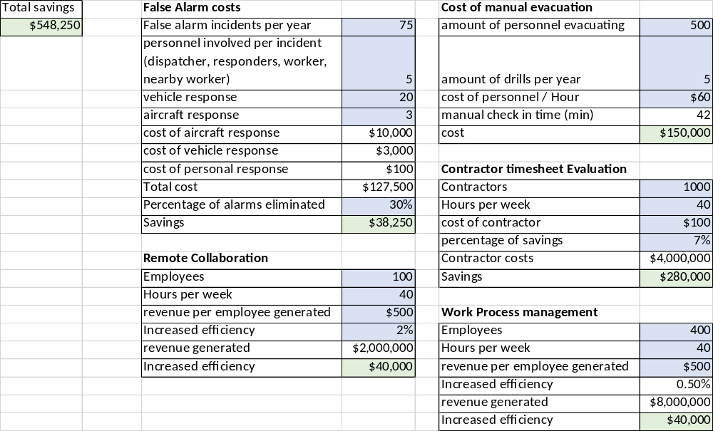
Value Calculator

Slide 19
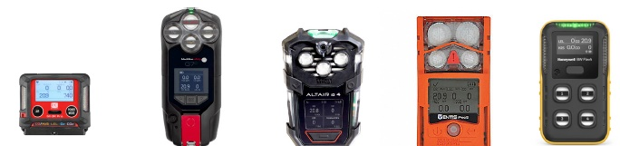
Competition – Solution
Solution Value | RKI GX-3R Pro | G7 Blackline safety | MSA Altair IO4 | ISC Ventis Pro 5 | Honeywell BW Flex
Worker incident Management with location | Yes | Yes | Yes | Yes | Yes
Remote collaboration with video, audio & text | Yes | Partial (Audio and text) | No | No | Partial (audio only through cell or Motorola radio)
Work process management | Yes | No | No | No | No
False Alarm reduction | Yes | Partial (Yellow alarm) | No | No | No
Biometrics, Collision avoidance, Radiation | Yes (optional) | No | No | No | No
Wear in breathing zone | Yes | Extremely difficult | Difficult | Difficult | Difficult
Worker Area restriction | Yes | No | No | No | limited
Worker Privacy | Yes | No | No | No | No
Flexible Data center options | In cloud or on premise | Cloud only | Cloud only | In cloud or on premise | In cloud or on premise
Worker productivity | Yes | Yes | No | (partial) | No
Worker incident local awareness | ,Yes | No | No | Yes with LENS | No
Low cost of ownership | Yes | No | No | No | No
Runtime | 23 hours Li-Ion or Alkaline | 18 hrs Li-Ion | 20 hrs Li-Ion & Alkaline | 18 hrs Li-ion | 15 hrs Li-ion
Size | 2.9 x 2.6 x 1.0” | 5.8 x 3.3 x 1.6” | 6.6 x 3.4 x 1.7” | 4.4 x 3.0 x 1.4” | 4.2 x 2.4 x 1.7
Weight | 4.58 oz | 14.5 oz | 16 oz | 8 oz | 6.7 oz

Slide 20
Competition – Pricing
Solution | RKI GX-3R Pro | G7 Blackline safety | MSA Altair IO4 | ISC Ventis Pro 5 | Honeywell BW Flex
Product List price | $795 (O2, LEL, CO, H2S) + cellular device | $821 (O2, LEL, CO, H2S) 2 year warranty + system access | $0 (O2, LEL, CO-H2, H2S) Minimum 3 year contract | $1739 (LEL, CO, H2S, O2) | $510 (O2, LEL, H2S, CO) + cellular phone
Level 1 | Safety Compliance $360 [Real-time readings w/ geolocation, management, worker area restriction, Reduced false alarms, Local incident awareness, protection in breathing zone, easy panic activation, Man down / no motion ] | System Access [Real-time readings w/ geolocation. Fall/no motion detection, SOS latch, OTA updates, compliance dashboard, live location, analytics and reporting interface, cloud based platform] $93 Optional push to talk | Starter $264 / Yr (3-year contract) [Real-time readings w/ geolocation, OTA updates, MSA IS digital device assignment, fleet cloud configuration, 90 days cloud logs] | iNET Now $25 [Real-time readings w/ geolocation, Compliance dashboard / reporting & reminders Automatic, recurrent compliance reports Fleet management Mustering, mass notification, Limited geofencing, man down, SOS, preprogrammed text messaging. | Connected Worker $420 [Real-time readings w/ geolocation, two-way audio through cell or Motorola radio, Bump test, calibration reporting & reminders Compliance dashboard Automatic, recurrent compliance reports Plume modeling Fleet management, limited geofencing
Level 2 | Productivity (Self monitoring) $550 [remote collaboration, two-way voice and video calling, work process management with media library, walk path tracking] | Real-Time safety (self monitored) $330 Custom emergency response protocols, Fall detection, no motion check in system, Mass notification and two way messaging, Base blackline analytics $93 Optional push to talk | Standard $420 Starter + fleet manager dashboard, streamlines device compliance, fleet manager reporting, dock monitoring] | N/A | N/A
Level 3 |  |  | Complete $576 [Standard + full event live monitoring ,event management ]
Level 4 | 24/7 monitoring service $670 3rd party monitoring service [experience monitoring police and fire services] | Real-Time safety (Blackline monitored) $501 Trained responder, 24/7, year round monitoring coverage, 99.5% response time in under 60 seconds $93 Optional push to talk | N/A | 24/7 Professional Monitoring $XX | N/A

Slide 21
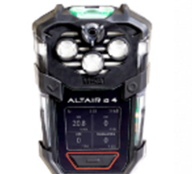
Objection Handling
MSA Altair IO4
Competitor Value | Counter statement
Onboard connectivity with gas monitoring, fall detection & panic alert through self monitoring software and compliance levels (bump and calibration) | The cellular signal from the cell phone is identical to the signal from the Altair IO4. there are many safety and productivity advantages the RKI safety solution has and the solution is growing
Tough | The GX-3R Pro has been drop-tested from over 23 feet. It can handle the rugged conditions of your work environment
Over the air updates | How many times has your corporation changed alarm setpoints.
Small, light weight 4 gas solution | The GX-3R Pro can do 4 gasses and up to 5 gasses. The weight is ¼ so does not burden the worker. Lays flat against the worker. With the silicone resistance LEL sensor less down time occurs.
Find lost device | SCC app will notify when the GX-3R Pro is away from the phone. Approximately 10% of devices are lost each year but this is typically the standard single gas and 4 gas compliance models. Higher more costly solutions are not typically lost because of their value
Self monitoring solution through software | RKI offers a self monitoring solution as well as a 3rd party 24/7 monitored solution
Gas replenishment program | Our gas costs are much lower than MSA

Slide 22

Objection Handling
BW Flex
Competitor Value | Counter statement
Maintain real time awareness of worker location and alarm status of gas alarms (Motorola network) or (connectivity through cell and app) | Only works with 1 style of Motorola radio and it is $3000 - $4000 for the device. Only gas alarms are monitored and there are only 2 alarm levels so high possibility of false alarms high false alarm rate can lead to very costly evacuation management or alarm fatigue as its not trusted. There is no fall or no motion detection
Use a single device for voice and data communications | The cell phone with safety app has video, voice so worker productivity and safety can be performed but there is no interlink between a group of users like the RKI solution
Honeywell safety suite displays worker location and sensor status | This solution only is for gas detection. No fall or no motion capability. No other PPE is planned
Group communications | This can be conducted on the safety app
Detects lost connection | The SCC app also will detect when the GX3R-Pro is outside of Bluetooth range

Slide 23
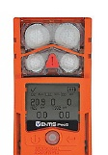
Objection Handling
ISC Ventis Pro 5
Competitor Value | Counter statement
Respond quickly and effectively in an emergency with gas detection alarm, fall/no motion and panic alarm. | iNET Now only offers worker location with 2 gas alarms, fall / no motion detection and panic alarm. There is no video, audio, remote worker collaboration. 2 alarms can lead to high false alarm rate and very costly evacuation management or alarm fatigue as its not trusted
Automatically trigger a tailored response to alerts with 24/7 Professional Monitoring. | RKI now has a 3rd party monitoring solution
Respond faster in an emergency with live map that shows where workers are located | Similar functionality with SCC
Create a map of work zones and allow operators to customize alerts for each zone. | The RKI solution can do the same as well as privacy zones and can be sued for evacuation management
Instantly verify worker status without burdening or distracting them with manual check-ins with zones | Evacuation, blackout privacy, worker productivity and worker restriction zones are available. Soon PPE compliance with 3M
See a visual summary of areas where gas alarms have occurred. | Similar functionality with SCC
Get real-time text and email alerts, so you know when and where you're needed. | Similar functionality with SCC
Monitor contractors during a turn around and learn from their pattern to plan future turnarounds | Similar functionality with SCC
Wi-Fi cellular, satellite, peer to peer ad-hoc networks | There has been minimal deployment for industrial Wi-Fi
Proactive safety | Similar functionality with SCC
Establish work zones to gather real-time insights about occupancy and entry. | Similar functionality with SCC
Remote locations via satellite and Wi-Fi gateways | This is a very small market that is extremely remote applications

Slide 24
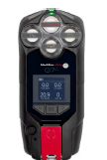
Objection Handling
Blackline safety G7
Competitor Value | Counter statement
G7 multi-gas connects in seconds without the need for any expensive, intrinsically safe smart phones, apps, hidden subscription costs or added infrastructure. | The price to roll out the G7 is quite expensive and the price is going up. If the customer already has a cell phone the cost is already there and with remote collaboration via video, more robust data integration at customer site, lower cost of ownership, expandable connected worker ecosystem RKI is the right approach
SOS latch | It is much harder to pull a latch vs double tapping the GX-3R Pro
Pre-calibrated sensors with scalable platform | Sensors cannot be changed individually so large cost. Changing and calibrating a sensor on the GX-3r Pro is lower cost
Connected safety device – Single gas, multi gas and Area monitor | The RKI solution has the flexibility to offer multiple types of single gas, Multigas, compliance solutions to fit all the customers needs as well as connected safety devices
Find lost device | SCC app will notify when the GX-3R Pro is away from the phone. Approximately 10% of devices are lost each year but this is typically the standard single gas and 4 gas compliance models. Higher more costly solutions are not typically lost because of their value
Audio push to talk feature | The push to talk feature is not equivalent to voice on a cell phone
Built-in cellular connectivity, with optional satellite and portable bridge, for remote or hard-to access locations | Extremely remote locations are very small part of customers operations
Location technology including geo-stamped alert status from any Internet-connected device | Cellular location is +/- 10 feet location which is more precise
Direct-to-cloud data streaming to Blackline Live software platform for real-time information at your fingertips | Safety control center operates in the cloud with multiple instances as well as has on premise capabilities
our cloud-connected G7 multi-gas detector has built-in layers of communication to send an alert during an incident. When paired with 24/7 live monitoring, it’s the critical lifeline to your people for the help they need during an emergency, health event, dangerous situation and more. | RKI now offers monitoring solutions
Data Analytics | Similar with SCC

Slide 25
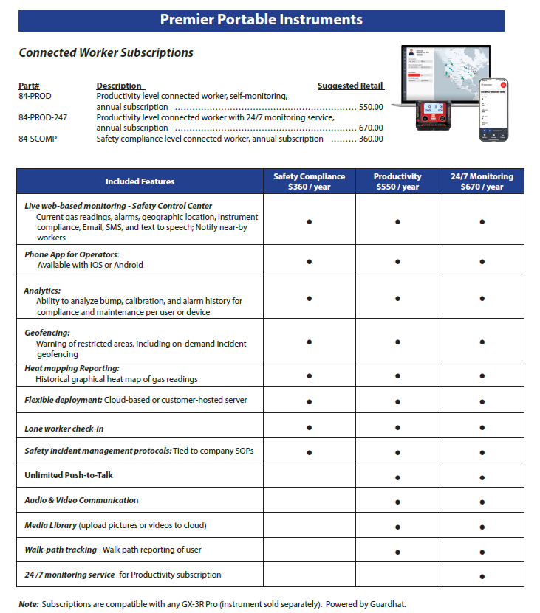
Pricing & part numbers

Slide 26

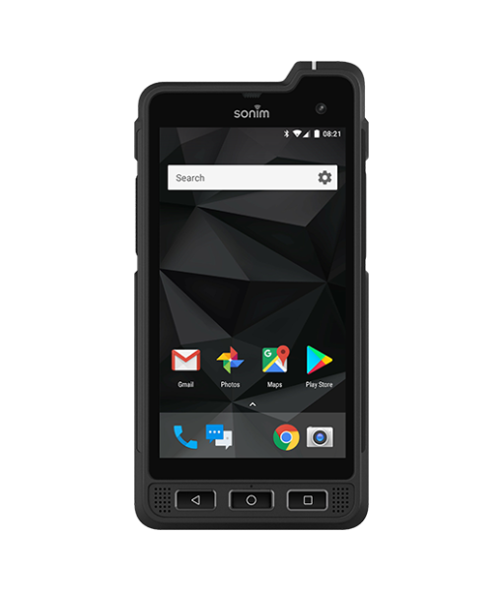
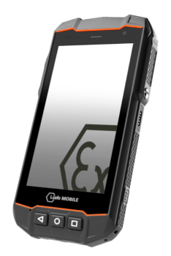

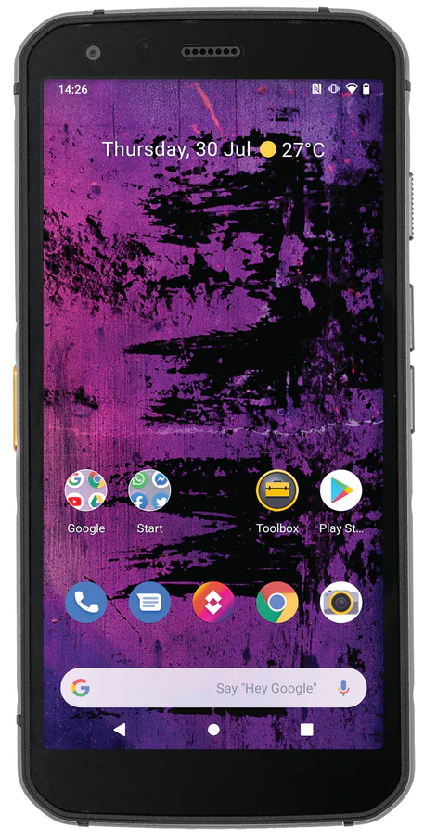
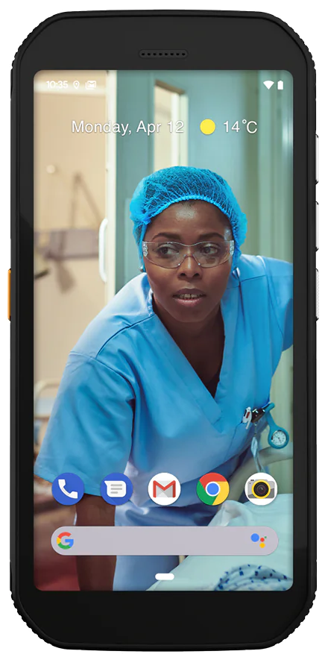
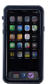
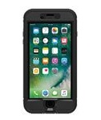
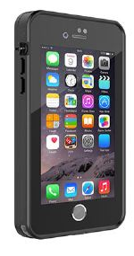
Device Compatibility
Iphone
11-13, and iOS 15.6 and up
Sonim XP8 & XP10
Android
Intrinsically Safe Device
i.Safe IS530
Android
Intrinsically safe device
Nokia XR20
Android
Cat
S62 Pro
Android
CAT
S42 H+
Android
Iphone
Intrinsically Safe cases
$700 -$850
https://intrinsicallysafestore.com/product-category/mobility/intrinsically-safe-cases/
https://www.xciel.com/rugged-iphones
https://www.orioncase.com/product-category/intrinsically-safe-mobile-device-cases
Iphone 12 IS case
$725
https://www.orioncase.com/product/iphone-12-case-c1d2
Iphone XR IS case
$685
https://www.orioncase.com/product/iphone-xr-case-c1d2
Iphone 11 IS case
$725
https://www.orioncase.com/product/iphone-11-case-c1d2

Slide 27



IIoP Privacy & Security
Designed for GDPR compliance
Data localization and sovereignty: Compliant with data localization requirements by leveraging dedicated instances, data lakes, and resources in every region we operate in
Apple and Google Play store privacy requirements
SOC II Type 1: achieved Dec. 2021
SOC II Type 2: achieved Dec. 2022
Compliance
End-to-end encryption: PSK on Wifi, LTE encryption, HTTPS encryption, SSL encryption, support a wide range enterprise encryption options (PEAP, MS-CHAPv2, etc)
Single tenancy and/or on-prem: Single tenant option for each customer and/or each site to enable full data isolation
Open-source monitoring: Vulnerability Scanning integrated in CI/CD pipeline and dynamically at runtime
Breach and uptime monitoring: Real time SOC monitored by full time staff to monitor all live instances and react in real time to any security concerns
Proxy ID assignments: Ability to associate devices anonymously to individuals, roles, or pseudonyms
Platform design considerations
Role based access control: Accessible via secure User ID, Password, and Encrypted Key as needed for higher levels of administration
Flexible consent process: Customer driven with all data owned by customer, Guardhat exists as a processor only
”Blackout” zone configuration: Ability to set geo-fences that limit or restrict any data capture from devices or people inside them
User controlled audio/video: Only the worker can activate the microphone or video functionality
User features and capabilities

Slide 28





























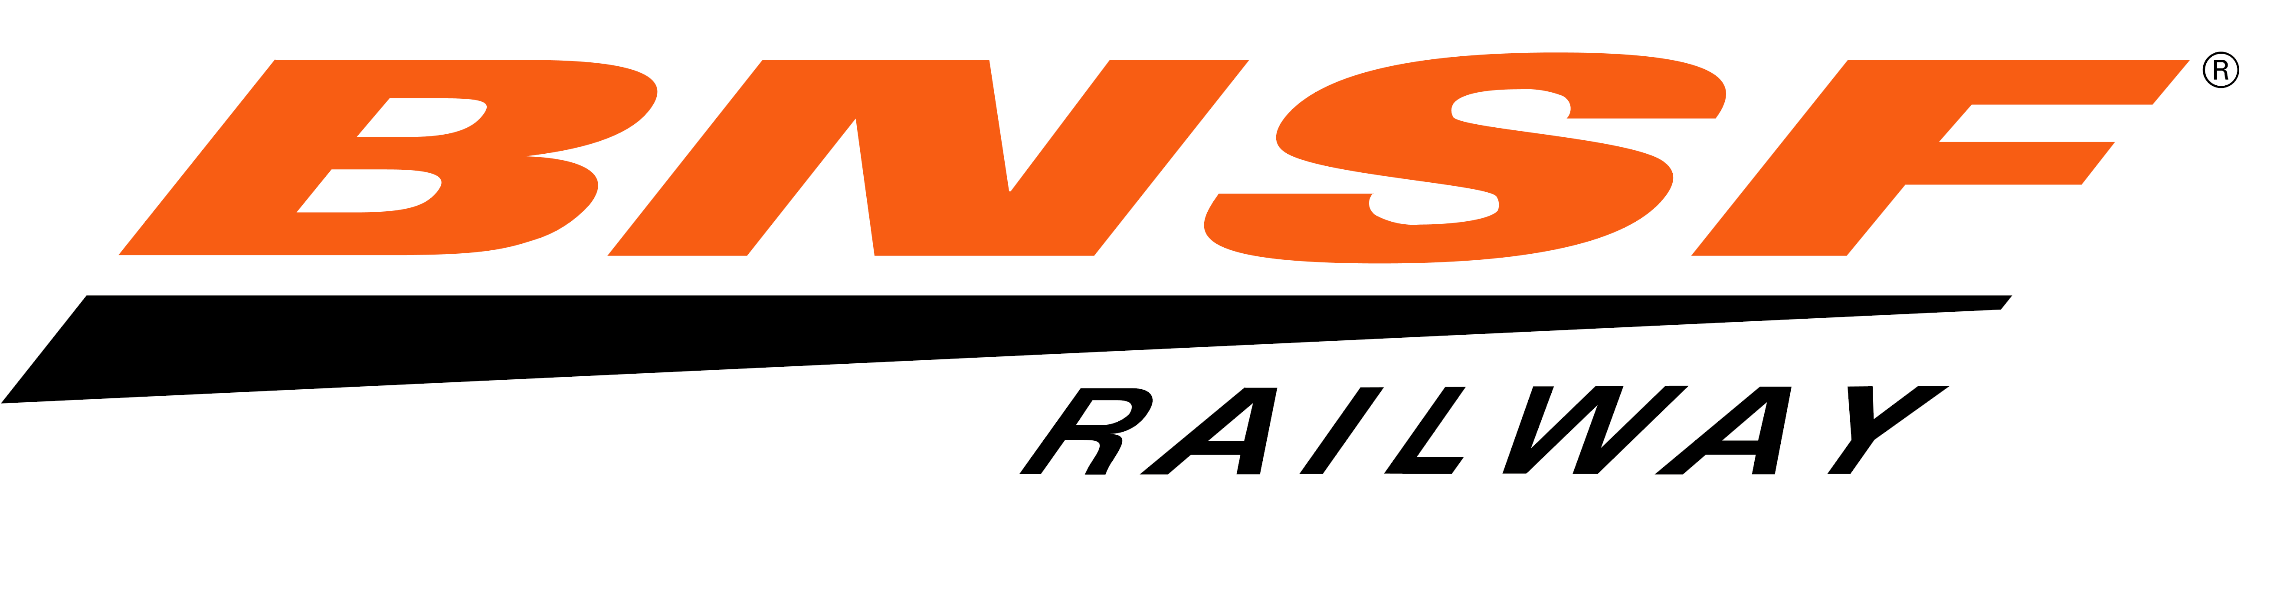


Customers

Slide 29




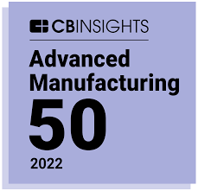
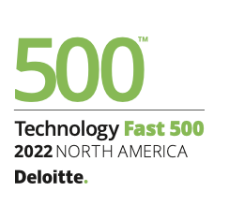





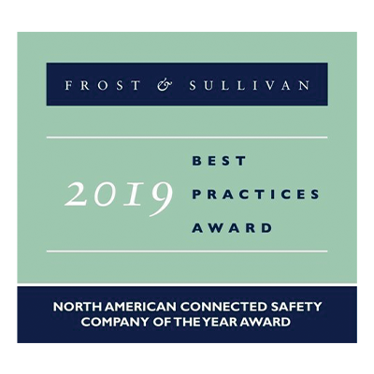




Awards:2019-2022

Slide 30
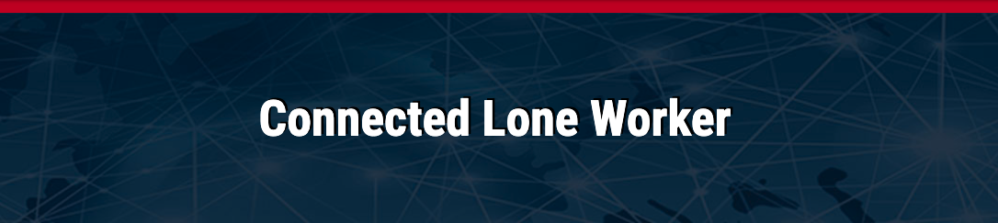
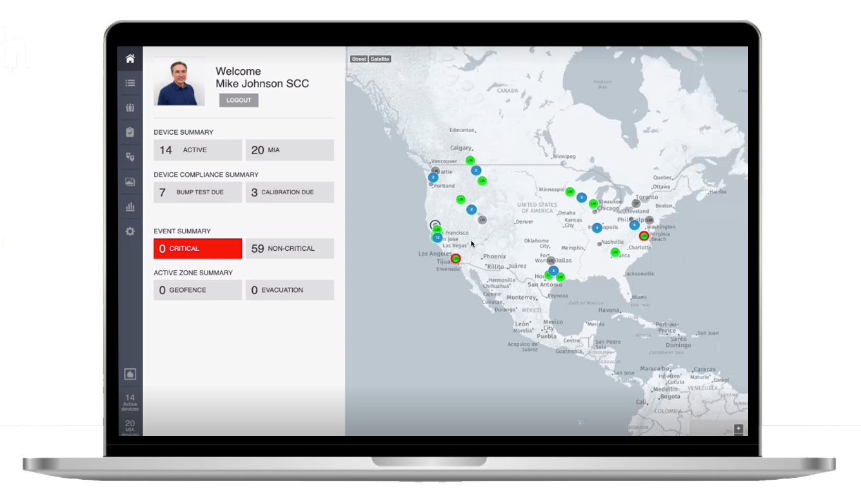

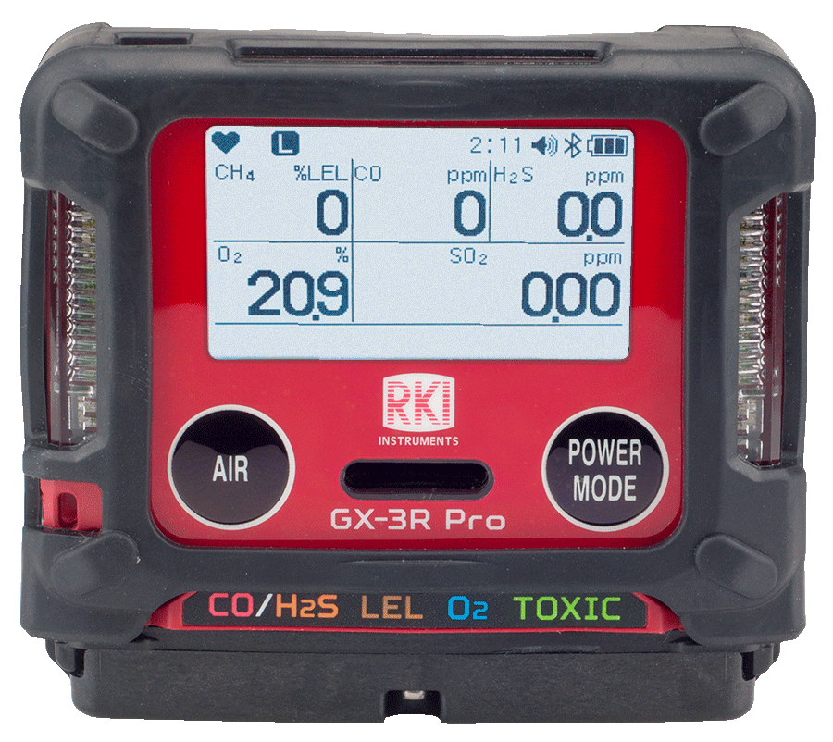

Slide 31
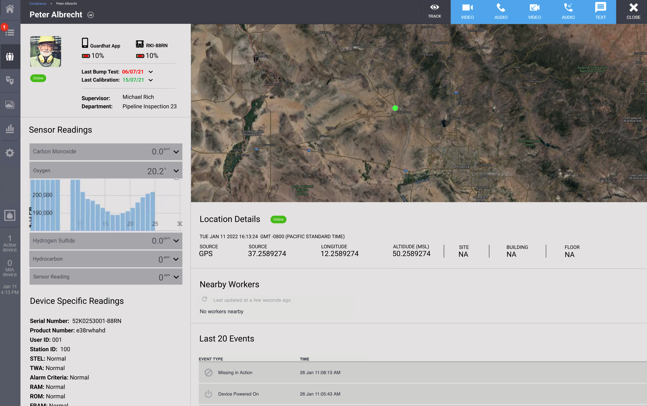
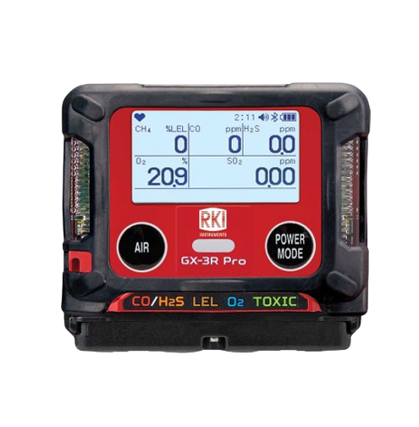



Live gas readings and alerts where and when they matter.
Automate critical
safety alerts and
incident management
Centralize
instrument data
RKI Connected Worker solution
Stay connected to
keep workers safe and
work moving

Slide 32
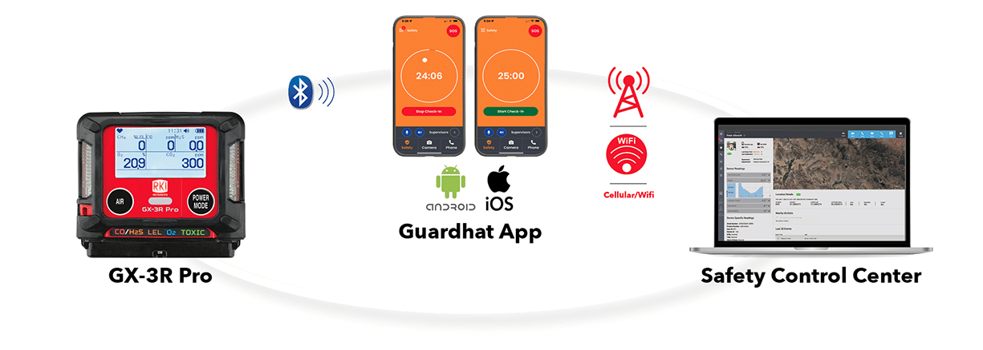

Slide 33
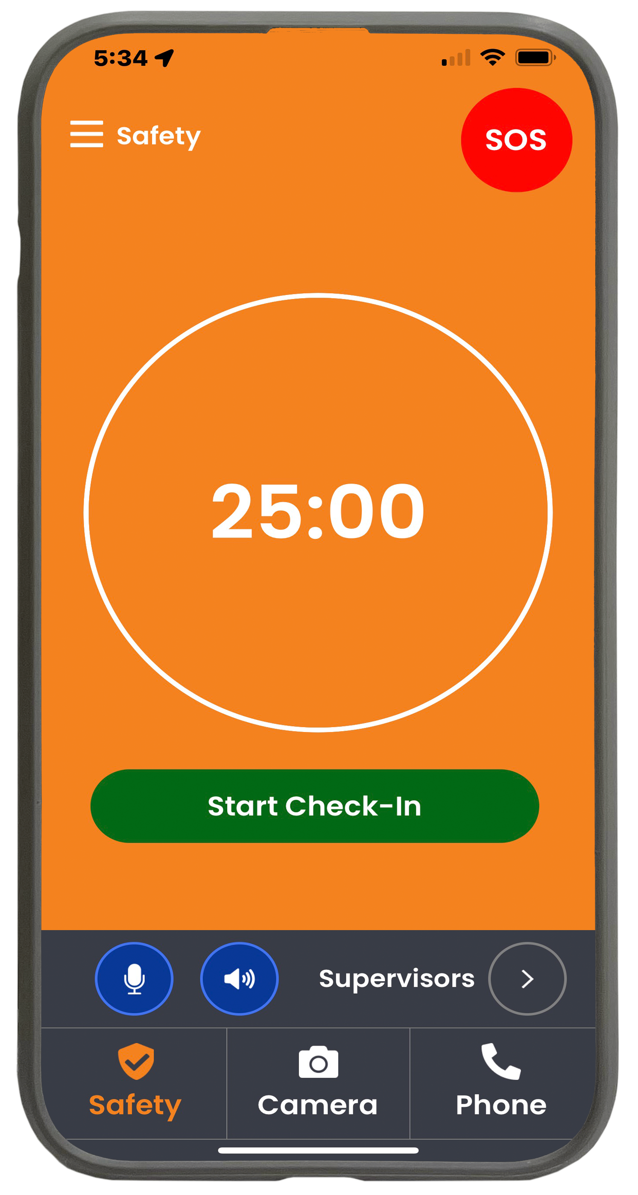
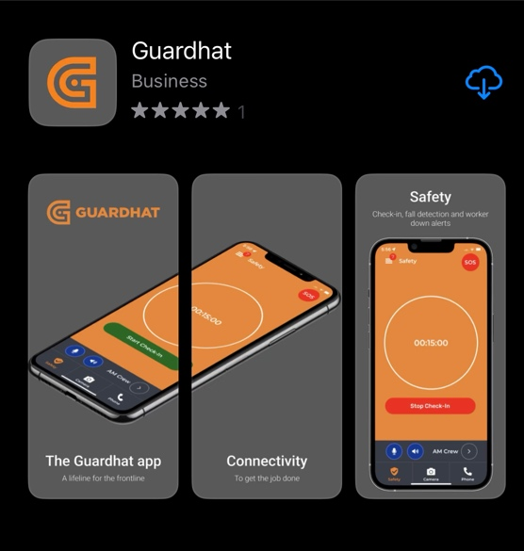

GuardHat App
Settings
SOS Alert
Lone Worker Check in
Push-to-talk
Customize PTP Channels
3 modes

Slide 34
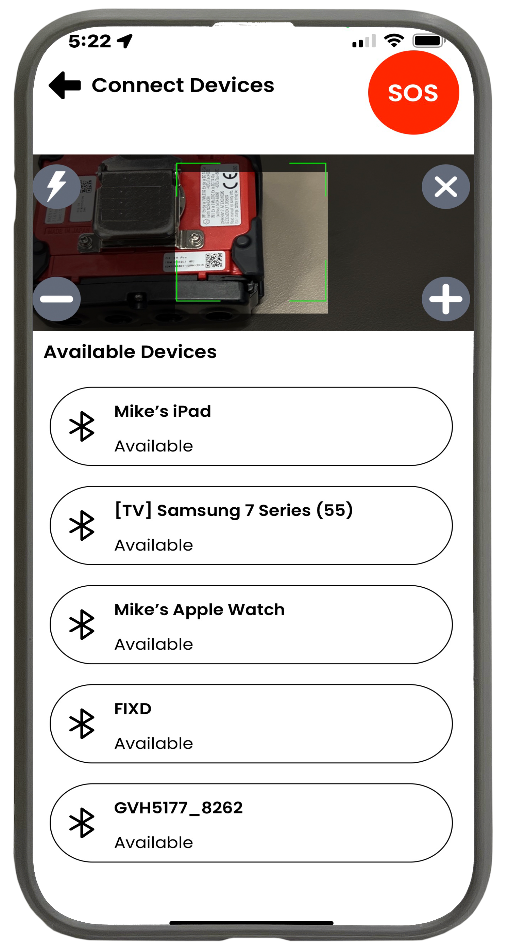
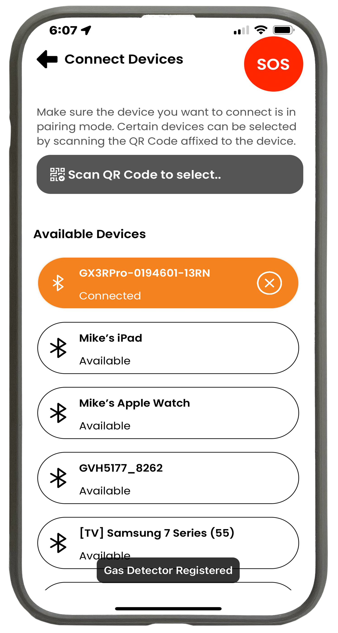
Simple Instrument Pairing
Scan instrument QR code to Pair
Instrument auto-connects after pairing
“GAS DETECTOR CONNECTED”

Slide 35
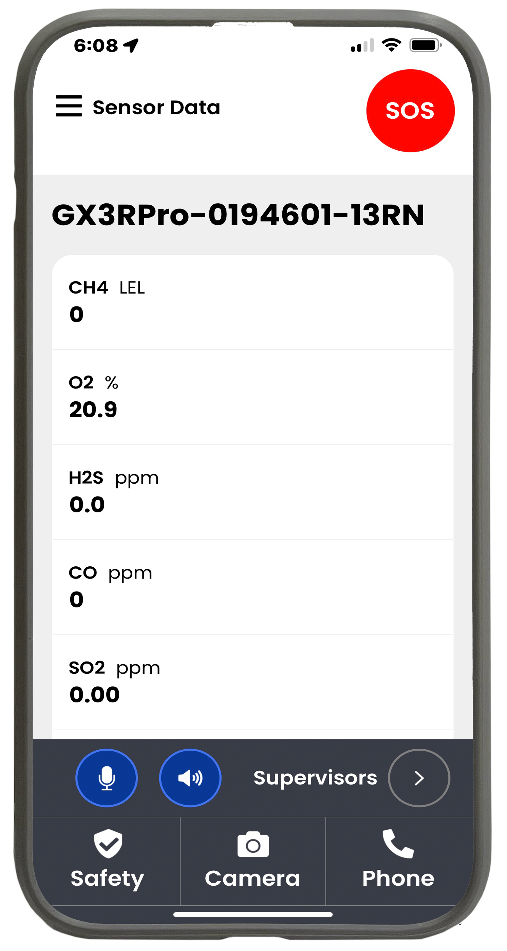
Subscriptions are User Based
Connect to any GX-3R Pro with a User Account

Slide 36
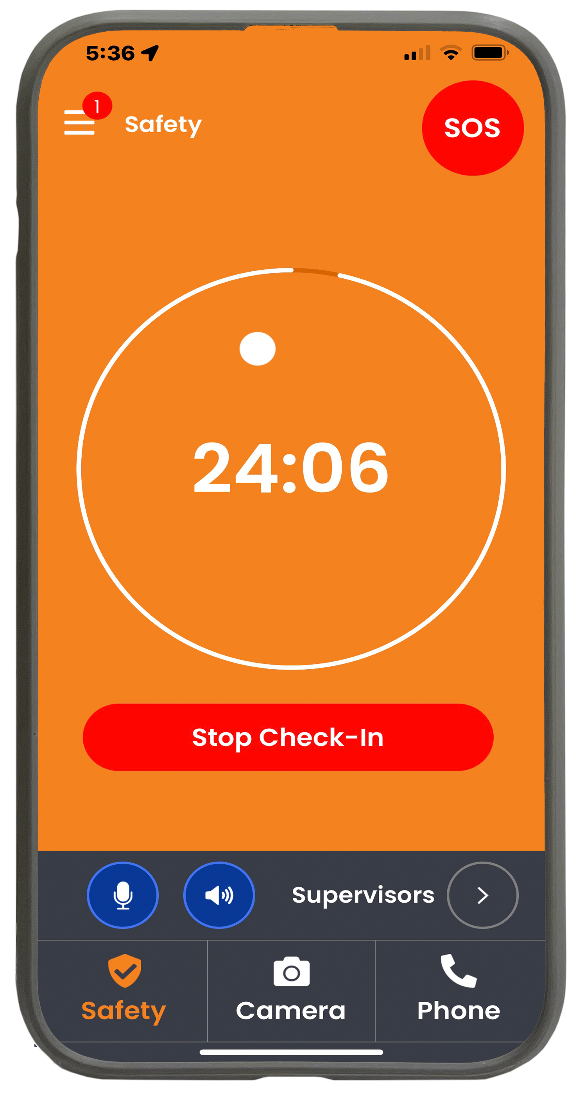
Lone worker with or without gas detection
Monitored check-in

Slide 37
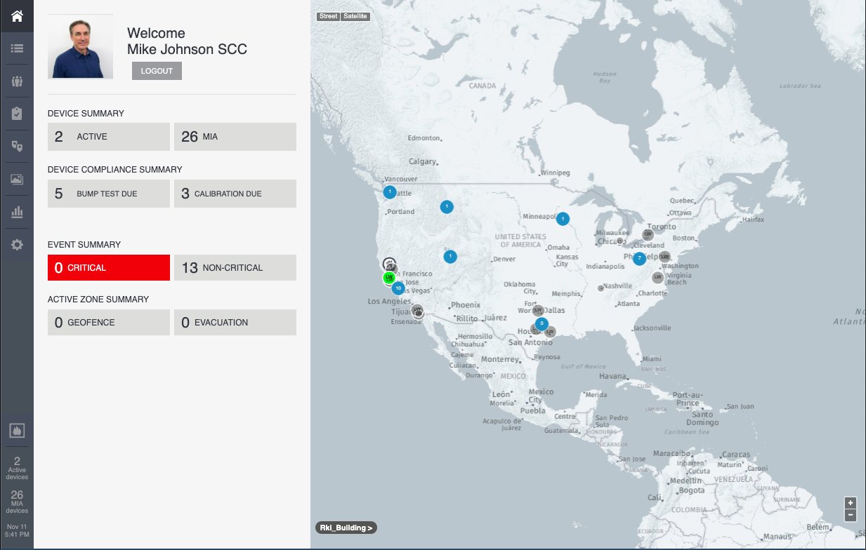
Safety Control Center
Simple Interface
Home
Events
People
Equipment Compliance
Geofencing
Multimedia Gallery
Analytics

Slide 38
Safety Control Center
Dashboard
Active Operators
Out of Compliance Instruments
Current Critical Events
Current Geofences

Slide 39
Safety Control Center
Home Site
Default Map Locations

Slide 40
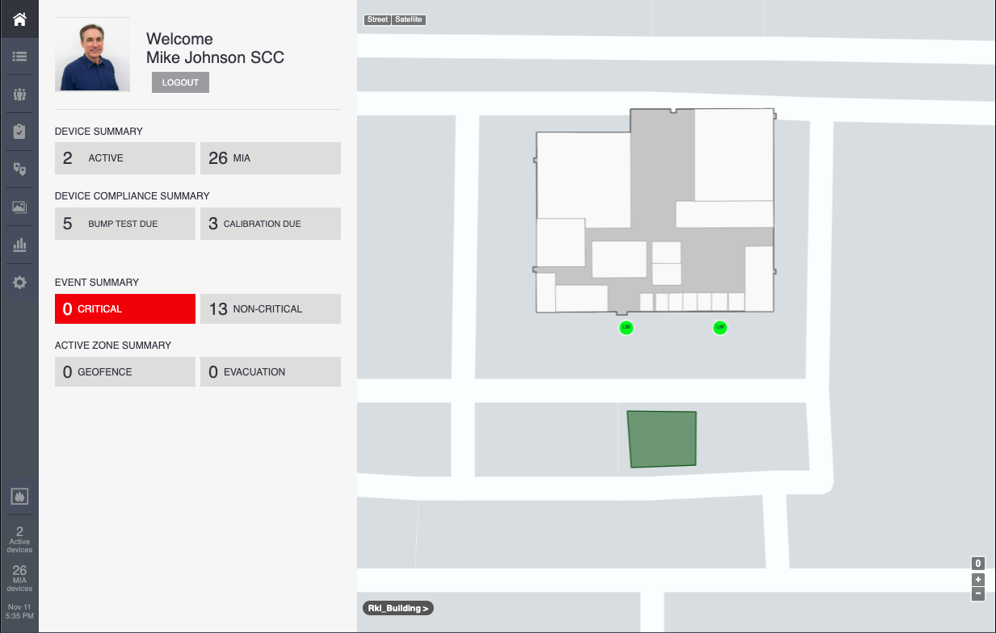
Safety Control Center
Home Site
Facility Floor Plans
Street View
Evacuation Geofence

Slide 41
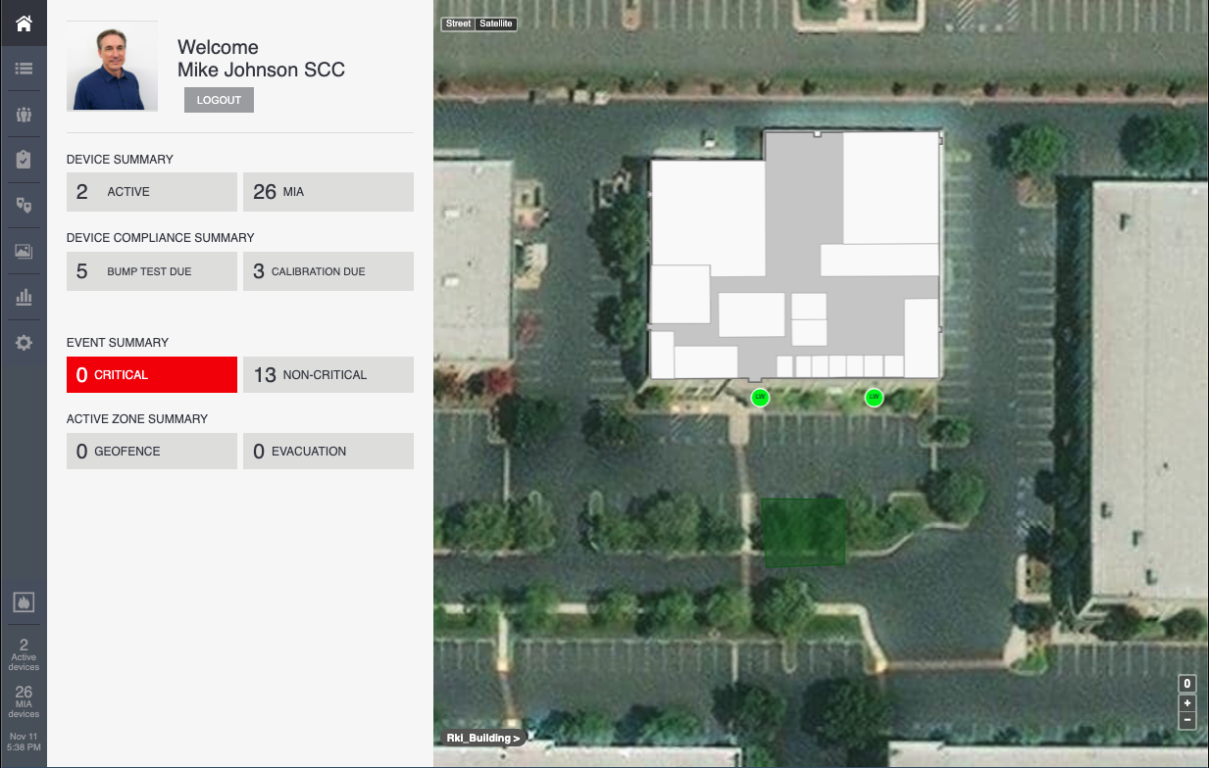
Safety Control Center
Home Site
Satellite View

Slide 42
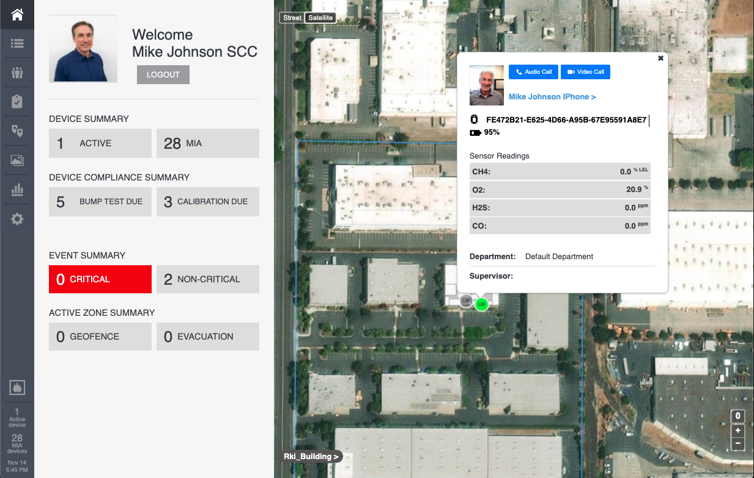
Safety Control Center
Home Site
Operator Detail
Live Geographic Location
Live Gas Sensor Readings
Audio / Video Calling

Slide 43
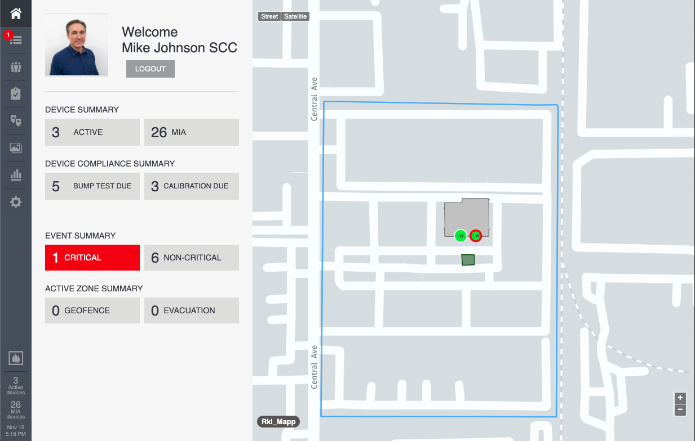
Safety Control Center
Home Site
Critical Alert Highlights

Slide 44
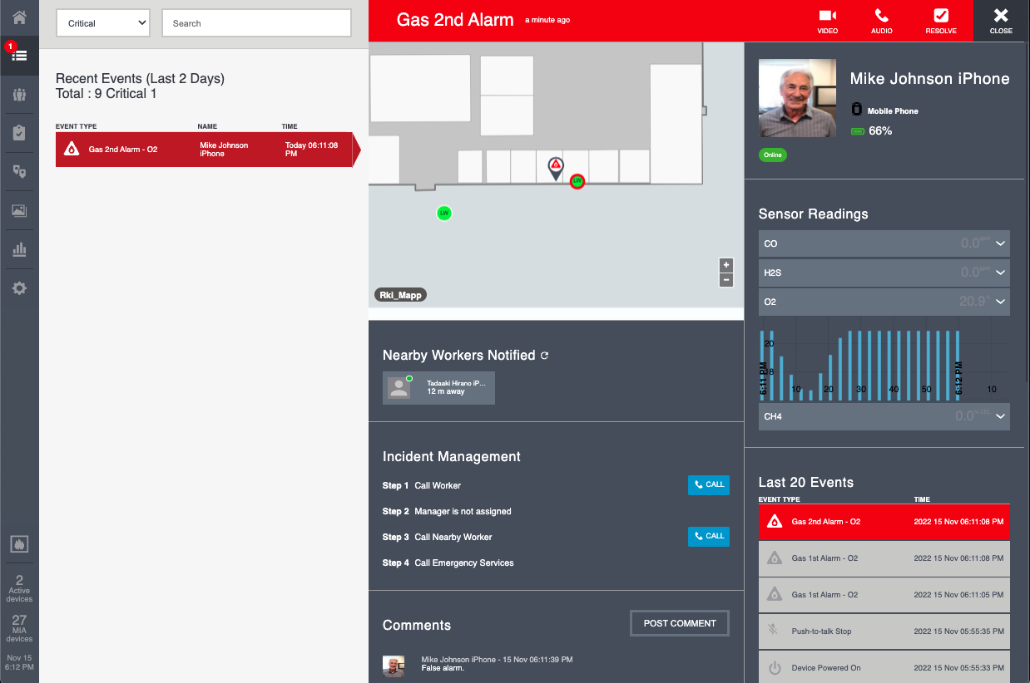
Safety Control Center
Alert Types
Gas Alarms
Panic Alarms
No Motion Alarms
Fall Detection
Lone worker missed check-in
SOS Alerts

Slide 45
Safety Control Center
Critical Alerts
Geographic location

Slide 46
Safety Control Center
Critical Alerts
Audio/Video Comms

Slide 47
Safety Control Center
Critical Alerts
Identify, alert, or contact nearby workers

Slide 48
Safety Control Center
Critical Alerts
Custom Incident Management Protocols

Slide 49
Safety Control Center
Critical Alerts
Incident comments from operators or SCC administrators

Slide 50
Safety Control Center
Critical Alerts
Current sensor readings.

Slide 51
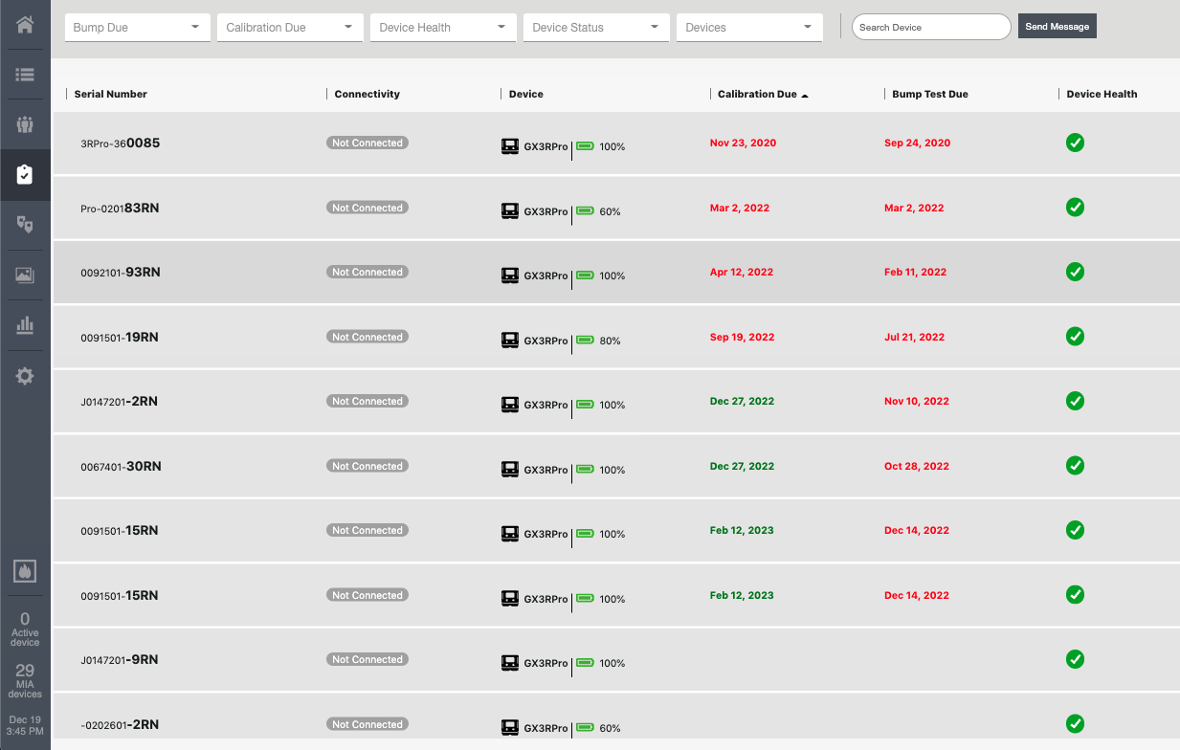
Safety Control Center
Instrument Compliance
Quickly identify instruments out of compliance

Slide 52
Safety Control Center
Instrument Compliance
Filter or search records

Slide 53
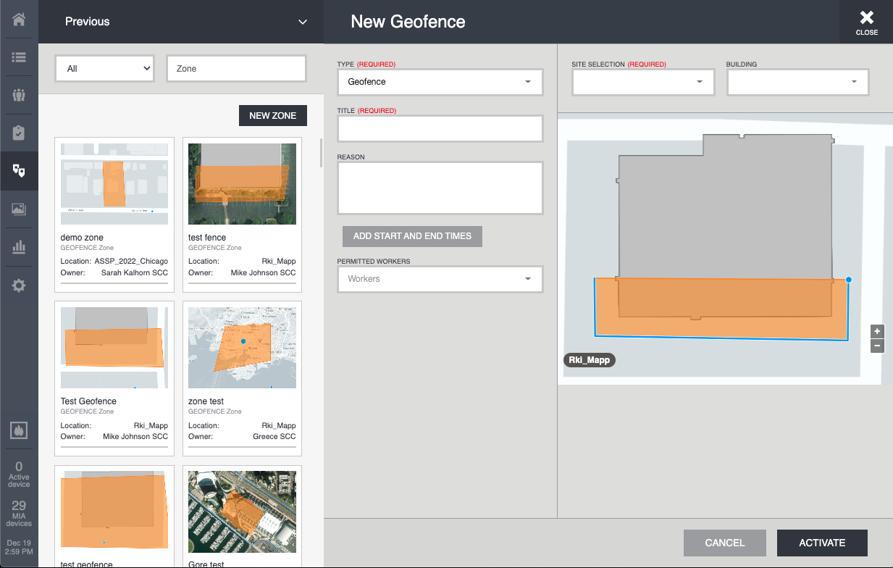
Safety Control Center
Geofencing
Create on Demand

Slide 54
Safety Control Center
Geofencing
Easily draw fence

Slide 55

Safety Control Center
Geofencing
Multiple Zone Types

Slide 56

Safety Control Center
Geofencing
Specify Start/Stop Times

Slide 57
Safety Control Center
Geofencing
PPE Compliance Zones

Slide 58

Safety Control Center
Media Gallery
Operators can upload field images / videos

Slide 59
Safety Control Center
Media Gallery
Stored by operator with location info

Slide 60

Safety Control Center
Analytics
Wide range of reports & filters

Slide 61

Safety Control Center
Analytics
Zoom in to get detail data points

Slide 62
Safety Control Center
Analytics
Download spreadsheets or screen shots of data

Slide 63

Safety Control Center
Critical Alerts
Automated Text / Email notifications with alarm and location info
Critical Event at rki-demo.guardhat.net instance:
Event Summary:
Type: Gas 2nd Alarm
Device: Mike Johnson iPhone
Event Time: 2022-11-15 17:24:25.654000Z PST
Event Status: ACTIVE
Location: https://www.google.com/maps/dir//37.599365234375,-122.03602482195842

Slide 64

Questions?

