Slide 1
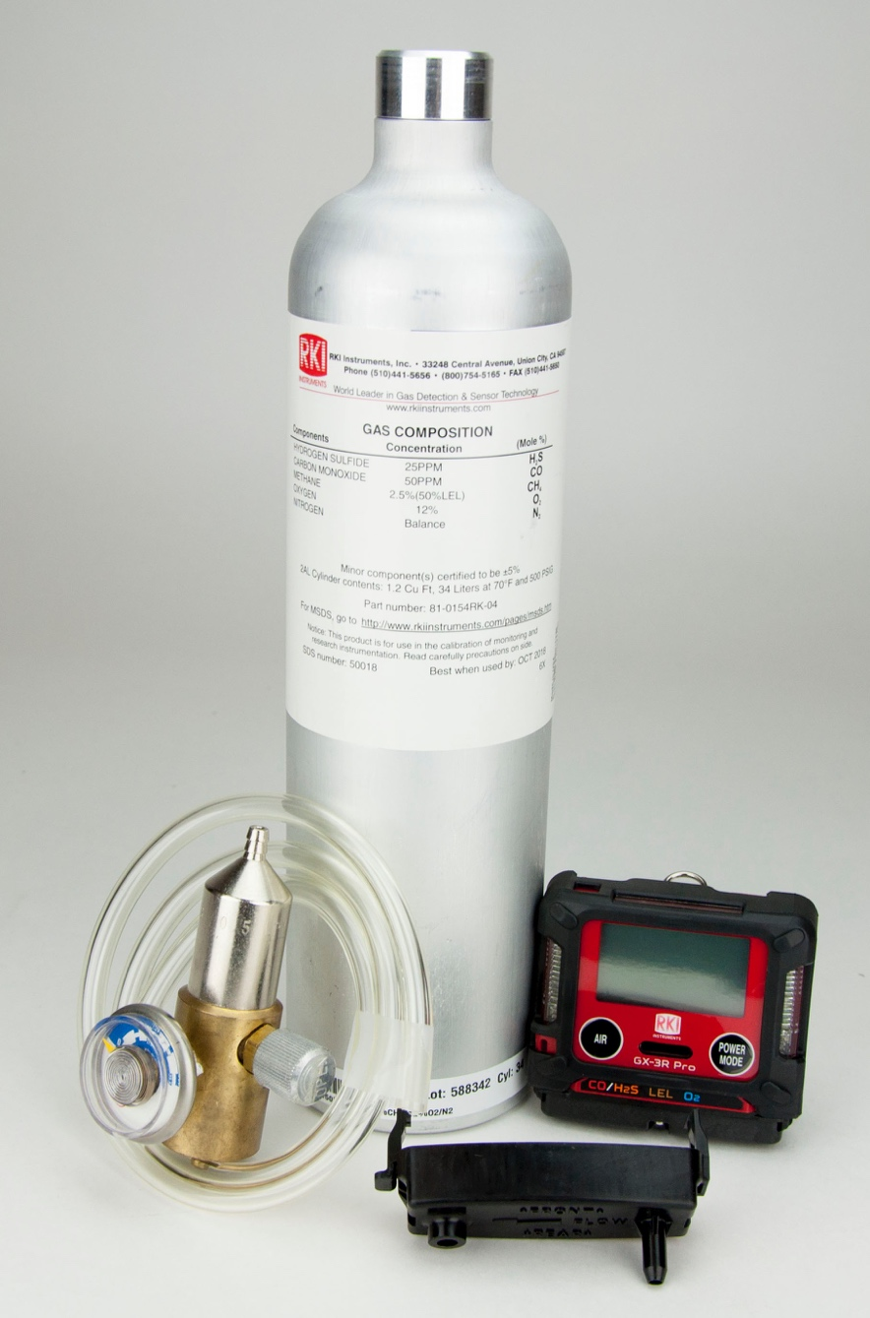
Manual Calibration

Slide 2
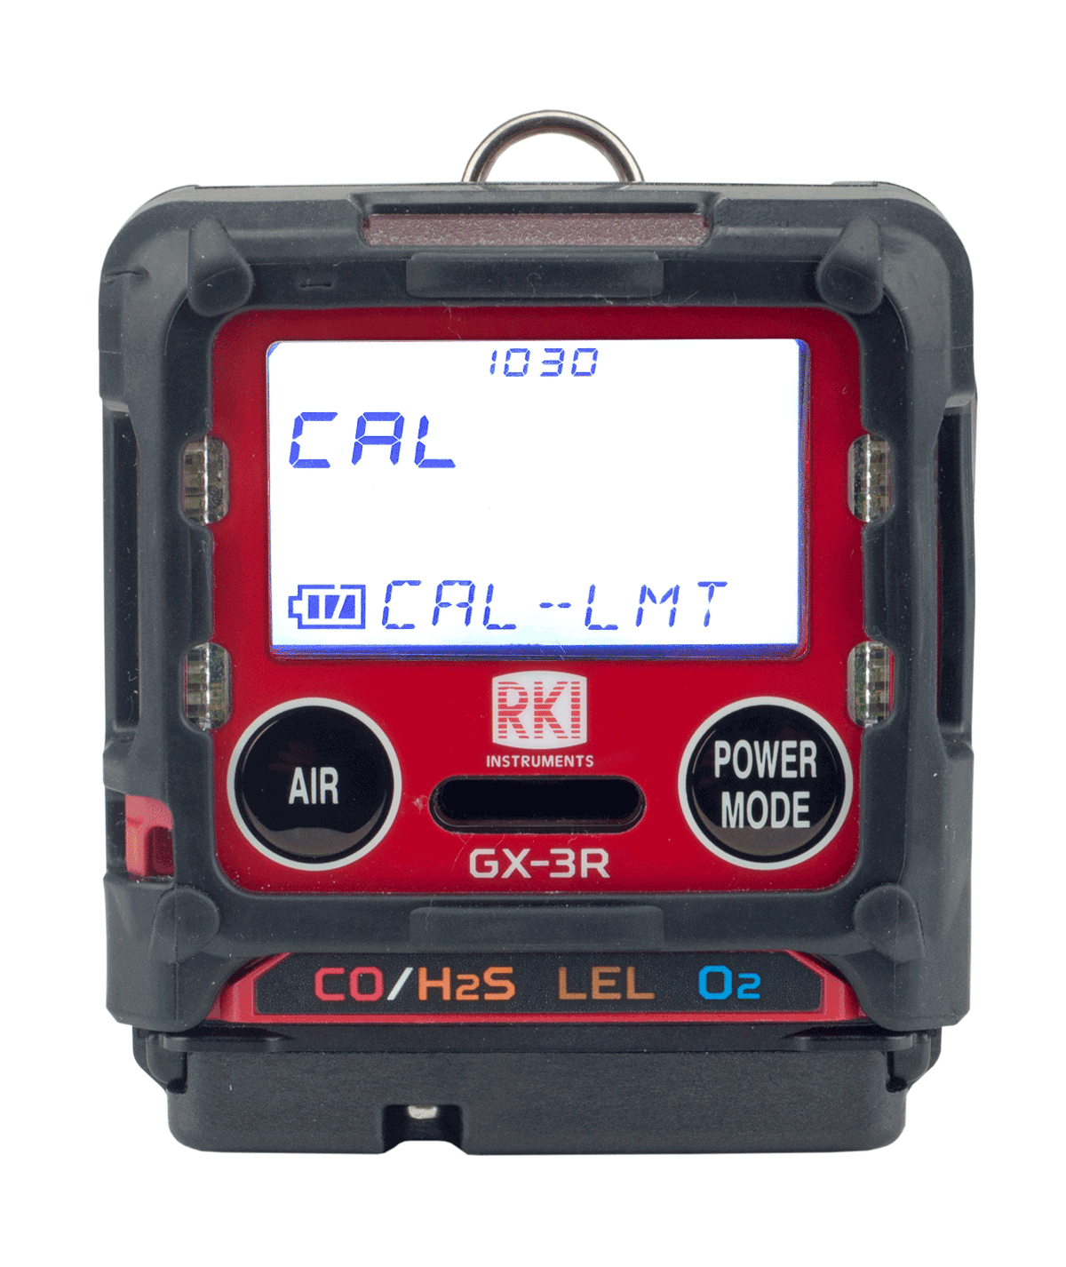
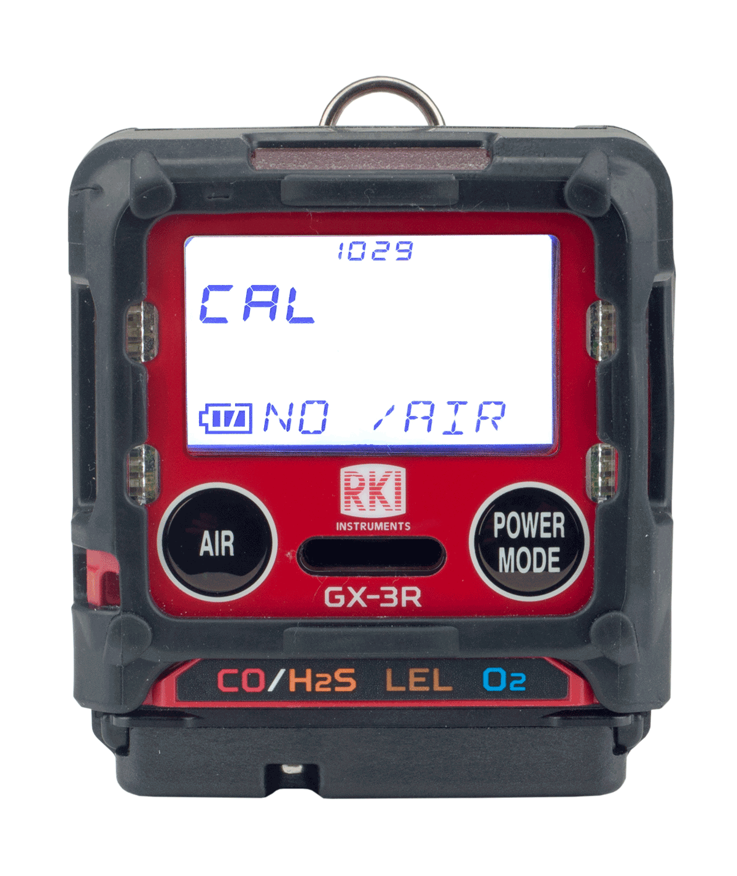
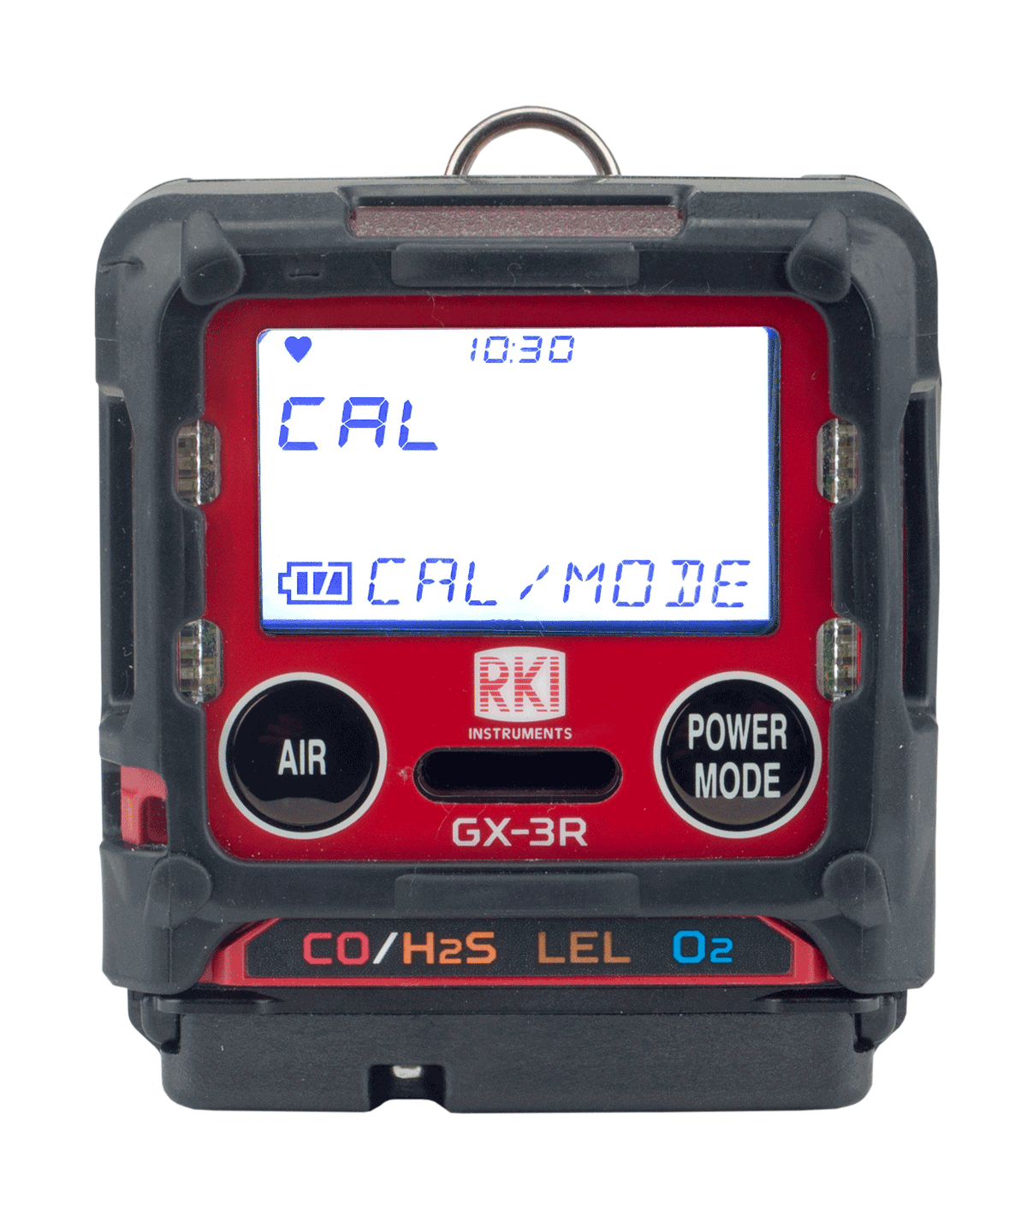
Calibration
Acknowledge and use
Perform a calibration
If your instrument is past its 90 day (factory set default) calibration limit, you will see a CAL-LMT reminder at start-up
Press the AIR button to continue without performing a calibration
Press the POWER/MODE button to perform calibration.

Slide 3
Calibration
To perform a fresh air calibration
⎯ Make sure you are in a gas free environment
⎯ Press and hold the “AIR” button
⎯ When prompted, release the button
Note: If you are unable to perform a Fresh Air adjustment, it may be that “DEM ZERO” in Maintenance Mode has been turned off.
In this case, you will have to enter User Mode and select
GAS CAL → AIR CAL to perform one.

Slide 4
Calibration
To perform a calibration without being prompted by the calibration reminder (CAL RMDR) turn the instrument off and restart it in User Mode
To enter User Mode:
Turn the GX-3R off
Press and hold the “AIR” button
Then press and hold the “POWER/MODE” button
Release after one beep

Slide 5
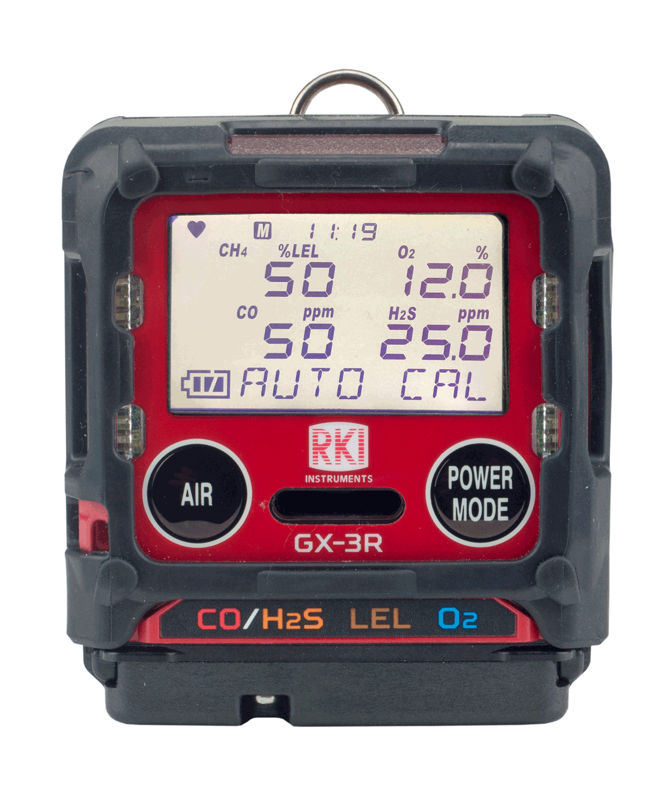
Calibration
In the User Mode menu
  Use the “AIR” button to scroll options
  Use the “POWER/MODE” button to select
Select “GAS CAL”
  Note your sub-menu options are “AIR CAL” and “AUTO CAL”
    (NOTE: This is where you can do a “fresh air” calibration if you did not on start-up)
  Select “AUTO CAL”
  Calibration values will be displayed
    (LEL – 50%, O2 – 12%, CO – 50ppm, H2S – 25ppm)
    (factory set default values)

Slide 6
Calibration
If the calibration values displayed do NOT match the gas cylinder values:
Enter the AUTO CAL menu (User Mode→ Gas Cal→ Auto Cal)
Scroll with “AIR” and select “CAL-P” with “POWER/MODE”
You should see the active channel marked with 3 dashes (- - -)
Use “AIR” to select which gas you want to change the value of
Press “POWER/MODE” to select
Use ”AIR” to adjust to the value matching your cylinder
(HINT: if you need to reverse the direction of your numbers, press AIR and POWER/MODE together quickly)
Press the “POWER/MODE” button to save
Press “AIR” to move to the next gas. Repeat as necessary
Select “ESCAPE” to return to the Auto Cal menu

Slide 7
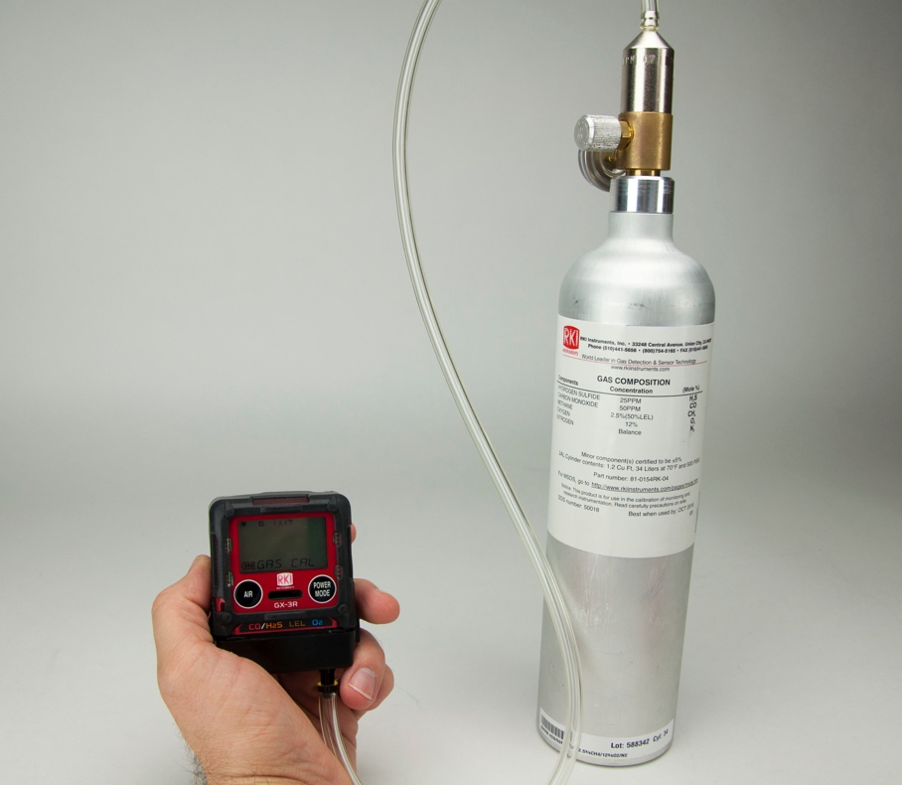
Calibration
Applying gas to the GX-3R
  Attach a fixed flow regulator to the calibration gas cylinder
  Attach the calibration adapter to the instrument and connect it to the 0.25 LPM regulator with tubing
  With “AUTO CAL” highlighted, press ”POWER/MODE”
  Turn on the regulator

Slide 8
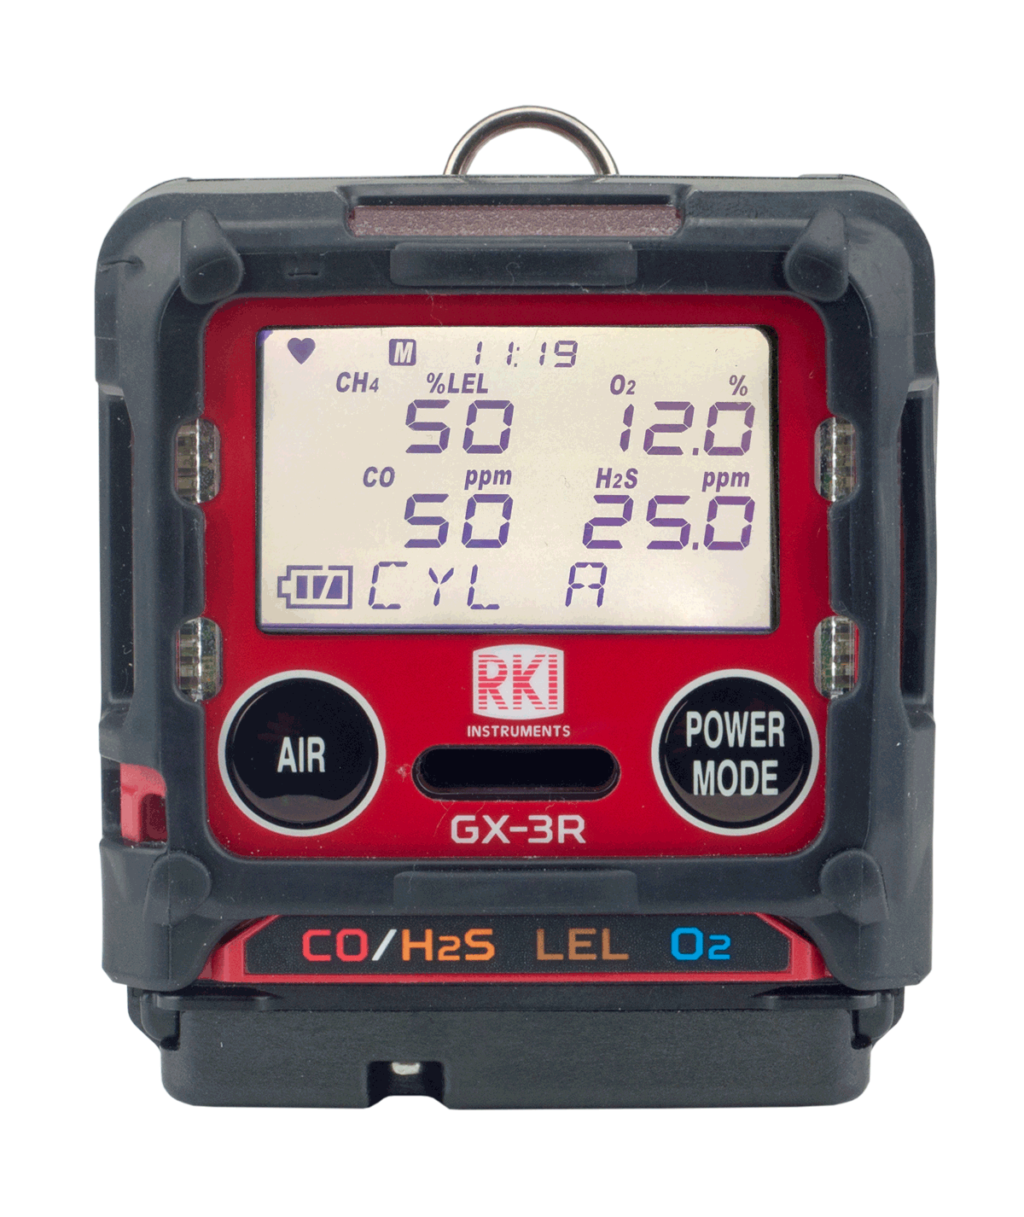
Calibration
  “AUTO CAL/CYL A” should be alternating on the display
  Press “POWER/MODE”
  Apply gas until readings stabilize or for 2 minutes maximum
  Press “POWER/MODE” Turn the gas regulator off

Slide 9
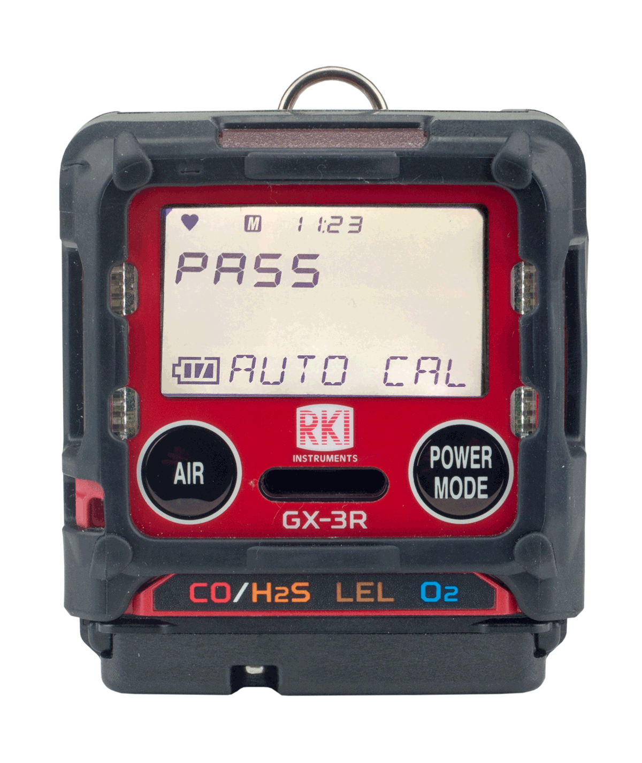
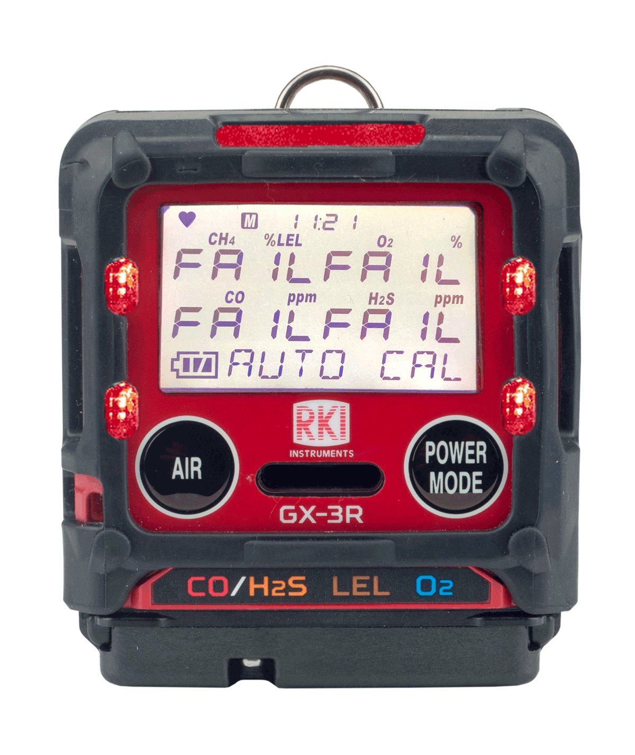
Calibration
  If the calibration is successful, the unit will read “PASS”
  If the calibration is unsuccessful, the unit will read “FAIL”
Note that the fail message gives status for each sensor

Slide 10
Calibration
AUTO CAL pass
  Remove the calibration adapter
  The unit will read “PASS,” then go through its start up sequence and enter measurement mode, ready for use
AUTO CAL fail
  The unit will read “FAIL” and return to the AUTO CAL menu in User Mode
  NOTE: In the “CAL EXPD” User Mode menu item, you can set the instrument to “CANT USE” to prevent the end user from continuing without calibration

