Slide 1
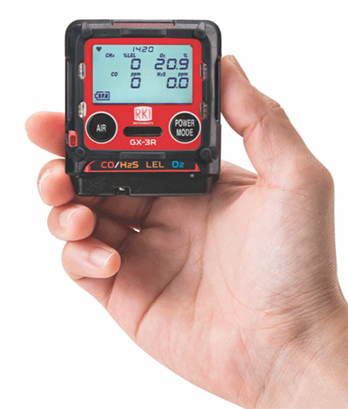
The GX-3R
The World’s Smallest 4-Gas Detection Unit
Evolution In Gas Detection

Slide 2
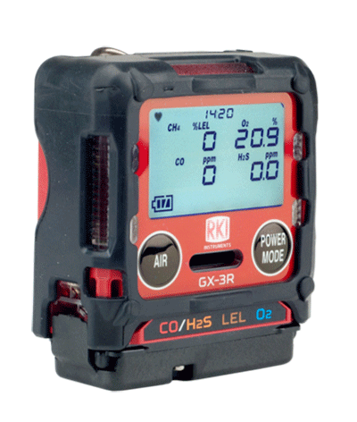
The GX-3R
The Smallest and Lightest 4-gas Monitor
GX-3R
D: 1.02”
H: 2.55”
W: 2.2”
And it weighs only 3.52 ounces!

Slide 3
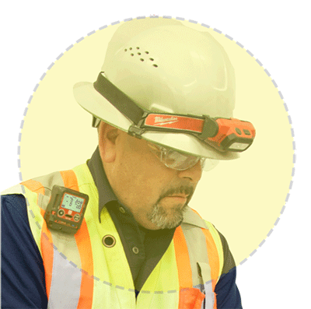
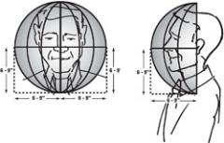

Size Matters
In the “Breathing Zone”
GX-3R
So small and light, the GX-3R clips comfortably in the breathing zone.
“The breathing zone is within a ten inch radius of the worker's nose and mouth. OSHA requires that worker exposure monitoring air samples be collected in the breathing zone. Air sampling filters may be attached to the collar or lapel.”

Slide 4
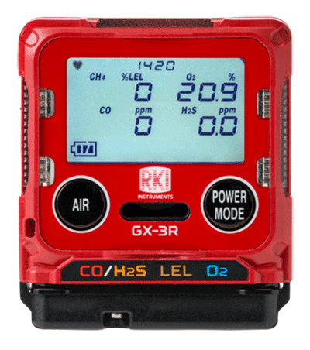



Simultaneously Monitor 4 Gasses
GX-3R
The GX-3R monitors:
CO – Carbon Monoxide
Dual sensor for CO and H2S in one channel
H2S – Hydrogen Sulfide
Dual filament design gives added silicone poisoning resistance to LEL sensor
LEL – Combustibles
and O2 – Oxygen
Lead free electro-chemical sensor design gives O2 sensor a 3-5 year lifespan
(H2 compensated CO sensor available)
Eliminate H2 interference with CO readings with optional H2 compensated O2 sensor
All gas readings displayed

Slide 5
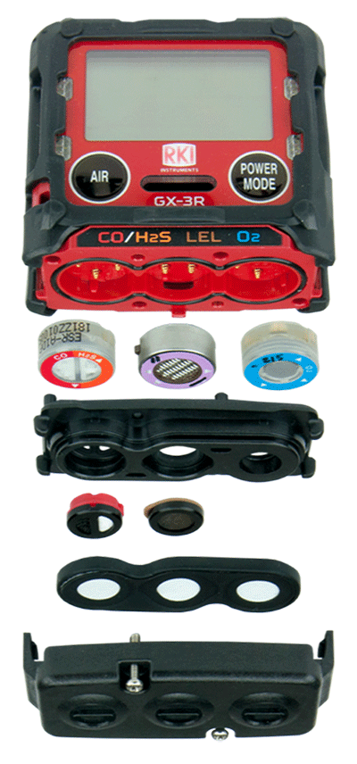
Sensors
GX-3R
Sensors are field replaceable
(as easy as changing a clock battery)
Can be configured with interchangeable combos to detect a multitude of gasses
Long-lasting with a 3-year warranty

Slide 6

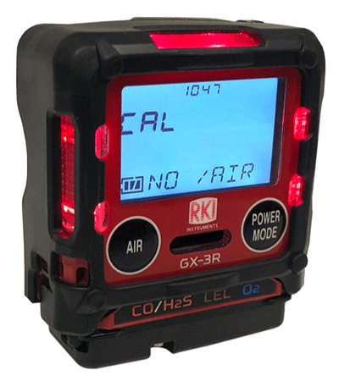
Non-compliance Indicator
GX-3R
Easily identify workers using instruments that have not been calibrated, bump tested, or have been in alarm. Red LED’s flash every 30 seconds.

Slide 7
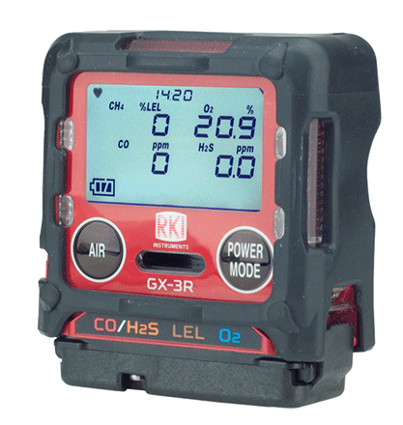
Large LCD Auto-backlit Display
GX-3R
Full dot LCD display is easy to read even in adverse conditions

Slide 8
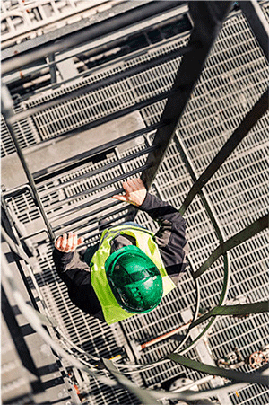
Concussion Resistant
GX-3R
The GX-3R has been drop-tested from over 23 feet.
It can handle the conditions of your rugged work environment

Slide 9
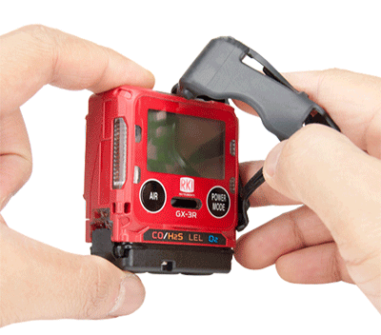
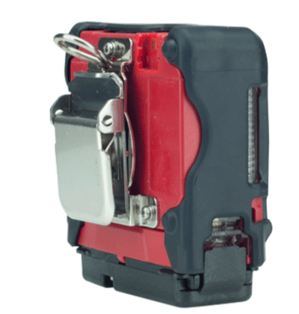
Removable Rubber Boot
GX-3R
The removable rubber boot adds impact protection, can be removed when cleaning and replaced if necessary.
Alligator Clip
Low profile alligator clip rotates 360°. Comfortably view the instrument display from a variety of positions.

Slide 10
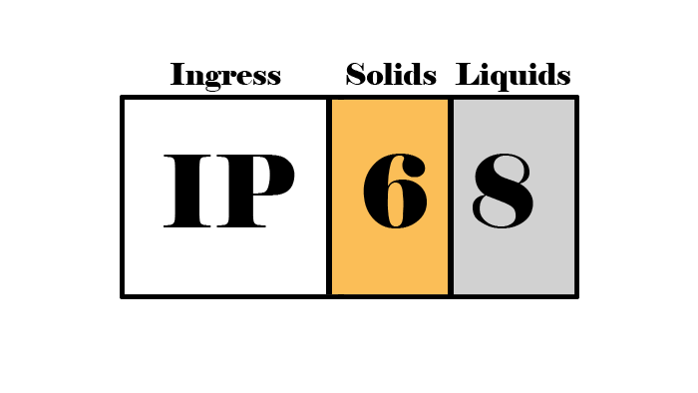
IP-66 / IP-68 Rating
GX-3R
The GX-3R is IP-66 rated because it can withstand jets of water
It is also IP-68 rated because it can withstand submersion in water
Critical for withstanding harsh industrial environments
The first digit shows that it is dust proof
The second digit shows it is waterproof

Slide 11
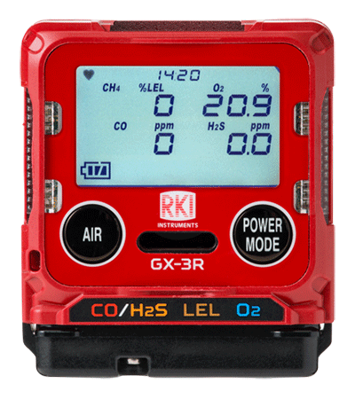


3 Year Warranty
GX-3R
The GX-3R has a 3 year warranty
The warranty covers workmanship of the device
AND the sensors.

Slide 12
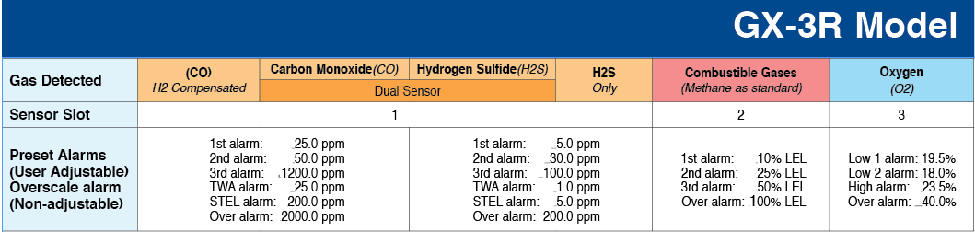
3 Adjustable Alarm Levels
GX-3R
Three adjustable alarm points let you customize your instrument to fit your needs.
Revert back to standard factory settings any time.

Slide 13


3 Alarm Types
GX-3R
Visual
LED light indicators
Alert you to gas, low battery, and failure alarms
Audible
95 decibel buzzer
Buzzer sounds for gas alarms, malfunctions, low battery voltage, and as an indicator
Vibration
An internal motor vibrates for gas alarms, unit malfunctions, and as an indicator

Slide 14

2 Button Operation
GX-3R
2 Glove -friendly Buttons
Easy to use!

Slide 15
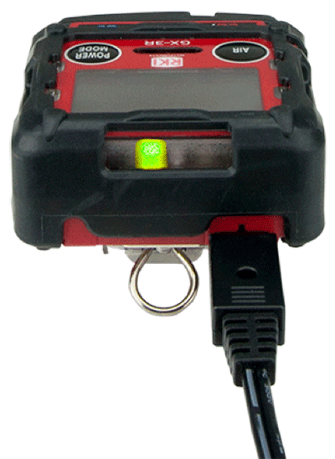
GX-3R
Rechargeable Lithium-Ion Battery
Lithium Ion battery gives 25 hours of continuous operation minutes, with a complete recharge in 90.
It has an easy and convenient charging cable, no cradle required!

Slide 16
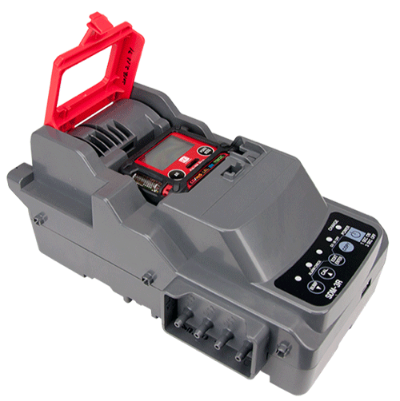
SDM 3R Calibration Station
GX-3R
Charge, bump test, and alarm test instruments using less calibration gas
Automatically schedule tests
Bank up to 10 units with tubeless connection
and has ethernet and USB outputs for data logging

Slide 17
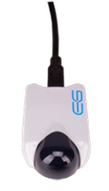
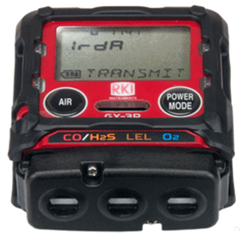
High Capacity Data Logging
GX-3R
The GX-3R automatically logs data every 5 minutes for 300 hours of measurement. (note: logging interval can be changed in settings)
Infrared Communication Port
Transfer data from the instrument to a PC with a USB/IR adaptor, no cradle required.

Slide 18
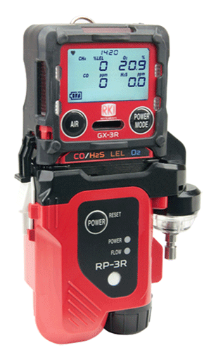
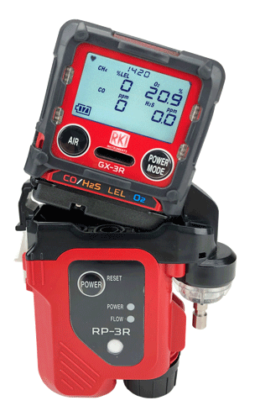
RP-3R Sampling Pump
GX-3R
Clip-on sampling pump has a 50’ range and independent power supply
Continuously operates for 10 hours
Eco mode will operate up to 16 hours

Slide 19

Lunch Break Mode
GX-3R
Retain TWA and PEAK values from last use to pick up where you left off.
Stealth Mode
Set the alarm to notify silently—perfect for law enforcement and other applications

Slide 20

Low Cost of Ownership
GX-3R
The GX-3R is a complete instrument. It is easy to maintain and is NOT disposable.
Long lasting sensors, low parts replacement costs, plus a history of long-term product support makes this the best value of any 4-gas instrument

Slide 21
9 Languages
GX-3R
Available in 9 languages:
English
日本語 (Japanese)
Español (Spanish)
Deutsch (German)
Français (French)
Italiano (Italian)
Pусский (Russian)
中文 (Chinese)
한국어 (Korean)

Slide 22
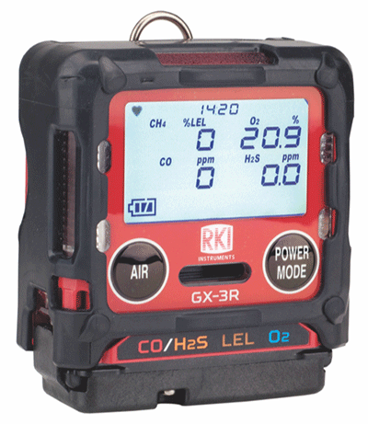
The GX-3R
GX-3R

Slide 23

GX-3R

