Slide 1
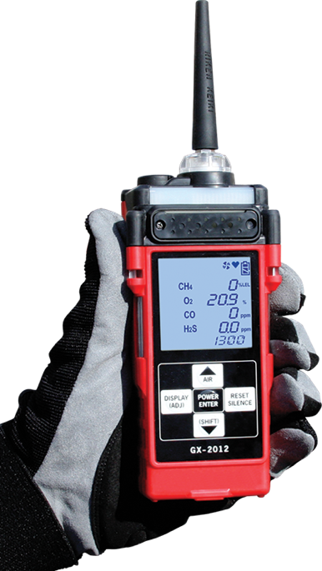
GX-2012
Confined Space / Multi-Gas Monitor
User Training

Slide 2
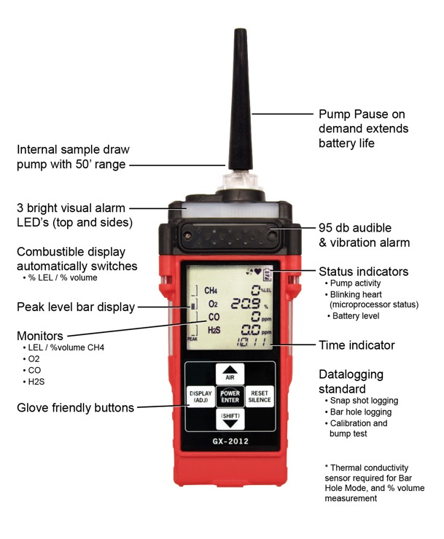
Overview
Notes:
Explain risks of potential cracked filter holder

Slide 3
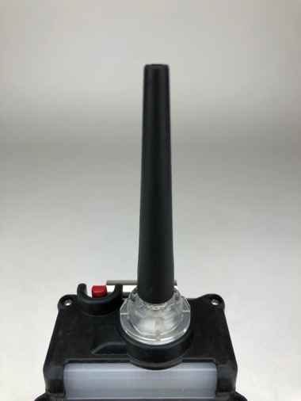
Inlet / Exhaust
Notes:
Explain risks of potential cracked filter holder

Slide 4
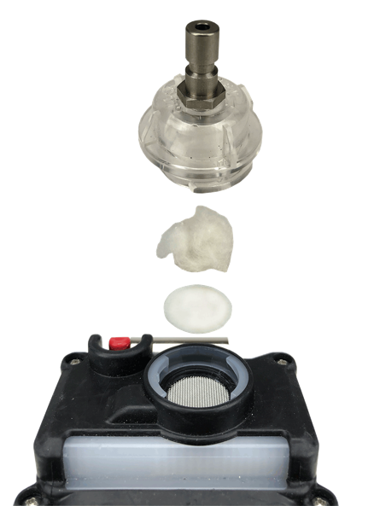
Filter Replacement
Inlet
Cotton
Hydrophobic Filter

Slide 5

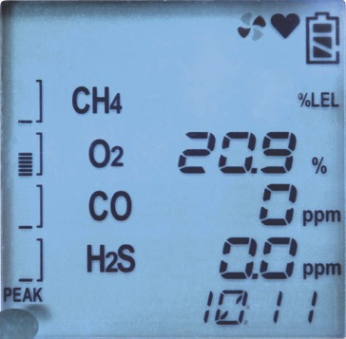
Damaged LCD Display
Missing characters
Blotches
Replace the LCD display when it is damaged

Slide 6

LED Alarms
Alarm Lamp 1
Alarm Lamp 3
Alarm Lamp 2

Slide 7
Buzzer
Buzzer
(more than 95dB)
Notes:
Explain blockage risks due to soils, etc.

Slide 8
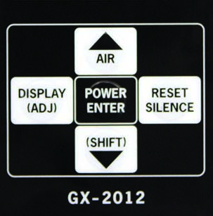
5 Key Touchpad
Notes:
Brief explanation of buttons

Slide 9
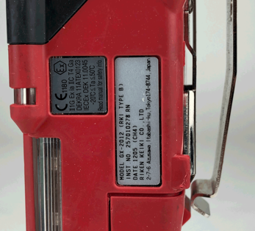
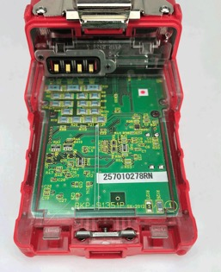
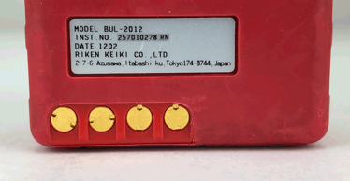
Instrument Serial Number
Side
Motherboard
Battery
Notes:
Three locations for serial number

Slide 10
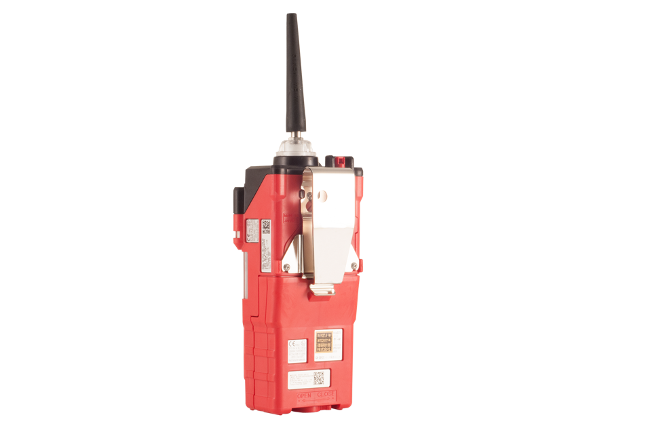
Battery
Battery case

Slide 11
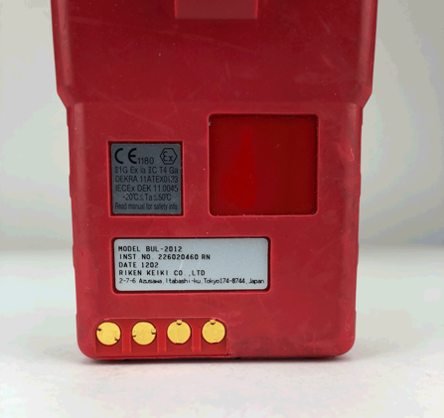
Battery
Charging terminals
(Rechargeable)
Notes:
Risk of oxidation and/or coated connections

Slide 12
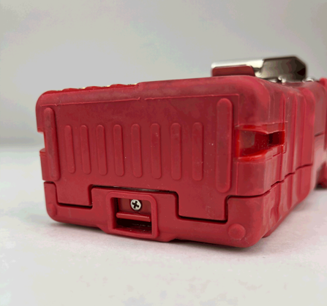
Battery
Battery release

Slide 13
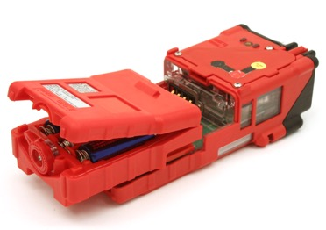
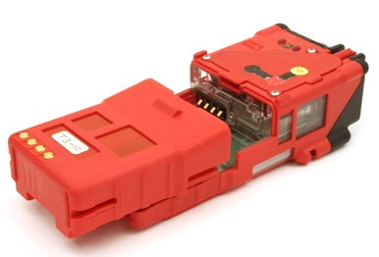
Battery
Alkaline
Rechargeable
Notes:
Brief description of battery options

Slide 14
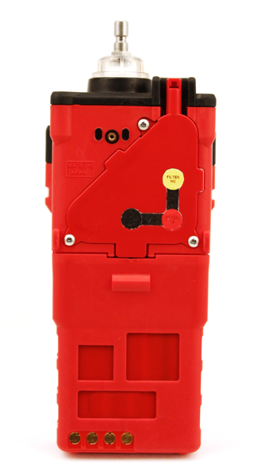
Sensor Cover
Notes:
Explain the risk of missing screws

Slide 15
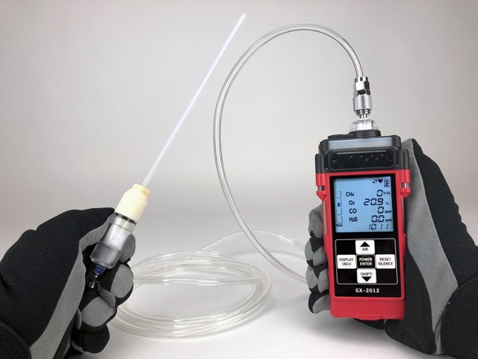
Hose and Probe
3.5” and 10’ ft hose available
Notes:
Explanation of Hose and Probe. Inspect for cut or damaged hose, cracked probe housing.
How to attach to each other and to instrument

Slide 16
GX-2012
Operation

Slide 17
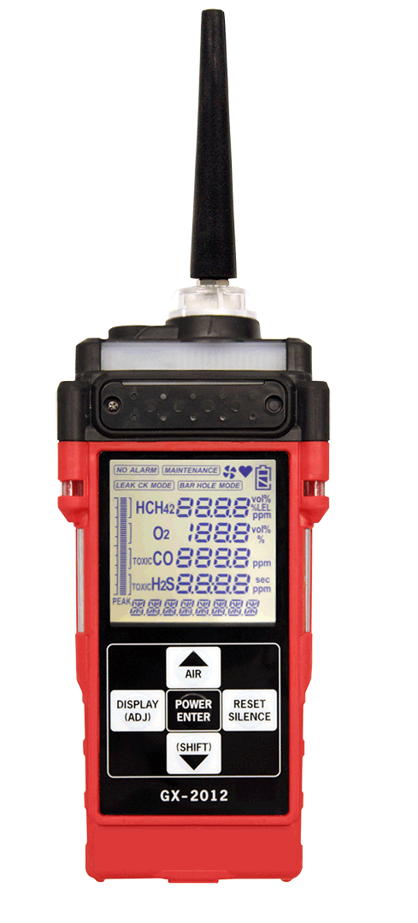
Turning unit on
Press and hold the POWER ENTER button until you hear one beep, and release. The pump will engage.

Slide 18


Cal and Bump Reminder
Calibration due
Bump test due

Slide 19

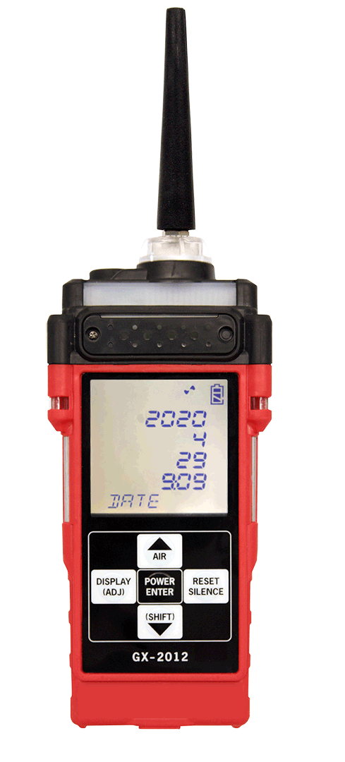
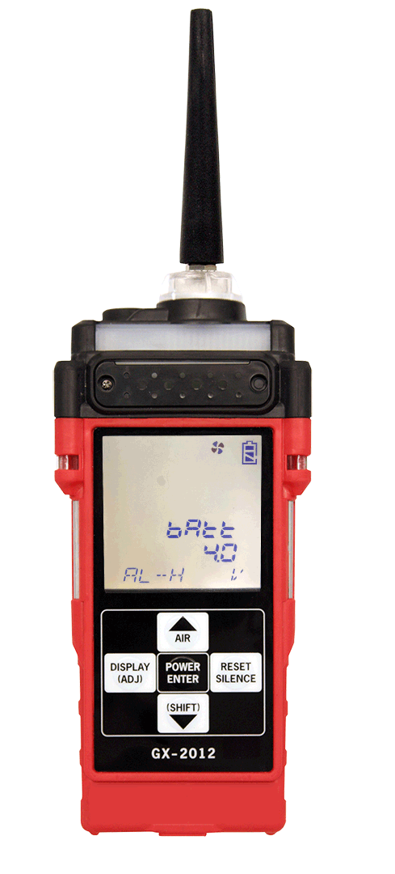
Start Up Display
Next Calibration
Next Bump Test
Date
Battery Level

Slide 20
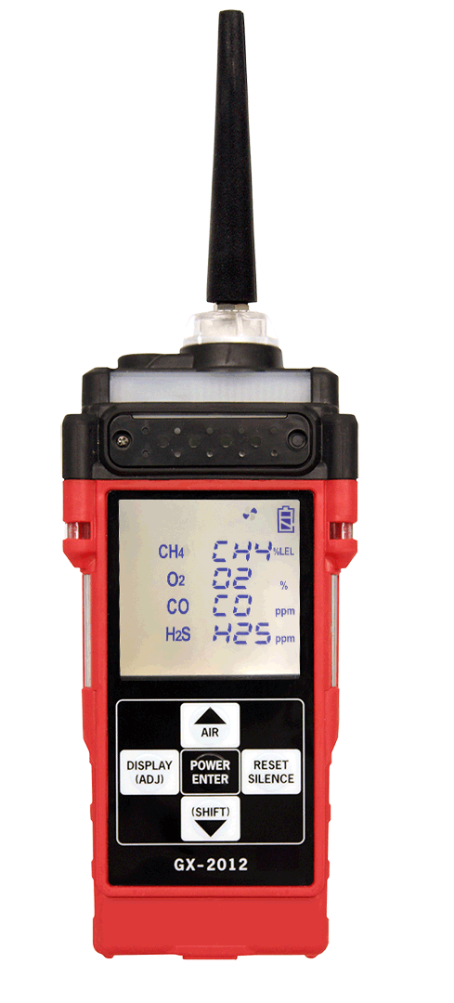
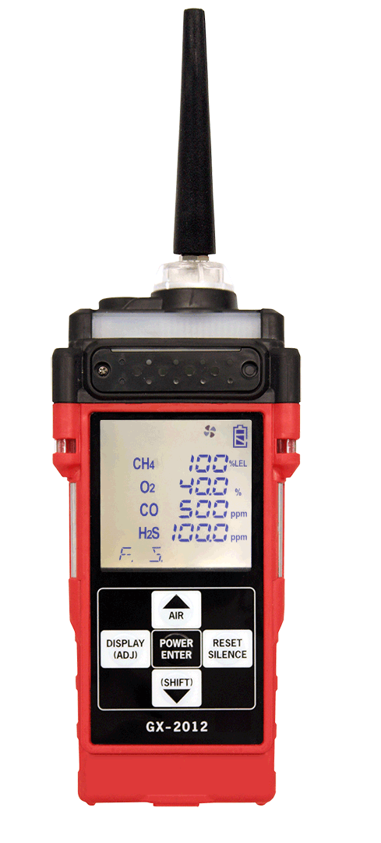

Start Up Display cont’d
Sensor(s) Installed
Full Scale
Warning Alarm

Slide 21



Start Up Display cont’d
High Alarm
STEL
TWA

Slide 22
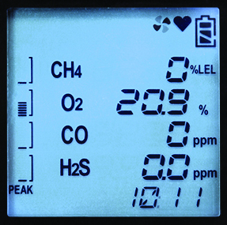
LCD Overview
Pump activity
Blinking heart
(microprocessor status)
Monitors
- LEL / %volume CH4
- O2
- CO
- H2S
Battery level
Peak level bar display
Combustible display
automatically switches
- %LEL / %volume
Time indicator

Slide 23

Display Mode
In normal measuring mode press DISPLAY(ADJ)

Slide 24
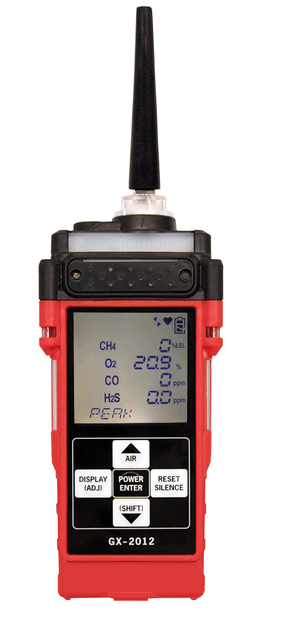
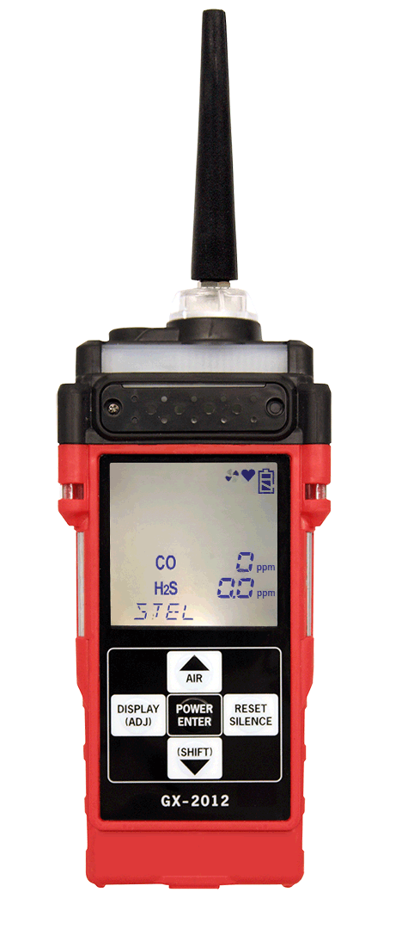

Display Mode
PEAK
STEL
TWA
Continue to press DISPLAY(ADJ) to scroll through the modes

Slide 25


Display Mode
Alarm point
Operating time
Date
Continue to press DISPLAY(ADJ) to scroll through the modes

Slide 26

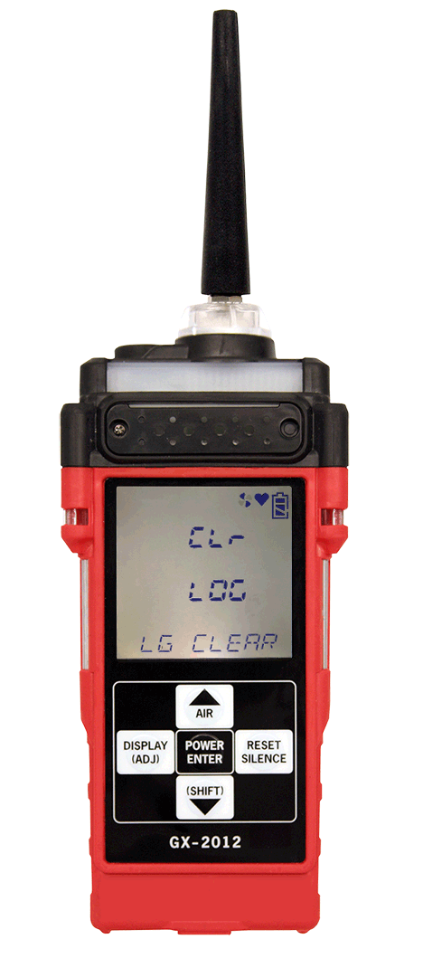
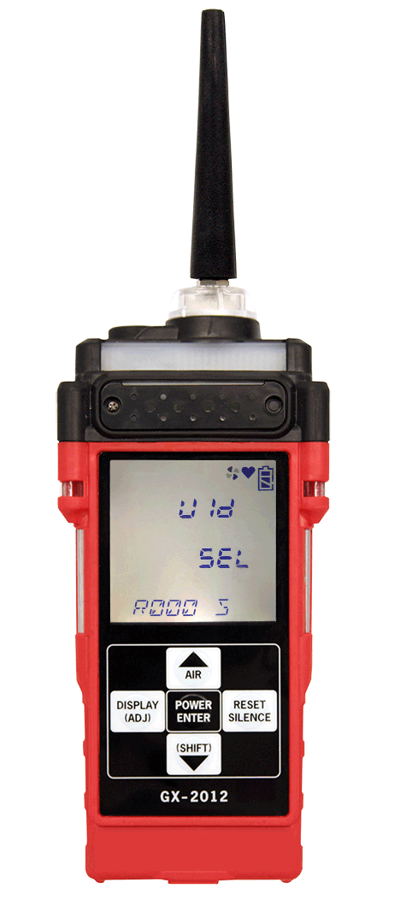
Display Mode
Remaining log time
Clear datalogger
User ID
Continue to press DISPLAY(ADJ) to scroll through the modes

Slide 27



Display Mode
Station ID
Snap logging
Peak bar select
Continue to press DISPLAY(ADJ) to scroll through the modes

Slide 28
Changing Operating Modes
In normal measuring mode press and hold (SHIFT) for 4 seconds

Slide 29


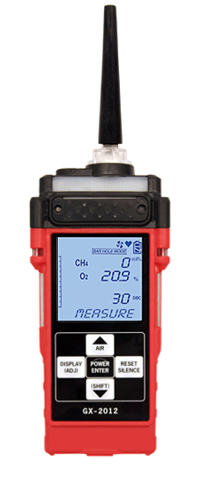
Changing Operating Modes
Normal Operating Mode
Leak Check Mode
Bar Hole Mode
Continue to press (SHIFT) to scroll through the modes

Slide 30
Fresh Air Adjust
ALWAYS perform fresh air adjust in a clean, fresh air environment
In normal measuring mode press and hold AIR▲

Slide 31

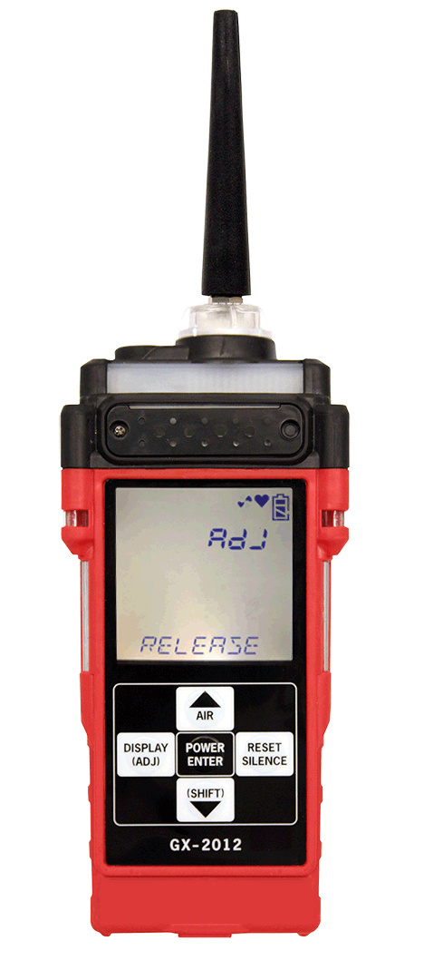
Fresh Air Adjust
Keep holding AIR▲
Release AIR▲
Screen returns to normal measuring mode

Slide 32
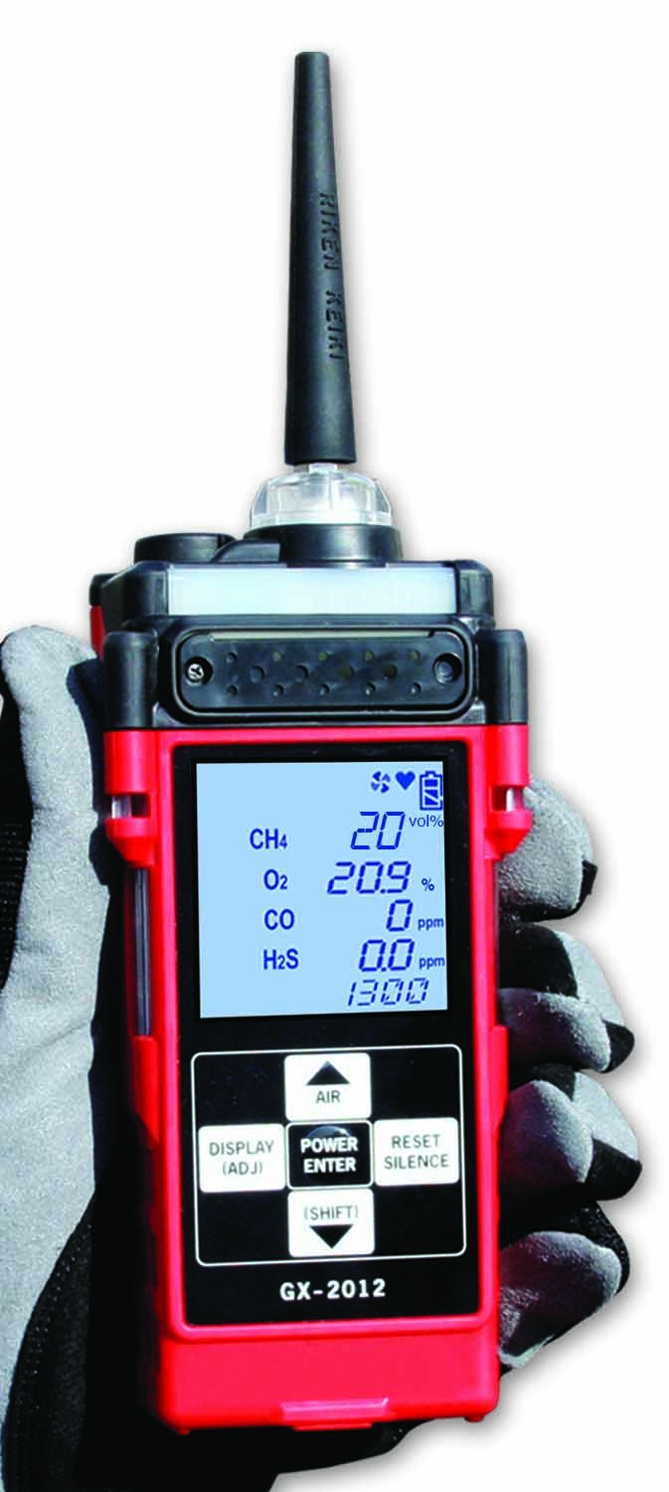


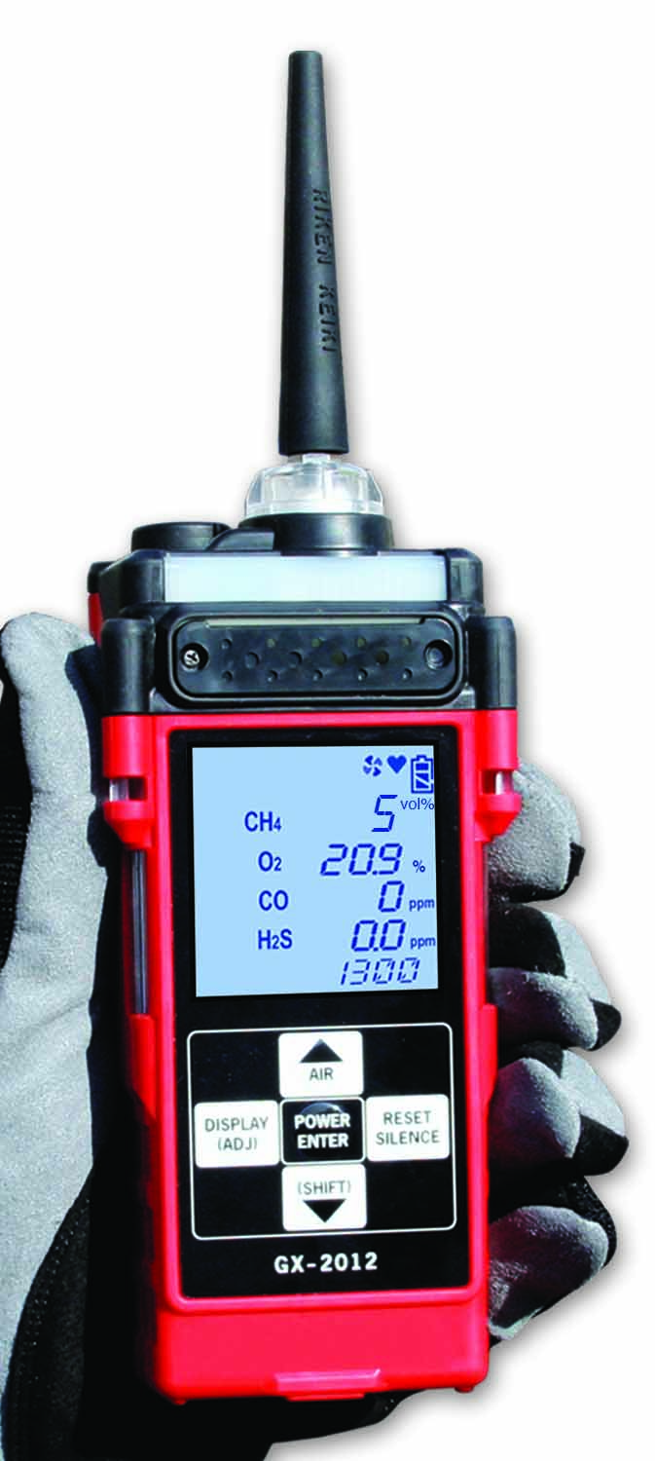




Auto Range % LEL - % Vol.
As % LEL rises above 100%, reading automatically switches to % Vol.

Slide 33

Pump Stall
The pump will automatically pause. A “FAIL” and a “LOW FLOW” status show on the screen

Slide 34

Turning unit off
Press and hold the POWER ENTER button until the pump disengages.

Slide 35
GX-2012
Bump Settings

Slide 36
Maintenance Menu
Press and hold the AIR▲ and (SHIFT)▼ buttons, then press and hold the POWER ENTER button.
When you hear a beep, release the buttons. The unit will prompt you for a password.

Slide 37

Password
Password is 2102
Enter the password by using the AIR▲ and (SHIFT)▼ buttons to select each password number and then pressing and releasing POWER ENTER to enter it and move on to the next one.

Slide 38

Latching
Arrow down (SHIFT)▼ to LATCHING
and press ENTER.

Slide 39


Latching
Set to “OFF” using AIR▲ or (SHIFT)▼ then press ENTER

Slide 40

Bump Display
Arrow down (SHIFT)▼ to BUMP DSP
and press ENTER.

Slide 41


Bump Display
Set to “ON” using AIR▲ or (SHIFT)▼ then press ENTER

Slide 42

Bump Set
Arrow down (SHIFT)▼ to BUMP SET
and press ENTER.

Slide 43

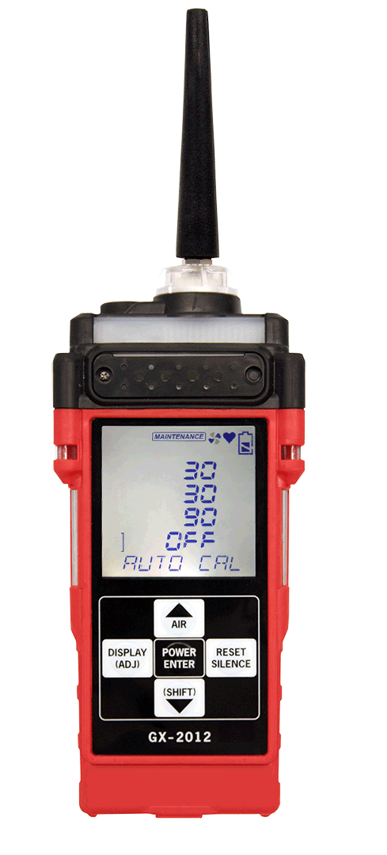
Bump Set
Scroll down (SHIFT)▼ the list to “AUTO CAL” and press ENTER
Change to OFF

Slide 44

Bump Set
Arrow down (SHIFT)▼ to ESCAPE
and press ENTER.

Slide 45

Bump Interval
Arrow down (SHIFT)▼ to BP INTVL
and press ENTER.

Slide 46


Bump Interval
Set to 1 day not 30 by using (SHIFT)▼
Press ENTER

Slide 47

Bump Reminder
Arrow down (SHIFT)▼ to BP RMNDR
and press ENTER.

Slide 48


Bump Reminder
Set to “ON” using AIR▲ or (SHIFT)▼
Press ENTER

Slide 49

Auto Zero
Arrow down (SHIFT)▼ to AUTOZERO
and press ENTER.

Slide 50


Auto Zero
Set to “ON” using AIR▲ or (SHIFT)▼
Press ENTER

Slide 51
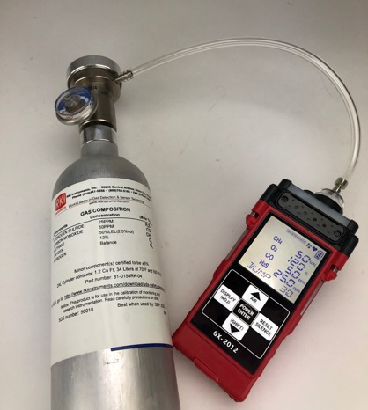
GX-2012
Bump Procedure

Slide 52
Bump
When bump is due press and hold the (SHIFT)▼ button, then press the DISPLAY(ADJ) button and release both.

Slide 53

Bump
AIR CAL (fresh air adjust) is the first menu to pop up and it is recommended to fresh air adjust the unit before performing a bump test.
Press POWER ENTER.

Slide 54

Bump
Push and hold AIR▲ until the screen prompts you to release.

Slide 55

Bump
Push AIR▲ or (SHIFT)▼ to scroll to BUMP and
press POWER ENTER

Slide 56

Bump
Push AIR▲ or (SHIFT)▼ to scroll to BUMP and
press POWER ENTER

Slide 57

Bump
Connect tubing from the demand flow regulator to the inlet fitting of the unit

Slide 58

Bump
Press POWER ENTER.
The unit will countdown from 30 seconds, and the values will begin to flash.

Slide 59

Bump
After 30 seconds, the unit will show the PASS/FAIL status.
If the bump test failed, calibration or service may be required
Remove tubing from inlet and press POWER ENTER to acknowledge the results.

Slide 60

Bump
Push AIR▲ or (SHIFT)▼ to scroll to NORMAL and
press POWER ENTER.
Unit will return to Normal measuring mode

Slide 61
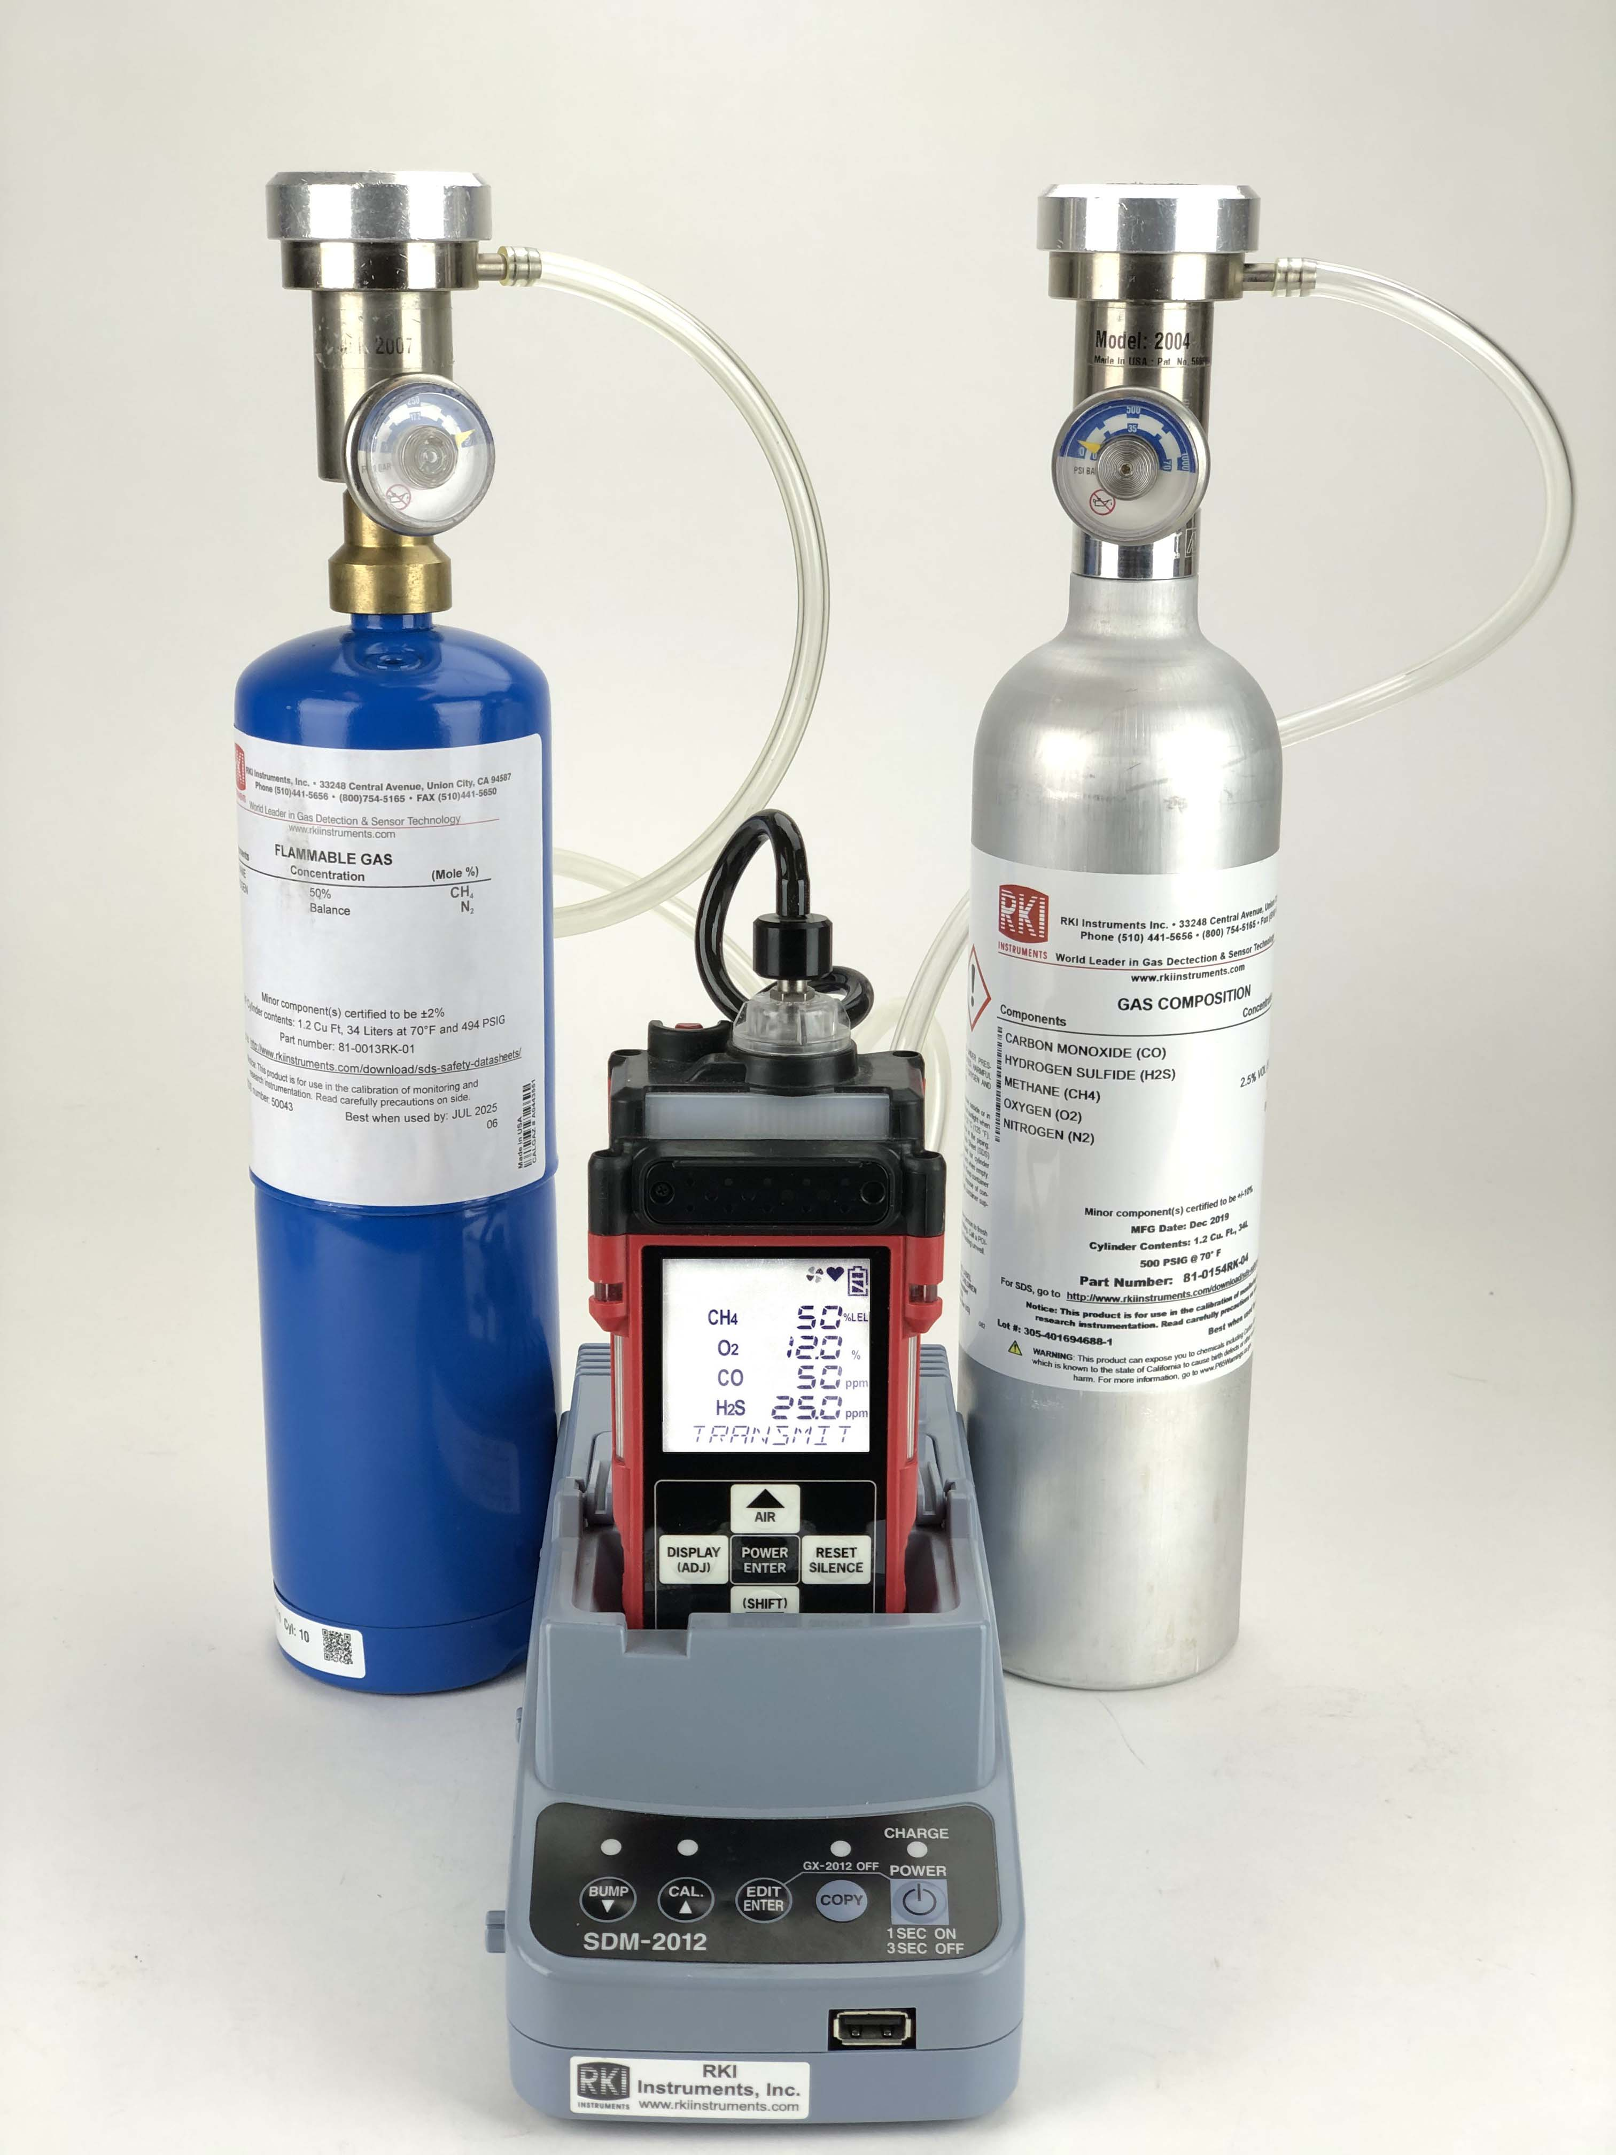
SDM-2012
Calibration
Press and hold the CAL button until the CAL LED turns on then release it.
  During calibration, display will show current gas readings
If a % volume sensor is installed the station will calibrate using Gas 2 port.

Slide 62

Questions?

