Slide 1
Confined Space
Confined Space Plus
Evolution In Gas Detection

Slide 2
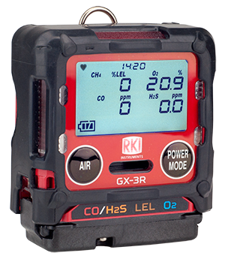
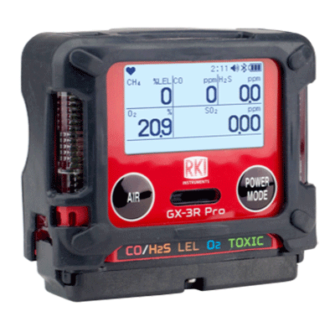
2 Models—Depending on Need
Compliance 4-gas model
5-gas pro model
GX-3R
GX-3R Pro
Worlds smallest and lightest 4-gas monitor
Impact, water, & dust resistant
3 year Warranty
  4-gas plus extra slot for toxic or IR sensor
  Wireless communication with mobile app
  Man-down and panic alarms
  Alkaline/Rechargeable option

Slide 3
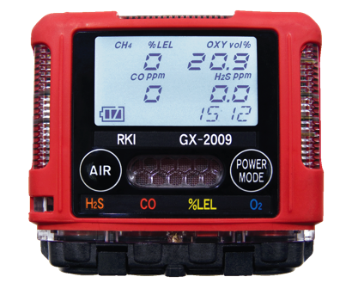
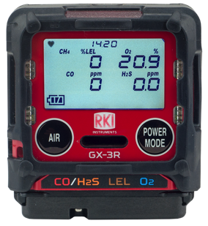
Advancements from GX-2009
Size & Weight
Smallest
— Meet Smaller!
The NEW Smallest and Lightest 4-gas Monitor
2.2” x 2.55” x 1”
3.7 ounces
GX-3R

Slide 4
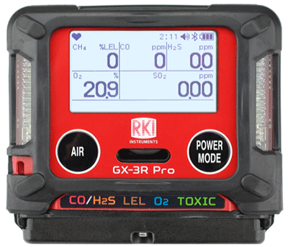
Advancements from GX-2009
Size & Weight
Advanced 5-gas version is the same size as GX-2009
2.9” x 2.6” x 1.06”
4.6 ounces
GX-3R Pro

Slide 5

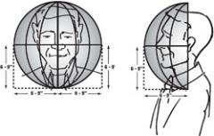

Size Matters
In the “Breathing Zone”
The GX-3R and GX-3R Pro’s small size enables them to easily be clipped into the “Breathing Zone.”
“The breathing zone is within a ten inch radius of the worker's nose and mouth. OSHA requires that worker exposure monitoring air samples be collected in the breathing zone. Air sampling filters may be attached to the collar or lapel.”
Source: https://webapps.dol.gov/elaws/osha/lead/glossary.asp#breathingzone

Slide 6

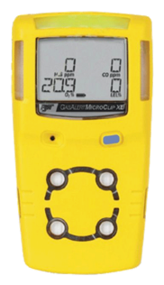
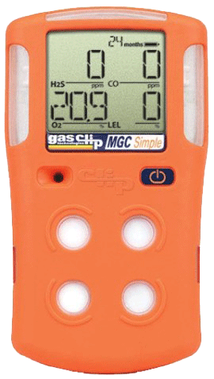
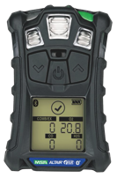
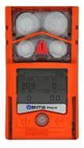
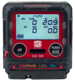
Size Matters in ‘The Breathing Zone’
Size & Weight
2.2” x 2.55” x 1”
3.7 ounces
2.9” x 2.66” x 1.06”
4.6 ounces
4.4” x 2.4” x 1.2
6.3 ounces
4.1” x 2.3” x 1.4”
6.4 ounces
4.7” x 2.7” x 1.2”
7.67 ounces
4.4” x 3.0” x 1.4”
7.9 ounces
5.12” x 1.9” x 1.8”
8 ounces
The GX-3R weighs about half of the average 4-gas detector!

Slide 7
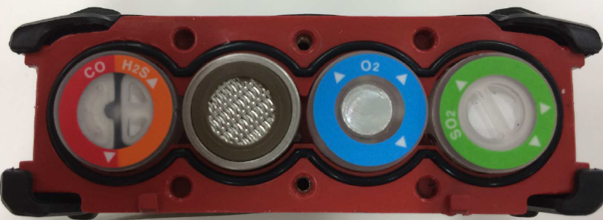
Sensor Advancements
Dual Sensor
4 Sensors slots for 5 gas channels
GX-3R Pro
CO/H2S
3 Sensors slots for 4 gas channels
GX-3R

Slide 8
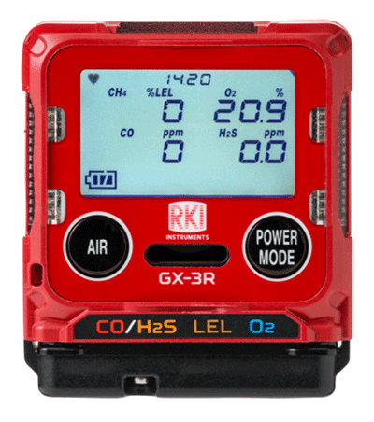



Sensor Advancements
The GX-3R simultaneously monitors:
Dual sensor for CO and H2S in one channel
CO – Carbon Monoxide
Dual filament design gives added silicone poisoning resistance to LEL sensor
H2S – Hydrogen Sulfide
LEL – Combustibles
Lead free electro-chemical sensor design gives O2 sensor a 3-5 year lifespan
and O2 – Oxygen
H2 compensated CO sensor available
Eliminate H2 interference with CO readings with optional H2 compensated O2 sensor
All gas readings displayed

Slide 9

Sensor Advancements
GX-3R Pro
Simultaneously monitor the four standard gases
5th channel for toxic and IR sensors
Toxic Channel
CO – Carbon Monoxide
IR sensor can monitor CO2 in ppm or % vol. *
EC sensor for SO2
(0-100 ppm)
HCN, NO2, NH3 and Cl2 planned for 2020
H2S – Hydrogen Sulfide
LEL – Combustibles
O2 – Oxygen
H2 compensated CO sensor available
And Toxics

Slide 10
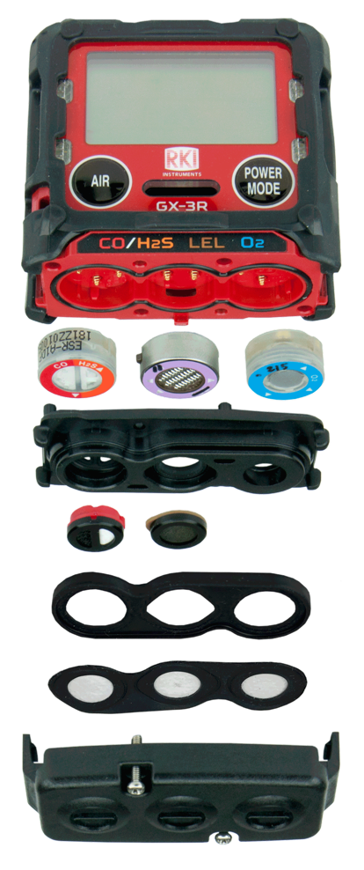
Sensor/Filter replacement
H2S/CO:
ESR-A1DP
O2 Sensor:
ESR-X13P
Scrubber Disk Filter for H2S/CO:
33-7130 (5 pk)
LEL Sensor:
NCR-6309
Scrubber Disk Filter for LEL:
33-7131 (5 pk)
Sensor Dust Filter:
33-0181-10 (10 pk)

Slide 11

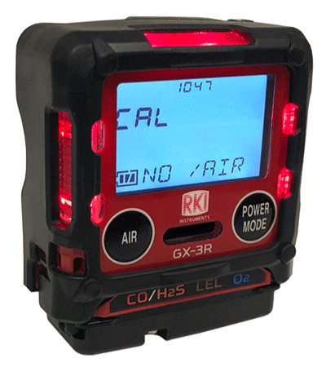
Non-compliance Indicator
Easily identify workers using instruments that have not been calibrated, bump tested, or have been in alarm.
Red LED’s flash every 30 seconds.
Non-compliance indicator in both GX-3R and GX-3R Pro

Slide 12

Concussion Resistant
Drop-tested from over 23 feet.
Handles the conditions of extremely rugged work environments

Slide 13
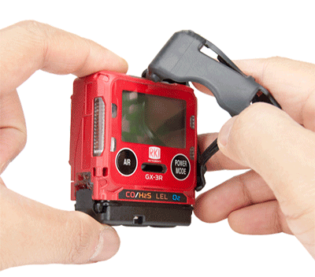
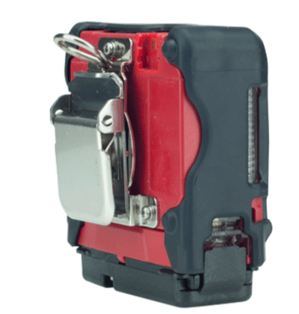
Removable Rubber Boot
The removable rubber boot adds impact protection, can be removed when cleaning and replaced if necessary.
Alligator Clip
Low profile alligator clip rotates 360°. Comfortably view the instrument display from a variety of positions.

Slide 14
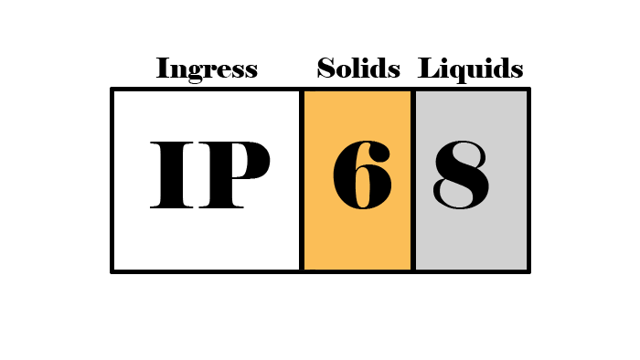
IP-66 / IP-68 Rating
The GX-3R is IP-66 rated because it can withstand jets of water
It is also IP-68 rated because it can withstand submersion in water
Critical for withstanding harsh industrial environments
The first digit shows that it is dust proof
The second digit shows it is waterproof

Slide 15
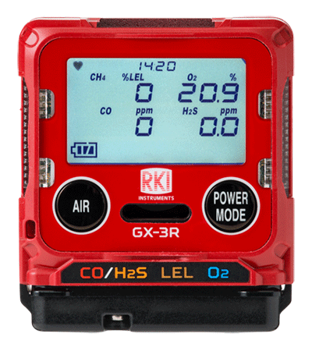


3 Year Warranty
The GX-3R has a 3 year warranty
The warranty covers workmanship of the device
AND the sensors.

Slide 16

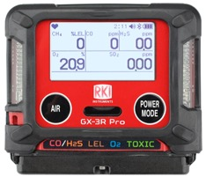


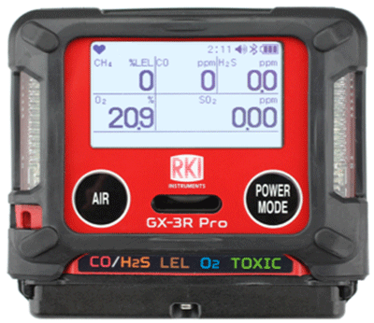

GX-3R Pro—Alarms
Panic Alarm
User can trigger instrument into alarm by tapping it twice to notify others of an immediate hazard.
Man Down Alarm
Man-down alarm sounds if no motion is detected for 30 seconds, increasing worker safety.

Slide 17

3 Alarm Types
Visual
LED light indicators
Alert you to gas, low battery, and failure alarms
Audible
95 decibel buzzer
Buzzer sounds for gas alarms, malfunctions, low battery voltage, and as an indicator
Vibration
An internal motor vibrates for gas alarms, unit malfunctions, and as an indicator

Slide 18
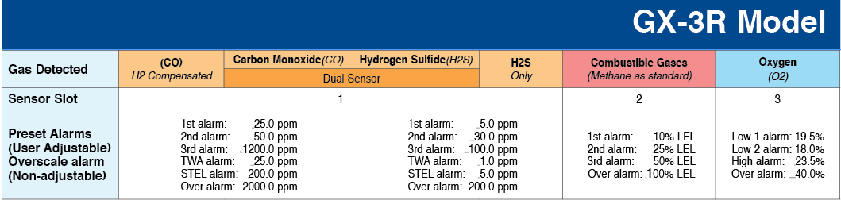
3 Adjustable Alarm Levels
Three adjustable alarm points let you customize your instrument to fit your needs.
Revert back to standard factory settings any time.

Slide 19

2 Button Operation
2 Glove -friendly Buttons
Easy to use!

Slide 20
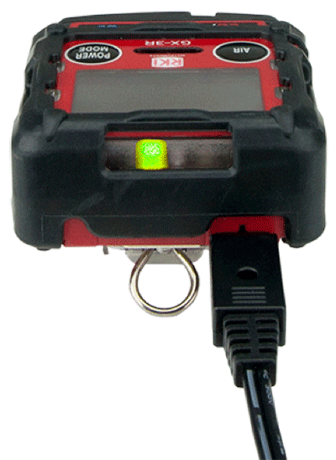
Rechargeable Lithium-Ion Battery
25 hours of continuous operation
Lithium Ion battery
Complete recharge in 90 minutes
Easy and convenient charging cable, no cradle required!

Slide 21
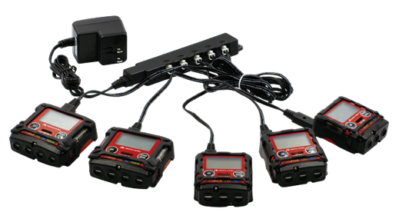
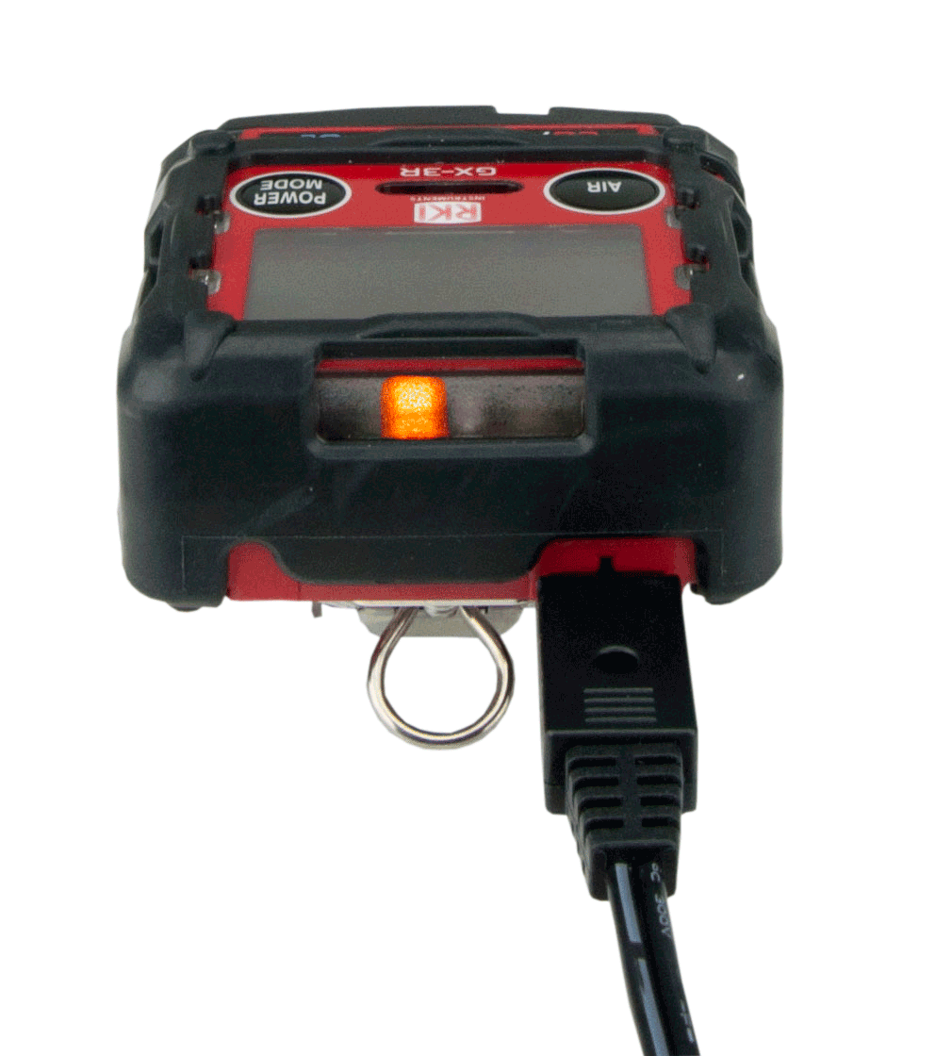

Charging the instrument
25 hours of continuous operation
Lithium Ion battery
Complete recharge in 90 minutes
Multi-unit AC Adapter (49-0134)
Once charged, the light will go from orange to green
A 30 minute charge provides 8 hours of operation time.

Slide 22
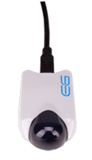
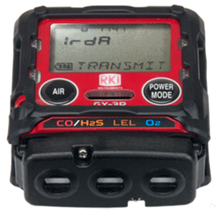
High Capacity Data Logging
Automatically logs data every 5 minutes for 300 hours of measurement. (logging interval can be modified)
Infrared Communication Port
Transfer data from the instrument to a PC with a USB/IR adaptor or with the SDM-3R docking station.

Slide 23
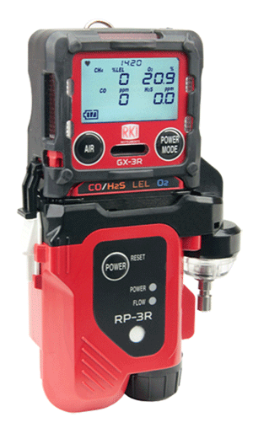
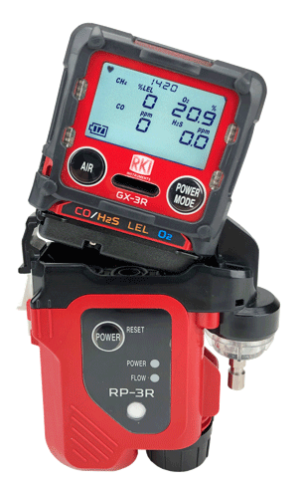
RP-3R Sampling Pump
Clip-on sampling pump has a 50’ range and independent power supply
Continuously operates for 10 hours
Eco mode will operate up to 16 hours

Slide 24
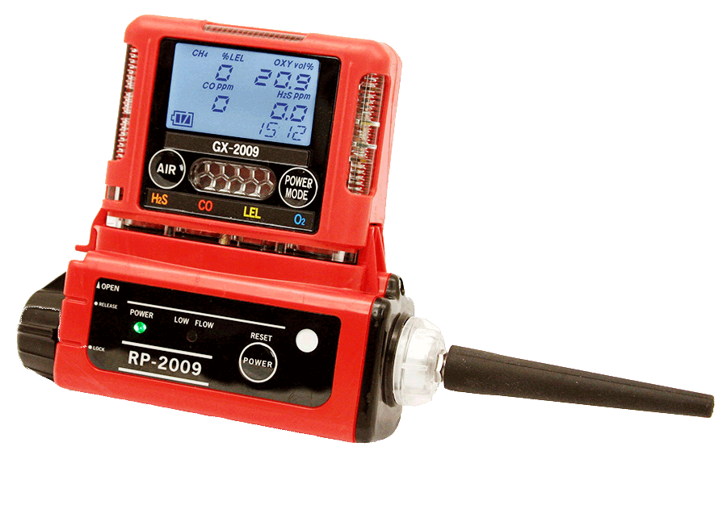
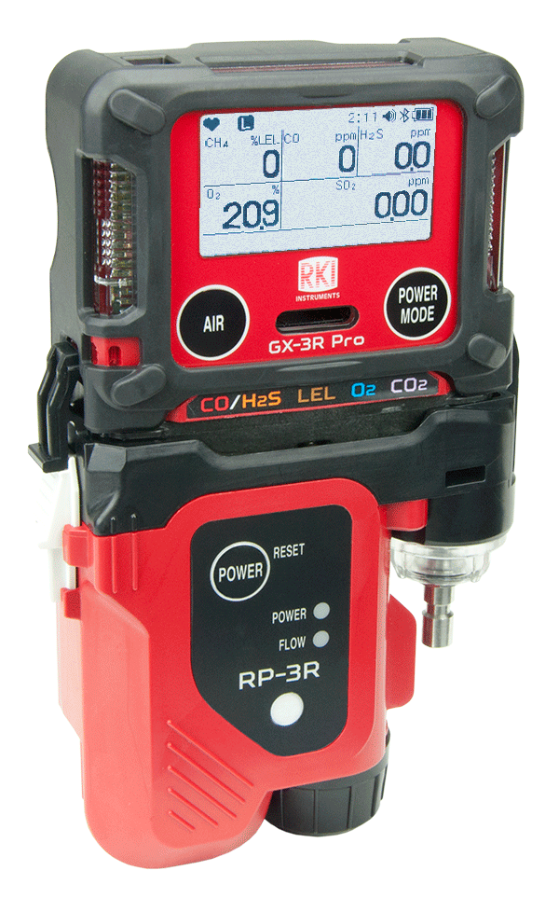
Advancements
Clip-on Pump Unit
Flow rate: 450ml / min
Distance to draw: 50 feet
Operation time: 8h
Operation mode: Normal mode only
RP-2009
Flow rate: 500ml / min
Distance to draw: 50 feet
Operation time: 10h
Operation mode: Normal mode, Eco mode
Compatible with GX-3R and GX-3R Pro
RP-3R

Slide 25
9 Languages
Available in 9 languages:
English
日本語 (Japanese)
Español (Spanish)
Deutsch (German)
Français (French)
Italiano (Italian)
Pусский (Russian)
中文 (Chinese)
한국어 (Korean)

Slide 26


Lunch Break Mode
Retain TWA and PEAK values from last use to pick up where you left off.
Stealth Mode
Set the alarm to notify silently—perfect for law enforcement and other applications
Available in both the GX-3R and GX-3R Pro

Slide 27
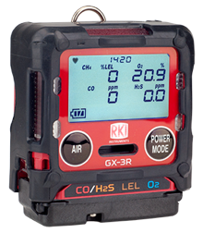
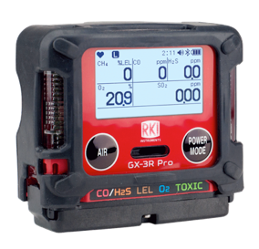
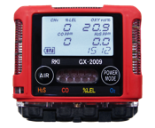
More Advancements
 | GX-2009 | GX-3R and GX-3R Pro
Battery life (continuous) | 20 hours | 24 hours*
Temperature Range | -4°F to 122°F | -40F° to 140°F
Calibration Cup | Not included | Ships standard
IP Rating | IP67 | Both units IP66 & IP68
Warranty | 2 years | 3 years (device & sensors)
Durability | 1 meter drop tested | 7 meter drop tested
User Adjustable Alarms | 2 | 3
*GX-3R Pro has alkaline option available (16 hour battery life)

Slide 28
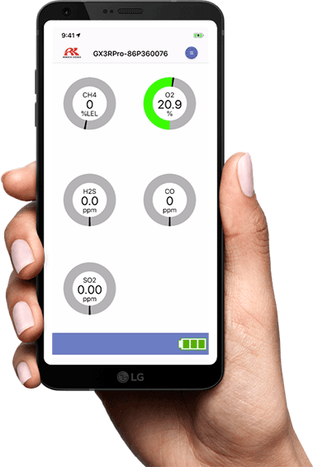


GX-3R Pro—Connectivity
Bluetooth connectivity
Direct readings from instrument
Email or text alarm notifications with GPS locations
Digital values/Graphical display
Alarm indications
Set bump/cal reminders, alarm parameters, and other
GX-3R Pro settings
Find my instrument feature
Available on iOS and Android

Slide 29
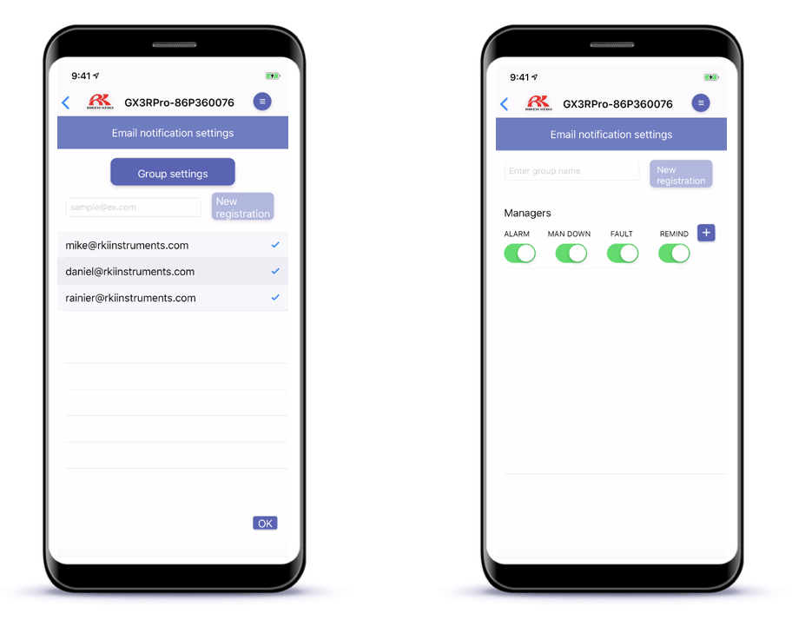

Configurable Alarm Notifications
GX-3R Pro—Connectivity
Email or text contacts who should receive alarm notifications
Configure the types of alarms to send
Gas alarm
Man down
Instrument fault
Past due service

Slide 30
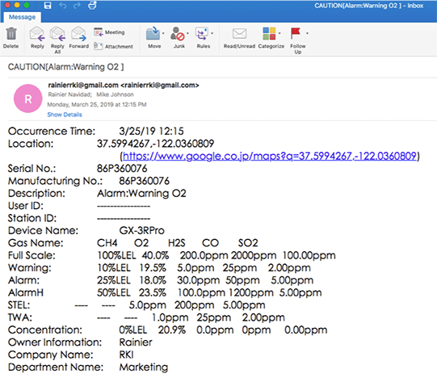
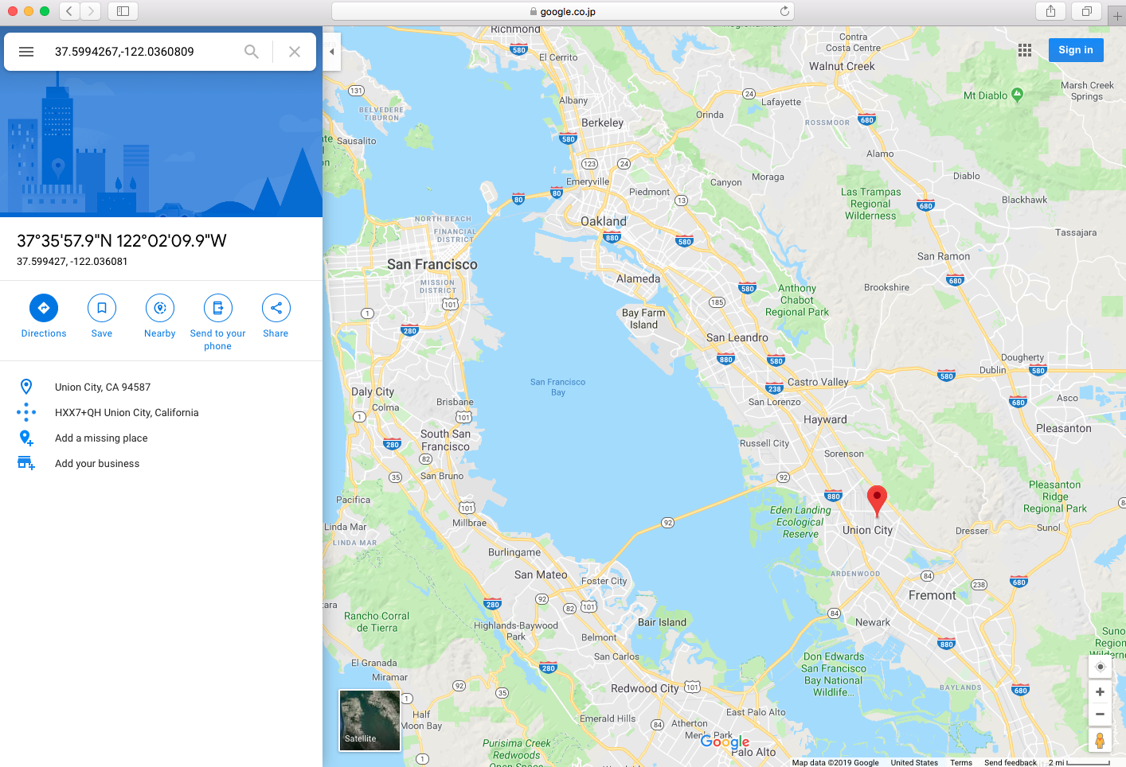
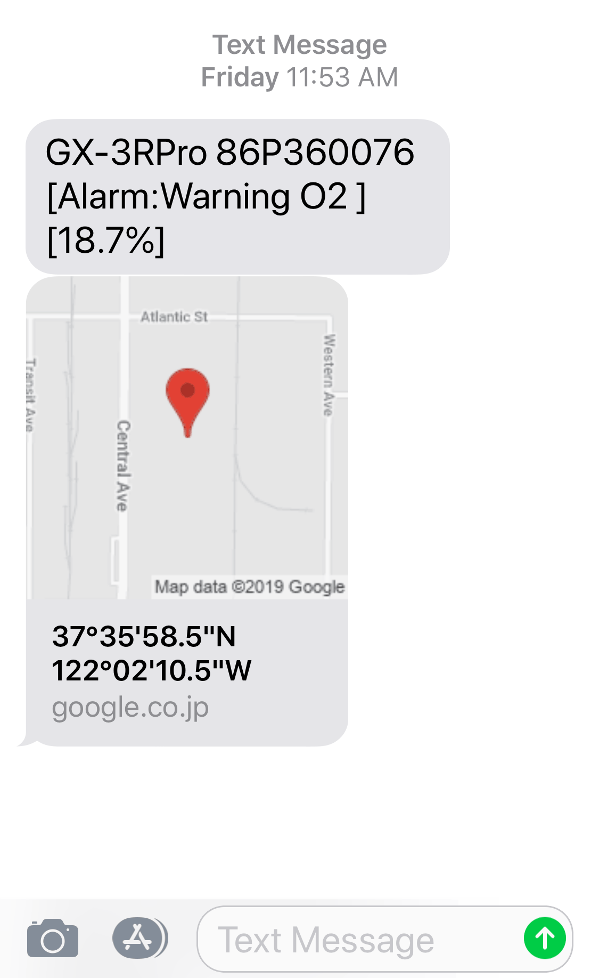
Alarm Location
GX-3R Pro—Connectivity
Email or text your contacts alarm locations
*SMS available early 2020

Slide 31
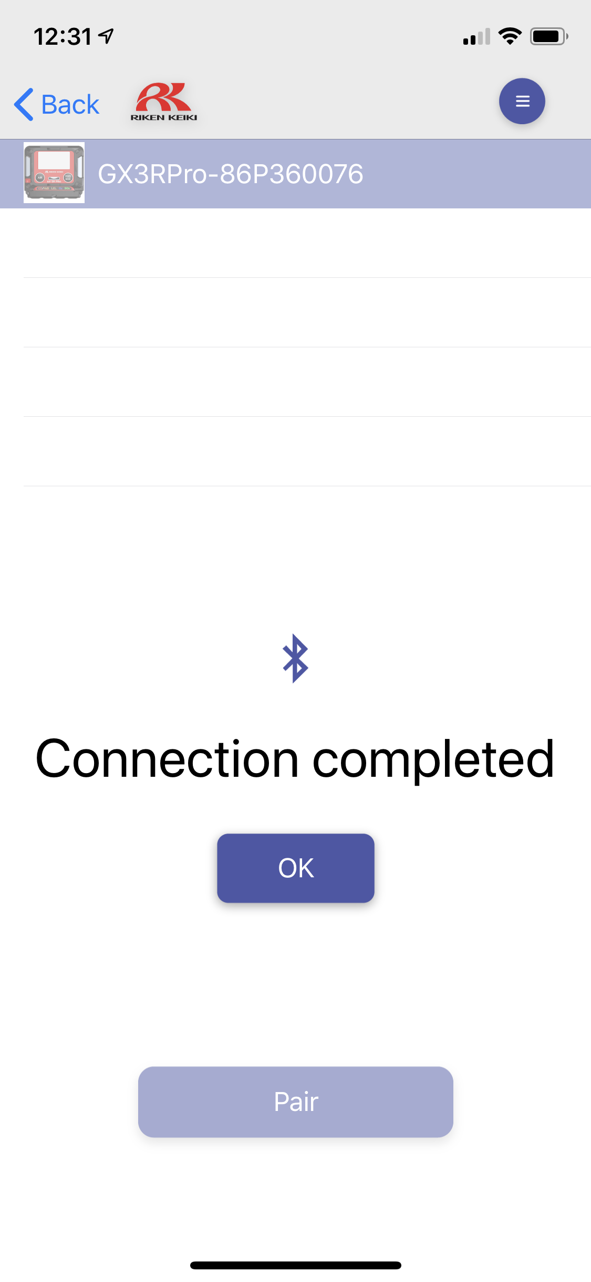
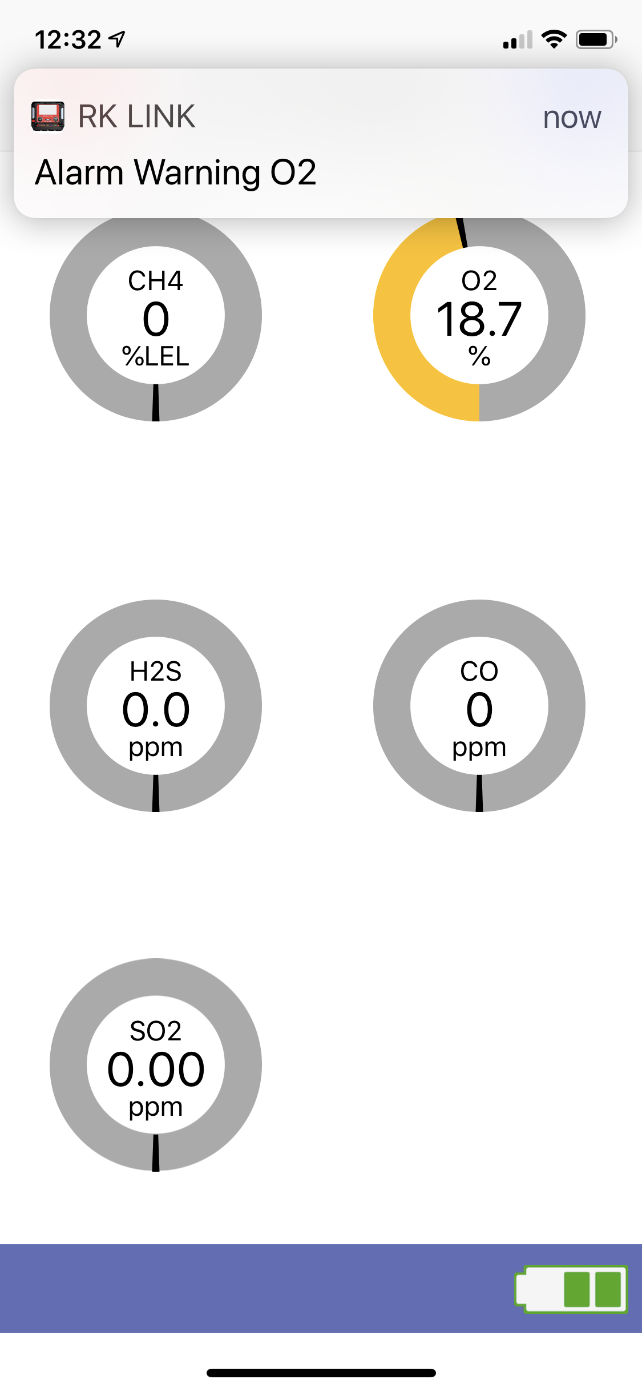
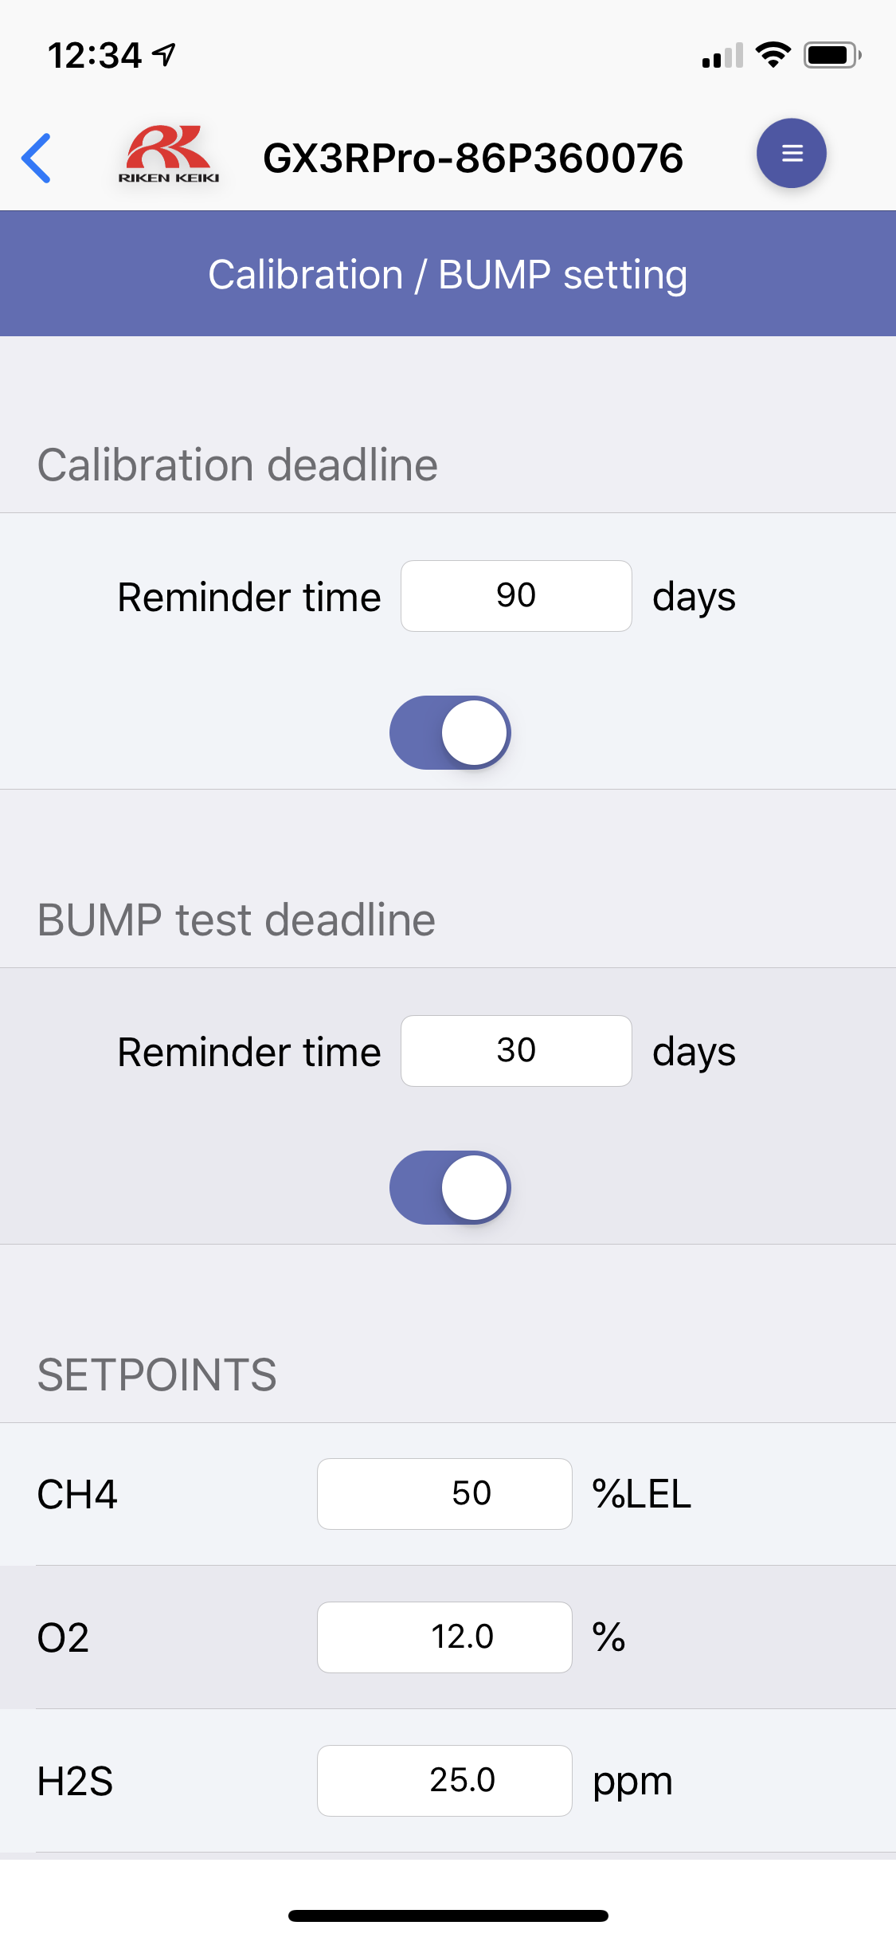
Settings & Notifications
GX-3R Pro—Connectivity
Easy to Pair
Phone Notifications
Instrument Settings
*SMS available early 2020

Slide 32
OPERATION

Slide 33
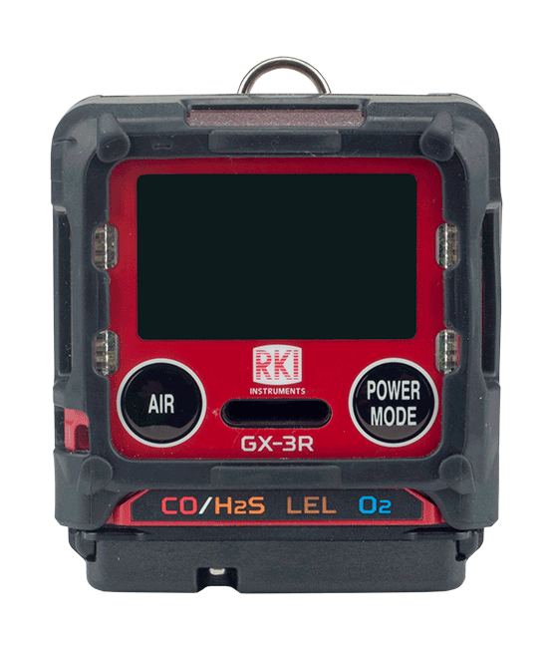
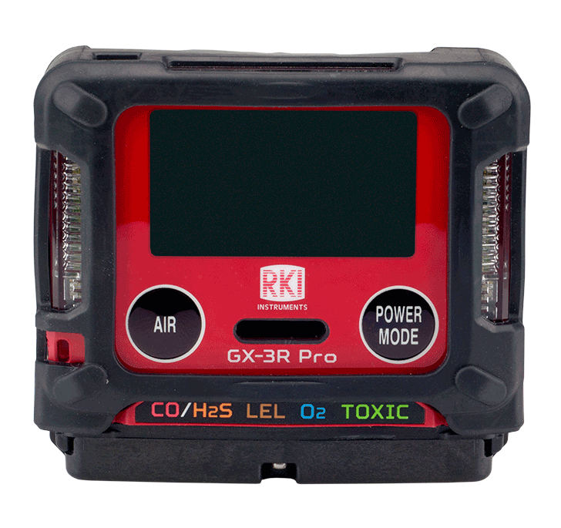
Turn on
GX-3R
GX-3R Pro
Turn on the GX-3R and GX-3R Pro by pressing and holding the POWER MODE button

Slide 34
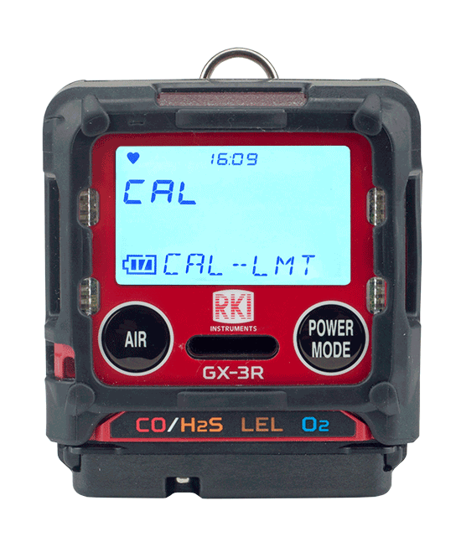
GX-3R Cal Reminder
Acknowledge and use
Perform a calibration
If calibration is due, press the POWER/MODE button to perform calibration.
Press AIR button to continue without performing a calibration

Slide 35
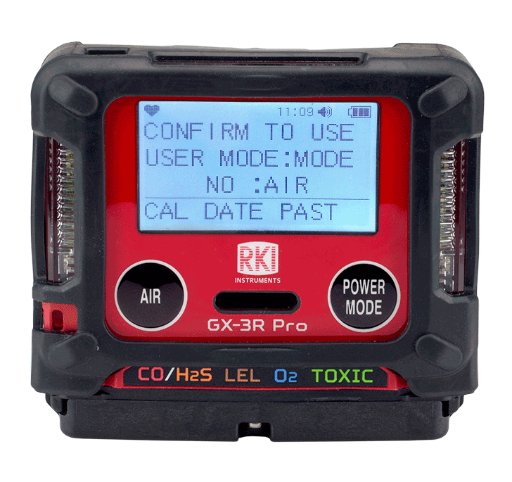
GX-3R Pro Calibration Reminder
Calibration Menu is located in User Mode
Perform a calibration
Acknowledge and use
If calibration is due, press the POWER/MODE button to perform calibration.
Press AIR button to continue without performing a calibration.

Slide 36
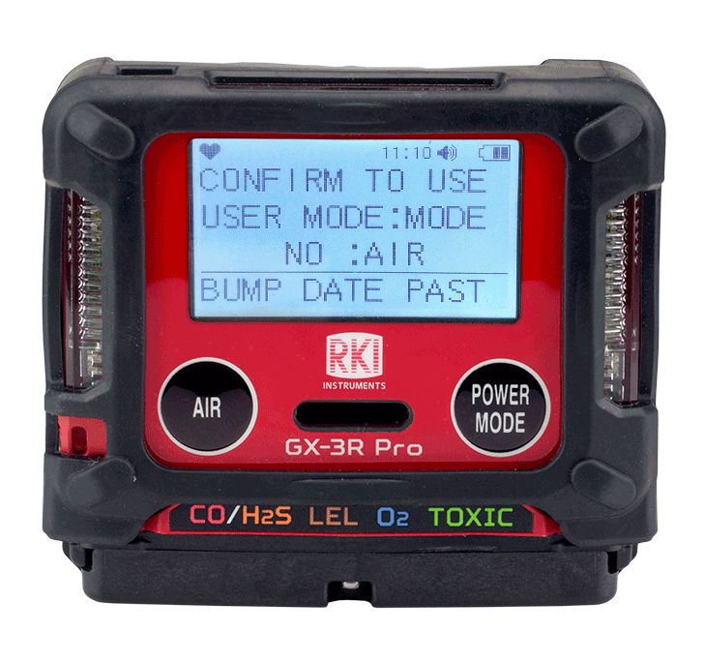
GX-3R Pro Bump Reminder
Calibration Menu is located in User Mode
Perform a calibration
Acknowledge and use
If bump is due, press the POWER/MODE button to perform bump.
Press AIR button to continue without performing bump.

Slide 37
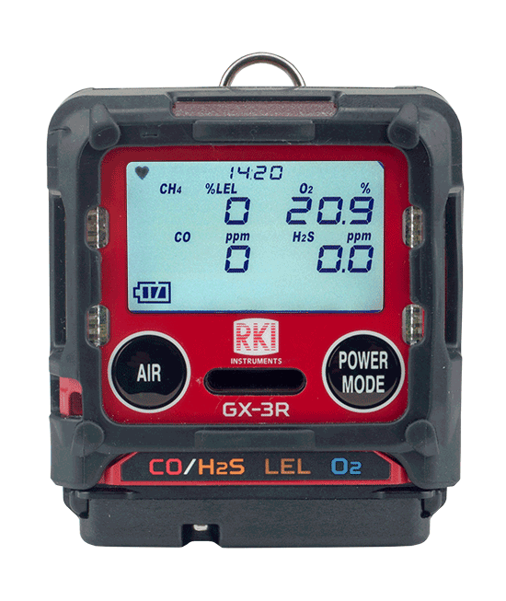
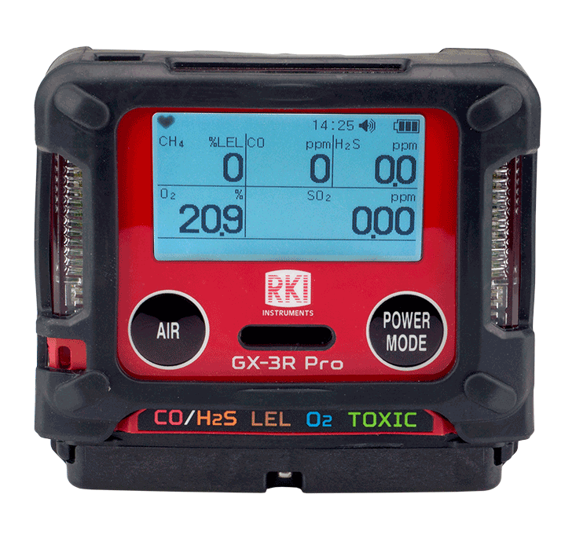
Normal Mode
GX-3R
GX-3R Pro
Several seconds after warm-up, these are the normal operating mode screens for the GX-3R and GX-3R Pro

Slide 38
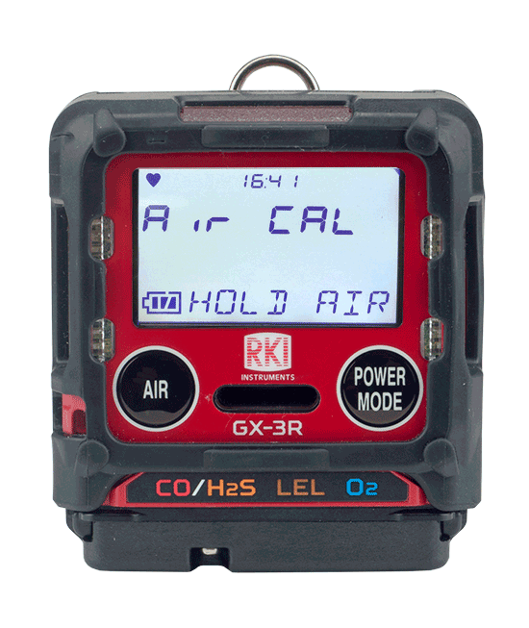

Fresh Air
GX-3R
GX-3R Pro
Press and hold the AIR button

Slide 39


Fresh Air
GX-3R
GX-3R Pro
Release the AIR button when it prompts you to release it

Slide 40




Alarm
GX-3R
GX-3R Pro
Once you’re in a safe location, and the reading goes back to normal, press the POWER/MODE button to silence the unit.

Slide 41

Display Mode vs. Normal Operation
Display mode allows you to toggle through a list of menus in your GX-3R or GX-3R Pro. This is where you can turn on Bluetooth, change alarm points, etc.
PEAK
STEL
TWA
LIST
USER ID
STN ID
CAL DATA
BUMP DATA
TEMP
ALARM-PT
You will know you are in display mode if you see the peak reading as indicated here.
To exit, simply scroll back to your standard gas readings, or leave it for 20 seconds and the unit will revert back to normal mode automatically.

Slide 42



Display mode vs. Normal Operation
PEAK
STEL
TWA
HC GAS LIST
USER ID
STATION ID
CAL DATA
BUMP DATA
DATE
ALARM POINTS
INVERT SELECT
LCD BACKGROUND
BLUETOOTH
BUZZER VOLUME
LANGUAGE
To enter into display, press POWER/MODE button…..

Slide 43
Turn off
GX-3R
GX-3R Pro
Turn off the GX-3R and GX-3R Pro by pressing and holding the POWER MODE button

Slide 44

SDM-3R Calibration Station

Slide 45

SDM 3R Calibration Station
Charge, bump test, calibrate and alarm test instruments using less calibration gas
Automatically schedule tests
Bank up to 10 units with tubeless connection
Access instrument data via USB or ethernet

Slide 46

SDM 3R Calibration Station
Automate bump tests, calibrations, charging, & data retrieval
Operate up to 10 stations with 1 set of calibration equipment
Automate entire process
Configure parameters
Archive Bump Test and Calibration records
Connect directly to a LAN network

Slide 47


Advancements
Calibration Stations
Bump Time: 10 seconds
Gas Consumption: 450 ml / min
Output: USB drive / USB Cable to PC
SDM-2009
Bump Time: 10 seconds
Gas Consumption: 250 ml / min
(About 50% less gas usage than GX-2009)
Output: Internal memory / USB drive / LAN cable / USB Cable to PC
Accepts both GX-3R and GX-3R Pro
SDM-3R

Slide 48

SDM-3R: Gas Ports
Gas 3
Gas 2
Gas 1
Air port

Slide 49

SDM-3R: USB port
USB port

Slide 50

SDM-3R: Rear ports
Ethernet
PC Connection
AC power

Slide 51

GX-3R Placement
Yellow tab up

Slide 52

GX-3R Pro Placement
Yellow tab down

Slide 53


