Slide 1
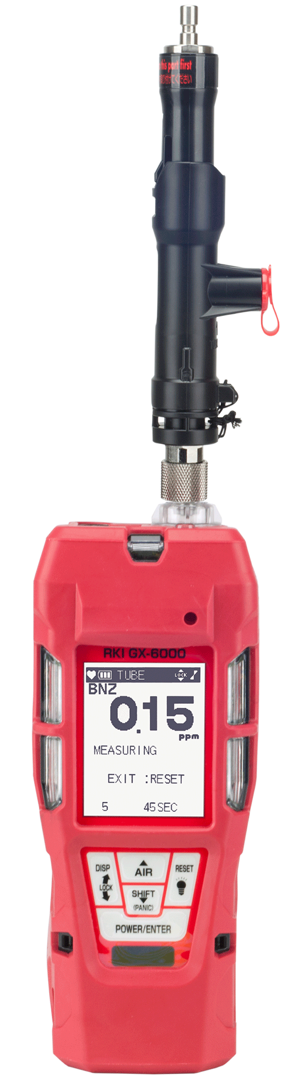
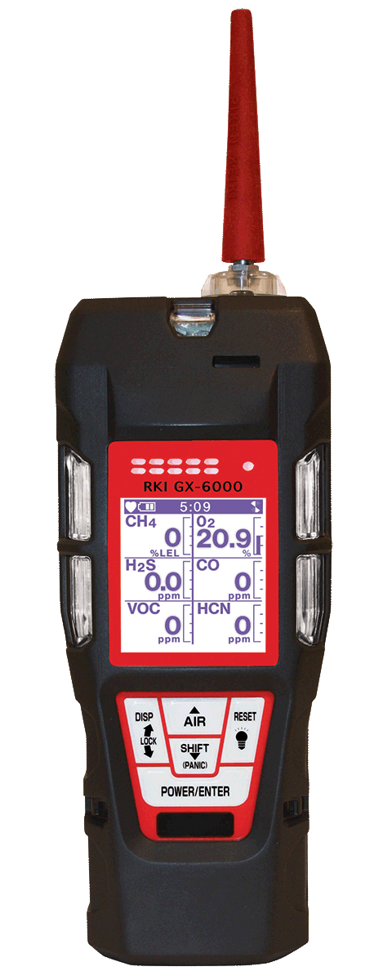
Strengths & Weaknesses
GX-6000

Slide 2
Strengths
Size and weight
Ergonomic: easily fits in the palm of a hand
6 operating modes
  Benzene, Leak Check, Normal
Dual PID’s in one instrument
  General VOC monitoring with 10.6 lamp
  Benzene specific readings with 10.0 lamp
LEL protection mode shields high hydrocarbon exposure

Slide 3
Strengths
Widest range of VOC library stored:
  Over 600 VOC’s for 10.6 lamp
  Plus over 100 VOC’s for the 10.0 lamp
Longer breakthrough time with pre-filter tube than Rae Systems
Benzene filter holder break-away design

Slide 4
Strengths
User friendly operational software
Customizable Display
  Auto flip
  Peak bar graphs
  Large font single gas view
  Customize gas order
Customer Service & Technical Support
Product Availability

Slide 5
Weaknesses
Lack of Market presence
Connectivity
Data logging Software

