Slide 1


Trusted Partners in Gas Detection

Slide 2
Who is RKI Instruments?
History
Selling Features
Started in 1994 in Union City California
Over 100 employees
Owned by Riken Keiki, Tokyo Japan
Over 84 years in gas detection
Our distributors can sell both portable and fixed gas detection
Smallest four-gas detector in the market
Smallest five-gas detector in the market
Full three-year warranty on most Premier Portable Products, including sensors
Products are designed to never be returned for service.

Slide 3




Company Culture
Customer Service
Technical Service
Fast Delivery
Quality

Slide 4

Realities of Confined Space

Slide 5
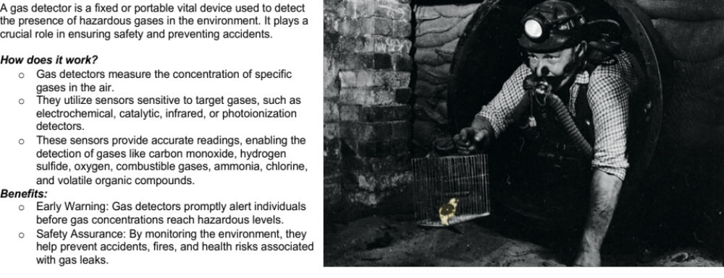
What is a Gas Detector

Slide 6



Primary Protection
Combustibles
LEL
Toxics
CO H2S
Oxygen Deficiency
‘I can’t breath’
N2, Argon

Slide 7
Selling Gas Detection
Where to go
Who to call
What to ask

Slide 8
Common Gas Hazards by Industry
Industry | Hazards/Gases | Portable Products
Oil & Gas | LEL, O2, H2S, CO, SO2, HCN, NH3, Benzene (C6H6), HF, VOCs | GX-3R & GX-3R Pro |GX-2012 | GX-6000 | Eagle 3 |GX-Force
Energy/Utilities | LEL, O2, H2S, CO, SO2, H2 | GX-3R & GX-3R Pro|GX-2012 |Eagle 3 | GX-Force
Construction | LEL, O2, H2S, CO, NO2 | GX-3R & GX-3R Pro|GX-Force|GX-6000
Water/Wastewater | LEL, O2, H2S, CO, NH3, Cl2, O3, SO2, VOC’s | SC-04|GX-3R & GX-3R Pro|GX-Force|GX-6000
Landfill/Waste | CH4, CO2, NH3, Cl2, NMOC’s, VOC’s | GX-6000|Eagle 3
Fire/First Responders | LEL, O2, H2S, CO, HCN, NH3, VOC’s | CO-03|GX-3R & GX-3R Pro|GX-6000 | GX-Force
Food and Beverage Production | LEL, O2, H2S, CO, HCN, NH3, CO2, PH3 | HS-04|SC-04|GX-3R & GX-3R Pro|GX-6000|GX-Force
Manufacturing | LEL, O2, H2S, CO, Process gases like CO2, NH3 | GX-3R & GX-3R Pro|GX-6000 GX-Force|OX-04|SC-04
Chemical | LEL, O2, H2S, CO, Cl2, H2, HCl, NO2, SO2, VOC’s | GX-3R & GX-3R Pro|GX-6000|Eagle 3

Slide 9

Who To Call
Looking for the person in charge of the following:
  PPE (personal protective equipment)
  HSE or EHS (Health, Safety, & Environment or Environmental, Health, & Safety)
  Industrial Hygiene
  Safety
  Instrumentation shop

Slide 10
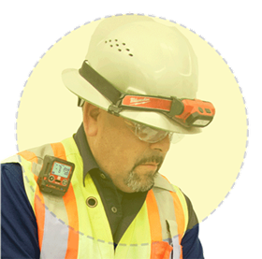
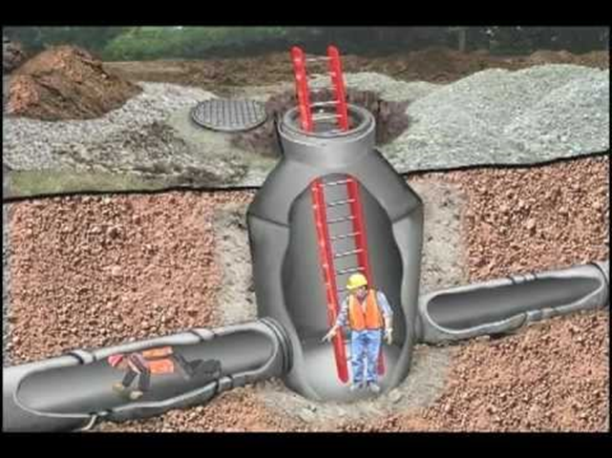
What to ask?
What are you using for gas detection?
Are you happy with your gas detection?
Who handles the gas detection here?
Do you have any failures?
What gases do you need to monitor?
Are you looking for a personal detector to mount in the breathing zone?
  (Diffusion Mode)
Do you need an internal pump to check vertically for tanks or manholes?
Do you need the standard four-gas sensors most popularly used (LEL/O2/CO/H2S)?
Does your facility have continuously monitored fixed systems?
Who services your gas detection?

Slide 11
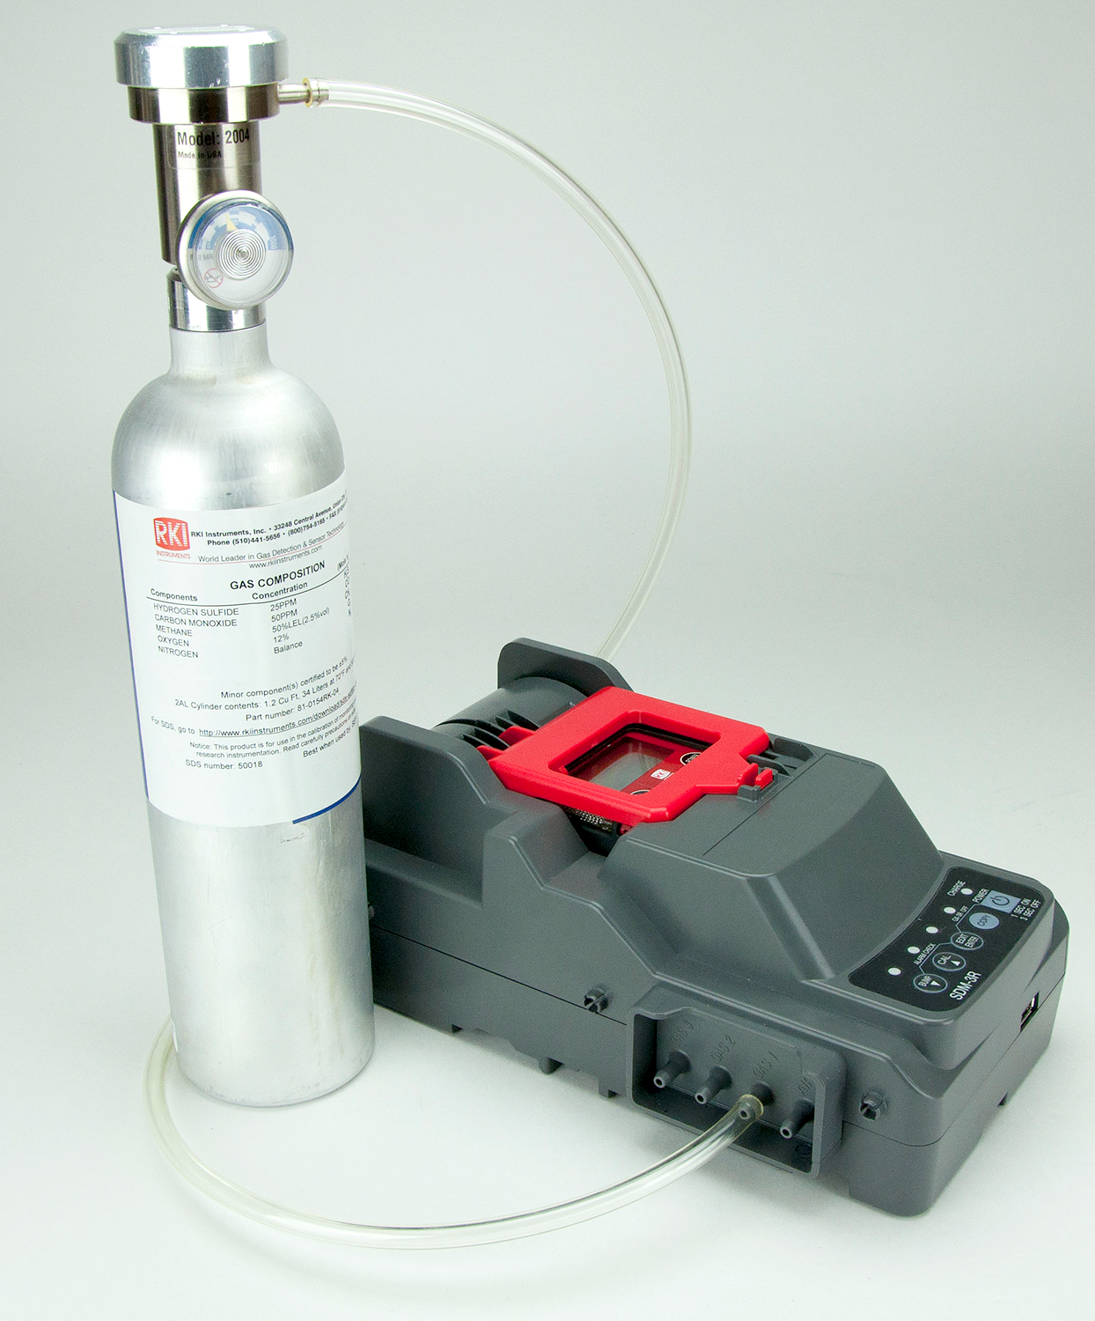
Calibration vs Bump vs Response check
What exactly is a Bump Check?
How often do I have to Bump?
How often do I have to calibrate?

Slide 12
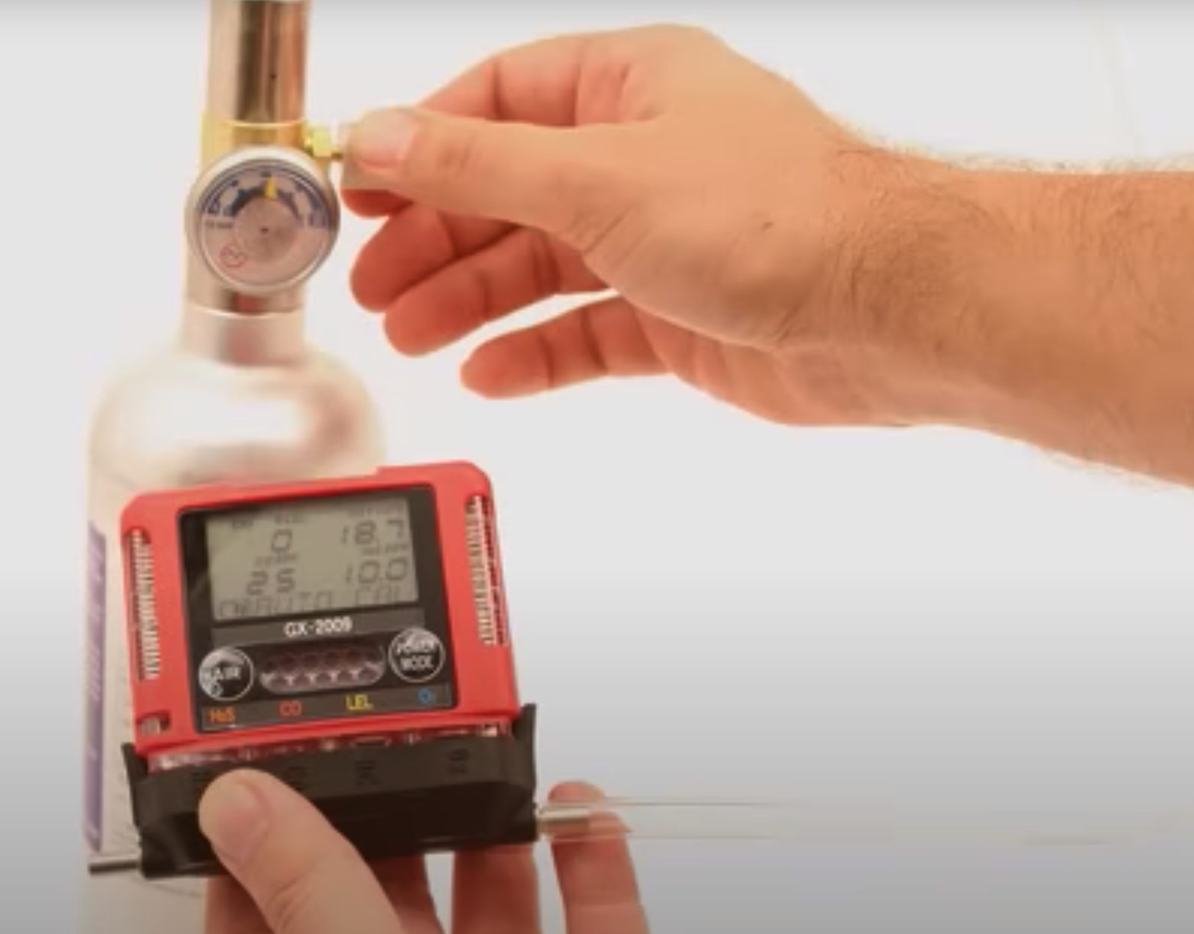
Bump versus Calibration
  Functional Check - A qualitative function check where a challenge gas (Example-25 ppm Hydrogen Sulfide, 50 ppm Carbon Monoxide, 50% LEL Methane, 12% Oxygen Balance N2) is passed over the sensor(s) at a concentration and exposure time sufficient to activate all alarm indicators to present at least their lower alarm setting. The purpose of this check is to confirm that gas can get to the sensor(s) and that all the alarms present are functional. This is typically dependent on the response time of the sensor(s) or a minimum level of response achieved, such as 80% of gas concentration applied. Note this check is not intended to provide a measure of calibration accuracy.
  Bump Check - A quantitative test utilizing a known traceable concentration of test gas to demonstrate that the sensor(s) and alarms respond to the gas within manufacturer’s acceptable limits. This is typically ±10-20% of the test gas concentration applied unless otherwise specified by the manufacturer, internal company policy, or a regulatory agency. This test can be done through the menu system which will record the “bump test” within the datalogger.
  Full calibration – The adjustment of the sensor(s) response to match the desired value compared to a known traceable concentration of test gas. This should be done in accordance with the manufacturer's instructions.

Slide 13
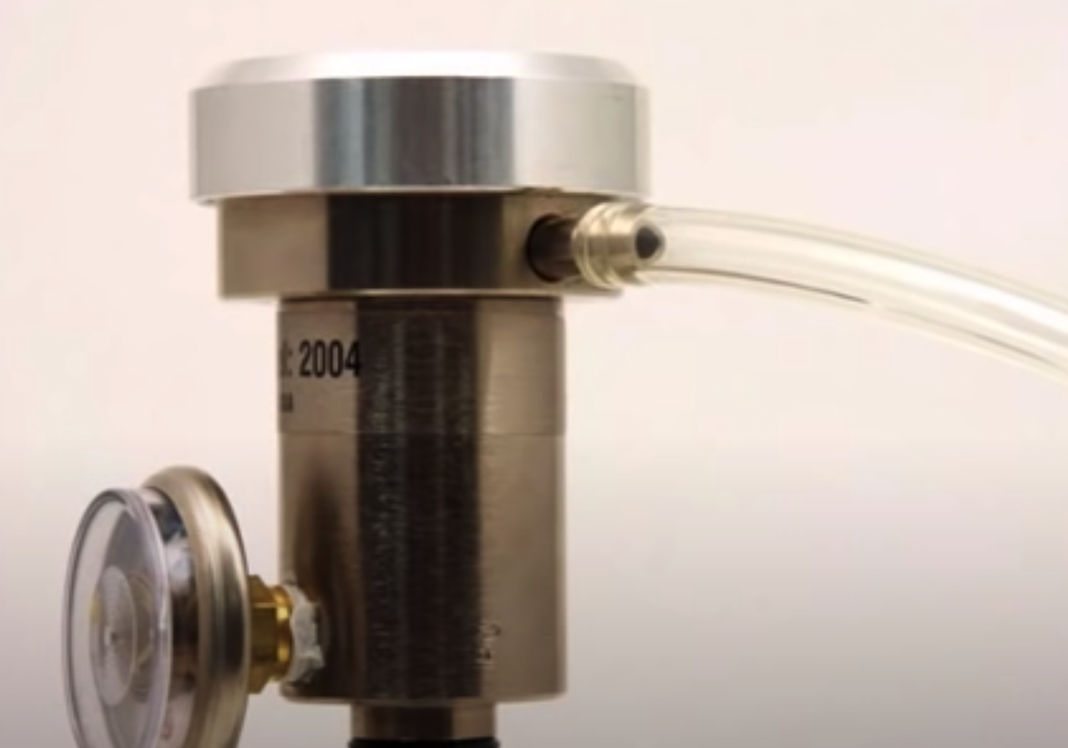
How often do I have to calibrate?
Customers want to hear the answer ‘you never have to calibrate’.
RKI generally recommends users develop a frequency of calibration that is tailored to their application and usage.
Actual calibration frequency ends up being somewhere between one and three months.
For users who “bump test” their instrument prior to each use, the calibration cycle can be extended until the bump test fails.
Instruments subjected to any condition that could have an adverse effect on the unit (sensor poisons, high gas concentrations, extreme temperature) should be calibrated before the next use.
RKI ships portables instruments defaulted with a 90-day calibration reminder.

Slide 14
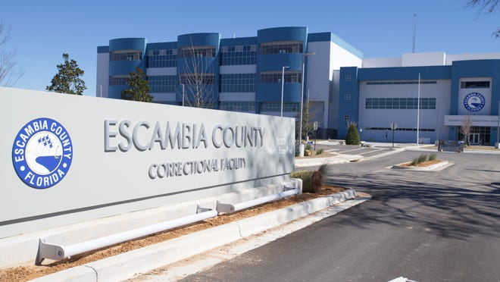
Ritz Success
Escambia County Public Buildings | Fixed System
Donovan Scioneaux
After an Explosion at a prison in Pensacola it was made a priority to have fixed monitoring in all public buildings where natural gas was present.
Met with RKI rep at one of the prisons for a walk-through for a system at the facility as well as a few buildings in Downtown Pensacola
Approximate Revenue from this project was $25,000.
Occasionally we are contacted for replacement sensors or parts for maintenance.

Slide 15
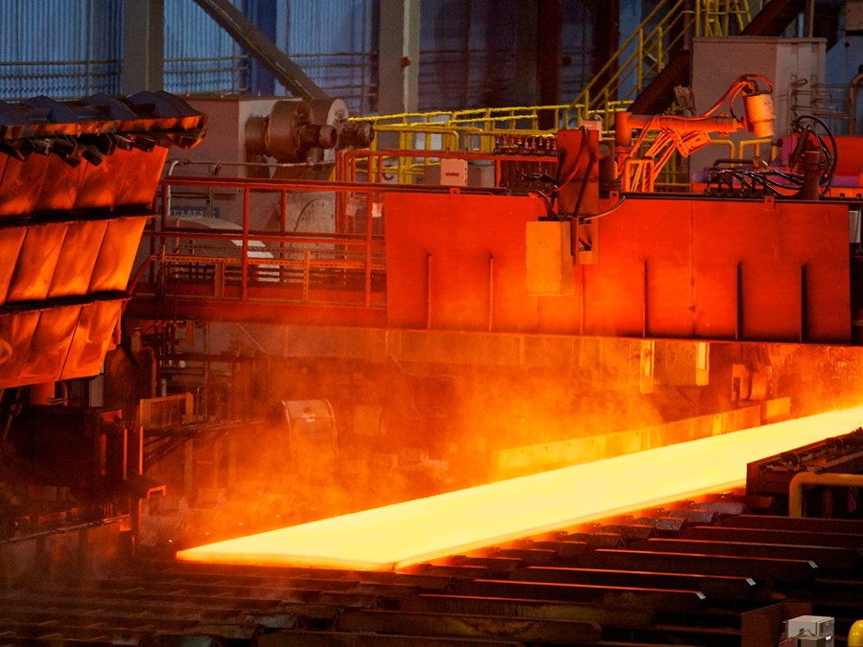
Ritz Success
AM/NS HDG Basement – Fixed System
Donavan Scioneaux
  This project started in 2018 and was moth balled for a year
  In 2021 same department contacted to re-evaluate.
  Brought in RKI reps to design a solution.
  This is a basement under a portion of a steel mill where ambient temperatures could reach an excess of 120°F.
  Four separate systems were designed and proposed.
  By the fourth quarter it was closed.
  RKI included the product and installation services as part of the scope.
  Total Revenue for this project was about $90,000.

Slide 16
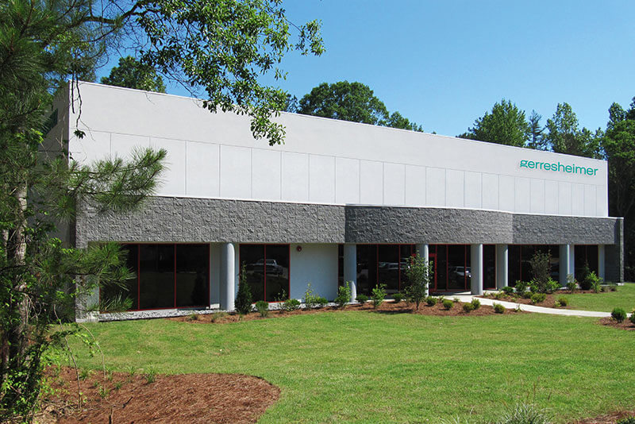
Ritz Success
Gerresheimer AG Peachtree City, GA | Fixed System
Donavan Scioneaux
  Contacted Safety Manager - had a relationship with at another facility.
  Needed Gas Detection for a new process purifying Nitrogen Dioxide.
  Worked with Todd Sauls and Clint Anderson to offer a solution
  Total Revenue for this project about $22,000

Slide 17
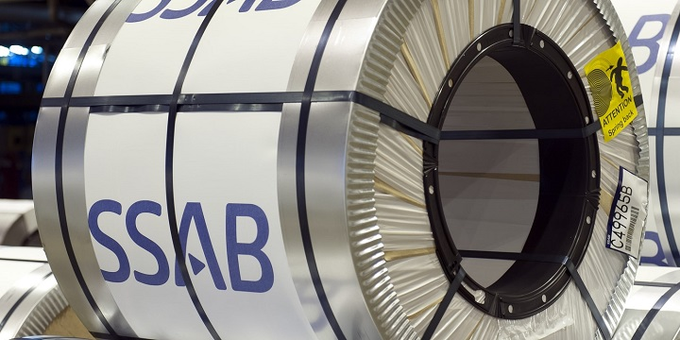
Ritz Success
SSAB | Fixed System - Donavan Scioneaux
  SSAB is a Steel Mill in Axis Alabama
  After an incident in one area of the mill we were brought in to evaluate an area for Fixed Monitoring
  RKI was brought in to design a system for the “VTD Mid Deck” where the hazard was identified.
  This project was proposed as a turnkey installation.
    Total Revenue including labor was about $54,000.
  While there, we were asked to look at 4 other older systems from another provider that no longer worked.
  Replacement systems were designed and were also proposed as turnkey installations.
  Total Value of these 4 projects was about $41,000.00

Slide 18

Ritz Success
Interstate Meats | Fixed System - Megan McDonald
Gas Detection Equipment = $19,957
Installation = $66,150
Total Project = $86,107

Slide 19
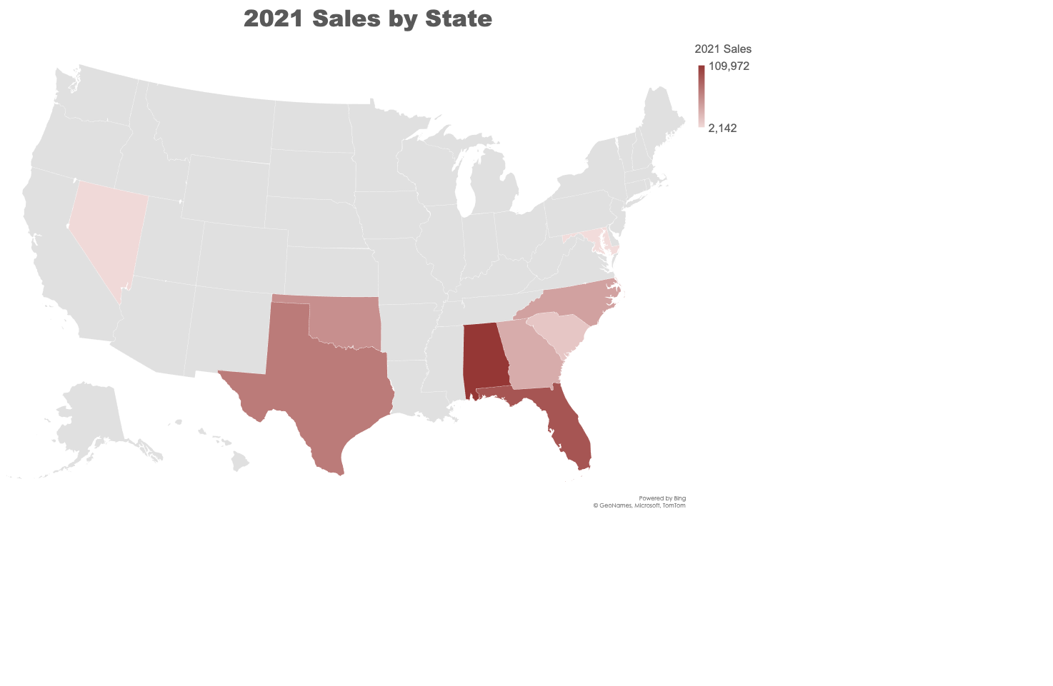

Slide 20
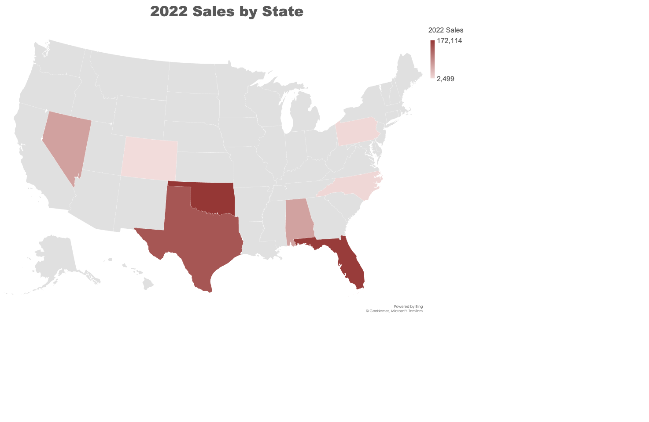

Slide 21
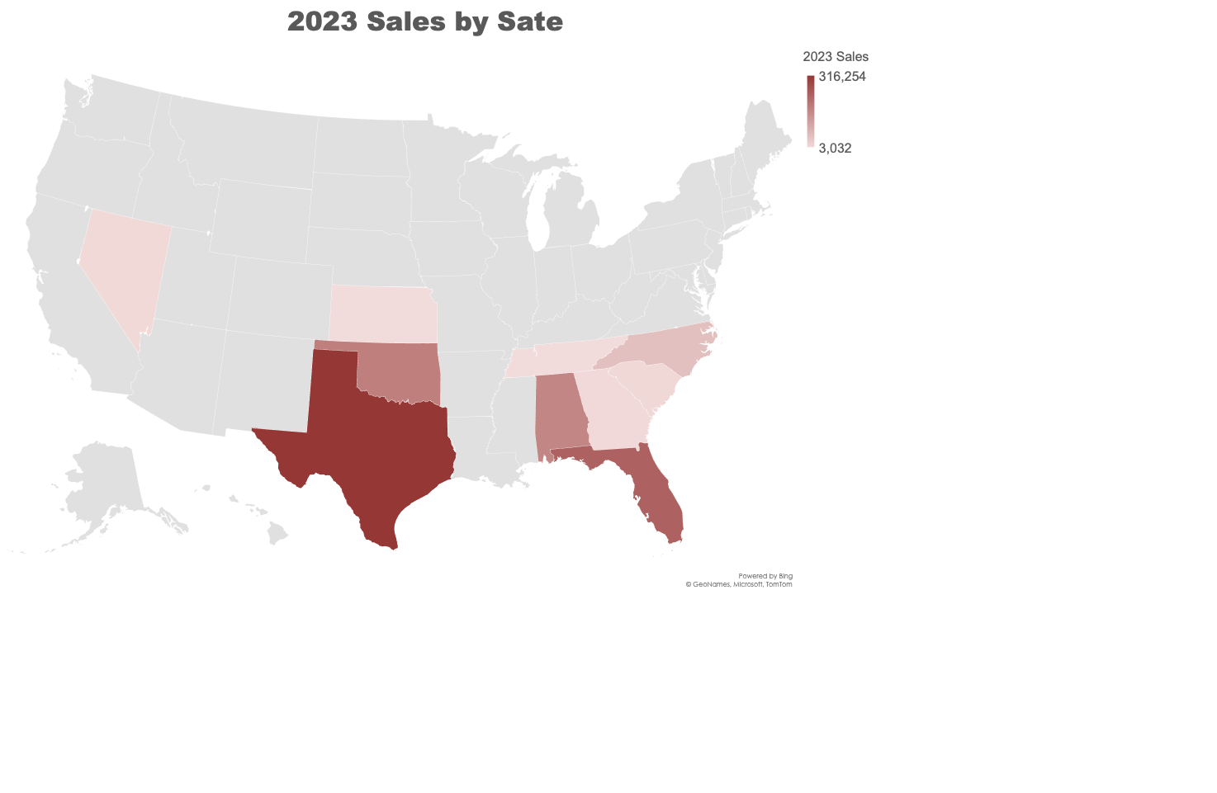

Slide 22
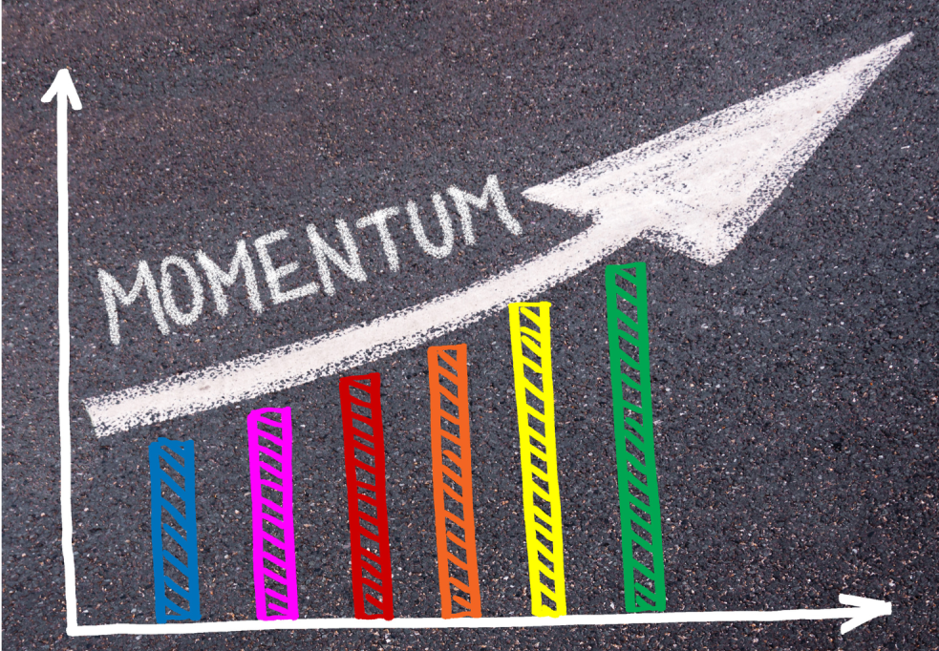
 | 2021 | 2022 | 2023 | % Change
TX | 65,799 | 140,389 | 316,254 | 225%
FL | 90,184 | 166,606 | 235,872 | 142%
OK | 52,263 | 172,114 | 179,548 | 104%
AL | 109,972 | 62,540 | 165,058 | 264%
NC | 40,488 | 7,305 | 55,941 | 766%
SC | 16,343 | 1,947 | 10,984 | 564%
NV | 4,307 | 63,541 | 9,742 | 15%
GA | 33,245 | 1,609 | 9,068 | 564%
MS | 8,319 | 3,060 | 7,779 | 254%
KS |  |  | 3,962
IN | 449 | 4,671 | 3,038 | 65%
TN |  |  | 3,032
OR | 22,036 | 17,245 | 2,348 | 14%
NY |  |  | 1,283
PA |  | 6,188 | 783 | 13%
AR |  | 2,246 | 589 | 26%
AZ | 693 | 109 |  | 0%
CA | 1,287
CO |  | 2,499 |  | 0%
KY |  | 1,432 |  | 0%
LA | 2,708 | 8,550 |  | 0%
MD | 2,142
MO | 417
ND | 315 | 1,439 |  | 0%
WA |  | 289 |  | 0%
WY | 1,643
Grand Total | 452,608 | 658,779 | 1,001,685 | 152%

Slide 23
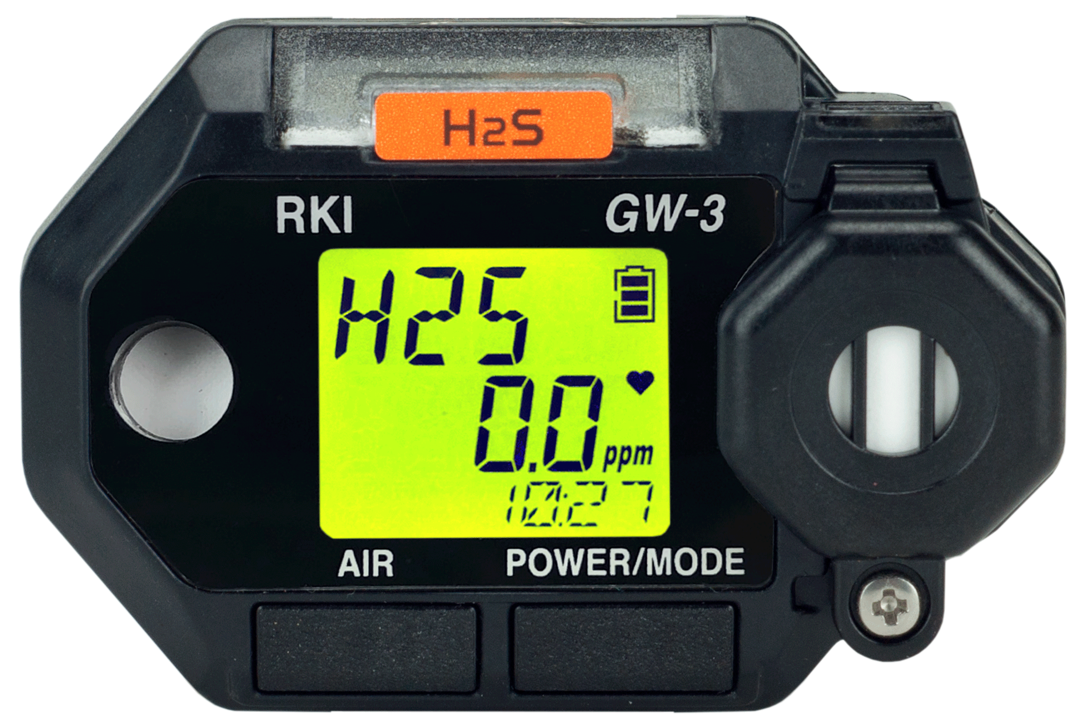
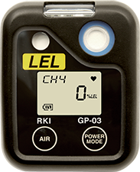
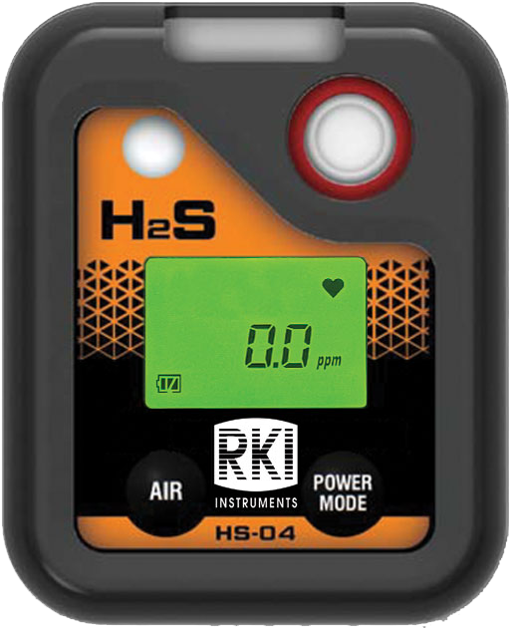
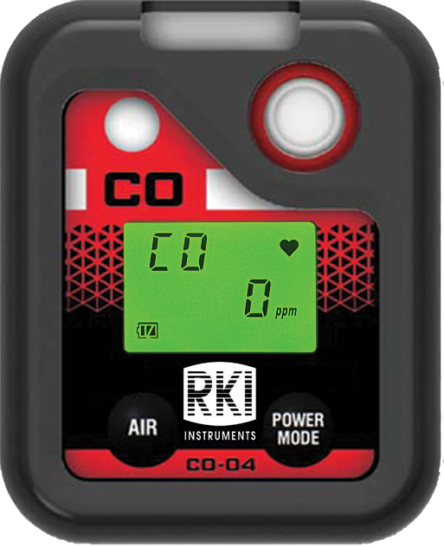
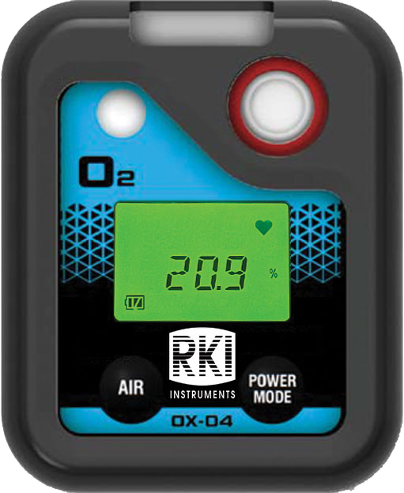
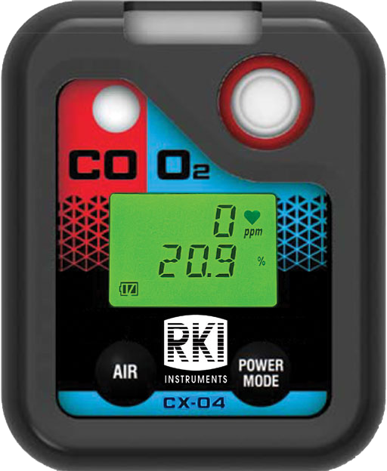
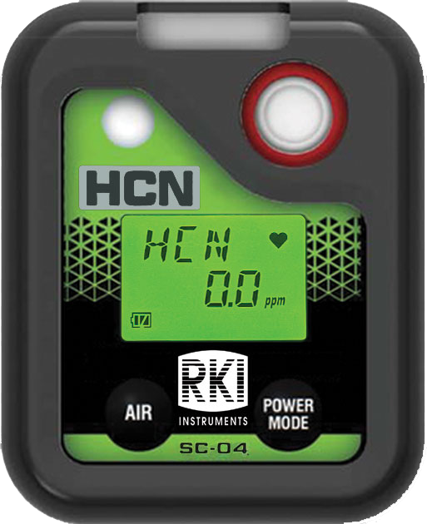
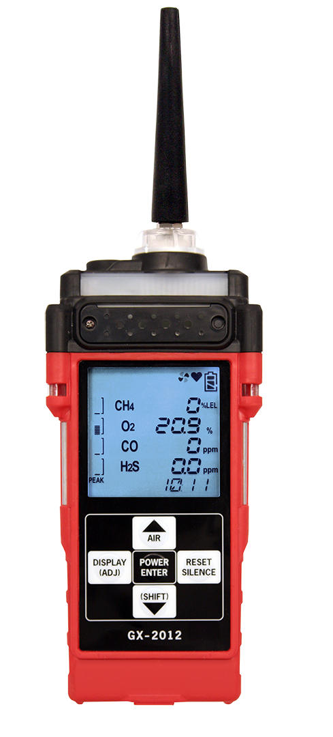
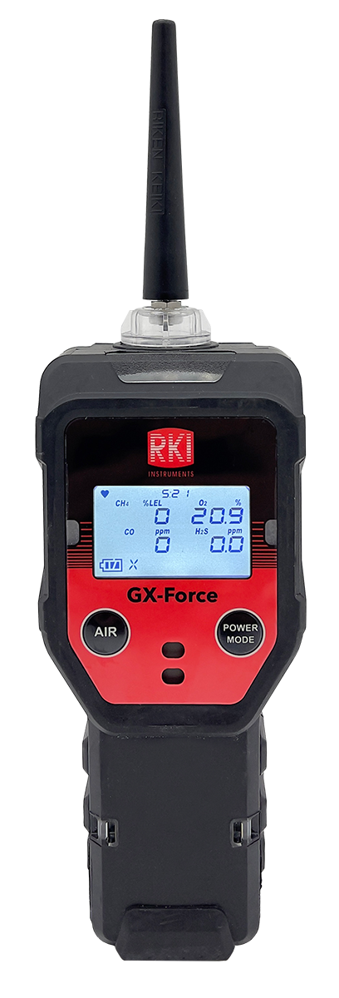
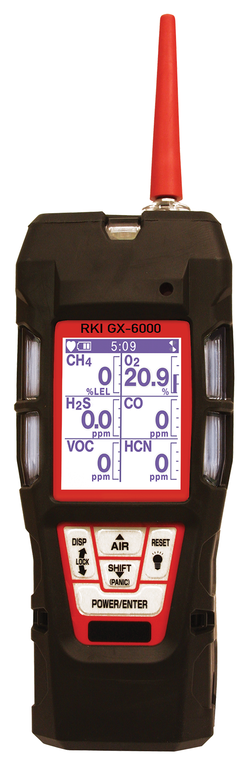
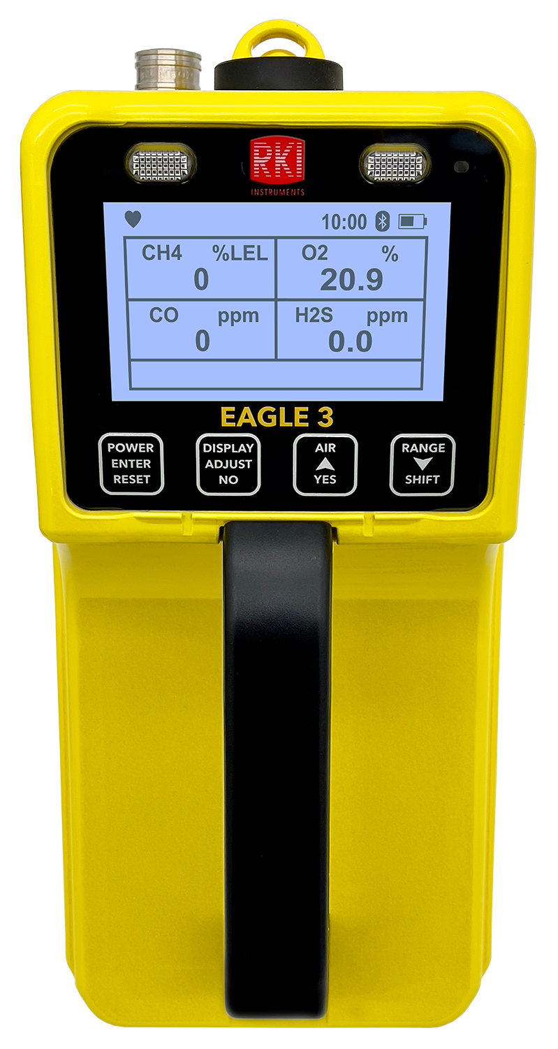
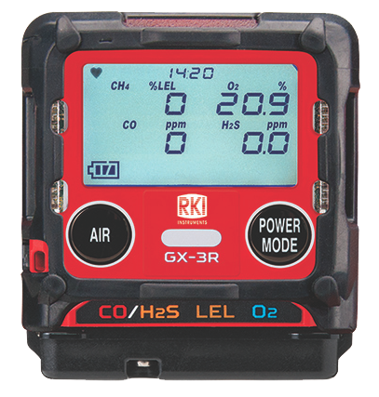
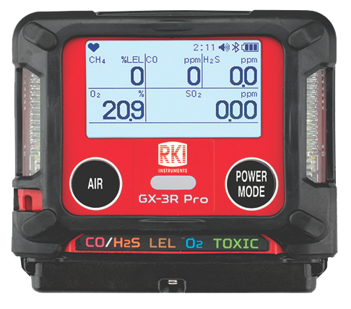
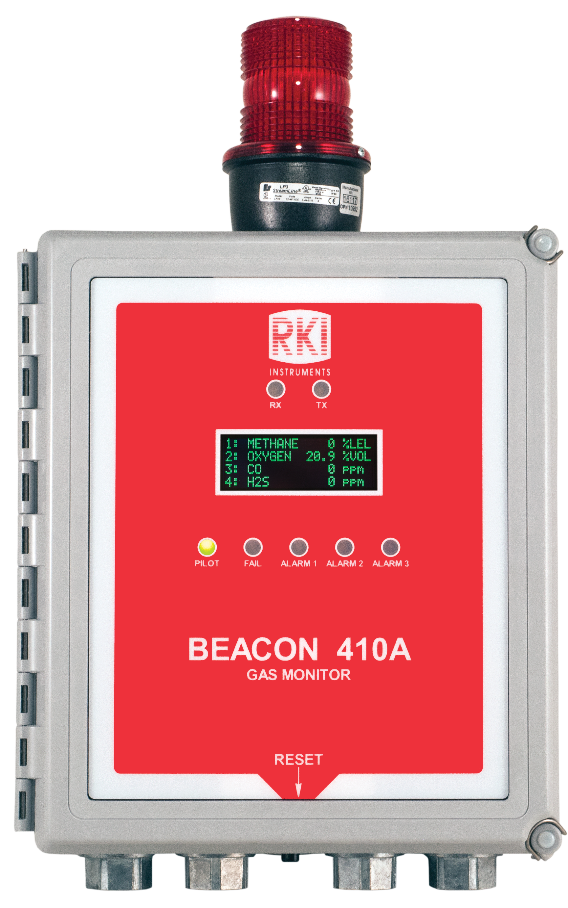
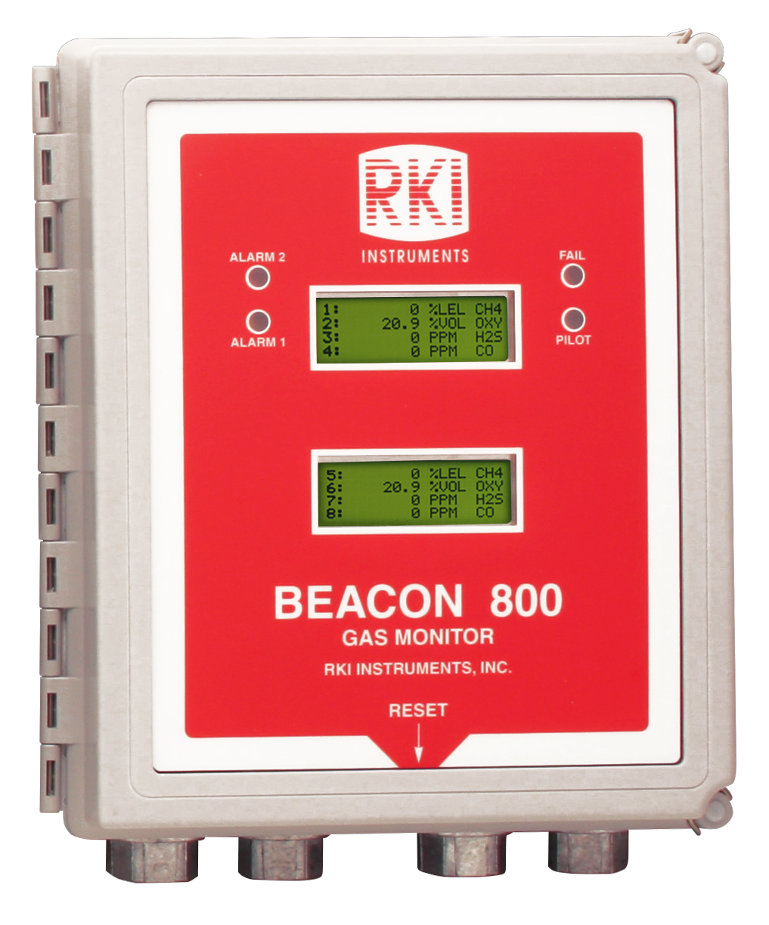
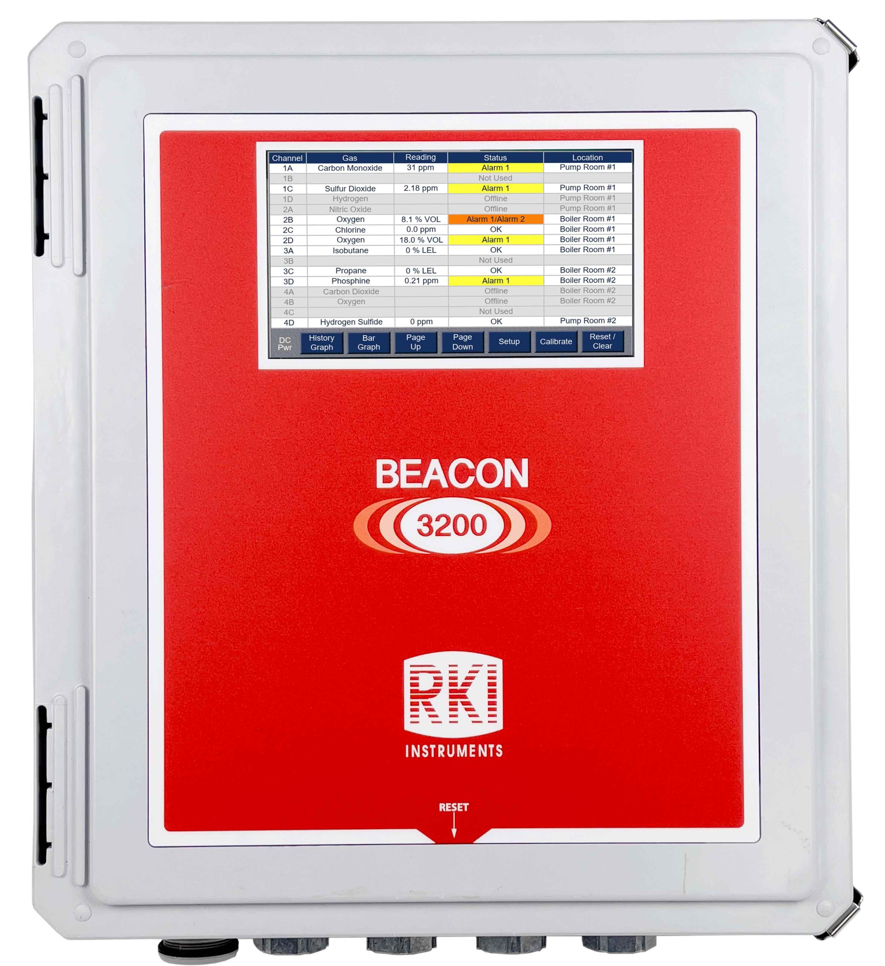
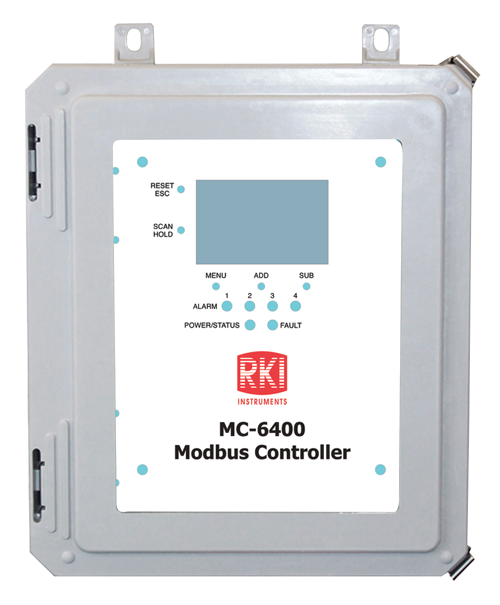
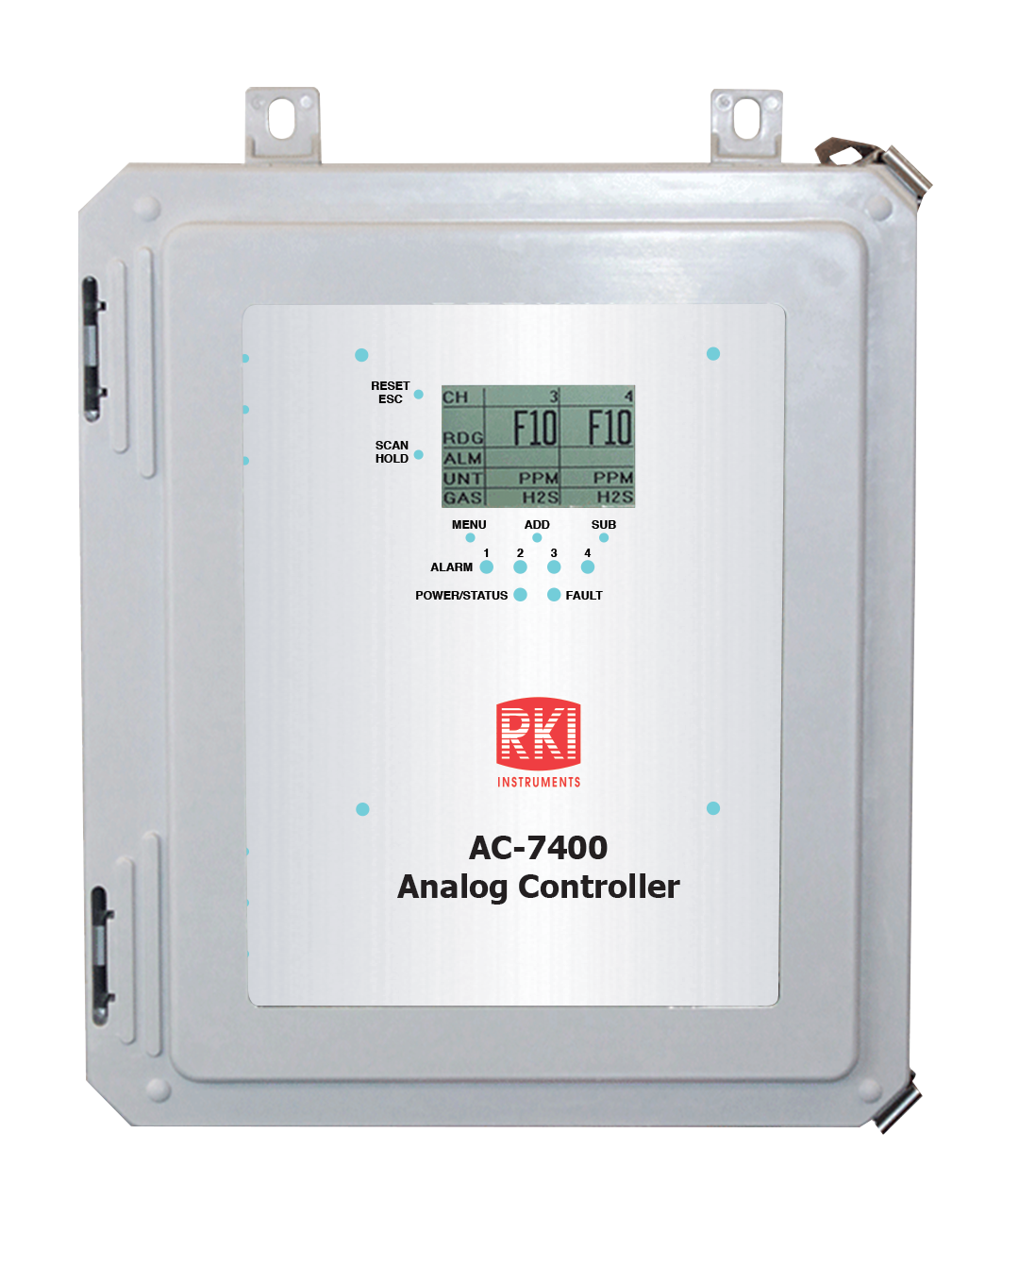
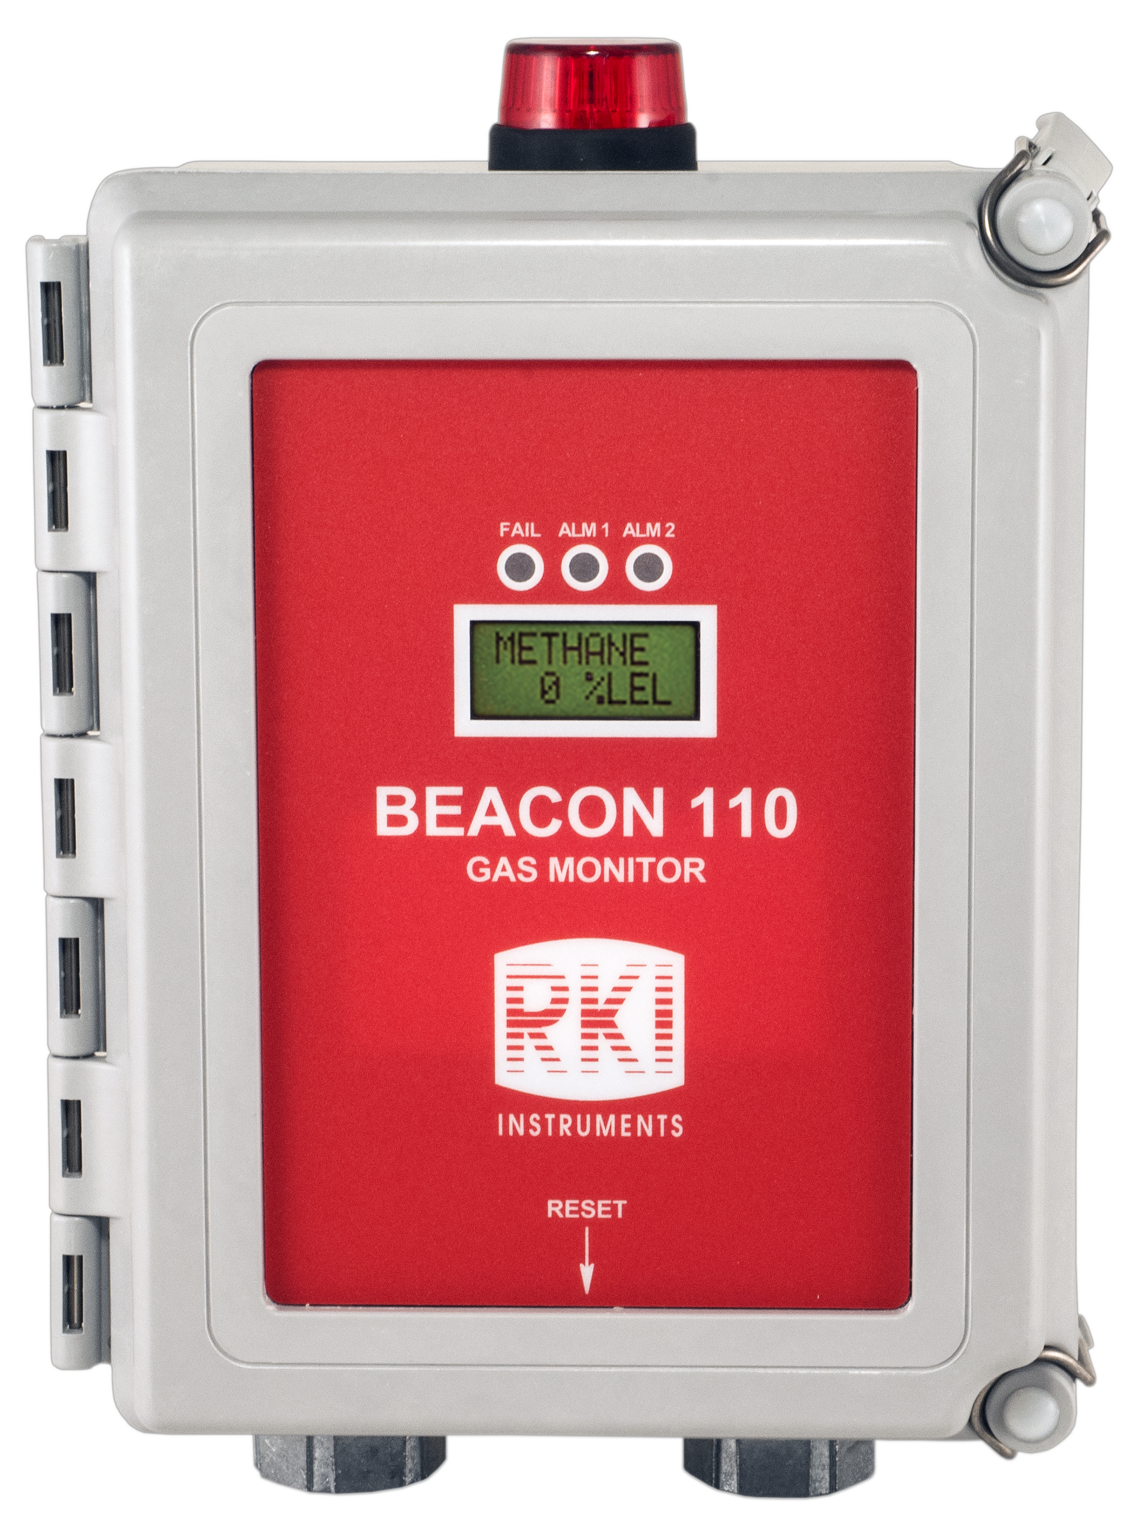
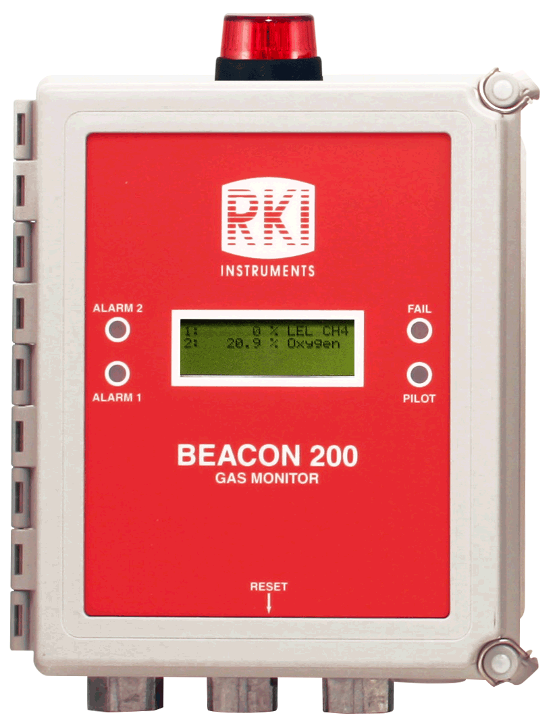
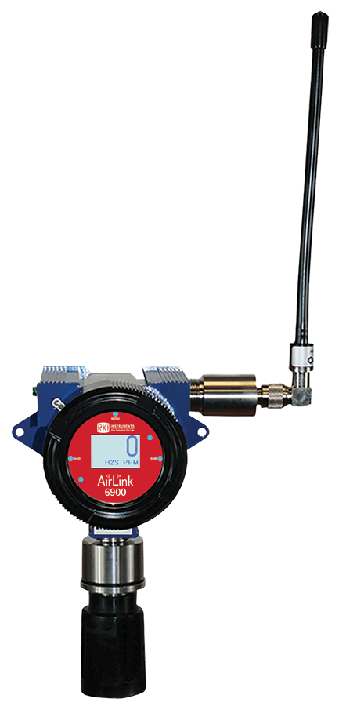
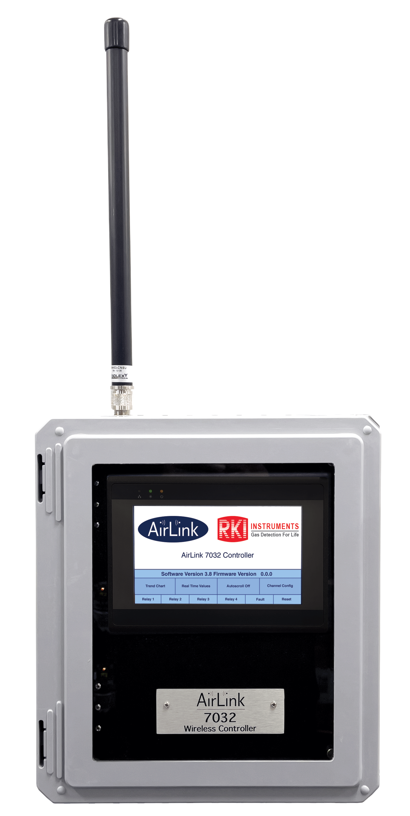
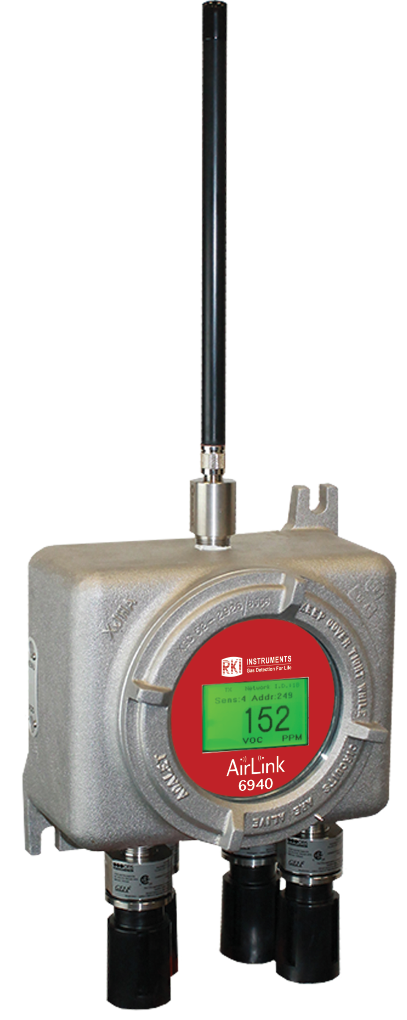
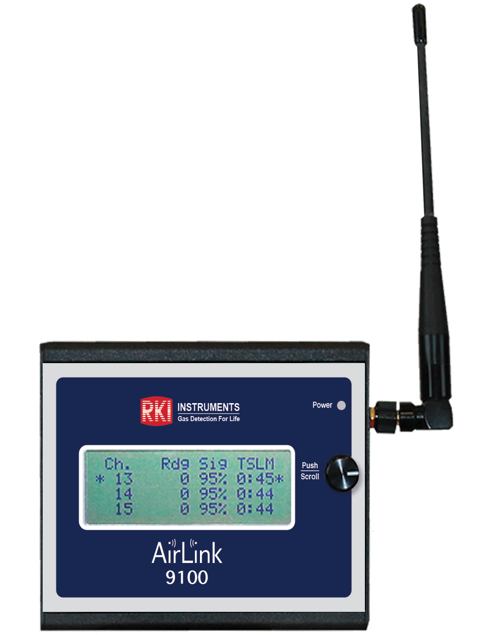
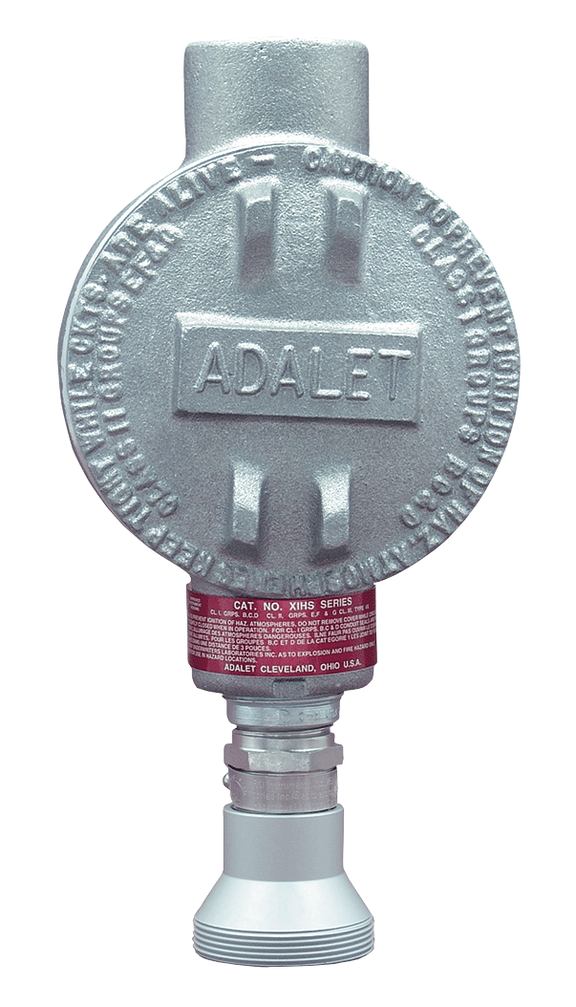
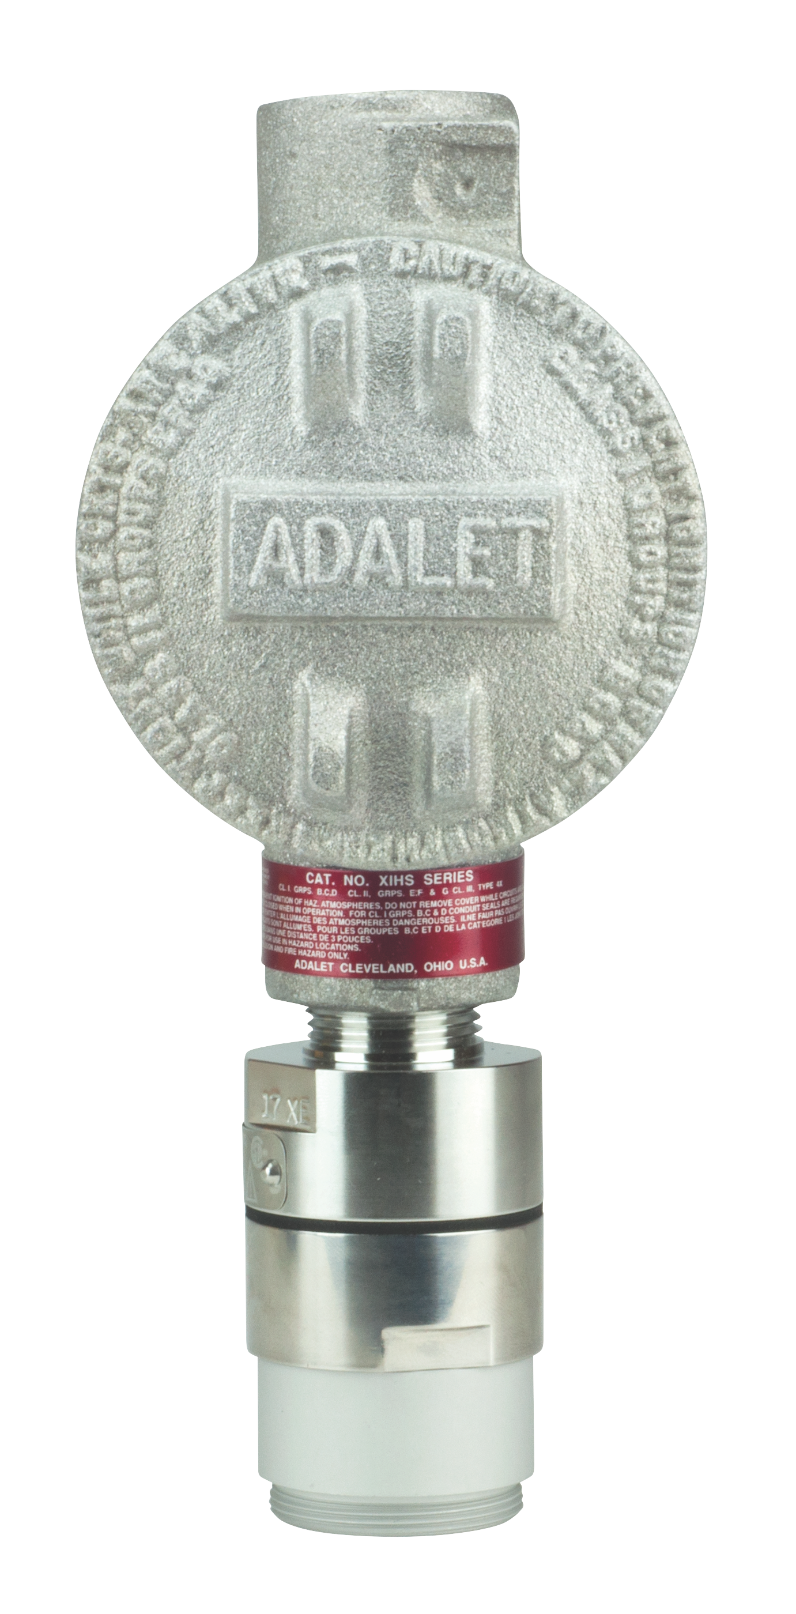
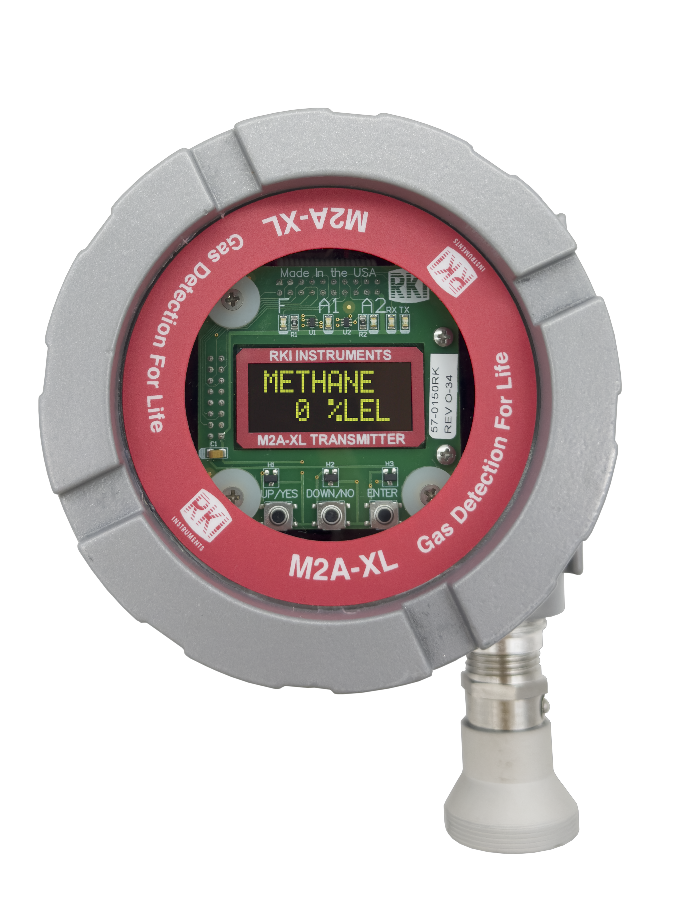
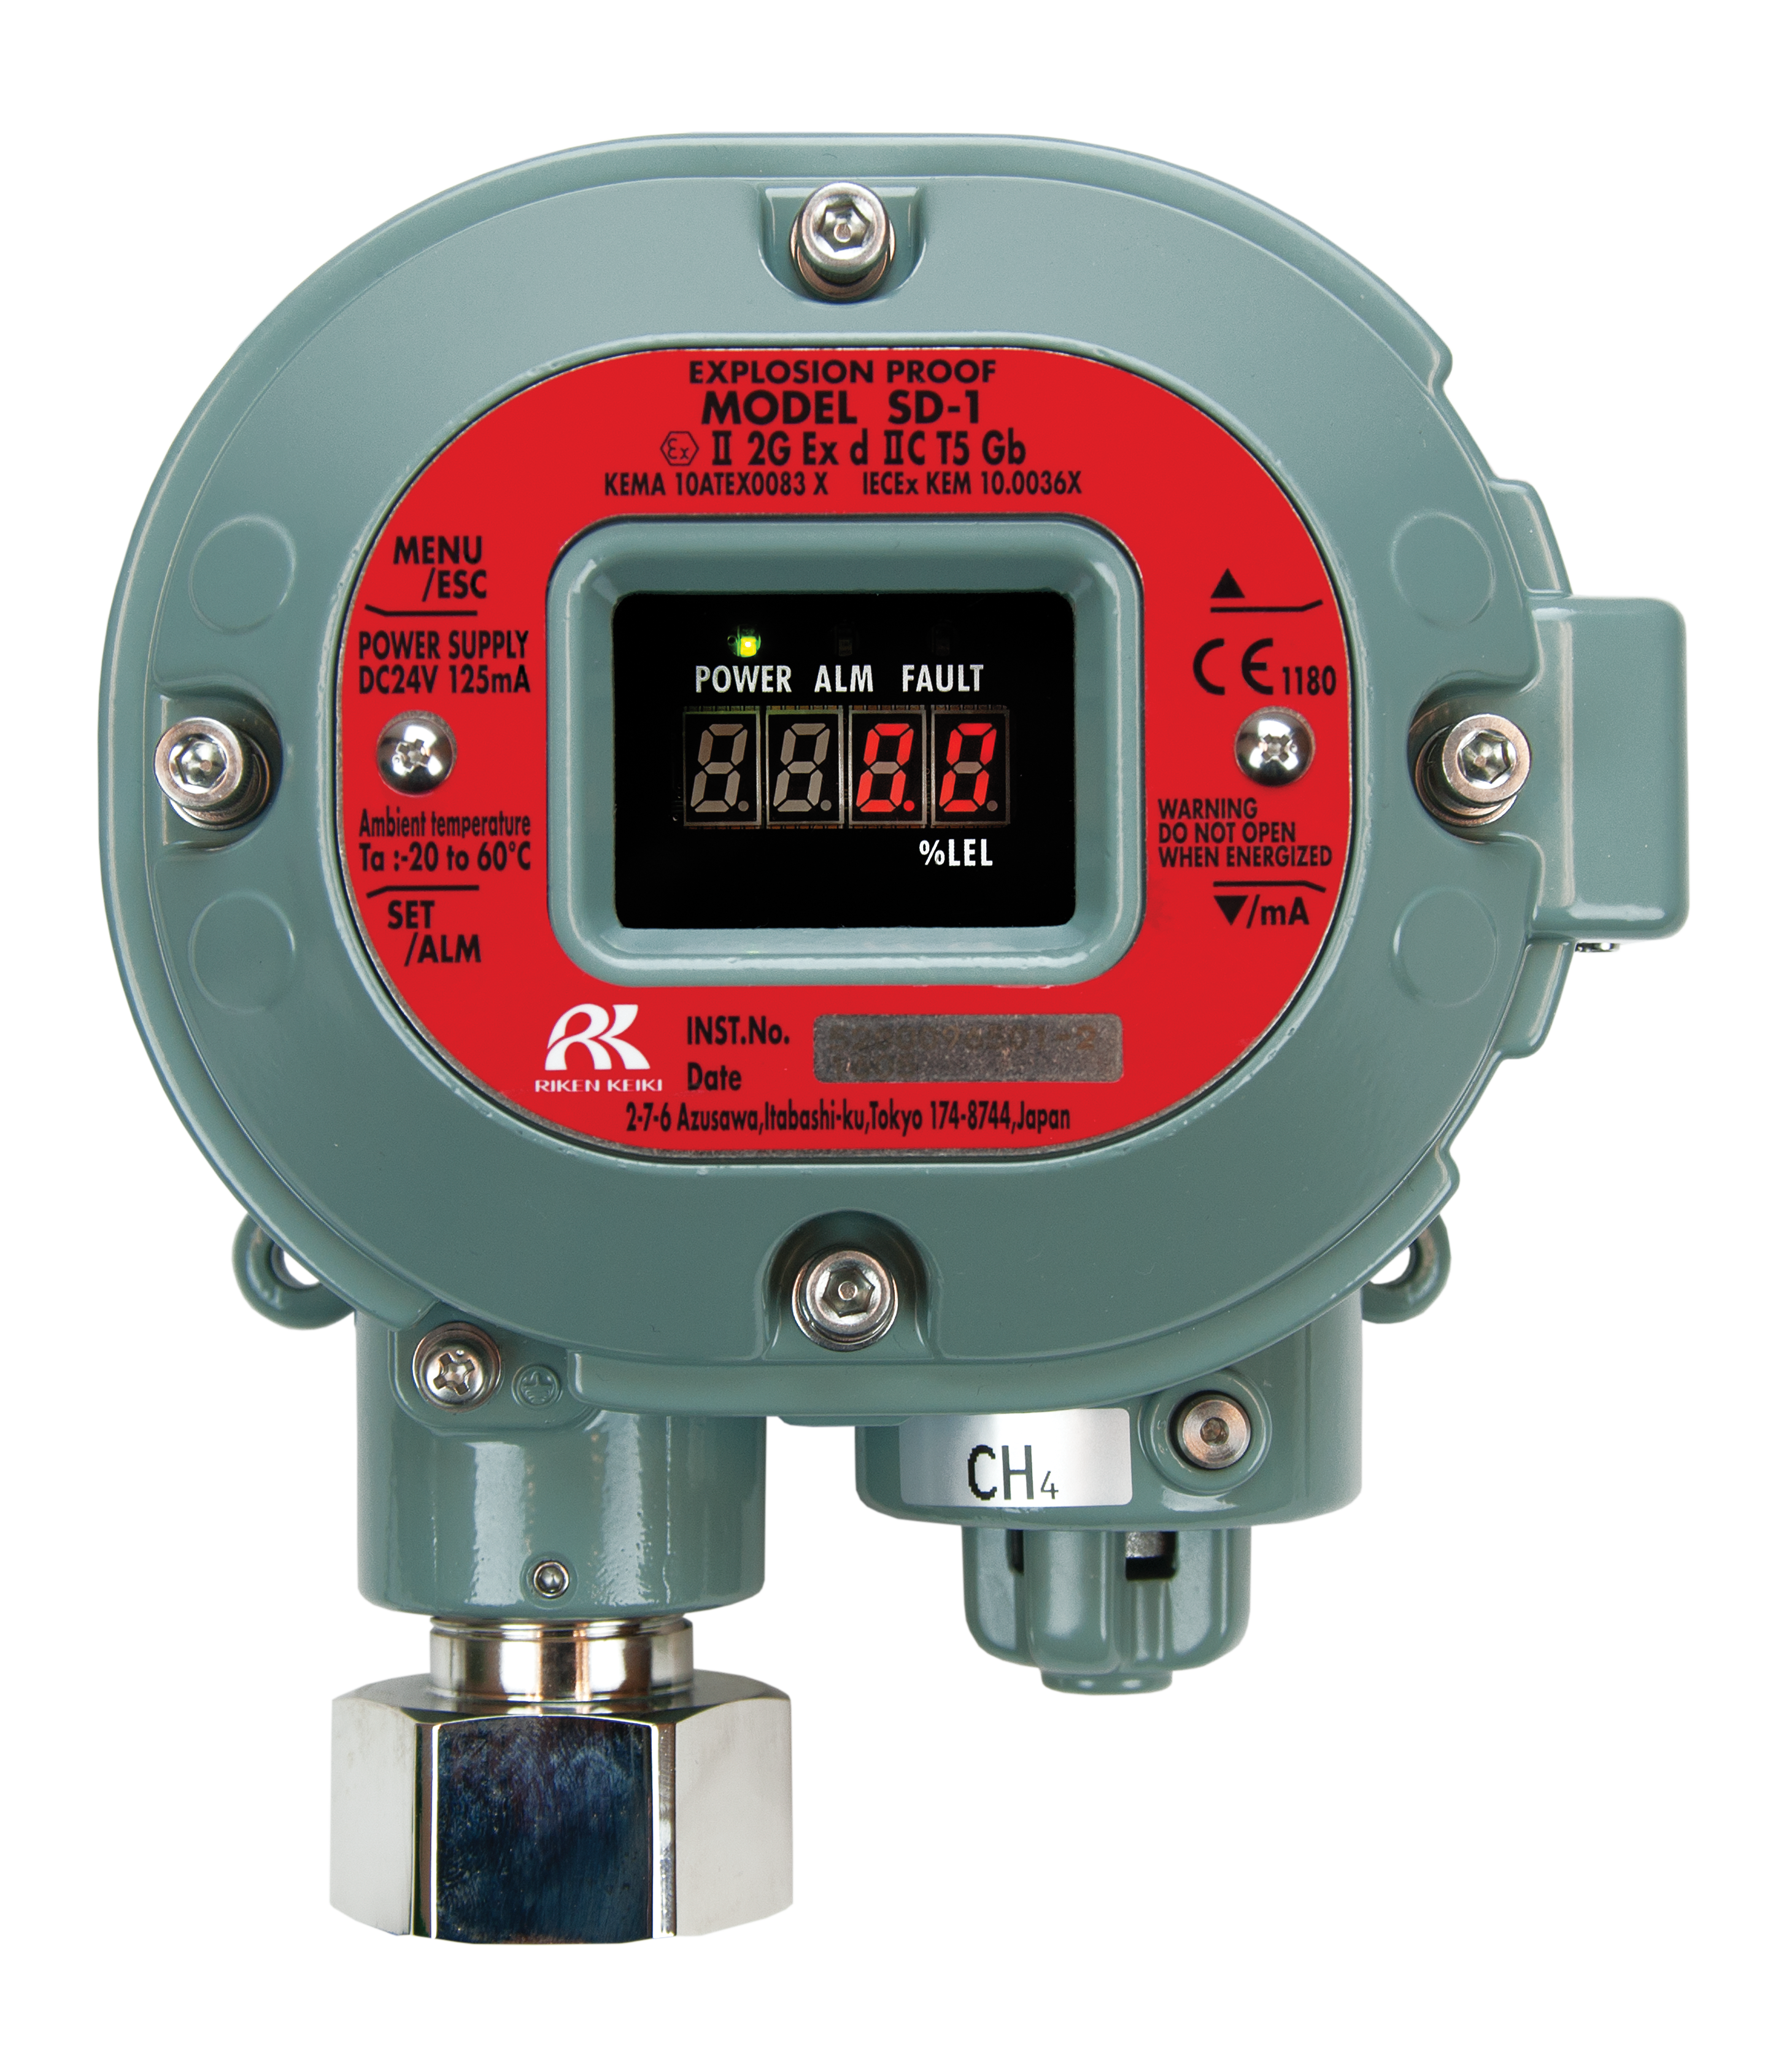
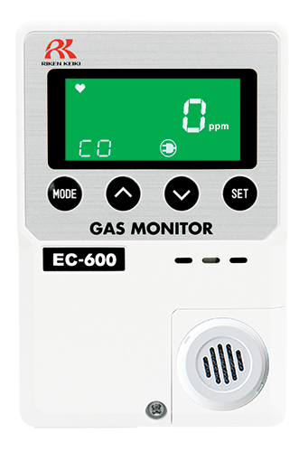
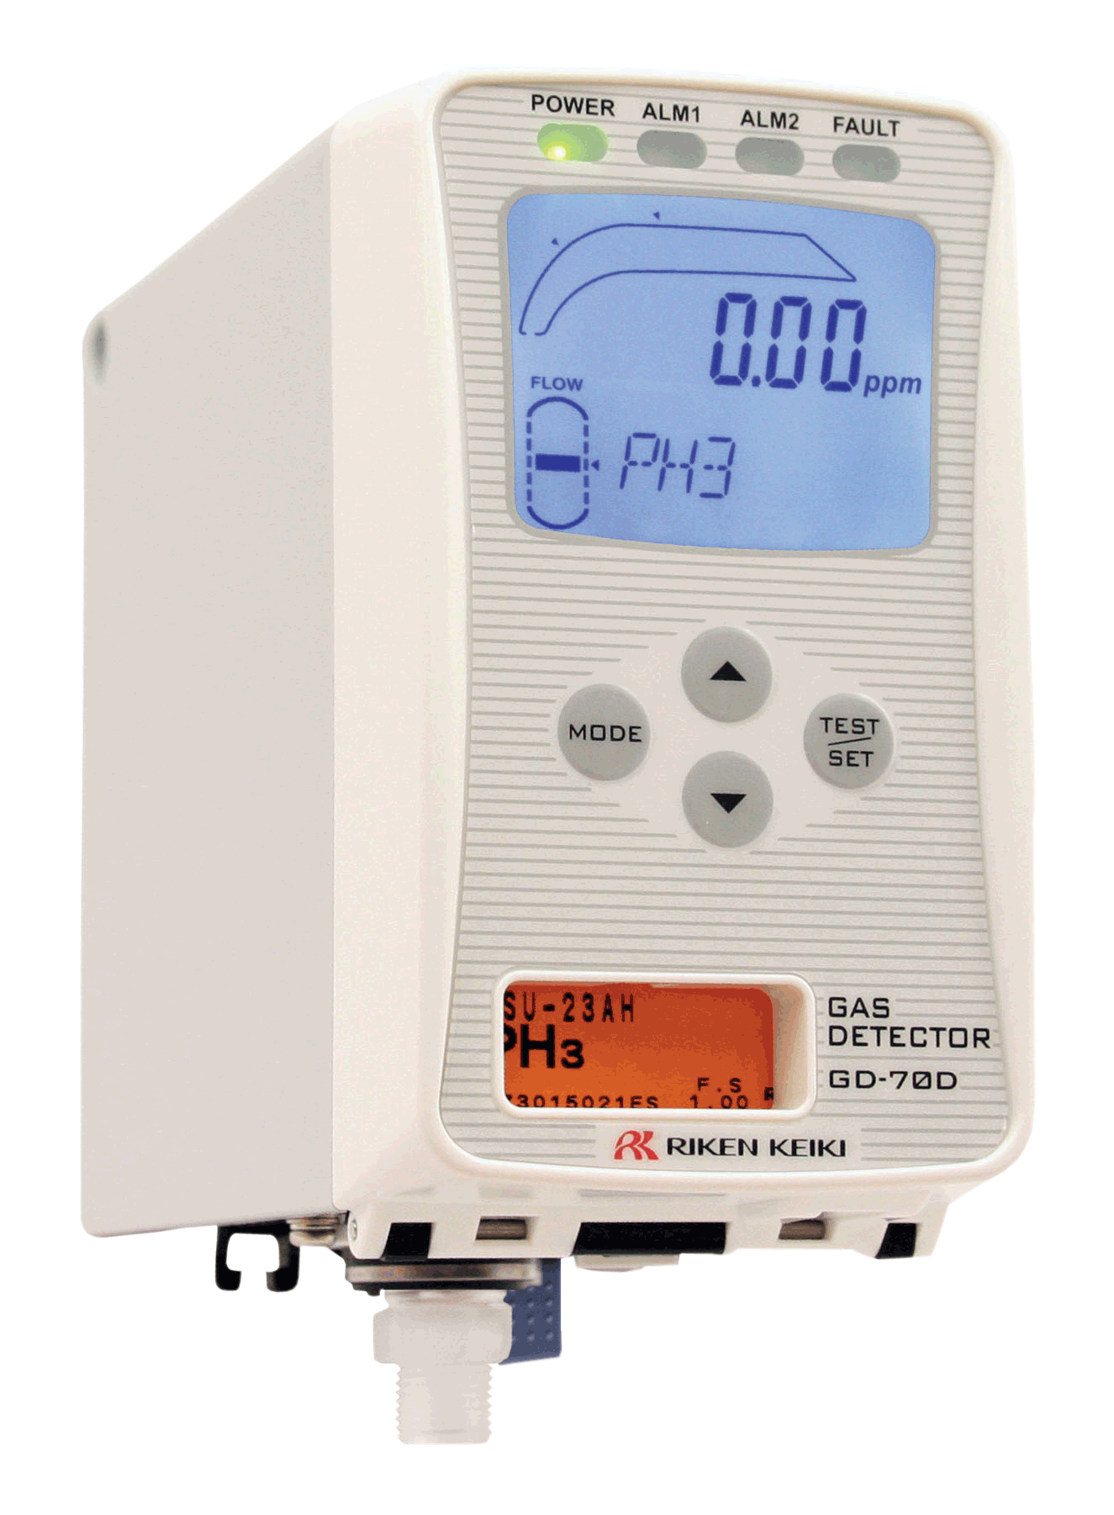

Comprehensive Offering
Portable Solutions
Single Gas
GasWatch 3
GP-03
HS-04
CO-04
OX-04
CX-04
SC-04
Multi Gas
GX-3R
GX-3R Pro
GX-2012
GX-Force
GX-6000
EAGLE 3
Fixed Solutions
Controllers
Beacon 110
Beacon 200
Beacon 410A
Beacon 800
Beacon 3200
MC-6400
AC-7400
Detector
Heads
Wireless
Solutions
S2
Series
Direct
Connect
M2A-XL
SD-1
Series
600
Series
GD-70D
Hybrid
Controllers
Quad Heads
Transmitters
Signal Meters

Slide 24


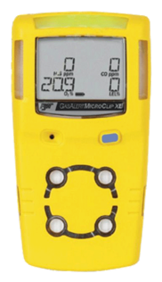
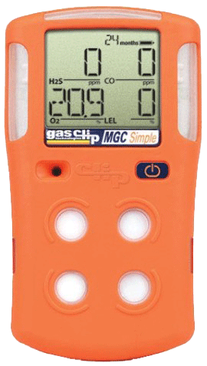
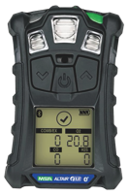
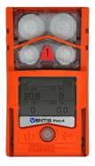
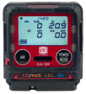
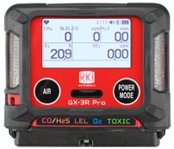
Wow Factor!
Size & Weight
2.2” x 2.55” x 1”
3.7 ounces
2.9” x 2.66” x 1.06”
4.6 ounces
4.4” x 2.4” x 1.2
6.3 ounces
4.1” x 2.3” x 1.4”
6.4 ounces
4.7” x 2.7” x 1.2”
7.67 ounces
4.4” x 3.0” x 1.4”
7.9 ounces
5.12” x 1.9” x 1.8”
8 ounces
The GX-3R weighs about half of the average 4-gas detector!

Slide 25





Slide 26

Single Gas
Single Sensor Personal Detection
Features
Disposable Price Point
  Quantity Discounts: $79.00 Ritz Cost when buying 100
  (CO,HS,O2)
Full 3-year warranty including sensors
  (excludes Ammonia and Chlorine)
Run Time 9,000 Hours (H2S & CO) on AA Alkaline
Gas Readings Displayed
Toxic gases include:
  NH3, Cl2, HCN, NO2, PH3, CO, H2S & SO2
Pocket size 2.1”(W) x 2.6”(H) x 0.9”(D), 2.8 ounces
Field serviceable

Slide 27


Compliance & Confined Space Plus
Features
GX-3R
GX3R Pro
GX-3R: $595.00 List
  2.2” x 2.55” x1”3.7 ounces
  IP66/68 Submersible
  25 Hours Run Time
  Simple two-button operation
  3-Year warranty, including sensors
GX-3R Pro: $980 basic 4-gas
  Bluetooth with Connected Worker Options
  Non-compliance indicator
  Panic Alarm & Man Down Alarms
  Toxics/IR Sensors:
    HCN, NH3, NO2, PH3, SO2, and CO2
    – H2 Compensated CO sensor available

Slide 28


4 Gas with Internal Pump
GX-Force
Features
Priced to compete with BW GasAlert Max XT II
  List Price = $860
  Quantity discounts same as GX-3R
2 Operating modes
  Normal and Leak Check
Internal sample pump with 100′ sample range
30 hours of operation (Lithium-ion battery)
USB Type-C charging & data connection
Easy to grip lightweight design
  2.5″ W x 6.81″ H x 1.85″ D, 9.87 ounces

Slide 29

Quantity Discounts

Slide 30






Fixed System Components
Beacon 410A Controller
M2A Transmitter
Remote Mount Sensor
with Cal Cup
S2 Transmitter
Remote mount detectors allow for easy calibrations in difficult access areas
Direct Connect Sensor
Alarm Relays Activate Ventilation / Exhaust System

Slide 31

RKI Regional Reps
NORTH WEST
John Foster
Cell: (509) 299-6777
Todd Rosencrans
Cell: (509) 299-6777
Jeremie Wise
Cell: (208) 659-2564
Justin. Wise
Cell: (208) 640-1564
Stacie Hendrickson
Cell: (425) 299-2112
Henry Dukart
Cell: (720) 301-1160
CENTRAL & MICHIGAN
Dave McEndarffer
Cell: (913) 634-0396
CENTRAL GREAT LAKES
John Maslowski
Cell: (262) 271-8956
NEW ENGLAND
Bob Carroll
Cell: (716) 725-3112
TRI-STATE
Nino Misiti
Cell: (610) 216-0393
N. CALIFORNIA
Ramey Packer
Cell: (510) 285-7506
MID ATLANTIC
John Dixon
Cell: (804) 334-5346
SOUTH WEST
Tammy Girton
Cell: (949) 397-5040
SOUTH EAST
Todd Sauls
Cell: (770) 654-7443
GULF COAST
Rick Winship
Cell: (713) 205-1694
SOUTH CENTRAL
James Emmons
Cell: (214) 980-4002

Slide 32

Questions?

