Slide 1
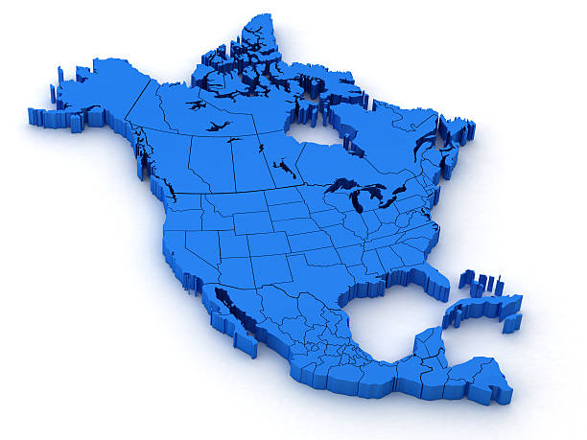
RKI Sales Strategy in
North America

Slide 2




RKI Company Culture
Customer Service
Technical Service
Fast Delivery
Quality

Slide 3
New Business Sources
New Business
Online Marketing
Direct Sales
National & Regional Trade Shows
Distributor Efforts
Online Chat
Customer Referrals

Slide 4
Sales Channels
RKI Sales Channels
Sales Reps
Direct Hire &
Manufactures Reps
Marine
Telecom Reps
US Export
OEM
Distributors
Direct Customers
Telecom Customers

Slide 5
Sales Channels

Slide 6
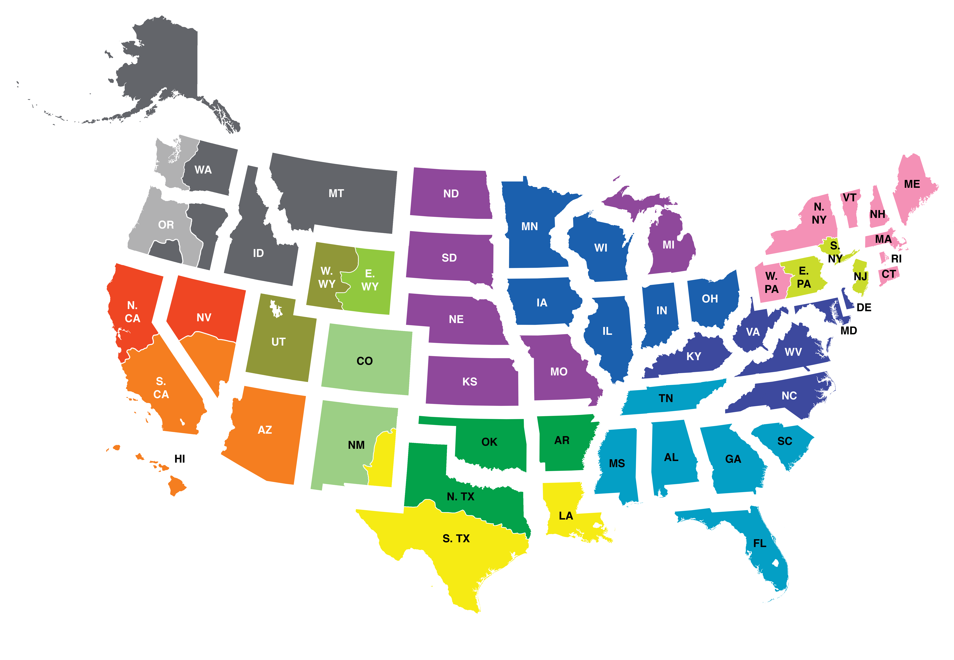
RKI Regional Reps
NORTH WEST
John Foster
Cell: (509) 299-6777
Todd Rosencrans
Cell: (509) 299-6777
CENTRAL & MICHIGAN
Dave McEndarffer
Cell: (913) 634-0396
CENTRAL GREAT LAKES
John Maslowski
Cell: (262) 271-8956
NEW ENGLAND
Bob Carroll
Cell: (716) 725-3112
N. CALIFORNIA
Ramey Packer
Cell: (510) 285-7506
TRI-STATE
Nino Misiti
Cell: (610) 216-0393
SOUTH WEST
Tammy Girton
Cell: (949) 397-5040
MID ATLANTIC
Don Brauninger
Cell: (571) 278-0478
ROCKY MOUNTAIN
Glenn H. Yamada
Cell: (303) 489-1145
Riley Dellalucia
Cell: (385) 405-4585
Marc Malezija
Cell: (303) 726-9989
Joseph M. Malezija
Cell: (303) 489-3249
SOUTH EAST
Todd Sauls
Cell: (770) 654-7443
GULF COAST
Darrell Pinckard
Cell: (713) 732-0513
SOUTH CENTRAL
James Emmons
Cell: (214) 980-4002

Slide 7

Sales Management
Customer Relationship Management (CRM System)
  Sales lead management
  Customer contact management
  Quotations
  Daily, Weekly, & Monthly Sales Summaries
  Monthly Sales Review & Strategy Meetings

Slide 8
Promotional Tools
RKI Web Site
  Optimized for portable devices
  Increased search engine optimization (Google search results)
  Increased sales leads
  Video product training
Email Marketing
  Distributor Announcements
  Application Briefs
  FAQ’s (frequently asked questions)
  Product Profiles
Google Advertising
  Produces highest quality, ready-to-buy leads
Webinar Product Training
  Training for large distributors with large sales forces
Exhibit at Over 50 Trade Shows per year
Service & Repair Training (offered 4 times per year)

Slide 9
Marketing Incentives
GX-6000 Competitive Trade In Promotion
  Receive $500 off for each competitive PID unit trade-in
Quantity Price Breaks available:
  03 Series
  GX-2009
  GX-2012
  GX-6000

Slide 10



Market Specific Promotions
Fire & Hazmat
Construction Confined Space
Marine
Brewery CO2
Hospital Nitrogen Storage Monitoring
Marijuana Grow Houses/Cannabis Oil Producers

Slide 11
Marketing Coop Program
RKI offers 1% of RKI purchases as coop funds to distributors.
For example, if a distributor purchases $100,000, RKI offer $1,000 of coop funds.
Distributors can use coop funds for:
  Trade shows expenses
  Demo equipment
  Purchase of instruments for Rental
  Training Classes
  RKI branded merchandise
  Print Brochures & Catalogues

Slide 12

Market Differences: USA & Japan
More diverse styles of business in USA
  Regional & cultural differences
More layers of sales channels
  Reps, Distributors, Internet

Slide 13
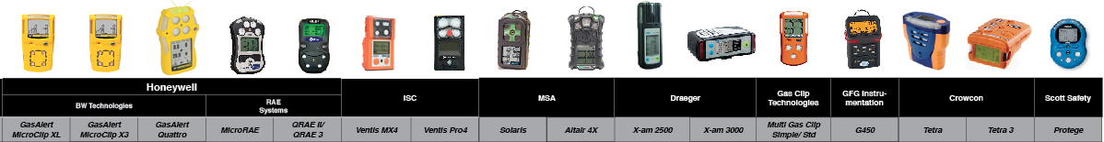
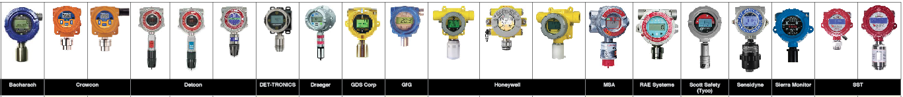
Market Differences: USA & Japan
More Competition
Portable competition
Fixed competition

Slide 14
Market Differences: USA & Japan
More Competition
Major Competitors
  Honeywell
    BW Technologies: BW Clip4 always on, no maintenance, 2 year run time, $500 end user price
    RAE Systems: Still has monopoly on PID market
    Fast product development.
  MSA
    Altair 4XR: 15 sec response time, 4 year warranty, bluetooth connectivity, 25’ drop test
  Industrial Scientific
    iAssign Technology-NFC tags & bluetooth to track users & locations with Android phone app. LENS Wireless communication with portables and area monitors

Slide 15
Market Differences: USA & Japan
More Competition
Minor Competitors
  Gas Clip Technologies: Multi Gas Clip Simple. 2 year run time. No calibration needed. IR LEL, immune to H2S & silicone poison.
  Drager: standard 3 warranty
  Blackline Safety: Cellular/GPS communications. Text/talk from monitor (monthly service charge). Live online map & alert system.
  GMI: stable low ppm detection
  Detcon: wireless fixed products
  Crowcon: small compact super toxics & CO2
  Det-Tronics: fixed systems
  Scott Safety / 3M: fixed systems
  GFG: popular CO2 portables with brewery applications
  Sierra Monitors: fixed systems
  Sensit Technologies: stable low ppm detection

Slide 16
Market Differences: USA & Japan
More Industry Segments
Oil & Gas Production (drilling, fracking, well operation)
  Success: GX-2009 strong solution, replacing I-net systems, HS-03
  Challenges: Depressed market, low price of oil, highly competitive
Oil & Gas Transport (Pipelines)
  Success: GX-2012 (leak check, purging, safety), M2A for compressor stations
Refining, Petrochemical and Chemical
  Success: EAGLE 2 / EAGLE inert gas version, GX-2009
  Challenges: Explosion proof and IS solutions for toxic gases

Slide 17
Market Differences: USA & Japan
More Industry Segments
Energy – Power Utilities
  Success: EAGLE transformer tester, GX-2012, GX-2009, fixed systems in coal power plants
  Challenges: Lack of awareness of RKI’s solution
  Mitsubishi
Alternative Energy –
  CNG: fixed systems for vehicle maintenance bays (UPS, Ryder, Waste Management)
  Biofuels: M2A & Digester monitor
  Battery: M2A & 1017
  Wind: GX-2009 confined space
  Fuel Cell: FSD & FHD

Slide 18
Market Differences: USA & Japan
More Industry Segments
Battery Backup for Telecom & Data Storage
  Success: H2 specific & PS2
Food & Beverage
  Success: CO2 fixed systems Disneyland & Disney World
  Opportunities: Breweries portable & fixed systems
Water & Waste Water
  Success: GX-2012, GX-2009, EAGLE 2, Fixed systems
  Challenges: Getting spec’d in. MSA is very strong with engineering companies
Marine
  Success: Stolt Nielsen, EAGLE / EAGLE 2, Marine versions, RX Series, GX-2009, GX-2012, calibration gas, service schools

Slide 19
Market Differences: USA & Japan
More Industry Segments
Semiconductor
  Success: Micron, Global Foundries, ASM, Lam Research
Bulk Gas Suppliers
  Success: Praxair & Air Liquide for fixed systems, Matheson portables & fixed systems
Fire/EMS/ Hazmat
  Success: EAGLE, EAGLE 2, target for CO-03 & GX-6000
  Challenges: Competition carries complete line of needs, Sales channel is not traditional safety distributors

Slide 20
Market Differences: USA & Japan
More Industry Segments
Environmental
  Success: EAGLE / EAGLE 2 methane elimination for soil testing, EAGLE / EAGLE 2 for landfills, GX-2012 ppm trace HC
  Opportunity: GX-6000, large rental market
  Challenges: Market is dominated by one competitor (RAE Systems)
Hospitals, Labs, & Cryogenics
  Success: OX-600
  Challenges: Lack of awareness of RKI offering, new sales channel required

Slide 21
Market Differences: USA & Japan
More Industry Segments
Construction
  Opportunity: New OSHA requirement for safety, GX-2009
  Challenges: Sales channel is not traditional safety distributors
Aircraft Maintenance
  Opportunity: GX-6000 with PID
  Challenges: Lack of awareness of RKI offering
Boiler Room Monitoring
  Opportunity: New regulation for CO monitoring: EC-600

Slide 22
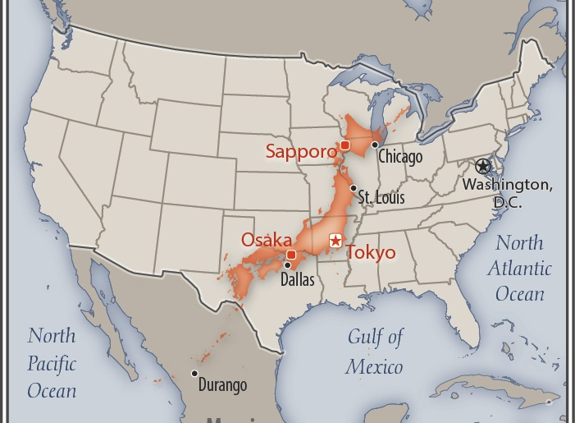
Market Differences: USA & Japan
Larger Geography & Population
Area: 24 times
USA: 9,148K km2
Japan: 378K km2
*California: 425K km2
Population
USA: 325.7 million
Japan: 127 million
California: 40 million

Slide 23
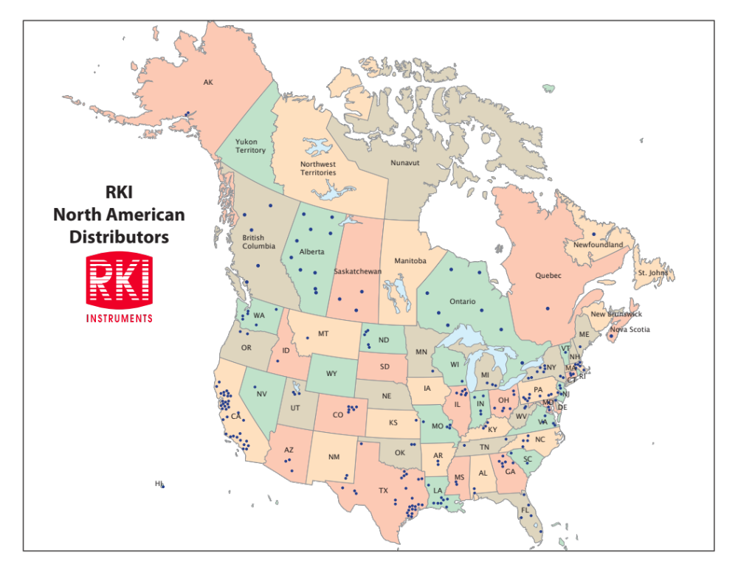
Market Differences: USA & Japan
Distributor Network
USA: 250
Canada: 30
Marine: 50

Slide 24
Market Differences: USA & Japan
More competition
More Diverse Styles of Business in US
More layers of sales channels
  Reps, Distributors, Internet
More industry segments
Larger Geography and Population
Increase in Internet Sales at Distributor level

Slide 25

Market Differences: USA & Japan
Increase in Internet Sales at Distributor level

Slide 26
Market Differences: USA & Japan
End users have more options in the USA
Local distributors
Walk-in retail safety stores
National distributors
Internet
Catalogues
More gas detection manufacturers

Slide 27
Market Differences: USA & Japan
USA –
Service is primarily provided by local distributors. RKI’s service business is primarily local fixed system products.
Calibration gas is sold to distributors & end users to maintain equipment. Disposable cylinders are available in USA, but not in Japan.
Japan –
Riken handles all service business directly through Riken service branches.

Slide 28
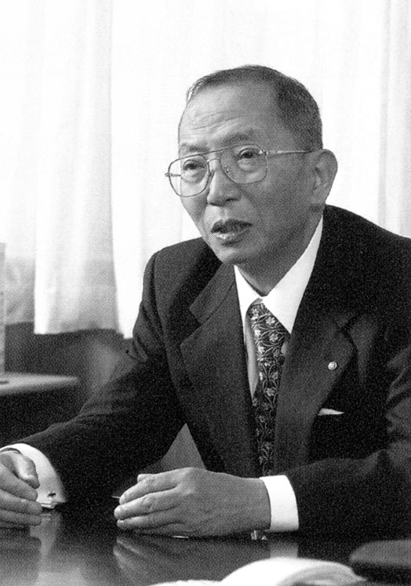
“There is no business without the personal relationship.”
Yoshio Nakajima

