Slide 1
Disruptor
A company or service that causes radical change in an existing industry or market by means of innovation.

Slide 2
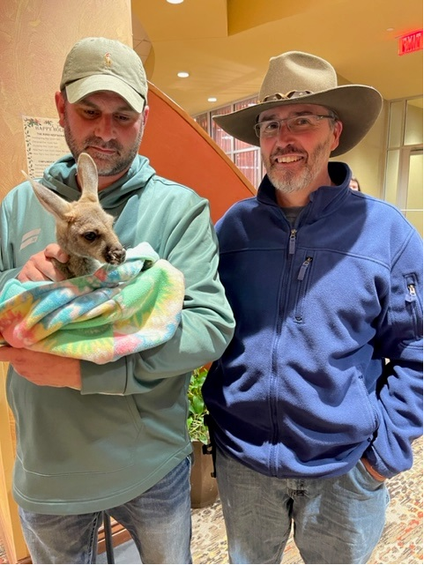

Slide 3

RKI is not just another gas detection company. We are a disruptor.
We are the only company that offers a full solution.
Engineered solutions
drawings
sales
Install
service
support

Slide 4





Disruptors

Slide 5
Name other disruptors

Slide 6
Disruptors
Tammy
Mike
Dave
Kevin
Randy
Murai san
Todd
John
Ryo
Jeremie
Justin
Clint
Marcos
Hirano san
Henry
James
Bob
Nino
Matt
Dan

Slide 7
Numbers
 | 2022 |  | 2023
 | Qty | Inv Amount | Qty | Inv Amount | Annualized
FIXED HEADS | 10,240 | 8,127,622.96 | 10,517 | 9,483,383.92 | 10,345,509.73
CONTROLLERS | 2,438 | 2,429,277.32 | 2,330 | 2,578,509.00 | 2,812,918.91
TURN-KEY | 34 | 372,149.00 | 64 | 603,403.98 | 658,258.89
Above 2022 number is for the entire year
Above 2023 annualized is where we should finish.
24% growth on products
76% growth on fixed system services

Slide 8
Systems Integration Team
THANKS!

Slide 9
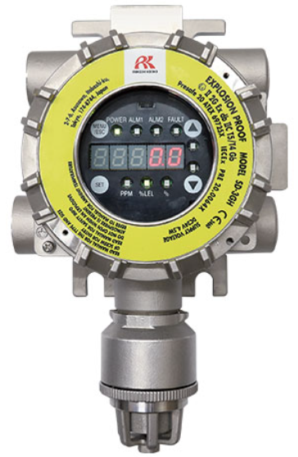
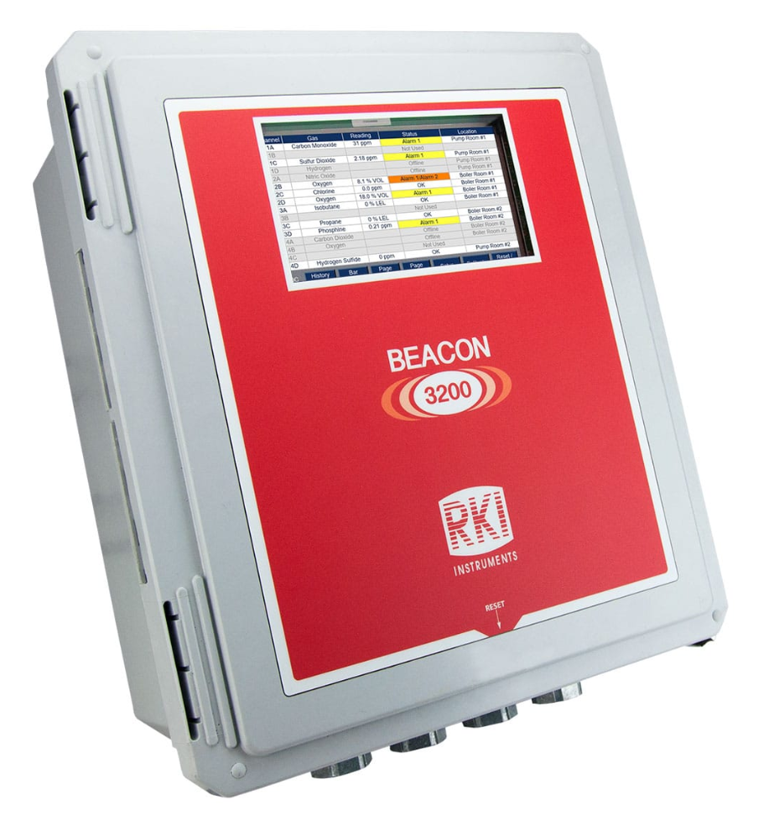
Products

Slide 10
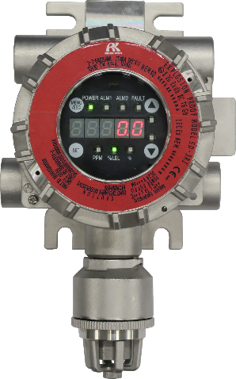
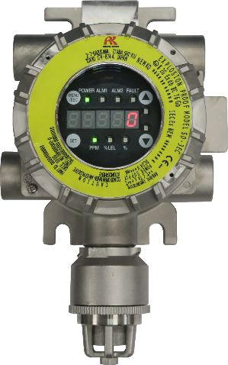
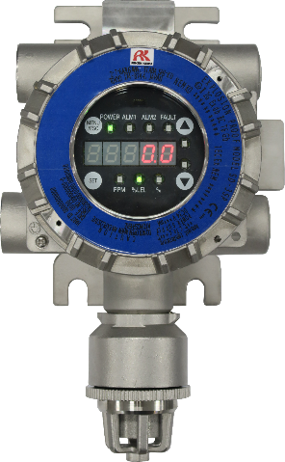
New Gas Detectors with Signal Converters
Model: SD-3 Series
Product Introduction

Slide 11
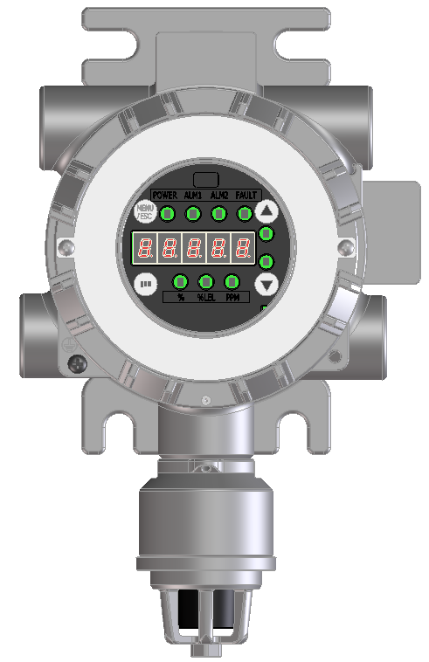
Overview (Product)
Detection target gases: Combustible gases, toxic gases, oxygen, etc.
Housing material: Stainless steel SCS14 (Equivalent to SUS316)
External output: 4 - 20 mA + HART
or 4 - 20 mA + HART + contacts (3c)
or 4 - 20 mA + HART + RS-485
Sampling methods: Diffusion, suction, remote
Mounting types: Wall-mounted, pole-mounted, duct
insertion
Sensor warranty: Max. three years *Specific sensors excluded
Standards and certifications * Including planned certifications
－ Explosion-proof construction (IECEx/ATEX, JPEx (Japan), FM, cFM)
－ CE marking
－ Protection rating: Equivalent to IP66/67
－ IEC/EN performance
－ Functional safety certification: SIL 2
－ MED certification
New Gas Detectors with
Signal Converters
Model:
SD-3 Series

Slide 12
SD-3 sensors
Now
  H2
  D2
  H2S
  LEL
  NO2
  O2
  CO
  NH3
  CL2
+ 20 more to come

Slide 13
Overview (Lineup)
The SD-3 Series consists of the following models, which vary by sampling method and detection principle. Please select the appropriate model for the intended use.
<List of detection target gases by model>
Model | Sampling method | Detection principle | Certification plate | Detection target gas |  |  | Remarks
 |  |  |  | Toxic gas | Oxygen | Combustible gas
SD-3RI | Diffusion type | IRF: Infrared type | Red | 〇 |  | 〇
SD-3DRI | Suction type
SD-3NC | Diffusion type | NCF: New ceramic type | Red |  |  | 〇
SD-3DNC | Suction type
SD-3GH | Diffusion type | SGF: Semiconductor type | Yellow | 〇 |  | 〇
SD-3DGH | Suction type
SD-3GHS | Diffusion type |  | Yellow | 〇 |  |  | CS2 (carbon disulfide) only
SD-3DGHS | Suction type
SD-3SP | Diffusion type | SHF: Hot-wire semiconductor type | Blue | 〇 |  | 〇
SD-3DSP | Suction type
SD-3EC | Diffusion type | ESF: Electrochemical type | Yellow/silver | 〇 | 〇 |  | Toxic gas: Yellow certification plate Oxygen: Silver certification plate
SD-3DEC | Suction type
SD-3ECS | Diffusion type |  | Yellow | 〇 |  |  | H2S (hydrogen sulfide) only
SD-3DECS | Suction type
SD-3ECB | Diffusion type |  | Yellow | 〇 |  |  | With EC barrier*
SD-3DECB | Suction type
*Differs depending on detection target gas.

Slide 14
Overview (Lineup)
<List of detection target gases by model (remote type)>
Model (Main unit) | SD-3SC
Main unit model (Remote sensor unit) | Sampling method | Detection principle | Certification plate | Detection target gas |  |  | Remarks
 |  |  |  | Toxic gas | Oxygen | Combustible gas
GD-3RI | Diffusion type | IRF: Infrared type | Red | 〇 |  | 〇
GD-3NC |  | NCF: New ceramic type | Red |  |  | 〇
GD-3GH |  | SGF: Semiconductor type | Yellow | 〇 |  | 〇
GD-3GHS |  |  | Yellow | 〇 |  |  | CS2 (carbon disulfide) only
GD-3SP |  | SHF: Hot-wire semiconductor type | Blue | 〇 |  | 〇
GD-3EC |  | ESF: Electrochemical type | Yellow/silver | 〇 | 〇 |  | Toxic gas: Yellow certification plate Oxygen: Silver certification plate
GD-3ECS |  |  | Yellow | 〇 |  |  | H2S (hydrogen sulfide) only
GD-3ECB |  |  | Yellow | 〇 |  |  | With EC barrier*
*Differs depending on detection target gas.

Slide 15

Feature ④
Rugged housing construction allows use even in harsh environments
・ Housing material: Stainless steel SCS14(Equivalent to SUS316)
・ Protection rating: Equivalent to IP66/67
・ Operating temperature range: -40 - +70 °C
・ Extensive range of optional accessories (sold separately):
Protective cover, sunshade, splash guard, filters, lightning arrester (excluding JPEx), etc.

Slide 16
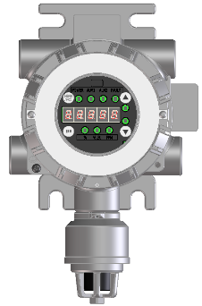

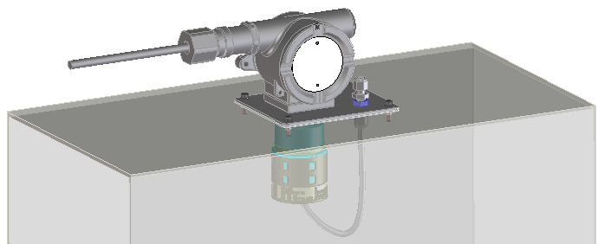
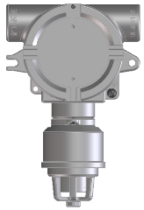
Feature ⑤
Wide range of types to suit a variety of uses and installation environments
The SD-3 Series detectors can be used with a remote sensor which can be installed in a location up to 20 m from the main detector unit. An optional splash guard and dedicated kit (sold separately) can be used to allow insertion inside ducts. Using a suction type model in conjunction with an external pump allows use in limited installation space and high places where maintenance work is not possible.
[Diffusion type]
[Suction type]
[Remote type]
[Duct insertion type]
Calibration gas inlet
Splash guard

Slide 17
SD3
4 month availability
Pricing in 2-3 months

Slide 18
Products-Beacon 3200
Will accept any sensor/transmitter except wireless
8 card slots for sensor (4 channel per card) or relay (8 relays per card) cards
Maximum of 32 channels (but no relay cards in this case)
Touch panel LCD for user interface
Outputs— RS-485 Modbus, 4-20 ma, TCP/IP

Slide 19
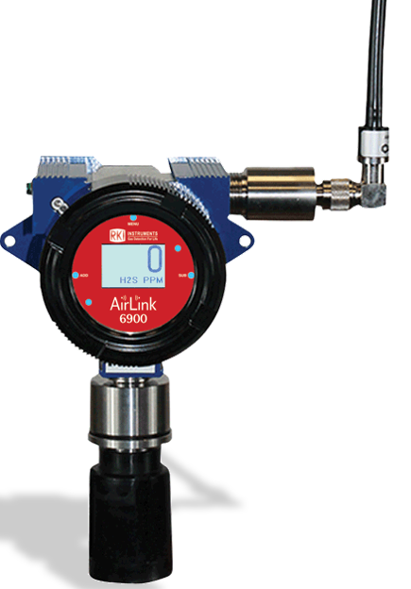
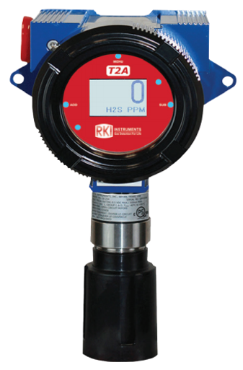
Products—Otis OEM
2022 sales = $987,069
2023 current sales = $1,566,587
2023 annualized sales = $ 1,709,004

Slide 20
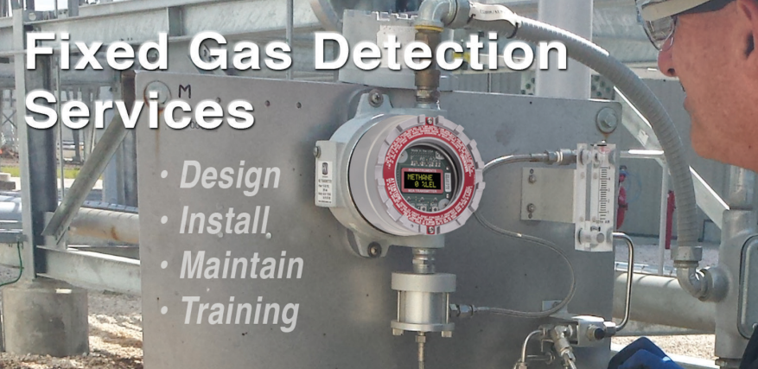
Services

Slide 21
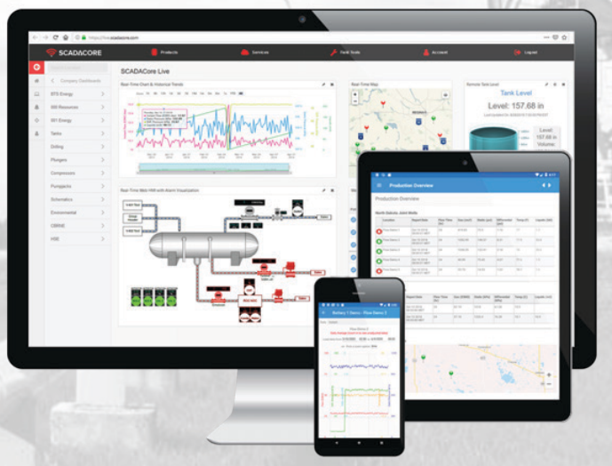
Services-Fully managed telemetry system

Slide 22
Gulf Coast
Field Applications Engineer
Oil and Gas Petrochemical market focus
Engineering firm focus
Utilize EIC Project Database
Approved/preferred vendor list

Slide 23
Outline of 2024 activity
Action | To do | Remark
Hire a new dedicated Field Application engineer for Gulf coast plan | ・Visiting End users / Engineer firm / OEM-Integrator ・Applying Approved Vendor List (AVL) ・Provide Gulf coast team with sales training. | Utilizing EIC project list
Maximize Teamwork synergy within Gulf coast team by communicating | ・Periodic meeting / reporting Once 2 month in person meeting =>Sharing the latest activities and Successes ・Involving End-users Activities (AVL included) ・Sales / Product training (Fire included) | Expected synergy = Enhancing Gulf coast team’s sales knowledge and network, and making a RKI’s fix detector business model
Narrow down the targets by gathering info. ・Industry map ・Networking | Joining Association, exhibition | Utilizing EIC project list
・Popularity UP marketing (RKI=Fixed) | Working closely with RKI marketing team ・Web site / Google ad /LinkedIN
Gathering Market demand, Future trend for new products | Accumulate market information

Slide 24
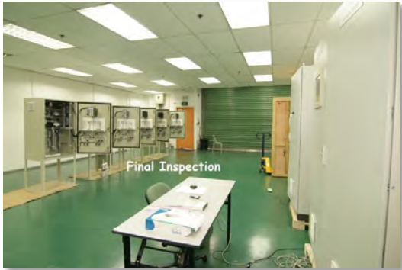
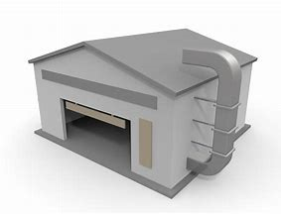



End user
OEM/Integrator
Sales target
TX, LA
Engineer
companies
Distributors

Slide 25
Gulf Coast plan - Road map
2024 activity
Teamwork synergy (Periodic meeting / End-user activity / AVL etc)
2025 activity
Increase AVL
2026 activity
Expand the Business model to the other regions
Accumulate New product info.
Enhance Fire business
Strengthen sales
Info. gathering
Strengthen Sales
Marketing
New hiring

Slide 26
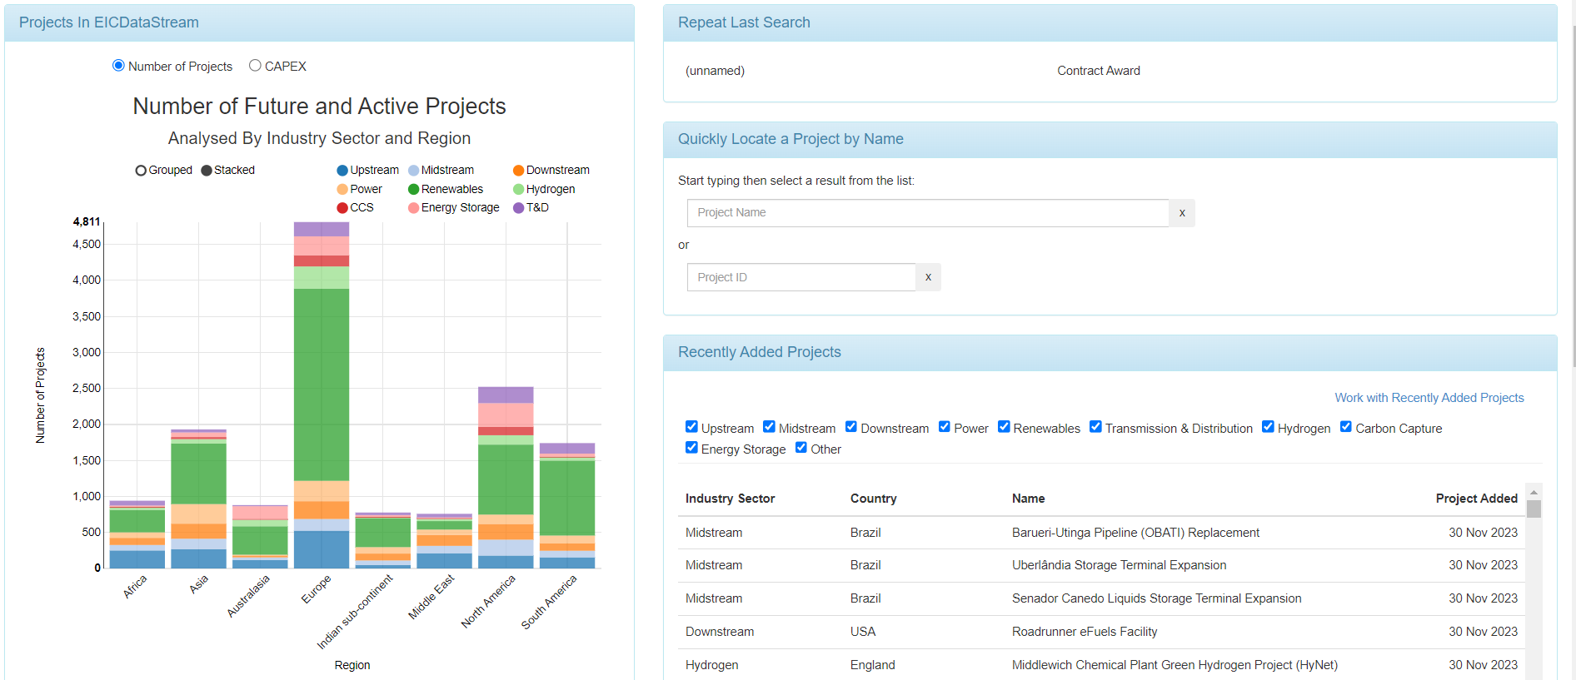
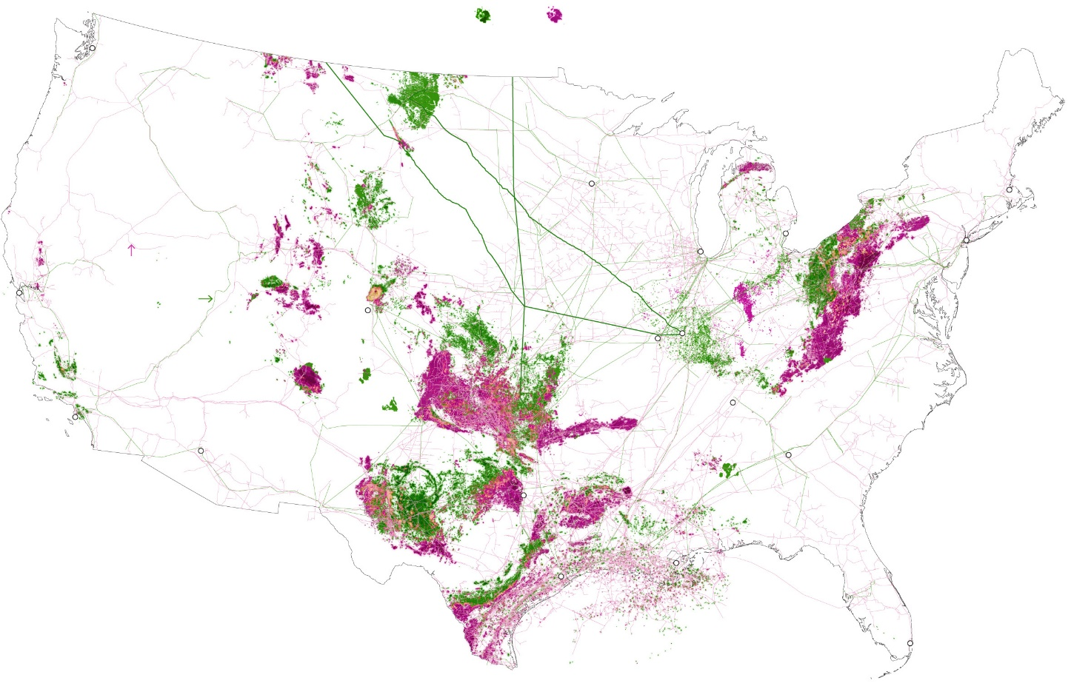
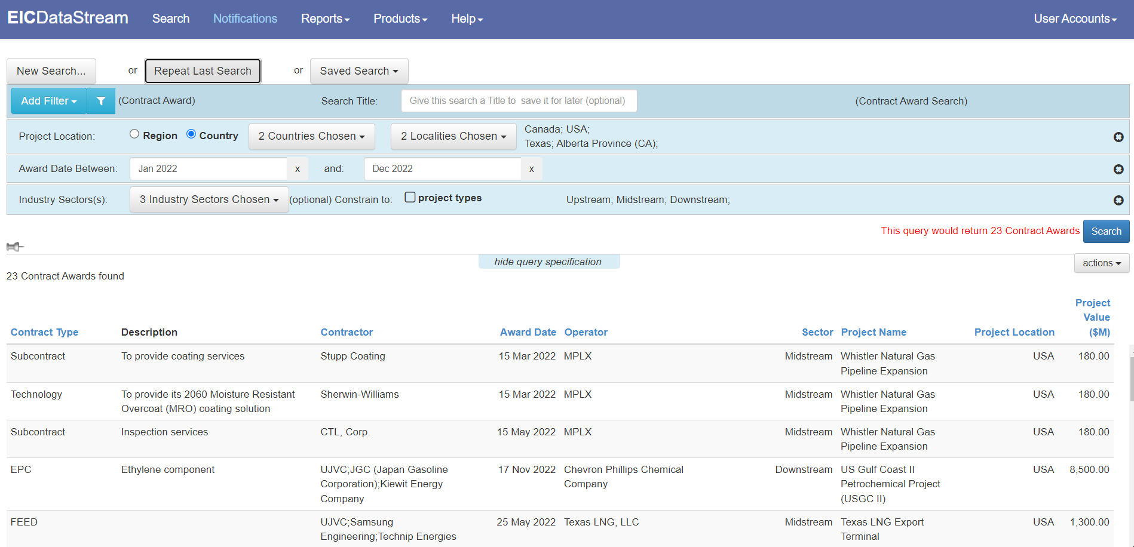
Utilizing EIC for Gulf Coast Plan
Gulf Coast Region
Notes:
Oil ＆Gas untapped market.

Slide 27
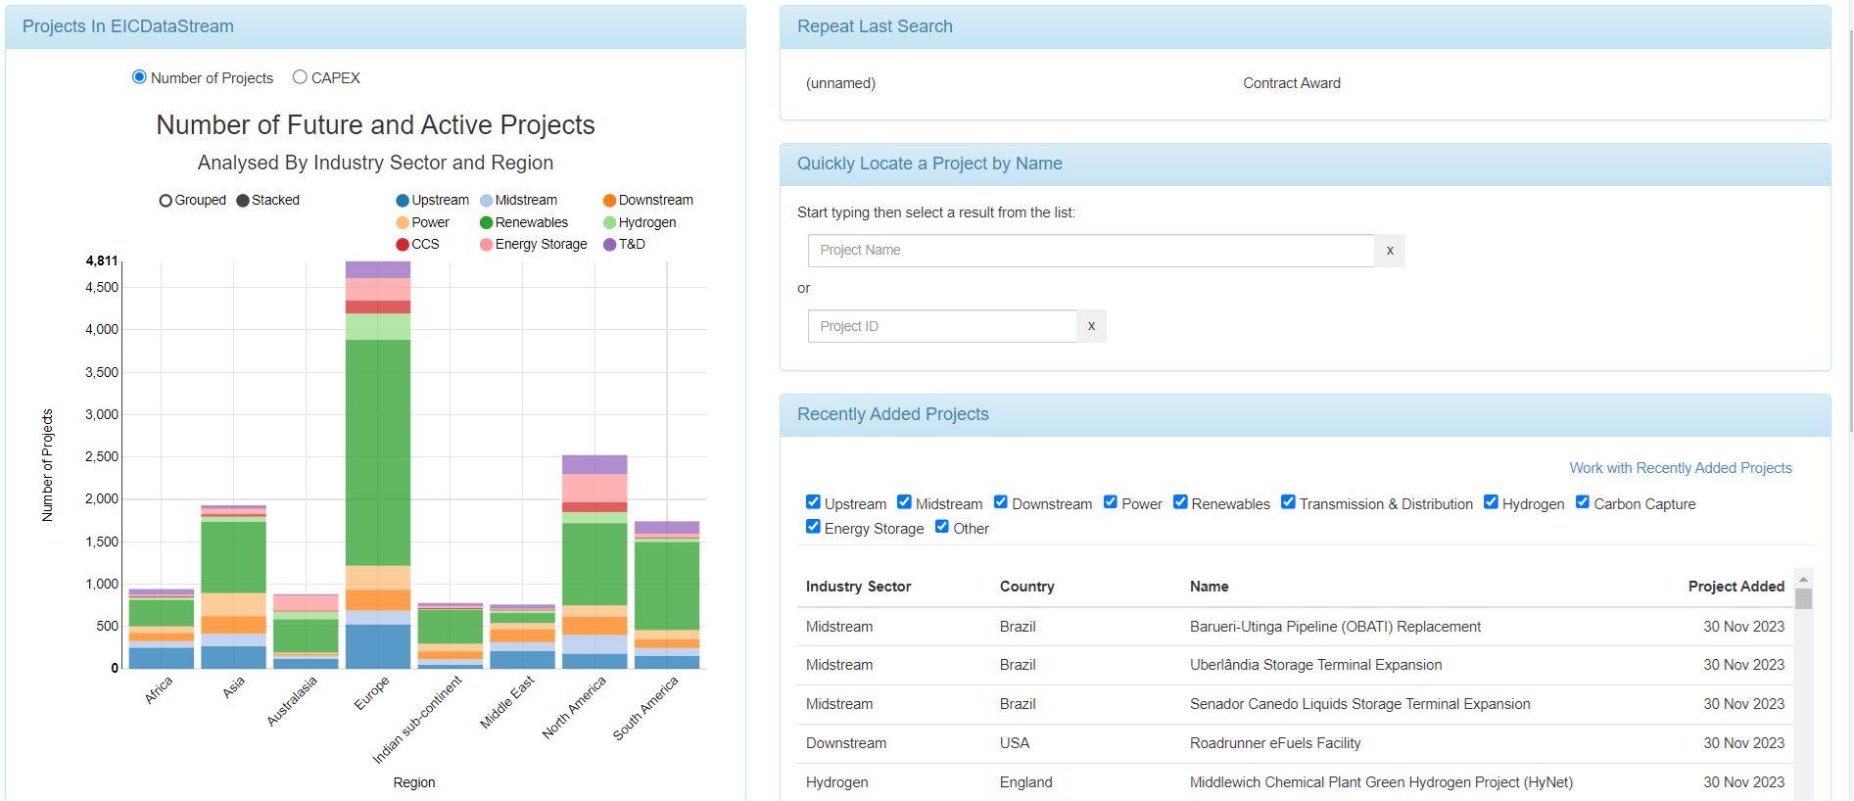
EIC

Slide 28
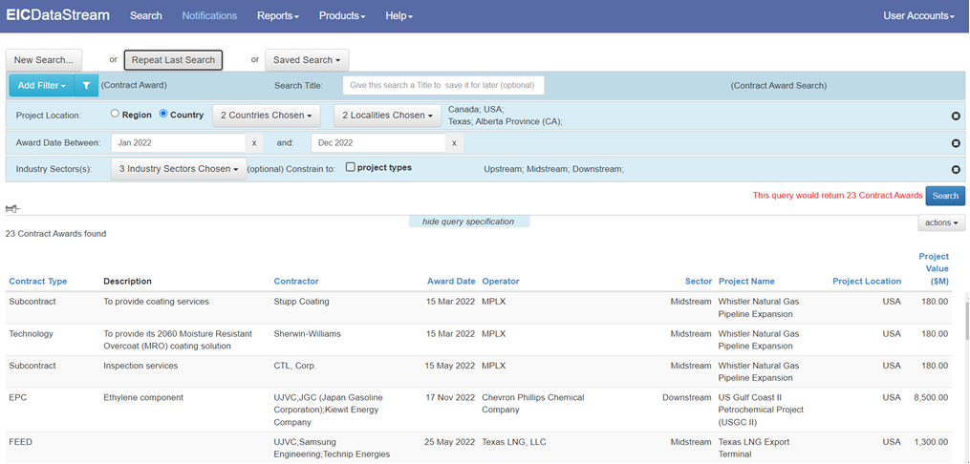
EIC

Slide 29
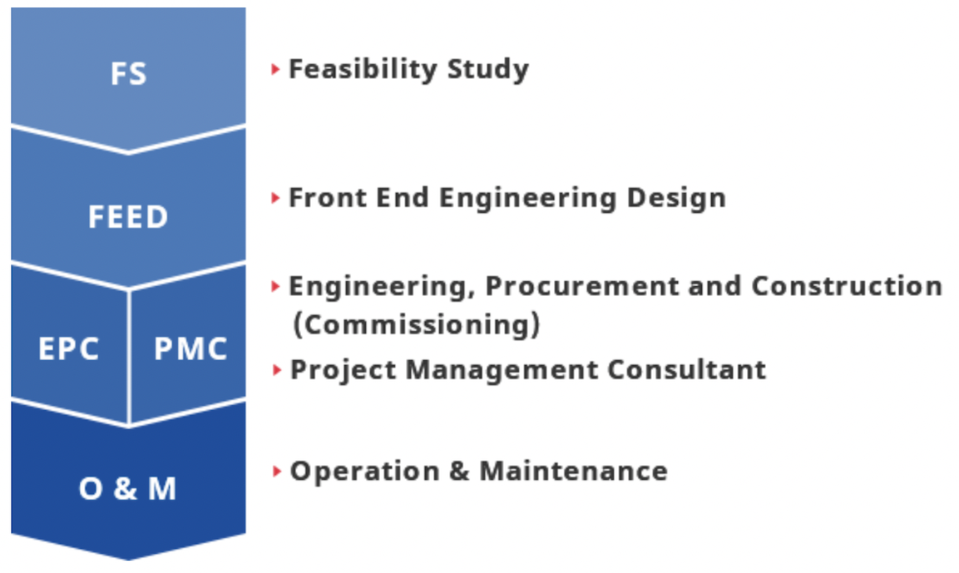



Typical Engineering process
End user | Process | Engineering companies | Output
Example |  |  | Evaluation data with economic perspective
 |  |  | tech requirements to be issued for EPC bidding
 |  |  | Site construction (Engineering, Procurement and Construction)
 |  |  | Site operation and maintenance

Slide 30
Importance of Approved Vendor List
Why is an approved vendor list (AVL) important?
An approved vendor list (AVL) reduces risk by ensuring that all vendors are properly vetted by an organization and meet its requirements for quality, pricing, delivery, and other established criteria.

Slide 31
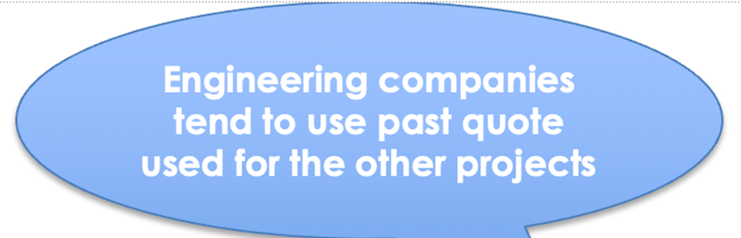
Possibility to be preferrable gas detectors
With AVL | Without AVL
High | Medium-low (AVL applicable)
High | Medium-high (AVL applicable)
High | Low (AVL less applicable)
- | -

Slide 32
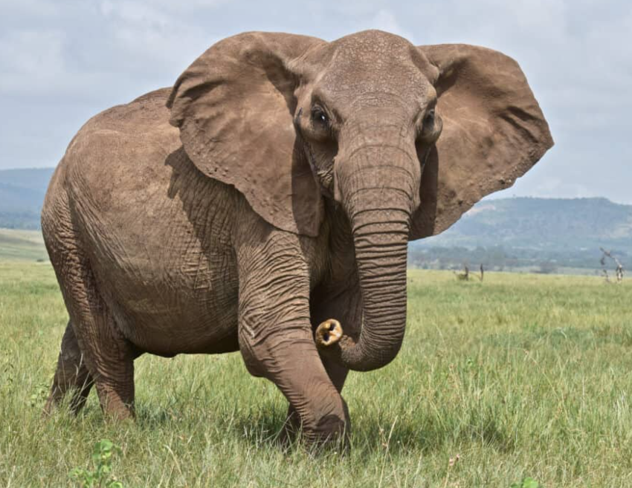


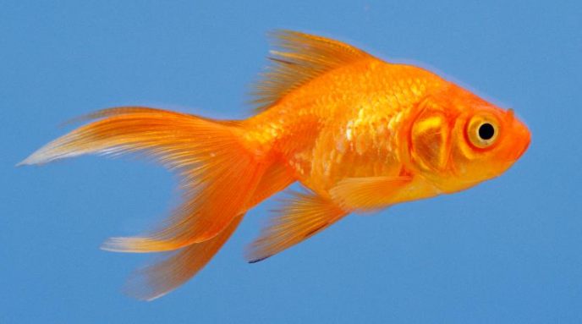
good not as good

Slide 33
Goals
Two fixed telemetry orders
  Ask the questions. Marketing to provide report.
Two installations
  Talk it up. Training/presentations
Sell two Beacon 3200 controllers.
  Distribution aware
  Example: Rush Enterprises
25% growth for fixed systems

Slide 34

Do or do not, there is no try!
Keep Disrupting!!

