Slide 1
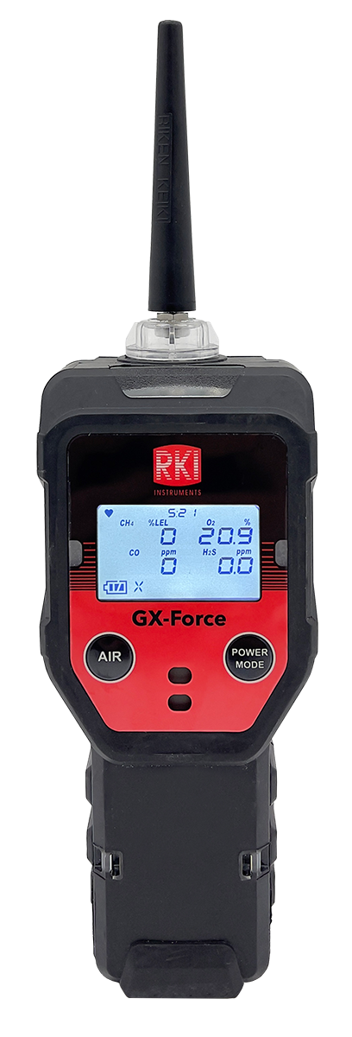
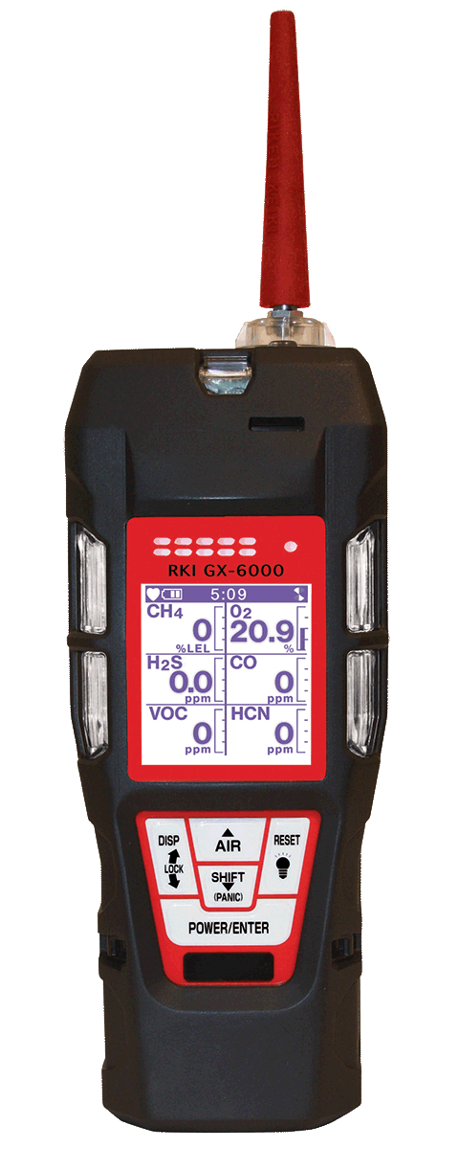
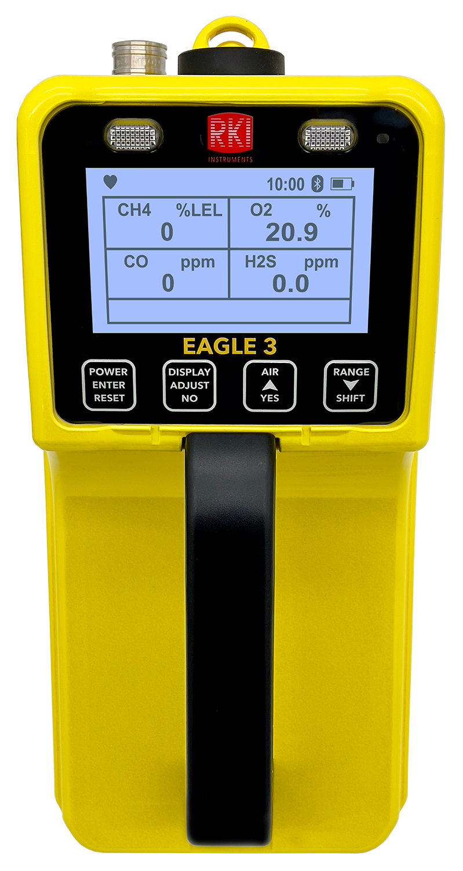
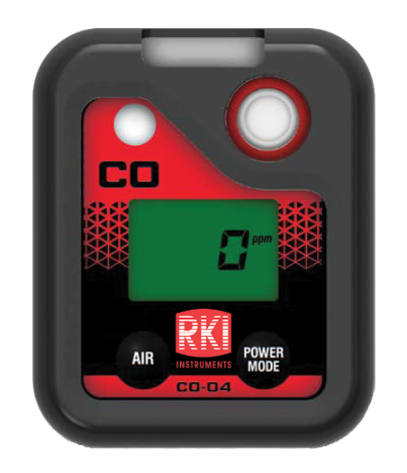

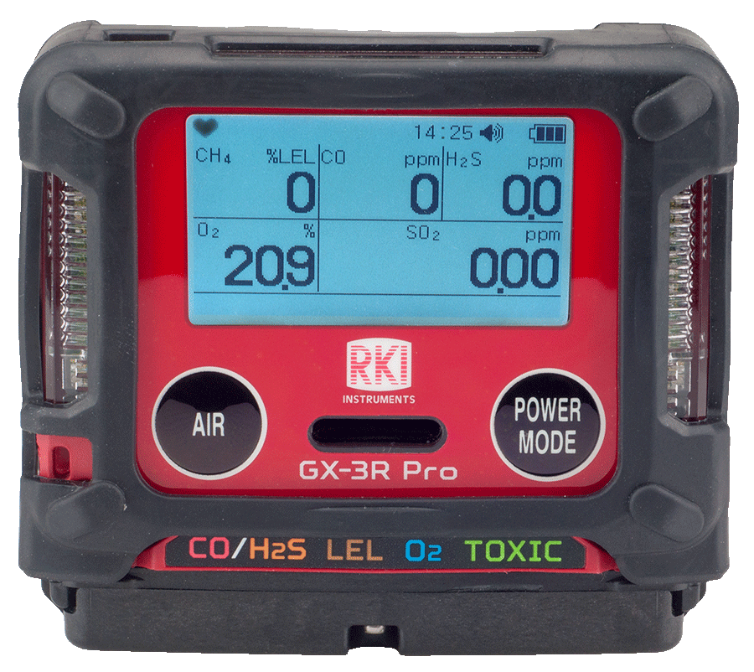
2024 Portables Plan
Markets & Strategies

Slide 2
2023 Portables Results
2023 Goal | 2023 Annualized | % of Goal | YoY % Change
18,285,000 | 20,511,434 | 112.2% | 109%

Slide 3
2024 Portables Plan
2024 Goal | % Change
21,172,000 | 3%
Re-Establish Distributor Confidence
  Regain traditional RKI delivery times
  TIIS versions can now ship within 5 days
  RKK production capacity for GX-3R doubled
  RKI production capacity increased to 150 GX-3R per day

Slide 4
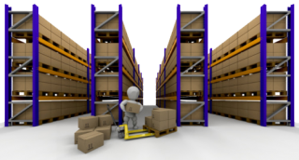
2024 Portables Plan
Go Red Strategy success is based inventory
  04 Series – current volume 6,000 / year (500 / month)
    HS-04 ~ 845 (1,000 HS-04 in stock today)
    HS-04 Tyson ~ 1,479
    CO-04 ~ 2,300
    OX-04 ~ 820
    SC-04 ~ 500
    SDM-04 coming Q3 2024
    2024 Target: 10,000 (833 / month)

Slide 5
2024 Portables Plan
Go Red Strategy success is based inventory
  GX-3R: current volume ~18K / year ( 1,500 / month)
    2024 Target Inventory: 30,000 (2,500 / month)
  GX-3R Pro: current volume 1,000 / year (83 / month)
    2024 Target Inventory: 1,500 (125 / month)

Slide 6
2024 Portables Plan
Target Markets
  Energy: Oil & Gas
    Upstream: Drilling & Initial Production
    Midstream: Transportation and Storage
    Downstream: Refining & Retail Distribution
  Utilities
  Food Manufacturing
  Construction
  Water / Waste Water
  Fire departments

Slide 7


Go Red Plan
Increase Market Share of Red over Yellow
  Each rep defines list of Team Red Distributors
    Target minimum 3 per region
    Minimum $50K annual sales to participate
  Goals are set as % growth measured by product model
  20% growth on at least 3 models = success (GX-3R | GX-Force | 04 Series)
    Achieve growth with at least 2 Team Red Distributors

Slide 8

Go Red Plan
Custom-Made Distributor Incentive Plans
  Reps create a specific incentive program for each Team Red Distributor with the goal to achieve 20% growth on Go Red portables.
  Be creative and choose what works for each distributor.
  Once size fits all incentive plans are ineffective

Slide 9
Custom-Made Distributor Incentive Plans
How would this work?
Define a budget based on target growth amount for each Team Red Distributor
  Budget = No more than 5% of the projected new sales.
    Ex. $10,000 in projected new sales = $500 budget for incentive plan.
Create a plan - With the budget defined, create a plan for each Team Red Distributor complete with the custom-made incentive offer.
Quarterly payouts - design the plan to pay out at the end of each quarter
Submit the plan to corporate
Introduce the plan to Team Red Distributor

Slide 10
Custom-Made Distributor Incentive Plans
Examples of possible plans
Distributor achieves $10K of new Go Red product growth, rep buys lunch for branch (lunch & learn). New sales must be above the prior year sales for any of the Go Red models.
Team Red Distributor Sales rep that sells the most Go Red models in the quarter gets $500 gift card. Entire team must have an increased sales by minimum of $10K over prior year period.
Distributor achieves $10K of new Go Red product growth and receives a free demo unit.

Slide 11
Go Red Plan
Next level Retail Point of Sale Material
  Develop a couple of retail space POS packages ($500 & $1,000 estimated value)
  Use outside professional contractor to create POS packages
  Offer Minimum stock purchase for POS Set up (ex. 10 units of each model) of GX-3R/GX-Force/04 Series, distributor receives new POS display (est. $1,000 value)
SDM Competitive pricing/promotion
  Buy 25 instruments, receive free dock
Target Distributor Rental Fleets
  Promotional offering for rental purchases (buy 10 units get dock at 50% off | buy 20 units get 1 unit free)?

Slide 12

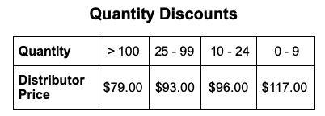
New List Price & Quantity Discounts
Nov 2022, Strategic action

Slide 13
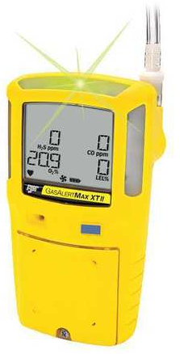

Quantity Discounts
GX-Force price
Order Qty | Distributor Discount | Distributor Price
List Price: $865.00
1 - 24 | 30% | $605.50
25 - 49 | 35% | $562.25
50 + | 40% | $519.00
ex. PK Safety (typical GP is 20-25%) PK Price for BW XT II = $781
[BW XT II lowest street price = $749.67]
↓
40% discount, PK could net 30% GP, selling at $749
Notes:
Here is the agenda for this webinar.
We will begin with a look at the sensing technology of Riken Keiki just briefly. Then, we will move into our presentation of the OHC-800.
First, we will explain the outline of OHC-800 and the OPT-SONIC calculation method, which is patented technology from RIKEN KEIKI.
After that, we will show you more details and why OHC-800 is chosen.

