Slide 1

Finding fee program for Calorimeter (BTU monitor)
Business
Dec 2023
Notes:
100 millionを視野に入れた基盤作り。
ポータブル：卸店店内シェアの獲得と強固な関係作り。
定置：南部

Slide 2






Business process
①Find key person
②Quote
③Evaluation
④Judgement
⑤Order
①Find key person (End user, Engineering company) RMS
Flare stack, Fuel gas PIC is ideal
②Quote (Technical discussion) RKI Direct
③Evaluation, demonstration, FAT
④Judgement
⑤Order
Incentive is paid for the activity ① when RKI receive an order

Slide 3
Incentive
Condition：
①Out of scope
Customers / projects already working with RKI Direct or our partners
are out of scope.
ex.
Calorimeter (BTU monitor) : Kaizen, Insight Analytical
②Incentive amount
2% of sales amount for a job.
Maximum limit amount is US$5,000 per a job
ex. US$100,000 sales for US$2,000 incentive
US$300,000 sales for US$5,000 incentive (not US$6,000)

Slide 4
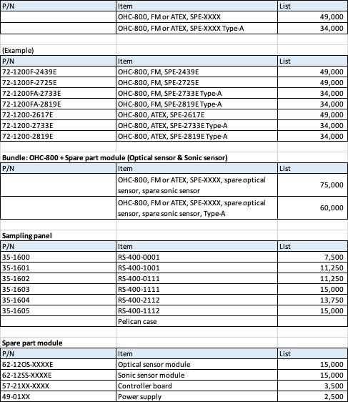
OHC-800
Price list
Typical incentive
OHC-800 US$49,000
Sampling panel US$15,000
US$64,000
2% of US$64,000 = US$1,280

Slide 5
Activity of OHC-800 sales
Target market | Positive points | Activity | Companies working
Flare stack, Upstream Potential：150 /year | ・EPA new regulation Flare stack gas in Oil well needs to be monitored RKI Web | ・Marathon done demo (Quote request 12 units) ・Exibition Apr 2024 in TX | Marathon Oil Exxon Mobil Oxi Western midstream
Flare stack, Midstream Potential：50 /year | ・Hobre, COSA calorimeter are poor performance for H2 mixed stream. | ・Exxon will do a demo in 2024 | Exxon Mobil Shintech
Natural gas pipeline Potential：50 /year | ・Less maintenance ・H2 injection ・H2S tolerance | ・Demo done for TC. ・New Mexico gas will demo 2024 | TC Energy New Mexico gas SASK Power
Fuel gas, Midstream Potential：20 /year | ・Hobre, COSA calorimeter are poor performance for H2 mixed stream. | ・Exxon will demo in early 2024 | Exxon Mobil Shintech
Gas turbine Potential ：5 /year | ・H2 injection ・High accuracy & fast response | ・RIKEN supplied MHPS ・RKI supplied GE ・Siemens (FL) interested | GE Siemens PMS
Gas appliance manufacturer Potential ：5 /year | ・CSA uses ・Less maintenance | ・Supplied to CSA、BSH | BSH Miles industries Wolf steel Daikin

Slide 6
Keywords
Who is engineer for BTU monitor or Calorimeter for Flare stack / Fuel gas (Off-gas) for internal facility?
RKI has Maintenance free, Optical based BTU monitor, which is replaceable from HOBRE, COSA, UNION, or GC.

