Slide 1
2024 RKI Business Strategy
November 2023
Notes:
100 millionを視野に入れた基盤作り。
ポータブル：卸店店内シェアの獲得と強固な関係作り。
定置：南部

Slide 2
Structure establishment
Foundation creation to become 100 million company
Common understanding within Riken group
New Product Roadmap R&D for North America
Portable:
Re-establish the BOND relationship with Distributor to increase the market share to pursue the GO-RED.
Fixed:
Gulf region strategy, Oil & Gas, Petrochemical market
Notes:
100 millionを視野に入れた基盤作り
製品ロードマップのグループ間共通認識
ポータブル：卸店店内シェアの獲得と強固な関係作り
定置：南部戦略 石油石化市場への本格参入

Slide 3
2023 Review Forecast 47.1 Million
2023 Sales finished very strong until Aug. lead both Fixed system and Portable.
Fixed: Product range with Otis and strengthened team expanded awareness among entire sales organization.
Portable: 04series, Force completed to initiate GO RED to increase the market share by transforming the distributor’s first choice.
Created fundamental of BTU and SEMI market.
Fixed system R&D to be submit to HQ.
Finalizing OPLS design and established production capability.
Investment in human and building for future expansion.
Notes:
活動を通じて分かったこと。
理研製品で定置製品レンジを充実する事で、連結利益の大幅改善可能。 グループ戦略の推進が重要。
石油石化市場での定置実績は皆無。 OHC-800、ポータブル、定置活動を通じ、Gulf Regionでの体制構築を行う。
既存商売の拡大を増進させ、将来への布石とする。
半導体はKFPIの人脈をフル活用しつつ、自らFABとのつながりを強化する。

Slide 4
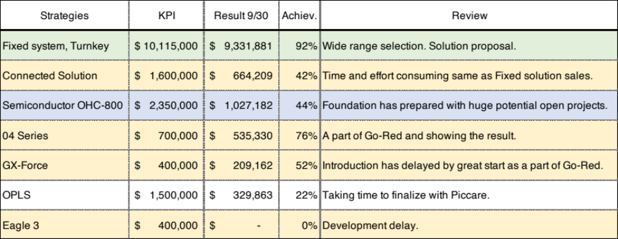
Strategies with KPI

Slide 5
Numerical result by product category
 | 2019 | 2020 | 2021 | 2022 | 2023 Forecast | 2024 Plan
Fixed Systems | 8,851,091 | 7,234,966 | 8,942,901 | 11,606,084 | 14,266,000 | 15,742,000
Portables | 15,290,372 | 12,463,609 | 16,460,101 | 18,898,924 | 20,423,000 | 21,172,000
Misc | 11,827,587 | 11,865,031 | 12,615,979 | 13,218,990 | 12,410,000 | 12,586,000
Total | 35,969,049 | 31,563,606 | 38,018,982 | 43,723,998 | 47,099,000 | 49,500,000
vs Previous year |  | 88% | 120% | 115% | 108% | 105%
2024 forecast based on Q3 YTD/9x12
Misc consists Sensors and Cal Gas which mainly contribute to Fixed system.
Fixed system sales has increased to become even with Portable sales.

Slide 6
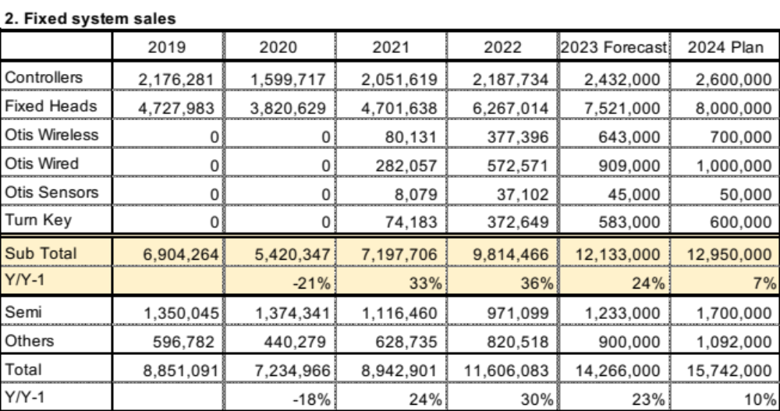
Fixed system

Slide 7
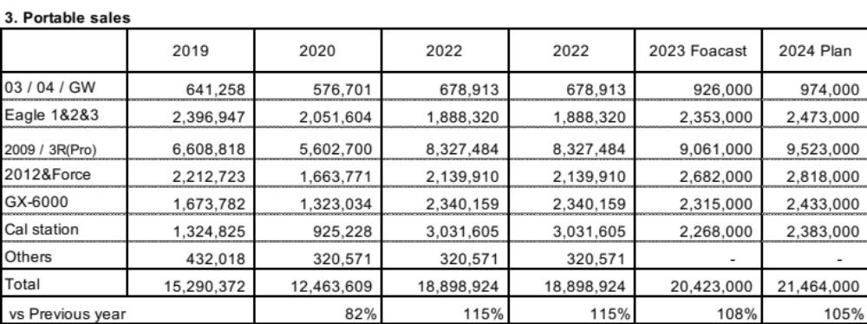
Portable

Slide 8
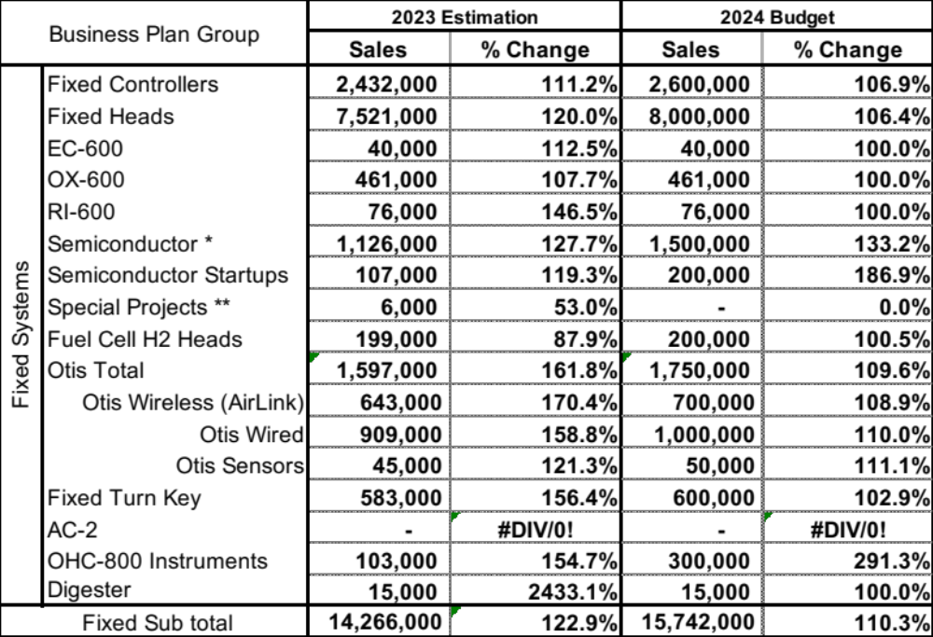
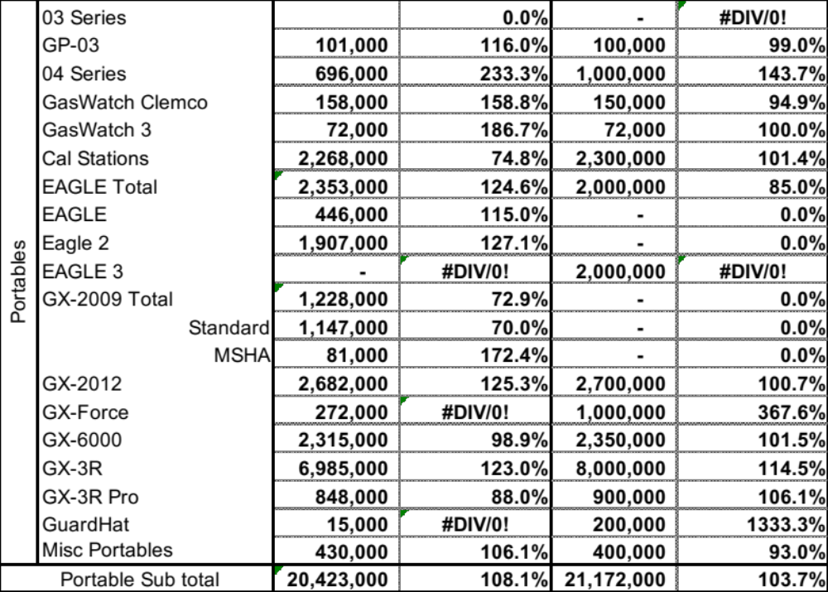
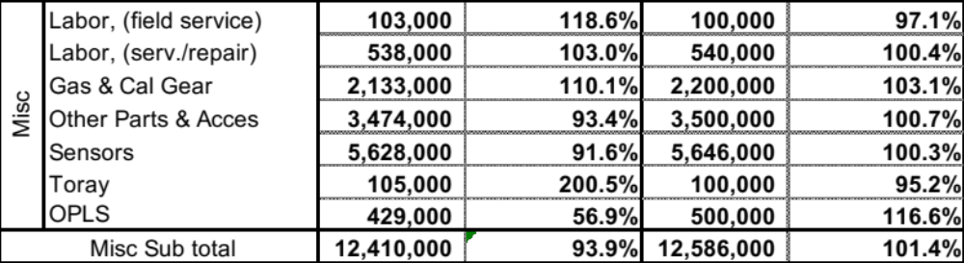
Total Sales

Slide 9
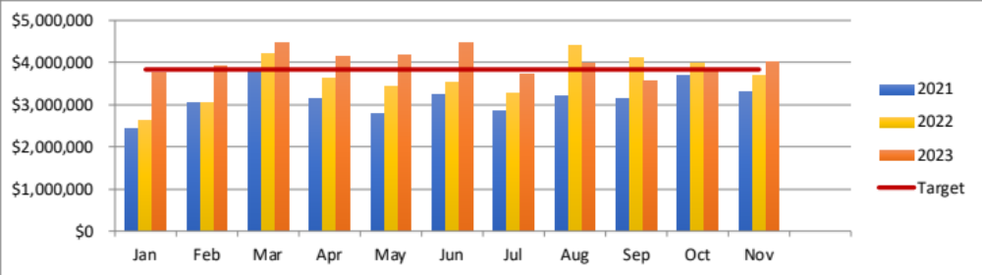
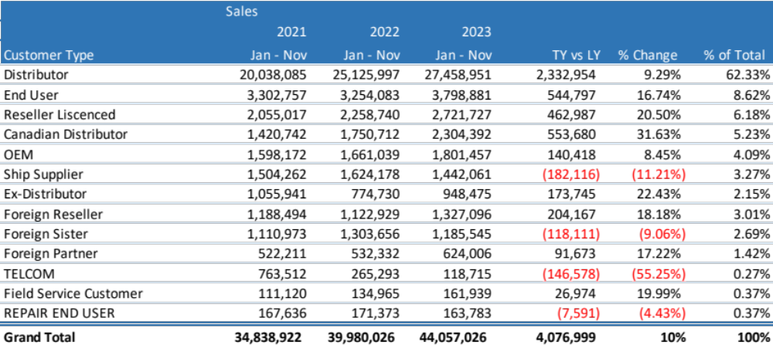
Sales by Customer

Slide 10
Customer Account Analysis
 | ALL |  | USA Dist |  | CANADA Dist |  | RKI Direct North America |  | Other |  | International
 | # of Cust. | Sale | # of Cust. | Sale | # of Cust. | Sale | # of Cust. | Sale | # of Cust. | Sale | # of Cust. | Sale
Total Account Number | 6,177 |  | 211 |  | 33 |  | 2,181 |  | 3,337 | - | 289
Acount without Sales in 2023 | 4,890 |  | - |  | - |  | 1,664 |  | 2,849 | - | 204
Account with Sales in 2023 | 1,287 | 44,029,280 | 211 | 27,733,156 | 33 | 2,304,392 | 517 | 8,295,006 | 488 | 2,571,348 | 85 | 3,125,378
Top 80% | 184 | 35,263,313 | 68 | 22,212,098 | 14 | 1,884,486 | 169 | 7,465,554 | 69 | 2,057,078 | 19 | 2,608,347
Rest of 20% | 1,103 | 8,765,967 | 143 | 5,521,058 | 19 | 419,906 | 348 | 829,452 | 419 | 514,270 | 66 | 517,031

Slide 11
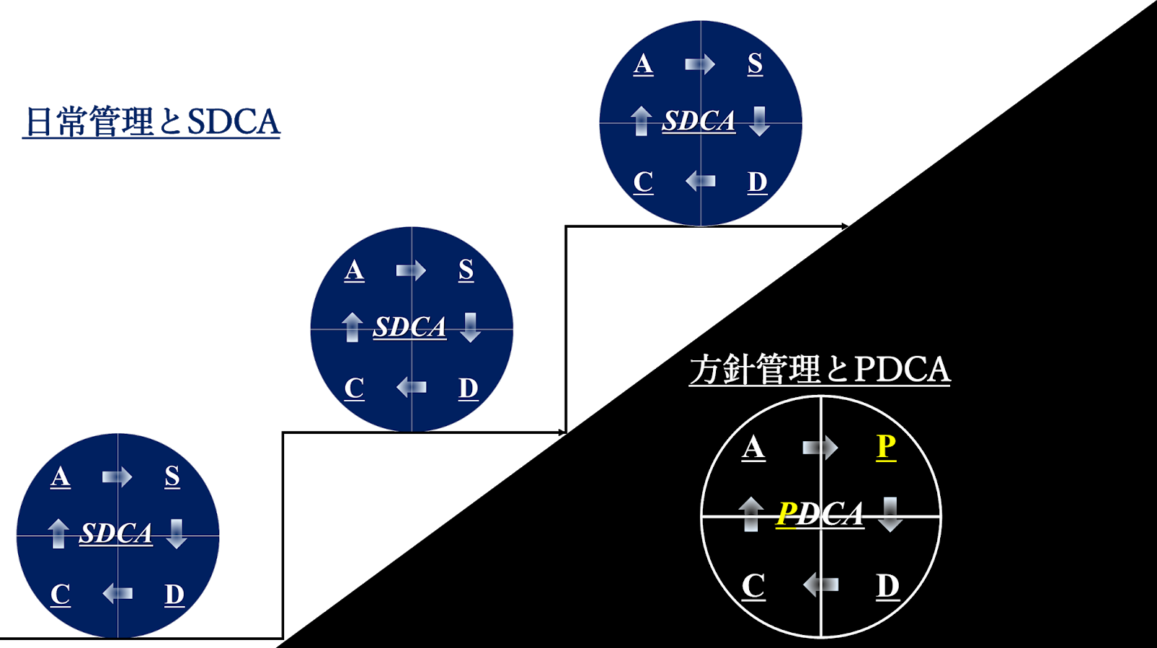
Strategy management / Daily management
Daily (ISO) Management
Every dept having KPI to maintain and perform with certain level to satisfy the customers.
Strategy Management
Step up challenges
Future preparation
New challenge
2021-2023
Fixed system
Efficiency
2024
Gulf region
New product planning
Semiconductor / Calorimeter development
Investment in human, building, R&D

Slide 12
2024 Goal: US$ 49,500,000.-
グループ企業の総力を最大限に発揮し売上１億ドルの礎を作る
Structure establishment
Create foundation to become 100 million company
Portable: Re-establish the BOND relationship with Distributor to increase the market share to pursue the GO-RED.
Fixed: Gulf region strategy, Oil & Gas, Petrochemical market
Finalize the North America R&D Road-Map and propose the Fixed-Heads range.

Slide 13
2024 Plan Sales Goal: 49.5 Million (105.2% vs 23)
Portable: Re-establish the relationship with Distributor to proceed GO RED.
Enhance the Stationary solution sales by strategizing the sales organization.
Semiconductor market: SUNY, WOLFSPEED
BTU market: Fuel gas, Flare gas, Pipeline
Notes:
OPLSは判断する

Slide 14
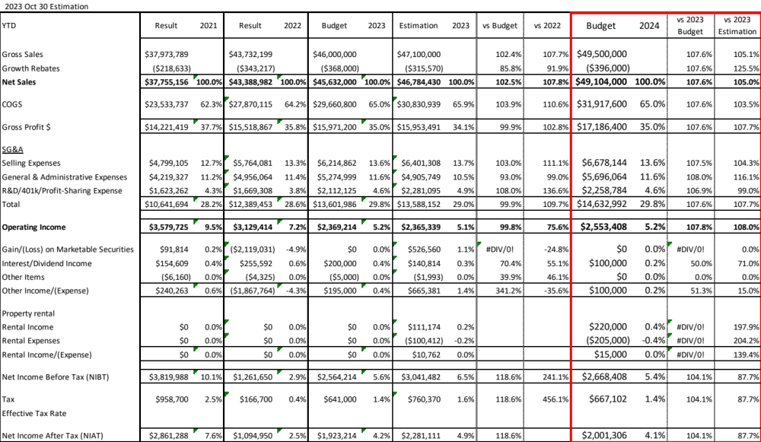

Slide 16
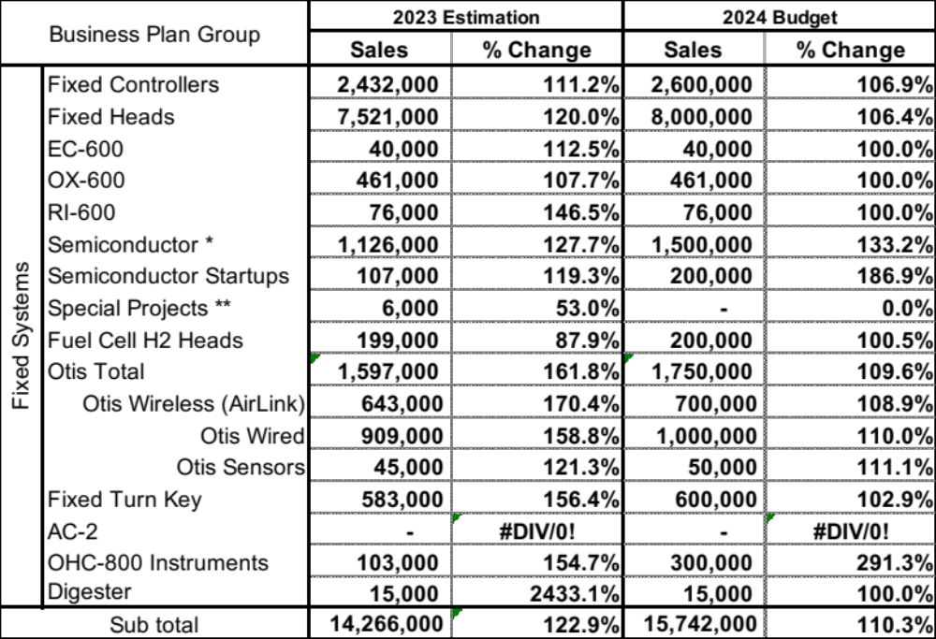

Slide 17
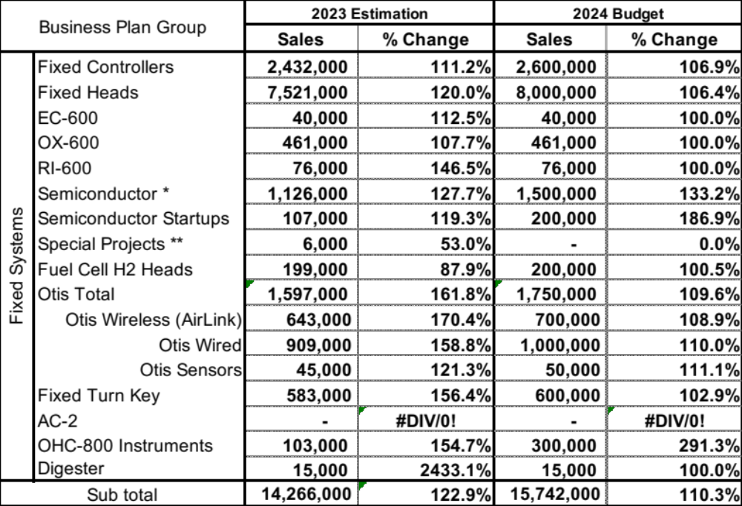
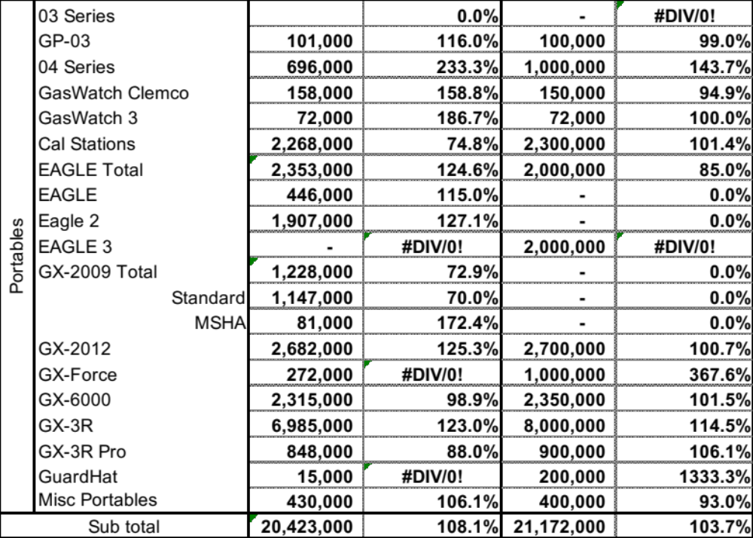

Slide 18
