Slide 1
2023 National Sales Meeting
Product Development
December 2023
Notes:
100 millionを視野に入れた基盤作り。
ポータブル：卸店店内シェアの獲得と強固な関係作り。
定置：南部

Slide 2
Fixed Gas Detector Market Size and Target
Market Size (World) | $ 1,000,000,000
North America | $ 350,000,000
Gas Detector product only | $ 175,000,000
Ave Punit price | $ 1,000
Unit 市場規模台数 | 175,000 | → | 2022 Result
Oil & Gas Petro Chem 67.3% | 117,779 |  | Honeywell | 25.0% | 43,750
新規市場開拓 | ↓ |  | MSA | 20.0% | 35,000
Target market share 5% in 2027 | 5,889 |  | Det-Tronics | 13.0% | 22,750
 | ↓ |  | Teledyne | 10.0% | 17,500
Organic Growth | 10,000 | ← | RKI | 4.5% | 7,800
Oil & Gas | 6,000 |  | Others | 27.5% | 48,200
Total RKI Goal | 16,000 |  | Total |  | 175,000
RKI Market share | 9.1%
Double the sales by strengthen the sales approach towards Oil & Gas and Petro-Chem industry. From 8,000 units to 16,000 units.
Notes:
狙い：対象市場とポテンシャルとターゲットの明確化

Slide 3
Fixed Gas Detector Market Size and Target
Market Size $175,000,000
Upstream
Oil & Gas
35.5%
$62.1M
Midstream
Petrochemical & Chemical
31.8%
$55.7M
Downstream
General Industries
General Industries
32.7%
$57.2M

Slide 4
Fixed Gas Detector Market Size and Target
High-End
Class I, Div1
SUS housing
SIL2
Market Size $175,000,000
Upstream
Oil & Gas
35.5%
$62.1M
Midstream
Petrochemical & Chemical
31.8%
$55.7M
Downstream
General Industries
General Industries
32.7%
$57.2M
M2A
Class I, Div1/2
Local display
Midium cost
S2/Direct Connect
Class I, Div2
No display
Low cost

Slide 5
Fixed Gas Detector Market Size and Target
High-End
Class I, Div1
SUS housing
SIL2
Market Size $175,000,000
9.1%
M2A
Class I, Div1/2
Local display
Midium cost
Upstream
Oil & Gas
35.5%
$62.1M
Midstream
Petrochemical & Chemical
31.8%
$55.7M
Downstream
General Industries
General Industries
32.7%
$57.2M
S2/Direct Connect
Class I, Div2
No display
Low cost
4.5%
9.1%
4.5% 7,800 units
9.1% 16,000 units
9.1%
4.5%

Slide 6
Fixed Gas Detector Market Size and Target
Gulf Coast Region
Incorporate RKI’s experience to the design
RKI市場理解を設計に反映
Developed by Riken with high quality
開発力のある本社で設計
Increase the share in energy industry
エネルギー市場でのシェア拡大
Preferred Vendor List

Slide 7
Future Transmitter Spec Wish List
Output: Analog, Digital, Relay
Housing: SUS, Aluminum, Off-the-Shelf, Ports, IP66/67
Local display: With, Without, Full dot 3 color LCD
Wiring: 3 wire, 2 wire
Sensor: Riken’s new F-Sensor series, Third party’s sensors
Approvals: cULus or cFMus, CSA for Canada, SIL2
Functionality;
Log – Event history
Plug and Play sensor, Hot swap sensor replacement
Configurable alarm test mode
Accessories;
Pump module attachment
Portable calibration unit via BLE
Water baffle cap
Strobe, Horn for stand-alone

Slide 8
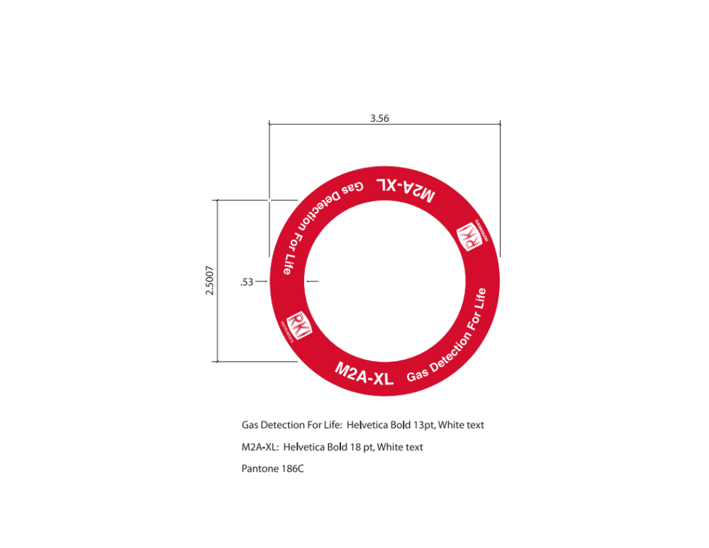
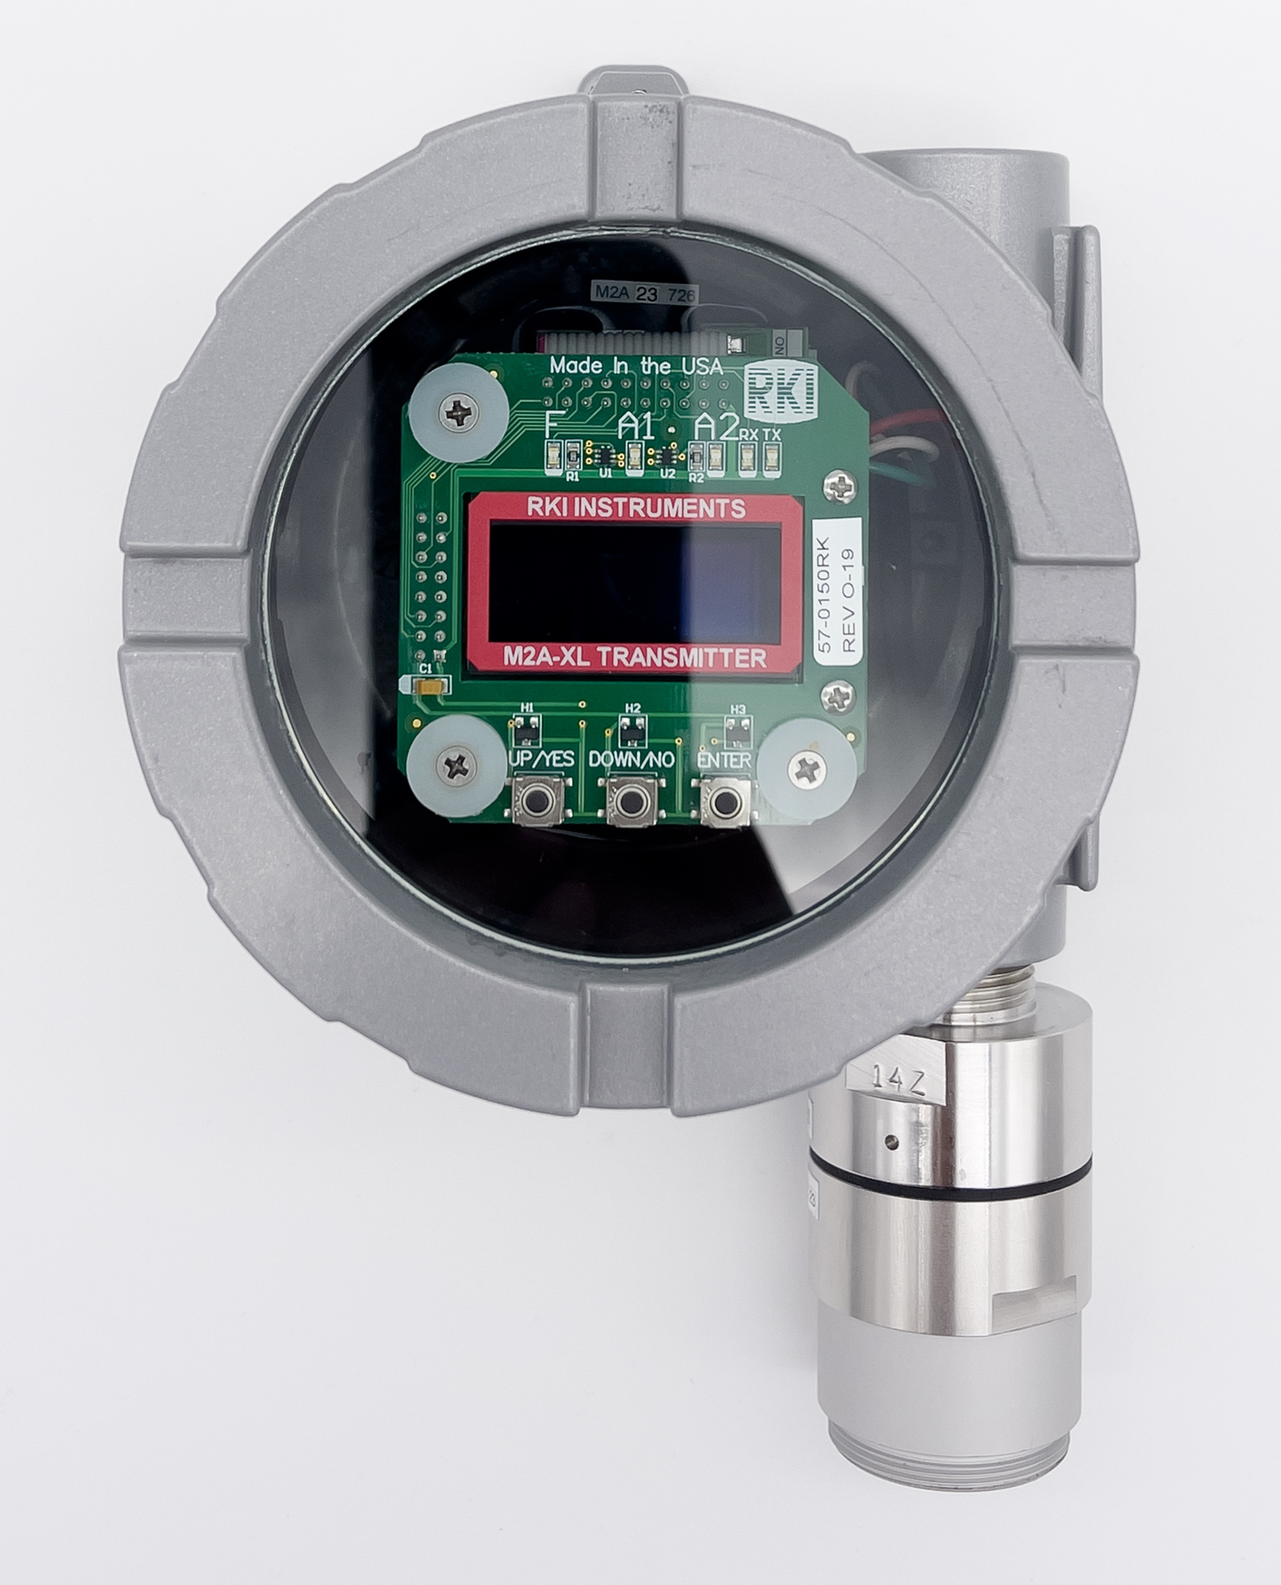
M2A– XL Standardized
Start from February 1st, 2024

Slide 9
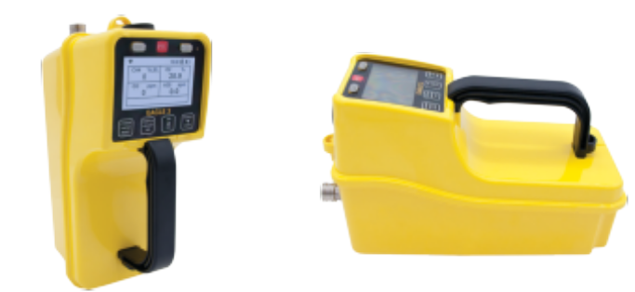

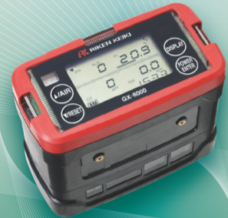
Eagle 3, GX-9000, GX-8000
Eagle 3
Six Gas Monitor
Same LEL sensor as Eagle 1/Eagle 2
Same O2, H2S, CO sensor as GX-3R
New series of F sensor for IR, TC, Toxic, and PID
Six Gas Monitor
Same O2, H2S, CO sensor as GX-3R
New series of F sensor for IR, TC, Toxic, and PID
Four Gas Monitor
Standard four gas + TC sensor
GX-9000
GX-8000

Slide 10
Eagle 3, GX-9000, GX-8000
High Price
Eagle 3
Low Spec
GX-8000
High Spec
GX-9000
Low Price

Slide 11
Eagle 3, GX-9000, GX-8000
 | 2024 |  |  |  |  |  |  |  |  |  |  |  | 2025
 | Jan | Feb | Mar | Apr | May | Jun | Jul | Aug | Sep | Oct | Nov | Dec | Jan | Feb | Mar | Apr
Eagle 3
SDM-E3
GX-9000
SDM-9000
GX-8000
We can offer GX-8000 for standard four gas.

Slide 12
SDM Universal Docks – Cradle Schedule
 | 2024 |  |  |  |  |  |  |  |  |  |  |  | 2025
 | Jan | Feb | Mar | Apr | May | Jun | Jul | Aug | Sep | Oct | Nov | Dec | Jan | Feb | Mar | Apr
SDM-Force
SDM-GW3
SDM-9000
SDM-04
SDM-E3
SDM-6100

Slide 13
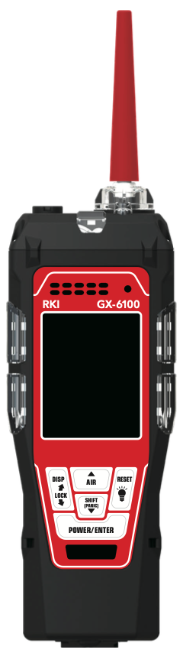
GX-2012 Remaining Stock – New Models
High Price
GX-6100
TC VOL Sensor
MOS PPM Sensor
Same Toxic Gas Sensors as GX-6000
BLE
GX-6100
GX-2012
Low Spec
High Spec
GX-Force
Low cost, smaller size
Leak Check Mode (by cat sensor): Q1
GX-Force
BW GasAlert Max XT II
Low Price

Slide 14
GX-2012 Remaining Stock – New Models
3,750 units is the total quantity we can receive from RKK, due to IrDA module obsolescence.
Usage: 250 units/month => 15 months
Discontinuation: March 2025
Idea of extending discontinuation
Sell GX-Force
Sell only GX-2012 with TC sensor
Change price, etc
GX-6100

Slide 15
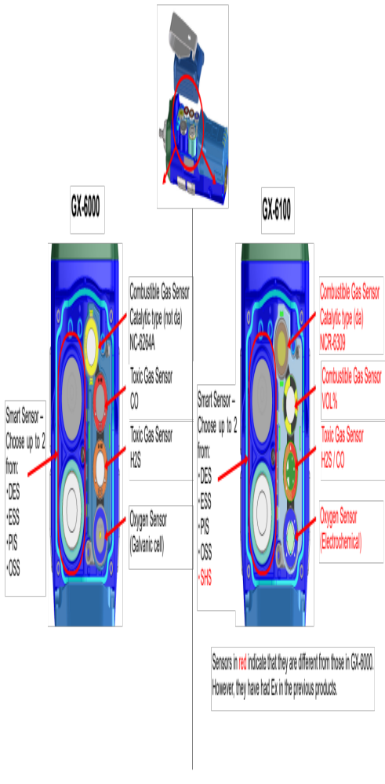
GX-2012 Remaining Stock – New Models

Slide 16
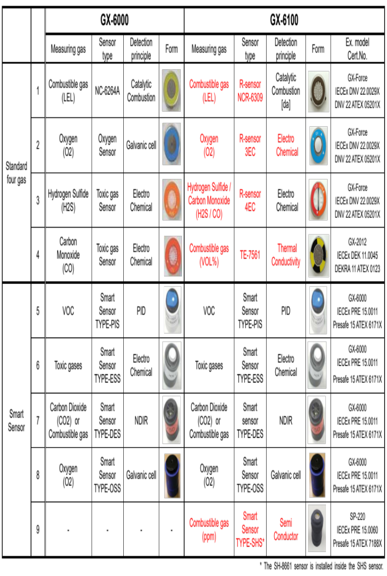
GX-2012 Remaining Stock – New Models

Slide 17
GX-2012 Remaining Stock – New Models
 | 2024 |  |  |  |  |  |  |  |  |  |  |  | 2025
 | Jan | Feb | Mar | Apr | May | Jun | Jul | Aug | Sep | Oct | Nov | Dec | Jan | Feb | Mar | Apr
GX-2012
GX-Force
GX-Force Leak Check Mode
SDM-Force
GX-Force CSA
GX-6100
SDM-6100
Standard 4 gas version can be replaced with GX-Force.
TC version can be replaced with GX-6100.

Slide 18
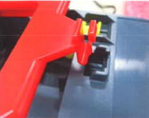
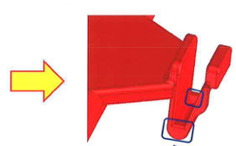
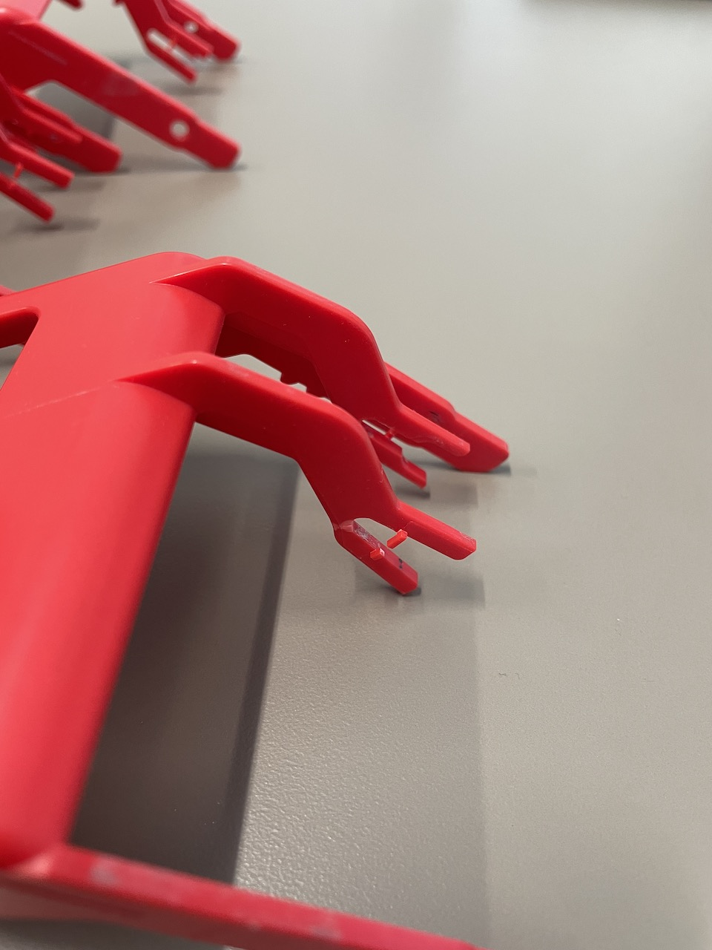
SDM-3R Red Door Issue
Improved in 2019 but still not robust enough.
Requested Riken to change the design (possibly w/o door).
Hinge is also broken sometime.

Slide 19
LEL Sensor Warranty Replacement
Energy Transfer replaced NC-6309 sensor 48 pcs out of 328 units under warranty in about 1.5 year. = 146,300 ppm
23,400 ppm for all of sales over the years
Sent returned sensors to RKK for analysis.
 | 2020 | 2021 | 2022 | 2023 | Total | Energy Transfer
GX-3R Sales | 7,658 | 13,064 | 14,125 | 14,615 | 49,462 | 328
NC-6309 Replacement | 52 | 178 | 391 | 537 | 1,158 | 48
Percentage/Year | 0.68% | 1.36% | 2.77% | 3.67% | 2.34% | 14.63%
GX-3R 3 Years Accumulation | 7,658 | 20,722 | 34,847 | 41,804
NC-6309 3 Years Accumulation | 52 | 230 | 621 | 1,106
Percentage/3 Years | 0.68% | 1.11% | 1.78% | 2.65%

Slide 20
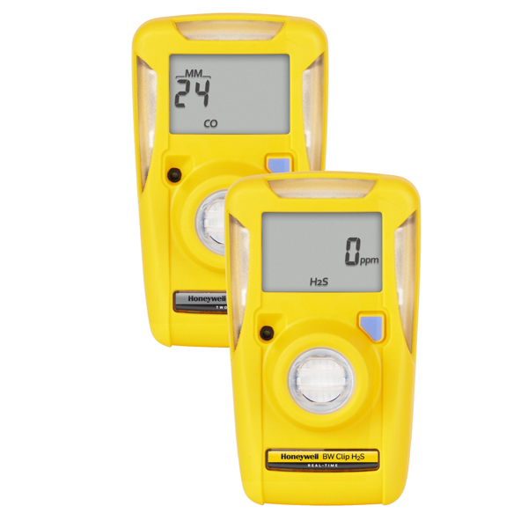
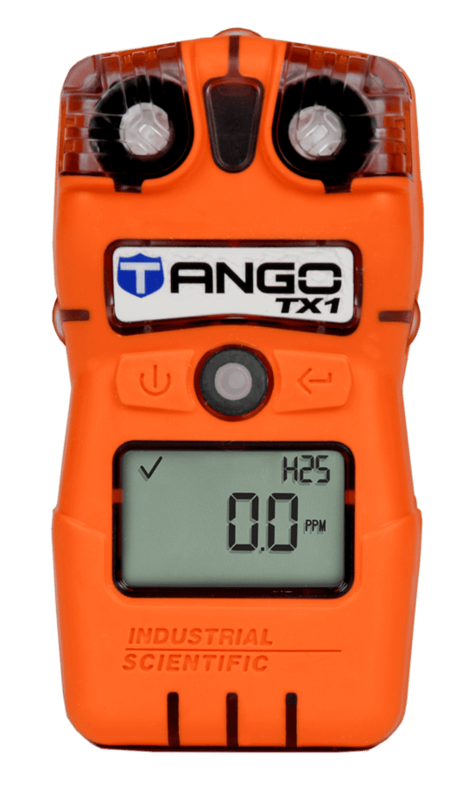
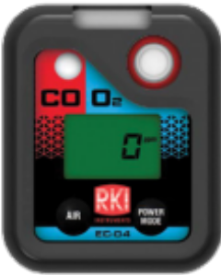
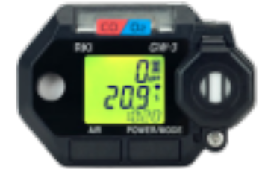
H2S/SO2 Combo Sensor
Opportunity at Suncor for H2S/SO2 gas monitor.
H2S: 12,000 units/year, CAN$250.00 = US$187.50
SO2: 4,000 units/year, CAN$88.00 = US$66.00
Total cost to distributor CAN$340.00 = US$255.00
ISC: New Tango H2S/SO2 will be available in 2024
RKK: H2S/SO2 Combo Sensor for 04 series or GW3?
(CX-04 net cost for RKI $200)
Any other market opportunity?

Slide 21
CLO2 Sensor for GX-6000/GX-6100
Specification
Range: 0 – 5.00 ppm (IDLH)
Lowest Alarm Point: 0.1 ppm (TWA-TLV)
Resolution: 0.01 ppm
H2S Interference: -0.21 ppm for H2S 10 ppm (Drager -0.14 ppm)
Schedule
June 2025

Slide 22
CL2 Sensor – GX-3R Pro/RP-3R Pro
Potential market and size?
Schedule: Q3 2024

Slide 23
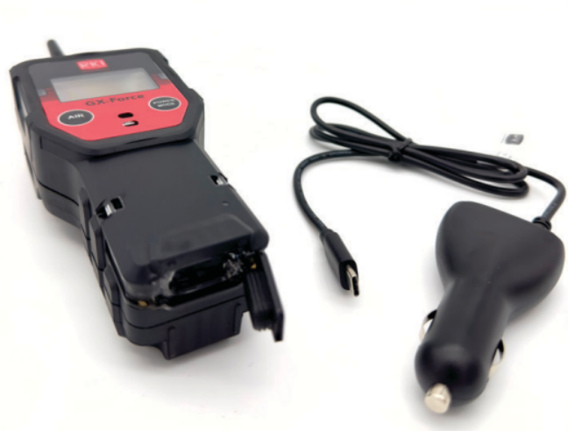
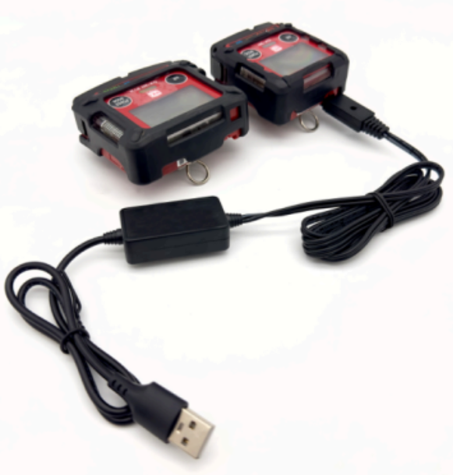
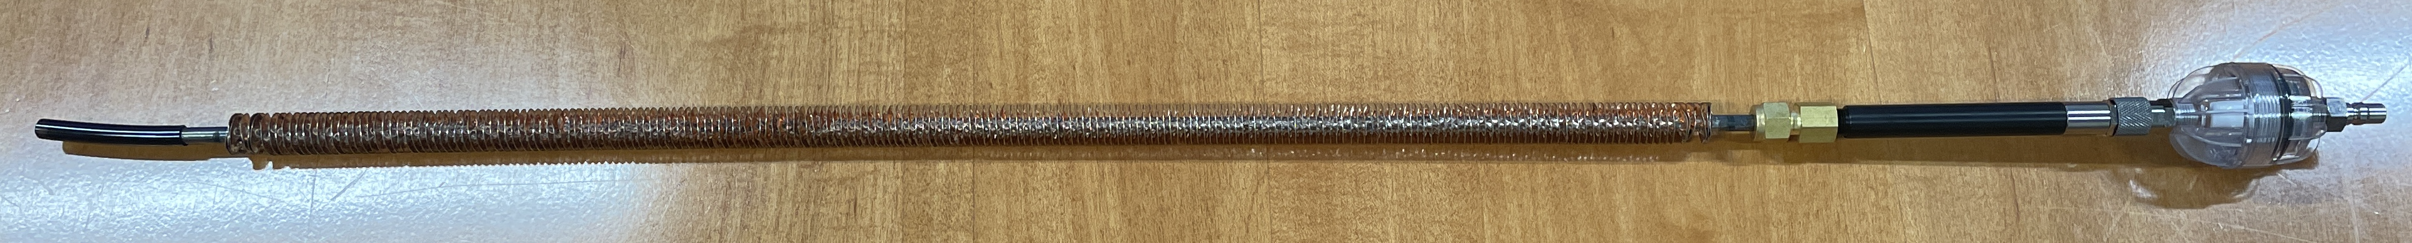
New Accessories
DC Adaptor for GX-Force
49-2022, $50.00/ea
USB Adaptor for GX-3R/3R Pro
49-2023, $50.00/ea
Finned tube probe for Eagles
- Cool down 600F to ambient temp.
80-0120, $330.00/ea

