Slide 1


Partners in Gas Detection 2021

Slide 2
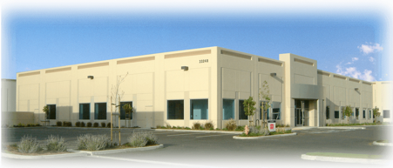
Who is RKI?
RKI founded in 1994
Partner company: Riken Keiki
  Leader In Gas Detection & Sensor Technology for over 80 years
California Corporation
Average employee gas detection experience is 10 years

Slide 3




Company Culture
Customer Service
Technical Service
Fast Delivery
Quality

Slide 4
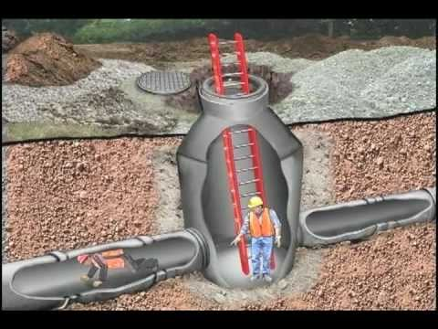
What is a Confined Space?
A confined space is a space that
is large enough for a person to enter and work
has limited or restricted means of entry and exit
is not designed for continuous occupancy

Slide 5

Applicable Standard
OSHA Code of Federal Regulations 29
Section 1910.146
  Permit-required confined space
  Confined spaces in General Industry
Section 1926.1204
  Permit-required confined space
  Confined spaces in Construction

Slide 6

Permit-Required
A permit-required confined space has at least one of the following characteristics
  contains or has the potential to contain a hazardous atmosphere
  contains a material that has the potential to engulf an entrant
  has an internal configuration such that an entrant could be trapped or asphyxiated
  contains any other recognized serious safety and health hazard

Slide 7

Realities of Confined Space

Slide 8




Types of Gases/Compounds
Combustibles
  Flammable gases and vapors
    Most are also toxic
    Organic compounds (HC’s)
“Toxics”
  H2S and CO most commonly monitored
    Inorganic compounds (Non-HC’s)
    Several inorganic compounds are also
    combustible
Oxygen Deficiency
Inert Gases
  Non-reactive gases
    Usually are N2, He, Ar

Slide 9

Flammability Monitoring
Measured in % LEL
  LEL-Lower Explosion Limit
    Least amount of gas needed to support combustion
Described as:
  Flammability
  Combustibility
  LEL-Lower explosion limit
  LFL-lower flammable limit
  Boom!

Slide 10
Oxygen Monitoring
Usually a decreasing measurement with a read-out in % volume.
This is a large measurement.

Slide 11
Toxic Monitoring
Measured in parts per million (ppm)
Very low measurement
Toxic relates to health issues, not combustibility.
25ppm Hydrogen Sulfide in normal atmosphere

Slide 12
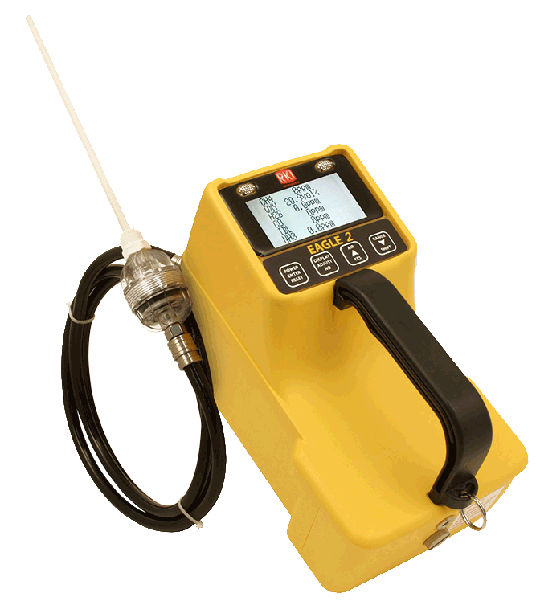
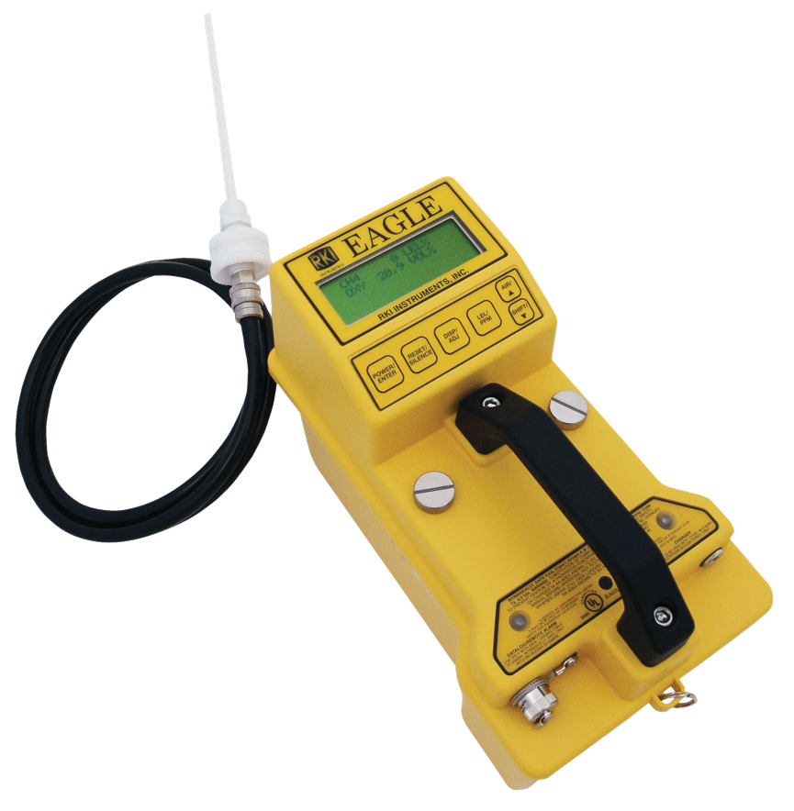
Recognize these?

Slide 13
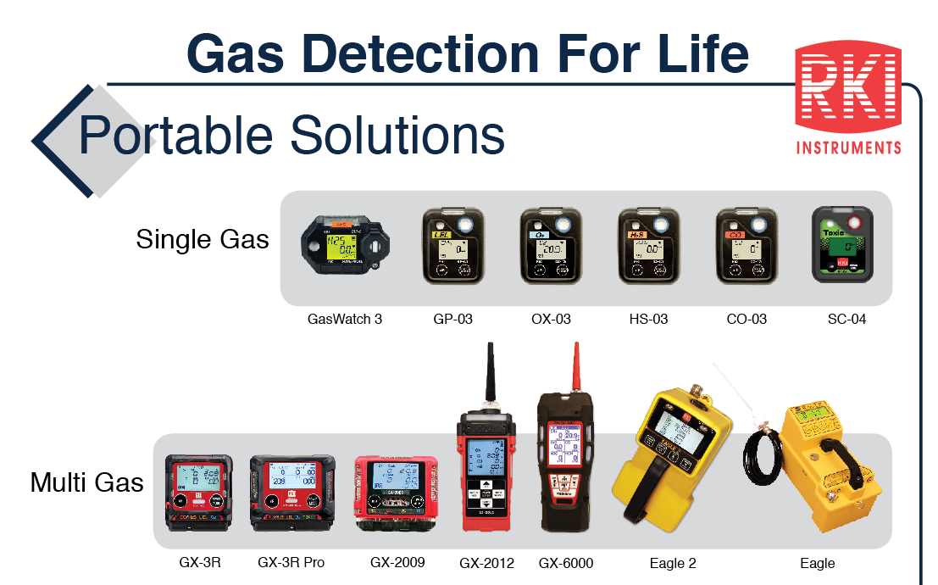
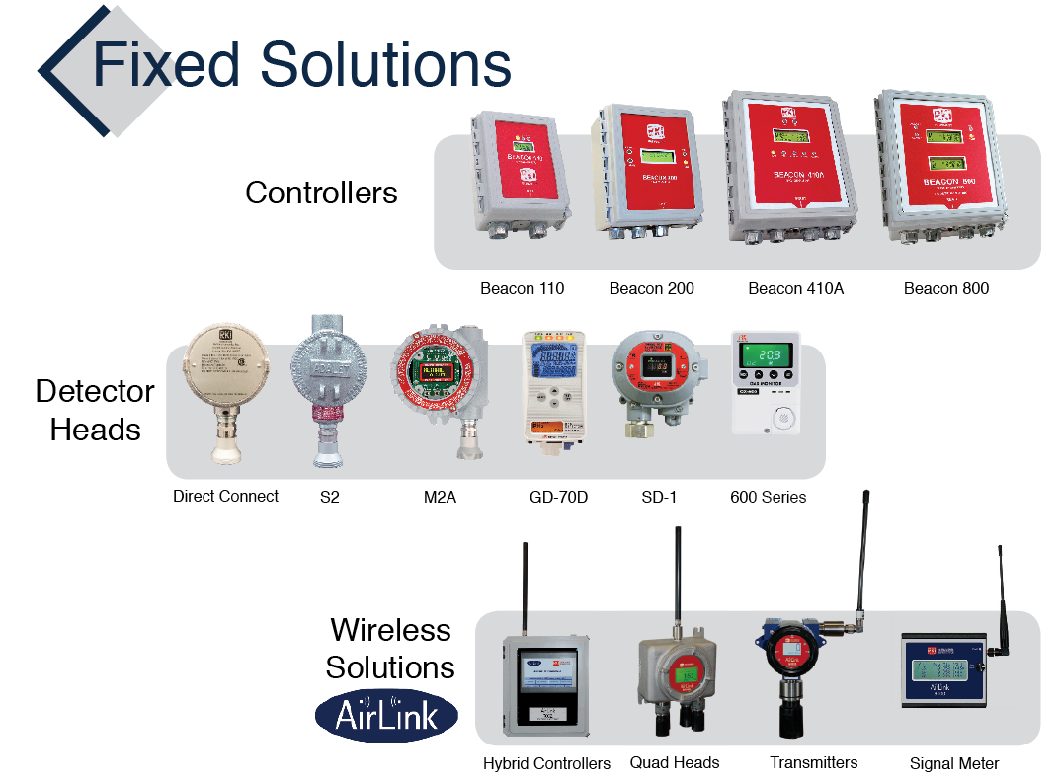
Product Family
Sample drawing instruments have internal pumps. Ideal for pre-entry work.
Wired products
Wireless Products
Diffusion style instruments detect what surrounds the sensor. Ideal for personal monitoring.

Slide 14
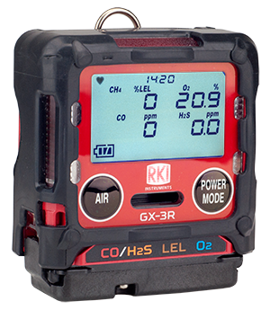
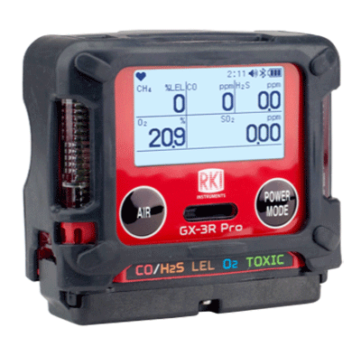
GX-3R & GX-3R Pro
2 Models—Depending on Need
4-gas compliance model
5-gas pro model
GX-3R
GX-3R Pro
Worlds smallest and lightest
4-gas monitor
Impact, water, & dust resistant
3-year Warranty
  4-gas plus extra slot for toxic or IR sensor
  Wireless communication with mobile app
  Man-down and panic alarms
  Alkaline & Rechargeable options

Slide 15

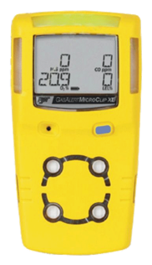
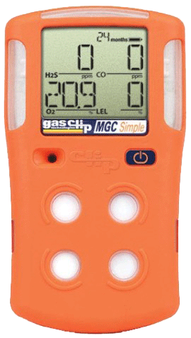

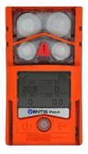
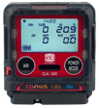
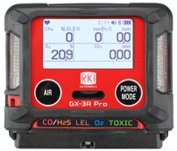
Competitor Comparison
Size & Weight
2.2” x 2.55” x 1”
3.7 ounces
2.9” x 2.66” x 1.06”
4.6 ounces
4.4” x 2.4” x 1.2
6.3 ounces
4.1” x 2.3” x 1.4”
6.4 ounces
4.7” x 2.7” x 1.2”
7.67 ounces
4.4” x 3.0” x 1.4”
7.9 ounces
5.12” x 1.9” x 1.8”
8 ounces
The GX-3R weighs about half of the average 4-gas detector!

Slide 16
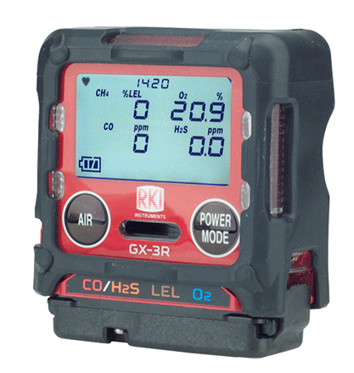


GX-3R
The world’s smallest and lightest 4-gas monitor
Size matters in the “Breathing Zone!”
Field replaceable sensors and parts
Non-compliance indicator
Concussion resistant – drop tested at > 20ft.
IP-68 and IP-66 rated
3-year warranty
3 adjustable alarm levels
Datalogging
Low cost of ownership
“The breathing zone is within a ten inch radius of the worker's nose and mouth. OSHA requires that worker exposure monitoring air samples be collected in the breathing zone. Air sampling filters may be attached to the collar or lapel.”

Slide 17
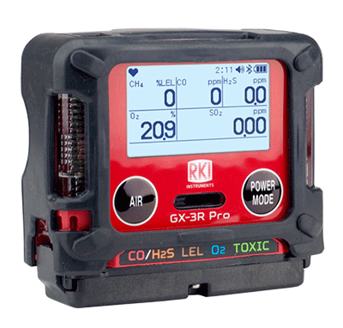
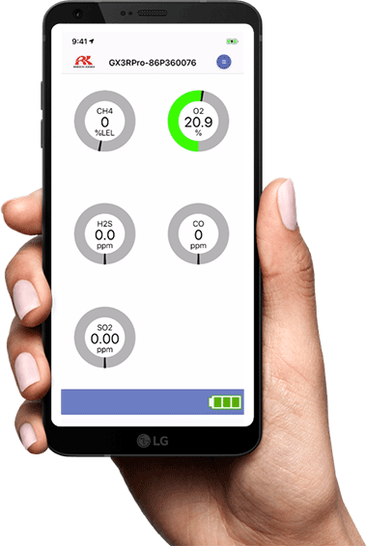

GX-3R Pro
All of the great features of the GX-3R, plus:
An extra sensor slot for IR or toxic sensors
Man down and panic alarms
Full-dot LCD display with auto-rotate and auto-backlight
Bluetooth (BLE) connectivity
RK Link mobile app
RK Link app:
Text or Email alarm notifications with GPS location
Direct readings from instrument
Alarm indications
Configure instrument settings
Instrument locator
Available on iOS and Android

Slide 18




No-Fee Lone Worker Solution
Text and / or Email alarm notifications with alarm data and GPS location of the worker.
Text and / or email up to 150 recipients
RK Link is a free download on iOS or Android.
No monthly service fees.
Stay connected with no fee!

Slide 19
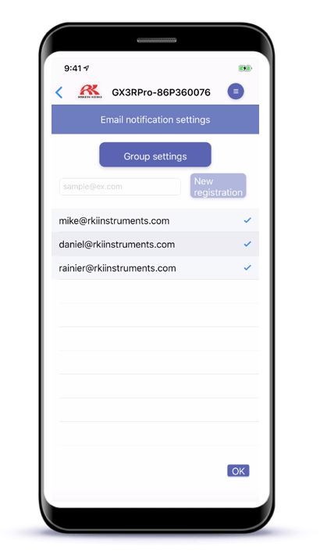
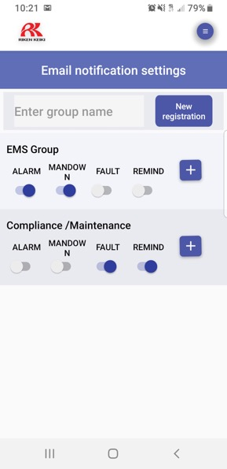


Alert Different Team Members
Based on Alarm Type
EMS Group
Compliance / Maintenance

Slide 20
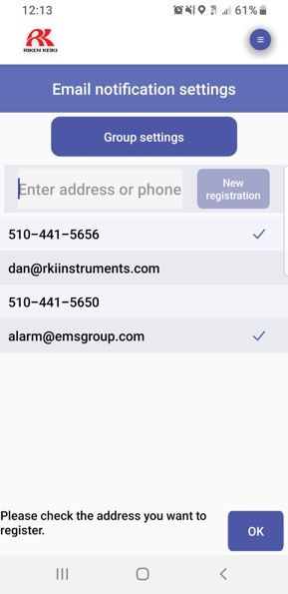


Send Alerts By SMS or E-mail

Slide 21
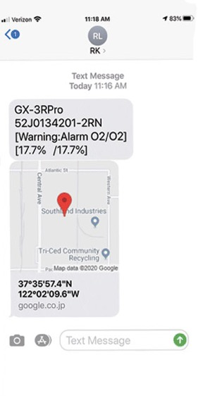
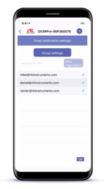
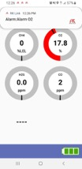
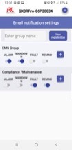

Alerts Include Alarm Data and GPS Location

Slide 22
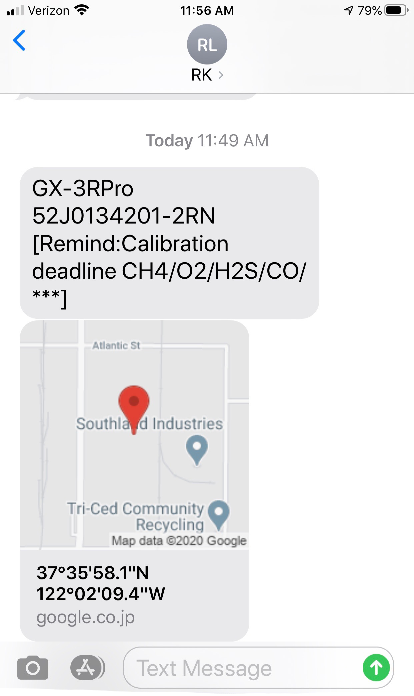
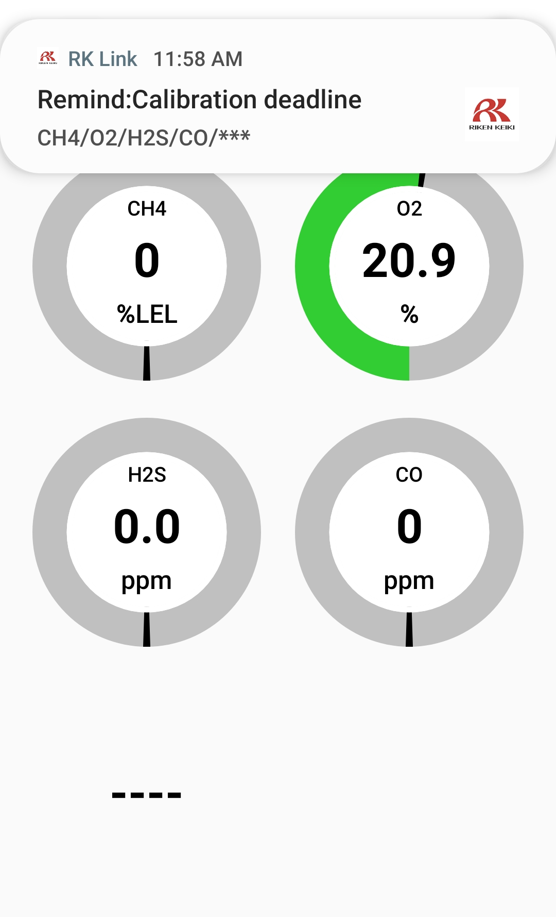
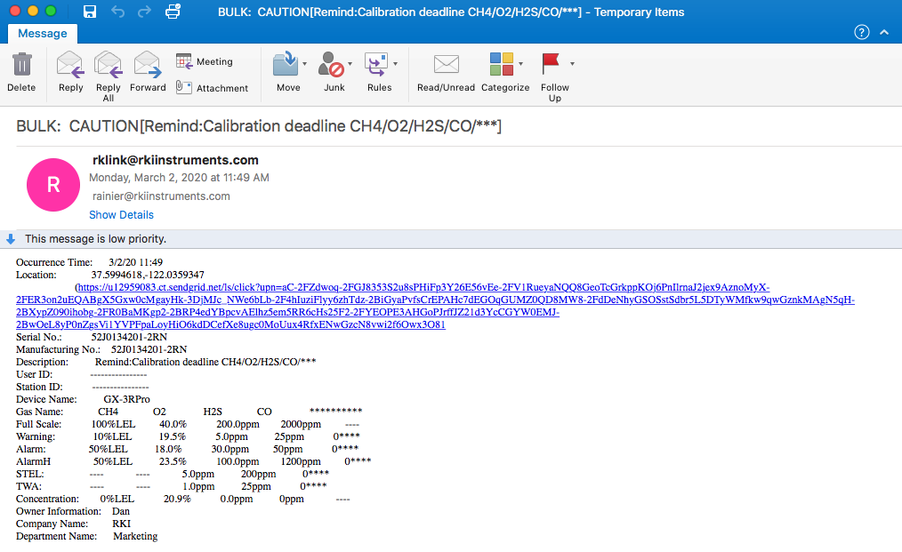
Automatically Send Compliance Notifications
Compliance / Maintenance

Slide 23
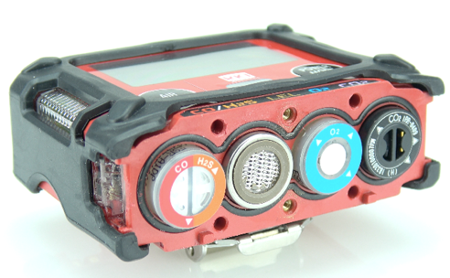

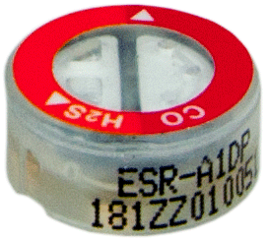
Sensors
The Heart of Every Instrument
We manufacture our own sensors
Our micro-sensors allow us to make the smallest gas detectors in the world
3-year warranty
New LEL sensor’s dual-filament design is silicon resistant
Lead-free EC tech gives O2 sensor 3-5 year lifespan
Dual sensor – 2 channels in one sensor slot
Dual filament
LEL sensor
F1
Dual Sensor
F2
+ Si removal filter
CO/H2S

Slide 24
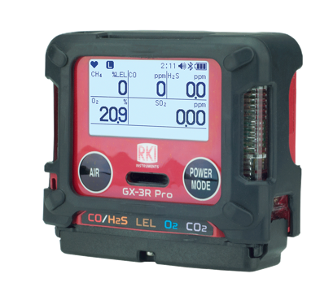

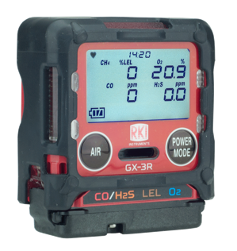
Sensor Options
GX-3R and GX-3R Pro
3-year warranty on all GX-3R and GX-3R Pro Sensors!
GX-3R and GX-3R Pro | GX-3R Pro Only | Coming in 2022 (GX-3R Pro only)
CO/H2S | CO2 ppm (IR) | Cl2
LEL | CO2 % vol (IR)
O2 | HCN
H2S | NO2
CO | PH3
(-H2) CO | SO2

Slide 25
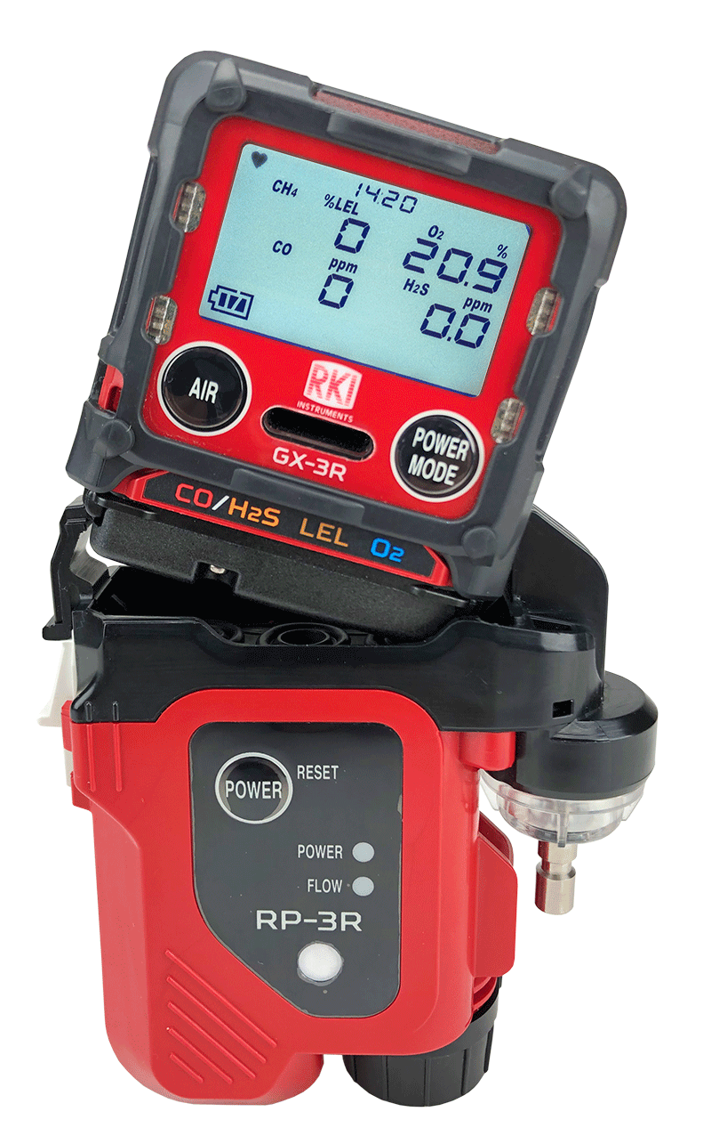
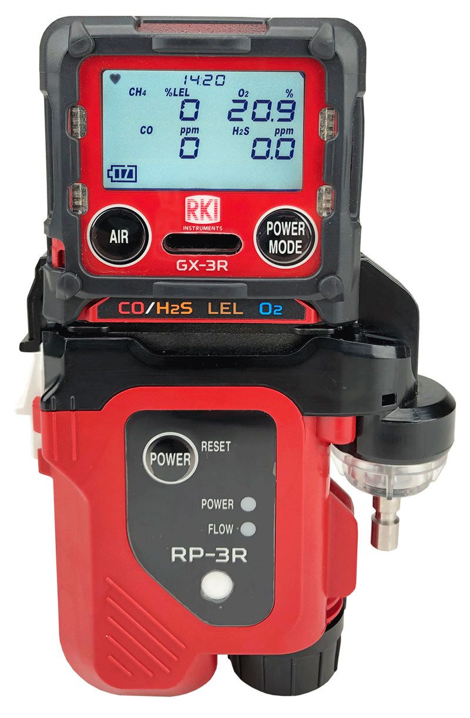

Attachable Pump and Cal Station
GX-3R & GX-3R Pro
RP-3R Sample Draw Pump
Available for either GX-3R or GX-3R Pro
Flow rate: 500ml / min
Distance to draw: 50 feet
Operation time: 10h
Independent power supply
RP-3R
SDM-3R Calibration Station
Accepts both GX-3R and GX-3R Pro
Bump Time: 10 seconds
Gas Consumption: 250 ml / min
Output: Internal memory / USB drive / LAN cable / USB Cable to PC
SDM-3R

Slide 26
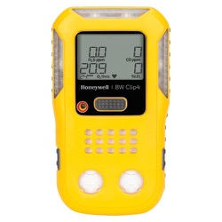
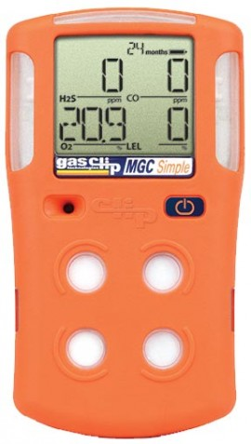
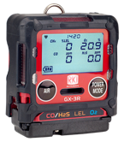

Stacking Up to the Competition
Feature | GX-3R | BW Clip4 | Multi Gas Clip Simple
Size and weight | Smallest and lightest | Larger and heavier
Sensor ranges | Better sensor ranges | Narrower sensor ranges
Alarm points | 3 adjustable alarm points | 2 alarm points
Warranty | 3 year warranty | 2 year warranty
Attachable sample draw pump | Available sample draw pump | No sample draw option
Cost of ownership | Lower cost of ownership | Disposable

Slide 27

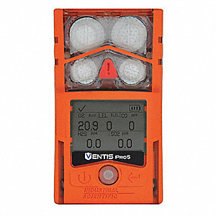
Stacking Up to the Competition
Feature | GX-3R | MSA Altair 4XR | ISC Ventis Pro 4
Price | Lower list price | Higher list price
Size and weight | Smaller and lighter | Larger and heavier
Replacement sensors | Less expensive | More Expensive
Alarm points | 3 adjustable alarm points | 2 alarm points
Durability | IP-66 AND IP-68 rating | Only IP-68
Attachable sample draw | Available sample draw attachment | More expensive sample draw
Cost of ownership | Lower cost of ownership | Higher cost of ownership

Slide 28
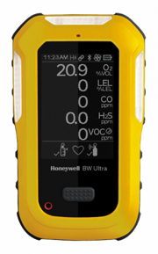

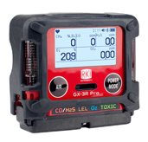

Stacking Up to the Competition
Feature | GX-3R Pro | BW Ultra (5-gas) | MSA Altair 5X | ISC Ventis Pro 5
Price | Lower list price | Higher list price
Size and weight | Smaller and lighter | Larger and Heavier
Sensor ranges | Better sensor ranges | Narrower sensor ranges
Sensor costs | Lower sensor costs | Higher sensors costs
Battery life | Longer battery life | Shorter Battery Life
Alarm points | 3 alarm points | 2 alarm points
Warranty | 3 Years – Instrument and Sensors | Instrument – 3 years, Sensors – 2 or 3 years, Battery – 2 years |  | Instrument-Lifetime, Sensors: 02/LEL/CO/H2S-4 years, all other 2

Slide 29
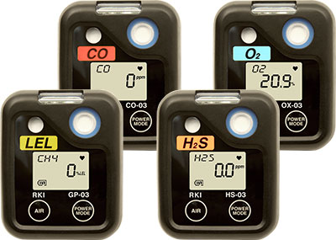

Single Gas Monitors
03 Series
Hands-free gas monitoring
4 gases available
Smallest LEL single gas available
2,000-3,000 battery life
Small, lightweight and durable
Datalogging
Overall warranty rate <5%
04 Series
Hands-free toxic gas monitoring
  HCN, NH3, NO2, PH3, SO2, CO (-H2)
O2 / CO combo available
3,000 battery life
Small, lightweight and durable

Slide 30


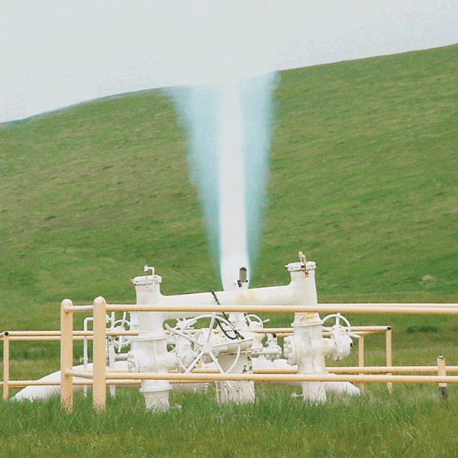
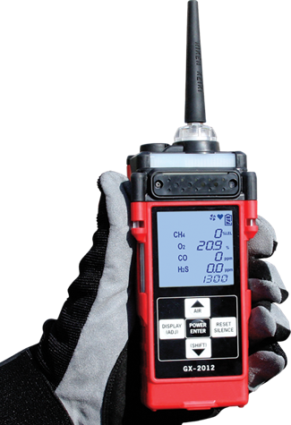
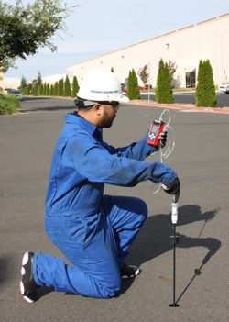
GX-2012
One Monitor – Four Functions
Leak Investigation
Confined Space Monitoring
Line Purge Testing
Bar Hole Sampling
Monitor LEL, O2, CO, H2S
Detects down to 100 ppm CH4
0-100% volume methane with 5th TC sensor
Auto-ranging (from % LEL to % volume)
Internal sample pump with 100’ sample range

Slide 31
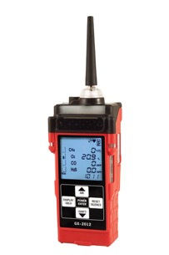

Stacking Up to the Competition
Feature | GX-2012 | BW GasAlertMax XT II
Battery options | Alkaline or rechargeable | Rechargeable only
Operating modes | Normal – Confined space Leak Check – ppm CH4 and CO surveying Line Purge – 100% vol CH4 Bar Hole – Timed underground CH4 sampling | One operating mode
Sensor slots | 5 sensor slots | 4 sensor slots
ppm/LEL/%vol auto-ranging | Auto-range readings from ppm → LEL → %vol* | LEL range only
Pump | 100’ max sample distance | 75’ max sample distance
*Requires optional TC sensor

Slide 32
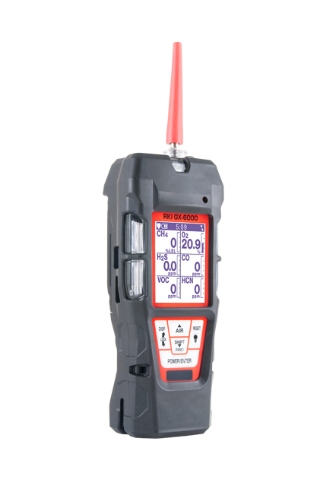

GX-6000
6-gas, sample draw with smart PID, IR & super toxics
VOC Monitoring
PID library of over 600 VOCs (10.6eV lamp)
Operates with 2 PID sensors for broad and specific monitoring
Accepts 10.6eV/10.0eV/11.7eV PID lamps
Robust photo ionization detector (PID)
Can be combined with other sensors to maximize capacity
Benzene specific pre-filter tube available

Slide 33
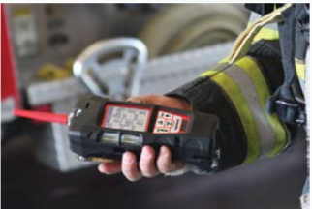
GX-6000
6-gas, sample draw with smart PID, IR & super toxics
FIRE INDUSTRY
Monitor low ppm levels of dangerous gases like NH3 or H2S commonly found in meth labs
Simultaneously monitor typical confined space hazards like LEL combustibles, O2 deficiency, CO & H2S
Find trace levels of flammables or HCN in arson investigation
Detect CO leaks or strange odors confidently
Man down alarm

Slide 34

GX-6000
6-gas, sample draw with smart PID, IR & super toxics
CONFINED SPACE ENTRY
Monitor LEL, O2, CO & H2S
Internal sample pump
Audible, visual and vibration alarms
Ideal for refinery applications
Man down alarm
Panic alarm
Optional sensors for toxic gases

Slide 35

GX-6000
6-gas, sample draw with smart PID, IR & super toxics
LEAK INVESTIGATION
Provides ppm detection of combustible gas
Leak check with changing blink/pulsing rate
    LEDs and alarm tones increase in frequency as gas concentration increases
Leak check mode displays both CO & combustible levels
Audible alarm silence
    Investigate leaks without alarming residents
Barhole mode for tracking leak migration

Slide 36
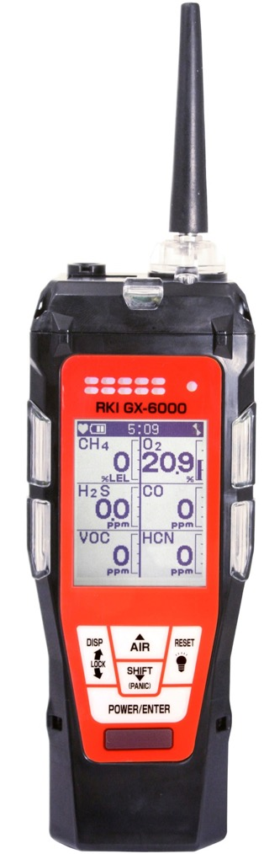
Features
Monitor up to 6 Gases
H2S, CO, O2, LEL
2 smart sensor slots
  PID for VOC’s (10.0, 10.6 & 11.7 eV)
  IR for CH4, HC, & CO2
  EC for NH3, Cl2, HCN, NO2, & SO2
  Dual PID capability
LCD display
Auto flip display
Peak bar graphs
Adjustable auto backlight
Customize order of gases
Single gas view with large font & auto sequence
5 operating modes
Normal
Leak check
Inert
Bar hole
Snap Log
Alarms
2 adjustable gas alarms per channel
Man Down alarm
4 alarm LED’s
Audible and vibration alarms
Trouble alarms for low flow, sensor connection, low battery, circuit error, & calibration
PID library of more than 600 VOC’s
0-6,000 ppm/ 0-50,000 ppb ranges
Easily choose a target VOC
  User defined VOC list of 30
  Recently used VOC list last 8
LEL Protection mode
Shields LEL sensor from damaging VOC exposure

Slide 37
Features
Smallest 6 gas sample draw
Lightweight & Ergonomic
High impact rubber boot
Ergonomic design fits comfortable in hand
Custom Unit Identification
User & Station ID selection Menu
Assign multiple users to select within one instrument
Internal Sample Pump
50’ sampling range
Weather & Dust Resistant
IP-67
Interchangeable battery options
Lithium-ion pack operates 14 hours
  Complete recharge in 3 hours
Alkaline pack operates 8 hours
9 Languages
English, Germany, Italian, French, Portuguese, Spanish, Japanese, Korean, Russian

Slide 38
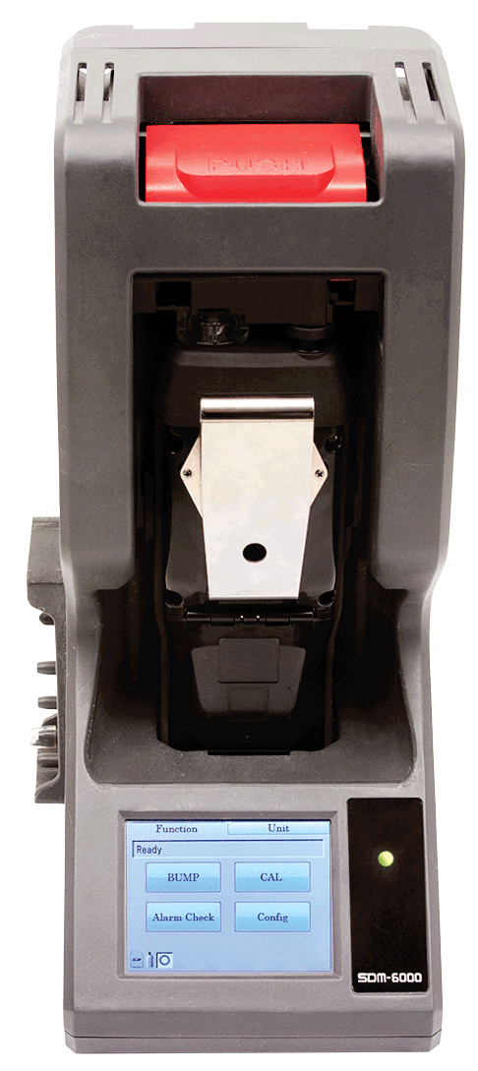
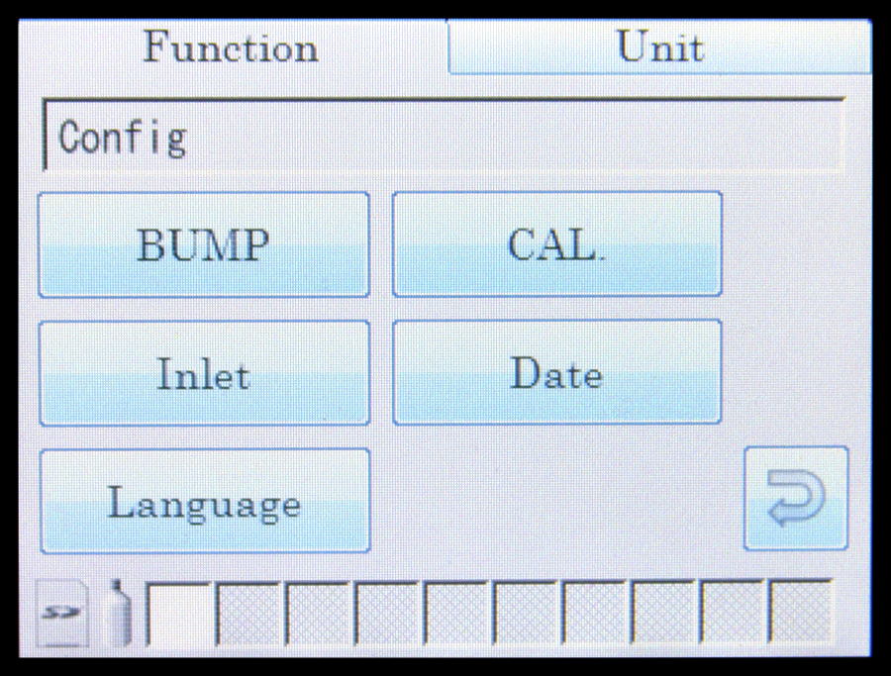
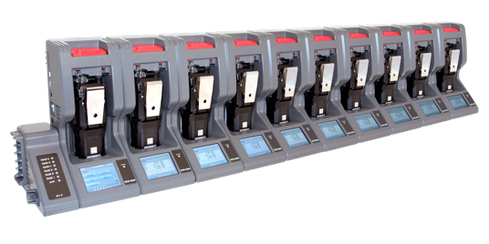
SDM-6000 Docking Station
  Stand alone station (no PC required)
  Touch screen menu display
  Charge, Bump, Calibrate, and Alarm tests
  Save calibration, bump tests, alarm history and exposure data to an SD memory card or to a computer
  Automatically power on or off for scheduled maintenance
  Up to 3 ports for separate calibration gas cylinders
  Manage up to 10 instruments with one power source, calibration source, and computer
  Configure GX-6000 parameters
  SV-3 unit expands calibration ports up to 6 ports
  Easily connects to adjacent docks
  Automatically distributes power, calibration gas, and data once connected
  DIN Rail wall mount
  Local print out of calibration/bump and alarm test results

Slide 39
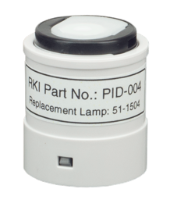



PID Options – GX-6000
4 PID’s to choose from:
Standard 4-gas sensor slots
PID Lamps |  | Range | Accuracy
10.6 eV low | 600 VOC’s | 0-50,000 ppb | +/- 10% of reading, +/- 1 digit
10.6 eV high |  | 0-6,000 ppm
10.0 eV | Benzene specific | 0.1-50 ppm
 | 300 VOC’s | 0-100 ppm
11.7 eV | High- voltage lamp | 0-1,000 ppm
The GX-6000 is the only multi-gas monitor with simultaneous dual-PID capability
Long life 11.7 eV lamp
  Typical 9 to 12 month life!
  Monitor carbon tetrachloride, acrylonitrile, chloroform, methanol, refrigerants (R-143, R-132A), and more
Two PID / smart sensor slots

Slide 40




Stacking Up to the Competition
Feature | GX-6000 | BW ultra (PID) | RAE Systems MultiRAE
Size and weight | Smaller and lighter | Larger and heavier
# of PID options | 4 PID options | 1 PID option
11.7 eV PID | 11.7 PID available | Not available
PID life | Longer PID life | Shorter PID life
Dual PID capable | Simultaneous dual PID | No
Benzene specific mode | Benzene specific mode | No
Leak check mode | Leak check mode | No
Bar hole mode | Bar hole mode | No
Sensor costs | Lower sensor costs | Higher sensor costs
Battery life | Longer battery life | Shorter battery life
Cost of ownership | Lower cost of ownership | Higher cost of ownership

Slide 41
Stacking Up to the Competition
Feature | GX-6000 | Altair 4XR (PID) | Ventis Pro 5 (PID)
Size and weight | Smaller and lighter | Larger and heavier
# of PID options | 4 PID options | 1 PID option
11.7 eV PID | 11.7 PID available | Not available
PID life | Longer PID life | Shorter PID life
Dual PID capable | Simultaneous dual PID | No
Benzene specific mode | Benzene specific mode | No
Leak check mode | Leak check mode | No
Bar hole mode | Bar hole mode | No
Sensor costs | Lower sensor costs | Higher sensor costs
Battery life | Longer battery life | Shorter battery life
Cost of ownership | Lower cost of ownership | Higher cost of ownership

Slide 42
Selling Gas Detection
Who to call
What to ask
Where to go

Slide 43

Who To Call
Looking for the person in charge of the following:
  PPE (personal protective equipment)
  HSE or EHS (Health, Safety, & Environment or Environmental, Health, & Safety)
  Industrial Hygiene
  Safety
  Instrumentation shop
Always wear your gas monitor when visiting customers.

Slide 44

What to ask?
What are you using for gas detection?
Do you use gas detection?
What do you use for confined space monitors?
Are you happy with your gas detection?
Who handles the gas detection here?
Can I see what you use for gas detection?
Who does your repairs of gas detection?
Do you have any failures?

Slide 45




Products and Market
Upstream Midstream
Energy, Oil, & Gas Production & Transportation
Gases encountered
    Combustibles
    O2 deficiency
    H2S, CO
    SO2, HCN, NH3
    Benzene (C6H6)
  RKI Products
    GX-3R & GX-3R Pro advantages:
      Smallest & lightest available
      Ideal for workers wearing monitors in the breathing zone for entire shifts
      Bluetooth connectivity and toxic sensors for GX-3R Pro
    GX-6000 advantages:
      6 Gas channels
      5 operating modes
      Benzene specific PID
      Smart sensors with toxic and PID options

Slide 46

Products and Market
Oil & Gas Refining (downstream operations)
  Gases encountered:
    Combustibles
    O2 deficiency
    H2S, CO
    SO2, HCN, NH3
    Benzene (C6H6)
  RKI Products
    GX-3R & GX-3R Pro advantages:
      Smallest & lightest available
      Ideal for workers wearing monitors in the breathing zone for entire shifts
      Bluetooth connectivity and toxic sensors for GX-3R Pro
    GX-6000 advantages:
      6 Gas channels
      5 operating modes
      Benzene specific PID
      Smart sensors with toxic and PID options

Slide 47



Products and Market
Power Utilities
  Gases Encountered
    Combustibles
    O2 deficiency
    H2S, CO
    H2
  RKI Products
    GX-3R & GX-3R Pro advantages:
      Smallest & lightest available
      Bluetooth capability and toxic sensors for GX-3R Pro
    GX-2012 advantages:
      3 operating modes: Normal, leak check, and bar hole sampling
      Internal sample pump
      Ideal for pre-entry sampling of manholes
    Eagle 2 advantages:
      Special transformer testing configuration

Slide 48


Products and Market
Manufacturing
  Gases Encountered
    Combustibles
    O2 deficiency
    H2S, CO
    Process gases like Carbon Dioxide, Ammonia
  RKI Products
    GX-3R & GX-3R Pro advantages:
      Smallest & lightest available
      Ideal for workers wearing monitors in the breathing zone for entire shifts
      Bluetooth connectivity and toxic sensors for GX-3R Pro
    GX-6000 advantages:
      6 Gas channels
      5 operating modes
    Fixed System Products
      Continuously monitor process gases

Slide 49


Products and Market
Water & Waste Water
  Gases Encountered
    Combustibles
    O2 deficiency
    H2S, CO
    Ammonia, Chlorine, Ozone, Sulfur Dioxide, & VOC’s
  RKI Products
    GX-3R & GX-3R Pro advantages:
      Smallest & lightest available
      Ideal for workers wearing monitors in the breathing zone for entire shifts
      Bluetooth connectivity and toxic sensors for GX-3R Pro
    GX-6000 advantages:
      2 Smart sensor slots to monitor NH3, Cl2, SO2, & VOC’s
      6 Gas channels
    Fixed System Products
      High range H2S solutions for extreme environments

Slide 50

Products and Market
Construction
  OSHA CFR 1926 –
    Confined Spaces in Construction
  Gases Encountered
    Combustibles
    O2 deficiency
    H2S, CO
  RKI Products
    GX-3R & GX-3R Pro advantages:
      Smallest & lightest available
      Ideal for workers wearing monitors in the breathing zone for entire shifts
      Man-down and panic alarms for GX-3R Pro
    GX-6000 advantages:
      Internal sample pump for pre-entry sampling
      PID sensors for VOC monitoring
      6 operating modes:
      Normal, leak check, and bar-hole sampling

Slide 51


Products and Market
Landfill / Waste / Environmental
  Gases Encountered
    EPA Method 21
    CH4
    CO2
    Ammonia, Chlorine, Sulfur Dioxide, & NMOC’s & VOC’s
  RKI Products
    GX-6000 advantages:
      2 Smart sensor slots to monitor NH3, Cl2, SO2, & VOC’s
      6 Gas channels
      6 operating modes:
      Normal, leak check, and bar-hole sampling
    Eagle 2 advantages:
      6 Gas channels
      PPM, % LEL, or % Vol. auto-ranging combustible detection
      Infrared (IR) CO2, % LEL CH4, % Vol. CH4, % LEL HC, % Vol. HC
      Powerful long-life pump up to 125’ range

Slide 52




Products and Market
Fire/First Responders
  Gases Encountered
    Combustibles
    O2 deficiency
    H2S, CO
    HCN, NH3, & VOC’s
  RKI Products
    CO-03:
      Clipped to gear bags, nuisance calls, Verify SCBA removal
    SC-04:
      Fire investigation or post-fire overhaul environments
    GX-3R & GX-3R Pro advantages:
      Stealth mode for law enforcement applications
      Man-down and panic alarms for GX-3R Pro
    GX-6000 advantages:
      Monitor low ppm levels of dangerous toxics like NH3 or H2S commonly found in meth labs
      Find trace levels of flammables or HCN in arson investigation
      Avoid HCN exposure in overhaul

Slide 53


Products and Market
Food & Beverage
  Gases Encountered
    CO2
    Combustibles, O2 deficiency
    H2S, CO
    HCN, NH3, PH3
  RKI Products
    GX-3R & GX-3R Pro advantages:
      Smallest & lightest available
      Infrared CO2 sensors available for GX-3R Pro
    GX-6000 advantages:
      Monitor dangerous toxics like NH3, H2S, HCN or PH3
    Fixed System Products
      Continuously monitor for oxygen deficiency,
      NH3 refrigeration leaks, CO2 levels in beverage
      dispensing locations

Slide 54

Products and Market
Chemical Manufacturing
  Gases Encountered
    Combustibles
    O2 deficiency
    H2S, CO
    Cl2, H2, HCl, NO2, SO2, VOC’s
  RKI Products
    GX-3R & GX-3R Pro advantages:
      Smallest & lightest available
      Ideal for workers wearing monitors in the breathing zone for entire shifts
      Bluetooth connectivity and toxic sensors for GX-3R Pro
    GX-6000 advantages:
      6 Gas channels
      5 operating modes
      2 Smart sensor slots to monitor NO2, Cl2, SO2, & VOC’s
    Fixed System Products
      Continuously monitor process gases

Slide 55




Emerging Markets
Lithium Ion Battery
  UPS containers
  Li-Ion Manufacturing processes
Natural Gas Vehicle Maintenance locations
Increase CO2 regulations around beverage dispensing
Grain coops & storage facilities for rodent extermination – PH3 monitoring
Marijuana growing operations (CO2) & extraction facilities (LEL)
Li-Ion UPS containers
Natural Gas Vehicle Maintenance
CO2 Storage & Dispensing
Marijuana Growth & Extraction

Slide 56
Common Gas Hazards by Industry
Industry | Hazard Gases | Portable Products
Oil & Gas | LEL, O2, H2S, CO, SO2, HCN, NH3, Benzene (C6H6) | GX-3R & GX-3R Pro, GX-2012, GX-6000, Eagle 2
Energy/Utilities | LEL, O2, H2S, CO, SO2, H2 | GX-3R & GX-3R Pro, GX-2012, Eagle 2
Construction | LEL, O2, H2S, CO, NO2 | GX-3R & GX-3R Pro, GX-2009 MSHA (for NO2), GX-6000
Water/Wastewater | LEL, O2, H2S, CO, NH3, Cl, O3, SO2, VOC’s | GX-3R & GX-3R Pro, GX-6000
Landfill/Waste | CH4, CO2, NH3, CL2, NMOC’s, VOC’s | GX-6000, Eagle 2
Fire/First Responders | LEL, O2, H2S, CO, HCN, NH3, VOC’s | CO-03, GX-3R & GX-3R Pro, GX-6000
Food and Beverage Production | LEL, O2, H2S, CO, HCN, NH3, CO2, PH3 | GX-3R & GX-3R Pro, GX-6000
Manufacturing | LEL, O2, H2S, CO, Process gases like CO2, NH3 | GX-3R & GX-3R Pro, GX-6000
Chemical | LEL, O2, H2S, CO, Cl2, H2, HCl, NO2, SO2, VOC’s | GX-3R & GX-3R Pro, GX-6000, Eagle 2

Slide 57






Common Fixed System Components
Beacon 410A Controller
M2A Transmitter
Remote Mount Sensor
with Cal Cup
S2 Transmitter
Direct Connect Sensor
RKI’s diffusion style remote mount detectors allow for easy calibrations in difficult access areas
Alarm Relays Activate Ventilation / Exhaust System

Slide 58






Fixed Sensors and Transmitters
Direct Connect
S2 Transmitter
M2A Transmitter
Cost Effective
Water repellent sensor coating
Explosion Proof
Transmitters 4-20mA output
Explosion Proof
Stainless steel option
T2A
Stand Alone or with controller
OLED display
2 programmable alarm relays
Non intrusive calibration
4-20mA and Modbus outputs
2-wire transmitter
Electrochemical sensors
Explosion Proof
35-3001 Sample Draw
GD-70D
VOC Pro
LEL, O2, H2S, CO CO2, & H2 available
Multi-gas versions
Internal sample pump with 100’ range
Smart Sample Draw
Wide range of plug & play sensors
Large LCD Display
4 PID sensor options
11.7 eV lamp with 6 month life span
Explosion Proof

Slide 59


OX-600 and RI-600
Continuous indoor air monitoring
Diffusion or remote sampling O2 and CO2 monitors Great for applications such as:
  Laboratories
  Cryogenic environments
  Liquid N2 storage rooms
  Warehouses
  Tunnels
  Parking garages
Breweries
Storage tanks
Greenhouses
RI-600
CO2 monitor
OX-600
O2 monitor

Slide 60




AirLink Wireless Solutions
Wireless Controllers
Hybrid Controllers
Transmitters
Relay Modules
Interface/Receivers
Repeaters
900 MHz / 2.4 GHz communication
Battery or wire powered
Signal Meter

Slide 61


Turnkey Installation Solutions
Design, consultations, and engineering
Installation
Start-up
Training
System Maintenance

Slide 62
Distributor Partnership Program
Stocking distributor: provide immediate delivery
  Increased sales
Service Center: provide immediate local instrument service, calibration and repair parts.
  Increased profits
Regional RKI Representatives provide ongoing product training and sales support.
  Increased confidence
RKI business culture is unlike any other gas detection manufacture in the industry. We provide the highest quality product, immediate and exceptional customer service and technical support (USA).
  Increased reliability
RKI believes in working with partner distributors to develop their markets by providing orders (not sales leads) from area end-users.
  Increased team loyalty and trust.

Slide 63

RKI Regional Reps
NORTH WEST
John Foster
Cell: (509) 299-6777
Todd Rosencrans
Cell: (509) 299-6777
Jeremie Wise
Cell: (208) 659-2564
Justin. Wise
Cell: (208) 640-1564
Henry Dukart
Cell: (720) 301-1160
Stacie Hendrickson
Cell: (425) 299-2112
CENTRAL & MICHIGAN
Dave McEndarffer
Cell: (913) 634-0396
CENTRAL GREAT LAKES
John Maslowski
Cell: (262) 271-8956
NEW ENGLAND
Bob Carroll
Cell: (716) 725-3112
TRI-STATE
Nino Misiti
Cell: (610) 216-0393
N. CALIFORNIA
Ramey Packer
Cell: (510) 285-7506
MID ATLANTIC
Amy Dodson
Cell: (410) 253-8866
SOUTH WEST
Tammy Girton
Cell: (949) 397-5040
SOUTH EAST
Todd Sauls
Cell: (770) 654-7443
GULF COAST
Rick Winship
Cell: (713) 205-1694
SOUTH CENTRAL
James Emmons
Cell: (214) 980-4002

Slide 64

Quantity Discounts
RKI is committed to supporting all of our Distributor Partners’ stocking needs with quantity based discounts. When you place an order for any Premier Portables that has one “ship to” location, the following discounts will automatically be applied based on the quantity ordered.

Slide 65

Growth Rebate Partnership Program
In an effort to reward our distributor partners who are growing RKI's business, RKI offers a Growth Rebate Partnership Program. This program is designed to reward your organization with cash for sales growth achieved.
Growth Rebate Program
Growth Targets will be set based on previous year's sales, averaged on a quarterly basis
• 10% growth earns a 3% payment on the growth achieved
• 20% growth earns a 5% payment on the growth achieved
Eligibility for Growth Rebate requires exceeding the Year to Date Growth Target and will be evaluated at the end of each quarter
Quarterly growth rebate payments will be made within 30 days after each quarter
Growth Rebate Program Requirements
Must be a fully authorized RKI Distributor for a minimum of 12 months to participate
Distributor's credit account with RKI must be in good standing
Must have a minimum of $50,000 in sales within the prior year

Slide 66























Slide 67

Questions?

Slide 68


